Slide 1
Ridgeview charter Middle School
2024-25 Scheduling process

Slide 2
ACAdemics
We offer a variety of academically challenging and rigorous classes designed to meet the various needs of your students
Math (on-level, Advanced, accelerated)
ELA (on-level, advanced and accelerated)
Science (on-Level and advanced)
Social sTudies (ON-Level and advanced)
Foreign Language (Spanish, French, and Japanese)
Reading

Slide 3
Ridgeview Charter Middle School Course Offerings
 | 6th Grade | 7th Grade | 8th Grade
Language Arts | On-Level | On-Level | On-Level
ELA Advanced | Advanced —more rigor/less scaffolding/enhanced vocabulary | Advanced- more rigor/less scaffolding/enhanced vocabulary | Advanced—more rigor/less scaffolding/enhanced vocabulary
ELA Accelerated | Accelerated -7th grade content | Accelerated - 8th Grade content | Accelerated - 9th Grade Lit.
MATH | Math On-Level | Math On-Level | Math 8
Math 6 Enhanced | Math 6 Advanced | Math 7 Advanced | Enhanced Math 8 and Algebraic Concepts and Connections (2 Yr. Accelerated) Honors
Math Advanced | Math 7 (accelerated) | Math 8 (Accelerated) | Algebra: Concepts and connections Honors
 |  | Enhanced Math 8 and Algebraic Concepts and Connections (2 Yr. Accelerated) Honors | Geometry:Concepts and Connections Honors
Science | On-level science | On-level science | On-level science
Science Advanced | Advanced science | Advanced science | Advanced science
 |  |  | High School Physical Science
Social Studies | On-level social studies | On-level social studies | On-level social studies
Social Studies Advanced | Advanced Social Studies | Advanced social studies | Advanced social studies

Slide 4
On-Level, Advanced, Accelerated
What Does It Mean?
On-Level – Curriculum consists of grade-level state standards ​
Advanced – Curriculum consists of grade-level state standards plus state standards from the next grade level (Grades 1-8) ​
Accelerated – Curriculum consists of state standards one or more years above assigned grade level (Grades K-8)

Slide 5
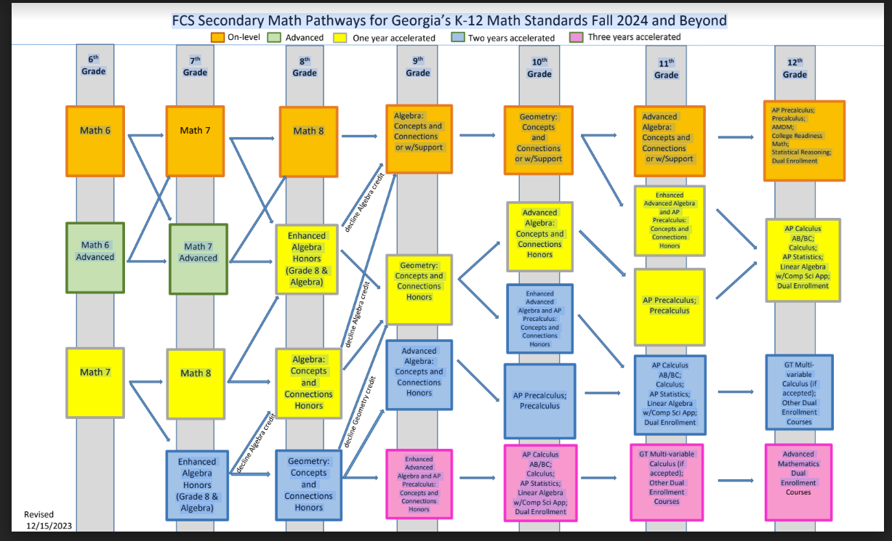

Slide 6
Reading and World Language
Reading
Data from iReady as well as Georgia Milestones is used to identify students who may need additional support.
Who should be placed in Reading?
1) Students who score <35% NPR on the Winter iReady Diagnostic
2) Students who score below level on GMAS Reading Indicator (Rising 6th Graders)
3) Students who have $≤$ 70 on unit assessments (Rising 7th and 8th Graders)
World Language
World Languages are offered at every grade level. We currently offer Japanese, Spanish and French.
 | 6th Grade | 7th Grade | 8th Grade
Japanese | Japanese6 | Japanese 7 Continuous | Japanese 1 (HS Course)
Spanish | Spanish 6 Native Speakers | Spanish 7 Native Speakers | Spanish 1 Native Speakers (HS Course)
 | Spanish 6 | Spanish 7 Continuous | Spanish 1 (HS Course)
 |  | Spanish YR 1. (No prev. Spanish) | Spanish 1 (HS) Course
 |  |  | Spanish Non-Credit – (No previous Spanish
French | French 6 | French 7 Continuous | French1 (HS Course)
 |  | French YR 1( No Prev. French) | French 1 (HS Course)
 |  |  | French Non-Credit – (No Previous French)

Slide 7
Courses for High School Credit
8th graders who are on an accelerated path in one or more content areas will have the opportunity to take these classes.
Math: Enhanced Grade 8 Math and Algebra Concepts and Connections
Algebra:Concepts and Connections
Geometry
English: 9th Grade Literature/Composition
Science: 9th Grade Physical Science
World Language: Spanish 1, French 1, Japanese 1
***High School courses are extremely rigorous and will require more work than your typical class. Students will have to be able to balance a heavy workload along with their extracurricular activities. Please think carefully before having your child take 4 high school credit courses.

Slide 8
Connections
Year long : band, orchestra, and chorus
Quarter long classes: art, technology, PE, health, broadcast video production/film/graphics/media design, general music, Career Awareness (6th only), Japanese, French , and Spanish
Japanese, French, and Spanish are basic courses with introduction to language, culture, etc. (Not offered at every grade level)
Avid - Advancement Via Individual Determination
Quarter long classes are randomly assigned. Students may repeat courses during their three years at Ridgeview.

Slide 9
What Is The Process?
Current teachers will make course recommendations for your students.
You will receive a course verification that shows you the courses recommended for your student.
Core classes and year-long connections(band, orchestra, chorus) classes will be listed.
Note any corrections on the verification and return to your child’s school.
Necessary changes/corrections will be made.
Schedules will be created over the summer.
Please note: Requests for acceleration consideration and waivers should be made prior to the end of the school year. The elementary school should test current 5th graders for acceleration and provide Ridgeview with any updates.

Slide 10
Waivers/Schedule Change Requests
Waivers are not required if students meet minimum placement guidelines.
If students do not meet minimum placement requirements and parents want to change placement a waiver is required.
The waiver acknowledges that the parents are aware that the school does not recommend placement in the requested course.
The parent is also acknowledging that they will be responsible for providing appropriate support for the student.
Placement will not be changed once a student is placed due to a waiver.

Slide 11
Course Verifications
Course verifications will be sent home the week of Feb. 26.
Core content and year-long connections classes (band, orchestra, chorus) will be listed.
You should review this document carefully, sign and return it to your child’s school.
Reach out to current teachers if you have questions.
What should you look for?
On-Level Courses end in 00 ex. 27.0210000 6th Grade On-Level Math
Advanced courses end in 40 ex: 23.0130040 Advanced 8th Grade ELA
TAG courses have a 2 as the 3rd digit ex: 26.2110000 TAG Life Science
Advanced Science and Social Studies Courses do not have “advanced” in the title. They are designated by course number only.

Slide 12
SAMPLE COURSE VERIFICATION
Student Name
Student Number
Grade: 06
Required Courses:
40.0610040 Earth Science 6 Advanced not in Title but 40 means advanced
23.0110040 Lang Arts 6 Lv A A – Advanced and ends in 40
27.0210000 Math 6 Lv O O – On-Level
23.0140000 Reading 6 Lv O
45.0070000 Social Studies 6

Slide 13
SAMPLE COURSE VERIFICATION
Student Name
Student Number
Grade: 07
Required Courses:
53.0340000 Band 7
27.2220040 TAG Math – 2 indicates TAG, 40 Advanced
23.2130040 Lang Arts 8 Lv A - 2 indicates TAG, 40 Advanced
60.0680009 Spanish 7 Continuous
26.2110000 TAG Life Science - 2 indicates TAG
45.2080000 TAG Social Studies 7 – 2 indicates TAG

Slide 14
Scheduling Timeline
Feb. 5 Middle School Teachers trained on scheduling process and
provided placement guidelines.
Feb. 7 Elementary Assistant Principals training
Feb. 23 Deadline for teachers to complete Course Recommendations
Feb. 26 (Week of) Course verifications sent home
(Parents will receive an email with link to waiver and form to request
changes)
Mar. 4 - 11 Parents review verifications and request changes or waivers
Mar. 12-17 Corrections/Changes made in Infinite Campus
Mar. 20 (week of) Updated verifications sent home (only those requesting
changes/waivers) – May be sent via email
March 31 Deadline for receipt of electronic waiver

Slide 15
WEBSITE
The following documents will be placed on the Ridgeview website:
Power point
Placement guidelines
Math flow charts
Link to waiver form
To access: Go to Ridgeview website
Click on Academics
Click on Academic Scheduling

Slide 16
Questions
Contact Info:
Vicki Bulluck
bulluck@fultonschools.org
470-254-7710

