Slide 1

digital citizenship
Brookview elementary
Cyberbullying and Digital Drama parent training
2020-2021

Slide 2

What Is Cyberbullying?
Cyberbullying is bullying that takes place over digital devices like cell phones, computers, and tablets. Cyberbullying can occur through SMS, Text, and apps, or online in social media, forums, or gaming where people can view, participate in, or share content.

Slide 3

Cyberbullying includes sending, posting, or sharing negative, harmful, false, or mean content about someone else. It can include sharing personal or private information about someone else causing embarrassment or humiliation. Some cyberbullying crosses the line into unlawful or criminal behavior.

Slide 4


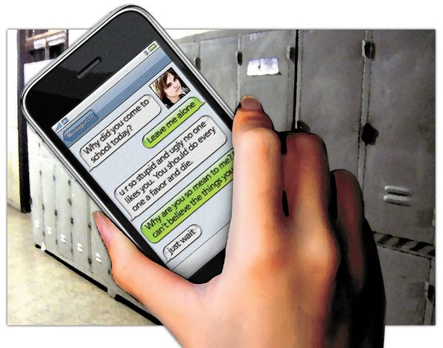
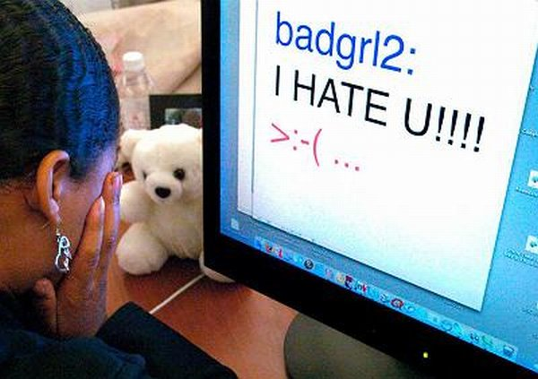
Don’t be a Cyber Bully
Just like there are bullies in the real world, there are bullies in the cyber world. The words you say online can hurt just as bad as being physically hurt.
In the Real world vs. the Cyber world a Bully uses Intimidation as their favorite tool.
Notes:
To intimidate: name-calling, profanity, rumors, threats, and abusive criticism
To frighten someone especially in order to make them do what one wants
Cyber Bullying is bullying through email, instant messaging, chat rooms, web and gaming sites, through digital messages or images sent on a cell phone

Slide 5
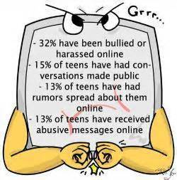

YOU ARE NOT ALONE!

Slide 6
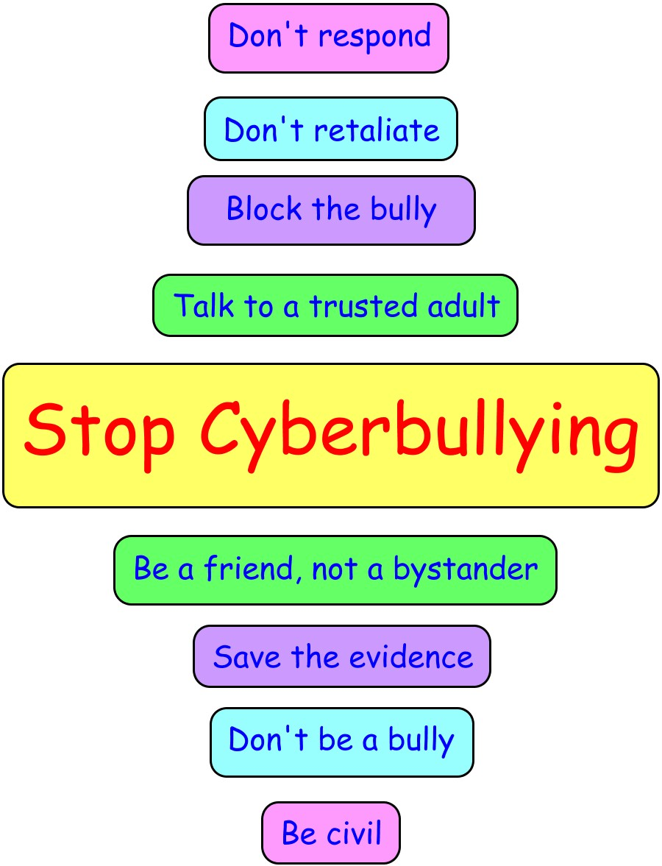

How Do You Stop a Cyber Bully?

Slide 7
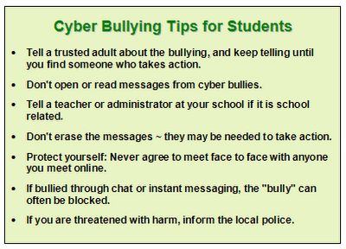
MORE TIPS…

Slide 8
For additional resources and information www.stopbullying.gov
This Photo by Unknown Author is licensed under CC BY-SA-NC

