Slide 1
brookview Elementary Parent Training Online Relationships and communication 2020-2021
Digital Citizenship

Slide 2
Online Communication
Communication is a bit different than in a face-to-face setting. We pride ourselves in providing several opportunities for social interactions, but the difference is that most communication is via written text in an online environment. Because this means you are missing body language cues and immediate feedback from your “listener,” it is very important to understand some common rules for good online etiquette. This ensures that the message you intend to convey is received correctly.

Slide 3
Be Respectful
Parents help you child to understand that it is important to remember that your classmates and teachers are real people who are affected by the words that are spoken as well as written. It is essential to keep in mind the feelings and opinions of others, even if they differ from your own. If you wouldn’t say it to someone’s face, don’t say it online either.

Slide 4
Helpful Tips Your child can learn to communicate in safe and healthy ways.
Give them the right words-Kids learn about appropriate verbal and physical communication from watching you. But online conversations can be invisible. Occasionally, narrate as you're writing texts or social media comments.
Learn about their worlds- As much as possible, keep an eye on what they're saying and doing online to understand the norm in their worlds. Don't police everything they say, but keep an ear out for aggressive trash-talking, hate speech, rude images, or anything hurtful.

Slide 5
Helpful Tips continued..
Empathize with the pressure to overshare-Tell them that you understand how bad it can feel to disappoint a friend. Then help them imagine how much worse it would feel if a private picture were shared with their whole school.
Develop their instincts-Help kids learn to trust their guts so they can weed out risky, or otherwise unsafe online situations. Playact a few scenarios: What if someone asks to take a conversation private? What if someone asks for your phone number? What if someone invites you to a private chat room? Be aware that some kids (even "good" kids) will explore iffy stuff online out of curiosity. But the minute they feel uncomfortable, they need to shut things down.

Slide 6
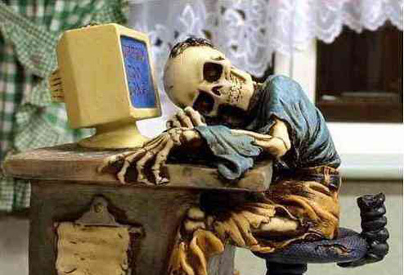
ARE YOU REALLY YOU?
Gee, you sound really cute and we have the same birthday! We must be destined to meet!
Some of your online “friends may not be who they say they are.
Someone who tells you “she” is a teenager could be a 40-year old man posing as a teenager.
Well, I don’t mind admitting I was homecoming queen and maybe we could celebrate our birthdays together.
Notes:
Never share personal information!
I have seen some of you on games after school where you can chat with strangers AND have even used your real names. That is so dangerous!

Slide 7
That’s Private
Please remind your child that everyone is not who they say they are online and to keep private information to themselves. Such as, their full name, parent’s name, address, birthdays, passwords, home address and phone numbers.

Slide 8
Remember to always be kind to each other!

