Slide 1
RCCSD
DATA REPORT
WINTER 2023

Slide 2
Instructional Vision
Mission
To create a safe and supportive learning environment for all of our students, in order to prepare them with the fundamental skills and knowledge to successfully and responsibly contribute to society.
Vision
A district committed to the use of data to inform decisions that promote individual student success and well-being.
Red Creek Rising: Rising Outcomes, Opportunities, Wellness, Pride
Notes:
Rising Outcomes: We aspire to elevate academic achievmeent and foster a passion for learning by empowering studnets with the knowledge and skills essential for future success.
Rising Opportunities: We work to create a learning landscape that opens doors to diverse opportunities for every student by embracing innovation and adaptability.
Rising Wellness: We foster a nurturing environment that promotes mental health, resilience, and a sense of belonging to ensure that every student feels welcomed and affirmed.
Rising Pride: We are creating a culture of learning that empowers students to take pride in their accomplishments and contribute positively to the collective success of the RCCSD.

Slide 3
Understanding the Data
Cohort Snapshot
Growth Goals by Grade Level/Department
Cohort Progress on Benchmark Assessments

Slide 4
Notes:
Considering multiple sources helps us to zero in on the right assumptions about the causes of what is working and not working.

Slide 5
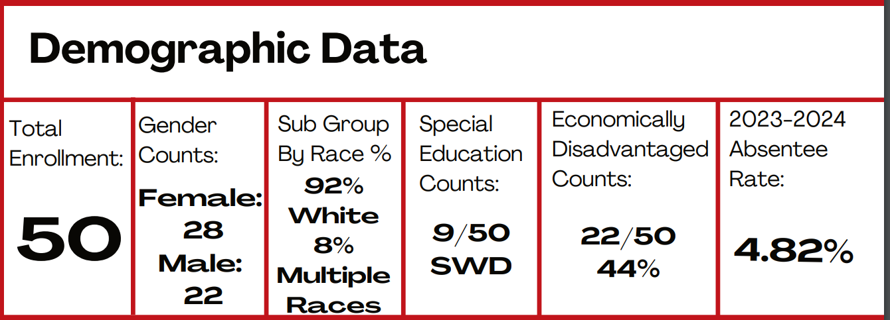
Snapshot of the 2nd Grade
Class of 2034
Notes:
First in depth view of data at this level prior to students getting to the state assessments

Slide 6
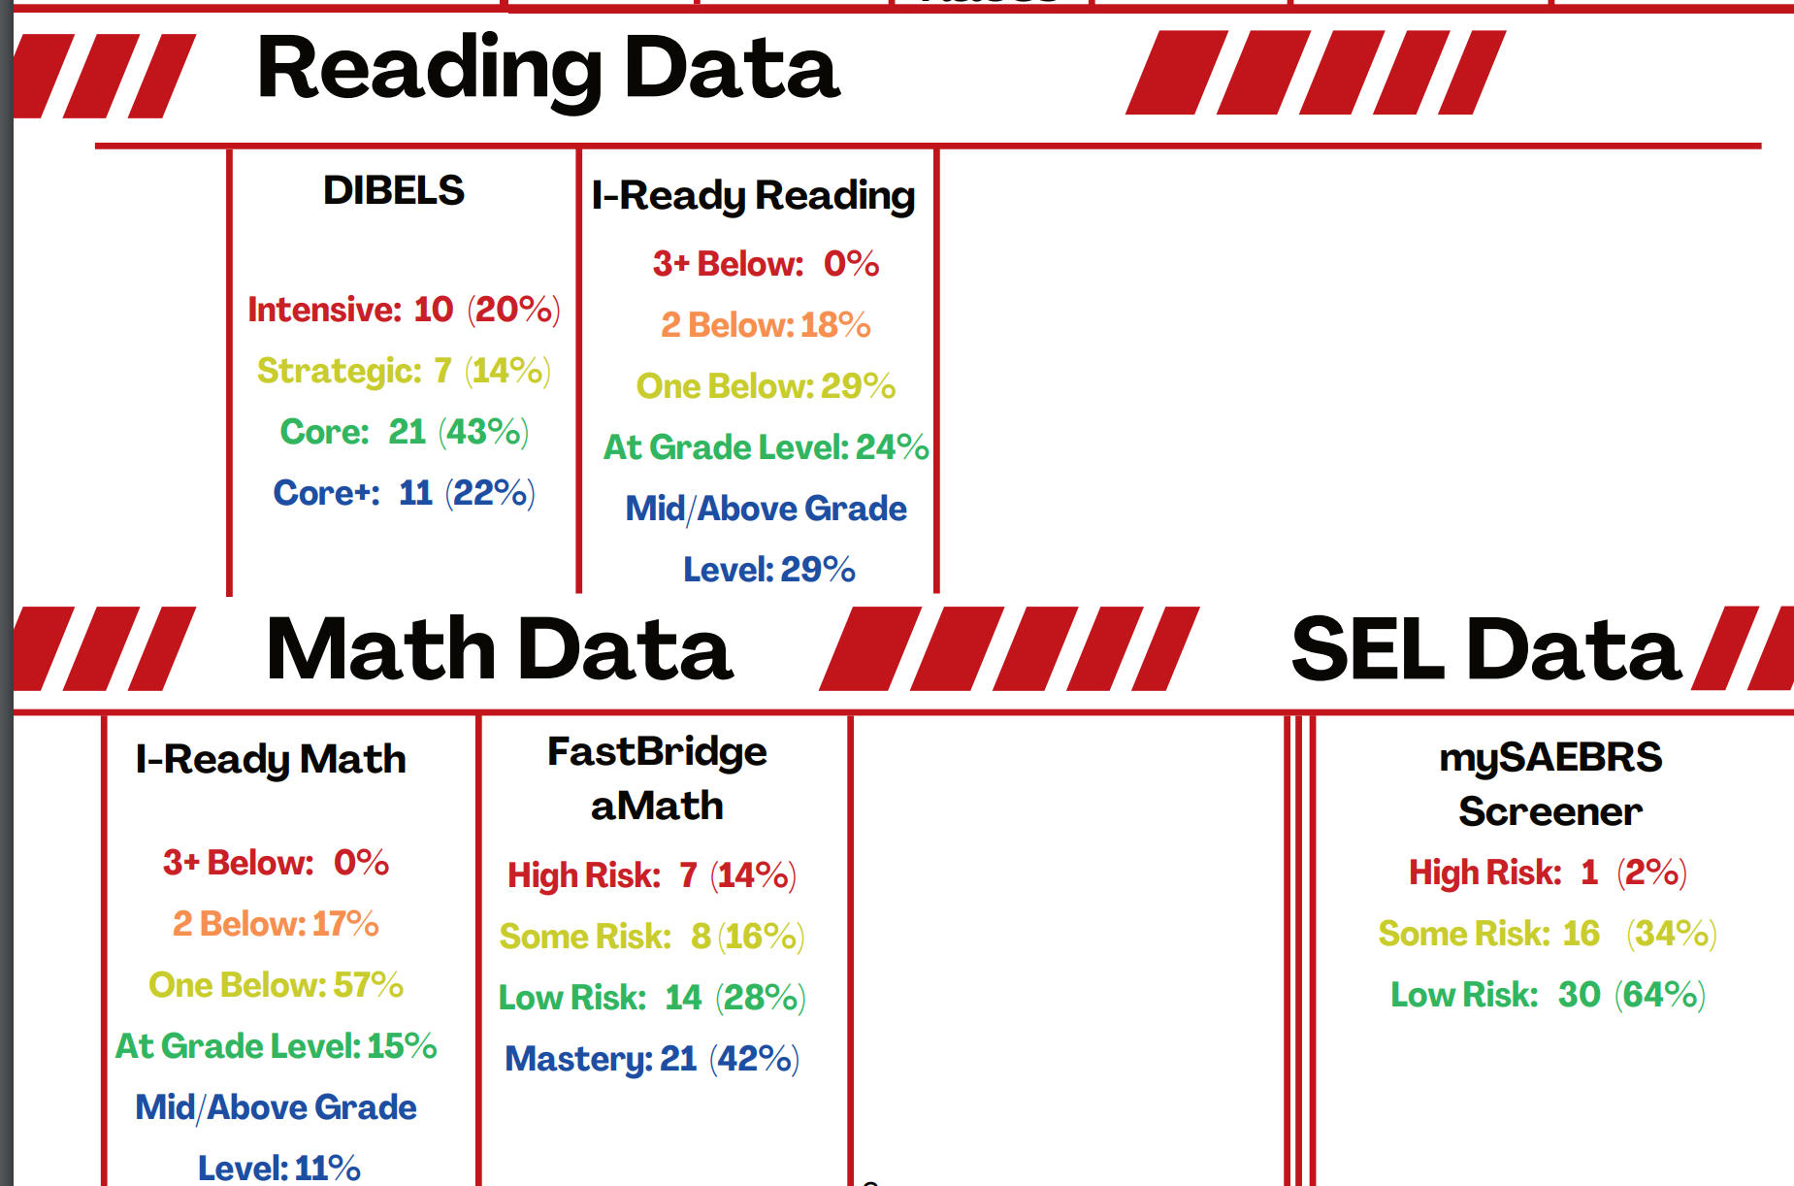
Snapshot of the 2nd Grade
Class of 2034

Slide 7
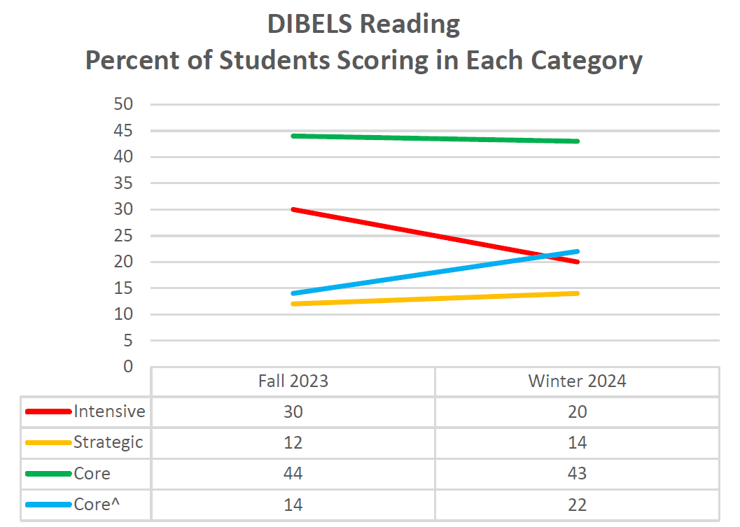
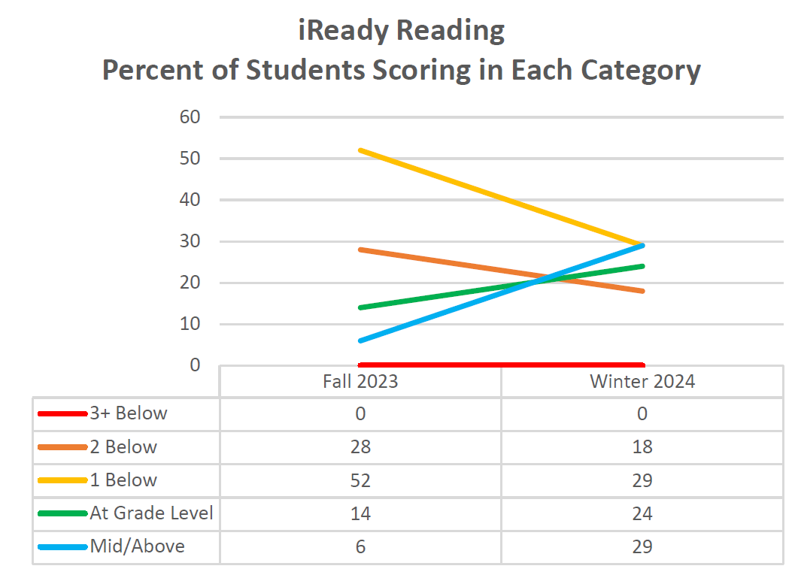
Snapshot of the 2nd Grade
Class of 2034

Slide 8
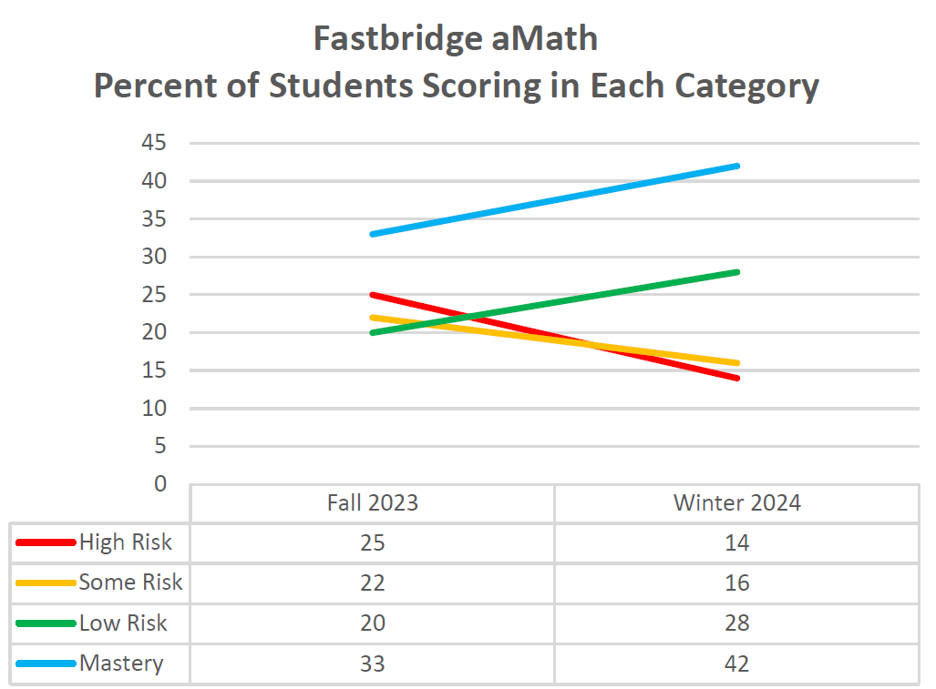
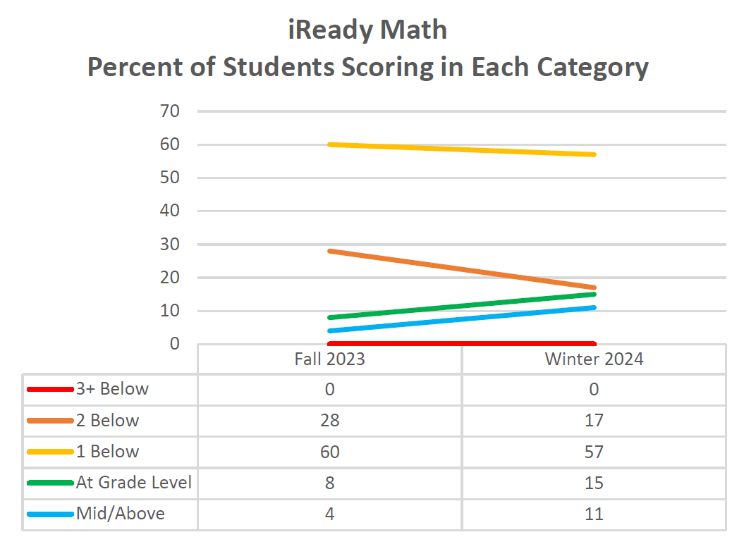
Snapshot of the 2nd Grade
Class of 2034

Slide 9
Actions Driven By Data
Standards Analysis
Priority Standards Mapping
Program Evaluation Follow Up
Regional Collaboration for New Exams
Cuyler Morning Meetings
Instructional Coaching
Elementary AIS Model & Data Collaborations
Qualitative Data- Knowledge Matters Book Study, Creating Thinking Classrooms Book Study
Priorities
Guaranteed and Viable Curriculum- 3/15
High Impact Teaching Strategies- 3/15
Effective MTSS Systems- Continue to grow SYSTEMS
Continued Growth of Data-Driven Culture- District Admin → Building Admin → Teachers → Students to promote data ownership

Slide 10
CELEBRATIONS
Cuyler AIS Model
Kindergarten Growth (Math and ELA)
First Grade Growth (ELA)
Second Grade Growth (Math and ELA)
Data used to support increased SEL Supports (3rd grade)
Fastbridge vs. iReady analysis- computing vs. problem solving (4th grade)
Priority standards identification and shifts (5th grade)
Curriculum shifts- refocusing on rigor
Team collaborations to support newer staff
9th Grade ELA iReady (20% decrease in red)
Notes:
Renewed energy to refocus on data usage to hone in on needs and necessary shifts

Slide 11
Goal Monitoring Process
Growth goals as standing team agenda item
MTSS progress monitoring each six months (Cuyler)
Mid-year full district progress monitoring of consistent measures (Reading, Math, SEL)
Mid-year data analysis (Instructional Council, Admins, Teams)
Mid-year growth reflection and action planning
Real-time data (check up vs. autopsy)
Ongoing support from coaches and Lead teachers
Adjustments in action as needed

Slide 12
Notes:
Not an overnight process- need to set midway measures, celebrate successes, and continue to analyze performance to promote the climb

Slide 13
Questions?

