Slide 1
Northern Online Academy
Elementary Family presentation

Slide 2
Northern Online Academy
What is the program?
Homeschool – providing education for your child through one of the four state regulated options (Homeschool Law)
Remote Learning – learning that takes place over distance for a time frame due to not being able to participate in person
Cyber School – all schooling aspects are done through an online platform

Slide 3
Northern Online Academy
What is the Northern Online Academy Cyber program?
Local consortium partnered with the CAIU called Capital Area Online Learning Association (CAOLA)
Cyber option for our students
Students are Polar Bears and remain at Northern
Students enroll in the cyber school program
Regional, comprehensive and student-centered learning opportunity
Teacher serve as learning coaches supporting the learning process
Vendors provide curriculum and instructional content
Accelerate Education (Elementary)
Edison and eDynamic (Secondary)
APEX Learning (Secondary – AP Courses)

Slide 4
Northern Online Academy
Student Profile – Who?
Students in grades K-12
Increase learning options
Provide flexibility and personalized experience
Need another environment

Slide 5
Northern Online Academy
Attendance Expectations
Measured through weekly assignment completion based on Enrollment Form
PA State Law says that parents/legal guardians are responsible for ensuring students attend school as per compulsory attendance (Compulsory Attendance Fact Sheet)
Excused Absences
Illness, School Approved Activity, Parental Excuse, Discipline Actions
Students that are unable to meet weekly expectations will result in conferencing with school staff.
If concerns continue, student may be removed from the cyber program.

Slide 6
Northern Online Academy
Family Responsibility
Attend the Northern Online Academy Cyber School enrollment meeting
Sign contract with Online Advisor
Login weekly to monitor progress
Provide physical environment for student success
Assist student with documents, forms and school needs
Monitor school computer use for appropriateness of access and usage
Notify the school of any change in contact information
Provide transportation as needed to participate in testing (Grades 3-5)
Communicate needs to counselors for support and continued progress
Communicate with counselor/advisor for scheduled absences

Slide 7
Northern Online Academy
Academic Support and Placement
Curriculum aligned with PA State Standards and vetted by highly qualified teachers
There are multiple modalities of learning for students in each lesson
School counselors/online advisor, families and students will work together to determine proper course placements
Each student has online teachers that monitor their progress in their courses and can create interventions to help master content
Meetings with their teacher during the week
Students are in grades 3-5 are required to continue with state mandated testing and will be contacted by the school’s assessment coordinator to complete the PSSA.
Students have 24/7 access to their courses with the academic week starting on Monday at 12:01 AM and ending on Sunday at 11:59 PM.

Slide 8
Northern Online Academy
Withdrawing
Students withdrawing from the program and district must have written legal parent/guardian reason for withdrawal and information provided for where the student will be enrolled
Transferring
If transferring to another district in partnership with CAOLA, coursework may be able to transfer
If absent from the area for multiple weeks, a temporary transfer of location form would need completed
Dropping Courses
Students have 14 days to drop an enrollment without incurring penalty (including weekends)
We use semester breaks (half-way through the year) to transition students between cyber and traditional schooling options.

Slide 9
Northern Online Academy
Student Services
Family Educational Rights and Privacy Act (FERPA)
Northern York County SD follows FERPA and requires that requests for academic records be made to the school of residence where all academic records are maintained
Student Records
A cumulative folder is maintained while students are enrolled in Northern York County SD and only contains verified information of educational importance and may be used for the benefit, promotion and welfare of the student
Special Education Services
Norther York County SD is required under Individuals with Disabilities Education Act (IDEA) therefore students with Individualized Education Plans (IEP) or 504 plans will be accommodated within their coursework. A student’s evaluation report and IEP will be used to determine if their needs can be met in an online setting effectively

Slide 10
Northern Online Academy
Grading
Lesson based assessments are graded quickly while the designated teacher grades quizzes, tests and written responses require more time
Teachers will have a week from the date of submission (not including weekends) to grade the assignments and provide feedback
Teacher conferences with students
Uncompleted assignments or not submitted properly will be graded as a zero when grades are finalized

Slide 11
Northern Online Academy
Accelerate Education
Vendor for Elementary Curriculum
Provides platform for all coursework
Objectives and learning goals provide direction for schoolwork
Pacing and a tasks list to keep materials structured

Slide 12
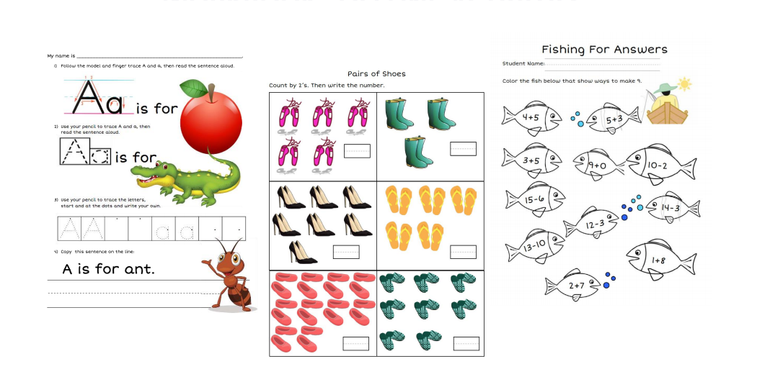
Northern Online Academy
Accelerate Education Workbook
Provides manipulatives for students
Reduces screen time
Can be done electronically
Eliminates need to print materials
Accelerate Education Curriculum Kit
Provides materials needed
School supplies for the semester

Slide 13
Northern Online Academy
Available Resources
CAOLA Helpdesk (717-732-8403)
Navigation and programmatic concerns
Teacher support during meetings
Learning Coach Resource (https://learningcoach.accelerate.education/)
Chromebook loaned from the district
Workbook and curriculum kits

Slide 14
Northern Online Academy
Creating a successful environment for your child:
Establishing a designated area for school
Quiet, free of distraction…
Daily routines to provide structure and consistency for learning
Set schedule of times for your child to work
Establishing breaks and re-engagement times
Engaging in the learning process with your child
Ask questions and engage in learning
Use the Learning Coach content to engage in dialogue and encourage continuation of the learning process
Recognize that young children will require assistance with any online experience

Slide 15
Northern Online Academy
Next Steps
Registering for the Northern Online Academy is committing to at least the first semester (first half) of the school year.
If committing to enroll in the Northern Online Academy:
Notify your child’s building principal:
lquintana@northernyork.org – Mrs. Quintana – Dillsburg Elementary School (717) 432-8691 x1400
jcal@northernyork.org – Ms. Cal – Northern Elementary School (717) 432-8691 x1500
dechelmeier@northernyork.org – Mr. Echelmeier – South Mountain Elementary School (717) 432-8619 x1700
arittle@northernyork.org – Mrs. Rittle – Wellsville Elementary School (717) 432-8691 x1600
An enrollment meeting will be scheduled

