Slide 1
Buckle Down – Genes and Alleles
Review 8

Slide 2
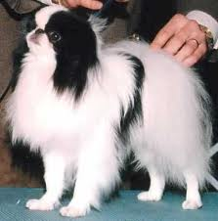
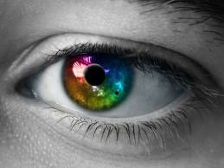
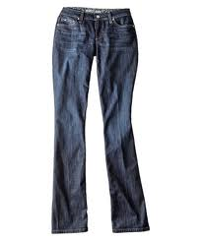
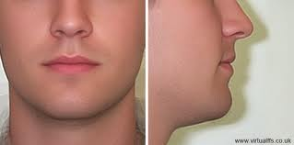
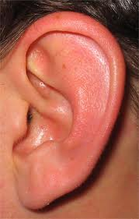
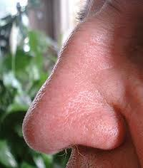
Important Vocabulary
Gene – piece of a chromosome that codes for a trait
Trait – a specific characteristic that varies from one individual to another

Slide 3
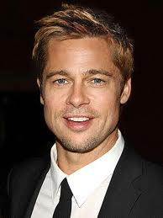
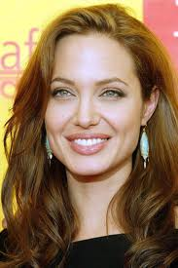
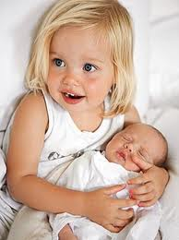
You are your parents!
Dad’s chromosomes
Mom’s chromosomes

Slide 4
Genes in Pairs
You have 23 PAIRS of chromosomes
Allele from each parent
Can be dominant or recessive

Slide 5
Phenotype and Genotype
PHenotype: What you see (PHysical appearance)
ie.: blue eyes, blonde hair
GENotype: The GENes you have
ie.: Bb, BB, bb (Heterozygous, homozygous, etc)

Slide 6
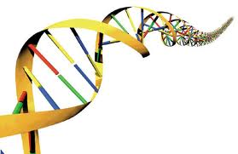
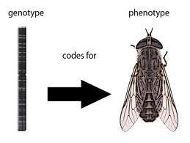
Review Break!
You get ½ your genes from mom, ½ from dad
Phenotype is physical (what you see)
Turn to page 117…
Trait – a characteristic
Genotype is the gene itself (Tt, tt, or TT)
Each gene has 2 alleles (one from mom, one from dad)
What do we know so far?
Is “detached ears” a phenotype or genotype?
An allele is dominant or recessive
What genotype produces white flowers in a pea plant?
Gene – piece of a chromosome that codes for a trait
Dominant (T) will always be seen, recessive (t) will be seen if there is no dominant

Slide 7
Ratio?
Flipping a coin:
50% chance of landing heads up, is a 1:1 ratio
If you flipped a coin, compared to your partner, compared to the room…
Would there be an expected ratio? Is it guaranteed?

Slide 8
Genetics Basics
Alleles shown using variables (2 alleles per gene, one from each parent) such as T or t
“Heterozygous” if it is hybrid (Tt)
“Homozygous Dominant” (TT) if pure dominant
“Homozygous Recessive” (tt) if pure recessive

Slide 9
When doing a Punnett
Alleles are shown with variable
Capital for dominant, lower case for recessive
Mother goes on side, father goes on top
Parent alleles on outside, possible offspring genotypes inside
Point is to find all possible genetic variations and the probability for it to appear

Slide 10
Probability and Punnett
 | Tt
Tt |  | T | t
 | T
 | t
Genotype | Phenotype
TT | Red Flower
Tt | Red Flower
tt | White Flower
TT
Tt
Tt
tt

Slide 11
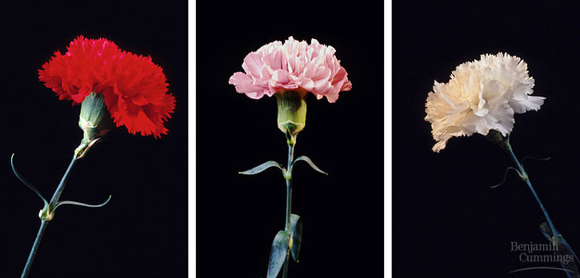
Punnett Possibilities
Incomplete Dominance- Neither are completely dominant over the other
(White x Red = Pink)
Heterozygous means a new phenotype!

Slide 12
Incomplete Dominance
 | Tt
Tt |  | T | t
 | T | TT | Tt
 | t | Tt | tt
Genotype | Phenotype
TT | Red Flower
Tt | Pink Flower
tt | White Flower

Slide 13
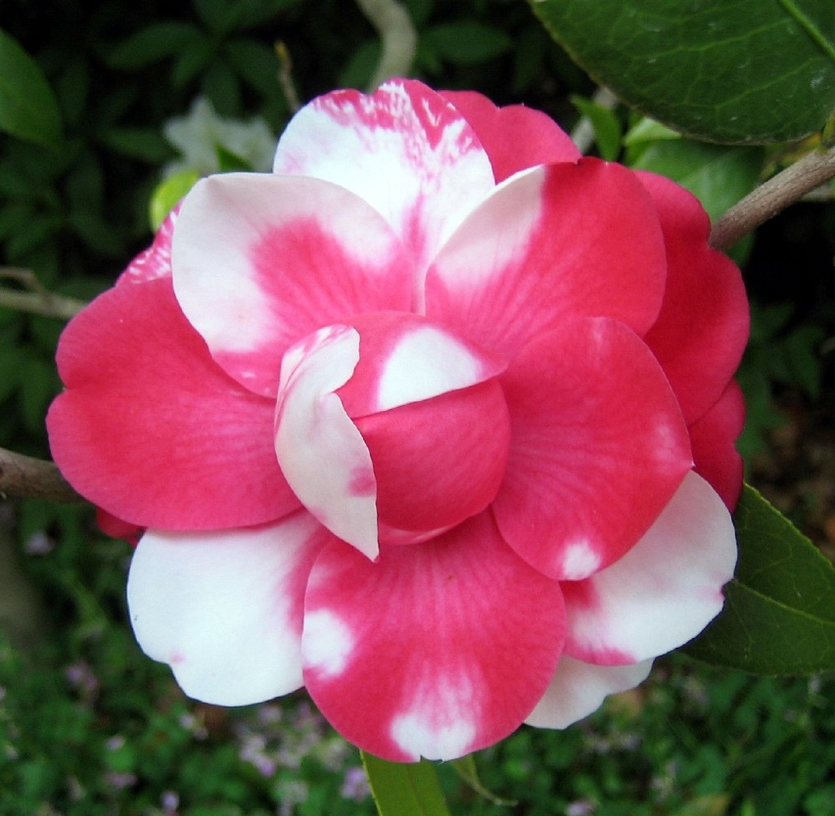
Punnett Possibilities
Codominance- Both alleles contribute to phenotype
(Pink x White = Speckled pink and white)

Slide 14
Codominance
 | Tt
Tt |  | T | t
 | T | TT | Tt
 | t | Tt | tt
Genotype | Phenotype
TT | Red Flower
Tt | Red and White Flower
tt | White Flower

Slide 15
Punnett Possibilities
Multiple alleles- More than two alleles
Blood types!
I^{A} = allele for A-type
I^{B} = allele for B-type
i = allele for O-type

Slide 16
Multiple Alleles
Genotype | Phenotype
I^{A}I^{A} | A-Type
I^{A}i | A-Type
I^{B}I^{B} | B-Type
I^{B}i | B-Type
I^{A}I^{B} | AB-Type
ii | O-Type
 | B
A |  | I^{B} | i
 | I^{A} | I^{A}I^{B} | I^{A}i
 | i | I^{B}i | ii

Slide 17
Punnett Possibilities
Sex-Linked Traits- genes found on the XY chromosome
Colorblindness
(X^{C} vs. X^{c} vs. Y)
Page 121

Slide 18
Multiple Alleles
Genotype | Phenotype
X^{C}X^{C} | Female Normal
X^{C}X^{c} | Female Colorblind
X^{C}Y | Male Normal
X^{c}Y | Male Colorblind
 | X^{C}Y
X^{C}X^{c} |  | X^{C} | Y
 | X^{C} | X^{C}X^{C} | X^{C}Y
 | X^{c} | X^{C}X^{c} | X^{c}Y

Slide 19
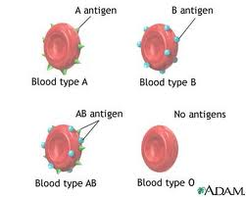
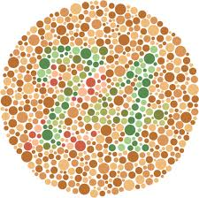
Review Break!
Codominance- Both alleles contribute to phenotype
Sex-Linked Traits- genes found on the XY chromosome
Incomplete Dominance- Neither are completely dominant over the other
Multiple alleles- More than two alleles
You get ½ your genes from mom, ½ from dad
Alleles are assorted randomly
What do we know so far?
Punnett Squares are used to determine chances of a trait occurring

Slide 20
Pedigree
Tracks transmission of a trait through generations
Circles = females, squares = males
Horizontal lines = mating, vertical lines = offspring
Generations shown with Roman numerals
Shaded = expressed trait

Slide 21
I
II
III
1 2
1 2 3 4 5 6
1 2 3 4 5 6 7 8 9
Page 124

