Slide 1
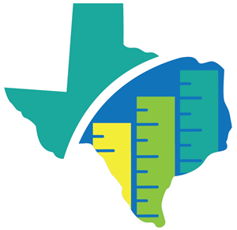

Teacher Incentive
Allotment Program at ILTexas
Reward – Retain – Recruit
The Teacher Incentive Allotment (TIA) provides an accessible pathway for effective teachers to earn a higher income while remaining in the classroom.

Slide 2

2023 Designations
13,774 Teachers Designated Statewide
$145,208,362 Dollars Awarded
196 Teachers Designated at ILTexas
$1,973,677 Dollars Awarded

Slide 3

Funding for Teachers
The Teacher Incentive Allotment provides extra funding, from $3,000 - $32,000 per designated teacher per year, with more money for high needs and rural schools​
ILTexas | $3,648 - $6,712
ILTexas | $7,296 - $13,431
ILTexas | $14,204 - $22,937

Slide 4

Teacher Incentive Allotment 2022-2023 Funding Map for Dallas Area Campuses
Campus | Recognized | Exemplary | Master
ILTEXAS GARLAND EL | $ 5,010.00 | $ 10,019.00 | $ 18,699.00
ILTEXAS GARLAND MIDDLE | $ 5,119.00 | $ 10,238.00 | $ 19,064.00
ILTEXAS GARLAND H S | $ 5,028.00 | $ 10,055.00 | $ 18,759.00
ILTEXAS LANCASTER EL | $ 5,484.00 | $ 10,968.00 | $ 20,279.00
ILTEXAS LANCASTER MIDDLE | $ 5,556.00 | $ 11,112.00 | $ 20,521.00
ILTEXAS LANCASTER DESOTO H S | $ 5,135.00 | $ 10,270.00 | $ 19,117.00

Slide 5
Teacher Incentive Allotment 2022-2023 Funding Map for Houston Area Campuses
Campus | Recognized | Exemplary | Master
ILTEXAS KATY EL | $ 4,153.00 | $ 8,306.00 | $ 15,843.00
ILTEXAS KATY MIDDLE | $ 4,381.00 | $ 8,763.00 | $ 16,604.00
ILTEXAS WESTPARK EL | $ 5,740.00 | $ 11,480.00 | $ 21,133.00
ILTEXAS WESTPARK MIDDLE | $ 5,564.00 | $ 11,128.00 | $ 20,546.00
ILTEXAS KATY WESTPARK H S | $ 4,832.00 | $ 9,664.00 | $ 18,107.00
ILTEXAS WINDMILL LAKES EL | $ 6,010.00 | $ 12,020.00 | $ 22,033.00
ILTEXAS HOUTON WINDMILL LAKES MIDDLE | $ 5,974.00 | $ 11,948.00 | $ 21,913.00
ILTEXAS OREM EL | $ 6,281.00 | $ 12,562.00 | $ 22,937.00
ILTEXAS OREM MIDDLE | $ 6,426.00 | $ 12,851.00 | $ 23,419.00
ILTEXAS WINDMILL LAKES OREM H S | $ 6,255.00 | $ 12,511.00 | $ 22,851.00
ILTEXAS COLLEGE STATION EL | $ 4,081.00 | $ 8,161.00 | $ 15,602.00
ILTEXAS COLLEGE STATION MIDDLE | $ 4,425.00 | $ 8,850.00 | $ 16,751.00
ILTEXAS AGGIELAND H S | $ 4,642.00 | $ 9,283.00 | $ 17,472.00
ILTEXAS BG RAMIREZ EL | $ 5,592.00 | $ 11,184.00 | $ 20,641.00
ILTEXAS BG RAMIREZ MIDDLE | $ 5,591.00 | $ 11,182.00 | $ 20,636.00

Slide 6
Teacher Incentive Allotment 2022-2023 Funding Map for Tarrant Area Campuses
Campus | Recognized | Exemplary | Master
ILTEXAS ARLINGTON EL | $ 5,419.00 | $ 10,838.00 | $ 20,064.00
ILTEXAS ARLINGTON MIDDLE | $ 5,432.00 | $ 10,864.00 | $ 20,107.00
ILTEXAS GRAND PRAIRIE EL | $ 5,463.00 | $ 10,925.00 | $ 20,209.00
ILTEXAS GRAND PRAIRIE MIDDLE | $ 5,537.00 | $ 11,074.00 | $ 20,457.00
ILTEXAS WOODHAVEN EL | $ 6,712.00 | $ 13,424.00 | $ 24,373.00
ILTEXAS WOODHAVEN MIDDLE | $ 6,715.00 | $ 13,431.00 | $ 24,385.00
ILTEXAS ARLINGTON-GRAND PRAIRIE H S | $ 5,509.00 | $ 11,019.00 | $ 20,365.00
ILTEXAS KELLER EL | $ 3,648.00 | $ 7,296.00 | $ 14,161.00
ILTEXAS KELLER MIDDLE | $ 3,661.00 | $ 7,322.00 | $ 14,204.00
ILTEXAS SAGINAW EL | $ 4,583.00 | $ 9,166.00 | $ 17,277.00
ILTEXAS SAGINAW MIDDLE | $ 4,625.00 | $ 9,251.00 | $ 17,418.00
ILTEXAS NORTH RICHLAND HILLS EL | $ 5,279.00 | $ 10,558.00 | $ 19,596.00
ILTEXAS NORTH RICHLAND HILLS MIDDLE | $ 5,466.00 | $ 10,931.00 | $ 20,218.00
ILTEXAS KELLER SAGINAW H S | $ 4,360.00 | $ 8,719.00 | $ 16,532.00

Slide 7
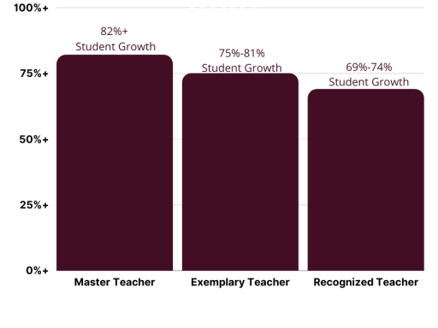
ILTexas Measures of Effectiveness
90%
10%
Student Growth
ILTexas T-TESS
Designation Level | Average Score Across Domain 2 and 3
Recognized | 3.7
Exemplary | 3.9
Master | 4.5
Minimum Rating of “3” Required for each Dimension in Domain 2 and 3

Slide 8


Domain 2 INSTRUCTION
Achieving Expectations (Dimension 2.1)
• The teacher supports all learners in their pursuit of high levels of academic and social-emotional success.
Content Knowledge and Expertise (Dimension 2.2)
• The teacher uses content and pedagogical expertise to design and execute lessons aligned with state standards, related content and student needs.
Communication (Dimension 2.3)
• The teacher clearly and accurately communicates to support persistence, deeper learning and effective effort.
Differentiation (Dimension 2.4)
• The teacher differentiates instruction, aligning methods and techniques to diverse student needs.
Monitor and Adjust (Dimension 2.5)
• The teacher formally and informally collects, analyzes and uses student progress data and makes necessary lesson adjustments.
Student-Centered Actions
Teacher-Centered Actions
5 = Distinguished
4 = Accomplished
3 = Proficient
2 = Developing
1 = Improvement Needed

Slide 9
Domain 3 LEARNING ENVIRONMENT
Classroom Environment, Routines and Procedures (Dimension 3.1)
• The teacher organizes a safe, accessible and efficient classroom.
Managing Student Behavior (Dimension 3.2)
• The teacher establishes, communicates and maintains clear expectations for student behavior.
Classroom Culture (Dimension 3.3)
• The teacher leads a mutually respectful and collaborative class of actively engaged learners.
Student-Centered Actions
Teacher-Centered Actions
5 = Distinguished
4 = Accomplished
3 = Proficient
2 = Developing
1 = Improvement Needed

Slide 10





ILTexas Elementary GROWTH Measures
Kinder & 1st Grade Teachers – iStation (English and Spanish) and ACTFL
2nd Grade Teachers – iStation (English and Spanish), ACTFL, and MAP Math
3rd Grade RLA Teachers – iStation (English and Spanish), ACTFL, and MAP Reading
4th & 5th Grade RLA Teachers – STAAR Reading, iStation (English and Spanish), and ACTFL
3rd Grade Math Teachers – MAP Math and ACTFL
4th & 5th Grade Math Teachers – STAAR Math and ACTFL
3rd – 5th Grade Science Teachers – MAP Science and ACTFL
Kinder – 5th Chinese – ACTFL
3rd – 5th Grade Performance Coaches – IWA
SPED – grade/subject level assessments

Slide 11
ILTexas Middle School GROWTH Measures
6th – 8th Grade Reading Teachers – STAAR Reading (English 1 EOC)
6th – 8th Grade Math Teachers – STAAR Math (Algebra 1)
6th – 8th Grade Science Teachers – MAP Science
6th – 8th Grade Spanish – ACTFL
6th – 8th Grade Chinese – ACTFL
6th – 8th Grade Performance Coaches – IWA
SPED – grade/subject level assessments

Slide 12
ILTexas High School GROWTH Measures
Algebra 1 Teachers – EOC Algebra 1
English 1 Teachers – EOC English 1
English 2 Teachers – EOC English 2
Biology Teachers – MAP Biology
9th – 12th Grade Spanish – ACTFL
9th – 12th Grade Chinese – ACTFL
9th – 12th Grade Performance Coaches – IWA
SPED – grade/subject level assessments
*seeking approval for Algebra 2 and Geometry for the Data Capture SY 24-25

Slide 13

Option for Other Teachers
National Board Certification
Automatic Recognized Designation
Eligible National Board Certified Teachers (NBCTs), working as teachers, may earn an automatic Recognized designation through the Teacher Incentive Allotment
What is National Board Certification?
A voluntary process to certify teachers against the standards established by teachers, for teachers.
Designed to develop, retain and recognize accomplished teachers and to generate ongoing improvement in schools nationwide.
Developed and overseen by The National Board for Professional Teaching Standards (NBPTS)

Slide 14
Certificate Areas
National Board Certification
To be eligible for National Board Certification, teachers must:
Hold a bachelor’s degree
Have completed three years of successful teaching experience
Hold a valid state teaching license or meet the licensure requirements established by your state for a school counselor
Meet any additional prerequisites for certificate area

Slide 15
National Board Certification
Resources
Cost of National Board Certification
The initial cost for each of the four components is $475, with the total cost for the initial attempt of all four components being $1,900. Retake attempts require an additional fee. For each assessment cycle in which a teacher plans to take components, a $75 nonrefundable and nontransferable registration fee is required and must be paid before purchasing a component.
The Teacher Incentive Allotment will reimburse up to $1,900 for initial certification after the NBC is awarded.
National Board Certification is active for a period of five years.
National Board Certification Website
Guide to National Board Certification
How Long Does it Take?
Becoming National Board certified can take up to four years from initial registration to certification, but most candidates are certified within 1-3 years.

Slide 16
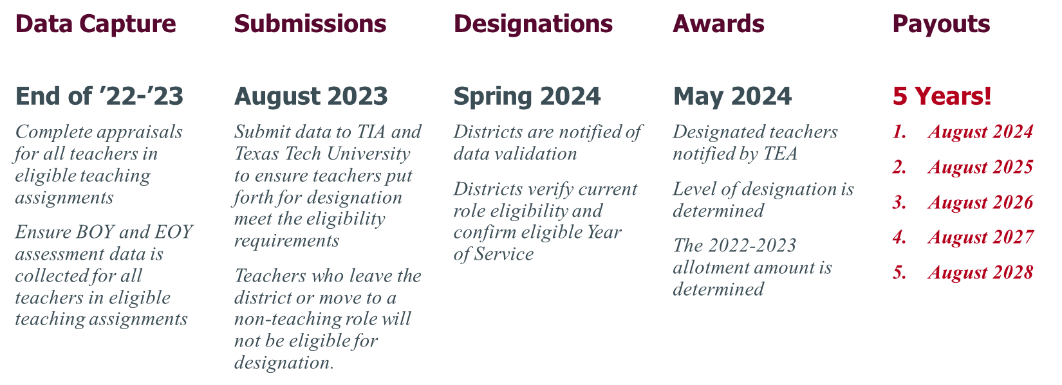
Teacher Incentive Allotment
                Understanding the Timeline
Example
$10,000
$10,000
$10,000
$10,000
$10,000
$50,000

Slide 17


Tiffany Harrod
Executive Director of Assessment and Data Analysis
tharrod@iltexas.org

