Slide 1
Nearpod.com
TRDLO

Slide 2
Chapter 1: First Peoples; First Farmers: Most of History in a Single Chapter, to 4000 B.C.E.
1. About how long ago did Homo sapiens appear?
a. About 25,000 years ago.
b. About 100,000 years ago.
c. About 250,000 years ago.
d. About 45,000 years ago.

Slide 3
Answer
Chapter 1: First Peoples; First Farmers: Most of History in a Single Chapter, to 4000 B.C.E.
1. About how long ago did Homo sapiens appear?
a. About 25,000 years ago.
b. About 100,000 years ago.
c. About 250,000 years ago.
d. About 45,000 years ago.

Slide 4
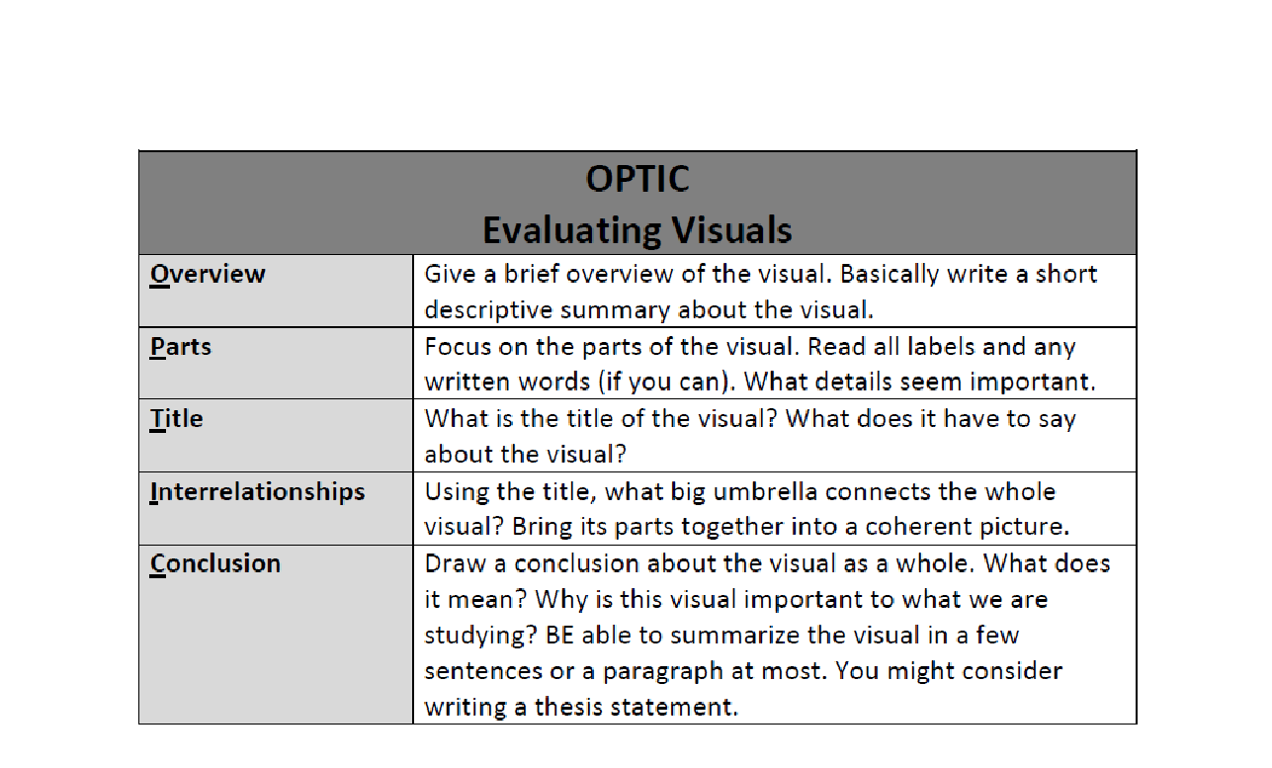
Lets learn and practice a strategy for analyzing images

Slide 5
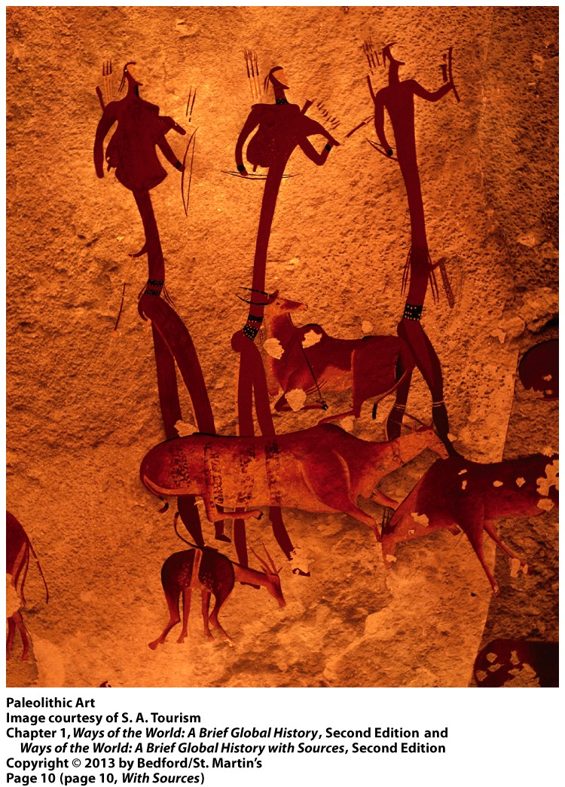
Now lets practice OPTIC:
Everyone needs a OPTIC Neolithic populations worksheet
You have 5 minutes to fill in the OPTIC
Be prepared to share

Slide 6
Big Picture History
Helps focus on the must know events in World History
Period 1: Technological and Environmental Transformations, to 600 B.C.E.

Slide 7
Paleolithic Era vs. Neolithic Era
The Paleolithic and Neolithic Eras, from 2.6 million to 12,000 BCE and 12,000 to 3,500 BCE respectively, vary greatly when it comes to their relative economies and social organization, but continue to show similarities in their religious values.

Slide 8
What are the Paleolithic and Neolithic Periods?
Paleolithic
  Derives from the Greek palaios meaning "old” and lithos meaning "stone", literally meaning "old age of the stone" or "Old Stone Age.”
Neolithic
  The term Neolithic derives from the Greek neolithikos meaning "new” and lithos meaning "stone", literally meaning "New Stone Age.”
How were stones used in the Old Stone Age versus the New Stone Age?

Slide 9
Human Origins in Africa
Watch Video on Origins of Humans in Africa
https://www.youtube.com/watch?v=yHIBYTBe_hc
Answer the following Questions:
  1) What did early humans need to do to survive?
  2) What physical actions would tools help these humans do?
  3) What materials did early humans use from their physical environment to make these tools?

Slide 10
Hadza
http://ngm.nationalgeographic.com/2009/12/hadza/hadza-map
http://www.cnn.com/2014/04/18/world/africa/africas-ancient-hunter-gatherers-hadza/
Why is this region referred to as the cradle of humanity?
How many Hadza remain?

Slide 11
Economies
Paleolithic
  Based mainly on hunting and gathering
    Constant movement in anticipation of the migration of game and fish was key
  The climate fluctuated between warm and cool periods
Neolithic
  Based mainly on farming and domesticated animals
    People began to rely on a steady supply of food, possibly even a surplus
  The climate began to become warmer and more consistent
Both
  Used stone tools
  Took part in long distance trade (barter)

Slide 12
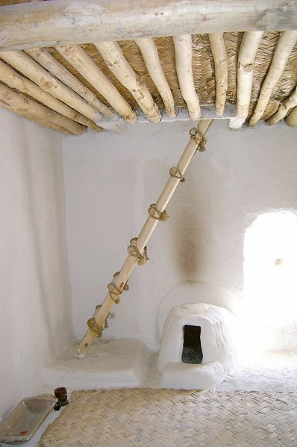
Neolithic Changes to Class Structure
Three Things Dominate the Change:
  Emergence of villages and towns
    i.e. Jericho
  Specialization of labor
    Neolithic site of Çatal Hüyük (south-central Anatolia) (crafts, pottery, woven material)
  Social distinctions
    Private Land Ownership
    Economic Inequalities

Slide 13
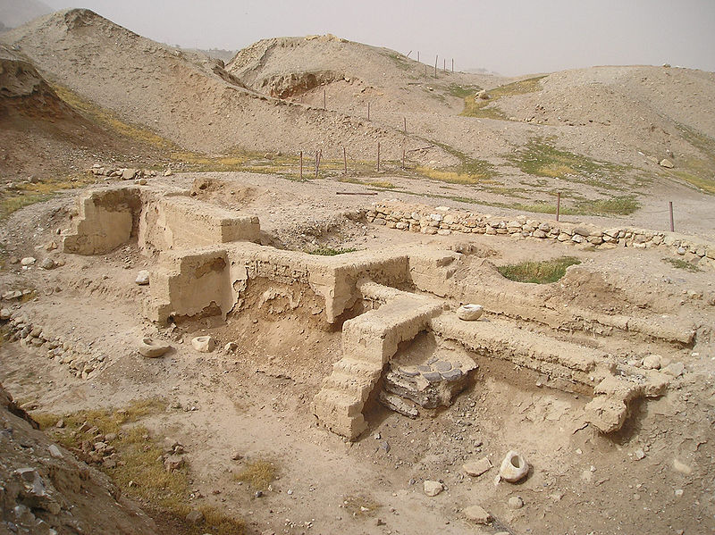

Slide 14
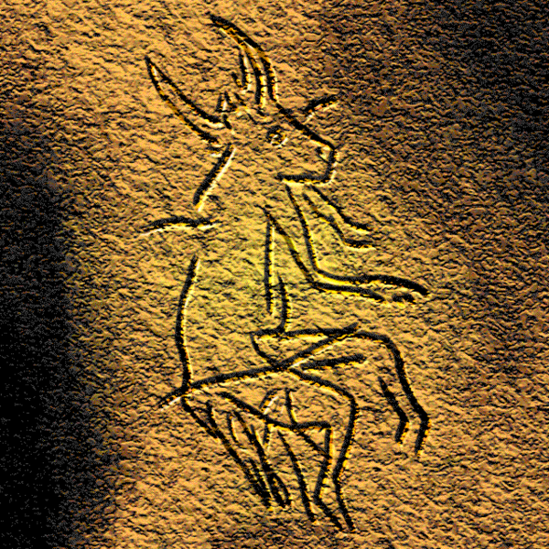
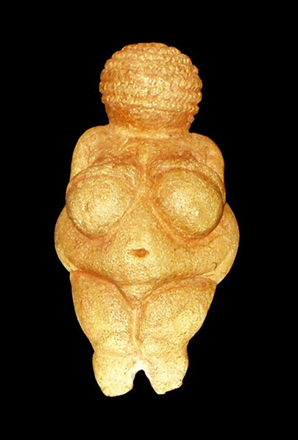
Religion
Evidence for belief in the afterlife first appears in the Paleolithic period, marked by the appearance of burial rituals and ancestor worship.
  Priests, or shamans, and sanctuary servants appear in prehistory.
Humans experienced altered states of consciousness and partook in ritual, and ritual was used in their societies to strengthen social bonding and group cohesion.
During the Neolithic period, there begins to be increased masculinization of the religious deities

Slide 15
Migration
http://www.bradshawfoundation.com/journey/
What was the sequence of human migration across the planet? (use the map to answer)
Homo Sapiens emerged in Africa 250,000 years ago
First human migration out of Africa into Eurasia 100,000-60,000 years ago
Human entry into Australia 60,000-40,000 years ago
Human entry into Europe 45,000 years ago
Human entry into Americas 30,000-15,000 years ago
Austronesian migration to Pacific Islands, Madagascar 3,500-1,000 years ago
Human entry into New Zealand 700-1,000 Years ago

Slide 16
What advantages does an agriculturally based society have over a hunter/gatherers society?
What disadvantages?

Slide 17
Kennewick Man
http://www.cbsnews.com/news/kennewick-man-an-ambassador-from-the-past/
What traditional theory does the discovery of Kennewick man challenge?
What evidence does Kennewick Man reveal to support this new theory?

Slide 18
Clovis Culture
Flourished briefly 13,000 years ago
Clovis points are scattered all over North America
Abrupt end, cause unknown
http://www.pbs.org/wgbh/nova/ancient/ancient-clovis-cache.html
http://www.pbs.org/wgbh/nova/ancient/stone-age-toolkit.html
Interactive!

Slide 19
Into the Pacific
What motivations would they have needed to sail such distances in an open boat?
These motivations do not change much over time (CCOT), overpopulation led to diminished resources, adventure, opportunity to start anew, and war pressures in their homeland.

Slide 20
Conclusion
It was one clear event that defined the two periods:
  The Neolithic Revolution (or transition)
Agriculture gave people more food and larger families, but brought about class structure, longer work days, disease, famine, and massive warfare.
Is the trade off worth it? Some societies, like the Hadza say no. Would you give up your cell phone? Car? House?

Slide 21
THINK ABOUT IT
One reason for the development of an early civilization in the Tigris-Euphrates river valleys was that
A) the location protected the people from land invasion
B) periodic flooding left rich soil, which was ideal for farming
C) these rivers provided a direct trade route between Europe and Asia
D) these rivers flowed into the Mediterranean Sea

Slide 22
Answer is B
One reason for the development of an early civilization in the Tigris-Euphrates river valleys was that
A) the location protected the people from land invasion
B) periodic flooding left rich soil, which was ideal for farming
C) these rivers provided a direct trade route between Europe and Asia
D) these rivers flowed into the Mediterranean Sea

Slide 23

We begin at about 8,000 BCE
when village life began in the New Stone Age. . . Also known as the
Neolithic Revolution.
NEW STONE AGE

Slide 24

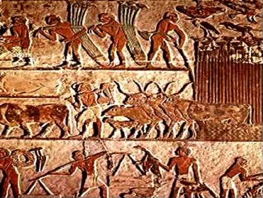
A TOTALLY new way of living:
From
Hunter-Gatherers
to Agriculture

Slide 25
The Neolithic Revolution
Systematic Agriculture means planting crops and domesticating animals for food, clothing, and work.
The ability to acquire food regularly gave humans greater control over their environment and made it possible to give up nomadic ways of life.

Slide 26
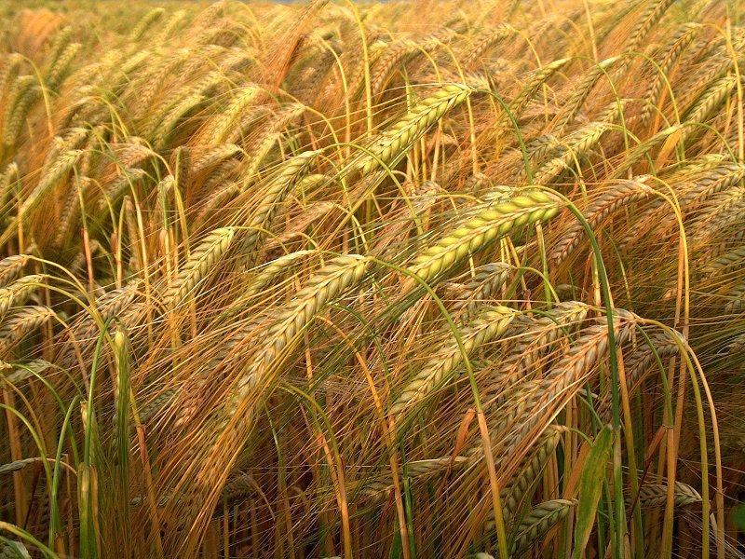
INVENTION OF AGRICULTURE
Mesopotamians first to engage in agriculture
  Around 8000 BCE
  Cereal crops
    Wheat
    Barley
  Herd animals
    Sheep
    Goats
Woman probably first farmer
  Grain-collecting then noticed that stored wild grain could be grown on purpose

Slide 27
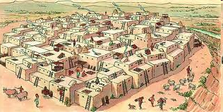
Catal Huyuk (artistic rendering)

Slide 28
Important Neolithic Changes
More Complex Communities
Trade caused people to specialize and a division of labor developed.
Basic crops were first cultivated, and cloth was woven.
Men became more active in farming and herding, taking them away from home.
Women began to do more domestic tasks
Men began to take on a more dominant role

Slide 29
Complete the Venn Diagram
Paleolithic
Neolithic

Slide 30
Quick Trip
http://archive.archaeology.org/0403/abstracts/time.html
Link is available on edmodo as well
Investigate the similarities and differences in how civilizations have viewed time.

Slide 31
Systematic Agriculture
Developed all over the world between 8000 and 5000 B.C.
Slash and Burn Farming: cut trees or grasses and burned them to clear a field. The remaining ashes acted as fertilizer.
Systematic Agriculture gave rise to permanent settlements, called Neolithic Farming Villages.
  Examples are Jericho in Palestine and Catal Huyuk in Turkey

Slide 32
POV Practice
http://thecaveonline.com/APEH/footballdbq.html

Slide 33
Interpreting Chauvet
How do locations of the artwork influence how we interpret it?
What does the location imply about their purposes?
Do these images imply a set of beliefs similar to the Dreamtime of Australia?
What types of figures are missing?
What can be inferred from the differences?
What might the emphasis on animals tell us about the purpose?
http://archeologie.culture.fr/chauvet/en/

Slide 34
Civilization: Whose Definition?
Are you civilized or just a barbarian?
18th Century European
Civilized vs. primitive
White vs. everyone else

Slide 35

What does it mean to be civilized?
Historians have determined 6 characteristics of civilization:
        Cities
        Organized central governments
        Complex religions
        Social classes
        Job specialization and the arts
        Writing

Slide 36
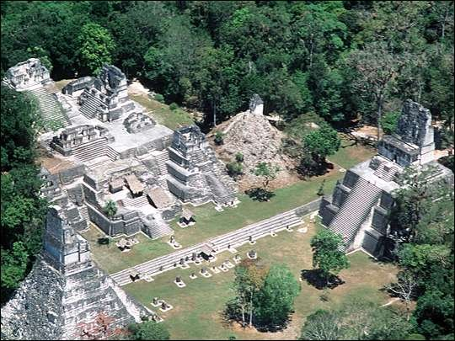
UNIQUENESS OF CIVILIZATION
Civilization was not simply next inevitable step from Neolithic Age
  Many peoples remained at simple food-raising stage for thousands of years—without developing any sort of civilization
Only four locations developed civilizations entirely on their own
  China
  Indus River Valley
  Mesopotamia/Egypt
  Central America and Peru

Slide 37
Common Characteristics ??
Water!!
  Deserts of river cultures short on resources
  River Valley Civilizations
Opportunity to adapt environment
Suitable for domesticated plants/animals
Relatively stable (a bit hot) climate

Slide 38
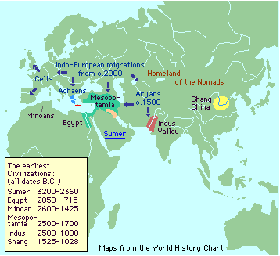
GEOGRAPHY influenced the development of river valley civilizations.

Slide 39
Early River Valley Civilizations
Environment
Flooding of Tigris and Euphrates unpredictable
No natural barriers
Limited natural resources for making tools or buildings
Mesopotamia
Flooding of the Nile predictable
Nile an easy transportation link between Egypt’s villages
Deserts were natural barriers
Egypt
Indus flooding unpredictable
Monsoon winds
Mountains, deserts were natural barriers
Indus River Valley
Huang He flooding unpredictable
Mountains, deserts natural barriers
Geographically isolated from other ancient civilizations
China
Mesoamerica & Andes
Mountains and ocean natural barriers
Warm temperatures and moderate rainfall
Geographically isolated from other ancient civilizations

Slide 40
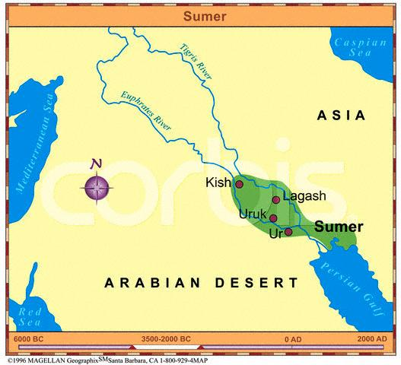
Mesopotamia – Fertile Crescent
Sumer – The Earliest of the River Valley Civilizations
Sumerian Civilization grew up along the Tigris and Euphrates Rivers in what is now Kuwait.

Slide 41

Sumerian Writing: cuneiform
Cuneiform is created by pressing a pointed stylus into a clay tablet.

Slide 42
Sumerians invented:
Brick technology
Wheel
Base 60 – using the circle . . . 360 degrees
Time – 60 minutes in an hour, 60 seconds in a minute
12 month lunar calendar
arch
ramp
ziggurat

Slide 43
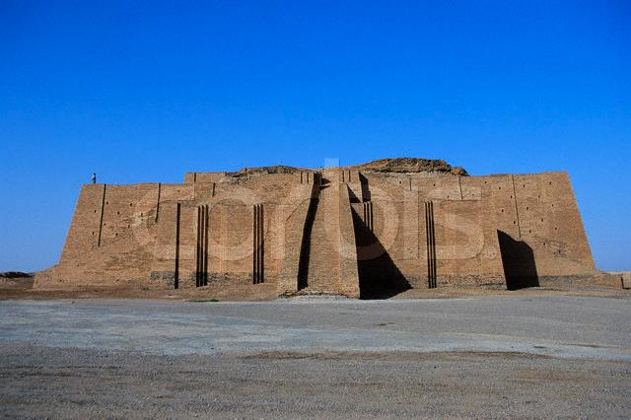
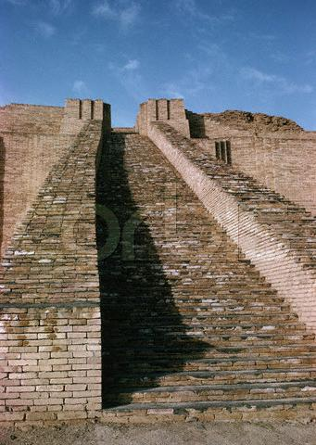
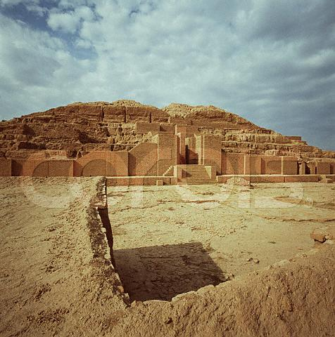
Ziggurat – Holy Mountain
Click on the pictures for more information on ziggurats.

Slide 44
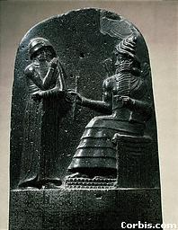
Babylon
First know written law code
  “Rule of Law”
Hammurabi’s Code - 1792 BC

