Slide 1
The road to graduation
Presented by the Westlake counseling department

Slide 2
Counselor conversations
Graduation Requirements
50’s Recovery Program
Incompletes
How to Order a Transcript
Semester Two Senior Timeline
Naviance Refresher
College Acceptance Letters

Slide 3
Graduation requirements
All 23 credits required for graduation MUST be satisfied:
4 Math credits
4 Science credits
4 English credits
3 Social Studies
3 World Language, Fine Arts, OR Career Tech
1 Health/Personal Fitness credit
4 Elective credits

Slide 4
Incomplete recovery Program & 50s recovery program
Last call for Incomplete Recovery and 50s Recovery Program….
An “Incomplete” in CORE CLASS MUST be satisfied from semester two of last school year
If you failed a CORE CLASS (Math, Science, Social Studies, English, or Spanish from semester one ONLY) with a grade of 50 or higher, you may qualify to retake the course through 50s Credit Recovery Program.

Slide 5
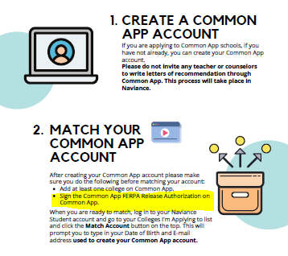
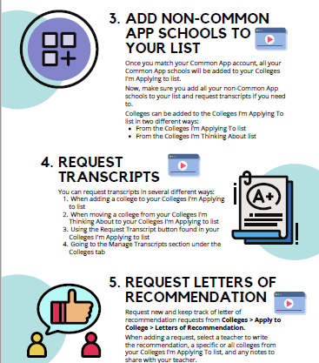
Naviance refresher

Slide 6
Naviance refresher CONt’d
You MUST sign the FERPA Release Waiver in Common App before you match your account to Naviance
Counselors cannot send transcripts to schools that you have listed in “Colleges I’m Thinking About”
Delete schools to colleges that you are not applying to for admission.
Check Fulton County email 111100100@fcstu.org!!!
Allow the colleges at least two weeks to download your documents

Slide 7
How to order a transcript
Transcript Requests Using Naviance
How to Request a Transcript for College Applications
How to Request a Transcript for Scholarships or Other Reasons.

Slide 8
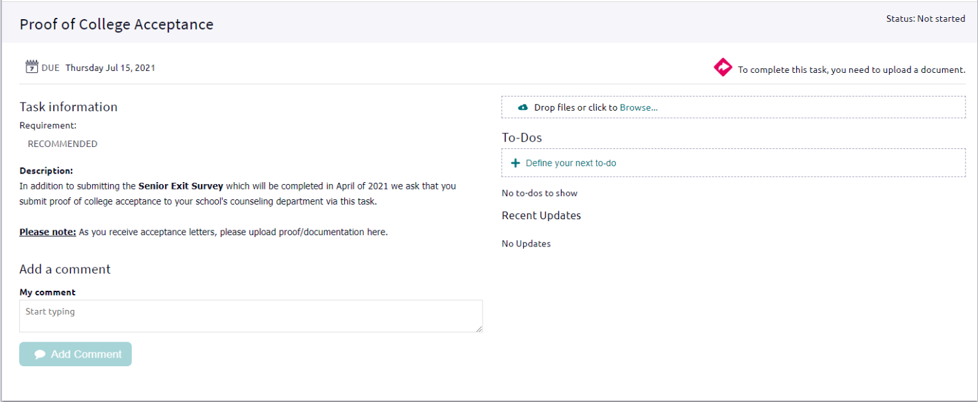
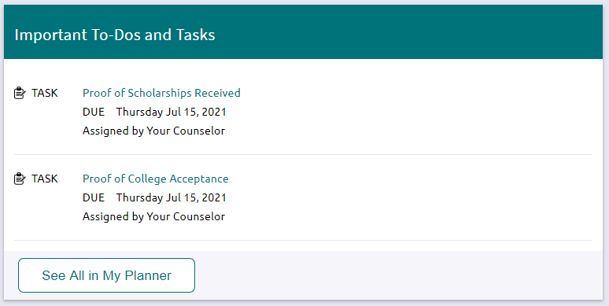
College acceptance letters In naviance
To complete this task:
1. Log in to your Naviance Student account through Classlink
2. Click on the Proof of College Acceptance Task under the Important To-Dos and Tasks section
3. Click on Browse in the Drop files or click to Browse option
4. Choose your file
5. Click open
Make sure the documents you are submitting are saved as .doc or .pdf.

Slide 9
Semester two senior timeline
Keep active in school. The college will want to know what you have accomplished between the time you applied and the time you learned of its decision.
Complete your FAFSA so you can get the most possible financial assistance for college. Westlake’s Financial Aid Night is February 24th.
Continue your hunt for scholarships and apply for scholarships.
Once you've received all responses from colleges, make your final decision!
Verify your financial aid before you make any college budget decisions.
Request your final transcripts in Naviance
Pass all required classes and graduate!
AFTER Graduation…
Start your last ever high school summer job.
Attend your college's summer orientation to get the lay of the land before school starts.
Apply for student housing and get matched with a great roommate.
There's no time to waste, begin preparing for your college coursework now.
Get ready for a new world of student organizations, on-campus living, and college life by learning more about what your school has to offer.

Slide 10
CongratulationS, it’s almost time to graduate!!!!

