Slide 1
Renewable
and Nonrenewable Resources

Slide 2
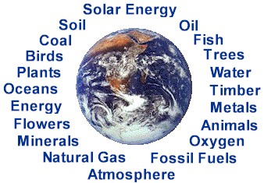
Resources
Natural resources can be divided into two main groups:
Material Resources - materials that are used to make different products
Energy Resources – resources that provide people with energy

Slide 3
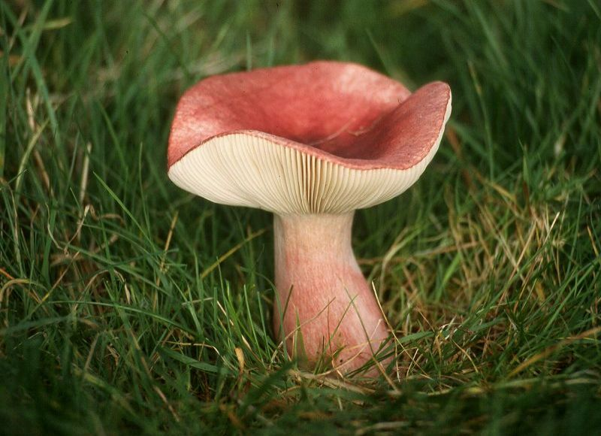
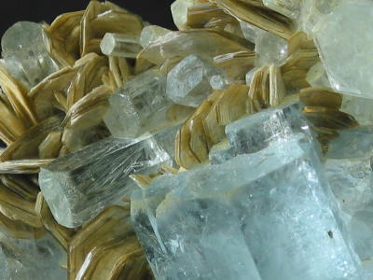
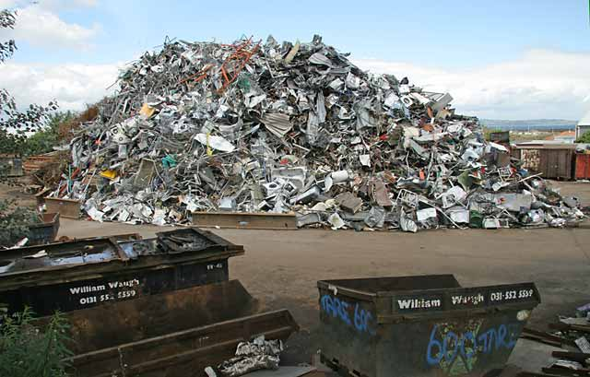
Materials Resources
Material resources can be:
Renewable (air, water, plants, animals, other organisms)
Nonrenewable (minerals, rocks, metals, plastics)

Slide 4
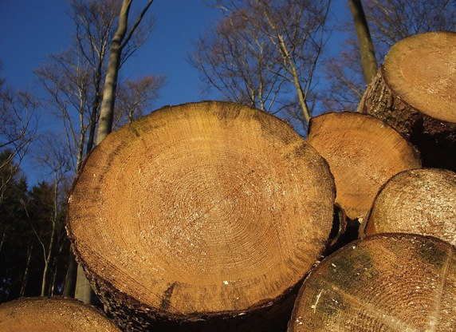
Renewable Materials Resources
The earth provides many natural resources in the form of materials. Some of these are used as they are and some are used to produce many other products.
Sustainability: meeting the needs of the present without compromising the ability of future generations to meet their needs.
As long as these renewable material resources are used sustainably, we will have a continually renewable resource for our use over time.

Slide 5
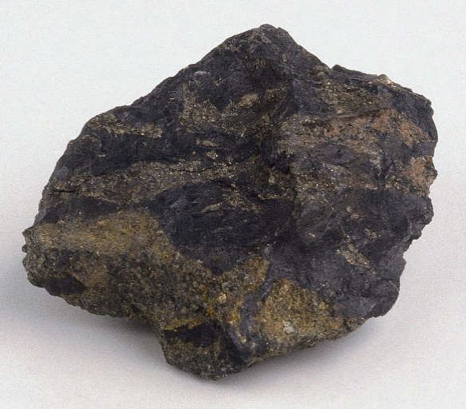
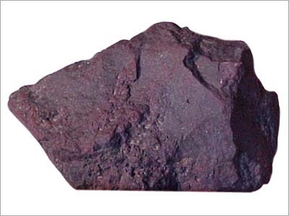
Nonrenewable Material Resources
A nonrenewable mineral resource is a concentration of naturally occurring material in or on the earth’s crust that can be extracted and processed into useful materials at an affordable cost.
Nonrenewable mineral resources include:
Metallic mineral resources (iron, copper, aluminum)
Nonmetallic rock and mineral resources (salt, clay, sand, phosphates, and soil)
Energy resources (coal, oil, natural gas, and uranium)

Slide 6
Ore is rock containing enough of one or more metallic minerals to be mined profitably.

Slide 7
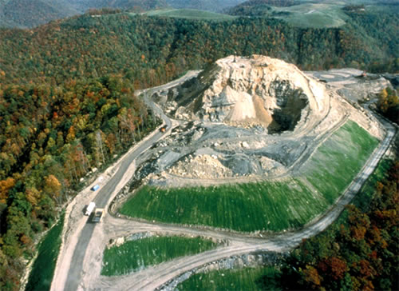
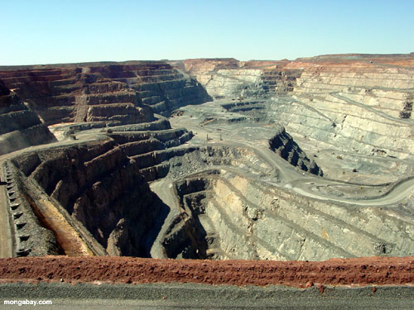
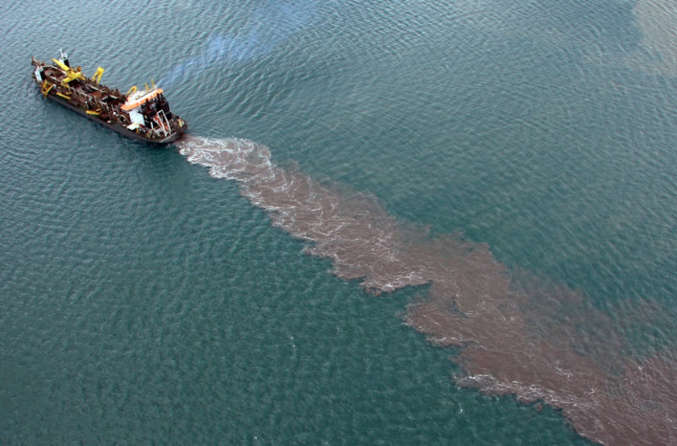
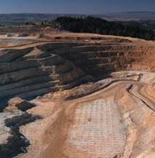
Mining techniques used to remove rock and mineral resources
Surface mining is used to remove shallow deposits, while subsurface mining is used to remove deep deposits.
Surface mining includes:
Open-pit mining (machines dig holes to remove deposits)
Dredging (machines scrape up underwater deposits)
Area strip mining (trenches are dug to reveal deposits)
Contour strip mining (terraces are dug on mountain sides for deposits)
Mountaintop removal (mountain tops are removed to reveal deposits)

Slide 8
Surface Mining Control and Reclamation Act of 1977
The act requires mining companies to restore most surface-mined land so it can be used for the same purpose as before it was mined.
The act also levied a tax on mining companies to restore land that was disturbed by surface mining before the law was passed.
Reclamation efforts are only partially successful and coal companies continue lobbying elected officials to have the law weakened or to chock off funds for its enforcement.

Slide 9
Subsurface mining disturbs less than one-tenth as much land as surface mining and usually produces less waste material.
But it leaves much of the resource in the ground and is more dangerous and expensive than surface mining.
Hazards include cave-ins, explosions, and lung diseases (such as black lung) caused by prolonged inhalation of mining dust.

Slide 10
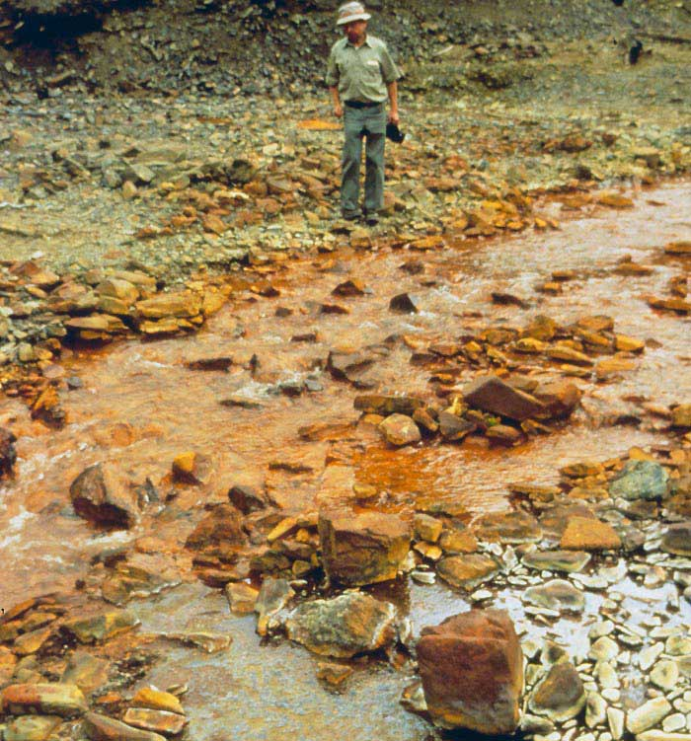
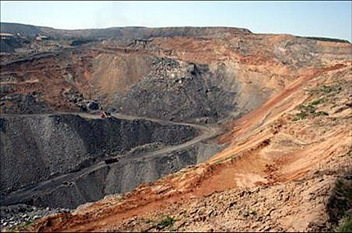
Environmental Effects of Using Rock and Mineral Resources
Extracting, processing, and using rock and mineral resources can disturb the land, kill miners, erode soils, produce large amounts of solid waste, and pollute the air, water, and soil.

Slide 11
How does mining affect the environment?
1. Scarring and disruption of the land surface
2. Subsidence (collapse of land)
3. Toxin-laced mining wastes
4. Acid mine drainage
5. Emission of toxic chemicals into the atmosphere

Slide 12
Supplies of Mineral Resources
The future supply of nonrenewable minerals depends on two factors: actual or potential supply of the mineral and the rate at which we use it.
We never completely run out of any mineral. However, a mineral becomes economically depleted when it costs more to find, extract, transport, and process the remaining deposit than it is worth.
When a mineral becomes economically depleted, there are five choices: recycle or reuse, waste less, use less, find a substitute, or do without.

Slide 13
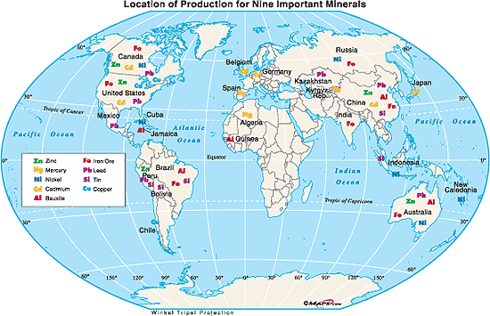
Depletion time is how long it takes to use up a certain proportion, usually 80 %, of the reserves of a mineral at a given rate of use.
Depletion time must take into account recycling and reusing of the mineral, new discoveries of the mineral, or finding a substitute for the mineral.

Slide 14
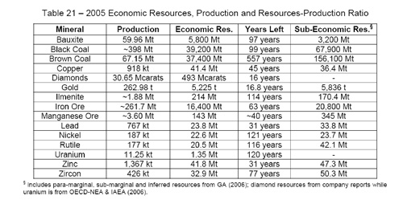
Depletion Time of Common Minerals

Slide 15
History:
- First fuel source was wood
- Water wheel and windmills during European Industrial Revolution
- 1850s Steam engines as important as waterwheel but horse/human power still used on farms
- 1900 Coal replaced wood as dominant fuel

Slide 16
History:
- Early 1900s Tractors replace horses on farms
- Fewer people needed to farm land, more people move into cities
- Distance between work and home increases

Slide 17
History:
- 1952 Pres. Truman warned we would be dependent on Mid East oil by 1970s
- 1970 U.S. had 6% population but used 1/3 total energy – most was import oil
- 1990 U.S. Had 5% population and used 1/4 total energy

Slide 18
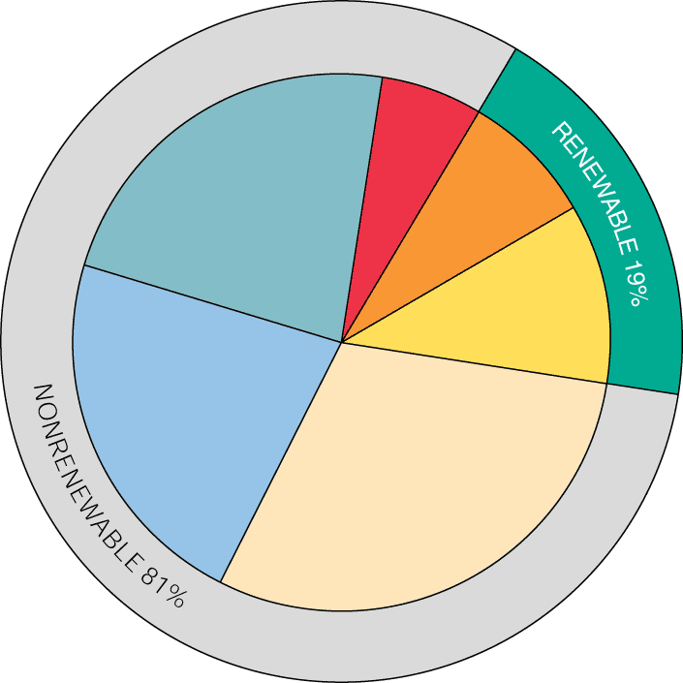
Evaluating Energy Resources
Renewable energy
Nuclear power
6%
Hydropower,
geothermal,
Solar, wind
7%
Non-renewable energy
Natural
Gas
23%
Future availability
Biomass
12%
Net energy yield
Coal
22%
Oil
30%
Cost
Environmental effects
World

Slide 19
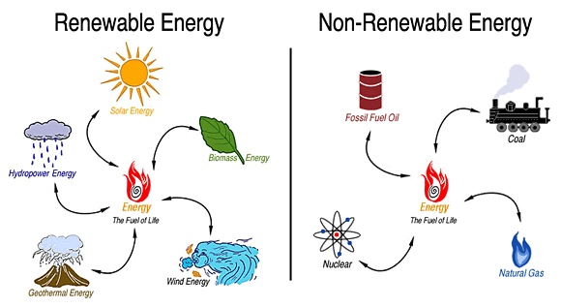
Energy Resources
Energy resources can be renewable or nonrenewable.
Nonrenewable energy resources are those that can be used only once or those that are not replaced by nature as quickly as they are used.
Renewable energy resources are resources that can be regularly replaced or replenished by nature.

Slide 20
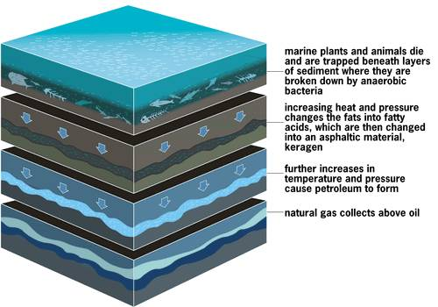
How is oil (petroleum) and natural gas formed?

Slide 21
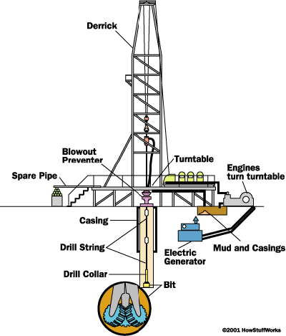
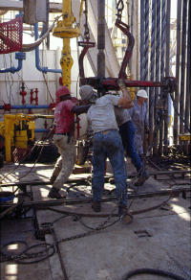
Drilling for Oil and Natural Gas
Drilling occurs in stages: Workers drill, then run and cement new casings, then drill again. When the rock cuttings from the mud reveal the oil sand from the reservoir rock, they may have reached the final depth. At this point, they remove the drilling apparatus from the hole and perform several tests to confirm this finding:

Slide 22
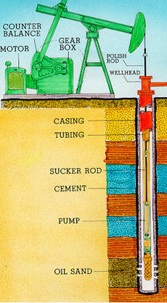
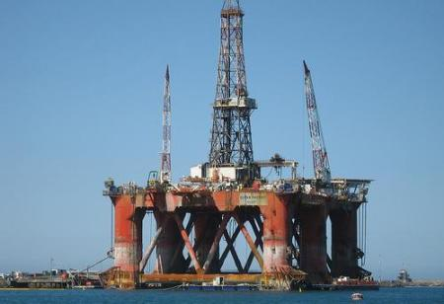
Extracting the Oil and Natural Gas
After the drilling rig is removed, a pump is placed on the well head. In the pump system, an electric motor drives a gear box that moves a lever. The lever pushes and pulls a polishing rod up and down. The polishing rod is attached to a sucker rod, which is attached to a pump. This system forces the pump up and down, creating a suction that draws oil up through the well.

Slide 23
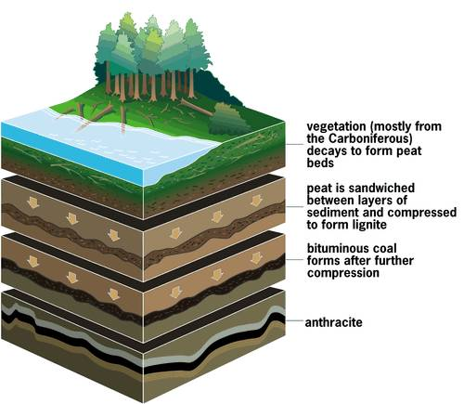
How is coal formed?
Peat – low heat, high carbon emission
Lignite
Bituminous coal
Anthracite coal – high heat, low carbon emission

Slide 24
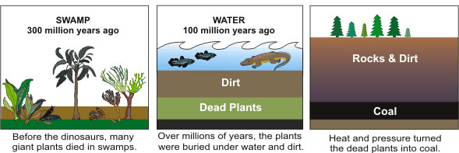
Mining of anthracite coal continues to this day in eastern Pennsylvania, and contributes up to 1% to the gross state product of the state. Over 2,000 people were employed in the mining of anthracite coal in 1995. Most of the mining currently involves reclaiming coal from slag heaps (waste piles from past coal mining) nearby closed mines. Some underground anthracite coal is also being mined. As petroleum and natural gas get more expensive, anthracite coal is growing in its importance as an energy source.

Slide 25
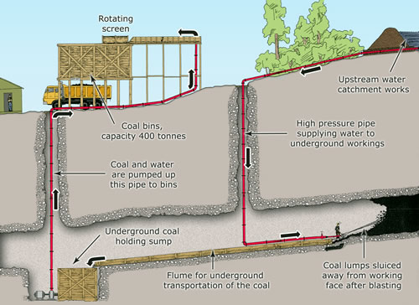
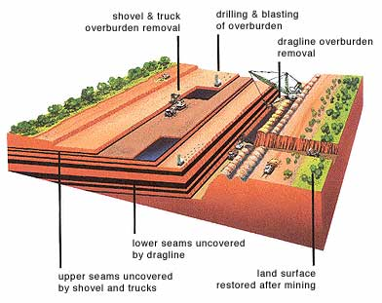
Surface and Subsurface Mining of Coal
Surface mining
Subsurface mining

Slide 26
Advantages and Disadvantages of Fossil Fuels
What are the advantages of fossil fuels?
Straightforward combustion process
Relatively inexpensive
Easily transported
What are the disadvantages of fossil fuels?
Probably a major cause of climate change
Cause of acid rain
Not sustainable in the long-term
Politics and economics can cause major price increases
Extraction can be very damaging to the landscape

