Slide 1
Kindergarten 2023-24
Heritage ES Kindergarten Kingdom

Slide 2
Heritage Elementary.... presents
HERITAGE ELEMENTARY ​
CURRICULUM NIGHT​
SEPTEMBER 14, 2023

Slide 3
ATTENDANCE POLICY
A tiered approach will be utilized to maximize student attendance in school. Attendance interventions will be implemented based on the following categories:
•Satisfactory (0-4% Absence Rate)
•At Risk (5-9% Absence Rate) - Preventative
Foundation of the support system and includes universal strategies to encourage good attendance for all students.
•Chronic Absent (10-19% Absence Rate) - Early Intervention
For students and families who need more encouragement and support in addition to preventative strategies. Chronic absent strategies will provide early intervention(s) to target students to avoid chronic absences.
•Severe Chronic Absent (≥20%Absence Rate)- Intensive Supports
Offers intensive support for students facing the greatest challenges to getting to school with individual interventions and wrap around supports.
The Superintendent will develop Operating Guidelines to implement this policy.

Slide 4
Queens of the Kindergarten Kingdom
Ms. Cochran, Teacher
Ms. Copeland Parapro
Ms. Dewan, Teacher
Ms. Charles Parapro
Ms. Fredrick Teacher
Ms. Camp Parapro
Ms. Wargo, Grade Level Chair
Ms. Morgan Parapro

Slide 5
Grade Level Expectations
Breakfast is important! Make sure your student eats before coming to class. Get here early!
Please be on time for class.
Students were given a homework folder. Homework is due on Fridays for a grade. Please help your child with their work. Include any notes for the teacher in the folder. Sign behavior color.

Slide 6
Notes:
We are not allowed to celebrate birthdays at school.
We DO NOT take naps. Please make sure your child goes to sleep early each night.
Please send a healthy snack with your child each day.
Class snacks are appreciated!

Slide 7
Class Schedule
7:40 Morning Meeting
7:50-9:55 Phonics Instruction, Shared Reading, Guided Reading
10:00-10:30 Lunch
10:35-11:20 Specials
11:20-12:30 Math
12:30-12:55 Recess
12:55-1:15 Intervention
1:15-1:40 Writing
1:40-2:15 Science/SS
2:20 Dismissal

Slide 8
Class Dojo
Behavior/Motivation Program
Points
Rewards
Communication with parents
Weekly Class Newsletters
Please join and check often

Slide 9
Behavior Expectations
Follow Directions
Share classroom materials
Work quietly & do your best
Walk quietly in a straight line in the halls and during classroom transitions
Be nice to others
Keep hands and feet to yourself
Use good manners
Follow Rules (Cafeteria, Specials, Playgroud, Bathroom)

Slide 10
Curriculum
Wonders​ (ELA)
Heggerty (Phonological Awareness)
95 Core (Phonics)
Kindergarten Enhanced Math
Inspire Science​
Gallopade Social Studies​
Standards:
Georgiastandards.org

Slide 11
Reading/ELA/Writing (Wonders)
Please practice letter recognition, letter sounds, and writing letters.
Please work on sight words with your students.
The goal is 75 words by the end of the school year.
Read nightly with your child and ask them to tell you about what you read.

Slide 12
Mathematics (My Math) Enhanced
Please practice:
Counting to 100 by ones and by tens
Writing numbers 1-20
Shapes, 2D & 3D
Counting objects using 1 to 1 correspondence (1 at a time)
Position Words
Measurement
Addition & Subtraction
Dimes & Pennies

Slide 13
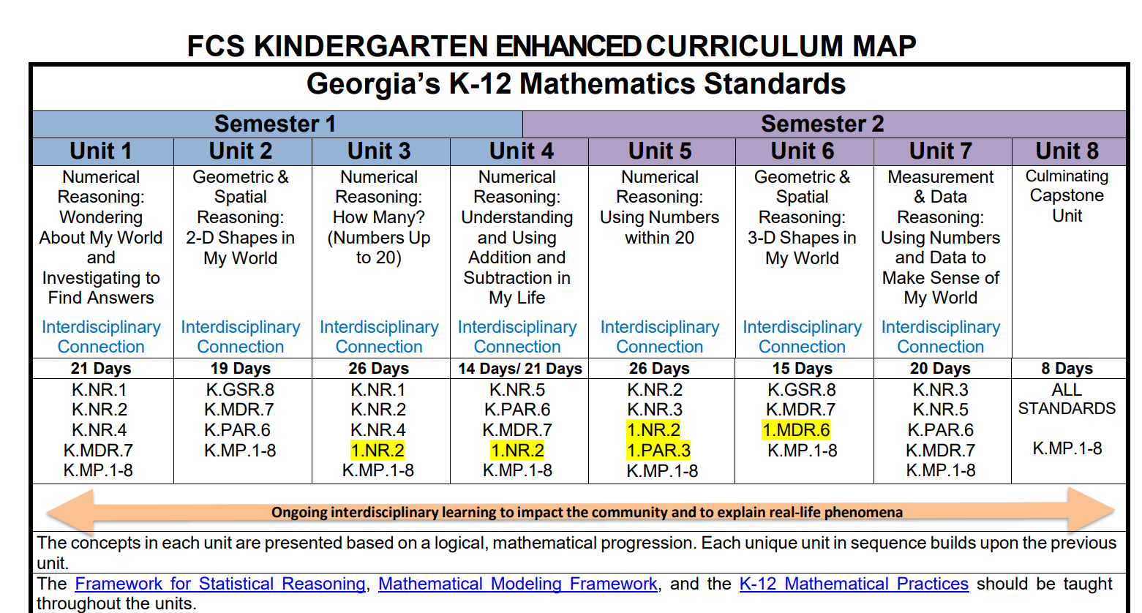
ENHANCED MATH
Goals of Mathematics Education
Each and every student in Georgia should be provided with opportunities to:
become confident in using mathematics to analyze and solve problems both in school and in real-life situations as they recognize that mathematics permeates the world around us.
develop the knowledge, skills including use the language, symbols and notation of mathematics and attitudes necessary to pursue further studies in mathematics.
develop abstract, logical, and critical thinking and the ability to reflect critically upon their work and the work of others.
develop a critical appreciation of the use of information and communication technology in mathematics.
appreciate the international dimension of mathematics and its multicultural and historical perspectives.

Slide 14
SCIENCE & SOCIAL STUDIES
Maps and Globes: Where we live – Address, City, State and Country
Physical Properties: Compare and sort objects, Classify common objects, Predict and observe whether objects sink or float
Motion: Pushes and Pulls, Physical Attributes and Motion, Direction and Force
Day and Night: Day and Night, Moon and Stars, Communicate changes Day –Night, Develop a model Day - Night
Rocks & Soil: Physical Attributes of Earth’s Materials, Soil and Rocks, Water and Air, . Identify and Describe Earth’s Materials, Observe and Group Earth’s Materials by Attributes

Slide 15
SCIENCE & SOCIAL STUDIES
Creating Classroom Culture
How and why we follow rules
Chronology and Time
National Holidays – Labor Day, Columbus Day, Thanksgiving, Christmas, New Years, Dr. Martin Luther King Jr., Presidents’ Day,
Diverse Celebrations and Customs
American Symbols – Flags, Songs, Pledge, Star Spangled Banner, Bald Eagle, Statue of Liberty, Lincoln Memorial, Washington Monument, White House
People in my Neighborhood
Earning Income
Goods and Services
US Currency
. Living and Nonliving, Difference in Organisms

Slide 16
District Wide Grading Categories:​
Major: An assignment or assessment that is cumulative in nature, and/or when there is a significant amount of dedicated instructional time devoted to the content being assessed.​
Minor: An assignment or assessment where there is a small amount of dedicated instructional time devoted to the content being assessed.​
Practice: Daily assignments, observations, and/or engagement activities given in class or for homework given to students to build and/or remediate skills. Practice has a maximum weight in the grade book as follows:​ Elementary (K-5): 10%​

Slide 17
Kindergarten Grading Scale​
EM - Exceeding Mastery (90-100)​
M - Mastering (80-89)
AM - Approaching Mastery (70-79)
NYM - Not yet Demonstrating Mastery (69-0)
NG - No Grade
Grades are posted on Infinite Campus
Progress reports sent home every 4 ½ weeks
Report Cards sent home every 9 weeks

Slide 18
Classroom Supplies
Please send in these items:
*tissues
*baby wipes
*crayons
*hand sanitizer
*Lysol wipes
*sharpened pencils
*Band-Aids
*glue sticks

Slide 19
Thank you for joining us today! We look forward to working with you this school year to help your student be successful in kindergarten!

Slide 20
How DID We Do?
Your feedback helps us improve the services and events we offer to build your confidence and ability to academically support your child(ren) at home and partner with the school in their education. ​
PLEASE USE YOUR PHONE TO SCAN QR CODE OR CLICK ON LINK TO COMPLETE SURVEY: ​
Select our school: HERITAGE​
Choose your role: Student, Parent, Staff​
Select CURRICULUM NIGHT WORKSHOP

Slide 21
Scan code to take Survey

