Slide 1
Welcome to HES
Curriculum Night
September 14, 2023

Slide 2
Meet the 5th Grade Team
Mrs. Goodrich
Mrs. Gittens-Martin
Ms. Slade
Ms. Griffin

Slide 3
What’s 5th Grade All About?
Think
Analyze
Learn
Make Connections
Write
More Complex Concepts

Slide 5
A tiered approach will be utilized to maximize student attendance in school. Attendance interventions will be implemented based on the following categories:
•Satisfactory (0-4% Absence Rate)
•At Risk (5-9% Absence Rate) - Preventative
Foundation of the support system and includes universal strategies to encourage good attendance for all students.
•Chronic Absent (10-19% Absence Rate) - Early Intervention
For students and families who need more encouragement and support in addition to preventative strategies. Chronic absent strategies will provide early intervention(s) to target students to avoid chronic absences.
•Severe Chronic Absent (≥20%Absence Rate)- Intensive Supports
Offers intensive support for students facing the greatest challenges to getting to school with individual interventions and wrap around supports.

Slide 6
Grading Policies
District Wide Grading Categories:
Major: An assignment or assessment that is cumulative in nature, and/or when there is a significant amount of dedicated instructional time devoted to the content being assessed.
Minor: An assignment or assessment where there is a small amount of dedicated instructional time devoted to the content being assessed.
Practice: Daily assignments, observations, and/or engagement activities given in class or for homework given to students to build and/or remediate skills. Practice has a maximum weight in the grade book as follows:
Elementary (K-5): 10%

Slide 7
Grading Policies Cont.
K-1 Grading Scale
S Satisfactory
N Needs to Improve
U Unsatisfactory
NG No Grade
2 – 5 Grading Scale
A 90 and Above
B 80-89
C 70-79
F Below 70
NG No Grade
Students will have one (1) opportunity each nine weeks to redo/retake one (1) major assignment/assessment.
For students who receive a 79 or below on a specific major assignment/assessment
Progress reports will be sent home every 4.5 weeks. Grades will be available to view on Infinite Campus

Slide 8
Communication
ClassDojo
Teacher will post announcements, files, events and reminders to class story.
Send private messages to keep you in the loop
Progress Reports:
Sent home every 4.5 weeks
Keeps you updated on how your child is doing socially and academically.
Please log into Infinite Campus to access progress reports. Contact your child’s teacher if you have questions or concerns.
Notes:
How will you communicate with parents?

Slide 9
Daily Schedule

Slide 10
Curriculum at Glance
Wonders
95 Phonics
My Math
Inspire Science
Gallopade Social Studies
Georgia Milestones (Parent Guide)
http://bit.ly/GAMilestones
Georgia Standards of Excellence
https://www.georgiastandards.org/Pages/default.aspx

Slide 11
Math

Slide 12
Reading/ Writing

Slide 13
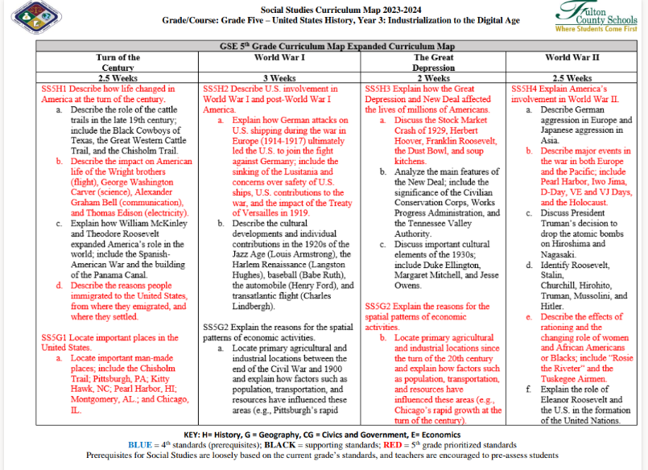
Social Studies

Slide 14
Social Studies

Slide 15
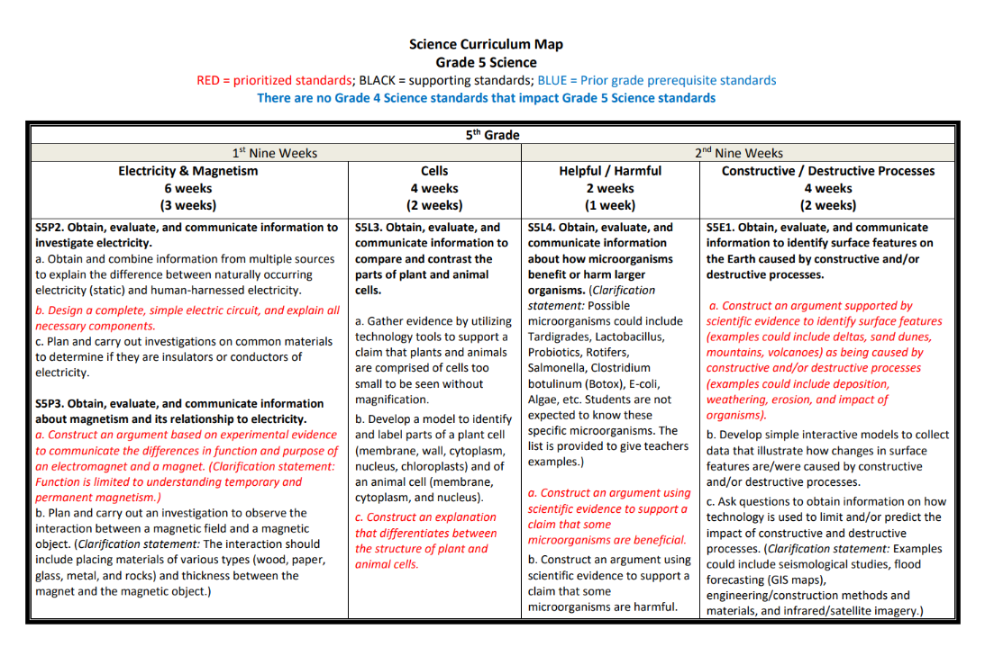
Science

Slide 16
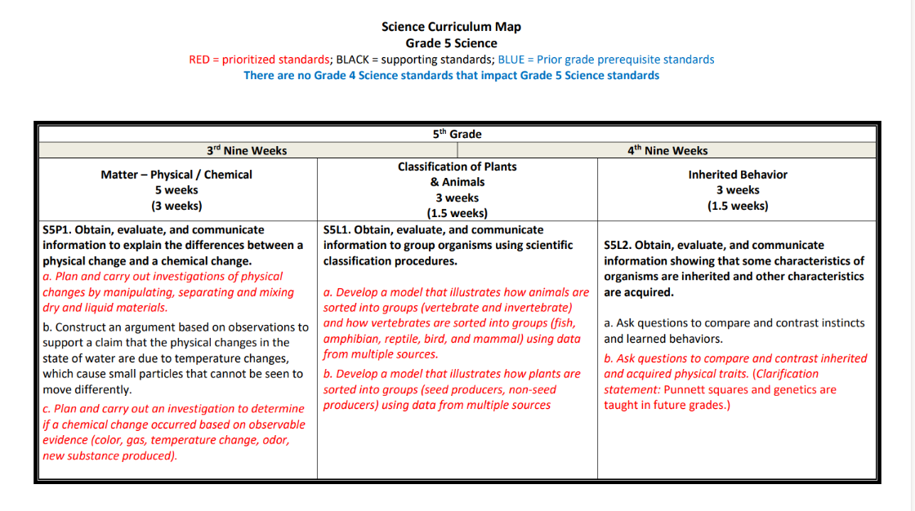
Science

Slide 17
Home Support
Take your 5th grader to the library, set aside reading time at home, and encourage your student to read directions, recipes, lists, or whatever you have to read. This will help increase reading fluency and comprehension. Keep reading together too. Reading and discussing the newspaper can help your child become more comfortable with informational text. Ask your child to tell you or write stories with detail about characters and plot. Additionally, try playing games to improve math and critical-thinking skills.

Slide 18
Home Resources
Classlink – www.launchpad.fultonschools.org
iReady (Reading and Math)
SeeSaw
Nearpod
E-Library – eBooks available to students
PebbleGo – eBooks
Galileo Elementary – Online Research

Slide 19
GMAS Overview
Georgia Milestones End of Grade- May 2024

Slide 20
THANK YOU!
Questions or Concerns?
Mrs. Goodrich goodrich@fultonschools.org
Ms. Griffin griffinhs@fultonschools.org
Mrs. Martin martinmp@fultonschools.org
Ms. Slade sladed@fultonschools.org

