Slide 1
WELCOME!
PLEASE SIGN IN

Slide 2
Welcome to Curriculum Night
4th Grade Team
September 14, 2023

Slide 3
Meet the 4th Grade Team
Mrs. Brucespence
Ms. Huguley
Mr. Justice
Dr. Maddox
Mrs. Mitchell
Ms. Slade

Slide 4
Agenda - Curriculum Night
Introductions of Team
Daily Schedule
Attendance/Notes for Absences/Transportation Changes
Grading Policy
Rules: PAWS/ CHAMPS/PBIS
Curriculum Overview
Protocols
Communication- Dojo
Testing
Safety Precautions
Upcoming Dates
Q & A

Slide 5
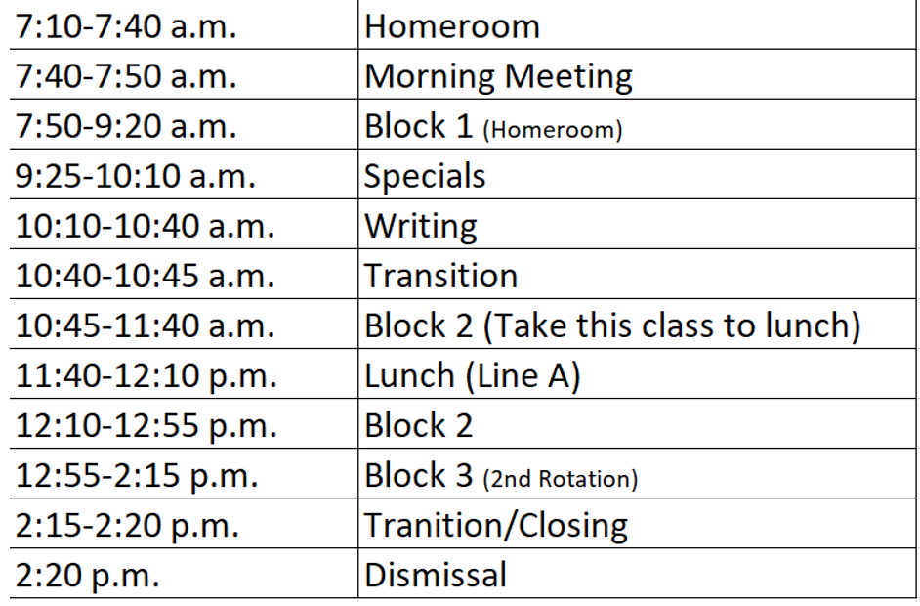
4th Grade Daily Schedule
P.E., Music, Art & Media

Slide 6
Attendance

Slide 7
Attendance Policy

Slide 8
Grading Policies
District Wide Grading Categories:
Major: An assignment or assessment that is cumulative in nature, and/or when there is a significant amount of dedicated instructional time devoted to the content being assessed.
Minor: An assignment or assessment where there is a small amount of dedicated instructional time devoted to the content being assessed.
Practice: Daily assignments, observations, and/or engagement activities given in class or for homework given to students to build and/or remediate skills.

Slide 9
Grading Scale
-
Grades>2 – 5 Grading Scale
A 90 and Above
B 80-89
C 70-79
F Below 70
NG No Grade
Progress reports will be available every 4.5 weeks. Semester grades will be available every nine weeks. Grades may be viewed in Infinite Campus.

Slide 10
PBIS >Positive Behavior Intervention System

Slide 11
Communication
Sign-up for Class Dojo
Confirm contact information- email and phone number.

Slide 12
Transportation Changes
All transportation changes must be submitted to the front office in writing.
Teachers cannot approve a transportation change.
Teachers cannot accept transportation changes via phone call, email, or Dojo.

Slide 13
Assessments
iReady Diagnostics
Unit Tests
Performance Tasks/Projects
Exit Tickets
Georgia Milestones

Slide 14
Curriculum at Glance Resources
Wonders
95 Phonics
My Math
Inspire Science
Gallopade Social Studies

Slide 15
ELA Curriculum
Reading Comprehension – Literary and Informational
Phonics
Vocabulary
Writing
Notes:
What should students learn in Reading/Writing this school year? What are the big focus areas?

Slide 16
MATH UNITS
Revised Curriculum – a strong focus on problem solving using
real word situations and word problems.
Unit 1 Making Relevant Connections with Place Value Understanding
Unit 2 Exploring Real-life Phenomena through Patterning and Algebraic Reasoning
Unit 3 Reasoning with Multiplication and Division
Unit 4 Investigating Fractions and Decimals
Unit 5 Building Conceptual Understanding of Angle Measurement
Unit 6 Reasoning with Shapes

Slide 17
Science and Social Studies Units
Science: Unit 1: Water & Weather Unit 2: Solar System Unit 3 Light Unit 4: Sound Unit:5: Force & Motion Unit 6: Ecosystem | Social Studies: Unit 1: American Revolution Unit 2: The New Nation Unit 3: Westward Expansion Unit 4: The Civil War Unit 6: Reconstruction Unit 7: Personal Finance

Slide 18
Protocols
Protocols are used as strategies to help engage students
in the learning process and used to self-evaluate
comprehension.
learning.
Traffic Light
Face-to-Face
Tea Party

Slide 19
As a Parent, how can I help my child be successful in school?
Be involved
Ask your child “What did you learn today?”
Check your child’s homework.
Make sure your child packs materials nightly.
Keep in touch with your child’s teacher.
Support class/ school functions.

Slide 20
Check School Calendar Frequently
October- Conferences
October Columbus Day Holiday

Slide 21
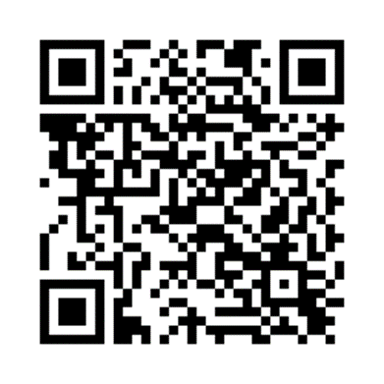
Parent Survey
Please click the link or type in your browser or scan the QR code below to access and complete our brief evaluation survey about this meeting/event. Your feedback helps us improve the services and events we offer to build your confidence and ability to academically support your child(ren) at home and partner with the school in their education.
When you open the survey:
Select: Elementary School
Select our school: Heritage Elementary School
Choose your role: student, parent, staff
Select Curriculum Night Workshop as the meeting you attended
Complete the remainder of the survey.
Click this link or type it in your browser or scan the QR code.
https://bit.ly/FCSEvaluation_Survey
Thank you for your time today. If you have any questions or concerns, please contact the Parent Engagement Facilitator, Ms. Harrell at (470) 254-8144.

Slide 22
Thank You For Coming!
Questions and/or Comments
Please sign Parent Compact

Slide 23
Contact Information
Dojo- fastest mode of communication
brucespenceg@fultonschools.org
maddoxm@fultonschools.org
Mitchella7@fultonschools.org
Sladed@fultonschools.org

