Slide 1
Heritage Elementary
Curriculum Night
September 14, 2023

Slide 2
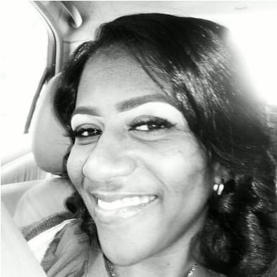
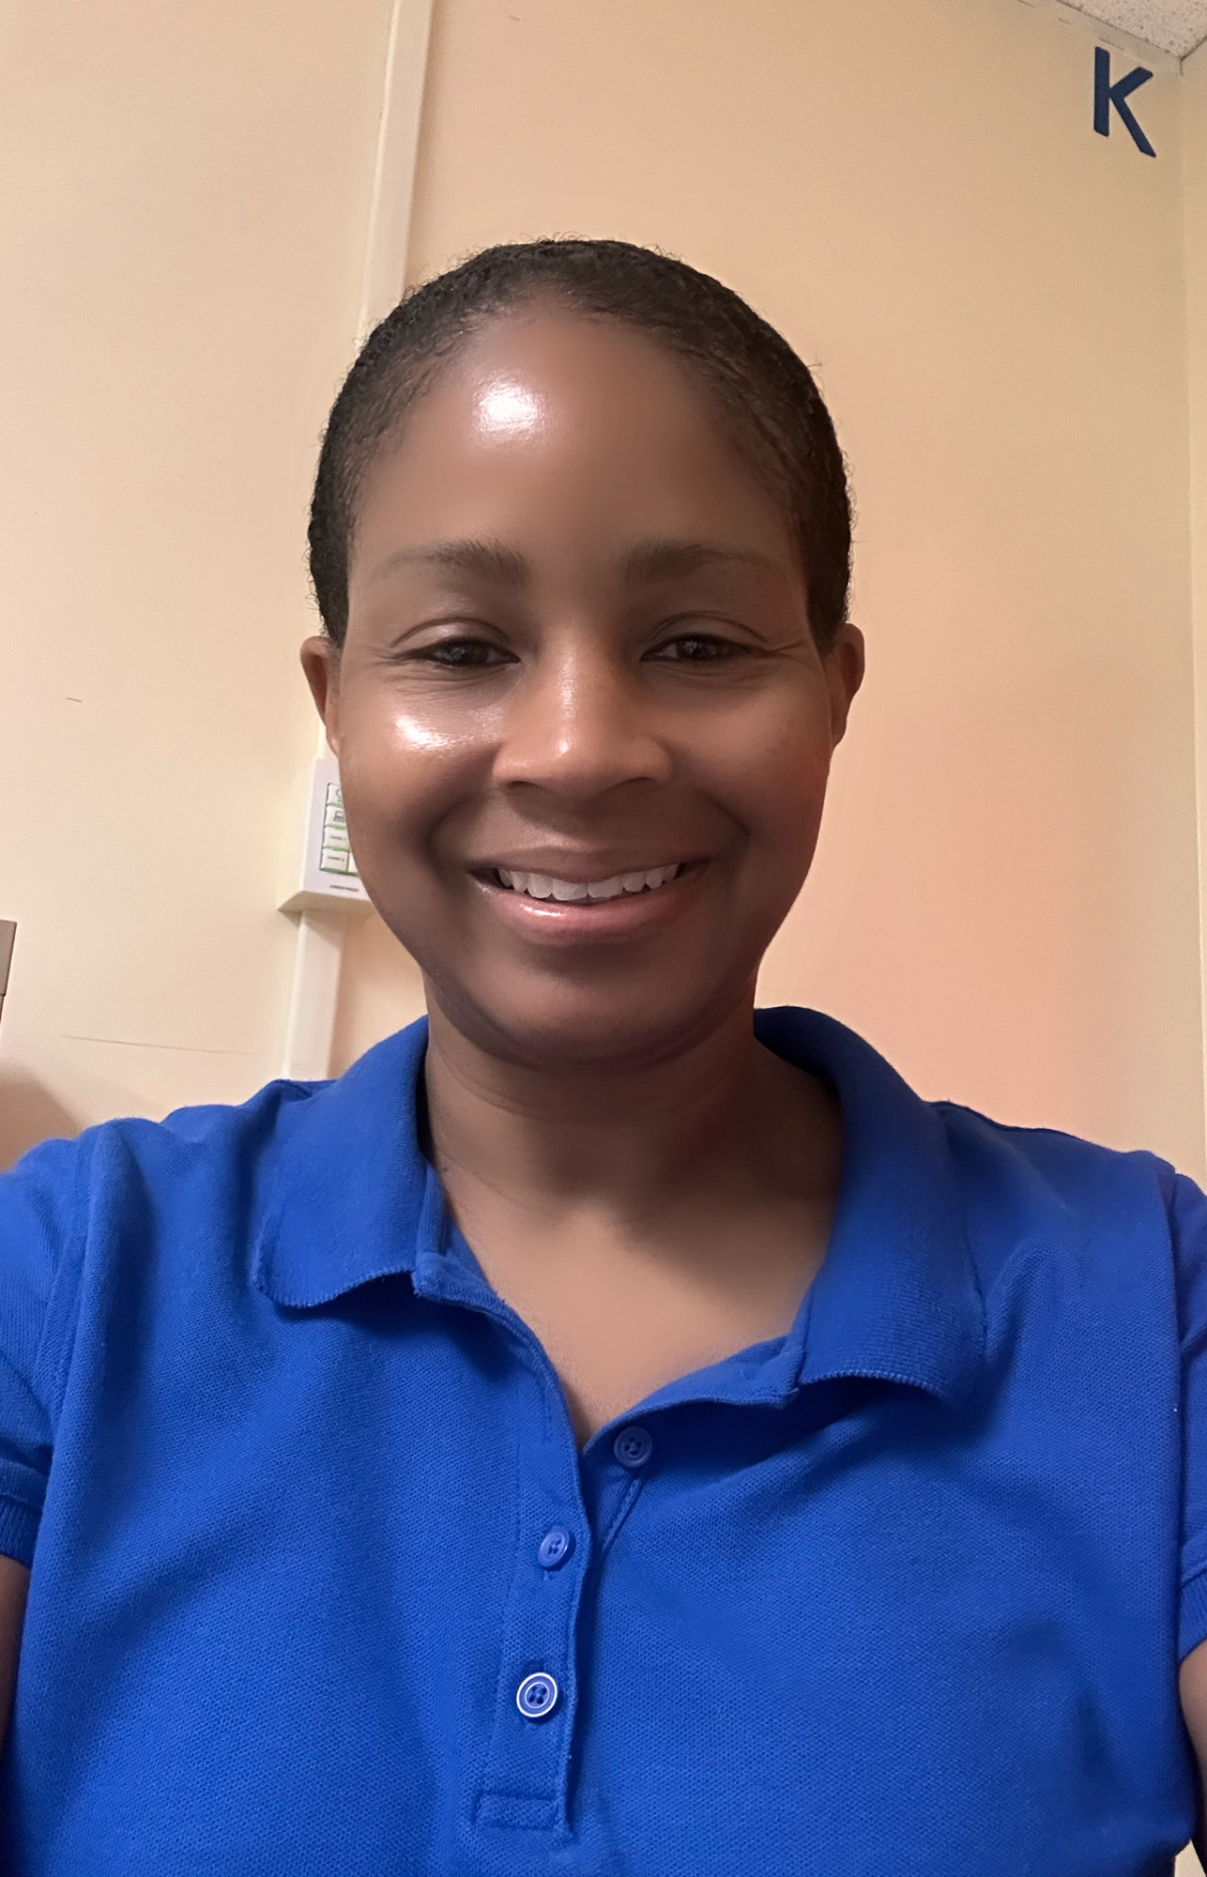
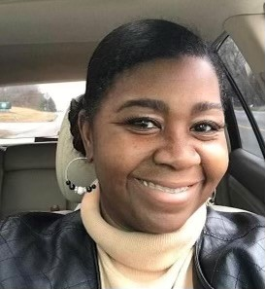
Meet the Teachers
Ms. Reed
Ms. G.G.
Mrs. Tindall
Instructional Support:
Ms. Davis
Ms. Vargas
Notes:
Please list the names of all teachers, paras and instructional support for your grade level.

Slide 3
Grade Level Expectations
At Heritage Elementary,
Children are in school to learn and allow others to learn.
Children are expected to be respectful, courteous and helpful to others.
Children will respect their school and its' property.
In Second grade
Students are expected to come to school prepared and ready to learn.
Students are expected to complete all homework and assignments on time.
Students are expected to take responsibility for their behavior.

Slide 4
Daily Schedule:
7:10-7:40a.m. | Homeroom
7:40-7:50 a.m. | Morning Meeting
7:50-8:35 a.m. | Specials
8:35-8:40 a.m. | Transition
8:40-9:40 a.m. | ELA Small Group
9:40-10:10a.m. | Phonological Awareness/Phonics
10:10-10:40 a.m. | Whole Group Reading
10:40-11:00 a.m. | Writing
11:00-11:30 a.m. | Lunch
11:30-11:40 a.m. | Transition
11: 40-12:10 p.m. | Intervention
12:10-12:30 p.m. | Recess
12:30-1:40 p.m. | Math
1:40-2:10 p.m. | Science/SS
Notes:
2:10-2:20pm Closing
2:20pm Dismissal

Slide 5
Curriculum at Glance
Wonders
95 Core
Heggerty
My Math
Inspire Science
Gallopade Social Studies
i-Ready
Georgiastandards.org
Notes:
Edit this slide to include the curriculum that is used for your grade level.

Slide 6
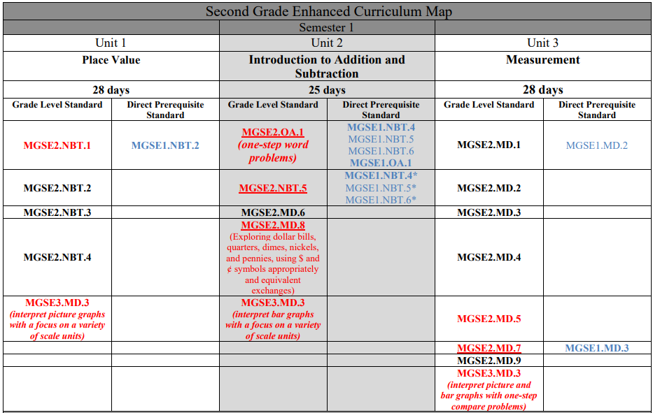
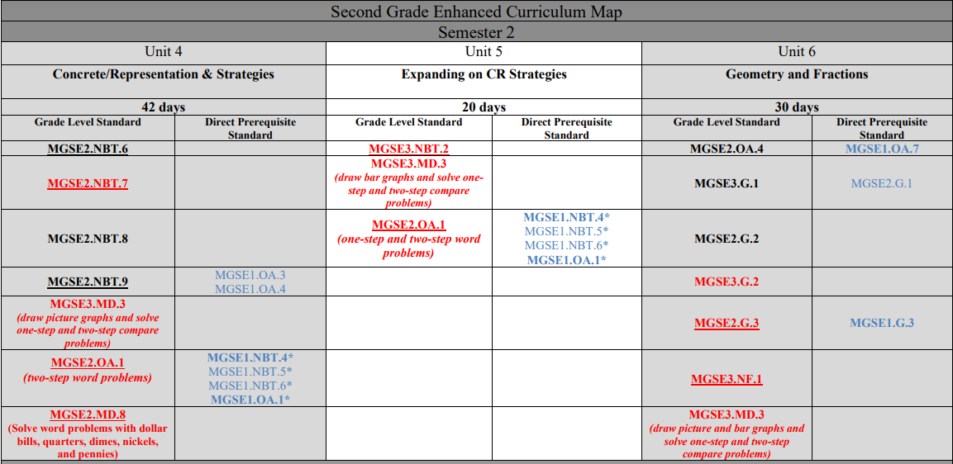
Second Grade Enhanced Curriculum
Math Curriculum
A Fulton County Board initiative that provides all 8th graders with the opportunity to take Algebra I.
Notes:
To that end, you are now looking at the Second Grade Enhanced curriculum map, and you will notice the third grade standards we have moved down to second grade are highlighted. There are a total of 5 standards moved from 3rd grade down to 2nd. You may also notice that some of the standards repeat in multiple units in order for mastery to fully take place by the end of the school year. The 3rd grade repeating standard is circled in green.

Slide 7
Reading Curriculum
Wonders
Through exploration of texts and daily development of their skills as readers, writers, speakers, and active listeners, students experience the power of literacy. Our focus on teaching the whole child – and every child – prepares students to be lifelong learners and critical thinkers.
95 Core
95 Phonics Core adds an explicit phonics strand to the daily Reading Block to ensure that students receive consistent evidence and research-based phonics instruction to improve outcomes.
95 Percent Group’s whole-class phonics program leads to student mastery of critical early literacy skills. It helps fill in gaps where the core instruction is not meeting the needs of all students.
Notes:
What should students learn in Reading/Writing this school year? What are the big focus areas?

Slide 8
Reading Curriculum
Heggerty Phonemic Awareness
24-weeks of daily phonemic awareness lessons that give students the tools to succeed.
Lessons are taught daily to improve student’s reading, spelling, and writing, as the student learns to hear the sounds in words.
Notes:
What should students learn in Reading/Writing this school year? What are the big focus areas?

Slide 9
Writing
Focus: Students will rotate between studying narrative, expository and opinion texts. ​
Narrative: Students will choose a small moment to write about as a story. These experiences can be fiction or nonfiction. ​
Opinion: Students will be provided with various topics, where they will state their opinion and support their opinion with evidence from texts.​
Expository: Students will be provided with various topics of interest, where they will research and write to teach about the topic. ​
Notes:
What should students learn in Writing this school year? What are the big focus areas?

Slide 10
Science and Social Studies Units
Science: Unit 1 – Matter Unit 2 – Force and Motion Unit 3 – Astronomy Unit 4 – Needs of Living Things | Social Studies: Unit 1 – Before There Was a Georgia Unit 2 – Georgia’s Beginning Unit 3 – Native Georgians Unit 4 – Civil Rights Unit 5 – Human Rights Unit 6 – Personal Finance & Review

Slide 11
How can I help my child at home? Home Resources
iReady (Reading and Math) – Blue Teacher Assigned
Classlink – https://launchpad.classlink.com/fcs
iReady
Online Textbooks
Microsoft Office 365
Notes:
Please list resources that parents can access at home to work with students.

Slide 12
Classroom Management
Notes:
Please list resources that parents can access at home to work with students.

Slide 13
Notes:
Please list resources that parents can access at home to work with students.

Slide 14
Grading Policies
District Wide Grading Categories:
Major: An assignment or assessment that is cumulative in nature, and/or when there is a significant amount of dedicated instructional time devoted to the content being assessed.
Minor: An assignment or assessment where there is a small amount of dedicated instructional time devoted to the content being assessed.
Practice: Daily assignments, observations, and/or engagement activities given in class or for homework given to students to build and/or remediate skills. Practice has a maximum weight in the grade book as follows:
Elementary (K-5): 10%

Slide 15
Grading Policies Cont.
2 – 5 Grading Scale
A 90 and Above
B 80-89
C 70-79
F Below 70
NG No Grade
Students will have one (1) opportunity each nine weeks to redo/retake one (1) major assignment/assessment.
For students who receive a 79 or below on a specific major assignment/assessment
Progress reports will be sent home every 4.5 weeks. Grades will be available to view on Infinite Campus

Slide 16
A tiered approach will be utilized to maximize student attendance in school. Attendance interventions will be implemented based on the following categories:
•Satisfactory (0-4% Absence Rate)
•At Risk (5-9% Absence Rate) - Preventative
Foundation of the support system and includes universal strategies to encourage good attendance for all students.
•Chronic Absent (10-19% Absence Rate) - Early Intervention
For students and families who need more encouragement and support in addition to preventative strategies. Chronic absent strategies will provide early intervention(s) to target students to avoid chronic absences.
•Severe Chronic Absent (≥20%Absence Rate)- Intensive Supports
Offers intensive support for students facing the greatest challenges to getting to school with individual interventions and wrap around supports.
The Superintendent will develop Operating Guidelines to implement this policy.

Slide 17
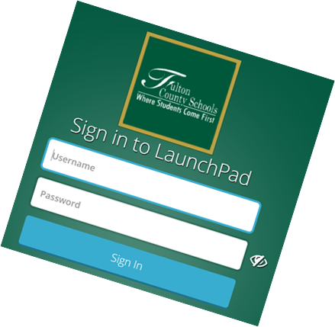
Helpful Websites
Everything you need can be accessed through FCS Launchpad
Go to www.fultonschools.org
Select Students and Parents
Select Resources
Scroll to Launchpad
All programs can be accessed using your child’s Username Number and Birthday
iReady Math
iReady Reading
Teams
PebbleGo

Slide 18
Communication
ClassDojo
Teacher will post announcements, files, events and reminders to class story.
Send private messages to keep you in the loop
Weekly Class Newsletter:
Teacher will send home a weekly newsletter to keep parents informed about what students are currently learning, important class reminders and helpful tips.
Progress Reports:
Sent home every 4.5 weeks
Keeps you updated on how your child is doing socially and academically.
Please log into Infinite Campus to access progress reports. Contact your child’s teacher if you have questions or concerns.
Notes:
How will you communicate with parents?

Slide 19
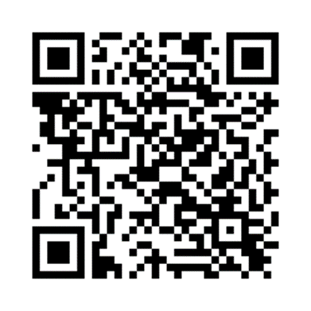
Parent Survey
Please click the link or type in your browser or scan the QR code below to access and complete our brief evaluation survey about this meeting/event. Your feedback helps us improve the services and events we offer to build your confidence and ability to academically support your child(ren) at home and partner with the school in their education.
When you open the survey:
Select: Elementary School
Select our school: Heritage Elementary School
Choose your role: student, parent, staff
Select Curriculum Night Workshop as the meeting you attended
Complete the remainder of the survey.
Click this link or type it in your browser or scan the QR code.
https://bit.ly/FCSEvaluation_Survey
Thank you for your time today. If you have any questions or concerns, please contact the Parent Engagement Facilitator, Ms. Harrell at (470) 254-8144.

Slide 20
THANK YOU!
Questions or Concerns?

