Slide 1
Digital Citizenship
Parent Workshop
Media Influence

Slide 2
Media Influence
News
Advertising
Body Image
Stereotyping
Notes:
(Start with a discussion with parents about how the times have changed. Ask: How is the way your children have access to news different from the way you accessed the news as a child? ETC. Stick with questions about the first 2 bullets and then move into the presentation.)

Slide 3
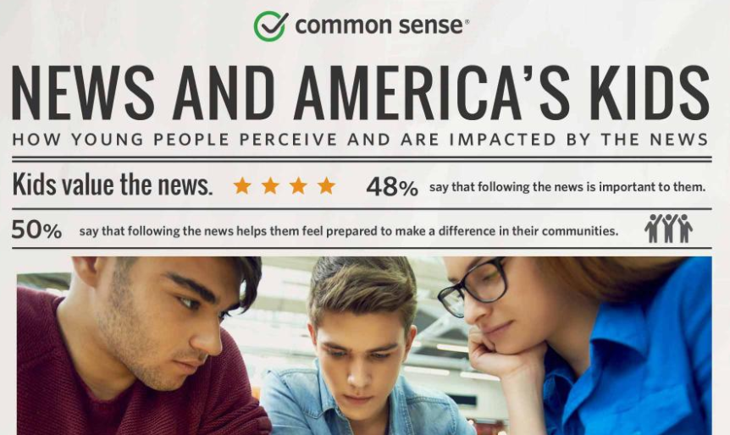
News Influence
https://www.commonsensemedia.org/research/news-and-americas-kids-infographic
Notes:
In March of 2017, News and America's Kids surveyed 853 children ages 10 to 18 years old to find out how they perceive and are impacted by the news. Let’s take a moment to view the infographic of the data they collected.
(Click on the image of the infographic to open the pdf. Spend a few moments reading a few key data points and scroll slowly allowing parents to skim.)
As parents, your goal is to be a trusted adult in your child’s life so they are comfortable coming to you when the news they see or hear upsets, frightens or confuses them. Let your child know that you want them to come to you and discuss these moments.

Slide 4
News Influence
https://www.commonsensemedia.org/blog/how-to-spot-fake-news-and-teach-kids-to-be-media-savvy
Notes:
In order to help our children with News Media Literacy, we as adults to model for them how to: consume news, process news, and think critically about what they read, hear, and see in the news. Here are a few tips from Common Sense Media about how to spot fake news.
(play video)

Slide 5
News Influence
Teachable
Moments
Notes:
Does anyone want to share a teachable moment they have encountered recently with their child and news influence? Or perhaps an instance that your child has asked questions about news they have heard or seen?

Slide 6
Advertising Influence
https://www.commonsensemedia.org/videos/making-kids-ad-savvy
Notes:
The best way that we can help our children develop Media Literacy is to be a model for Media Literacy. As you encounter ads online, at the movies, on billboards, on tv, etc. look for teachable moments and have conversations with your child about the purpose of advertising. Here are a few tips from Common Sense Media.

Slide 7
Advertising Influence
Teachable
Moments
Notes:
(begin by sharing your OWN teachable moment, if you don’t share this one: The other night we were watching the E.T. movie and we stopped to talk about the Reese’s Pieces that are used in the movie. When I looked it up, I discovered that the producer asked permission to use M&Ms but they declined so he used Reese’s Pieces instead and their candy sales skyrocketed!! This was a great example to share with my own children to help them understand that permission must be granted and that product placements are considered advertising.)
Does anyone else want to share a teachable moment they have had or one you can think of that you will talk to your child about in the future?

Slide 8
Stereotyping
https://www.youtube.com/watch?v=-CU040Hqbas
Notes:
Gender stereotyping is briefly touched on with students in relation to advertising and marketing. Here is the video included with the Common Sense Media curriculum for younger elementary students. This video is always a student favorite!

Slide 9
Stereotyping
Children of both genders working, playing or problem solving together
Feature characters working in different and non-traditional careers
Highlight accomplishments, character traits, and meaningful friendships
https://www.commonsensemedia.org/blog/gender-stereotypes-are-messing-with-your-kid
Notes:
If you are concerned about gender stereotyping and it’s influence on your child, here are some tips from Common Sense Media for things to look for in TV shows and movies that avoid stereotyping. Look for shows and movies that: (read the slide)
We are going to discuss teachable moments while looking at this slide. Does anyone have media to suggest to other families who are concerned about gender stereotyping that follow the suggestions on this slide?

Slide 10
Body Image Influence
https://www.youtube.com/watch?v=hibyAJOSW8U
Notes:
Using the Common Sense Media curriculum, students in the upper grades are taught that photos can be altered. This helps us teach that photos used in ads can be altered, but it also allows us to address how photos of anyone can be altered using technology. This is the video that accompanies the Common Sense Media Curriculum for upper grades.
(play video)

Slide 11
Body Image Influence
Make health a habit
Look for alternative media
Do a reality check
Keep an eye on your child’s social network
https://www.commonsensemedia.org/blog/girls-and-body-image
https://www.commonsensemedia.org/blog/boys-and-body-image
Notes:
Although we touch on altered body images in the Digital Citizenship curriculum, we encourage you to use these tips from Common Sense Media to promote positive body image with your child at home.
Make health a habit - Foster a healthy lifestyle
Look for alternative media - Avoid media that is contrary to stereotypes and gender roles your family values. Look for media with role models that are “real life” role models – kind, diligent, wise, etc.
Do a reality check – Discuss how images are altered, celebrities have make-up artists, cosmetic surgeries, etc.
Keep an eye on your kid's social networks – Unfortunately, our children subject themselves to criticism when posting to social media.

Slide 12
Body Image Influence
Teachable
Moments
Notes:
(begin by sharing your OWN teachable moment, if you don’t share this one: I run across many stories on my news feed about positive body image and the other day there was one about a company that was being praised for not retouching photos in their advertisements. I immediately began a conversation with my daughter and was sure to show her the images so that she could see “reality.”)
Does anyone else want to share a teachable moment they have had or one you can think of that you will talk to your child about in the future?

Slide 13
Additional Information
www.commonsensemedia.org

Slide 14
Resources
“Dove Evolution Commercial” https://www.youtube.com/watch?v=hibyAJOSW8U
Filucci, Sierra. "How to Spot Fake News." Common Sense Media: Ratings, Reviews, and Advice. Common Sense Media, 20 Mar. 2017. Web. 29 June 2017.
Knorr, Caroline. "Boys and Body Image." Common Sense Media: Ratings, Reviews, and Advice. Common Sense Media, 05 Jan. 2015. Web. 29 June 2017.
Knorr, Caroline. "Girls and Body Image." Common Sense Media: Ratings, Reviews, and Advice. Common Sense Media, 01 Jan. 2015. Web. 29 June 2017.

Slide 15
Resources
Knorr, Caroline. "How Kids Can Resist Advertising and Be Smart Consumers." Common Sense Media: Ratings, Reviews, and Advice. Common Sense Media, 23 Feb. 2017. Web. 29 June 2017.
"News and America's Kids Infographic | Common Sense Media." Common Sense Media: Ratings, Reviews, and Advice. Common Sense Media, Jan. 2017. Web. 30 June 2017.
“Riley on Marketing” https://www.youtube.com/watch?v=-CU040Hqbas

