Slide 1
Digital Citizenship
Parent Workshop
Privacy and Security

Slide 2
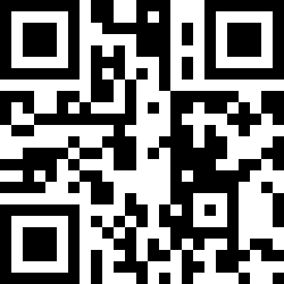
Creating Online Accounts
What online accounts does your child have?
answergarden.ch/491212
Notes:
(Open with parent participation. This can be in discussion format or using a live polling tool. If you choose live discussion, delete the links and QR code from this slide. If you choose to use a polling tool, you may create your own or use the one on the slide from AnswerGarden. If you use the one on the slide, you will see polling information from other parent communities as well.)

Slide 3
COPPA Children’s Online Privacy Protection Act
1998
name
address
telephone
Social Security number
2012 Amendments
video
pictures
audio files
geolocation
IP address, etc.
Notes:
First passed by the Federal Trade Commission in 1998, COPPA prevents online services from collecting identifying information from children under 13 without parent permission,. In 2012, the Federal Trade Commission adopted amendments to strengthen the online security and protection of children under 13.
Any online services that your children use should require parents permission.
K-2 are taught, using the Common Sense Media Curriculum, that they should have a parent with them when they are online.
3-5 students are taught that they should have parent permission to share personal information online.
(link to complete COPPA is on the resources slide at the end of this presentation for presenter reference)

Slide 4
Quick Tip Time Out - Geotagging
Notes:
It’s time for a quick tip time out! One of the amendments to COPPA involved geolocation… Did you know that your child can be tracked through the photos and videos they are posting online? Here’s a quick video from the San Diego County Sheriff’s Department about the dangers of geotagging and how to turn off geolocation on your device’s camera and video app.

Slide 5
Terms of Use
Parent Permission
http://www.musical.ly/en-US/term
No one under 13
https://www.snap.com/en-US/terms/
Notes:
(Show the terms of use for one website that requires parent permission and one website that does not allow anyone under 13. You may use the ones on the slide or use others that are prevalent in your community.)
Always check the Terms of Use with your child. Some will allow the use of the service with parent permission. Some will NOT allow anyone under the age of 13 to use the service. If a services indicates that no one under 13 is allowed to use it, we need to question why?? When you are trying to decide if a website or app is appropriate for your child, Common Sense Media can provide valuable insight!
(when you click on the websites above, do a quick Ctrl+F to “find on page” and type in 13 – this will show you where the Terms of Use discusses use by children under 13)

Slide 6
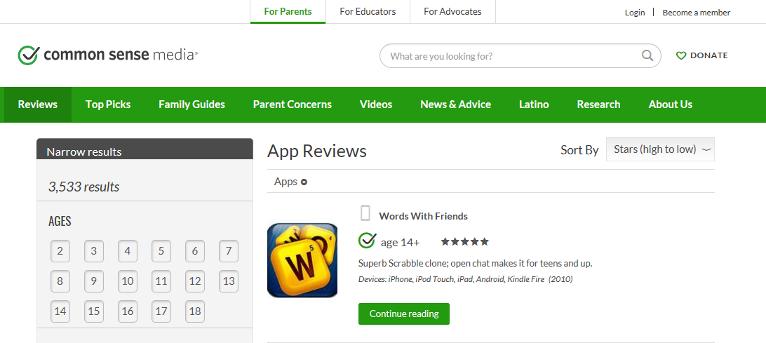
Common Sense Media
Notes:
Common Sense Media is a fantastic resource for parents. They provide reviews and information on apps, websites, games, movies and more! (visit and show this portion of the website, the image on the slide is hyperlinked)

Slide 7
Private Information
First name
Last name
Address
Social Security number
Telephone number
Notes:
When creating accounts for your child or helping your child create accounts, private information should not be used in the username, screen name, or password that your child selects.

Slide 8
Personal Information
School name
Neighborhood
City or town
Favorite park, restaurant, etc.
Pet’s name
Sports team
Jersey number
Notes:
Using personal information in creating an account: username, screen name, password, etc. could also be a risk. It might make their password easy to guess or give others online too much information that could endanger your child.

Slide 9
Secure Passwords from Common Sense Media curriculum: Grades 3-5, Unit 2
DOs
DO share your password only with your parents.
DO create passwords with at least eight characters.
DO use combinations of letters, numbers, and symbols.
DO change your password regularly – at least every six months.
Notes:
In the Common Sense Media curriculum students are taught to create secure and strong passwords. As you sit with your child to create passwords for accounts, keep these Dos and Don’ts from Common Sense Media in mind.

Slide 10
Secure Passwords from Common Sense Media curriculum: Grades 3-5, Unit 2
DON’Ts
DON’T give a password to anyone else – not even your friends.
DON’T use passwords that are easy for people you know to guess, like your nickname or your pet’s name.
DON’T use any private information in your password.
DON’T use a word in the dictionary as a password.

Slide 11
Quick Tip Time Out – Secure Websites
http:// - Not secure
https:// - SECURE! ☺
Notes:
It’s time for another quick tip time out! Did you know that the S in “https” part of the URL stands for “secure?” Before entering private information into a website, make sure that there is an S at the end of the http!

Slide 12
Protecting Your Devices & Identity
Notes:
Before video - The most effective way of teaching your child about navigating phishing scams, pop-ups, etc. is to model for them appropriate actions when you encounter computer issues and questionable emails. As you watch this video, consider ways and opportunities in which you can engage your child in conversations about being proactive in device security and protecting their identity.

Slide 13
Protecting Your Devices & Identity
Install security software
Set software and browsers to update automatically
Do not click on pop-ups
Use a pop-up blocker
Do not click on links in emails from people you do not know
Beware of free downloads
Notes:
After video - I would like to encourage you to “think out loud” in front of your child the next time you get a questionable email or pop-up. Talk through why you are or why you are not going to open it, etc. Model the behavior for them. They need to know that adults are also using the steps they are learning in the Common Sense Media curriculum to stay safe online. And that sometimes, even adults have to go to other adults for help online. For example, there are times at work when I get a questionable email and go my Tech Specialist to ask if it is a phishing scam, etc. We are teaching them, through the Common Sense Media curriculum, to always go to a parent or trusted adult when something online makes them uncomfortable. Beginning these conversations at home with your child when they are young will help keep the lines of communication open.

Slide 14
Additional Information
www.commonsensemedia.org
www.onguardonline.gov
www.ftc.gov
www.netsmartz.org

Slide 15
COPPA and Fulton County Schools
“
The purpose of using these providers is to create a dynamic and rich educational experience for your child. As discussed in Board Policy IFBGA, we believe that use of this provider will "contribute to communication, collaboration, creativity, and critical thinking" for students.
Please sign below to allow our staff to create an account for your child on the above website. By signing below, you are also permitting your student to create and store his/her class content on the website. This permission will remain in effect unless or until you provide written notice to your child's Assistant Principal.
“
Notes:
At the beginning of each school year, each school creates a list of educational apps and websites they will use during the school year. These are added to an FCS parent permission form.

Slide 16
Resources
COPPA - https://www.ecfr.gov/cgi-bin/text-idx?SID=4939e77c77a1a1a08c1cbf905fc4b409&node=16%3A1.0.1.3.36&rgn=div5
Geotagging. Sdsheriff. YouTube. YouTube, 1 Nov. 2013. Web. 30 May 2017.
"App Reviews - Kids Apps." Common Sense Media: Ratings, Reviews, and Advice. Common Sense Media, 2017. Web. 30 May 2017.
"Strong Passwords (3-5)." Common Sense Media: Ratings, Reviews, and Advice. Common Sense Media, 2015. Web. 30 May 2017.
"Consumer Information." Protect Your Computer from Malware. OnGuardOnline, 2017. Web. 29 May 2017.

