Slide 1
Digital Citizenship Parent Workshop Cyberbullying & Digital Drama

Slide 2
What is Cyberbullying?
“Cyberbullying involves online harassment or cruelty, and is often characterized by repeated or ongoing incidents.”
Common Sense Media
Case & Family Tip Sheet- Cyberbullying
Notes:
Cyberbullying is a growing issue around the country. It is often something that takes place over a period of time.

Slide 3
Cyberbullying vs. Digital Drama
“Digital Drama – the everyday tiffs and disputes that occur between friends or acquaintances online or via text.”
https://www.commonsense.org/education/digital-citizenship/cyberbullying-and-digital-drama
Notes:
Remember, kids will have disagreements. Digital Drama may just be a small disagreement between friends. We need to make sure the kids have the tool to ensure it doesn’t grow into a cyberbullying situation.
QUICK STOP AND TALK!! Parents, talk about the difference between these two terms.

Slide 4
Common Sense Media
Notes:
BEFORE THE VIDEO...ask the parents what they think cyberbullying may look like with younger students. Can they see it changing as the students get older?
Here is a video we show to the kids when we teach Digital Citizenship lessons at school. With younger students, cyberbullying is usually along these lines. As the kids become teenagers, cyberbullying can take on a more serious tone. If we deal with it when they are younger, we may give them pause when they are teenagers.
(play video)

Slide 5
Terms to Know
target: a person who is the object of an intentional action.
offender: a person who has a malicious intent to hurt or damage someone.
bystander: a person who does nothing when they witness something happening.
upstander: a person who supports and stands up for someone else.
Notes:
These are the terms we teach the students in our Digital Citizenship lessons at school. We try to encourage the kids to stand up for anyone they see being bullied. But, they should never put themselves in harms way. They need to know that they can always talk to a TRUSTED ADULT, whether its at home or at school.

Slide 6
Terms to know
escalate: to increase or make more intense.
de-escalate: to decrease or make less intense.
https://www.commonsense.org/education/digital-citizenship/cyberbullying-and-digital-drama
Notes:
While we encourage kids to be an UPSTANDER and support their friends, we need to be sure they are not escalating the problem. Jumping in and bullying the bully isn’t helping. Remind your kids, if they see bullying (online or offline) tell a TRUSTED ADULT.

Slide 7
http://www.netsmartz.org/Presentations/Parents
Notes:
The Georgia Bureau of Investigation advises the use of NetSmartz.org to help keep children safe on the internet. The next few slides contain information from a NetSmartz parent presentation.
Cyberbullying can take many forms. Here are some things to be on the lookout for. If your child is using the web or social media, make sure you are monitoring that activity. You need to know what your kids are doing and what their friends are doing as well.
(give parents time to read slide)

Slide 8
http://www.netsmartz.org/Presentations/Parents
Notes:
In the digital age, information spreads quickly. They spend so much time in the digital world (especially once they become teenagers) they can’t get away from it.
(give parents time to read slide)

Slide 9
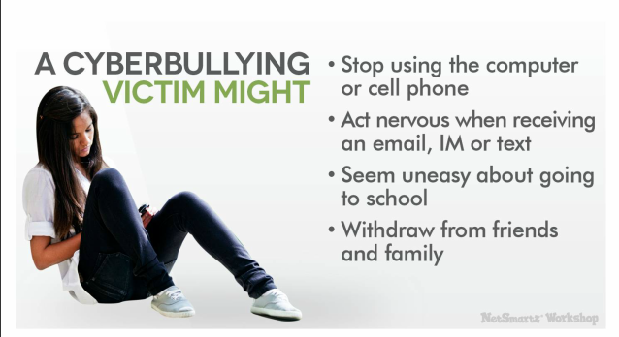
Notes:
This list from Netsmartz.org gives parents a good list of things to look for. Pay attention to your children while they are using devices.
(give parents time to read slide)

Slide 10
Notes:
And as much as we hate to admit it, our own child may be the bully. Here are some tips to look for from Netsmartz.org. Again, pay attention to your children while they are using devices.
(give parents time to read slide)

Slide 11
How do you deal with Cyberbullying?
Build a support network for your children.
Encourage kids to stand up to the bully-or at least to stand with the victim of cyberbullying.
Be strategic in your support
LISTEN
Show “blocking” features
Case & Family Tip Sheet- Cyberbullying
Notes:
It is also important to note that if your child continues to be cyberbullied, you would save the evidence with screenshots, etc.

Slide 12
When someone is mean to your child online… from Common Sense Media curriculum: Grades 3-5, Unit 1
S…step away from the computer
T…tell a TRUSTED adult
O…okay sites first
P…pause and think while online
Notes:
This is what we use when we teach Digital Citizenship lessons to the kids at school. Parents can reinforce this with their children at home. As we keep saying, COMMUNICATION is important.

Slide 13
Resources
Common Sense Media. “Power of Words.” You Tube. 14 July 2017.
Web. 27 June 2017.
“Cyberbullying & Digital Drama.” Common Sense Media: Digital Citizenship. Common Sense Media. 2017. Web. 22 June 2017.
"Internet Safety." NetSmartz Workshop. National Center for Missing & Exploited Children, 2015. Web. 30 June 2017.
www.netsmartz.org/Presentations/Parents
“The Power of Words (3-5).” Common Sense Media: Curriculum: Unit 1 Lesson 3. Common Sense Media. 2015. Web. 22 June 2017.

