Slide 1
Digital Citizenship Parent Workshop Internet Safety

Slide 2
From Common Sense Media:
Teens are more likely to be targeted by online solicitors.
Online solicitations may come from someone they know.
Respect your “gut feeling” if something makes you feel uncomfortable.
Notes:
According to Common Sense Media, while there is certainly risk in using the internet, most children (like most adults) use it to explore topics they are interested in. So you may find your child engrossed in baseball statistics. Teenagers are more likely to be targeted than younger children. And those teens will likely be targeted by another teen or a young adult.

Slide 3
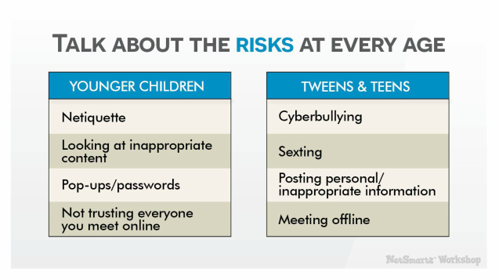
http://www.netsmartz.org/Presentations/Parents
Notes:
The Georgia Bureau of Investigation advises the use NetSmartz.org to help keep children safe on the internet. The next few slides contain information from a NetSmartz parent presentation. We need to adjust our internet safety conversations with our children according to their age. This chart from netsmartz.org does a great job of breaking it down.

Slide 4
If you are concerned…
http://www.netsmartz.org/Presentations/Parents
Notes:
Online predators often “groom” children they are targeting. NetSmartz is part of the Nation Center for Missing and Exploited Children.

Slide 5
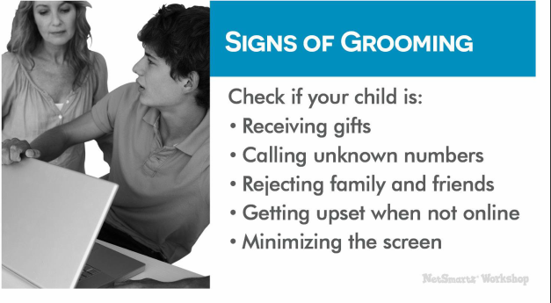
http://www.netsmartz.org/Presentations/Parents
Notes:
If you are worried that your child may be susceptible to grooming by an online predator, here are signs you can look for. But, remember this is far more common with teens than with younger children.

Slide 6
Keeping our children safe online
On Websites:
Age appropriate language/activities
DON’T let young kids talk to people they don’t know
If they feel uncomfortable, TELL A TRUSTED ADULT!!
Bookmark sites for them to access
Notes:
(This presentation breaks the topic of keeping kids safe into 2 main categories: On Website and On Social Media.)
Your children may stumble upon inappropriate content without really trying. If they come to you with a question, it’s important to stay calm and let them know it’s okay. If they feel comfortable talking to a trusted adult, they won’t get embarrassed. The trusted adult can calmly explain that the site is just not appropriate for them. A really good way to make sure your kids don’t stumble onto inappropriate content is to bookmark sites for them and make sure they know how to navigate to those sites.
No filtering system in 100% perfect.
DISCUSSION BREAK! Discuss with your fellow parents who their child/children would be able to talk to if they felt unsafe. A Teacher, family friend, older sibling etc...

Slide 7
Red…risky
Yellow…iffy
Green…Okay
https://www.commonsensemedia.org/educators/digital-citizenship/internet-safety
https://commons.wikimedia.org/wiki/File:Traffic_lights_icon.svg
Notes:
This is a good way for you and your children to decide if a site is appropriate for them. They can show you sites they have visited and you can discuss which color you would assign them. Then you can create your bookmarks based on the green sites. Be prepared that you may not agree on the red sites, you as the parent have the final say.
(At my house, we had a “Kids Folder” for our girls to go to when they used the computer. We also kept our computer in the family room so when they were younger, they couldn’t get on the internet w/o a parent nearby.)

Slide 8
Keeping our kids safe online
On Websites DON’T share private information
Address
Telephone number
First name
Last name
Location information: school, name of the team you play for, name of park you visit, etc.
Notes:
(We’ll keep revisiting the idea throughout all of these lessons that students should NOT share private information. Make sure you make that point numerous times in your presentations.)
We, as parents and educators have always been good about discussing stranger danger with our children. We need to approach online safety and ONLINE stranger danger in the same manner. We need to teach our children that private information is information that we would never walk up to a stranger and share.

Slide 9
Keeping our kids safe online
On Social Media:
“Twitter doesn’t ask your age when you sign up, but Facebook does, and on Facebook the minimum age requirement is a hard and fast 13. It’s the same number on Instagram, Pinterest, Tumblr, Reddit, Snapchat and Secret, too.
http://www.adweek.com/digital/social-media-minimum-age/

Slide 10
Keeping our kids safe online:
On Social Media:
Check Terms of Agreement
Monitor accounts
“Friend” your children
If they feel uncomfortable, TELL A TRUSTED ADULT!!
Notes:
For most social media sites the age limit is 13 or over. Some sites allow kids to create an account with a parent’s consent. Think about that, most of our elementary age students really shouldn’t be using most social media platforms. If they are, please follow the above guidelines.

Slide 11
Parents set an example…
http://www.netsmartz.org/Presentations/Parents
Notes:
This list from netsmartz.org provides a great list of things parents can do to ensure that kids stay safe and behave appropriately online.

Slide 12
Keeping our kids safe online
On Social Media DON’T share private information
Address
Telephone number
First name
Last name
Location information: school, name of the team you play for, name of park you visit, etc.

Slide 13
Online Friends vs. In Person Friends from Common Sense Media Curriculum: 3-5 Unit 3
Can’t tell if online friends are male or female
Can’t tell their age
Notes:
Even if the picture associated with an account looks like a child, there is no way know if it is someone you DO NOT know in the real world.

Slide 14
Resources
Bennett, Shea, 2014. September 29. “Minimum Age Requirements: Twitter, Facebook, Instagram, Snapchat, WhatsApp, Secret.” Adweek. Retrieved from http://www.adweek.com/digital/social-media-minimum-age/
“Internet Safety” Common Sense Media: Digital Citizenship. Common Sense Media, 2017. Web. 21 June 2017.
"Internet Safety." NetSmartz Workshop. National Center for Missing & Exploited Children, 2015. Web. 30 June 2017.
www.netmartz.org
“Talking Safely Online (3-5).” Common Sense Media: Curriculum: Unit 3 Lesson 1. Common Sense Media. 2015. Web. 22 June 2017.

