Slide 1
MS. WILLIAMS
AU 3RD-5TH GRADE
S

Slide 2
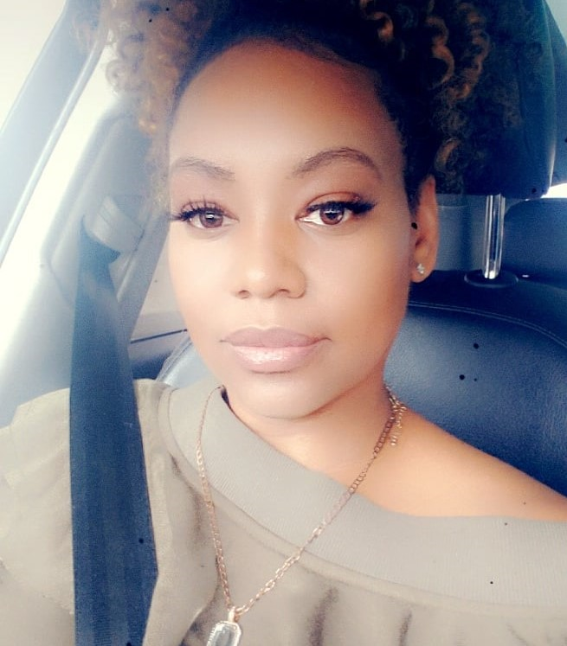
insert picture here
My name is Lakisha Williams. I will be the 3RD-5TH Grade Autism Teacher. I look forward to getting to know your child this year!!
I have over 20 years in the education field. I have worked in the general education field and the self-contained environment for many years. This is my 5th year at Gullatt Elementary School. I received my Bachelor of Arts degree from Georgia State University and Masters of Science from Capella University.
I am originally from Savannah, GA. I am mother of a 7 year old boy and 14 year old girl.
My philosophy of education is that all children are unique and must have a stimulating educational environment where they can grow physically, mentally, emotionally, and socially. It is my desire to create this type of atmosphere where students can meet their full potential.
CONTACT INFORMATION
EMAIL: | williamsla2@fultonschools.org
PHONE: | (404) 254-3425
WEBSITE: | https://sites.google.com/view/ms-l-williams-class/home
A FEW OF MY FAVORITES
COLOR: | Green
SEASON: | Spring
ANIMAL: | Dogs
SPORT: | Basketball
FOOD: | Mac and Cheese
DRINK: | Diet Coke
RESTAURANT: | Cheesecake Factory

Slide 3
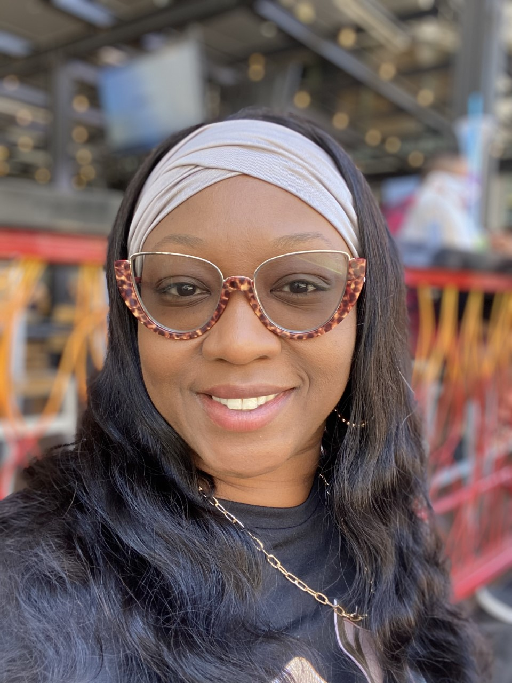
insert picture here
My name is Mrs. Kenya Livas. I am originally from New Orleans, La. I attended Griffin Technical College & Mercer University. I have been working in education as a Paraprofessional for 17 years.
I absolutely love working with kids. I have a passion for the Exceptional Ed kiddies.
My hobbies are traveling, crafting (which turned into a business) shopping (is that really a hobby)🤷🏽‍♀️
I trying different foods, hosting parties, seafood, pasta. I dislike Liver, Falcons Football Team, and COVID. I am a die-hard New Orleans Saints fan! Who Dat Baby🖤⚜️🖤⚜️

Slide 4
SCHOOL NAME: | Gullatt Elementary School
SCHOOL ADDRESS: | 6110 Dodson Rd. Union City, GA 30291
SCHOOL PHONE NUMBER: | (470) 254-3425
PRINCIPAL: | Mrs. Shawanna Arnold
VICE PRINCIPAL: | Ms. Kartisha Bentley
COUNSELOR: | Mrs. Aundrea Hammock
SCHOOL WEBSITE: | https://www.fultonschools.org/gullattes
SCHOOL HOURS: | Building hours 7:10 am-4:00 pm (bell 7:40 am-2:20 pm)
The first day of school is: August 9, 2021
Elementary Expectations
Instructional days are Monday through Friday 7:10 am-2:00 pm
Students must be present for half of the instructional day to be marked present for the day. Elementary attendance messages begin going out around 10:45 a.m. on the day of the absence.

Slide 5
Students are expected to arrive daily starting at 7:10 am.
Teacher will reward Positive Behavior Intervention System (PBIS) points for students who exhibit desired behaviors at school.
Students will be able to utilize rewards to purchase prizes from the PBIS Store at the end of each month.
Each student will have their own specialized designed token system to manage behaviors as well.
Parents will receive daily and/or weekly communication, monthly newsletter.

Slide 6
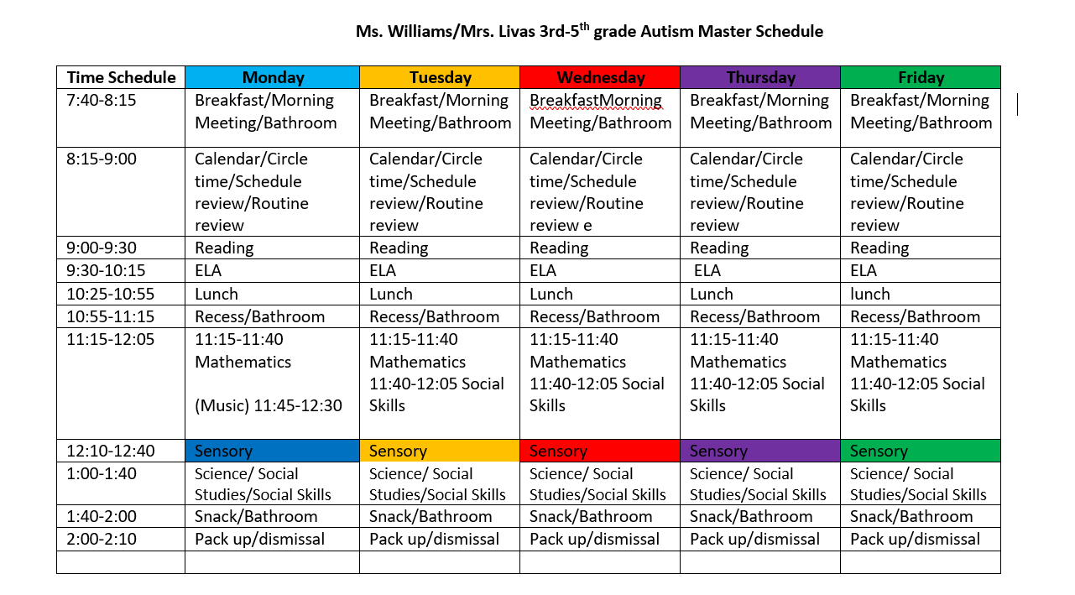
SUPPLIES YOUR CHILD WILL NEED THIS YEAR
2 PKG OF PENCILS W/ERASERS
(4) GLUE STICKS
(1) PAIR OF SCISSORS
(6) FOLDERS W/ POCKETS
(2) PRIMARY WRITING JOURNALS
(1) BOX OF CRAYONS
(1) BOX OF MARKERS
CLOROX WIPES
BOXES OF KLEENEX
ZIP LOCK BAGS
(2) LIQUID HAND SOAP
(2) HAND SANITIZER
BOOK BAG
LATEX GLOVES
SMALL HEADPHONES
CHANGE OF CLOTHES

Slide 7
MATH
LANGUAGE ARTS
READING
WRITING
SCIENCE
SOCIAL STUDIES
HEALTH
Curriculum and Instructional Support Resources
We will use the Unique Learning System® as the classroom curriculum. The curriculum program has been designed specifically for children with special learning needs.
We will use TeachTown computer program as supplemental learning tool.. This program will teach language, social, academic, cognitive, and others things in a fun, interactive, effective on-computer lessons.
We will use i-Ready in our classroom. i-Ready is an interactive online learning environment designed to assess students and provide individualized instruction based on each one's unique needs.

Slide 8
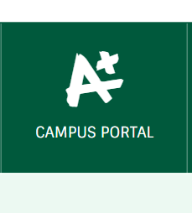
Grading Policy
Students will receive numerical grades
Grades will be based on accuracy not completion
Incompletes grades will be used in lieu of zeros
Minimum number of 7 assignments for students each quarter
No homework will be given
Infinite Campus
To see grades log into Infinite Campus
Setting Up Your Infinite Campus Parent Portal Account
It is CRITICAL that all FCS parents be connected through Infintie Campus. All portal accounts require a 1-time activation to create your ID and password. You must be a parent/guardian of a current FCS student and have the following information to activate an account.
Student first and last name (as entered on birth certificate)
Student ID number
Student Date of Birth (DD/MM/YYYY)
Student grade level (19-20 grade level)
To set-up your account, please visit www.fultonschools.org and clink on Campus Portal

Slide 9
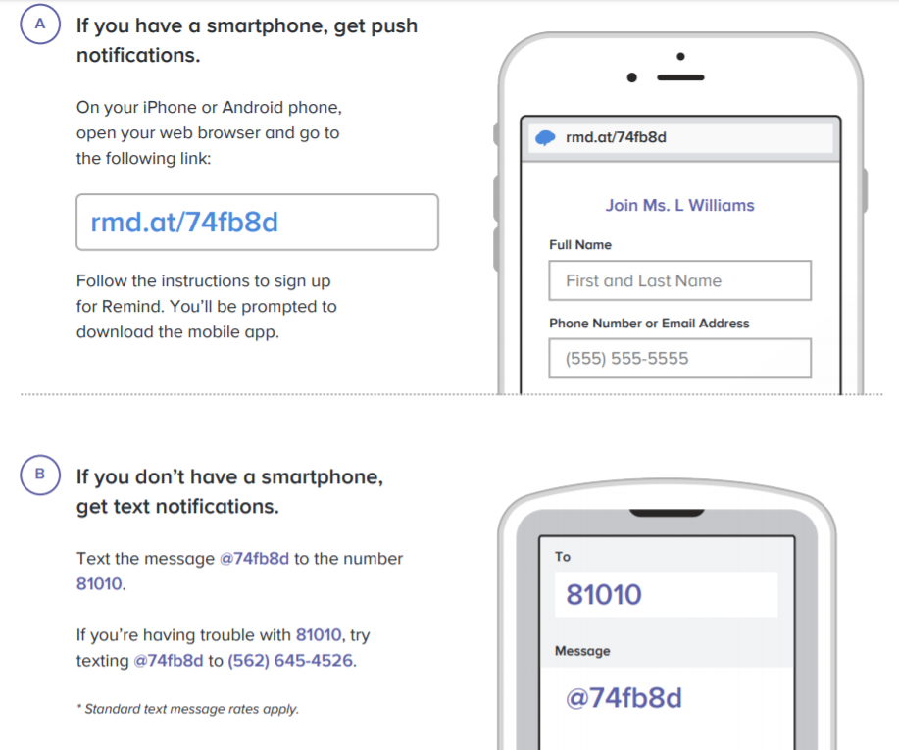
How to access Microsoft Teams
English Verison
https://drive.google.com/file/d/1bXbxosAe45di8Fa6S4c8sgEu2J3b5lOn/view?usp=sharing
Spanish Verison
https://drive.google.com/file/d/1EHqdm7H_1dlrRfPWmzb0L0R0PwQTaLcc/view?usp=sharing
Communication for school, home, and everywhere in between…
To join there are two options:

Slide 10
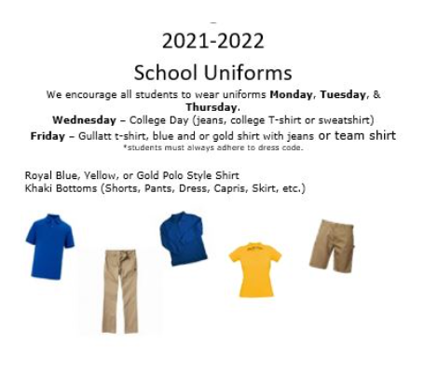

Slide 11
