Slide 1
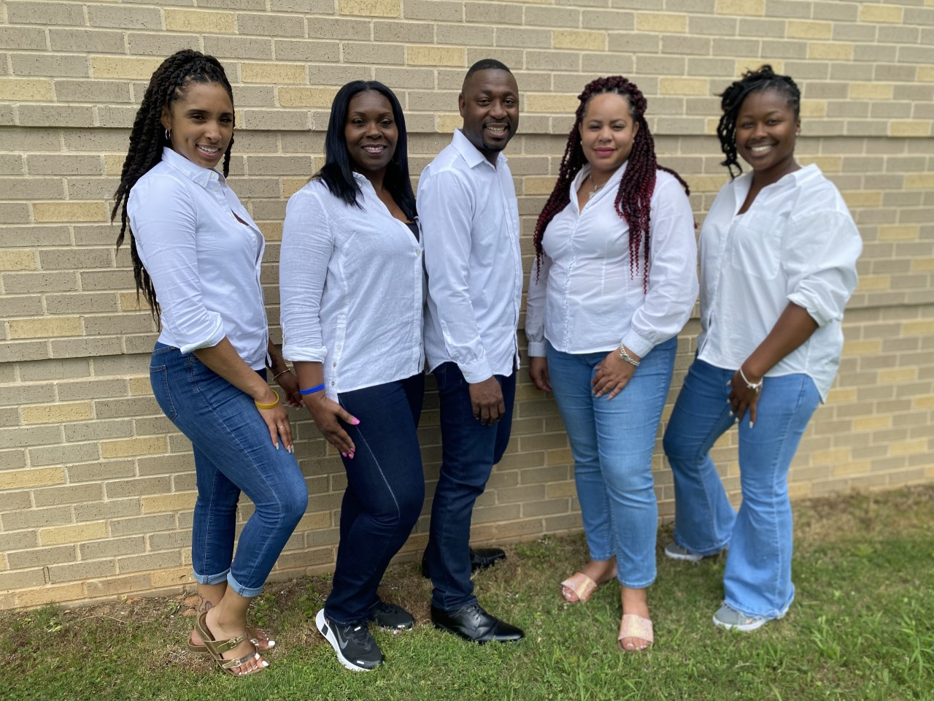

Slide 2
Meet your Teachers

Slide 3
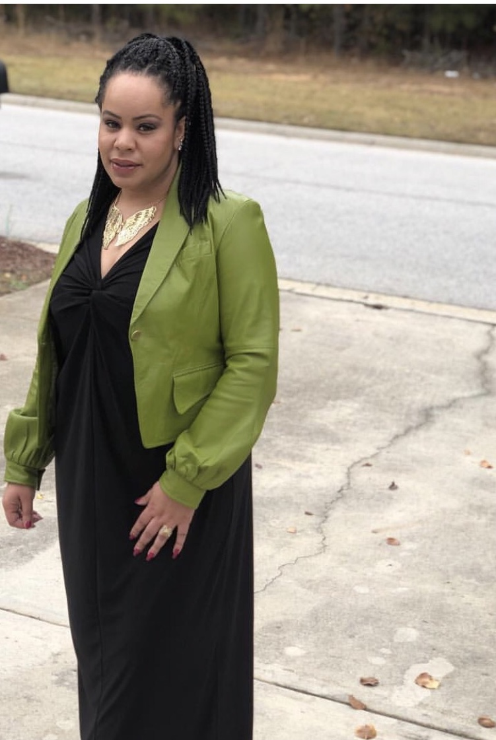
Ms. Barlow
Supplies Needed
*Please label student’s supplies*
Bookbag
School Issued device (label with tape)
Earbuds/headphones
3 composition notebooks
4 folders with pockets (one for each subject)
Pencils and erasers
Notebook paper
Highlighters
Crayons or Color pencils
Markers
Supply pouch
Hand sanitizer
Refillable water bottle
Wish List Items
Lysol Spray
Clorox wipes
Class snack donations ( 30 students) *Must be prepackaged. NO peanuts, gum or sunflower seeds*

Slide 4
Supplies Needed
*Please label student’s supplies*
Bookbag
School Issued device (label with tape)
Earbuds/headphones
3 composition notebooks
4 folders with pockets (one for each subject)
Pencils and erasers
Notebook paper
Highlighters
Crayons or Color pencils
Markers
Supply pouch
Hand sanitizer
Refillable water bottle
Wish List Items
Lysol Spray
Clorox wipes
Class snack donations ( 30 students) *Must be prepackaged. NO peanuts, gum or sunflower seeds*
Mr. Howard
Mr. Howard is entering his 17th year in education and is a graduate from Nova Southeastern University. He is a father of 3 children and has a passion to teach and inspire students. He loves to read and write, is an avid movie watcher, and loves to sing. He is an independent gospel recording artist and has traveled the country singing at various churches. He is excited about this school year, and he looks forward to see the students grow as writers.

Slide 5
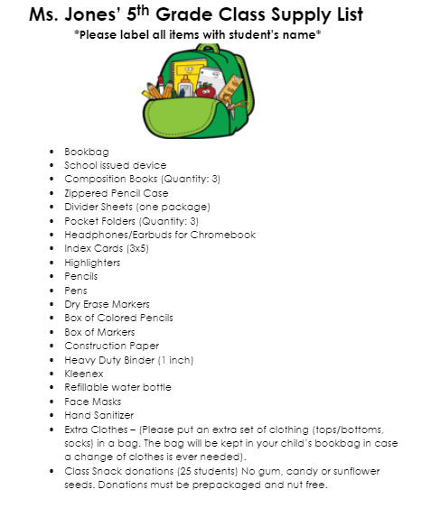
Ms. Jones

Slide 6
Mrs. Seegars
Supplies Needed
*Please label student’s supplies*
Bookbag
School Issued device (label with tape)
Earbuds/headphones
3 composition notebooks
4 folders with pockets (one for each subject)
Pencils and erasers
Notebook paper
Highlighters
Crayons or Color pencils
Markers
Supply pouch
Hand sanitizer
Refillable water bottle
Wish List Items
Lysol Spray
Clorox wipes
Class snack donations ( 30 students) *Must be prepackaged. NO peanuts, gum or sunflower seeds*

Slide 7
Supplies Needed
*Please label student’s supplies*
Bookbag
School Issued device (label with tape)
Earbuds/headphones
3 composition notebooks
4 folders with pockets (one for each subject)
Pencils and erasers
Notebook paper
Highlighters
Crayons or Color pencils
Markers
Supply pouch
Hand sanitizer
Refillable water bottle
Wish List Items
Lysol Spray
Clorox wipes
Class snack donations ( 30 students) *Must be prepackaged. NO peanuts, gum or sunflower seeds*
Mrs. Wright

Slide 8
School is Monday-Friday from 7:10 am until 2:20 pm. Closures will be communicated.
Attendance is required unless medically or religiously necessary. Doctors’ / Guardian excuses can be turned into the front office.

Slide 9
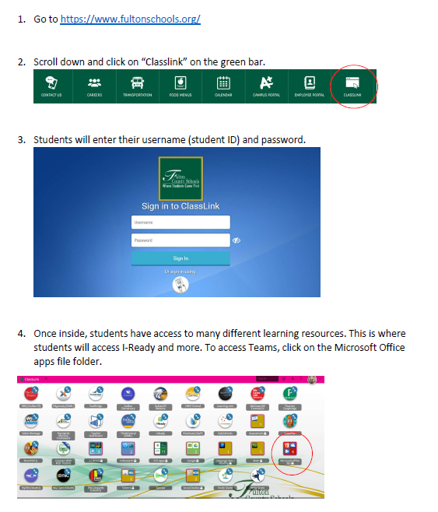
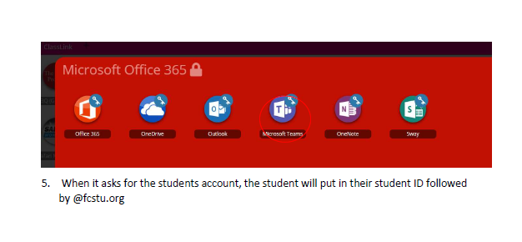
Microsoft Teams
In efforts to incorporate technology or in the event we need to learn remotely, MS TEAMS will be utilized to deliver instruction. Please familiarize yourself with this platform.

Slide 10
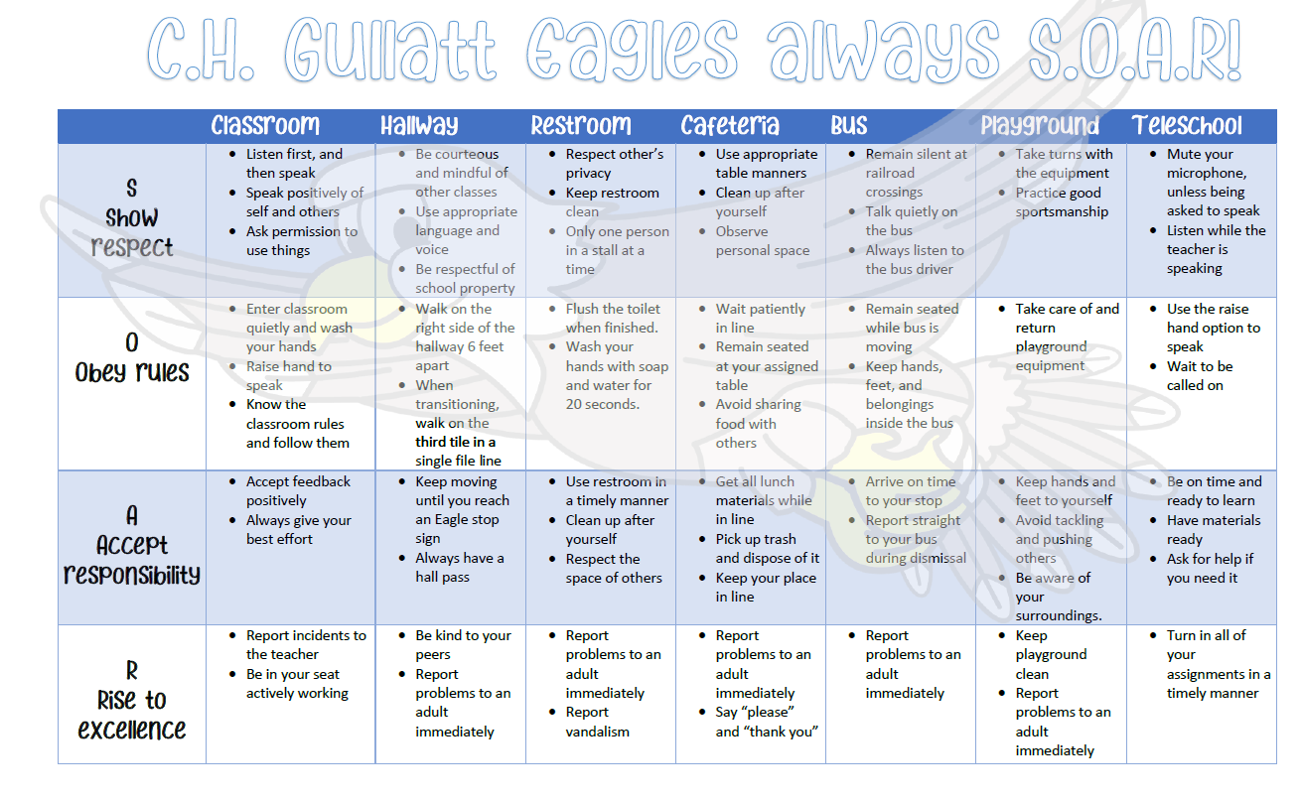
Students will still earn PBIS points for SOARing with the Eagles!
Students can earn
Assignment passes
Toys
Parties
& much more!
*Guardians can keep up with students progress and contact teachers by joining PBIS app for parents.

Slide 11
We will not be sending printed progress reports. In order to stay up-to-date with your scholar’s grades, please use Infinite Campus. New to Fulton? Register for Infinite Campus here Need more information? Infinite Campus step-by-step instructions

Slide 13
Thank You for your time, please sign out here.

