Slide 1
C.H. gullatt elementary 2021-2022
second grade open house

Slide 2
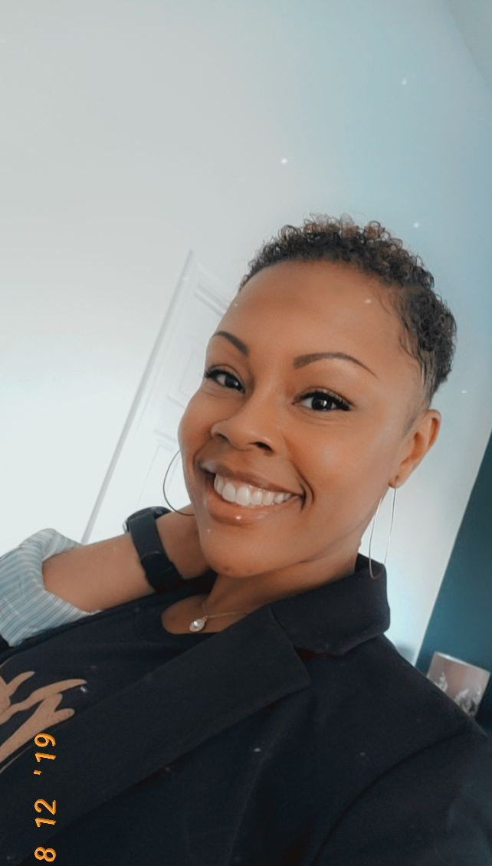
Ms. Nesbitt Grade Level Chair All Subjects

Slide 3
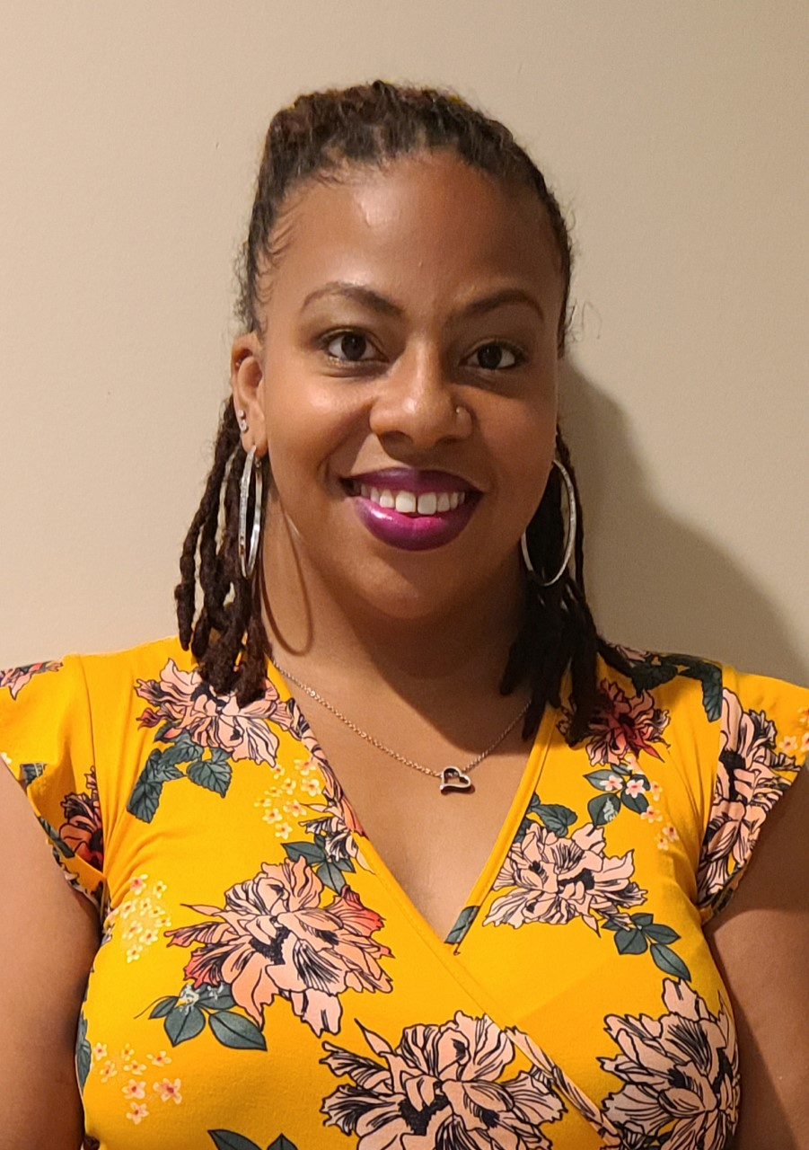
Ms. Harris All Subjects

Slide 4
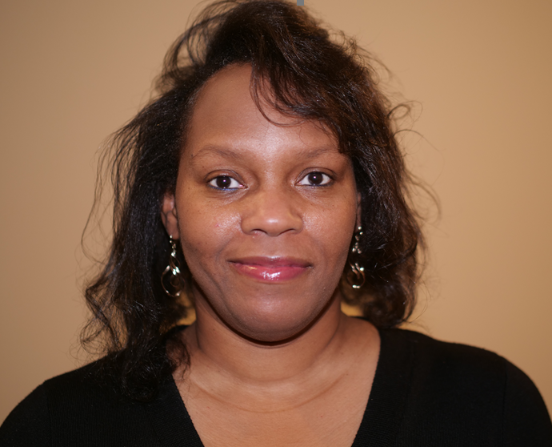
Mrs. Nichols All Subjects

Slide 5
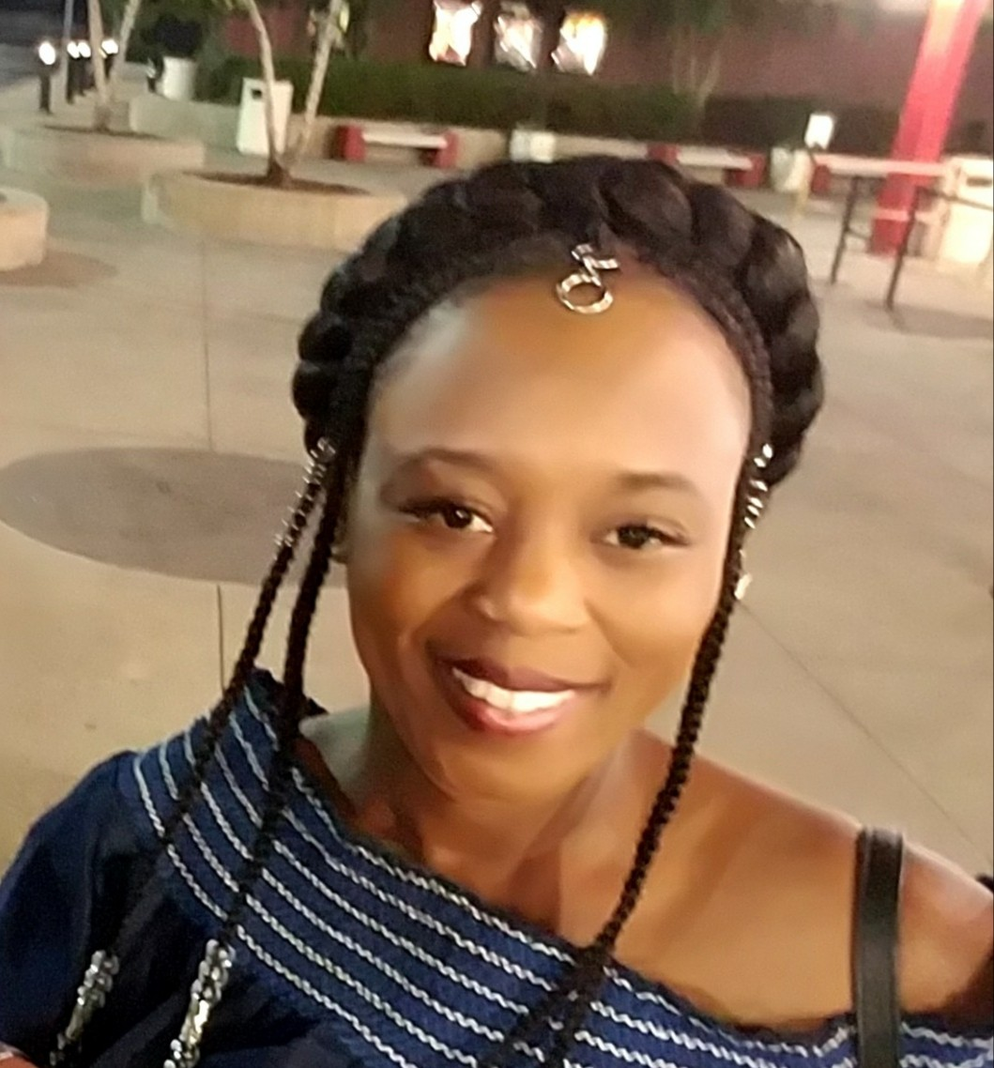
Ms. West All Subjects

Slide 6
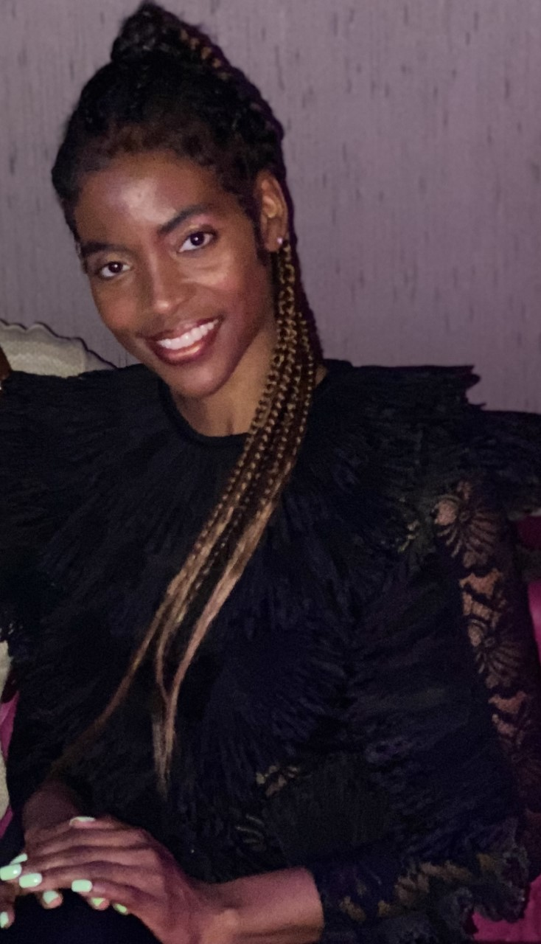
Mrs. Amos All Subjects

Slide 7
School supplies
3-4 Composition books
Pencils (Non-Mechanical)
3 Folders (Plastic, 2 Pocket, 3 Prong)
Erasers
Colored Pencils, markers, Crayons
Notebook paper
Ruler
Scissors
Glue sticks
Refillable water bottle
Hand sanitizer
Lysol Wipes
Ziplock Bags (Gallon/quart)
Headphones (not Bluetooth)
(2) boxes of Kleenex
(2) bottles of hand soap

Slide 8
assignments
assignments will be given on the following platforms
Microsoft Teams- (Platform May be Used occasionally- School Events, School closure..)
Illuminate-assessments
i-Ready- learning paths, assigned lessons, and standards mastery assessments
Paper/Pencil

Slide 9
Homework
Homework will be sent Home weekly in the student's communication Folder.
Majority will be Math and Reading.
Students will be given a Science or Social Studies Project every Quarter.
Please make sure they complete it Nightly; It will be checked.

Slide 10
How to access classlink
If students are using a computer have them utilize this link https://launchpad.classlink.com/fcs
If students are utilizing a tablet please have them download the fcs class link app
Once on class link students should use their student id and birthdate to login.

Slide 11
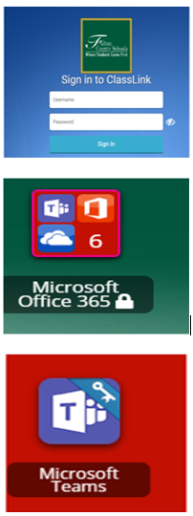
How to access microsoft teams
If using a computer login to FCS Class link
Click on Office 365
Click on Microsoft teams

Slide 12
How to long into i-ready
Login to fcs class link
Click on i-ready
Choose reading or math
Complete pathway or teacher assigned lessons

Slide 13
How to access illuminate
Login to fcs class link
Click on illuminate
Click take assessment and complete quiz

Slide 14
How to access infinite campus
Use the link below to see how to sign up and access infinite campus
On this platform, parents/Guardians can access student grades/Report Cards. It’s Imperative that you are signed up and have access.
https://www.fultonschools.org/infinitecampus

Slide 15
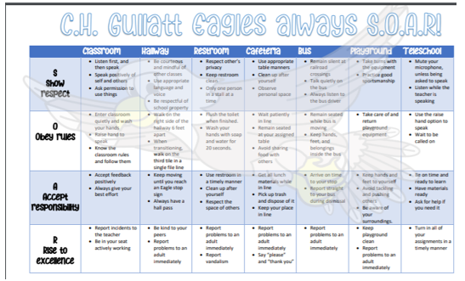
behavior plan
We are a PBIS school and we will continue to use PBIS Rewards. Students will be rewarded for behaviors that are displayed through SOAR (Show respect, Obey rules, Accept responsibility, and Rise to excellence). Weekly/monthly rewards will be given out.

Slide 16
Grading policy
Below is our grading scale
A- 100-90
B- 89-80
C- 79-70
F- 69- below

Slide 17
Teacher contact information
Ms. Nesbitt- nesbitta1@fultonschools.org
Ms. Harris- harrise4@fultonschools.org
Mrs. Nichols- nicholsr@fultonschools.org
Ms. West- westq@fultonschools.org
Mrs. Amos- amoskl@fultonschools.org
School Phone- 470-254-3425

