Slide 1
Pre-K
Orientation
C.H Gullatt ES
2021-2022

Slide 2
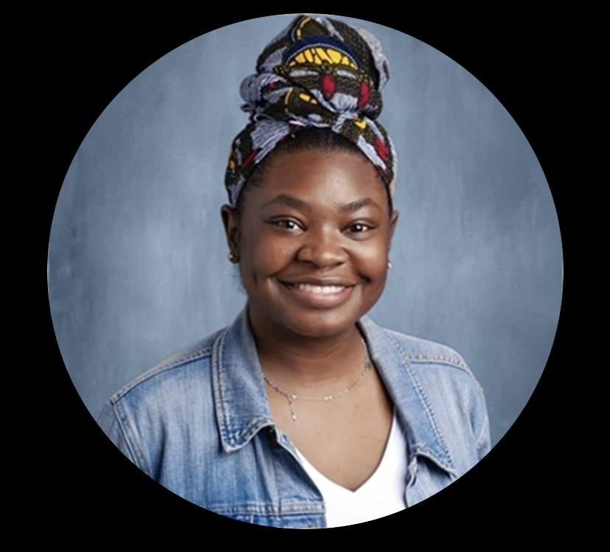
Teachers
Lead Teacher
Ms. Dockery
Assistant Teacher
Ms. James

Slide 3
Administration
Mrs. Arnold
Principal
Ms. Bentley
Asst. Principal

Slide 4
Daily Communication
This is your direct line of communication with us before, during, & after the school day.
It is an INSTANT:
text messaging service
behavior notification tool
video recorder
The schools preferred method of parent teacher communication.

Slide 5
Attendance
School starts at 7:40 a.m.
Arrival after 7:40 a.m. is TARDY. You must escort the student inside the building and check them in at the front office. The student will need a TARDY SLIP to enter class.
Arrival after 11:00 a.m., the student’s attendance will reflect the student as being ABSENT.
Check out for early dismissal ends at 2:00 p.m.
School Social Worker Referral
Excessive tardiness and/or absences
A pattern of checking out a student early

Slide 6
What is an Excused Absence?
Doctor’s note (upon return) with seen in office date and/or can return to school date
Death in the family
Wedding
What is an Unexcused Absence?
Car trouble
Overslept
Child not feeling well so you kept them home
ALL absences require a WRITTEN note whether they are excused or unexcused for student records

Slide 7
Early Dismissal
If a student needs to leave before school is dismissed at 2:20 p.m.
Notify the teacher the morning of via ClassDojo
Parent, guardian, or authorized person must come to the office to sign out the student and escort them from the building
A picture ID is required
No student will be released to any person
without prior permission from the parent or guardian unless their name appears on the student contact card.
NO CHECKOUTS AFTER 2:00 p.m.

Slide 8
Transportation Changes
Requests to change your child’s mode of transportation must be submitted in writing by 1:45 p.m. Phone calls to request changes must be made by 1:45 p.m. and documented with a written or faxed message. Feel free to use the Transportation Change form located in the front office.
School Contact Information
C.H. Gullatt Elementary School
6110 Dodson Rd, Union City, GA
30291
Phone: 470-254-3425
School Hours:
7:40 a.m.-2:15 p.m.
Business Hours:
8:00 a.m.-4:00 p.m.

Slide 9
Student Health Services
If your child must be given
any medication during school hours,
you must complete and return an Authorization & Instruction form to Mr. Makini. This form may be picked up from Mr. Makini in the school clinic.

Slide 10
Car Rider Policy
When picking up or dropping off your child please adhere to the directions of staff and follow the rules of the car riding zone:
DO NOT park or leave your car unattended.
DO NOT drop students off in the parking lot.
ALL vehicles should stay in a single lane of ONE WAY traffic in the morning.
Students may load or unload from either side of their vehicle, so DO NOT PASS any vehicle.
Do not attempt to conference with teachers while in the loading zone, work to keep traffic flowing.
Children will not be allowed to leave the loading area to cross the loading zone or the parking lot unless escorted by a parent or staff member.

Slide 11
Uniforms Encouraged
Polo Shirt
Gold, royal blue or White
BOTTOMS
Khaki or Black

Slide 12
Class Schedule
7:10–7:55 Arrival/Breakfast
8:00–8:30 Morning Meeting
8:30–8:35 Music with Movement
8:35-8:55 Literacy Circle/Phonological Awareness/Phonemes
8:55–9 Music and Movement
9:00–9:35 Small Group/Transition to Carpet
9:35–9:50 Second Step
9:50–10 Restroom Break-Handwashing
10-10:30 Lunch
10:30–11 Recess
11:00-11:10 Restroom/Water
11:10-11:25 Math Circle
11:25-12:25 Centers/Free Play
12:25–12:35 Clean Up
12:35-12:45 Story Time
12:45-:45 Rest Time
1:45-2:00 Snack/Restroom
2:00-2:15 Closing Circle/Literacy/Story
2:15 Dismissal

Slide 13
Supplies
Full Size Book Bag (label w/name)
1- pair of Personal Headphones (label w/name)
2- pair of Blunt Tip Scissors
2- 24 pk of Crayola Crayons
10- Glue Sticks
1- pk of Fine Tip Expo Markers
1- pk of Blunt Tip Expo Markers
2- pks of Ticonderoga or Dixon Large Pencils
1- box of Regular #2 Pencils
1- Plastic School Supply Box (label w/name)
2- reams of White Copy Paper
1- roll of Clear Packing Tape
1- pk of Paper Plates
1- pk of Brown Lunch Bags
3- rolls of Paper Towel
3- pks. Baby Wipes
3- pks. Clorox/Lysol Wipes
2- cans Clorox/Lysol Spray
3- boxes of Kleenex
2- Bottles of Hand Sanitizer
2- Bottles of Hand Soap
1- box Gallon Ziploc Bags
1- box Sandwich Ziploc Bags
1- box of Band Aids
1- Poster Board
All About Me Project
Due Thurs. Sept. 2nd

Slide 14
Nap Time
Towel or Small Sheet (to lay on)
Small Blanket or Beach Towel (to cover up with)
Small Pillow (optional)
All items must be able to fit inside students book bag. Items are sent home every Friday to be washed and returned on Monday.
ALL students are required to lay down
during this time.
They DO NOT have to go to sleep, but they must remain quiet so they don’t disturb the other students.

Slide 15
Change of Clothes
Each student needs complete sets of extra clothes. Please include the following
Underwear & Socks
Shirt & Shorts/Pants
Place all items in a ziploc bag labeled with child’s name. Please be mindful that students are experiencing new things, so their change of clothes are NOT just for bathroom accidents.
Ex., opening milk cartons & condiment packages, carrying lunch trays, painting w/washable paints

Slide 16
Snack Calendar
The GA Pre-K program incorporates time for students to receive a snack before dismissal. In our class we use a Snack Calendar System. Each student is assigned a day once a month to provide snack for the entire class of 22 students.
Snacks DO NOT have to be individually wrapped.
For example you could send (1) big box of Honey Nut Cheerios, Fruit Loops, Cheetos, or a bag of Animal Crackers and we would distribute amongst the students.
Participation in the Snack Calendar System is completely OPTIONAL. If you choose not to participate, please sign the
OPT OUT FORM and send your child a snack DAILY.
**NO PEANUTS OR PEANUT PRODUCTS**

Slide 17
Celebrations
There are (2) recognized by Fulton County Schools
Winter Holiday
held at the end of 1st semester & right before students are released for Winter Break
End of the Year
held at the end of 2nd semester & right before students are released for Summer Break
Birthday Parties are not permitted.

Slide 18
Poster Board Project
Due Tuesday, August 31st
Tell us about yourself…
Include all of Your Favorites
Color
Toy
Food
Place to Go
Thing to Do
Book
Age
Family
Pets
Friends
Birthday
Don’t forget the Pictures

Slide 19
Office Hours
My Office Hours for any questions or concerns will be from 2:30-3:30

Slide 20
Parents what we need from you?
Parents we need your email address and phone number so we can send you your
child Seesaw information, and other information that you may need relating to your child.

Slide 21
Questions
Or
Concerns

