Slide 1

Getting Ready for Senior Year
Using Naviance for College Applications

Slide 2
What To Expect
Getting Ready for Senior Year
WHAT?
WHEN?
HOW?
You’ll be using Naviance Student to request transcripts from your counselors and letters of recommendation from your teachers for your college applications
Early next school year
This presentation will provide you the steps on how to request these documents and track your applications using Naviance Student
WHY?
Accurately tracking your college applications in Naviance Student will allow the counseling office to send transcripts and your teachers to send letters of recommendation on your behalf.
You will also be able to check the status of materials being sent right in your account, which saves you time and stress!
Notes:
What other things do you need from students:
Brag Sheet Counselors/Teachers
Anything from parents?
Test Scores
NCAA

Slide 3
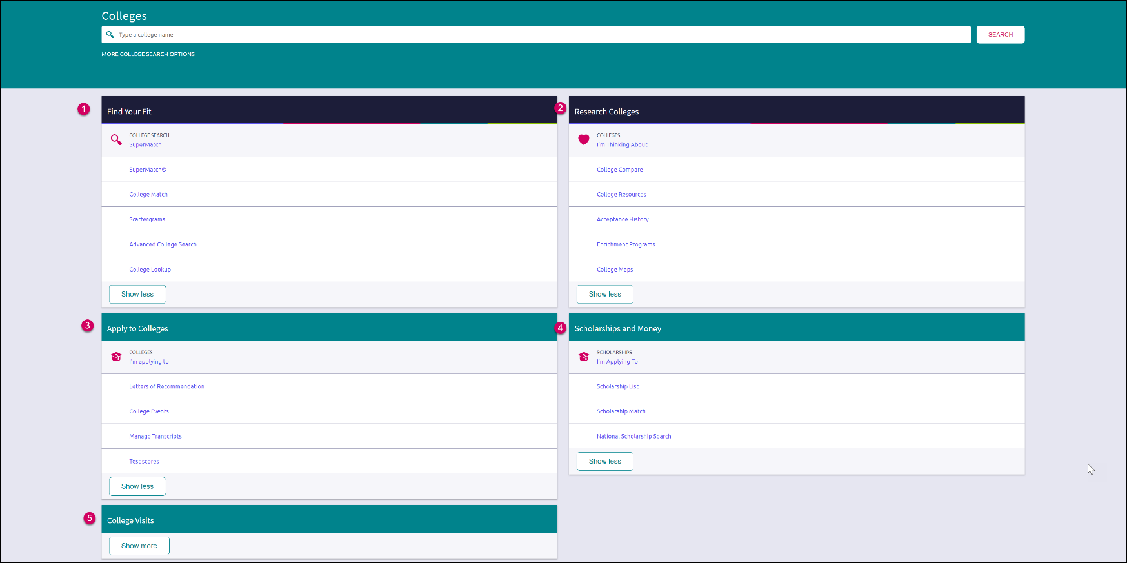
Colleges
Page
Find Your Fit: Use tools like SuperMatch and Scattergrams to identify your best-fit college.
Research Colleges: Dig deeper into colleges of interest using tools like Acceptance History.
Apply to Colleges: Manage college applications and corresponding documentation.
Scholarships & Money: Search for and keep track of scholarships.
College Visits: Check out and sign up for colleges visiting the school.

Slide 4
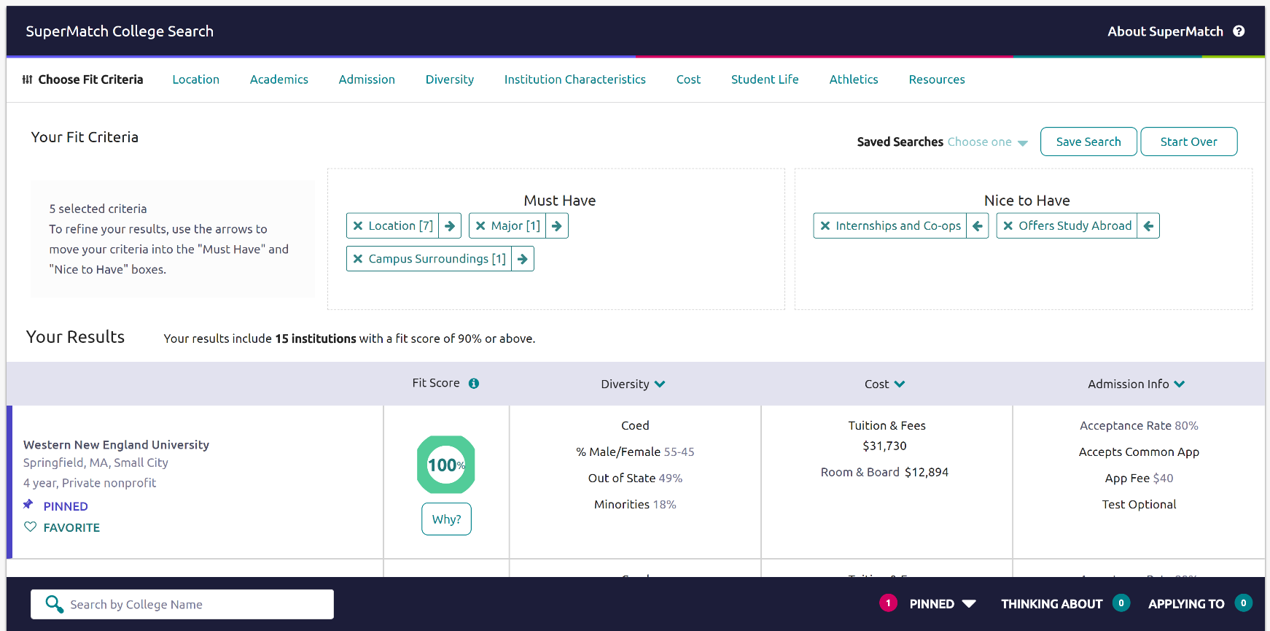
New and Improved SuperMatch College Search
Tooltips guide you through searching over 20 new filters to find your best-fit institution.
See WHY a College got a Certain Fit Score.
Pin and Favorite Colleges of Interest
Compare your Pinned Colleges
Notes:
Students can finetune their college search to find the perfect college match

Slide 5
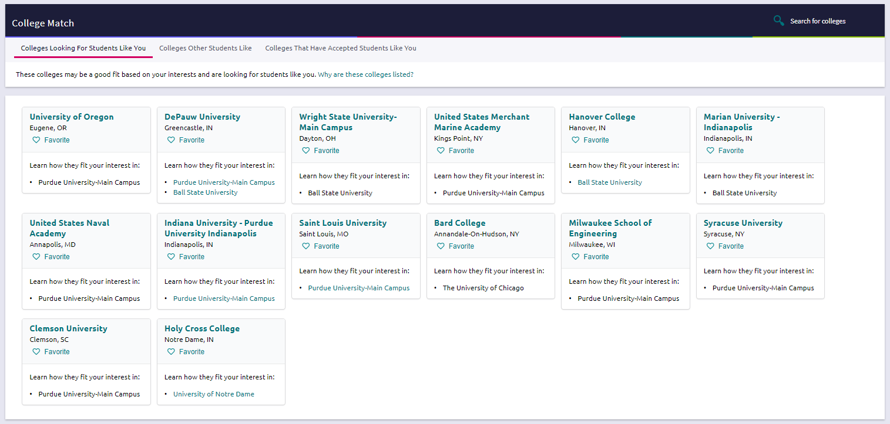
ActiveMatch helps students discover colleges that are interested in students like them based on the student’s specific GPA
and test scores.
College Match
Colleges Interested in Students with the Same Criteria
Recommended Colleges Based on GPA and Test Scores
Colleges that other students who applied to your school, also applied here.
Favorite Colleges of Interest

Slide 6
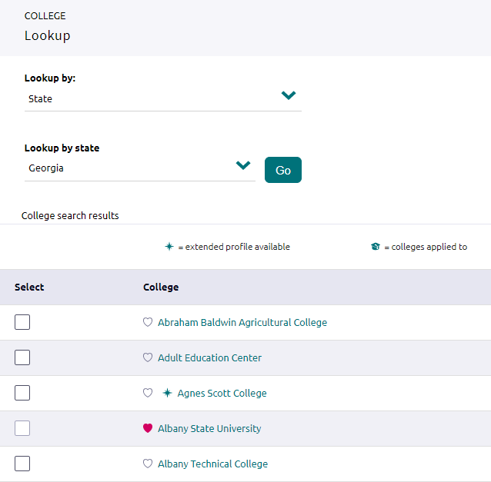
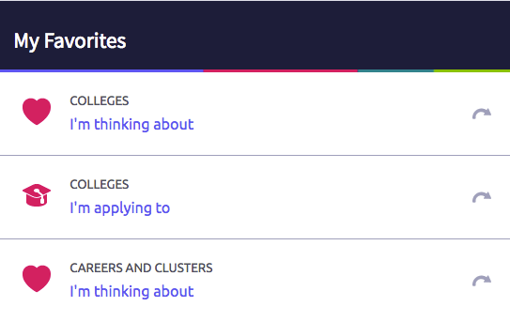
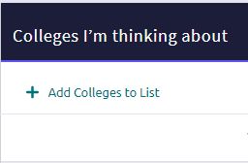
Adding Colleges to your Favorites List
To add colleges to your Favorite list, you will:
From the home page, click on Colleges I’m Thinking About
Select +Add Colleges to List
Search for the college(s) of interest
Select the heart icon to add to Favorite’s list.
3.
1.
2.
4.
Favorite Colleges of Interest

Slide 7

Student College Application Flow
1
Match Common App account to Naviance Student
(August 1st)
Do not invite recommenders in Common App until after August 1st after you match your accounts.
2
Add non-Common App colleges to the Colleges I'm Applying To list in Naviance
Track status of requested transcripts and recommendations
Request application and transcripts for Common App and non-Common App colleges via Naviance Student
5
3
Request teacher recommendation letters via Naviance Student
Do not invite recommenders in Common App until after August 1st after you match your accounts.
4

Slide 8
Common App: Create Account / Sign FERPA Waiver
Students should follow the steps in this video to learn how to setup their Common App account & how to sign the FERPA Release Waiver.
1st- Students must create Common App accounts via www.commonapp.org
2nd- Match Common App and Naviance account in Naviance Student on or after August 1st.
**Once a student has matched their account, schools from their application list in Common App will feed into their Colleges I’m Applying To list in Naviance**
Go to Colleges I’m Applying To List
Select the hot pink bar to Match Accounts
Enter the email address used for the Common App account
Confirm that the birthdate is correct
Select Match Accounts

Slide 9
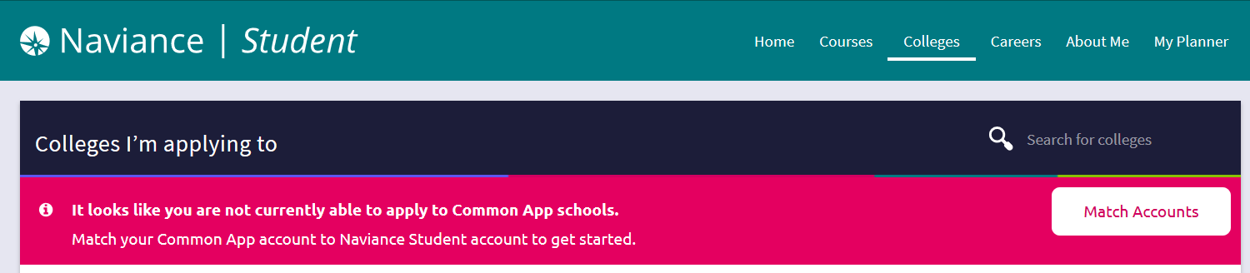
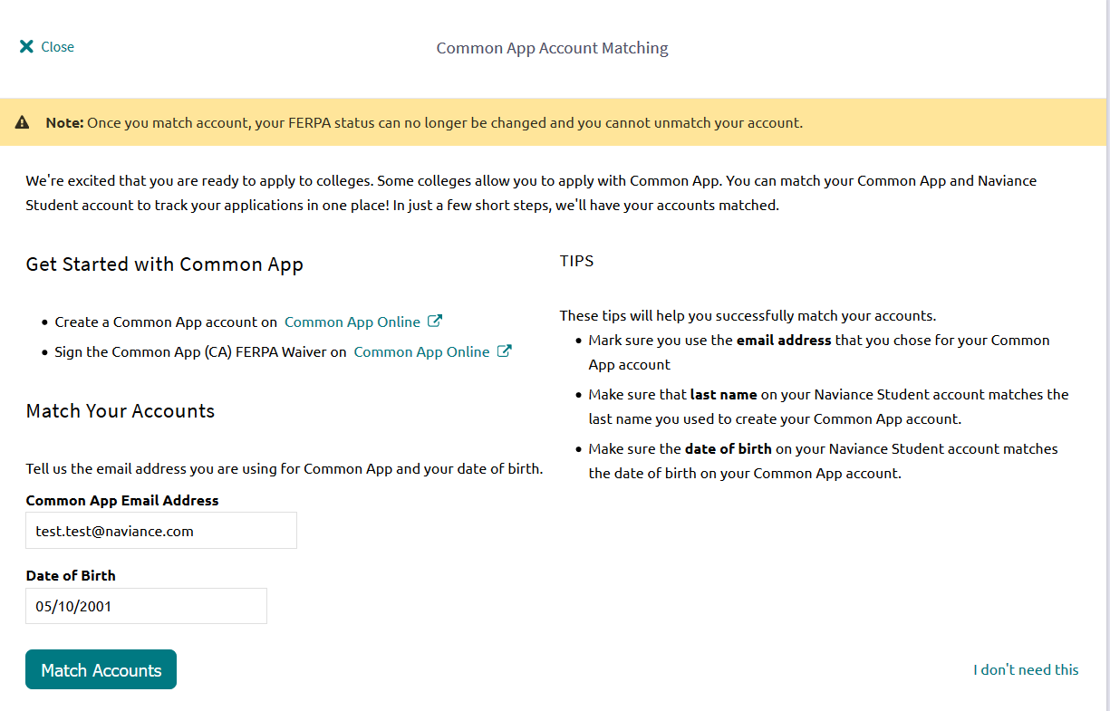
Match your Common App Account
1.
Select Match Accounts
2.
Enter the original email address that you used when creating your Common App account.
4. Select Match Accounts
4.
3.
Enter or confirm your Date of Birth
Now, all your Common Applications will automatically feed into your Colleges I’m Applying to list in Naviance. Now, you should request transcripts & Letters of Recommendation in Naviance!

Slide 10
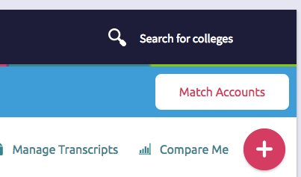
Adding Colleges to your Application List
To add colleges to your application list, you will:
From the home page, click on Colleges I’m Applying to
Click Pink circle with the plus sign
Search for the first college you are applying to
Update your decision type and how you’ll apply
Add and request initial transcript
1.
2.

Slide 11
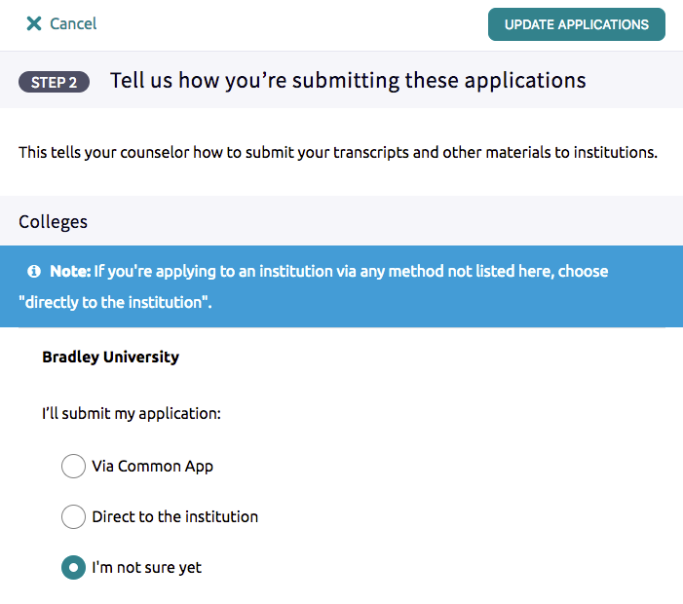
Adding Colleges to your Application List
Make sure you indicate how you are applying to the particular college.
Some colleges accept applications through Common App or another method. You will need to update how you are applying in Naviance Student so the counseling office knows how to send the materials.
If you are NOT applying to the college via Common App, select the “directly to the institution” option.

Slide 12
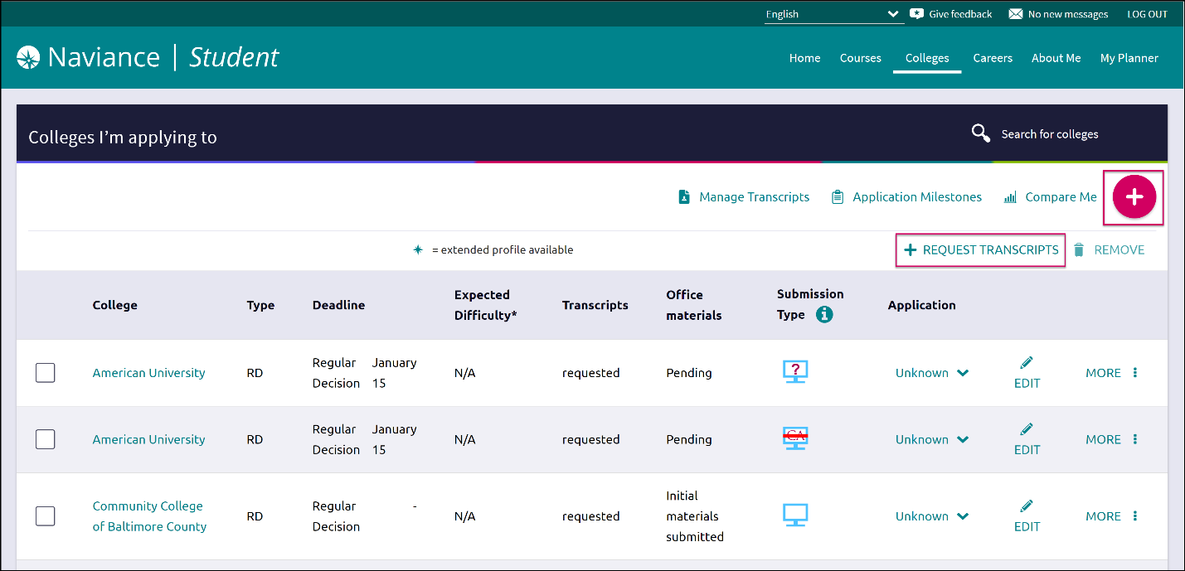
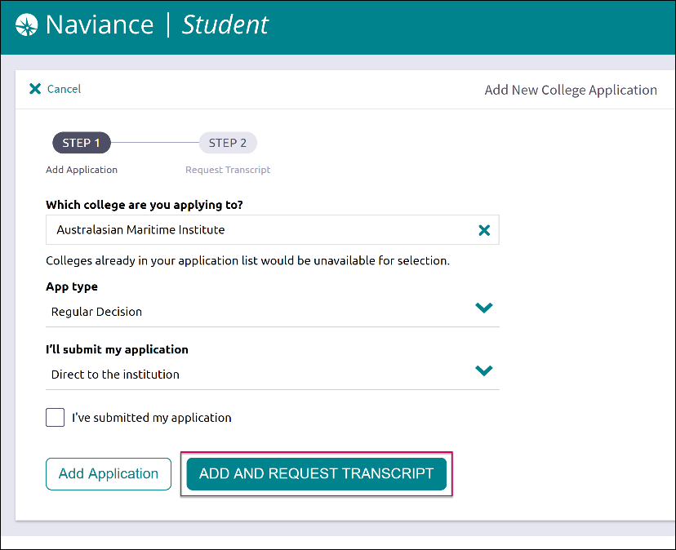
Request Transcripts
In order to access a transcript request, open the Colleges I’m Applying To list
Option 1: When using the plus (+) to add a new college, you can request a transcript during the process.
Option 2: The Request Transcripts option allows you to request a transcript for any of the colleges on your list.

Slide 13
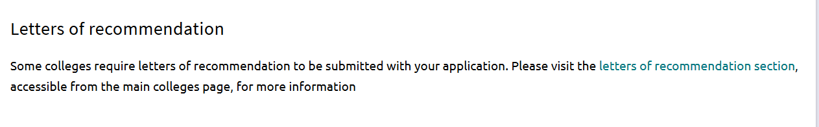
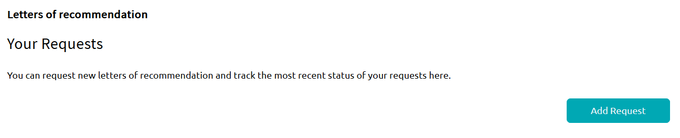
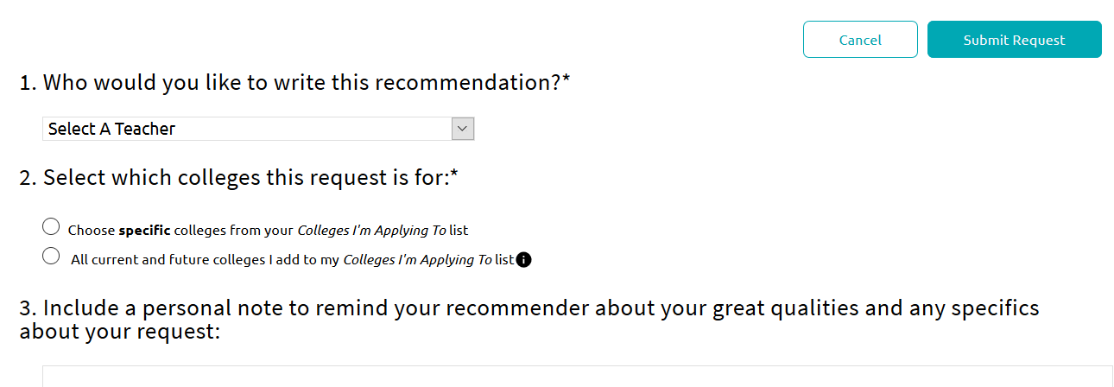
Request Letters of Recommendation
Requesting LORs
Go to Colleges I’m Applying To List
Select Letters of Recommendation (LOR) at the bottom of the list
Select Add Request
Select a recommender
Select which colleges the request is for
  Best practice is to select specific colleges, since many colleges accept a limited number of recommendations.
Include a personal note
  Best practice is to include a note. This assists the teacher in remembering special tasks or events.
Select Submit Request
Select Request and Finish

Slide 14
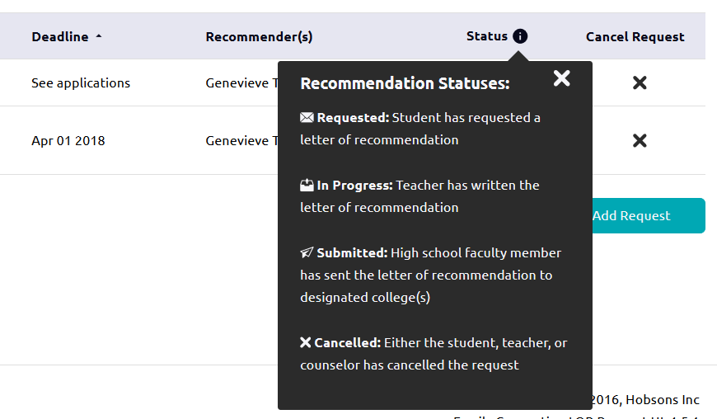
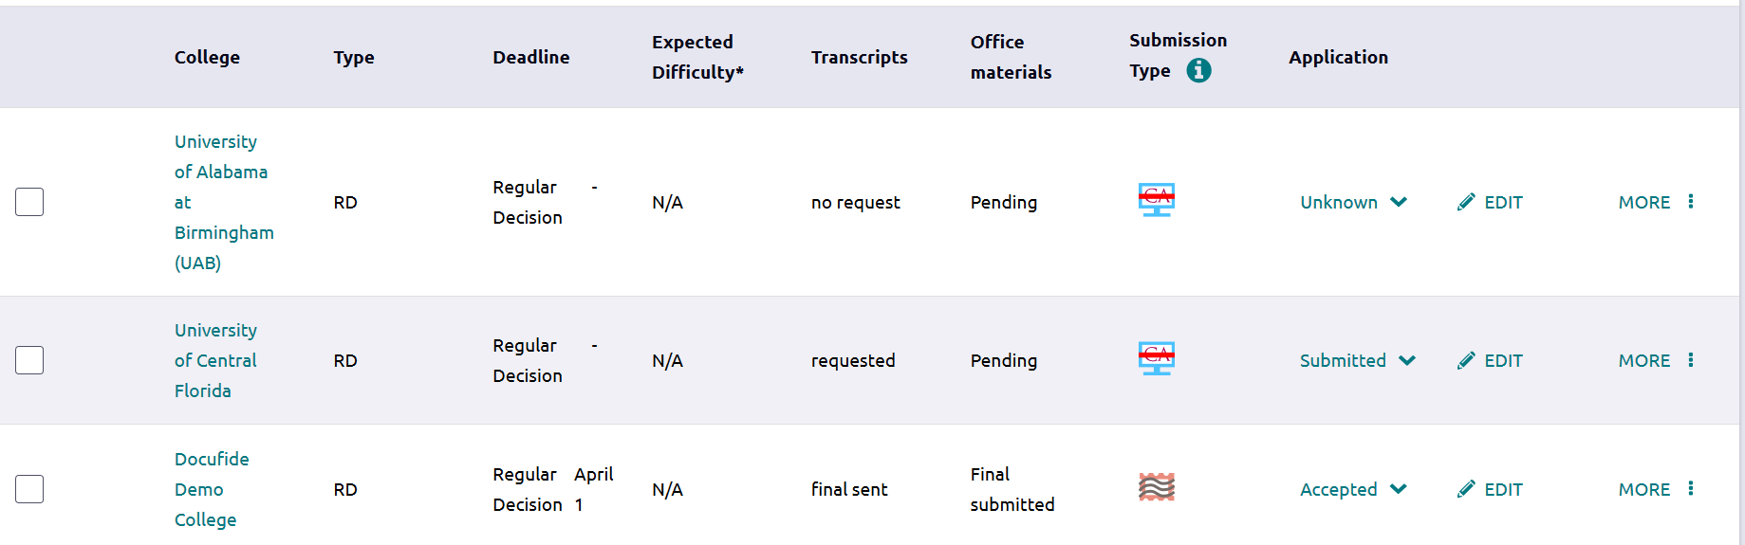
Track Submission Process in Naviance
Tracking Transcript & App Materials Status
Go to Colleges I’m Applying To List
Check the Transcript column to review when a counselor has submitted a transcript
  The transcript column will say ‘sent’ if the transcript has been sent
Check the Office Materials column to review when a staff member has indicated that all materials have been sent for that application
The Office Materials column will say ‘submitted’ if transcripts and any other required materials, like Common App forms or other school-specific forms, have been sent
Tracking LOR Status
Go to Colleges I’m Applying To List
Select Letters of Recommendation at the bottom of the list
Check the Status column to review when a teacher has submitted a LOR

Slide 15
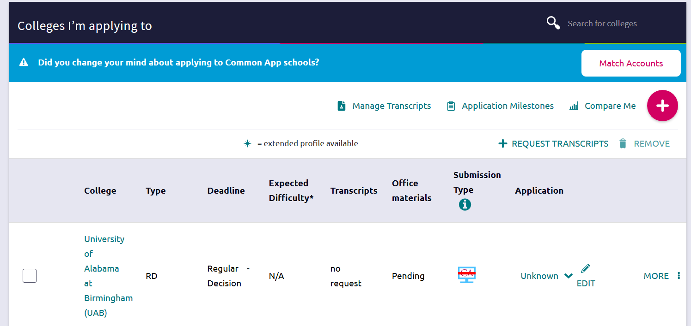
Track Submission Process in Naviance
How do I request more transcripts? Select Request Transcripts
How do I know if my transcript has been sent?
Watch the Transcript Request column to determine when the transcript has been sent
How do I know if my counselor has submitted everything I need for an application? If the Office Materials column says “submitted”, this means all necessary materials from your school have been sent

Slide 16





eDocs Delivery Type Icons
  Mail Only: documents can only be sent by mail
Electronic: documents can be sent through eDocs
Common App: Common App docs can be sent through eDocs
  Unknown: documents can be sent through eDocs. Student has not yet indicated how they are applying
  Common App via Electronic: documents can be accepted through eDocs
Common App Mail only: documents prepared but not sent through eDocs

Slide 17
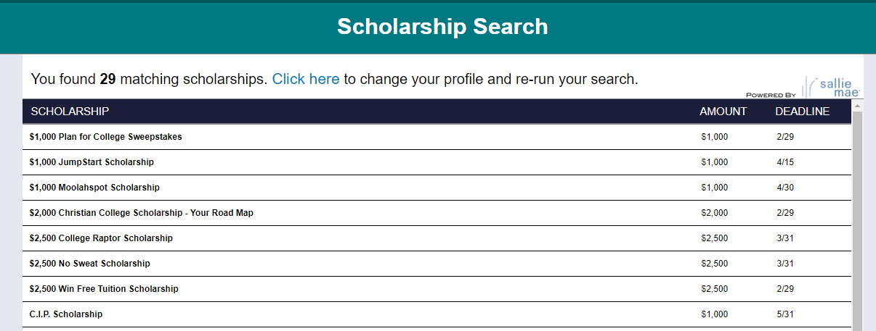
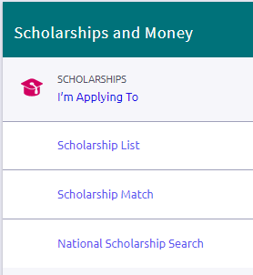
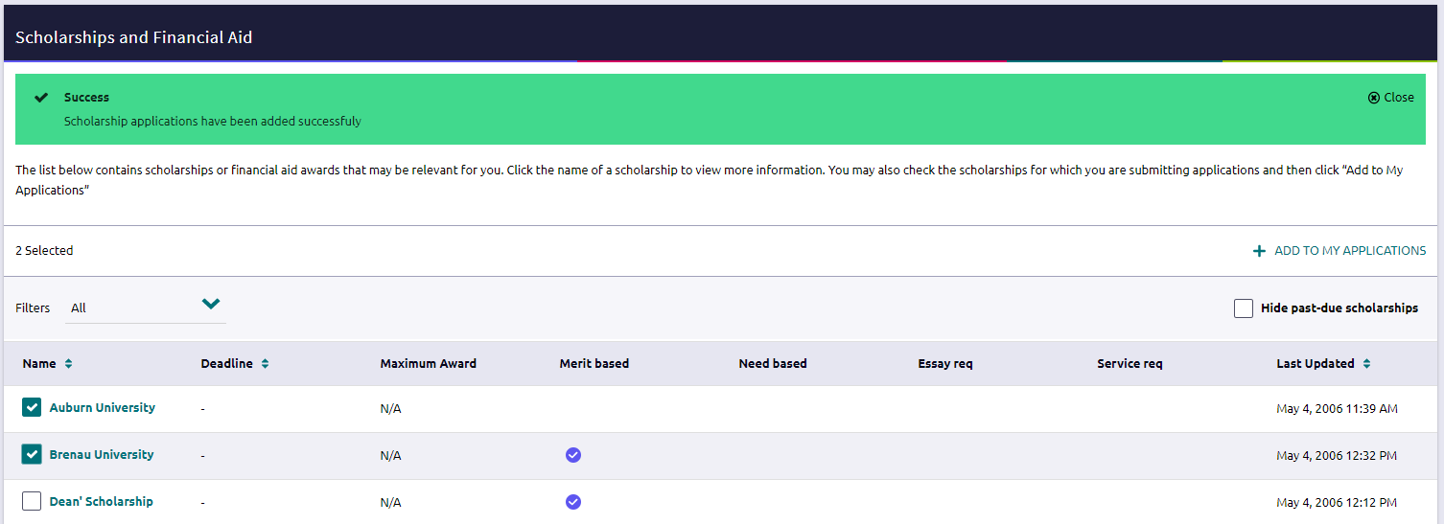
Adding Scholarships to your Favorites List
To add scholarships to your Application list, you will:
From the Colleges home page, click on Scholarship List
Select scholarship Name to view specifics
Select scholarship(s) and +Add to My Applications
Select National Scholarship Search for listing of national scholarships.
National Scholarship Search
Add to Applications list

Slide 18
Next Steps
Decide which colleges you will be applying to:
Do additional research in Naviance Student over the summer to narrow down your college application list.
If you are not sure if you will apply to a particular college, add that college to the Colleges I’m Thinking About list until you are sure.
Review application requirements and begin working on your essay. Common App essay prompts can be found on their website: http://www.commonapp.org/11th-grade
Start thinking about which teachers you will need to request recommendations from
Match Your Common Application
After 8/1, you’ll be able to create your Common Application account
Once you create your Common Application account, you’ll need to match your Common Application account to your Naviance Student account

Slide 19

Ready, Set, Go!
Make sure to check Naviance Student throughout your senior year for important updates and information to keep you on the path to success!
Notes:
What other things do you need from students:
Brag Sheet Counselors/Teachers
Anything from parents?
Test Scores
NCAA

