Slide 1
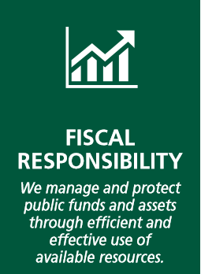
School Logo
Campbell Elementary
3rd grade literacy:
85% of 3rd grade students will read at or above grade level
Climate and Culture:
Increase to and maintain a 5 star climate rating
Partnerships:
Increase the number of impactful partnerships that align to our school’s goals
Transparent and Efficient
Management of Local Funds
Reduce the number of audit
findings for Student Activity funds and ensure effective management between schools and Student Governance Councils
Outcomes: What will success look like for our school?
5th grade math:
85% of 5th grade students will perform at proficient or distinguished levels in math
Teacher Retention:
Increase our retention rate of teachers who remain beyond 5 years to 75% or above
Family Engagement:
Increase the percentage of families who feel empowered to support their student’s educational journeys
Balanced Literacy Framework:
Campbell Elementary will implement Balanced Literacy Framework in grades K-5
Stellar Customer Service:
Work to create a culture where families, students, and staff feel welcomed and appreciated
Campbell Community Champions:
cultivate and sustain community champions to support student outcomes
Effective Budgeting:
Refine and adjust our modified zero-based budgeting process to ensure that resources ae used effectively and efficiently to impact district goals.
Initiatives: What will we do to achieve success?
Balanced Math Framework:
Campbell Elementary will implement Balanced Math Framework in grades K-5
Staff Leadership Development:
Provide staff with the necessary coaching and opportunities to grow.
Parent University:
Offer courses and activities to equip families with knowledge, skills, and resources

