Slide 1
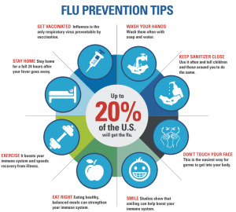
Illness prevention
By: Sybil Schooler BSN, RN, NCSN
This Photo by Unknown Author is licensed under CC BY-NC-ND
Notes:
NOTE: Want a different image on this slide? Select the picture and delete it. Now click the Pictures icon in the placeholder to insert your own image.

Slide 2
Flu Prevention Tips
Get vaccinated.
Avoid close contact.
Stay home when you are sick.
Cover your mouth and nose.
Avoid touching your eyes, nose, or mouth.
Practice other good health habits.
CLEAN YOUR HANDS.

Slide 3
Get Vaccinated
The seasonal flu vaccine protects against the influenza viruses that research indicates will be most common during the upcoming season.
This Photo by Unknown Author is licensed under CC BY-SA-NC

Slide 4
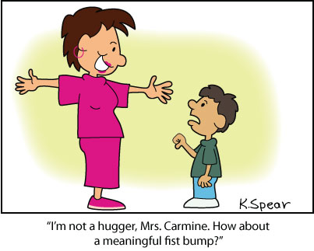
Avoid Close Contact
Avoid close contact with people who are sick.
When you are sick, keep your distance from others to protect them from getting sick too.
This Photo by Unknown Author is licensed under CC BY-NC-ND

Slide 5
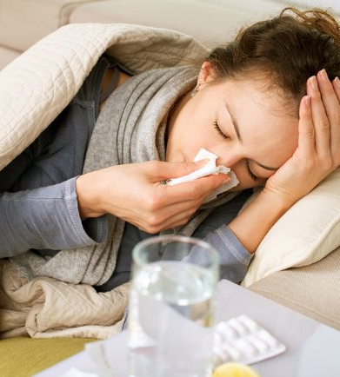
Stay Home When You Are Sick
If possible, stay home from work, school, and errands when you are sick. This will help prevent spreading your illness to others.
This Photo by Unknown Author is licensed under CC BY-NC-ND

Slide 6
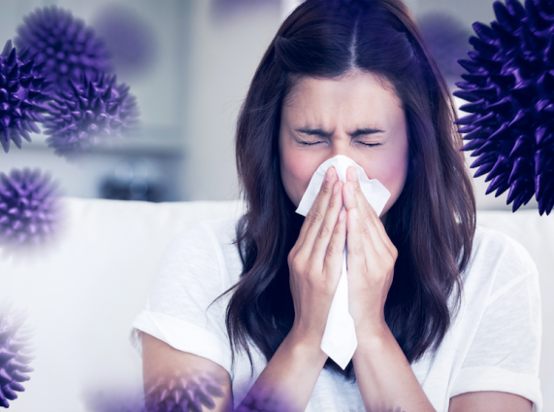
Cover Your Mouth and Nose
Cover your mouth and nose with a tissue when coughing or sneezing. It may prevent those around you from getting sick.
Flu and other serious respiratory illnesses, like respiratory syncytial virus (RSV), whooping cough, severe acute respiratory syndrome (SARS), AND coronavirus are spread by cough, sneezing, or unclean hands.
This Photo by Unknown Author is licensed under CC BY-NC-ND

Slide 7
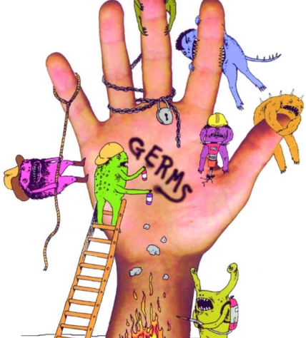
Avoid Touching Your Face
Germs are often spread when a person touches something that is contaminated with germs and then touches his or her eyes, nose, or mouth.
This Photo by Unknown Author is licensed under CC BY-SA

Slide 8
Practice Good Health Habits
Disinfect surfaces often
Get plenty of sleep
Be physically active
Manage your stress
Drink plenty of fluids
Eat nutritious food
This Photo by Unknown Author is licensed under CC BY-NC-ND

Slide 9
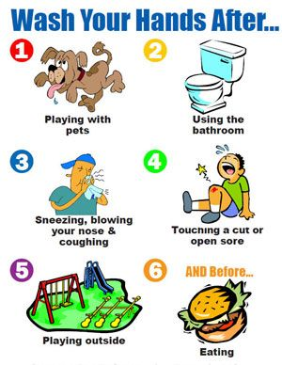
Clean Your Hands
Washing your hands often will help protect you from germs. If soap and water are not available, use an alcohol-based hand rub.
This Photo by Unknown Author is licensed under CC BY-SA

Slide 10
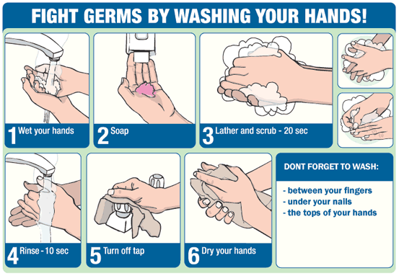
This Photo by Unknown Author is licensed under CC BY

Slide 11
Videos
Handwashing: Clean Hands Save Lives Tips on hand washing and using alcohol-based hand sanitizers
https://www.youtube.com/watch?v=LWmok9avzr4
This Photo by Unknown Author is licensed under CC BY-SA-NC

Slide 12
References
https://www.cdc.gov/flu/prevent/actions-prevent-flu.htm

