Slide 1
Welcome to SWMS
We are glad you will be a colt! Please take some time to get to know a little about our school ☺

Slide 2
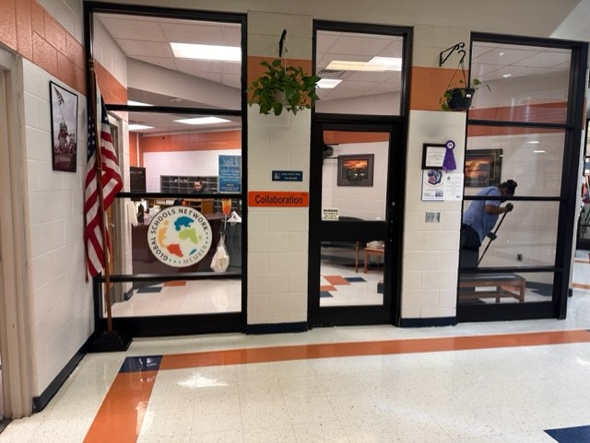
Front Office:
When you arrive on campus, you will come straight to the front office. Here you can enroll, get a student schedule, pay fees, pickup, withdrawal, and many other things. Main number is 910-455-1105

Slide 3
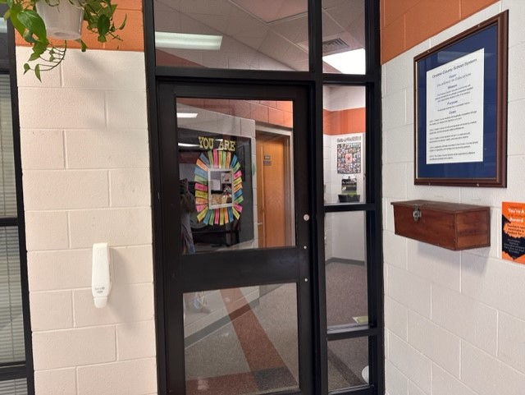
Near the front office you will find the counseling suite. In here you will find the school counselor, the social worker, and the SRO. You can call the main # to be connected to any of these staff or to make an appointment with them.

Slide 4
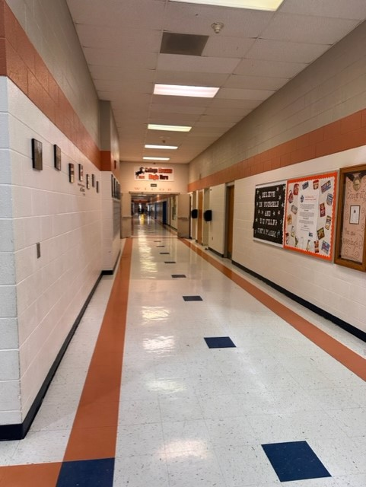
This is one of our hallways at SWMS. All of the student’s core classes (ELA, Math, Science, and Social Studies) are located in these hallways.

Slide 5
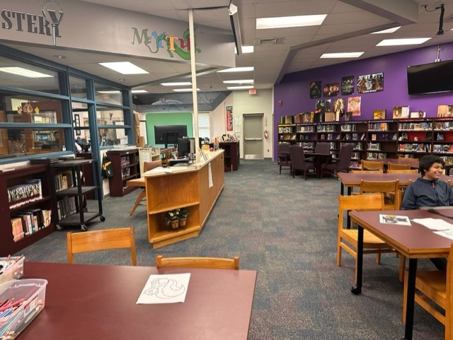
This is the media center. You will come here to check out and return library books, get help with your laptop, or you may come here for class now and then.

Slide 6
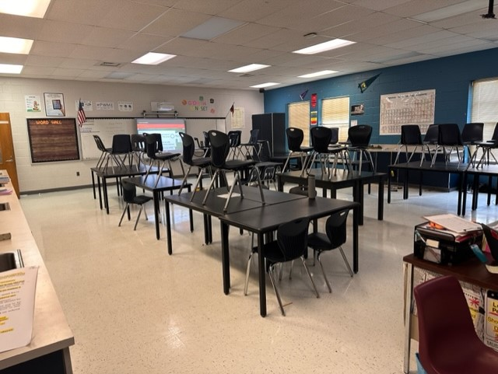
Here is a picture of a science classroom. These classes have different tables in them, as well as sinks, that may be used to do science experiments.

Slide 7
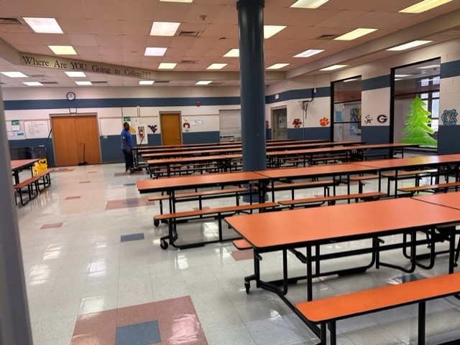
The cafeteria is where you will go for breakfast and lunch daily. You can bring or buy your lunch. Student breakfast is $1.25 and lunch is $2.25. You can also find the free and reduced application on our schools website.

Slide 8
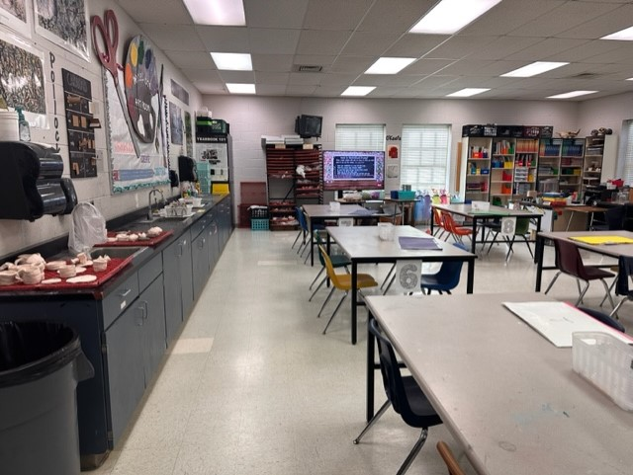
This is the art room. This is 1 of the electives we offer at SWMS. This class is a semester long which is two 9 weeks. You will draw, paint, make pottery, and even possibly help with the yearbook. Your art can be displayed in the hallway or at our local airport.

Slide 9
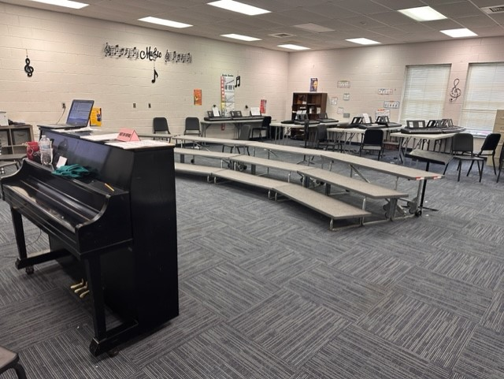
The chorus room is where you will learn to sing as a group You will perform for the school, guests, and parents throughout the year. This class is a year long.

Slide 10
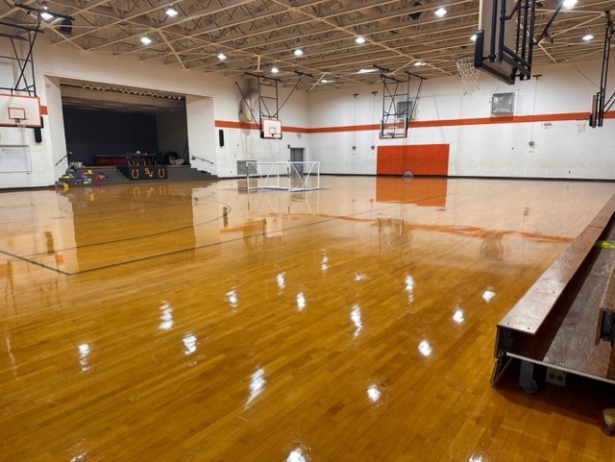
This is the gym and you will have PE in here or outside. You will also have health class here. PE is a semester long (2- 9 weeks). Many of our sports are played in here as well. The sports that are available for eligible 7 and 8 graders are: football, softball, girls soccer, wrestling, basketball, boys soccer, volleyball, baseball, track and field, and cheerleading

Slide 11
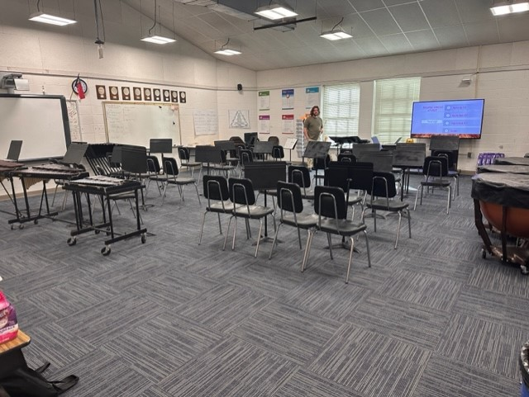
The band room is where you will have band class. This is a year long class where you will learn or refine playing an instrument of your liking. Instruments can be purchased or rented. Like chorus, you will perform for students, guests, and parents at some point in the year.

Slide 12
Other electives offered at SWMS include:
Orchestra
Spanish
Business
Technology and Engineering
Piano
General Music

Slide 13
Some of the clubs that are offered at SWMS include:
National Junior Honor Society
Yearbook
Battle of the books
Chess club
Odyssey of the mind

