Slide 1
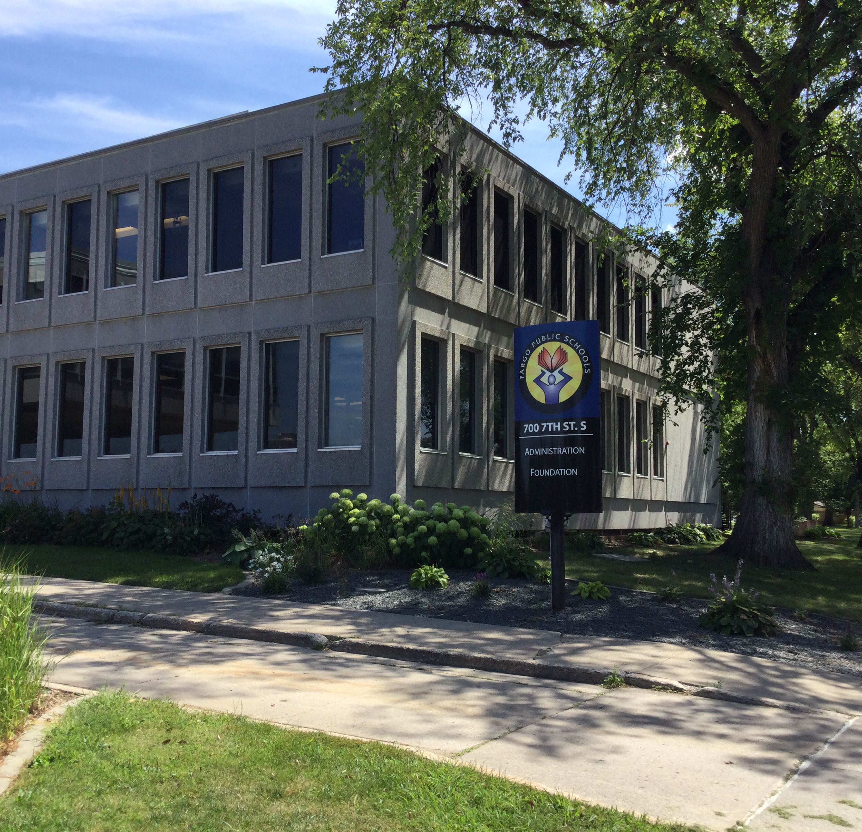

Fargo Public Schools
District-wide Preliminary Energy Assessment
FARGO, NORTH DAKOTA | OCTOBER 10, 2023

Slide 2
Preliminary Energy Assessment Goals
Introduction
Executive Summary
  Optimize and Enhance student environmental and learning spaces
  Identify District-wide prospective energy and operational cost savings opportunities
Utility Rate Analysis – Baseline Development
Energy Conservation Measures (ECMs)
Facility Improvements Measures (FIMs)
Suggested Bundled Scope Options
Next Steps

Slide 3
High Level Assessment – Identified Results
Annual Energy and Future Avoided Maintenance Costs Savings | $630k-770k Cost Savings each year *
Construction Project Value using a Guaranteed Energy Savings under North Dakota Century Code** (Financed over 15 yrs.) | Self-Funding Construction Value $9.3M - $11.4M
Energy Cost Savings ~15% of current annual utility spend Avoided O&M and Future Capital Cost Avoidance $167k | Carbon Reduction of 16% to 21%
* Based on 3-year historical utility data and baseline
**North Dakota Century Code -
§48-05-11 Guaranteed Energy Savings Contracts
3

Slide 4
Energy Efficiency Projects
A Budget-Neutral Solution: Leverage energy savings to generate capital to Refresh facilities & building systems.
Excess savings remains with District for other non-energy projects or possibly increasing Staffing FTEs
Goals of guaranteed energy savings projects:
Optimize Student Learning Environment
Provide technical and financial assistance to upgrade District Assets and Infrastructure *
* North Dakota Century Code
§48-05-11 Guaranteed Energy Savings Contracts

Slide 5

Historical Utility Analysis
Project Baseline
Notes:
Erin

Slide 6



Utility Providers Rates
    Electric Rates
    Xcel Energy
      4.2¢/kWh
      $12.31/kW
    Cass County Electric Cooperative
      5.1¢/kWh
      $37.37/kW
    Water Rates
    City of Fargo
      $5.96/kGal
    Gas Rates
    Xcel Energy
      $0.966/Therm
Rebates Available
    Xcel Energy
    No business rebates currently offered
    Cass County Electric Cooperative
    Rebates geared toward residential
    North Dakota State Energy Program
    Total of $350,000 available for entire state.

Slide 7
Utility Baseline Summary - by Building
* ECI – Energy Cost Index
** EUI – Energy Use Index
*ECI
**EUI

Slide 8
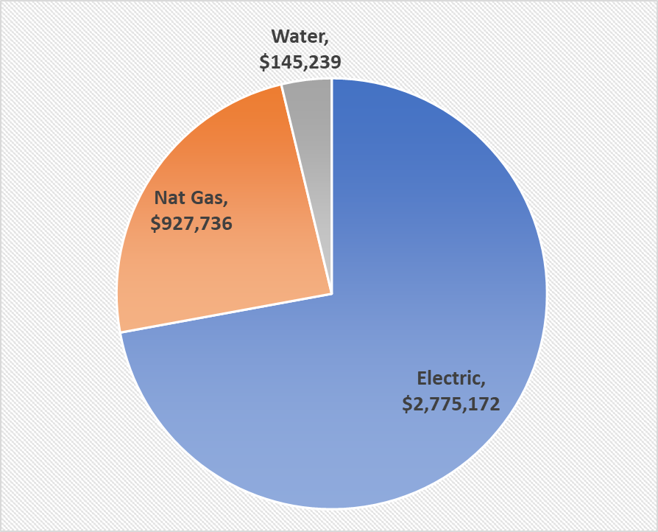
Historical Utility Spend by Source and Building

Slide 9
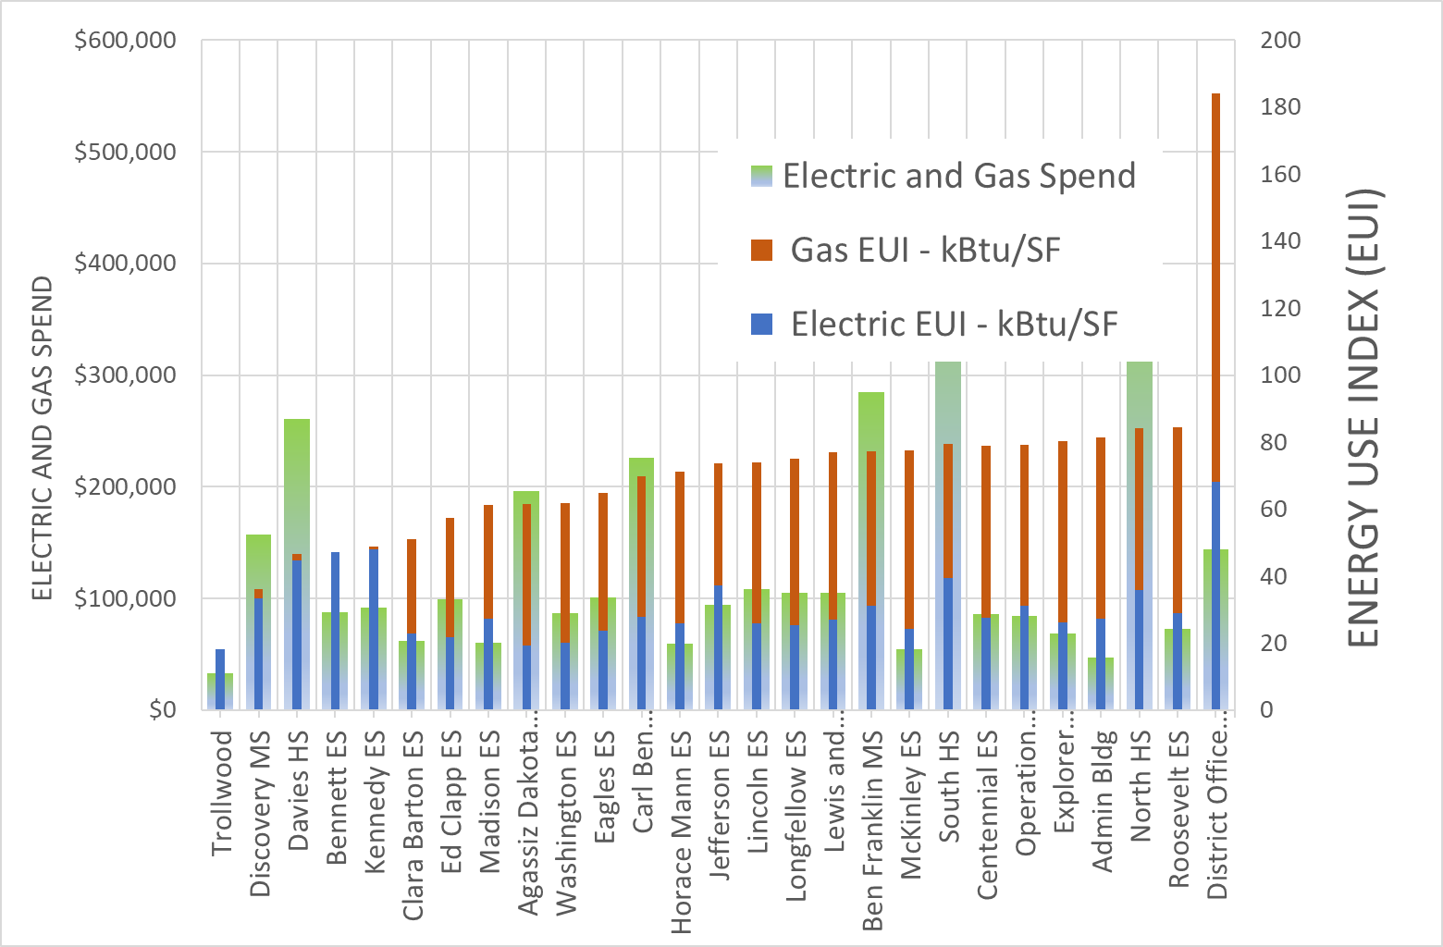
Building EUI with Historical Building Spend
EUI Range – typical education facility in the Midwest Region *
* Typical Energy Use Index number (EUI) is based on 2018 Commercial Buildings Energy Consumption Survey (CBECS) – Education
“https://www.eia.gov/consumption/commercial/building-type-definitions.php#Education”

Slide 10
Energy Conservation Measures (ECMs)
Facility Improvement Measures(FIMs)

Slide 11

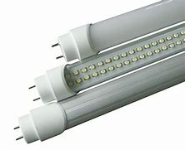
LED Lighting Upgrades
Estimated Benefits
LED Interior Scope & Benefit:
  Re-lamp existing fixtures with new LED lamps
    Bright
    Energy Efficient
    Enhanced safety
    Longer lifetime
    Greater durability
Utility Savings $210,000
O&M Savings $94,000

Slide 12
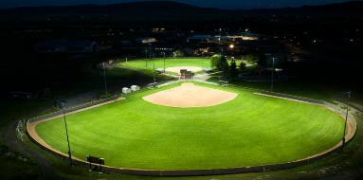
Field Lighting LED Upgrade
Estimated Benefits
Athletic Field Lighting:
  Replace High School Field Lighting
    North HS
    South HS
    Davies HS
  Benefits
    Reduced lamp failures
    Reduced HID Strike times – faster illumination
    Significant O&M Savings
    Limited burn-hours / limited savings
Utility Savings $5,000
O&M Savings $16,000
Example Only: LED Athletic Fields

Slide 13
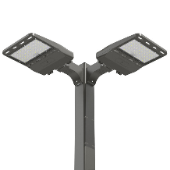
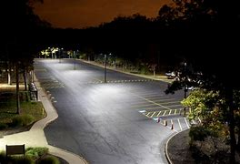
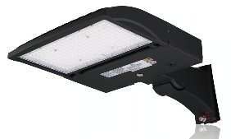
LED Parking Lot Lighting
Estimated Benefits
  LED Exterior Upgrades
  Replace exterior fixtures
    Area lighting in parks
    Street Lighting
    Motion Sensors
      Improved Security Illumination
Utility Savings $8,000
O&M Savings $6,000
Example Only: LED Parking

Slide 14
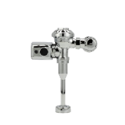
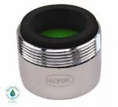
Plumbing Upgrades
Estimated Benefits
Reduced Flow Flush Valves on Urinals
    Urinals were noted to have standard flow ratings of 1.0 gpf
    Waterless and high efficiency pint-per-flush options require replacing the porcelain fixtures
    Replace existing fixtures with new ½ gpf flush valves
Low Flow Faucet Aerators
    Lavatory Faucets (observed aerators - 2.0 gpm)
    Replace aerators with 0.5 gpm units; reduces water, sewer and domestic hot water (DHW) heating utilities
    Water Closets
    Existing vs are rated for 1.6 gpf
      Ameresco recommends recommissioning flush valve and existing 1.6 gpf toilets
      Replace all 3.5 gpf fixtures with 1.28 gpf porcelain and valves
Utility Savings $47,000
O&M Savings $7,000
Faucet Aerator
Flush Valve
Example Only

Slide 15

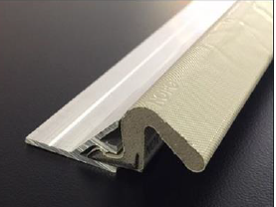
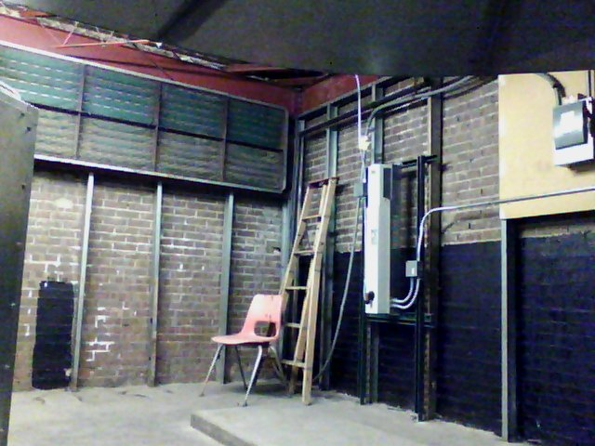
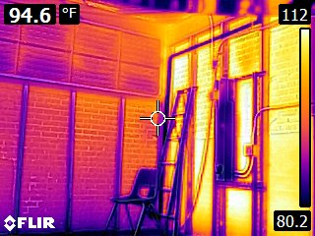
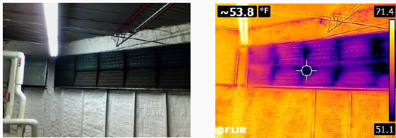
Envelope Weatherization
Estimated Benefits
Weatherization
  Goal: Minimize outside air leakage and conductive heat transfer
  Typical Buildings Points of Concern: door frames, thresholds, window frames, wall and ceiling penetrations, wall/roof joints
  Solutions include Foam infill ceiling and wall electrical/mechanical penetrations
Utility Savings $54,000
O&M Savings $0
Thermal loss examples; photograph/infrared

Slide 16
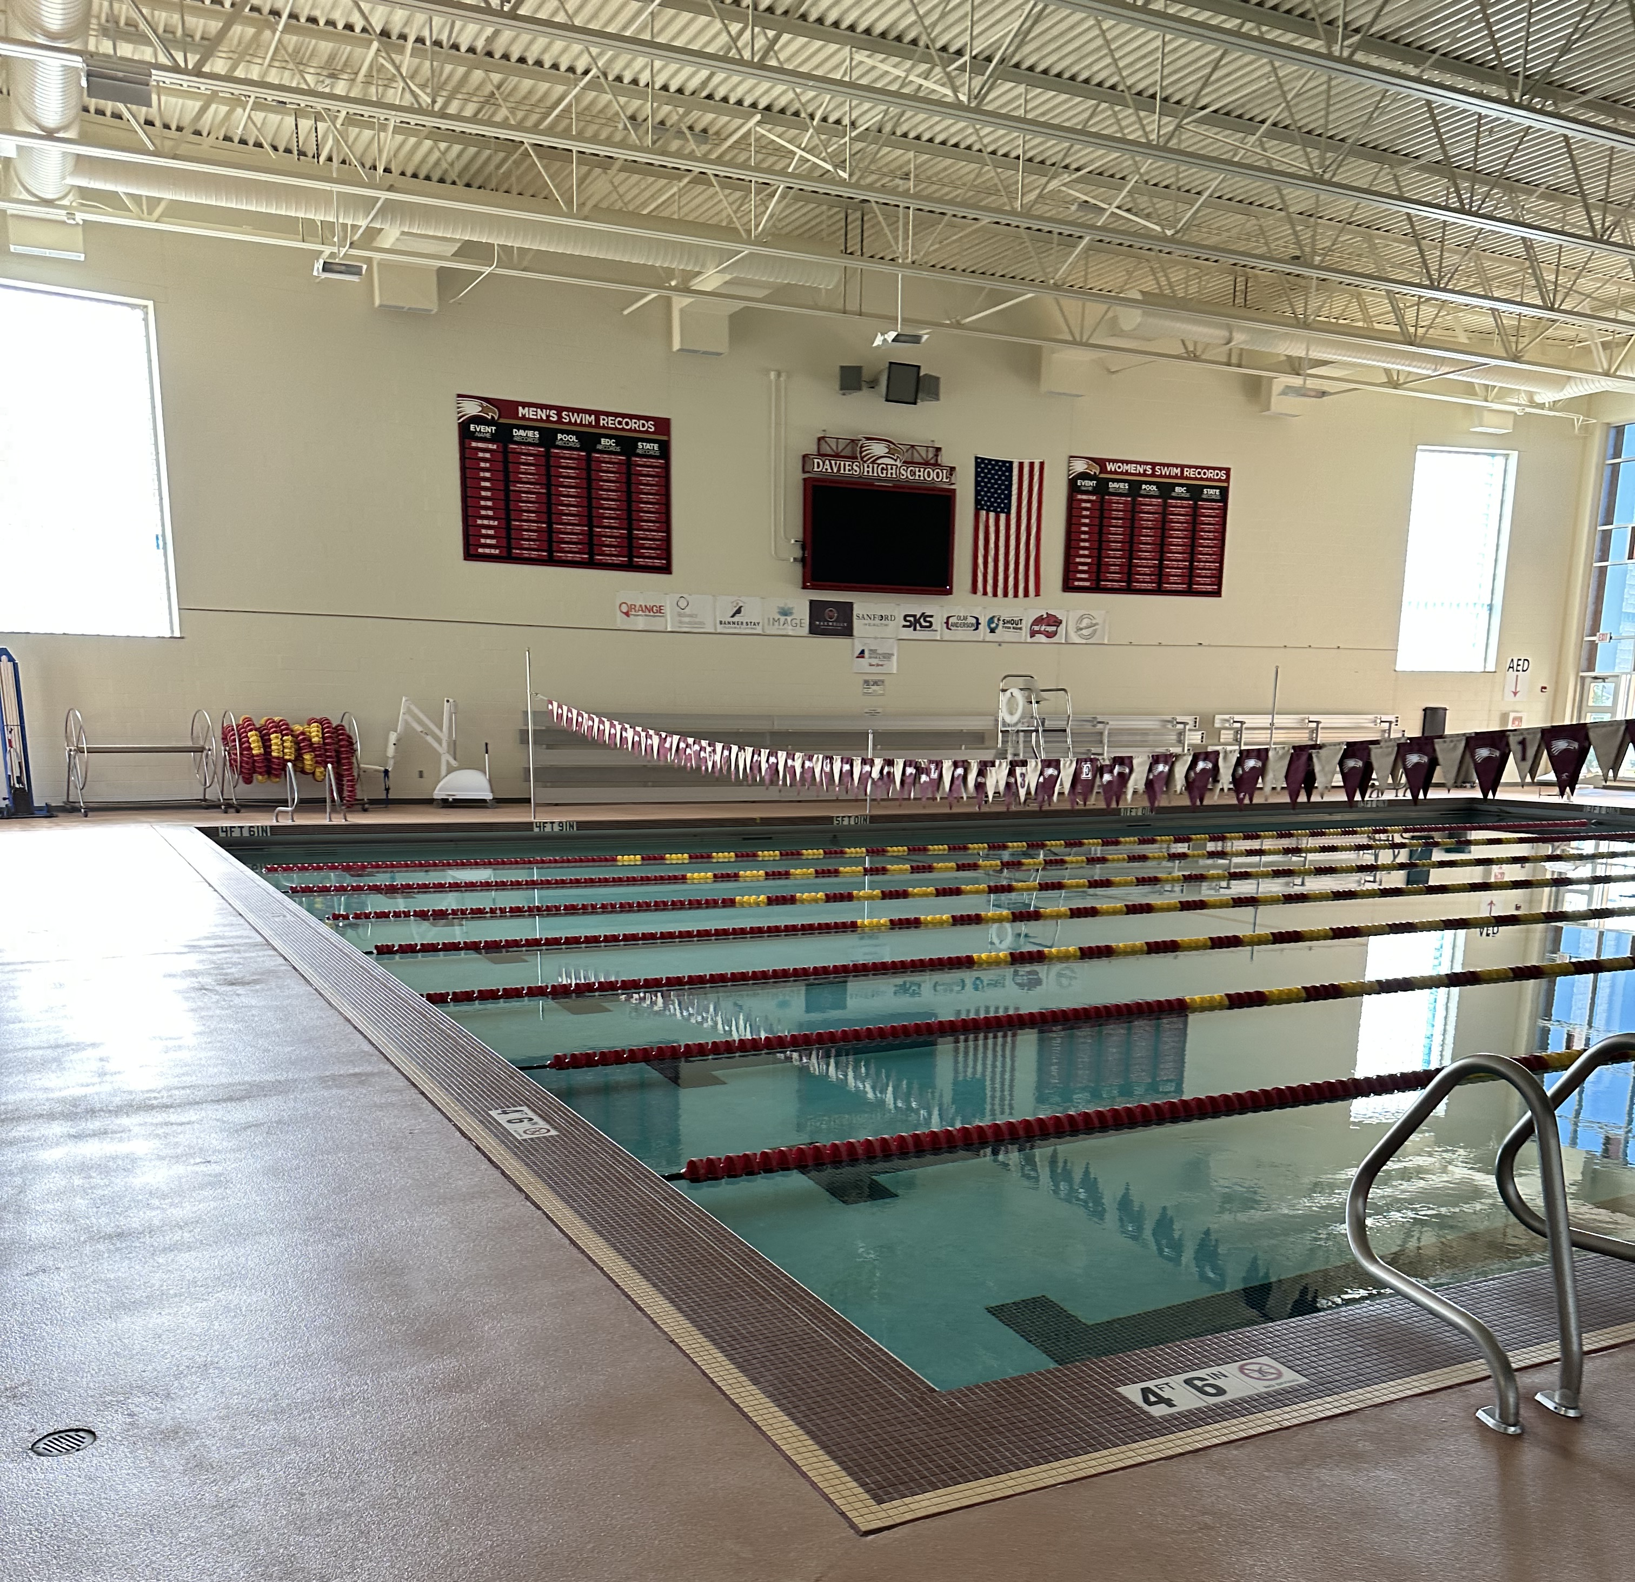
Liquid Pool Cover
Estimated Benefits
Liquid Pool Cover
  Install Liquid Pool system for automated operations
  Safe and effective
  Reduces the pool heating load by up to 40%
  Reduces water consumption by reducing evaporation
  Eliminates costly fabric pool cover alternative
Utility Savings $21,900
O&M Savings ($12,000)

Slide 17
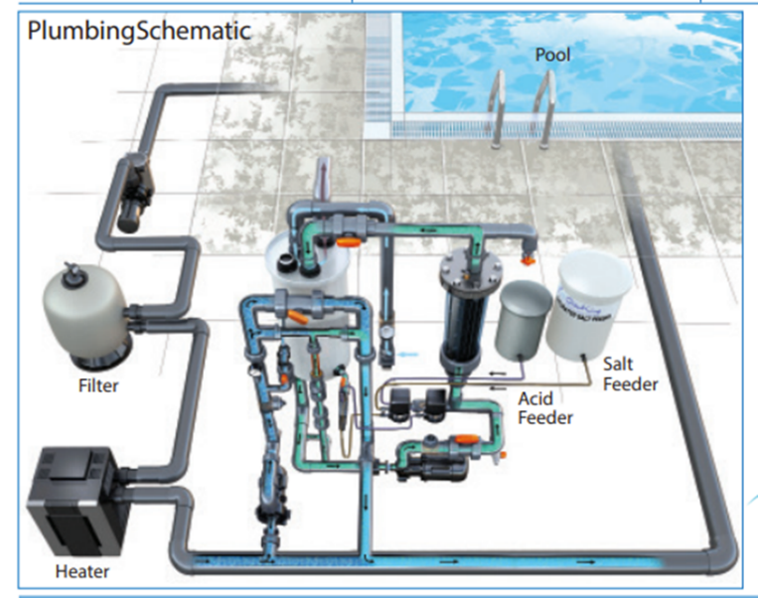
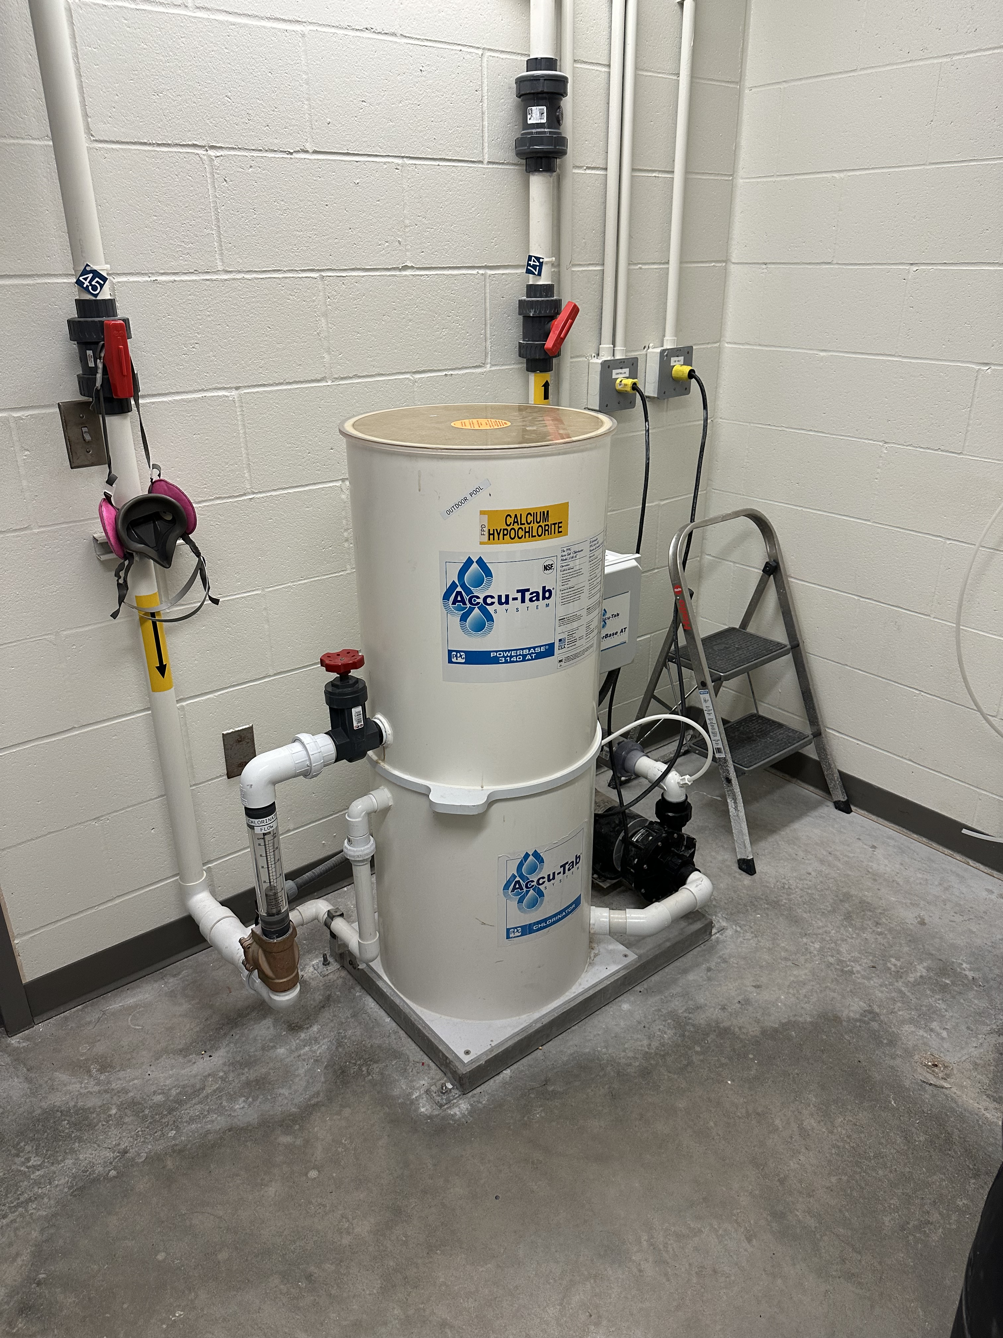
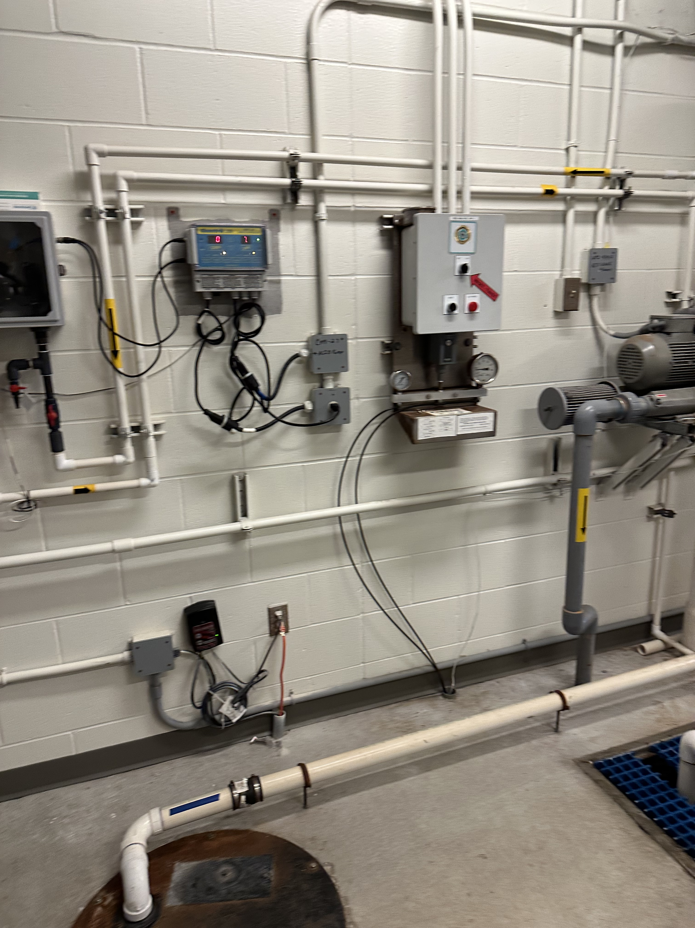
Chlorine Generators
Estimated Benefits
Chlorine Generators
  Install new system components for automated operations
  Provides Alternative Chemical Treatment
  Uses Salt to make Chlorine
  Reduces pool chemical costs drastically
  Minimizes chemical storage safety concerns vs chorine
Utility Savings $0
O&M Savings $56,000

Slide 18
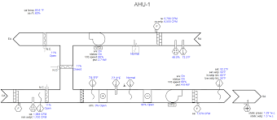
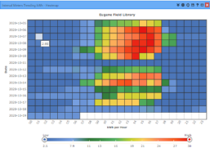
Controls: BAS Master Systems Integration, RCx, Repairs
  Building Automation Systems (BAS) Recommissioning (RCx)
  Verify and update sequence of operations
  Standards of Comfort Document
  Variable Frequency Drives (VFD) Install and optimize programming
  Discharge Air Temperature resets
  Occupancy Scheduling and Night Setbacks
  Heating Hot Water(HHW) and Chilled Water(CHW) resets
  Free economizer cooling
  Demand-controlled ventilation (CO2)
Estimated Benefits
Rc_{x}
Utility Savings $154,000
O&M Savings $0
Example: Hot deck/cold deck HVAC
  Additional Smart Building Solution Offerings:
    DDC Upgrades
    Front-End Integration
    Advanced Metering
    Advanced Analytics
Example: heat mapping day/24 hours

Slide 19
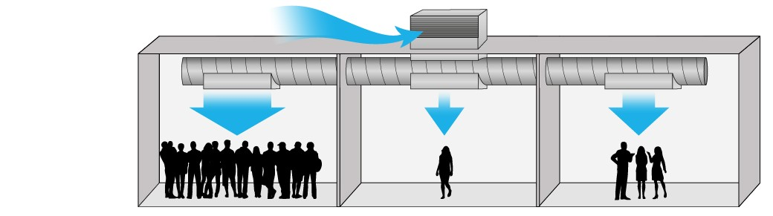
Demand Control Ventilation
Estimated Benefits
  Operational Demand Control Ventilation
  Outside air intake based on CO₂ measurement within space
  Deployed in the North and South HS Sports Domes
  Matches fresh Outdoor air supply to current indoor air quality/occupant density
  Reduces HVAC loading by meeting ASHRAE recommended ventilation rates
Estimated Benefits
Utility Savings $5,000
O&M Savings $0

Slide 20
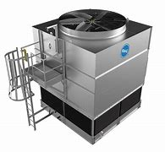
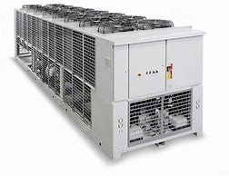
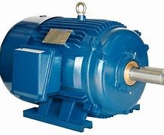
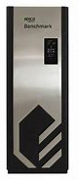
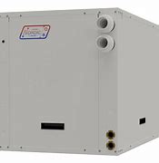
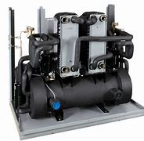
Heating Ventilation Air Conditioning (HVAC) Upgrades
Estimated Benefits
  Replace HVAC Equipment at End of Life
  Equipment to be Replaced
    Water-Source Heat Pumps
    Boilers
    Chillers
    AHUs/RTUs
    Motors
    Split Systems
  Leveraging energy savings to reduce CIP expenditures
  Avoided maintenance costs
    Eliminates future repair/replacement costs
Utility Savings $45,000
O&M Savings $25,000

Slide 21
Gym Space Conditioned Air
Estimated Benefits
  Add Cooling to Gymnasium(s)
  Provide Gym space cooling system(new) in 10 schools which currently are without cooling
  Community Resiliency
  Increased Summer availability for additional programming
  Simplify building comfort in summer
  Minimize bio-growth
Utility Savings $0
Cost – Bundled with short term ROI ECMs
Example Only

Slide 22
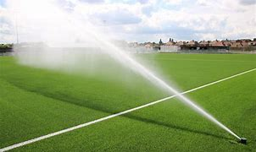
Irrigation Controls
Estimated Benefits
  Smart Irrigation Controls
  Evapotranspiration (ET) controllers calculate irrigation schedules to minimize irrigation to optimize lush grass presentation and soil conditions
  Efficient irrigation management system with sprinkler heads which reduce evaporation during operation
Utility Savings $2,000
O&M Savings $0
Example Only

Slide 23
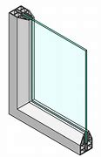
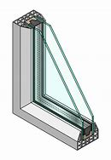
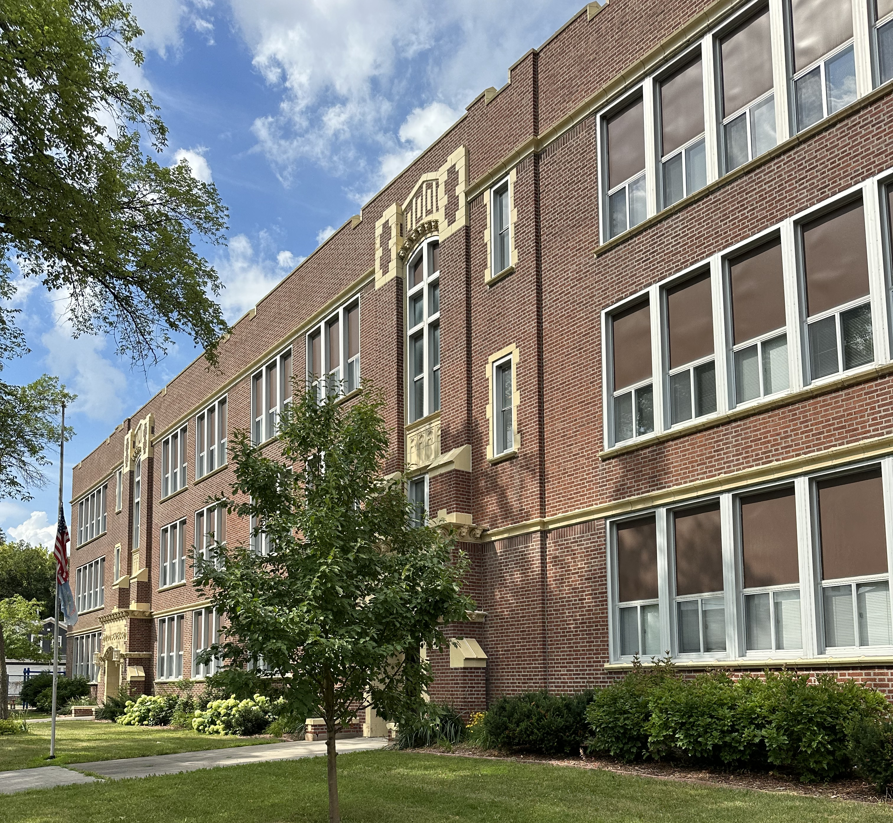
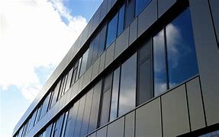
Window Replacements
Estimated Benefits
  New Energy Efficient Windows
  Replace existing single pane windows w/ energy efficient double pane windows w/ thermal break
  Increases Occupant comfort - minimizes air convection/drafting near windows
  Energy Cost Savings - Reduces building HVAC system load
Utility Savings $25,000
O&M Savings $0
Examples Only

Slide 24
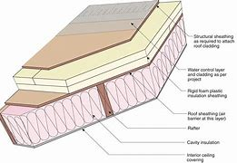
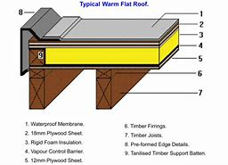
Roof Replacements
Estimated Benefits
  New Roof w/Insulation
  Replace roofing adding R49 insulation (existing R10 – R30)
  Increased occupant space comfort
  Reduces building HVAC system load
Utility Savings $23,000
O&M Savings $ 0

Slide 25
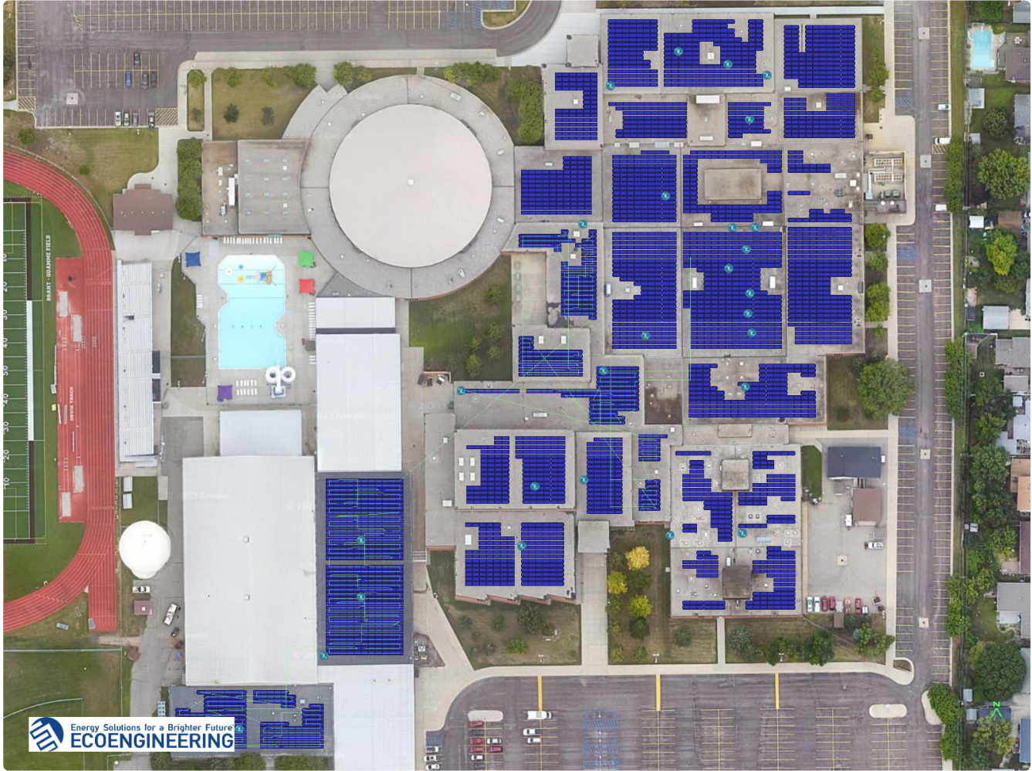
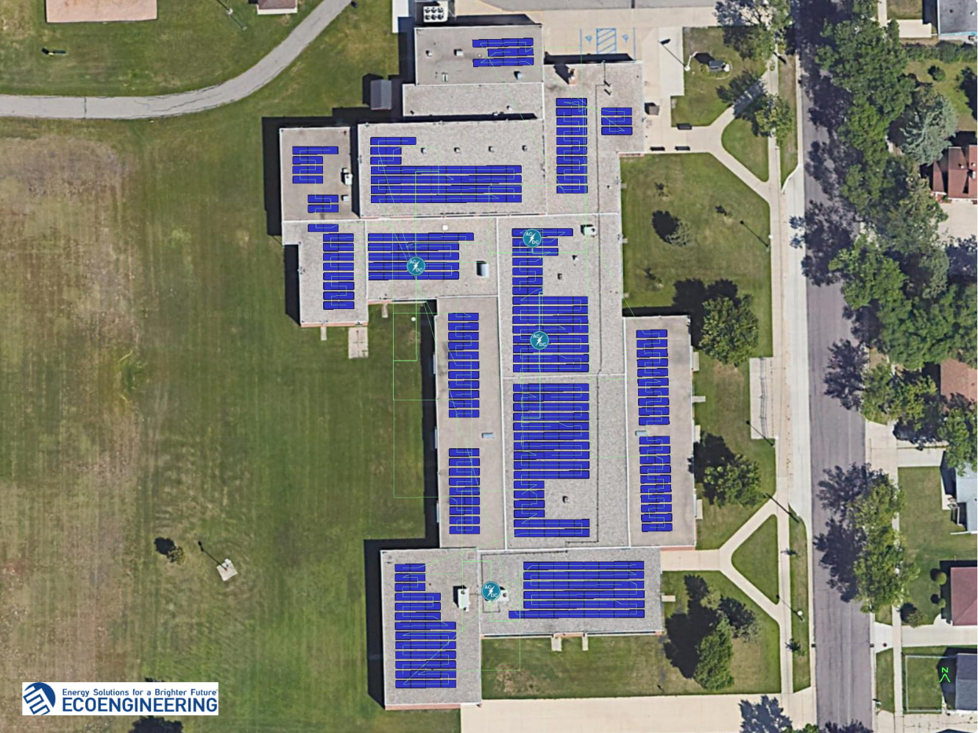
Solar PV Options
Systems Considered
    South High School 1,940 kW dc
    Madison Elementary 244 kW dc
Benefits - Pros
    Carbon-free electricity
    Demonstrates Districts commitment to sustainable development
    Renewable Energy – Sets an example for students and their future
    District is eligible for investment tax credits (time sensitive)
    Detractions - Cons
    Low cost of electricity creates a longer payback
    Rebate programs currently not available
    Capitol Contribution required – self funding if bundled w/ECMs over 15-year EPC term
Estimated benefits for
South HS
Utility Savings $90,800
O&M Savings $0
ITC Est $1.13M*
Estimated benefits for
Madison Elementary
Utility Savings $12,800
O&M Savings $0
ITC Est $198k*
* ITC-Investment Tax Credit

Slide 26
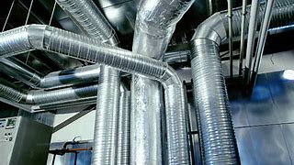
Duct Sealing
Estimated Benefits
Duct Sealing
  Sealant Application reduces conditioned air loss prior to reaching Student occupied space
  Occupied space temperature setpoints are met quickly reducing energy consumption and system run-time
  Increased duct pressure provides improves classroom air distribution
Utility Savings $28,000
O&M Savings $0

Slide 27
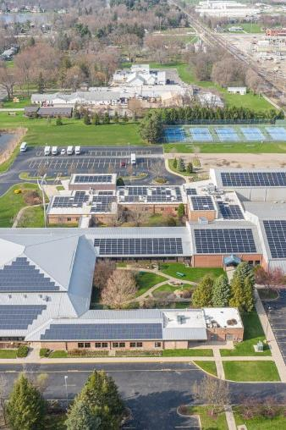
Summary
Notes:
Kent

Slide 28
Project at-a-Glance – Master Table
Note:
This table is also summarized on following slides
This table can also be found in the ASHRAE Level I report

Slide 29
SUMMARY OF RECOMMENDED ECMs
Note:
This table is summarized on following slides
This table can also be found in the ASHRAE Level I Report

Slide 30
SUMMARY OF BUNDLE- OPTION A
Options | Project Costs | Utility Savings | O&M Savings | Capital Contribution Req'd for 15 Yr Payback | SPB | % Carbon Reduction
Total for Projects in Option A | $ 10,365,000 | $ 534,000 | $ 167,000 |  | 14.8 | 19%
Total for Projects in Option B | $ 14,630,000 | $ 579,000 | $ 192,000 | $ 3,069,000 | 15.0 | 21%
Total for Projects in Option C | $ 33,737,000 | $ 641,000 | $ 254,000 | $ 20,315,000 | 15.0 | 23%
Total for Projects in Option D | $ 42,193,000 | $ 689,000 | $ 254,000 | $ 28,055,000 | 15.0 | 24%
Benefits
Self-funded via :
  Energy Savings
  O&M Savings
15% Reduction in Energy
19% Reduction in Carbon
$10.3M Paid from Savings
Option A:
Interior/Exterior/Sports LED lighting,
Plumbing upgrades
Building Envelope/ Weatherization
Liquid pool cover,
Chlorine Generators,
DDC MSI & RCx,
Demand Control Ventilation
Irrigation controls,
Duct Sealing

Slide 31
SUMMARY OF BUNDLE - OPTION B
Options | Project Costs | Utility Savings | O&M Savings | Capital Contribution Req'd for 15 Yr Payback | SPB | % Carbon Reduction
Total for Projects in Option A | $ 10,365,000 | $ 534,000 | $ 167,000 |  | 14.8 | 19%
Total for Projects in Option B | $ 14,630,000 | $ 579,000 | $ 192,000 | $ 3,069,000 | 15.0 | 21%
Total for Projects in Option C | $ 33,737,000 | $ 641,000 | $ 254,000 | $ 20,315,000 | 15.0 | 23%
Total for Projects in Option D | $ 42,193,000 | $ 689,000 | $ 254,000 | $ 28,055,000 | 15.0 | 24%
Benefits
Funded via :
  Energy Savings
  O&M Savings
  Capital Contribution
17% Reduction in Energy
21% Reduction in Carbon
$11.6M Paid from Savings
Option B:
Includes all ECMs in Option A
Boiler Replacement
Chiller Replacement
RTU Replacement
Split System Replacement
New Gym Cooling

Slide 32
SUMMARY OF BUNDLE - OPTION C
Options | Project Costs | Utility Savings | O&M Savings | Capital Contribution Req'd for 15 Yr Payback | SPB | % Carbon Reduction
Total for Projects in Option A | $ 10,365,000 | $ 534,000 | $ 167,000 |  | 14.8 | 19%
Total for Projects in Option B | $ 14,630,000 | $ 579,000 | $ 192,000 | $ 3,069,000 | 15.0 | 21%
Total for Projects in Option C | $ 33,737,000 | $ 641,000 | $ 254,000 | $ 20,315,000 | 15.0 | 23%
Total for Projects in Option D | $ 42,193,000 | $ 689,000 | $ 254,000 | $ 28,055,000 | 15.0 | 24%
Benefits
Funded via:
  Energy Savings
  O&M Savings
  Capital Contribution
18% Reduction in Energy
23% Reduction in Carbon
$13.6M Paid from Savings
Option C:
Includes all ECMs in Option B
Water-Source Heat Pumps
AHU Replacement
Motor Replacement

Slide 33
SUMMARY OF BUNDLE - OPTION D
Options | Project Costs | Utility Savings | O&M Savings | Capital Contribution Req'd for 15 Yr Payback | SPB | % Carbon Reduction
Total for Projects in Option A | $ 10,365,000 | $ 534,000 | $ 167,000 |  | 14.8 | 19%
Total for Projects in Option B | $ 14,630,000 | $ 579,000 | $ 192,000 | $ 3,069,000 | 15.0 | 21%
Total for Projects in Option C | $ 33,737,000 | $ 641,000 | $ 254,000 | $ 20,315,000 | 15.0 | 23%
Total for Projects in Option D | $ 42,193,000 | $ 689,000 | $ 254,000 | $ 28,055,000 | 15.0 | 24%
Benefits
Funded via :
  Energy Savings
  O&M Savings
  Capital Contribution
20% Reduction in Energy
24% Reduction in Carbon
$14.2M Paid from Savings
Option D:
Includes all ECMs in Option C
Replace Windows
Replace Roofs

Slide 34

North Dakota Enabling Legislation
Project Benefits
North Dakota Century Code
§48-05-11 Guaranteed Energy Savings Contracts
Allows projects to be financed - 3rd party
Ameresco to apply for available grants, utility rebates, local and other incentives, on District’s behalf
Projects may self-fund with guaranteed cost savings or bundled with longer payback infrastructure needs
Cost savings are guaranteed by Ameresco
Project Risk transferred to Ameresco
The Legislature gave North Dakota School Districts a procurement tool to combine multiple, comprehensive infrastructure improvements into one turn-key project. The Century Code allows Customers to:
  Reduce Utility Costs
  Reduce Operational Costs
  Modernize Infrastructure
  Improve the Indoor Air Quality in Public Spaces
  Provide Districts with an alternative method to “get things done”
Since inception, multi million(s)-dollar projects have been completed across North Dakota
34

Slide 35

Feedback & Next Steps
Notes:
Kent

Slide 36

Timeline - Moving Forward
Project Development Process *
Concept Meeting
Review Preliminary Assessment findings with Decisionmakers.
Approval / ECM Selections for next steps
Review and consider proposal for energy performance contract
School Board Action Items
✓
✓
✓
1
2
3
4
5
6
7
1
1
1
1
Complete Detailed Analysis – Proposal; firm fixed price, energy cost savings, financing options
90-120 days
Implementation Period
6–9 months
Performance
Period
<15 yrs.
Preliminary Assessment
Ameresco Responsibilities
* Timeline does not include Decisionmakers review and consideration time allowance between each step
** Timeline allowance for each step may change depending on ECM scope selection and complexity
Notes:
Kent

Slide 37
Project Development – To Date!
Questions??

Slide 38
Thank You!
Kent Wolf
Senior Account Executive
Ameresco, Inc.
701 Xenia Ave S 215, Minneapolis, MN 55416
kwolf@ameresco.com
612.804.6274
ameresco.com

