Slide 1

Executive Summary
October 10, 2023

Slide 2





AASG is a leading Asset Management advisory and software division within
Ameresco, Inc., providing total cost of ownership solutions to our broad customer base.
Advisory & Support
3.2 Billion+ SF in building gross floor area managed within AssetPlanner®
55+ Dedicated professionals
AASG works with customers to provide strategic frameworks and thought leadership, enabling enhanced decision making and promoting sustainable action. Our trusted analysts & subject matter experts are often retained long beyond our initial engagement to provide continued support and value-add services for our Clients
35 States and Provinces currently served by AssetPlanner®
1.2 Million+ Maintenance activities actioned and tracked per year
Software Solutions
AssetPlanner® is a powerful multi-module software solution which organizes complex and disparate information into a single data warehouse for analysis and reporting
61,800+ Active software users
42,000 GWh of energy consumption measured through AssetPlanner®

Slide 3









K-12 Client Examples

Slide 4
Objectives / Deliverables
Developed life cycle cost profiles for each Fargo Public Schools facility
Quantified the portfolio’s short- and long-term renewal needs
Ranked renewal needs based on both current and potential risks
Produced reports to evaluate key metrics (FCI, Backlog, Unfunded Liability, Funding Targets, etc.)

Slide 5

Data Development

Slide 6

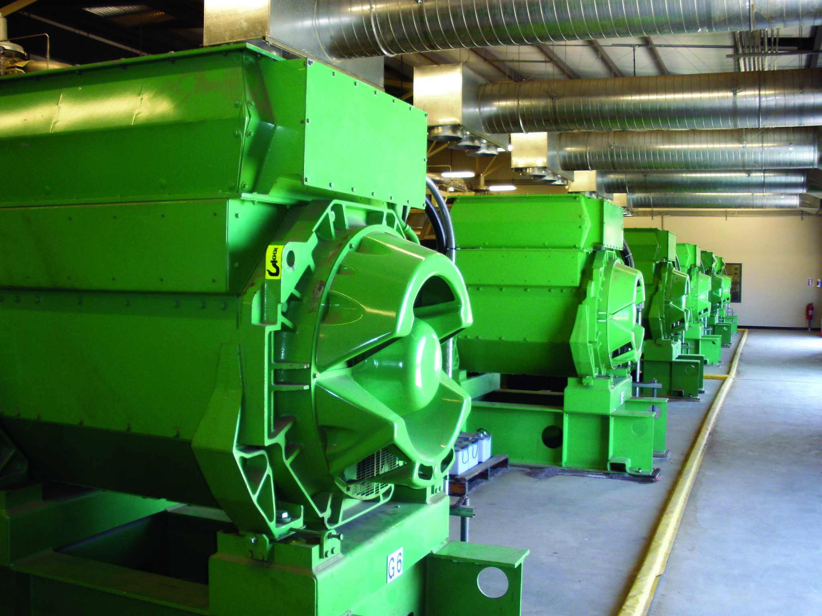
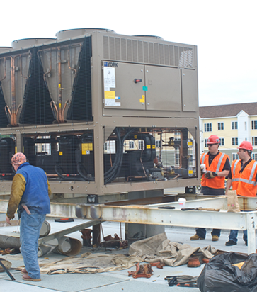
Key Concepts
Assets
  Assets are the primary items being managed within AssetPlanner™ and are organized within an Asset Register (ex. Buildings, Sites, Linear, Process, Fleet)
  Details include: Size, Quantity Construction Year, Floors, etc.
Elements
  Elements are related Asset Inventory items defined by templates for a given Asset Class or Functional Use
Actions
  Actions are work that Elements require (Replacements, Repairs, Installs, Studies, Upgrades)
Notes:
“I believe you’ve all seen this in a previous presentation, but to bring it back to top of mind, our AssetPlanner software has 3 main levels….”
Assets -> Elements -> Actions
Critically important that all (3) of these levels are aligned and tell a consistent story

Slide 7
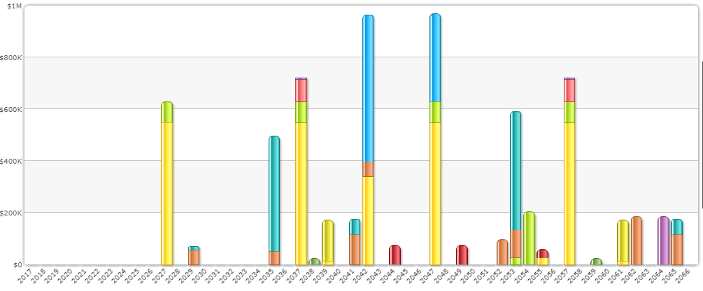
Typical Life Cycles of Building Systems
Roofing
HVAC
Validation of Asset Templates:
Plumbing
Incorporation of existing Data Sources
Staff Interviews
Targeted On-site Validation
Bldg. Envelope
DHW Heaters
Interior Painting, Kitchens, Bathrooms
Years 10-15
Years 20-30
Years 30-35
Years 40-50
35% of Building Replacement Value
65% of Building Replacement Value
Notes:
Industry standards – RS Means – consistent - standardized
All Buildings
All Systems
80/20 Rule???

Slide 8
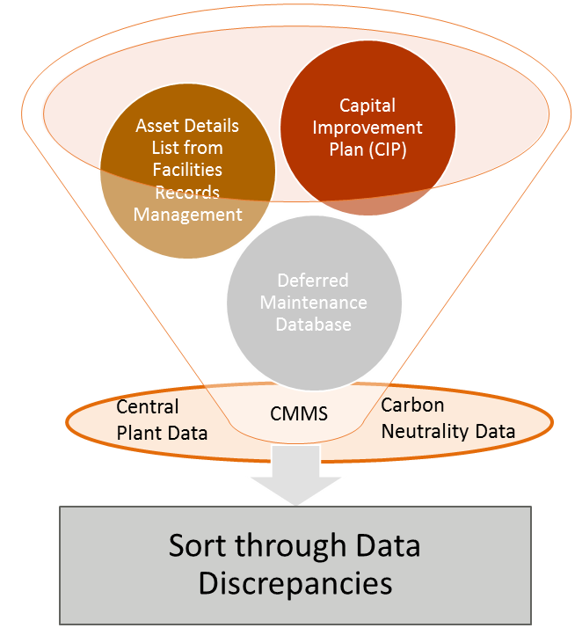
Unique Data Development Approach
A balanced and repeatable process to develop consistent and standardized lifecycle forecasts for capital assets
AssetPlanner™ represents “Practical useful life” vs. “theoretical useful life”, by leveraging over 3 Billion SF of capital planning data
Validation of Asset Templates:
Basic Asset Details:
Life Cycle
Cost
“Templates”
Incorporation of existing Data Sources
Staff Interviews
Targeted On-site Validation
Life Cycle
Forecast for
each Asset
Age
Size
Number of Floors
Use / Type
of Asset
MODEL
DATA VALIDATION
Notes:
Industry standards – RS Means – consistent - standardized
All Buildings
All Systems
80/20 Rule???

Slide 9
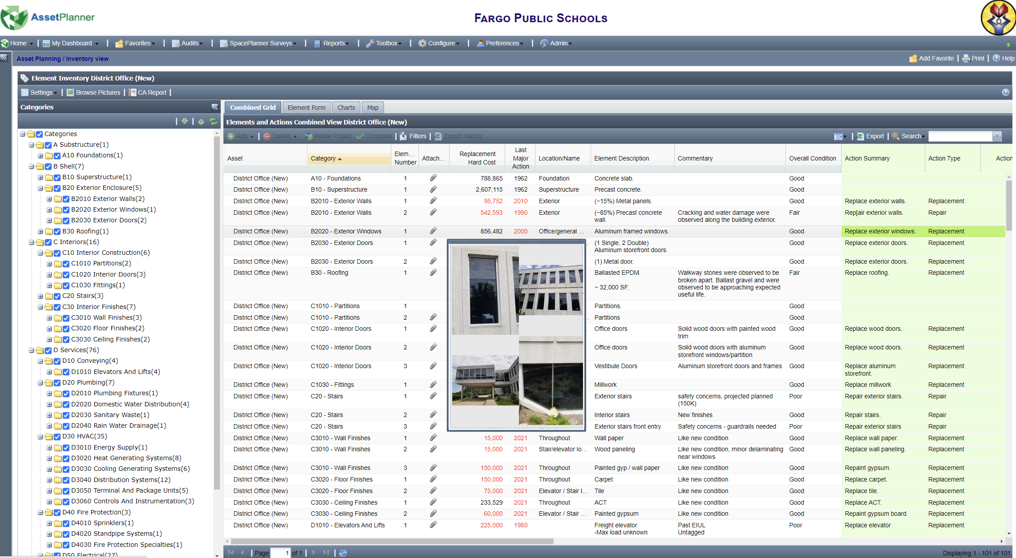
Predictive Lifecycle Templates
Key benefits
ASTM Uniformat II Industry Standards
Consistent and standardized across portfolio of assets
Integrates existing records and transfer institutional knowledge
Field assessments to validate “Practical” vs. “Theoretical” condition
Example AssetPlanner™ Template
The data in this template has been refined and validated through our data development process
Notes:
Elaborate here on practical/predictive vs. theoretical

Slide 10
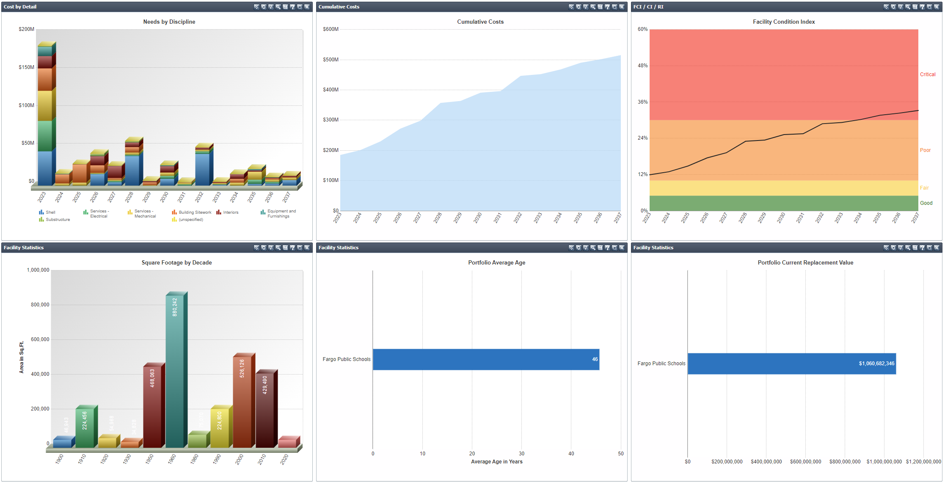
Portfolio Statistics
Key statistics
Total GSF: 3.01M GSF (35 facilities)
Total CRV: $1.06B
~66% of the portfolio’s total SF was constructed before 2000
Average age of Fargo Public Schools portfolio is 46 years (circa 1977)
AssetPlanner™ custom dashboard showing key statistics by campus. Access it here

Slide 11
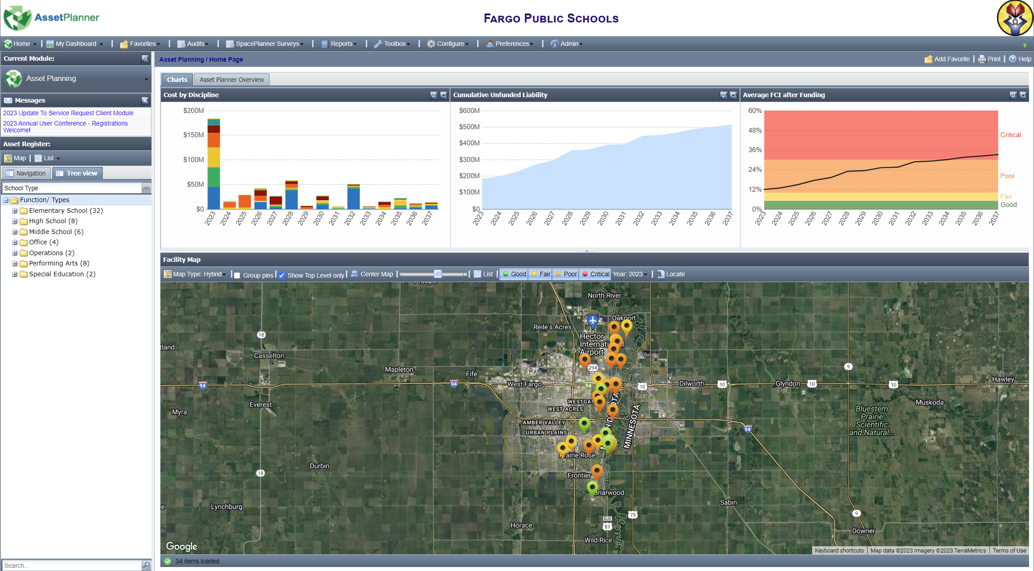
Executive Dashboard
Highlights
Configurable asset register unique to each unlimited user
Interactive home page with key charts and map view
AssetPlanner® should be kept current with good business processes to support your decision development framework for capital planning
AssetPlanner® home page provides an Executive Dashboard for the Portfolio
Notes:
Stopped at this slide

Slide 12
Full Portfolio

Slide 13
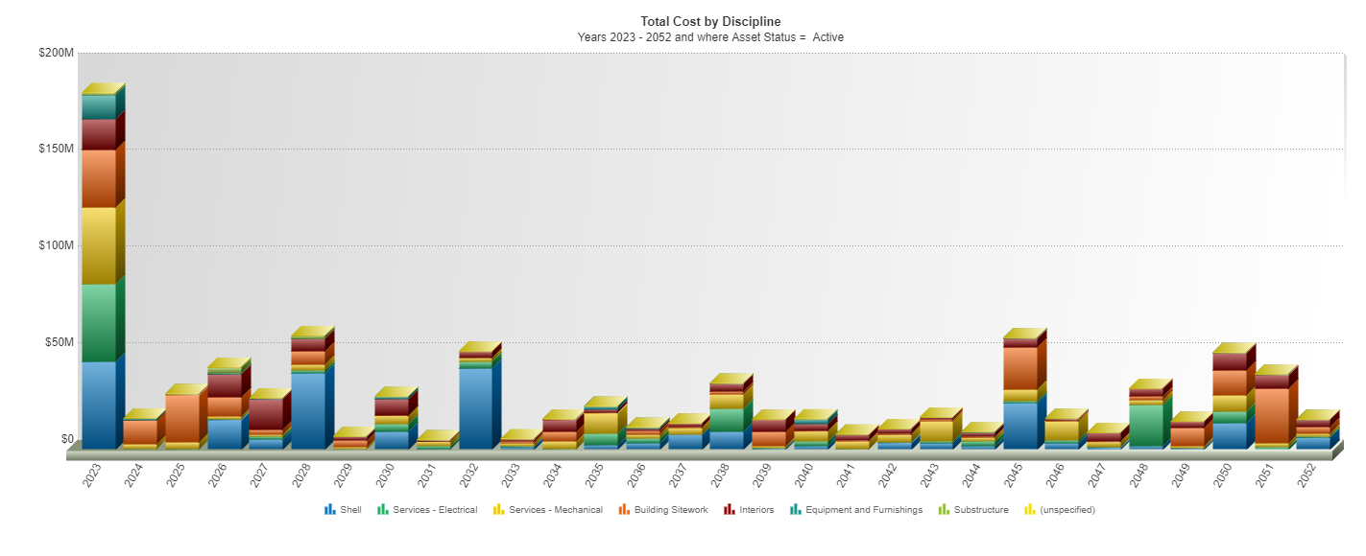
Capital Needs Profile
Insights
Displays the lifecycle forecast of each element within each asset rolled up for the portfolio
The deferred maintenance backlog is $184 Million (2023)
With the deferred maintenance backlog now quantified, it is recommended to address the backlog by order of Priority
DM Backlog: $184 Million
Life cycle forecasts have been established for the major building elements for each asset. This determines the capital renewal budget requirements over time.
Notes:
Report – Costs by Detail

Slide 14
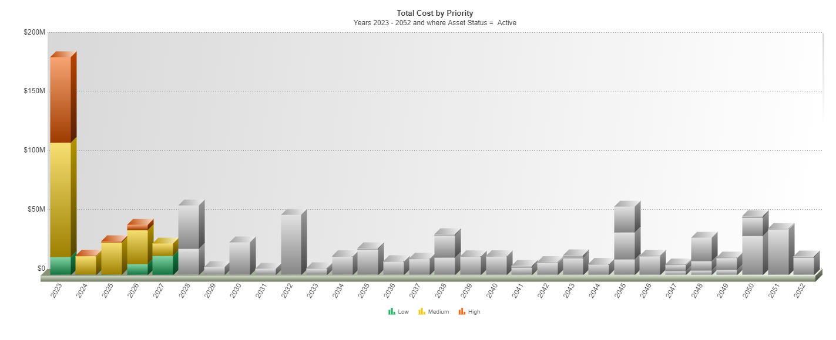

Capital Needs by Priority
Insights
In 2023, roughly $72.7M of the portfolio’s needs are categorized as High priorities
$72.7M represents roughly 39% of the portfolios deferred maintenance backlog
Each year, unaddressed capital needs are deferred impacting the Cumulative Total Liability
High Priorities (2023):
$72.7M Total Needs
Notes:
Report – Capital Needs by Priority

Slide 15
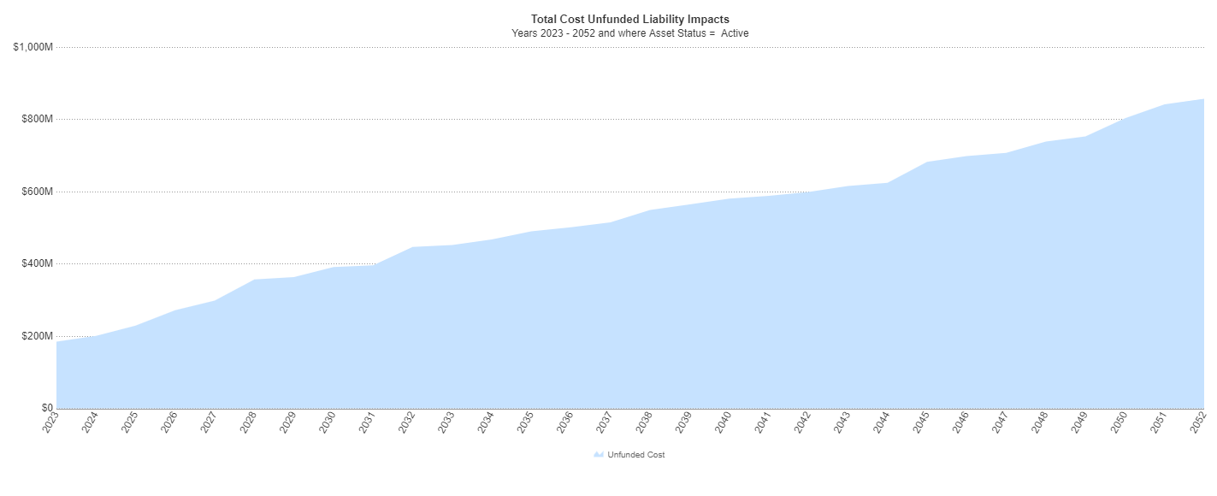

Projected Total Liability
Insights
Represented in current year dollars, the cumulative total liability is predicted to increase from $184M to $857M over the next 30-years
Over the next 10-years, the needs will increase by ~2.5x from $184M to $452M
Overlaying a budgeted capital plan can help decision makers understand their unfunded liability and prioritize the future capital investments requirements
$857M
$452M
$357M
$184M
The total liability represents the cumulative renewal needs of the portfolio based on the findings and results obtained from the life cycle renewal cost analysis.
Notes:
Report – Unfunded Liability (30 years)

Slide 16
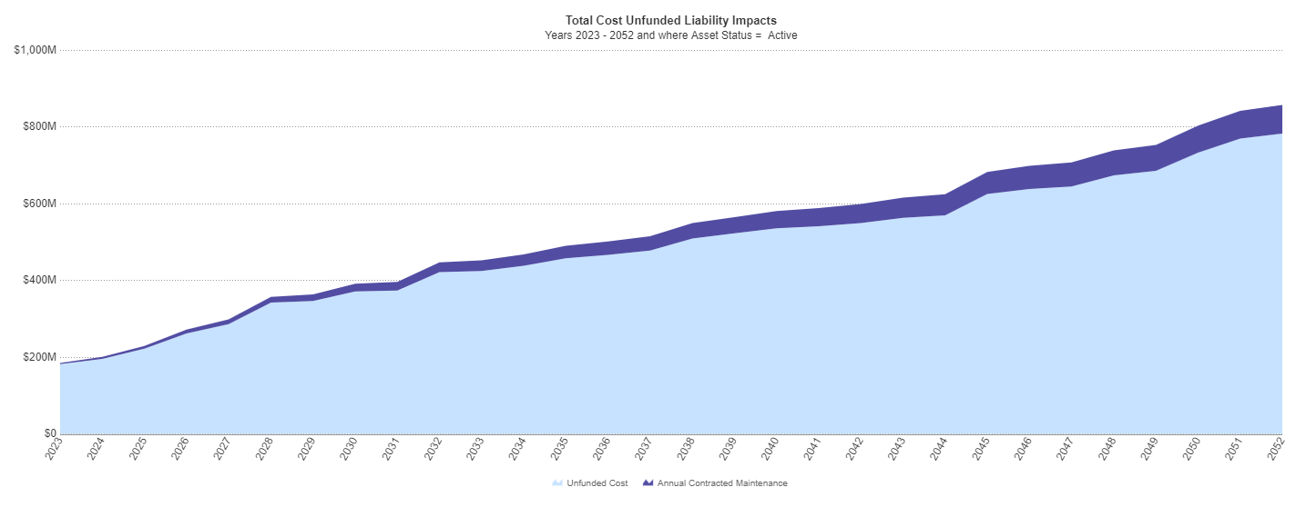
Projected Unfunded Liability
Insights
The chart represents the impact of planned capital renewal using the average annual funding stream of $2.5M per year
In this example, the total liability of $857M in 2052 is reduced to an unfunded liability of $782M but still suggests a funding gap exists
To quantify the funding appropriation needs of the portfolio, Ameresco recommends using the Facility Condition Index (FCI)
$857M
$782M
Annual Contracted Maintenance:
$2.5M per year
Reduced
Unfunded Liability
$184M
The projected unfunded liability represents the remaining cumulative capital needs with funding applied. In this case, the annual funding amount was an average of $2.5M/year.
Note: Industry standards suggest a 2% CRV (minimum) for capital renewal (APPA)
Notes:
Report – Unfunded Liability with Funding (30 years)

Slide 17

What is the Facility Condition Index (FCI)?
Industry standard to measure condition and performance of facilities and portfolios
FCI Calculation:
FCI Ranges:
$$FCI=\frac{Renewal Costs (Actions)}{Current Replacement Value (CRV)}$$
GOOD FCI (0% - 5%)
FAIR FCI (5% - 10%)
POOR FCI (10% - 30%)
CRITICAL FCI (> 30%)
Notes:
What is the Condition?
The Facility Condition Index is a key metric that allows you to see how your buildings are performing in both the short and long term.
The FCI takes the renewal and repair costs and measures them against the replacement cost and can be viewed at an individual building level but also at a portfolio level.

Slide 18
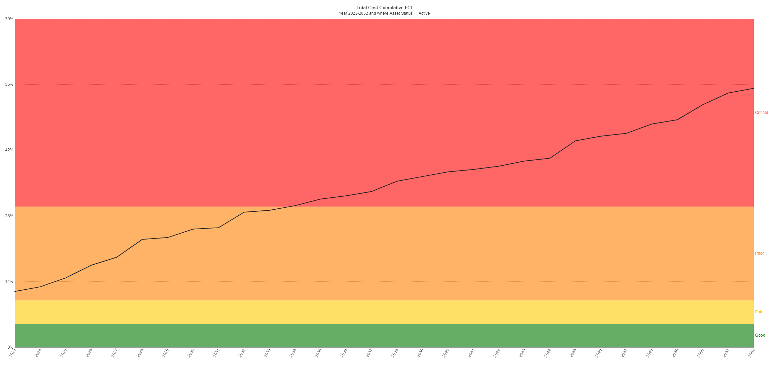
FCI Unfunded (30-Years)
Insights
The chart shows the risk of aging infrastructure; with growing levels of deferred maintenance backlog over time
The FCI of 11.9% places the portfolio into the “Poor” range
Unfunded, the FCI will accelerate to “Critical” (>30%) by 2034
FCI Critical by 2034
11.9% (“Poor”) in 2023
The projected facility condition index (FCI) displays the relative levels of risk of the portfolio over time, represented in percent risk (%)
Notes:
Report – FCI/CI (30 Years)

Slide 19
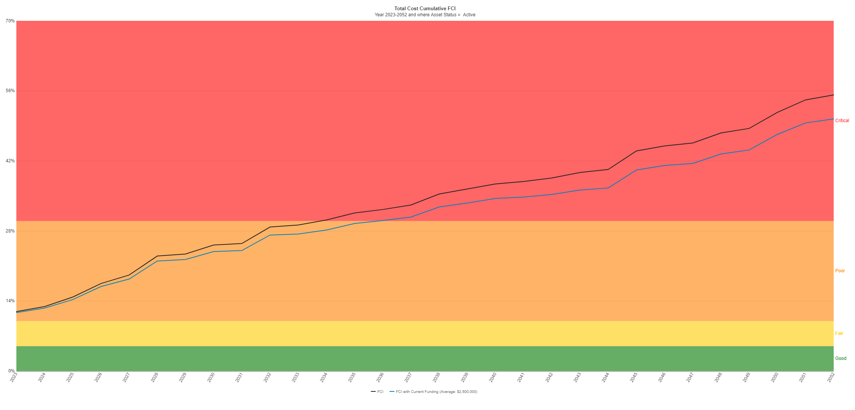
FCI Funded (30-Years)
Insights
With funding ($2.5M/yr), the blue line shows a shallower profile; delaying the migration to Critical by 2-years (2036)
From a funding appropriation standpoint, more funding is required to sustain the portfolio at an acceptable level of risk
Establishing an “Asset Sustainability Target” is a best practice for managing such risk
Life extension
Additional Funding Required
Overlaying and projecting the average annual capital funding of $2.5M/yr delays the migration of “Portfolio” FCI to Critical by several years.
Notes:
Report – FCI/CI with Funding (30 Years)
Additional funding will be required to sustain the portfolio at an acceptable level of risk.

Slide 20
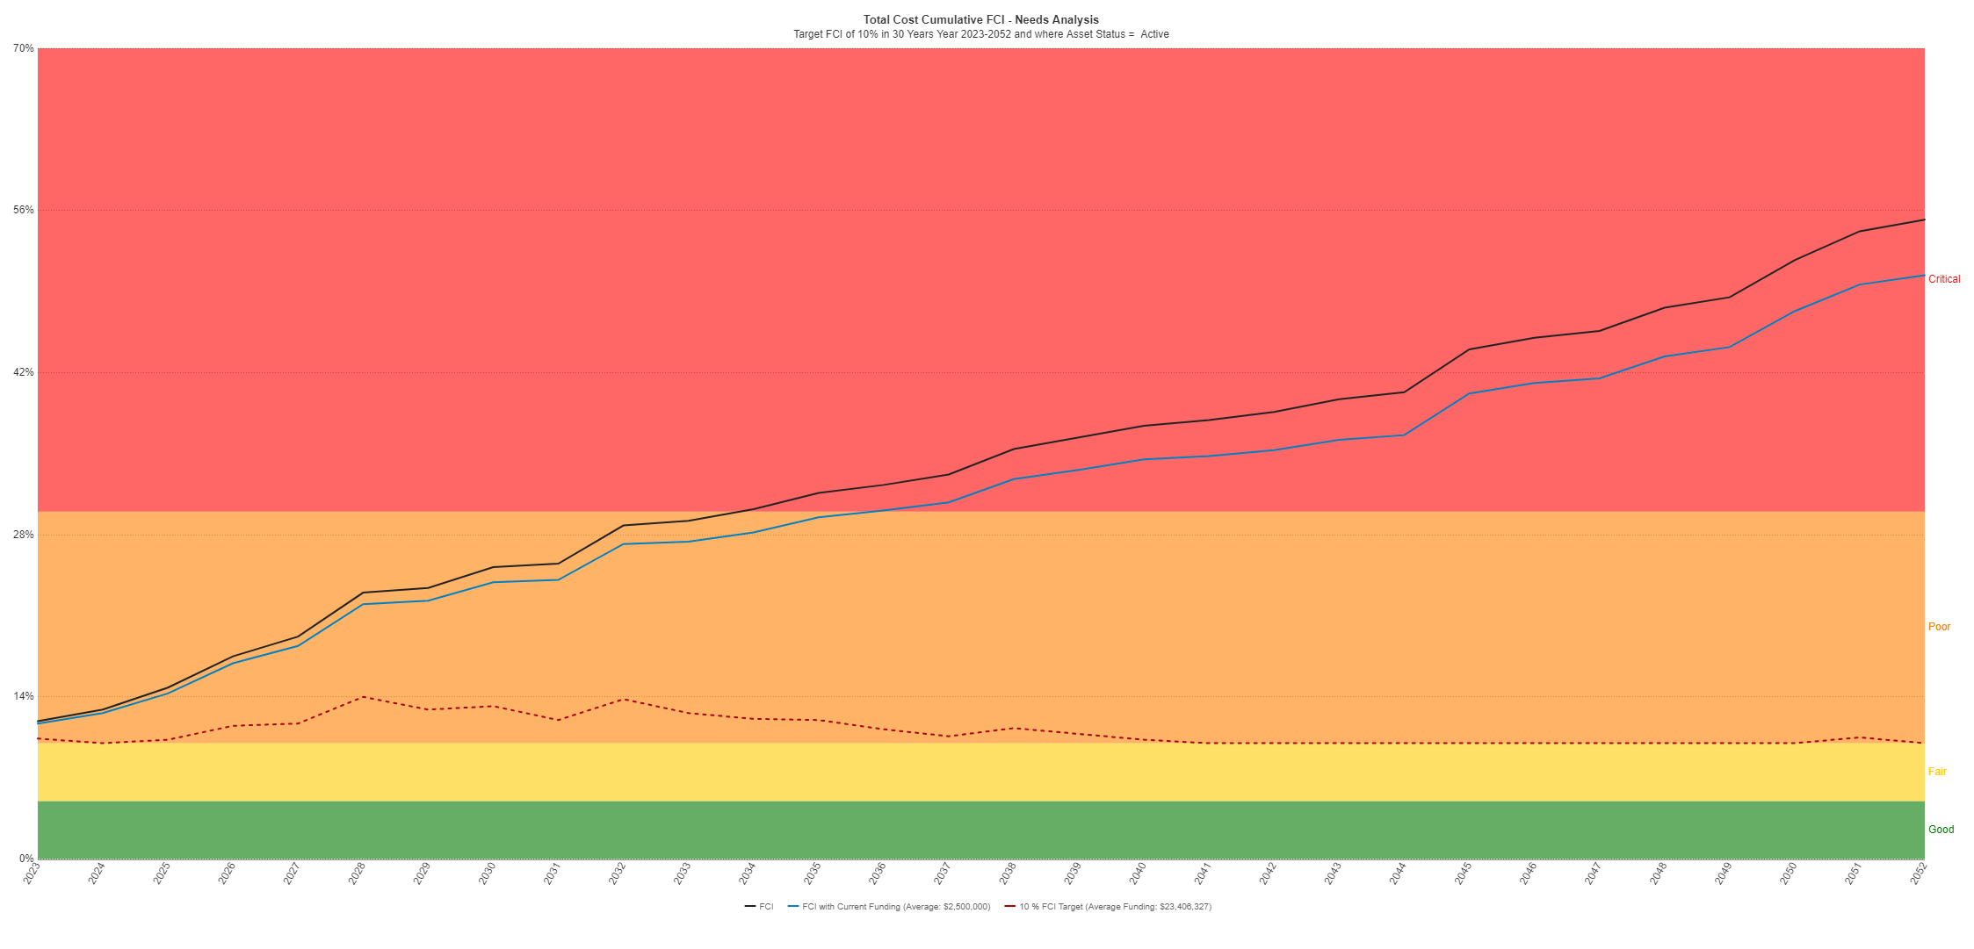
FCI with Asset Sustainability Target
Insights
The buildings will require $23.4M per year of capital funding to achieve an FCI of 10% by 2052; amounting to $702M over the period
Over 10-years (2033), the portfolio requires $29.2M per year or $292M to maintain asset sustainability
Understanding funding appropriation needs at the portfolio level helps decision makers prioritize assets and prepare data-defensible capital improvement plans
Requires $23.4M per year over the next 30-years
Asset Sustainability Target
The chart represents the amount of funding required to achieve an Asset Sustainability Target (10% FCI); showing both current levels of funding and the funding needed
Notes:
Report – FCI/CI with Funding and 10% FCI / AST Target (30 Years)

Slide 21
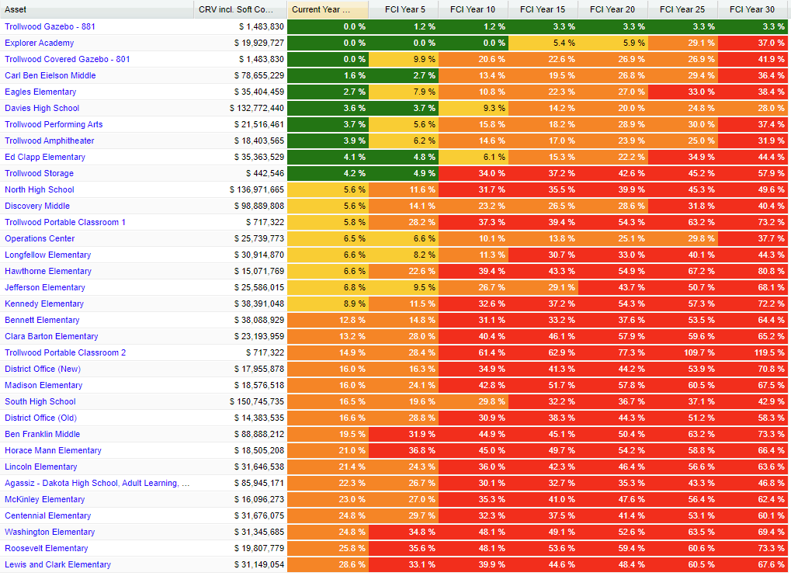
FCI Grid
Notes:
Industry standards – RS Means – consistent - standardized
All Buildings
All Systems
80/20 Rule???

Slide 22
Marc Retish
Senior Business Developer
Mitch Boatman
Project Manager &
FCA Program Lead
Any Questions?

