Slide 1


Fargo Public Schools
Educational Adequacy and Capacity Findings
October 10th, 2023

Slide 2


EDUCATIONAL ADEQUACY ASSESSMENTS
OVERVIEW
Process
Walked & assessed all buildings in July
    Measured for square footage
    Inventory of room number and space type
    Noted existence of required elements by category:
      Electrical – outlets, motion sensor lights
      FFE – storage casework, age-appropriate flexible seating
      Mechanical – kiln exhaust system
      Physical Attributes – flooring, access to natural light
      Plumbing – science lab sinks, on-suite restroom
      Safety & Security – fire horn system, secure vestibule
      Site – bus lane, parent drop off queue, acreage

Slide 3
EDUCATIONAL ADEQUACY ASSESSMENTS
OVERVIEW
Methodology
Standards by school type were developed based on discussions with FPS staff, and HPM best practices
    Number and size of spaces
    Elements within each space type
    Site level elements
A cost is assigned to all elements and space
The cost of the elements and space not present within the building is compared to the ideal target cost
This allows us to develop a score and deficiency cost for each building

Slide 4
EDUCATIONAL ADEQUACY ASSESSMENTS
OVERVIEW
Why ideal target cost and square footage?
Sq ft per student of based on grade level and capacity was used to calculate target square footage and replacement cost
  4 different elementary models (2, 3, 4, and 5 section capacity)
  1,000 student middle school model
  1,300 student high school
This helps determine a standard to compare each building to
Some buildings may have “missing” spaces compared to the capacity model (commons, art room, etc.)

Slide 5
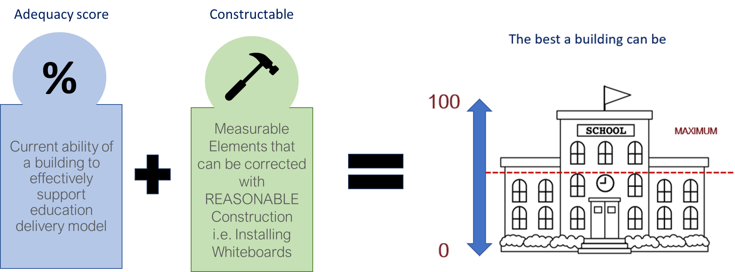
EDUCATIONAL ADEQUACY ASSESSMENTS
MAXIMUM SCORE
Schools Can Have a Maximum Possible Score NOT equal to 100
Only way to exceed maximum possible score is to either replace, add to, or alter the existing facility.

Slide 6
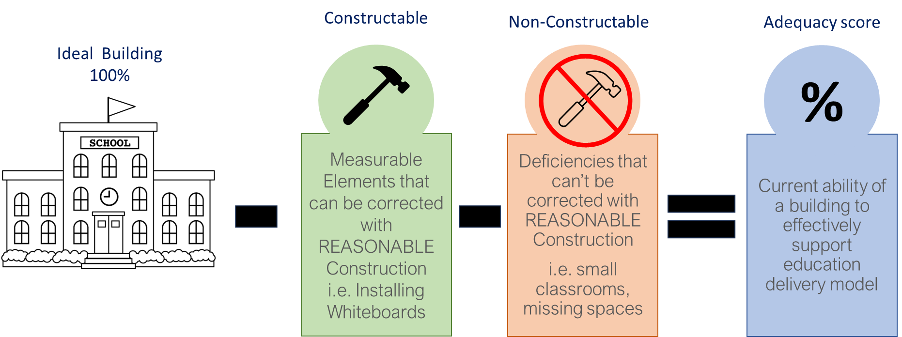
EDUCATIONAL ADEQUACY ASSESSMENTS
SCORING

Slide 7
EDUCATIONAL ADEQUACY ASSESSMENTS
Overall Score & Max Score – Elementary Schools

Slide 8
EDUCATIONAL ADEQUACY ASSESSMENTS
Overall Score & Max Score – Middle and High Schools

Slide 9
EDUCATIONAL ADEQUACY ASSESSMENTS
SUMMARY
Priority by Campus

Slide 10
EDUCATIONAL ADEQUACY ASSESSMENTS
SUMMARY
Deficiency by Program Area

Slide 11
Capacity Analysis

Slide 12
CAPACITY ANALYSIS
METHODOLOGY
Elementary
Operate on a homeroom model
  Specialty spaces such as art, music, gym don’t carry capacity
Section based capacity model (# of CR’s for each grade)
  Total classrooms minus recommended Art/Music and any Self-Contained SPED
  Allows for equitable program offerings at ES, based on size of building
  Remaining count divided by number of grades within the building to determine # of sections and capacity bearing classrooms
  May result in additional “flex” classrooms

Slide 13
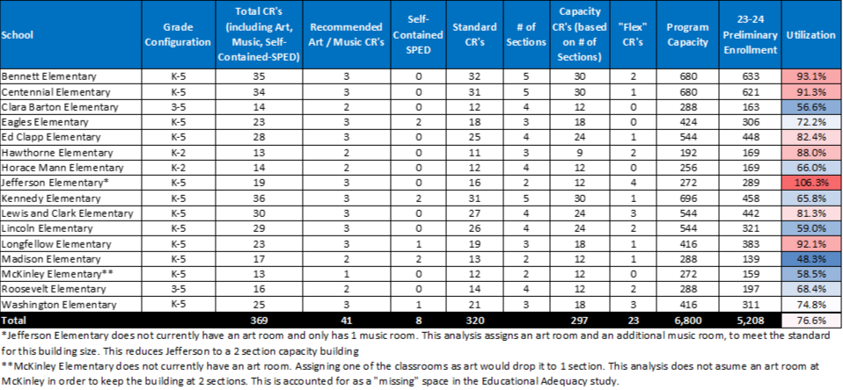
CAPACITY ANALYSIS
ELEMENTARY SCHOOLS

Slide 14
CAPACITY ANALYSIS
METHODOLOGY
Middle & High School
Function differently than ES – students move throughout the building
  Capacity is assigned to all teaching spaces
Scheduling factor is applied to account for course offerings, planning periods, lunch periods
  Middle – 62.5% factor (5 out of 8 periods)
  High – 75% factor (6 out of 8 periods)

Slide 15
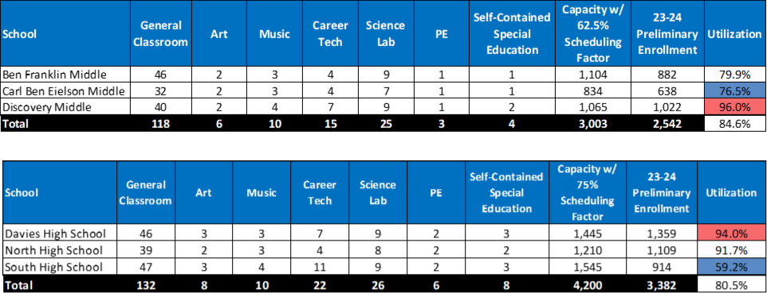
CAPACITY ANALYSIS
MIDDLE & HIGH SCHOOLS

Slide 16
Questions?

