Slide 1
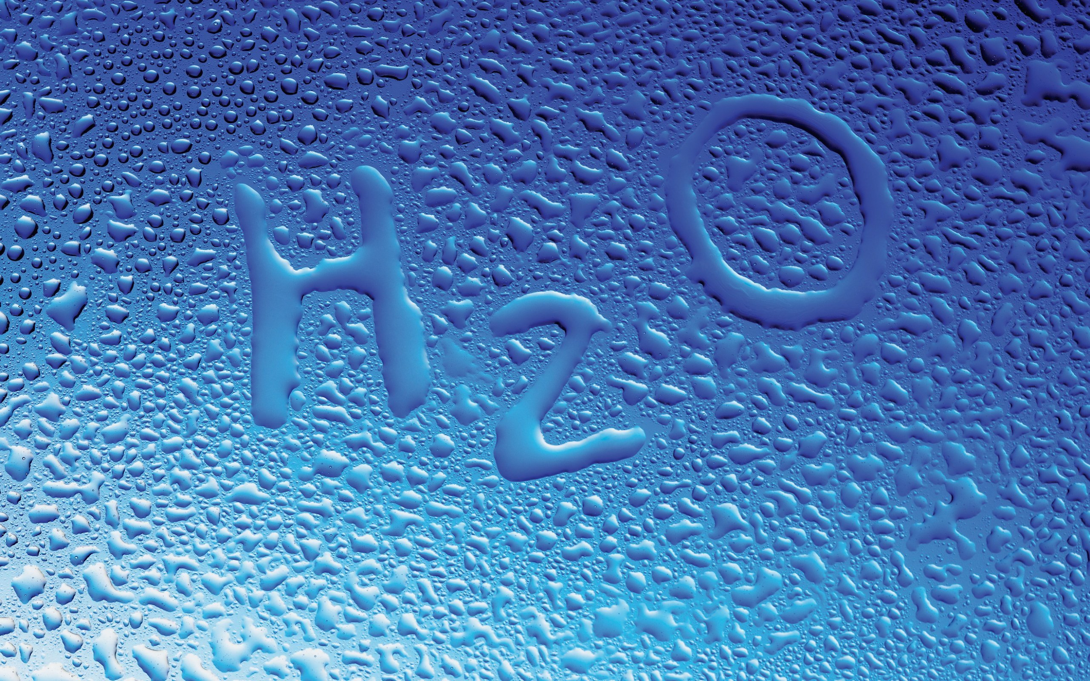
Notes:
Who’s learned in science class what H20 is?

Slide 2
WATER IS ESSENTIAL TO OUR EXISTENCE.

Slide 3
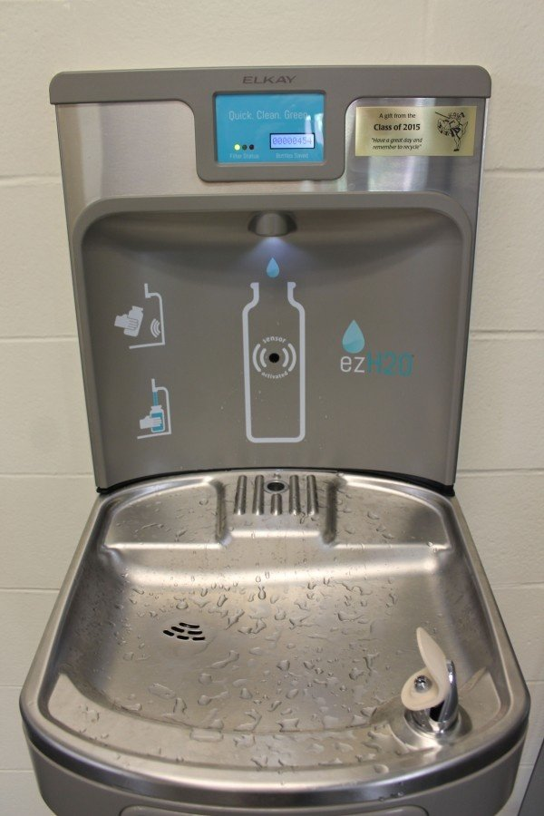

Slide 4
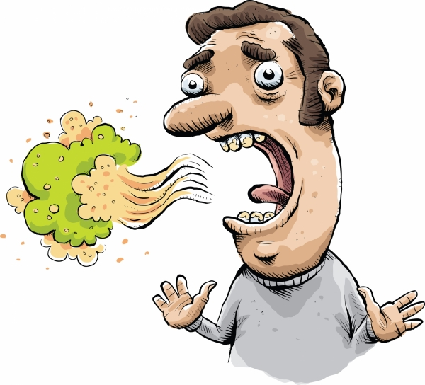
WHY IS WATER IMPORTANT?
Water helps beat bad breath.
Notes:
Drinking water keeps your mouth moist and washes away food particles and bacteria. It also dilutes the smelly compounds that oral bacteria create.
Source for the “Why Is Water Important” slides: http://healthyfutures.nea.org/s-e-w-what-10-benefits-of-drinking-water/

Slide 5
WHY IS WATER IMPORTANT?
Water promotes healthy skin.
Notes:
Water helps replenish skin tissues, moisturizes skin, and increases the elasticity in your skin. It can also plump skin up a bit, reducing signs of aging.

Slide 6
WHY IS WATER IMPORTANT?
Water improves your mood.
Notes:
Drinking water can improve your mood and ability to think. Even mild dehydration can have a negative impact on how you feel, so be sure to keep sipping water throughout the day.

Slide 7
WHY IS WATER IMPORTANT?
Water treats headaches & migraines.
Notes:
Headaches and migraines are often caused by dehydration. So, to get some relief, drink plenty of water.

Slide 8
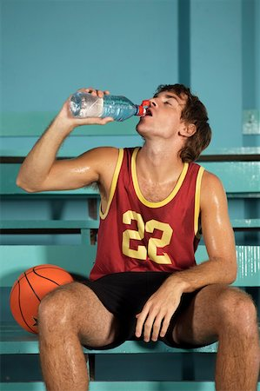
WHY IS WATER IMPORTANT?
Water flushes out toxins.
Notes:
Water is a detoxifier that helps to flush out toxins and get rid of waste primarily through sweat and urine.

Slide 9
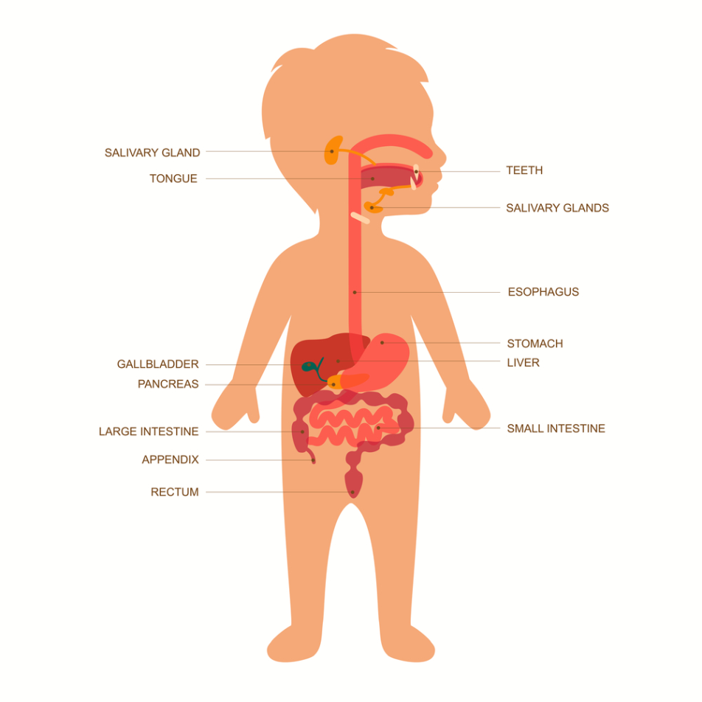
WHY IS WATER IMPORTANT?
Water helps with digestion.
Notes:
Drinking sufficient water boosts your metabolism and helps the body properly break down food.

Slide 10
WHY IS WATER IMPORTANT?
Water helps you to be less tired.
Notes:
Consumption of water makes the body function efficiently, while dehydration decreases alertness and concentration.

Slide 11
WHY IS WATER IMPORTANT?
Water regulates body temperature.
Notes:
Water’s ability to release heat from the body when sweat evaporates from the surface of the skin greatly helps maintain an even body temperature.

Slide 12
WHY IS WATER IMPORTANT?
Water keeps you alive!
How many days can you survive without having any water?

Slide 13
HOW MUCH SUGAR IS IN…
2 spoonfuls
b. 4 spoonfuls
c. 6 spoonfuls
d. 8 spoonfuls

Slide 14
HOW MUCH SUGAR IS IN…
10 spoonfuls
b. 12 spoonfuls
c. 14 spoonfuls
d. 16 spoonfuls

Slide 15
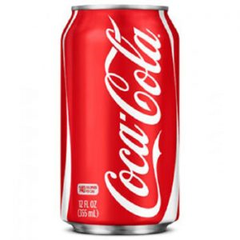
HOW MUCH SUGAR IS IN…
2 spoonfuls
b. 5 spoonfuls
c. 8 spoonfuls
d. 10 spoonfuls

Slide 16
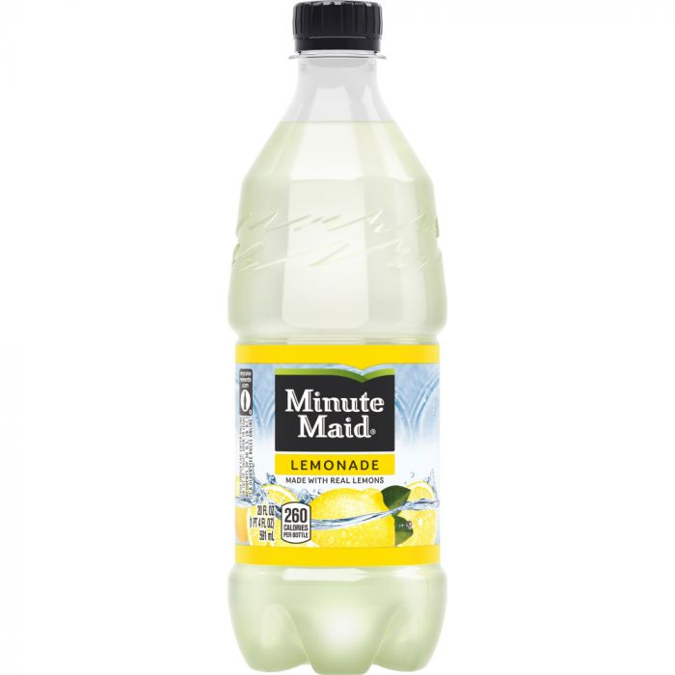
HOW MUCH SUGAR IS IN…
7 spoonfuls
b. 12 spoonfuls
c. 18 spoonfuls
d. 20 spoonfuls

Slide 17
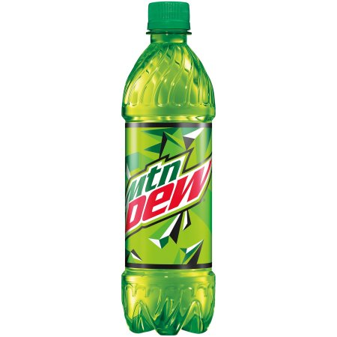
HOW MUCH SUGAR IS IN…
10 spoonfuls
b. 12 spoonfuls
c. 18 spoonfuls
d. 20 spoonfuls

Slide 18
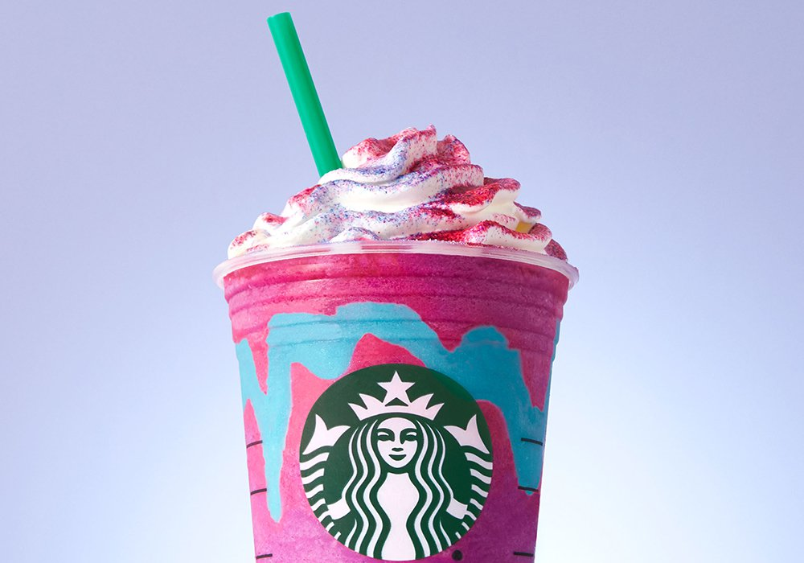
HOW MUCH SUGAR IS IN…
12 spoonfuls
b. 16 spoonfuls
c. 20 spoonfuls
d. 24 spoonfuls

Slide 19
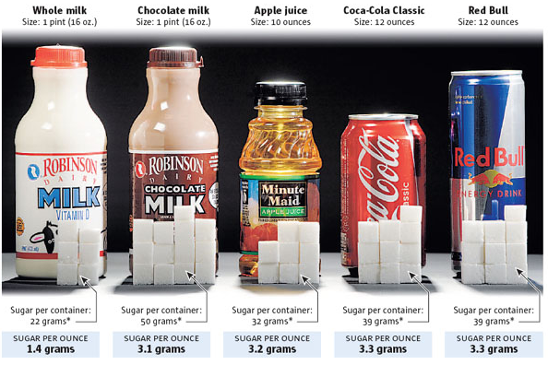
WHY IS WATER IMPORTANT?
Water has no sugar!
Watch Video:
https://www.youtube.com/watch?v=unZHay4w2uk
Notes:
Water has no preservatives or sugar!
Amount of sugar in popular drinks: https://www.nhlbi.nih.gov/health/educational/wecan/downloads/tip-sugar-in-drinks.pdf

Slide 20
TEENS & SUGAR
“American teens eat more added sugar than any other age group: The CDC has stated that 1/5 of a typical American adolescent's calorie intake comes from sugar – mostly from soda, energy drinks, and sports drinks.”

Slide 21
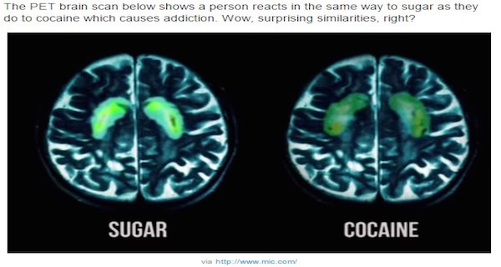
TOO MUCH SUGAR CAUSES
Obesity
Health Problems
Mood Disorders
Cavities
Reduced performance with your memory
Sugar is addictive and rewarding to the brain
Watch Video:
https://www.youtube.com/watch?v=JEA-G9m9S0Y&list=RDQMtq8760A8HDY&start_radio=1
Notes:
Increased sugar can lead to mood disorders such as depression and anxiety. “In recent years, scientists have linked sugar and sugar additives, as well as fast food and processed food, to depression, addictive behavior and anxiety. ” -https://health.usnews.com/health-care/for-better/articles/2018-10-24/how-sugar-and-poor-diet-affect-teen-mental-health
“Teenagers are particularly drawn to rewards, including eating tasty foods high in fat and sugar. The adolescent reward system is sensitive to stimulation and may be permanently altered by overactivation during this period.
Combined with the reduced ability to resist rewarding behaviours, it is not surprising that teenagers prefer to eat foods that are easy to obtain and immediately gratifying, even in the face of health advice to the contrary.” -https://theconversation.com/why-sugar-is-so-much-worse-for-teenagers-brains-67238
“In [a] study, rats preferred sugar water to cocaine, even when they were addicted to cocaine prior to the study. And the adolescent brain, which doesn't fully mature until the mid-20s, is particularly vulnerable to addictive stimuli.” -https://health.usnews.com/health-care/for-better/articles/2018-10-24/how-sugar-and-poor-diet-affect-teen-mental-health
Video talks about effects of sugar on the body. STOP VIDEO at 4:07

Slide 22
Plastic Water Bottles Are Not Environmentally Friendly

Slide 23
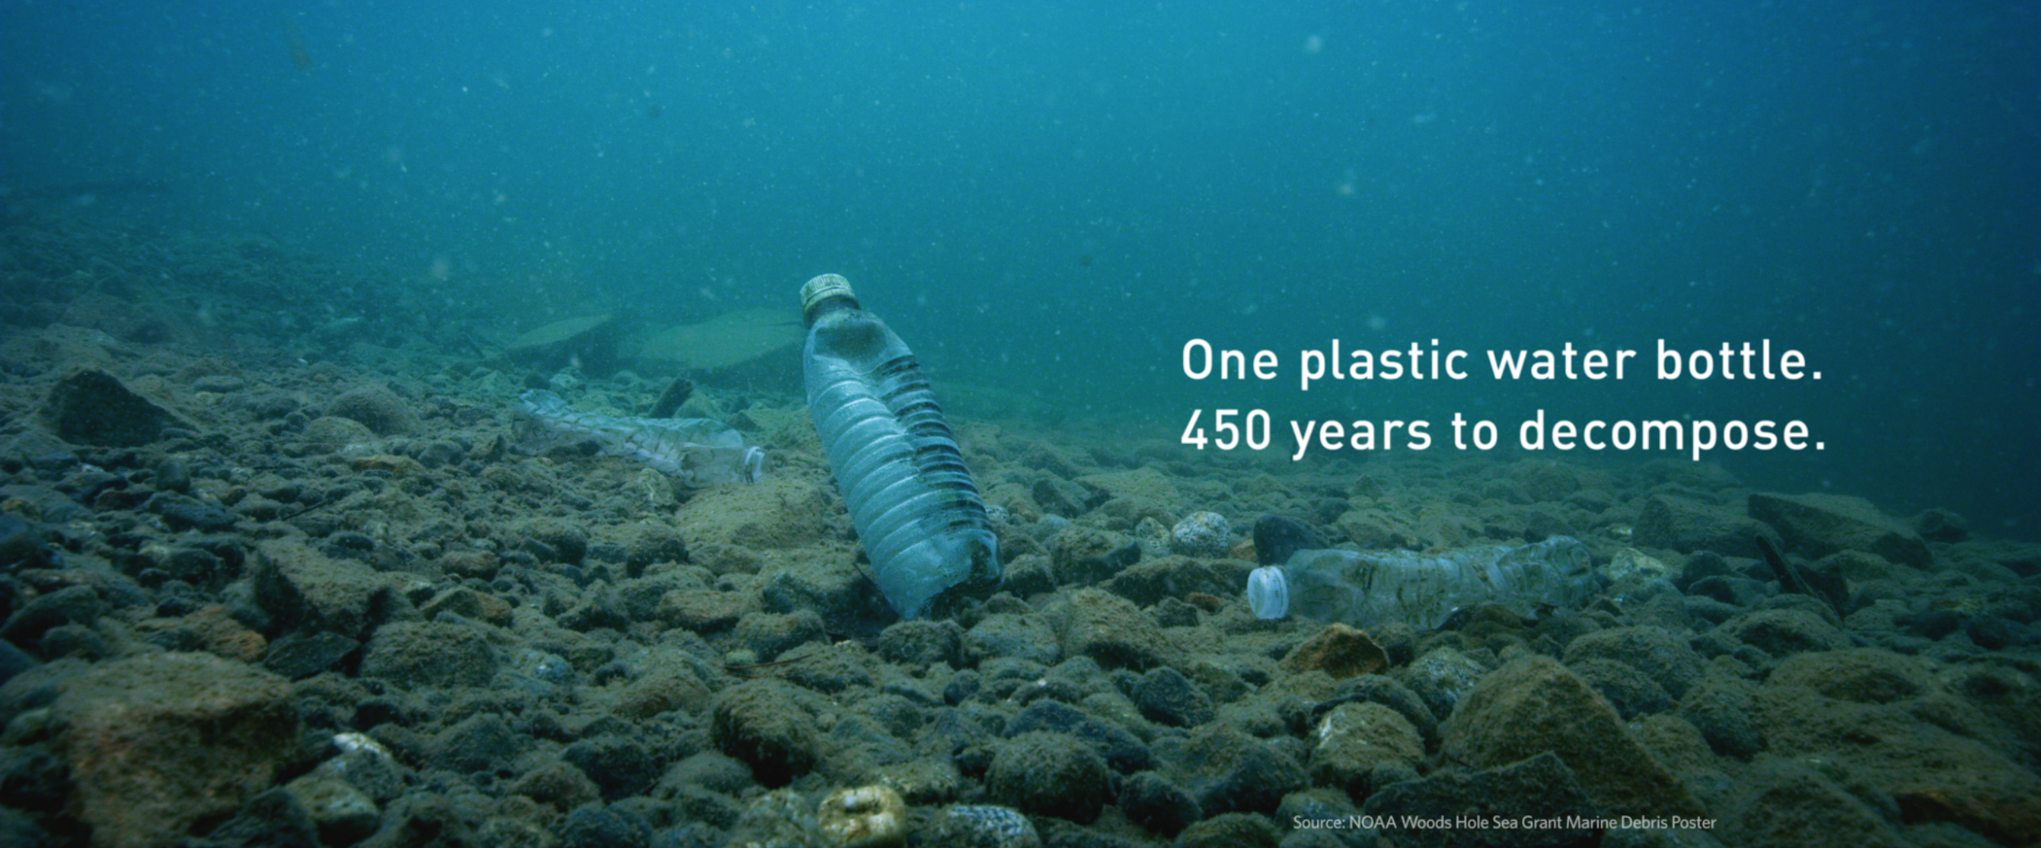
Notes:
The range if from 450 to 1000 years!

Slide 25
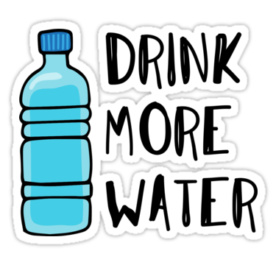
HOW MUCH WATER SHOULD I DRINK?
7 glasses for 9 to 12 year olds.
8-10 glasses for ages 13+
Notes:
If you sweat more, drink more!

