Slide 1
Welcome 8th Grade Families!
Class of 2028
February 22, 2024

Slide 2
Transitioning to High School
Class of 2028

Slide 3
Class
of
2028

Slide 4
Agenda
Thinking about 9th grade & beyond!
High School Options
Registration Process & Timelines
Counselor Classroom Visits
Challenger Application Process
Questions

Slide 5
BSD offers High Quality Options for High School

Slide 6
As you think about options for next year, ask yourself:
What careers might I be interested in exploring? What do I need to do or experience to reach my goals?
Do I love music, art, theatre, video productions?
Am I interested in advanced programs such as Cambridge, AP, or advanced math classes?
What are my interests and hobbies?
Do I want clubs, leadership, and social experiences to be a part of my High School Experience?
Do I like to play school sports, and need transportation to make it happen?

Slide 7
Dreams, Goals, and 4-Year Plans
In the next few days, students will begin to think about their high school goals.
Think about and discuss possible four-year plans for their HS Experiences.

Slide 8
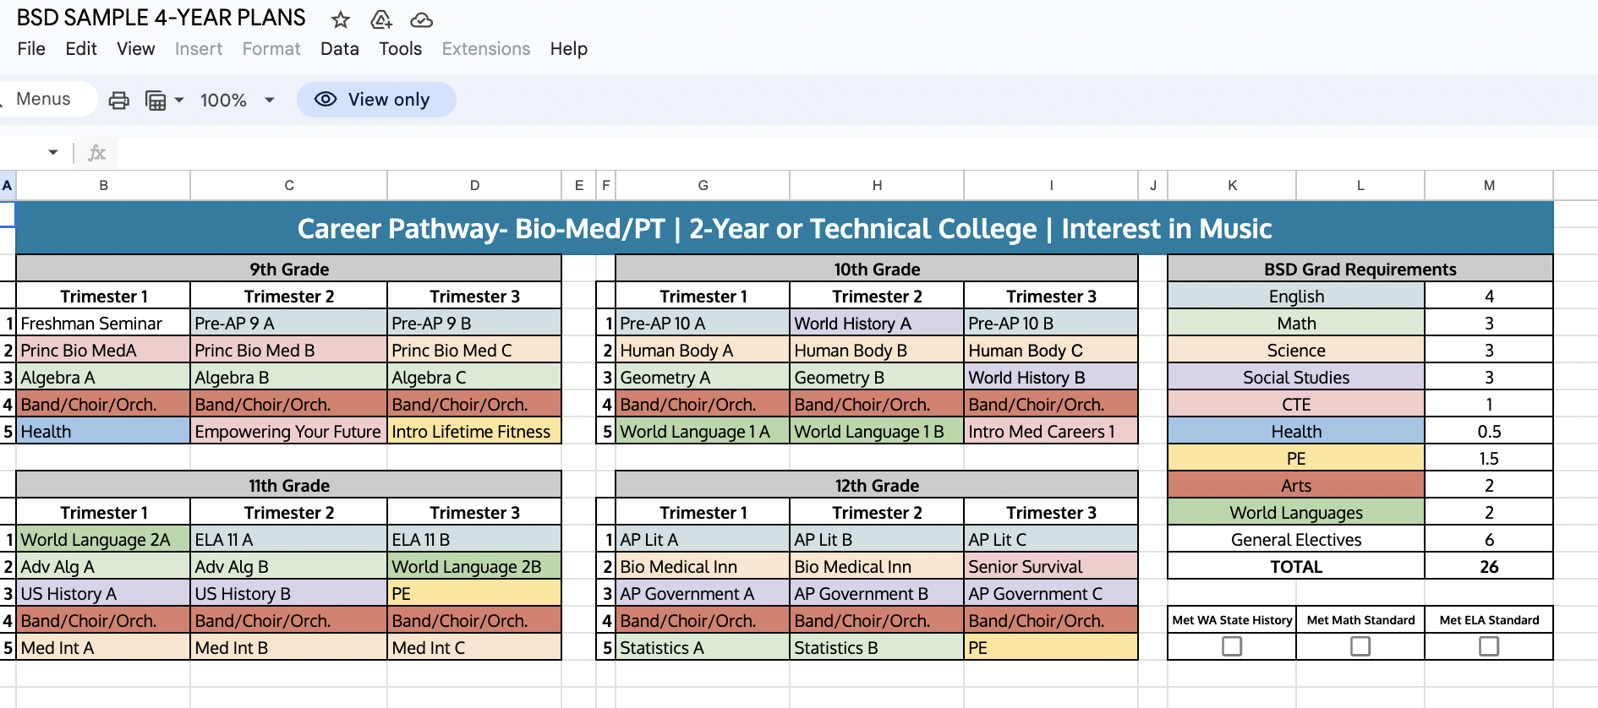
What are your goals? 4-year Plans

Slide 9
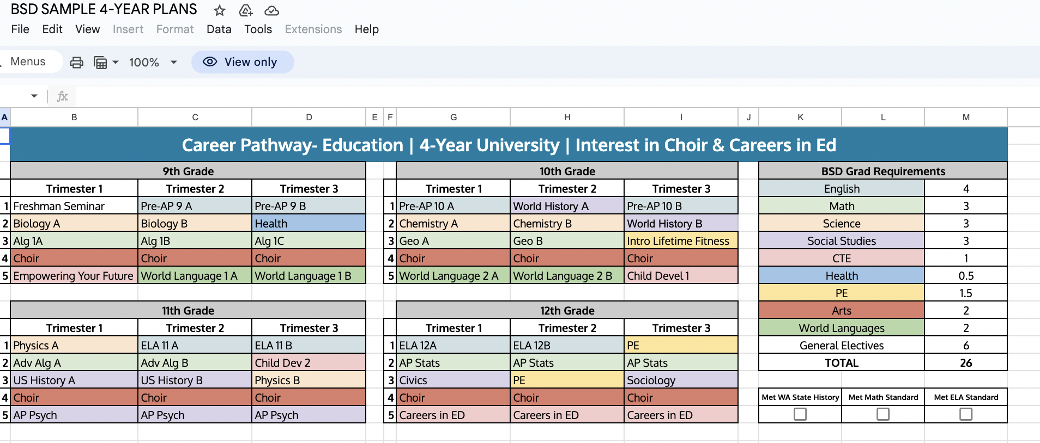

Slide 10
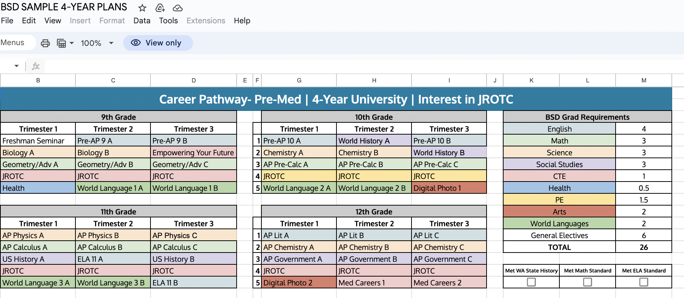

Slide 11
Comprehensive High School Options
Full day, 6 hour program
Social activities, clubs, sports
Earn up to 7.5 credits/year
Wide Variety of Courses in Course Catalog
Advanced program options:
Cambridge, AP
Pre-Calc, Calculus, Statistics
The Arts:
Music, Art, Theatre, Video, Yearbook
Career and Tech Electives
Robotics, Teaching, Sports Medicine, Medical Careers, Engineering

Slide 12
Bethel Virtual Academy
Online, virtual academy (ALE)
Follows ALE laws
Trimester schedule
Independent learners who like a flexible schedule
Advanced placement options
Apply online
Application window for fall enrollment opens: April 22, 2024
Take me to BVA Website!

Slide 13
Challenger HS Facts:
½ day schedule (3 hours)
Small class size/small campus
Grab and go lunches
Quarter system (vs. trimester)
6.0 credits a year (vs. 7.5 credits)
Limited electives
Limited special education supports and services (talk to your case-manager)
Option to apply to Skills Center or Running Start Junior/Senior years
No afterschool activities

Slide 14
Research, Research, Research!
BSD Course Catalog
For High School Registration
(click me)
Investigate all of your options
Visit the other high schools
Develop your 4-year plan
Review the BSD course catalog
Consider all your course options and interest areas
Talk to your Challenger advisor

Slide 15
Is Challenger a Good Fit for Me?
Ask yourself the following questions:
Am I working at or near grade level? – Challenger does not offer after-school help like at the larger high schools.
Will I be able to keep up with quicker work pace of the quarter? – One day at Challenger is like 2 days at a comprehensive high school.
Do I already have 80% or above attendance? – Missing school has a big impact on student learning and you can be unsat for attendance.
Am I mature enough to be occupied and busy for the ½ day when I am at home? – You will not be able to stay on campus all day

Slide 16
When are the Sessions for CHS?
AM Session: 7:55am to 10:55am (3 hours)
PM Session: 11:25am to 2:25pm ( 3 hours)

Slide 17
What is looked at in the application process?
9th Grade: Thirty seats available.
Applications are screened for:
A complete and descriptive student statement demonstrating:
A desire to attend and engage in school
Explaining why CHS is a good fit for them and why they are a good fit for CHS.
Discipline: Minor to no discipline.
Grades and Attendance
Student interest and course availability (advanced programs not available)
Program ability to support a student’s IEP (individualized education plan)

Slide 18
How many classes do students take at Challenger HS?
4 classes at a time (ELA & math is all year, all other classes are semester)
ELA & math are .25 credit each quarter and all other classes are .5 each quarter
Advisory time is 30 minutes on Mondays & Fridays (typically)

Slide 19
Is there District Transportation?
Yes, the students session will be determined by their area of residence
GKHS - 99% are AM session only
SLHS - 99% are PM session only
BHS - Split between AM & PM - Some student will be in the “flex area”

Slide 20
Can Students take a Class at their Neighborhood HS?
Yes, with these stipulations:
Only one class at neighboring school
Must not be offered at CHS
Must fit with student’s CHS schedule
Must provide own transportation to and from neighborhood school (self-transport)
Must complete Dual Enrollment process (both schools sign Dual Enrollment form)
Common classes include Music classes, JROTC, World Language other than Spanish

Slide 21
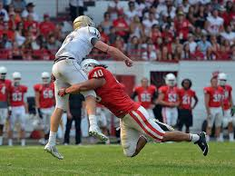
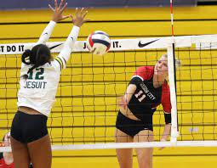
Can CHS Students Play Sports, Participate in Clubs, Attend Dances?
Yes, CHS students may participate in both sports and clubs at their neighborhood school (requires self-transport for AM student or various situations)
CHS Students may attend dances and events at other schools if invited by an enrolled student and approved as a guest by their admin. All schools require a guest pass for dances.

Slide 22
How do New Students know what to expect?
All new High School students attend a “New Student Orientation” one week prior to the first day of the new quarter.
One hour session
Parent/Guardian is required to attend
Review ALE (Alternative Learning) law & monthly progress reporting
Review Challenger daily schedule, graduation requirements, expectations, etc.

Slide 23
Registration Timeline
Registration at the comprehensive high schools is happening in March. Reach out to counselors now.
Find out about special program deadlines (Cambridge, AP, music, etc.)
Email krunge@bethelsd.org if you know you are planning on attending your home high school.
Challenger Application Window: April 22 - May 20, 2024.
Applications will be screened last week of May.
Families will be notified of application status by email within the first week of June.
If approved, families must accept offer of enrollment within 1 week of notification.
Challenger will work with the other high schools for smooth transition between schools

Slide 24
Challenger Contact Info
Julie Shultz-Bartlett (Principal) - jshultzbar@bethelsd.org 253-800-6889
Kara Runge (Assistant Principal) - krunge@bethelsd.org 253-800-6888
Kim Nelson (Principal’s Secretary/Applications) - kknelson@bethelsd.org 253-800-6891
Alison Von Stein (Academic Counselor) - avonstein@bethelsd.org 253-800-6808
Lauren Riley (School Social Worker) - lariley@bethelsd.org 253-800-6871
Christney Kpodo (Family Resource Coordinator) - ckpodo@bethelsd.org 253-800-6825

Slide 25
Questions?

Slide 26
How many credits can you earn at Challenger HS?
6.0 credits in a standard year (yes, less than the comprehensive high schools)
7.0 credits in 11th and 12th grade is ELA SBA is “Met” in 10th grade
10.5 credits in 11th and 12th grade if attending both CHS & PCSC (6.0 at CHS & 4.5 at Skills Center in opposite session)

Slide 27
WAIT WHAT?….Challenger is on Quarters & not Trimesters?
CHS has four quarters a year and there are four intake windows (September, November, February & April)
Applications are “due” approximately three weeks prior to the start of a new quarter

Slide 28
Who is the Contact for the Middle School Program?
Challenger now has a middle school program (7th & 8th grade only)
Approx 30 students in each grade level
Daily schedule on next slide: 7:55am to 1:20pm
Follows Quarter System (not on Trimesters)
Intake timelines are the same as high school
Contact: Kara Runge (Assistant Principal) - krunge@bethelsd.org 253-800-6888

Slide 29
