Slide 1
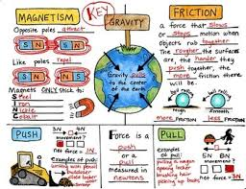
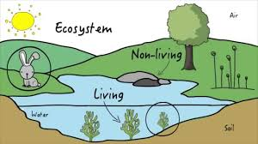
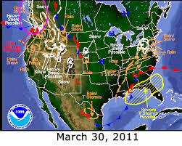
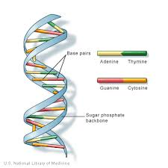
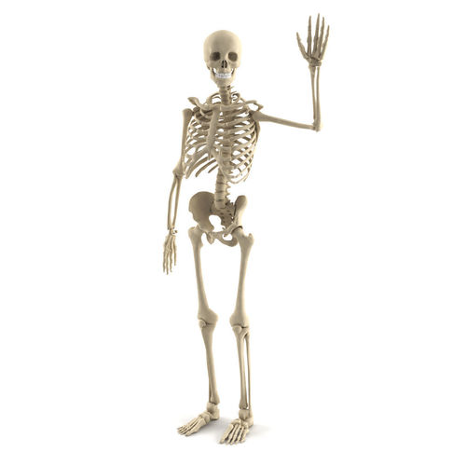
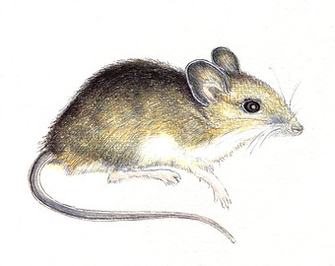
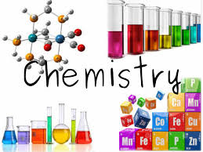
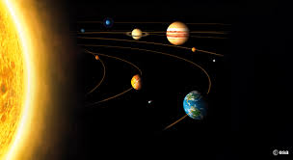
Science Course Selections
WGHS Science Department

Slide 2
Careers In Science
Medical field (nursing, medical office work, Medical technician)-
Need a good work ethic and should take anatomy, microbiology, genetics
Physician or Medical Researcher
Should take Chemistry A, Physics A and any of the Advanced courses that interest you
Engineering- need strong math and science skills, should include at least pre-calculus, Chemistry A and Physics A. AP Physics/AP Chem highly recommended
Specific field like Environmental Science or Forensics have specific courses required (talk to those teachers)

Slide 3
Freshmen
Both Biology courses (Biology and Biology A) are one credit and one year courses. Both courses cover the same concepts, but Biology A moves at a much faster pace and covering topics at a greater depth.

Slide 4
Sophomores
Both Chemistry courses are 1 year/1 credit and cover the basic concepts of chemistry
Conceptual Chemistry is for those students who prefer
Slower paced
More general aspects of chemistry
Low emphasis on math
Emphasize the practical applications of chemistry and not the science needed for a college course in chemistry
Chemistry A is
More rigorous
Faster paced
More detailed/more homework
Heavily emphasizes math
Higher level of critical thinking
Emphasizes the concepts needed for a college course in chemistry

Slide 5
Juniors
Physics Choices.
Conceptual Physics…….
Slower pacing
More teacher supports in class
Basic algebra skills (solving for variables, exponents)
Basic ideas of physics--not a preparation for college courses or upper level physics
Physics A ….
Faster/more independent work
Higher level math and trigonometry concepts used.
More rigorous
AP Physics 1 …..
Higher level math and trigonometry
More rigorous
Can take the AP Physics 1 test at the end of the year
Equivalent to a 1st semester algebra based college course

Slide 6
Juniors or Seniors
Advanced Biology courses:
Anatomy (1 Sem, 0.5 credits - Honors course)
Anatomy and Physiology is the study of the structure and function of the systems in the body. In this course, we cover an overview of anatomical terminology and the types of tissues found in the body in addition to the 11 body systems. This class completes dissections and a field trip to a cadaver lab as part of the course.
Animal Behavior (1 Sem, 0.5 credits, Honors grade can be requested for this course)
Animal behavior is very important in our lives because we depend on animals in many ways. In this course, we will use methods of animal behaviorist and a variety of other activities to try to understand why animals do what they do. Topics covered include: behavioral genetics, nervous/endocrine system, communication, aggression, reproduction and learning.

Slide 7
Juniors or Seniors Continued
AP/ACC Environmental Science….2 semesters- 1 credit honors
Interdisciplinary science-biology, geology, ecology, economics, chemistry, health, and politics will all be combined
Analytic thinking skills
Independent learner-fast paced
Can be taken for SLU lab credit (4 college hours) or AP test
Summer work and field trips are required
Microbiology….
Focus on the characteristics and uses of fungi, protists, bacteria and viruses, as well as learning about disease caused by these organisms. Basic concepts and lab techniques used in college biology courses are taught. Discuss antibiotic resistance, immune system functions, and human microbiome.
Genetics...
More in depth look at DNA replication, mechanics of protein synthesis, and causes and occurrence of genetic mutations. Advanced genetic inheritance traits and patterns are taught and analyzed. Discuss cancer, stem cells, gene therapy, and epigenetics.

Slide 8
Juniors or Seniors Continued
Other Advanced Science courses
Astronomy-1 semester (0.5 credit)
Exploring the Night Sky and its features
Discussing the history of astronomy (how we know what we know)
Exploring the previous and current models of our universe
Cosmology (theories of the origins of the universe)
Meteorology…1 semester 0.5 credit
Explore the mechanisms driving weather in the world and the impact of the weather on humans
Performance based assessments and labs
Introduction to Oceanography-1 semester 0.5 credit (honors weighted)
Explore the origins, mechanics, and life of the oceans
Can be taken for dual credit through SLU 1818 program
Critical thinking, chemistry and biology prior knowledge helpful

Slide 9
Juniors and Seniors Continued
AP Chemistry:
The Advanced Placement Chemistry course is designed to be the equivalent of the general Chemistry course usually taken during the first college year. For some college freshmen, this course will allow them to take second-year work in the chemistry sequence (as a freshman); or to register for other college coursework in which Chemistry is a prerequisite. For others, the AP Chemistry course may fulfill the laboratory science requirement for most majors thus freeing time for other classes.
Topics include structure of matter, kinetic theory of gases, chemical equilibrium, chemical kinetics, and the basic concepts of thermodynamics.
Recommendations:
Grade of A in Chem A
Grade of B or higher in Algebra II

Slide 10
Juniors and Seniors Continued
Forensic Science (1 sem , 0.5 credits)
Covers the science concepts used in the average Crime Laboratory: Crime scene processing, fingerprints, trace evidence, drugs, & DNA using a college text & tests and requiring critical thinking to explain answers.
Advanced Forensic Science ACC (1 sem 0.5 credits (weighted course))
Dual enrollment course for college credit through SLU 1818. Must be able to use deductive reasoning and critical thinking to reason through.
Advanced Forensic Science Research (1 or 2 semesters 0.5 or 1 credit) Requires instructor approval. Independent study forensic science. Requires participation in Forensic Shoe Field trip, editing data from the the field trip and independently research two topics not covered in the other two courses.

Slide 11
Seniors
For seniors who have taken AP Physics 1
AP Physics 2
Need to have taken AP Physics 1 1st
Can take the AP Physics 2 test at the end of the year
Equivalent to a 2nd semester algebra based college course
ANY SENIOR with instructor approval
Independent Study Science- 1 to 2 sem 0.5-1.0 credits
The choice of topics is limited to those that are not offered as a course by the WGHS science department. We have had students research geology, history of science, aviation, optics, AP Biology, and other topics. You must be able to describe the research you intend to do and the assignments you will complete with a timeline for completion to a teacher who agrees to sponsor this course for you.

