Slide 1
Class of 2023

Slide 2
Congratulations…
Kevyn Adams………………………...Class of 1992
Elizabeth Dunne…………Class of 1973/Coach
Deb Gresens Gallagher………...Class of 1982
John Lally……………………..……...Class of 1977
Norm Miosi…….….……..…………..Class of 1977
Joe Rotundo……………………………………...Coach

Slide 3
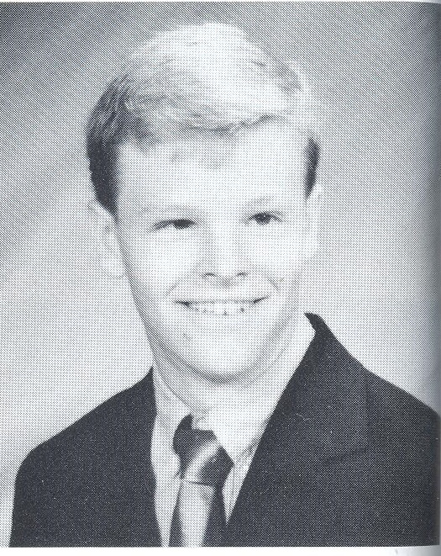
Varsity Baseball – 2 yrs.
Most Valuable Player
Voted Best Batter
1st Team ECIC All-star
Played Hockey in WNY
Miami (OH) HOF
NHL for 11 seasons
Stanley Cup Champ ‘06
GM Buffalo Sabres
Kevyn Adams

Slide 4
Varsity Baseball

Slide 5
Varsity Baseball

Slide 6
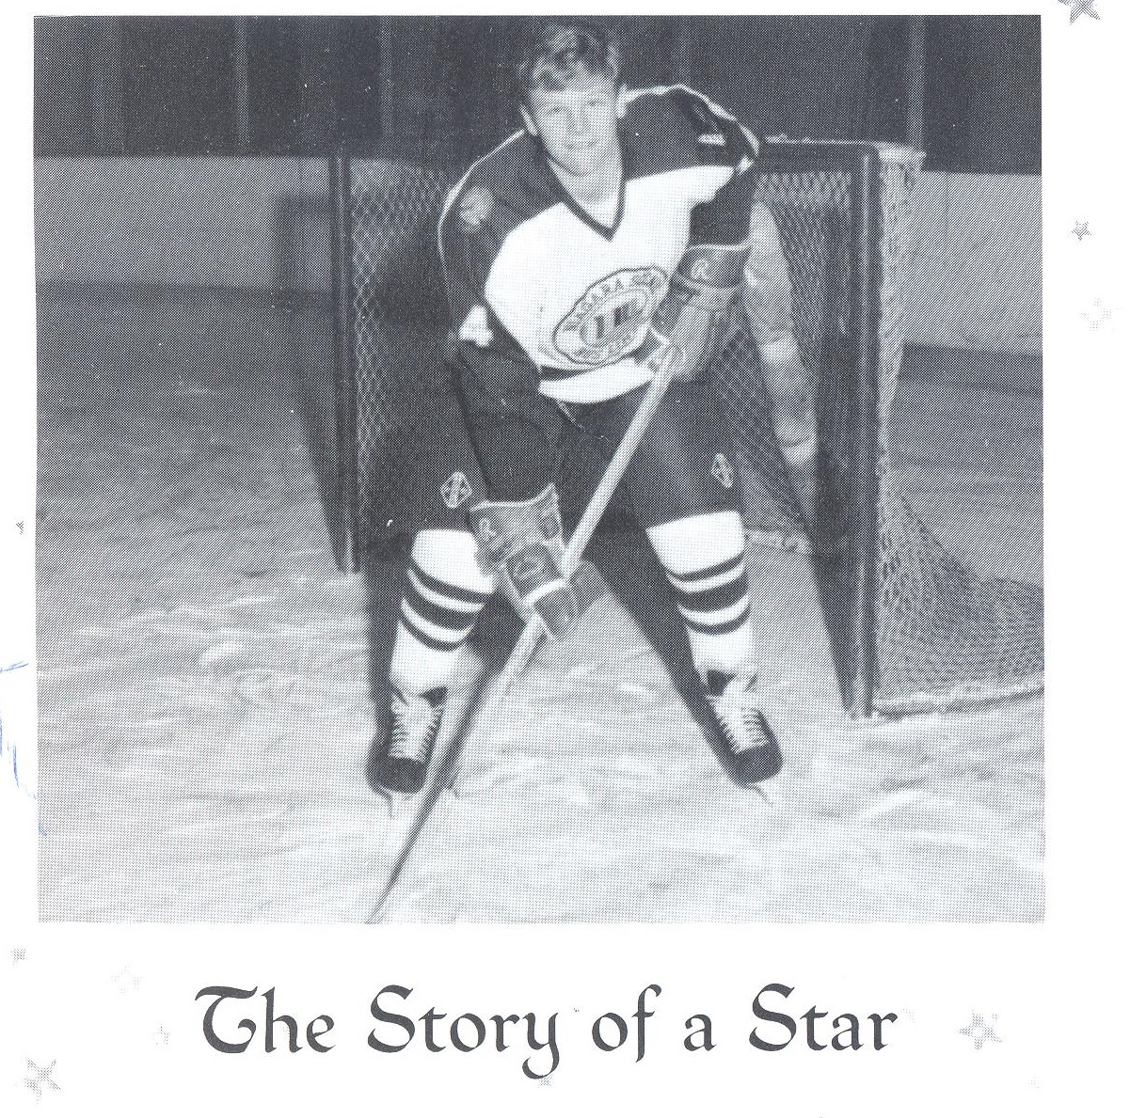

Slide 7
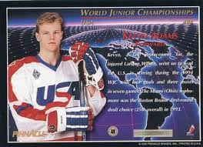
World Junior Championship

Slide 8
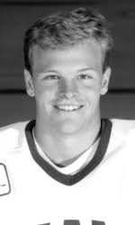
Kevyn Adams
Miami (OH)
Hockey
Hall of Fame

Slide 9
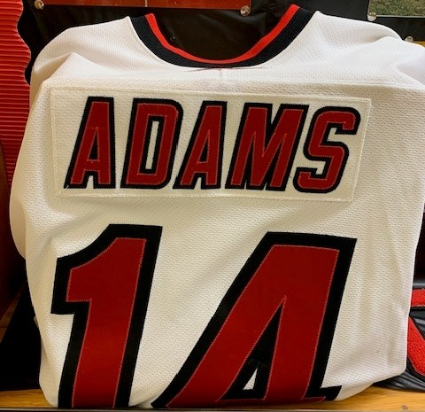
Kevyn Adams
NHL
Carolina Hurricanes

Slide 10
Kevyn Adams
NHL
Stanley Cup Champion 2006

Slide 11
Kevyn Adams
NHL
Columbus Blue Jackets

Slide 12
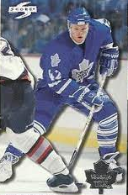
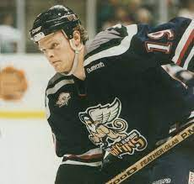
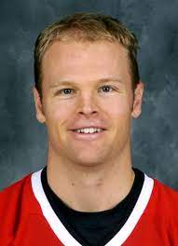
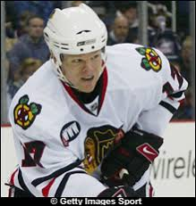
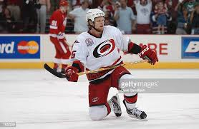
NHL Career

Slide 13
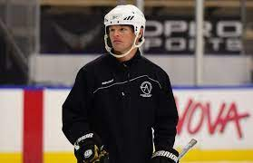
Buffalo Jr. Sabres

Slide 14
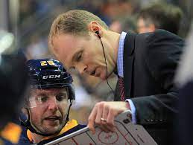
Buffalo Sabres
Assistant Coach
’11 – ’13

Slide 15
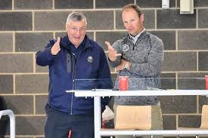
Kevyn and Owner Terry Pegula

Slide 16
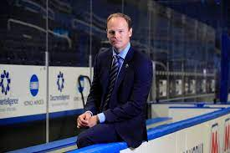
Kevyn Adams
NHL GM
Buffalo Sabres

Slide 17
Congratulations Kevyn

Slide 18
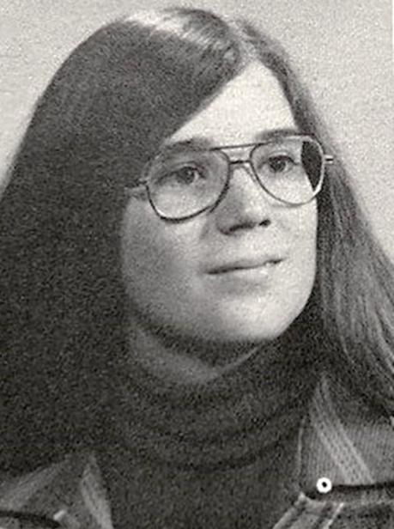
Varsity Volleyball
Varsity Basketball
Varsity Swimming
Varsity Softball
Varsity Track and Field
Female Athlete of the Year 1973
Elizabeth Dunne

Slide 19
40+ years
Teacher
Coach
Varsity Swimming
Varsity Volleyball
Numerous Modified Sports
Elizabeth Dunne

Slide 20
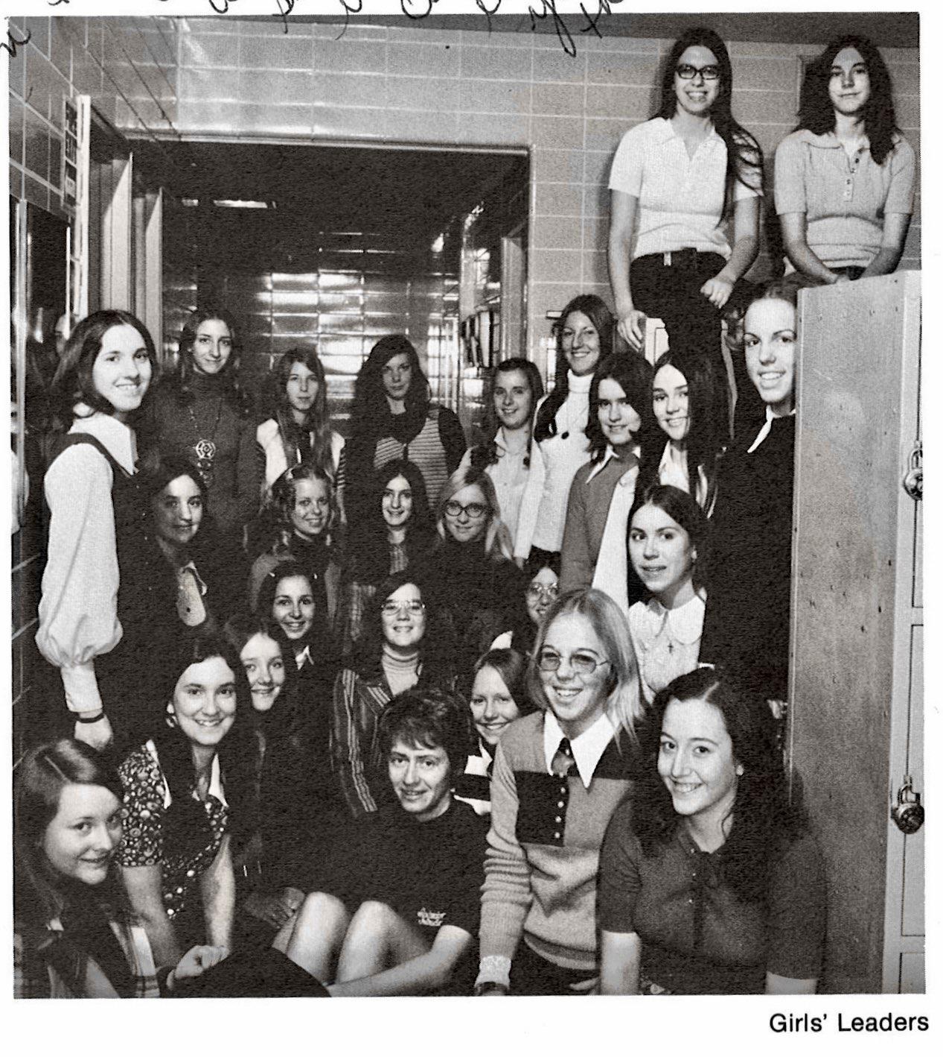
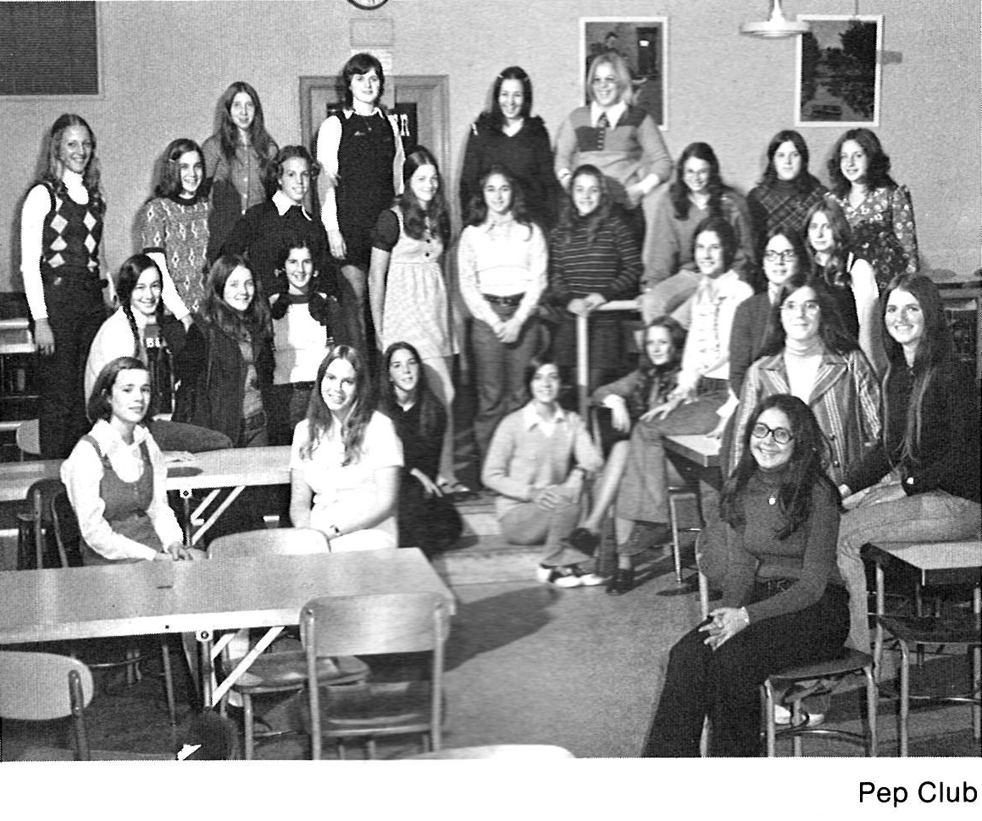

Slide 21
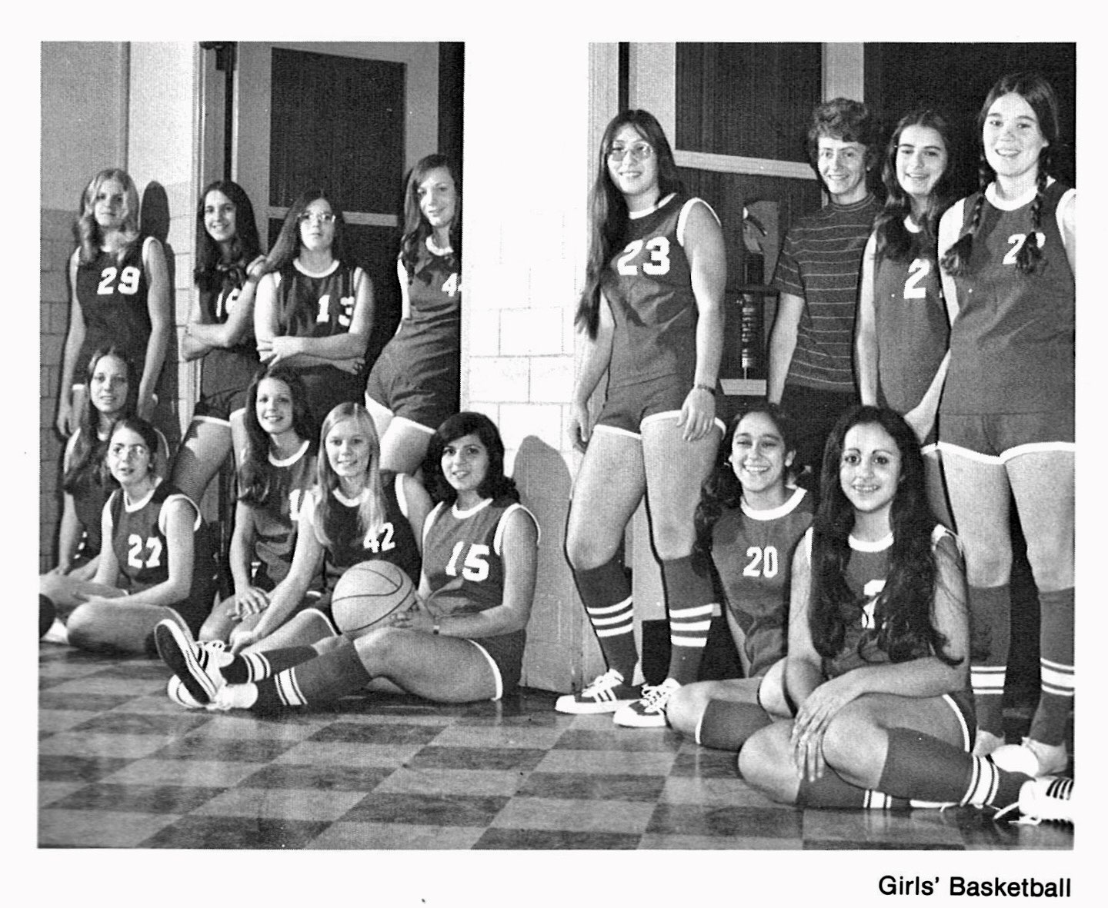

Slide 23
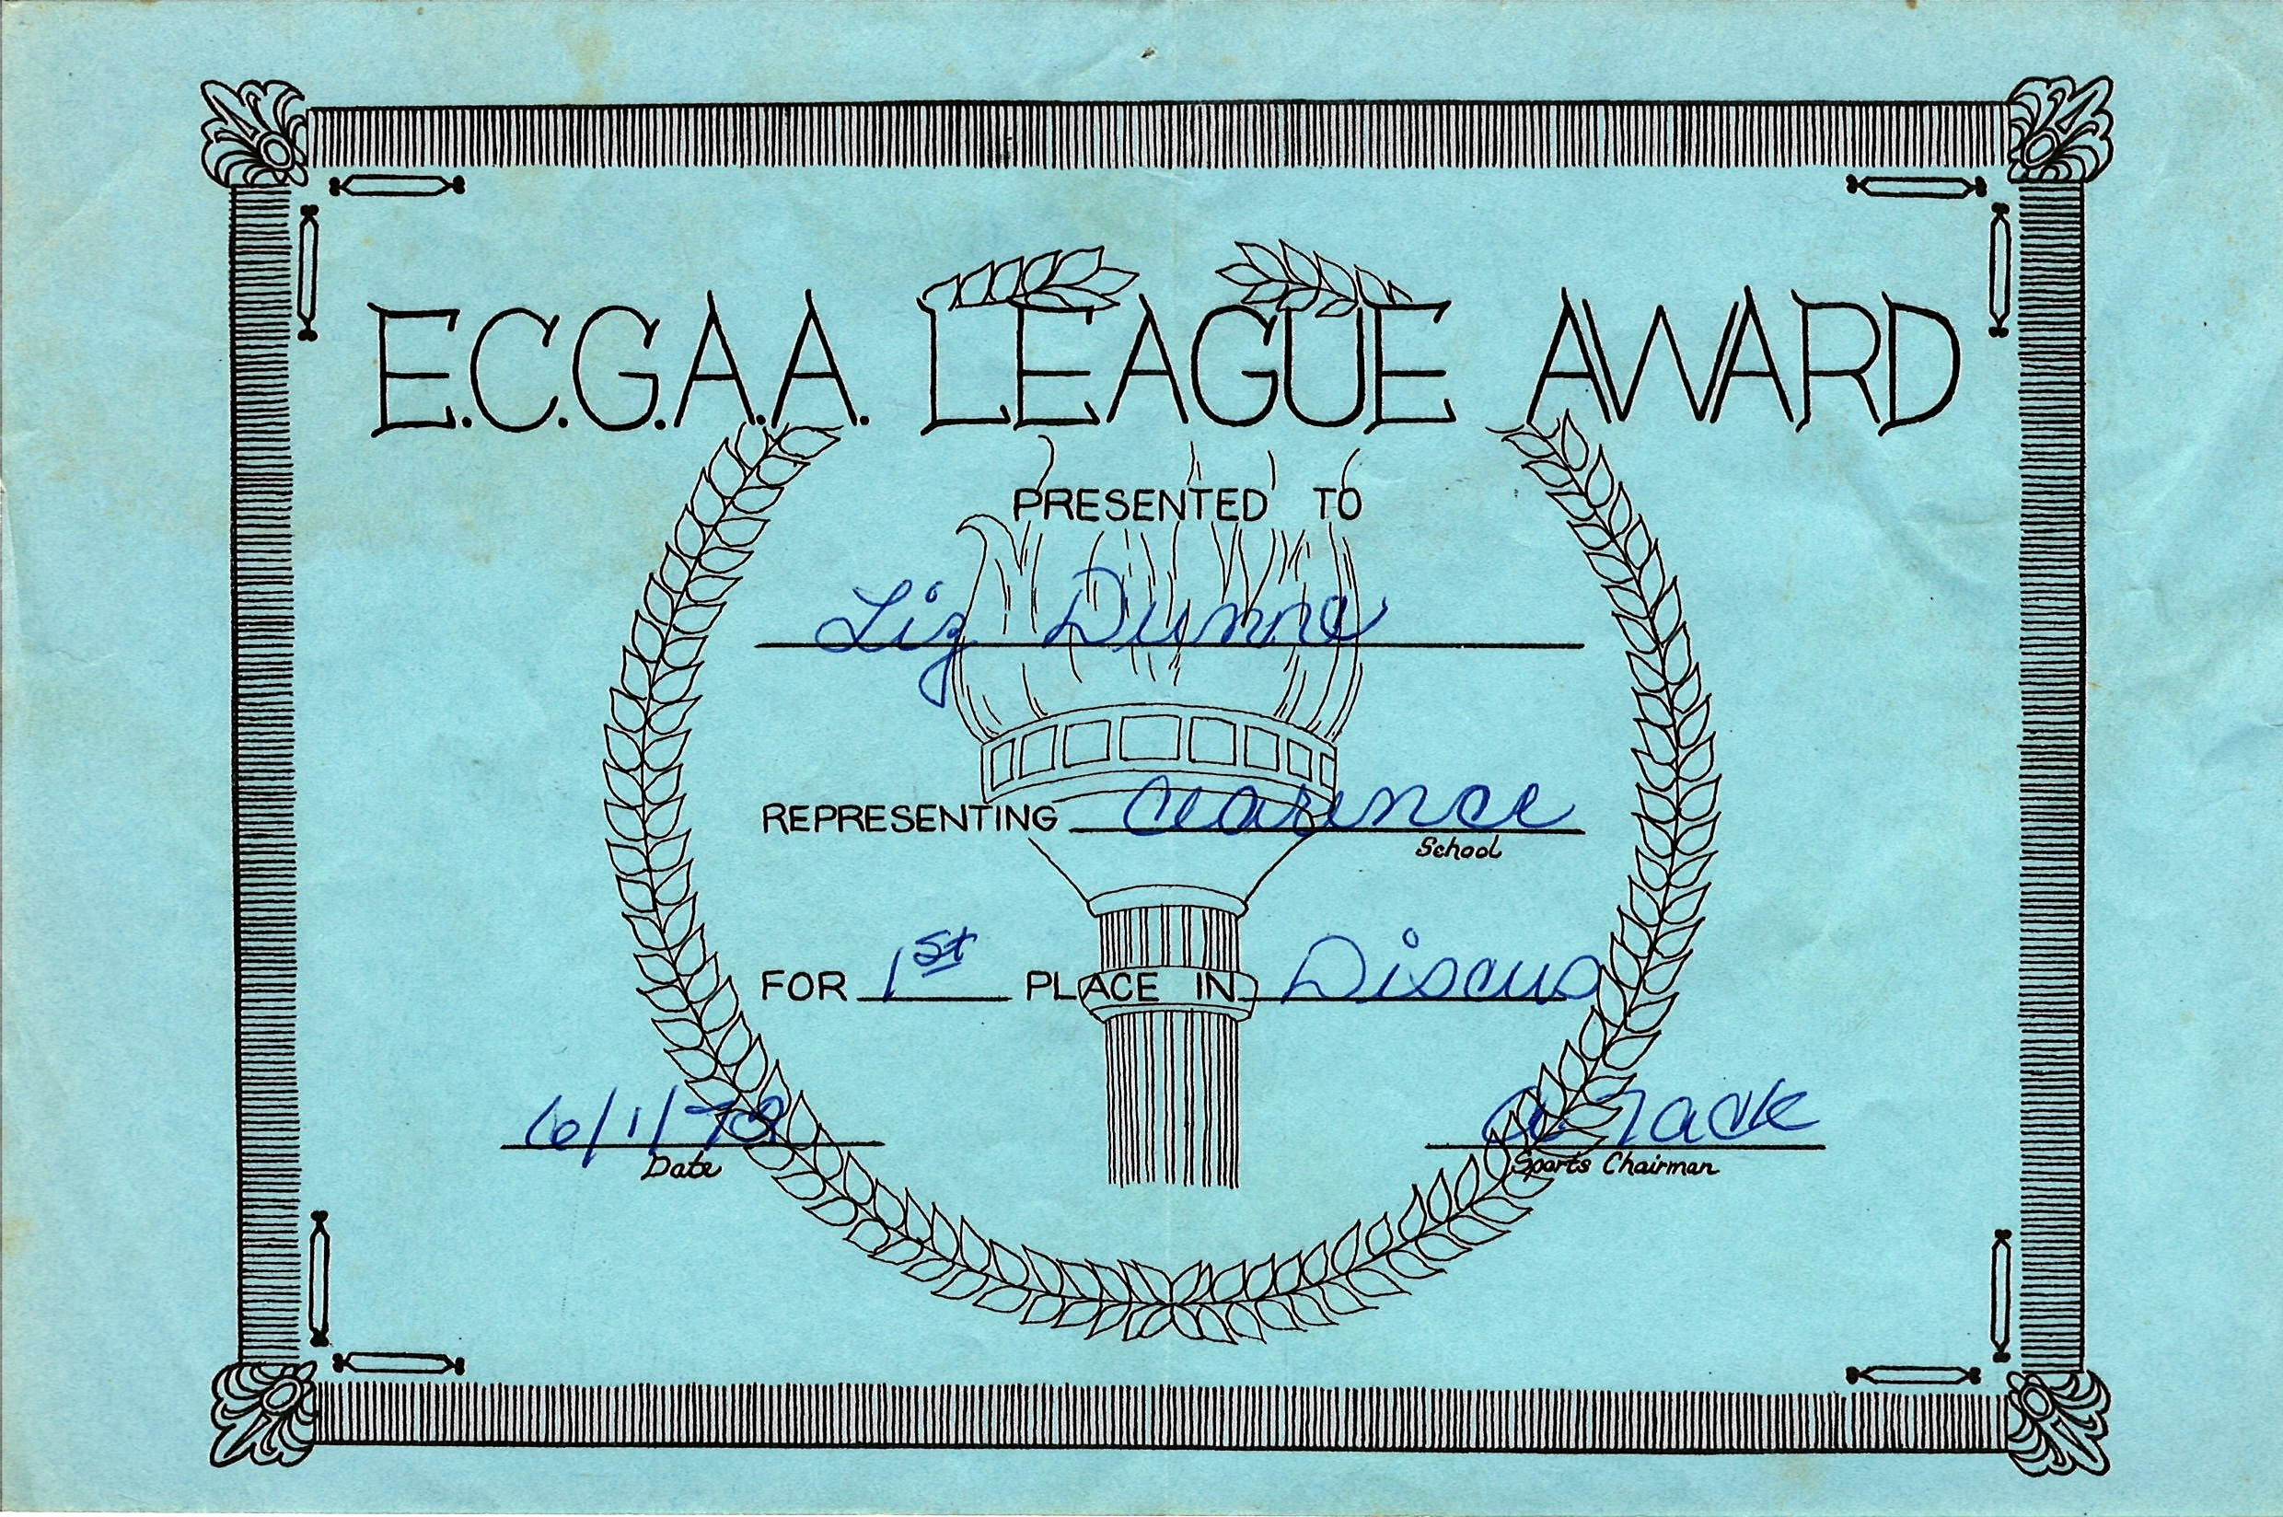
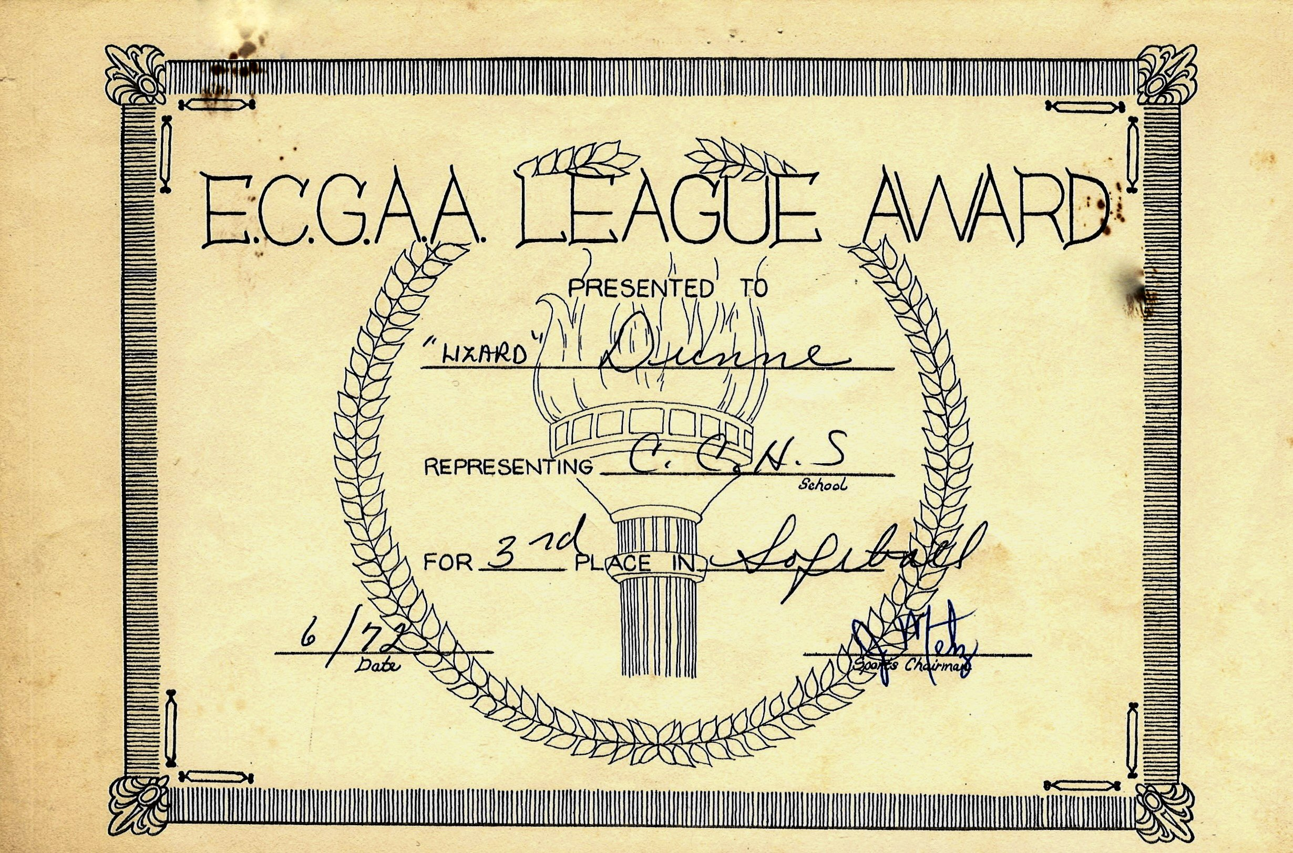
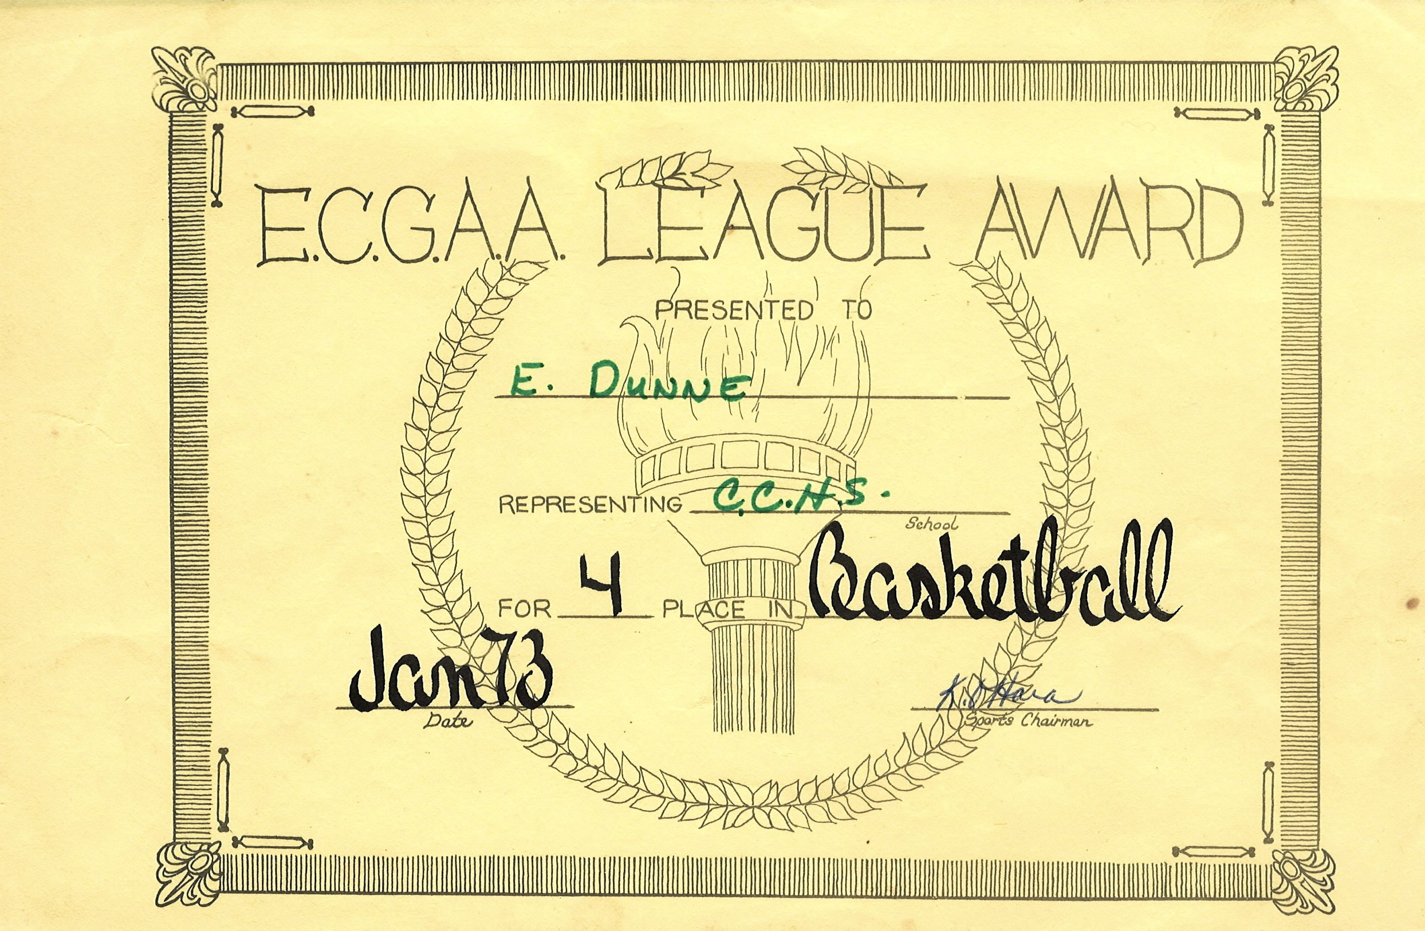
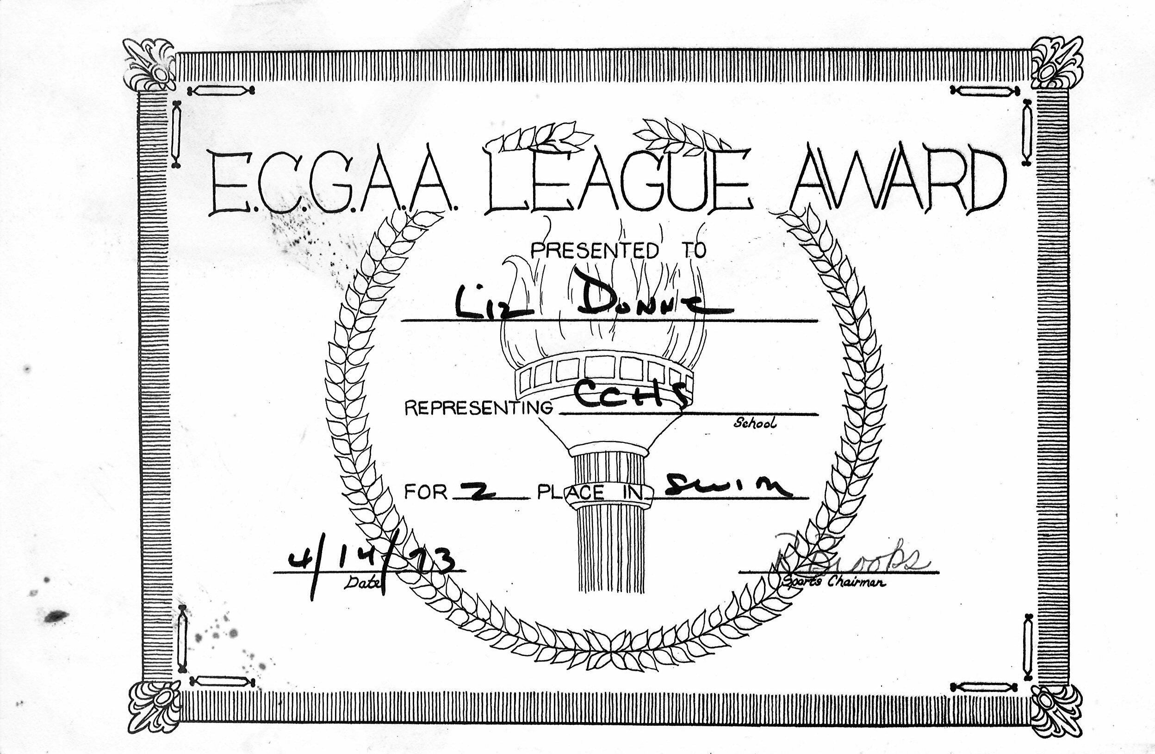

Slide 24
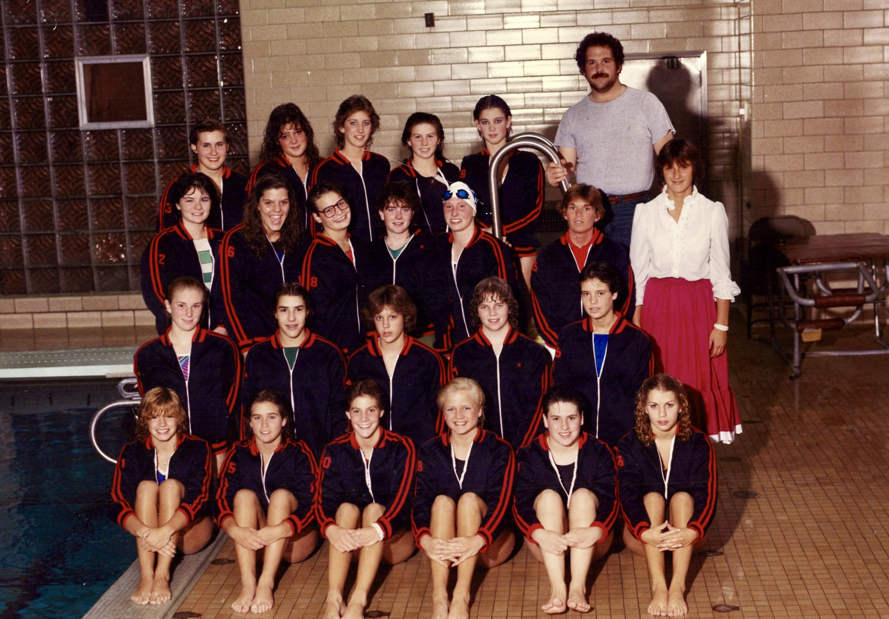

Slide 25
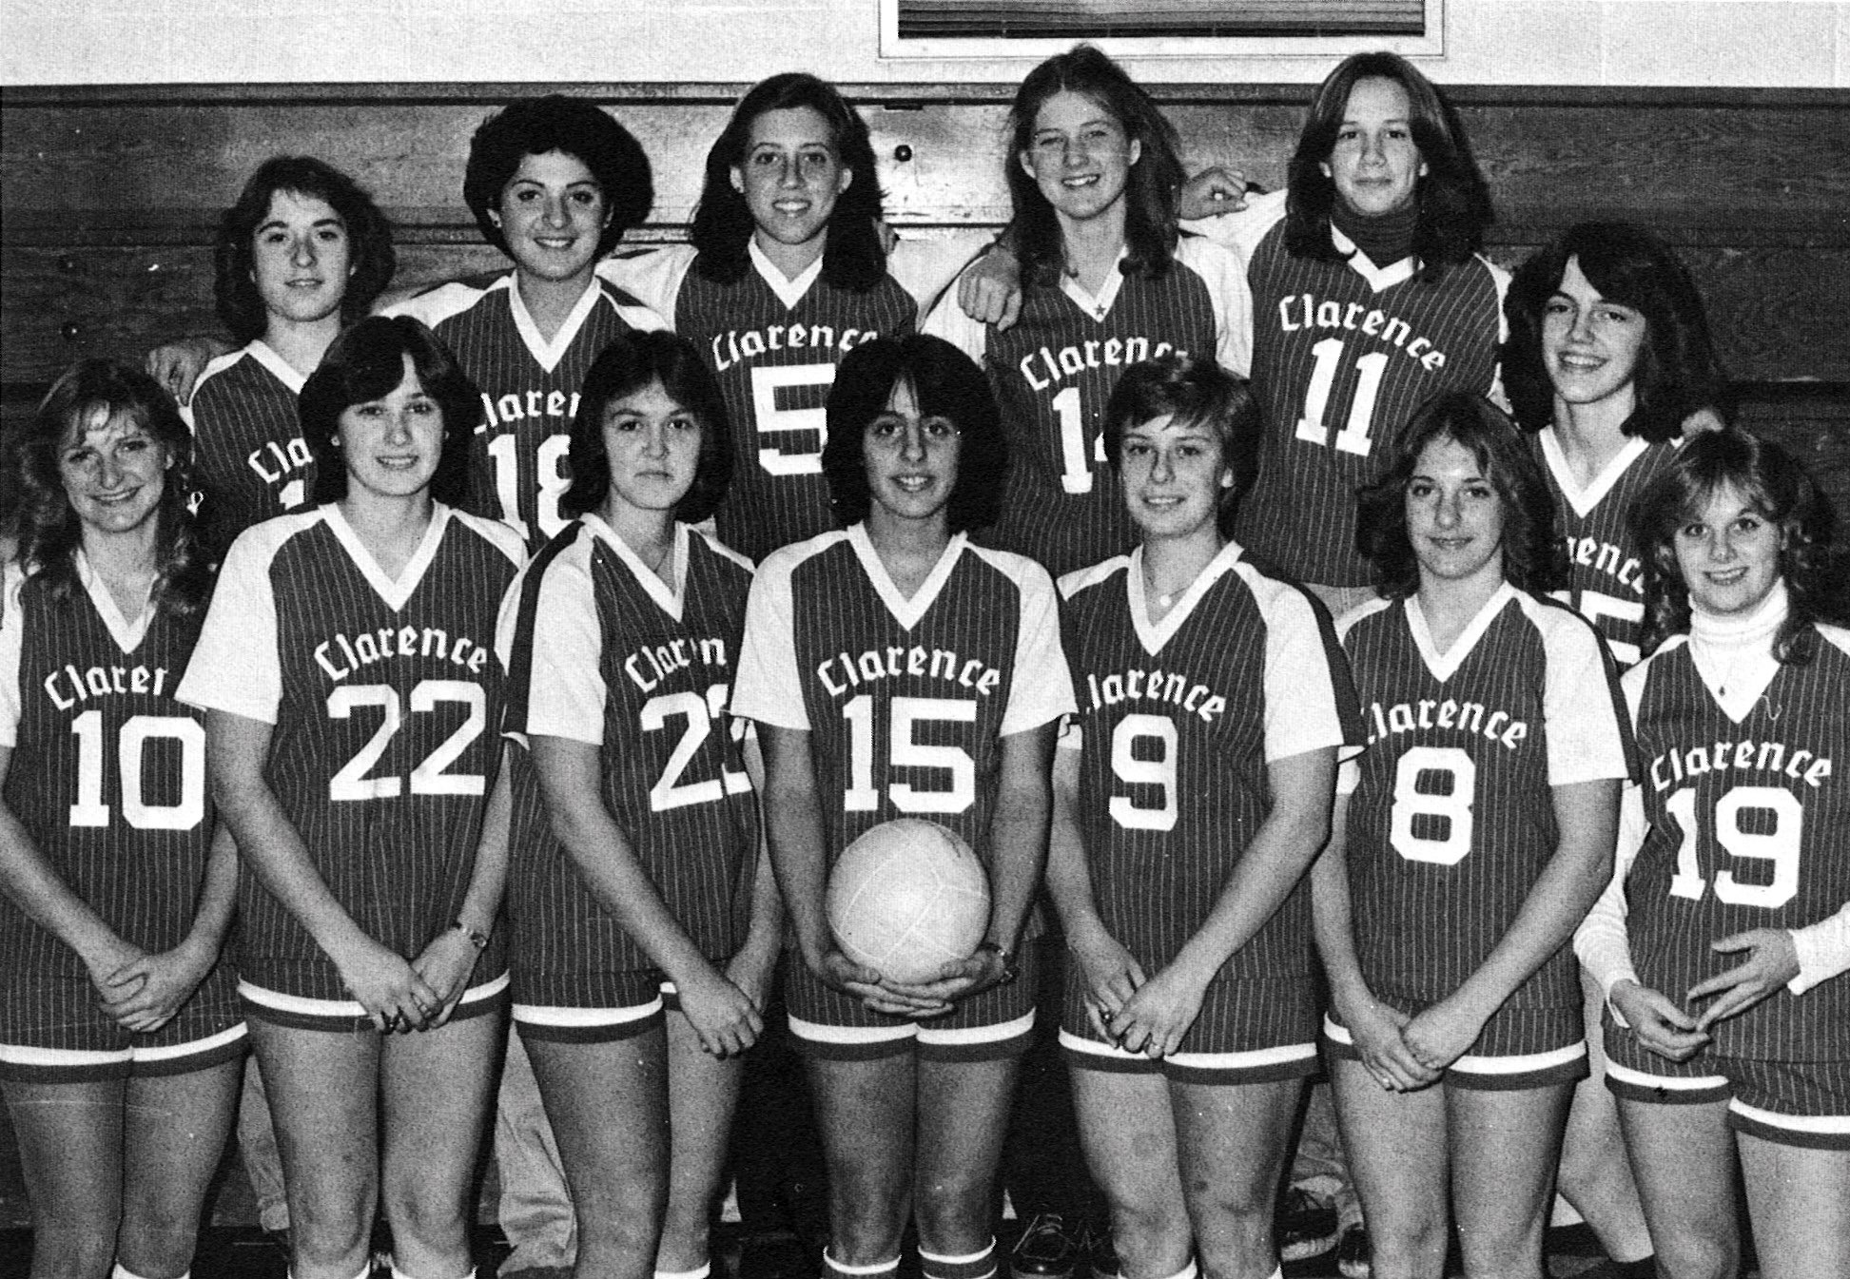
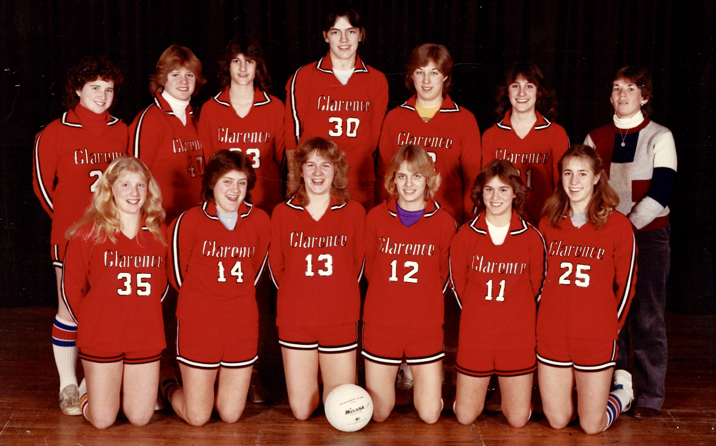
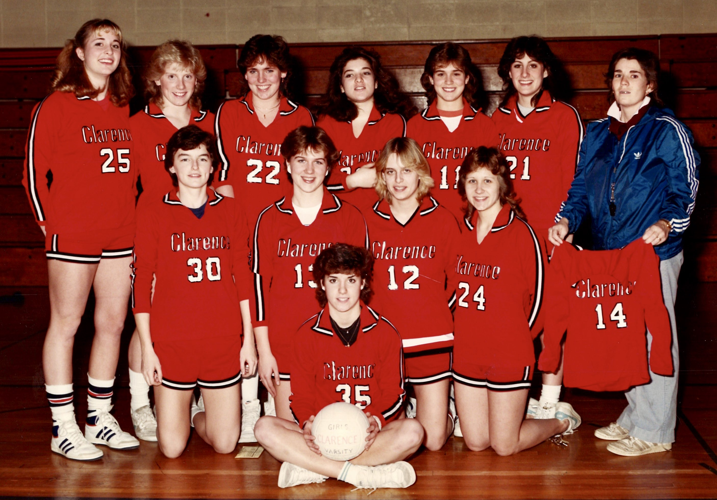

Slide 26
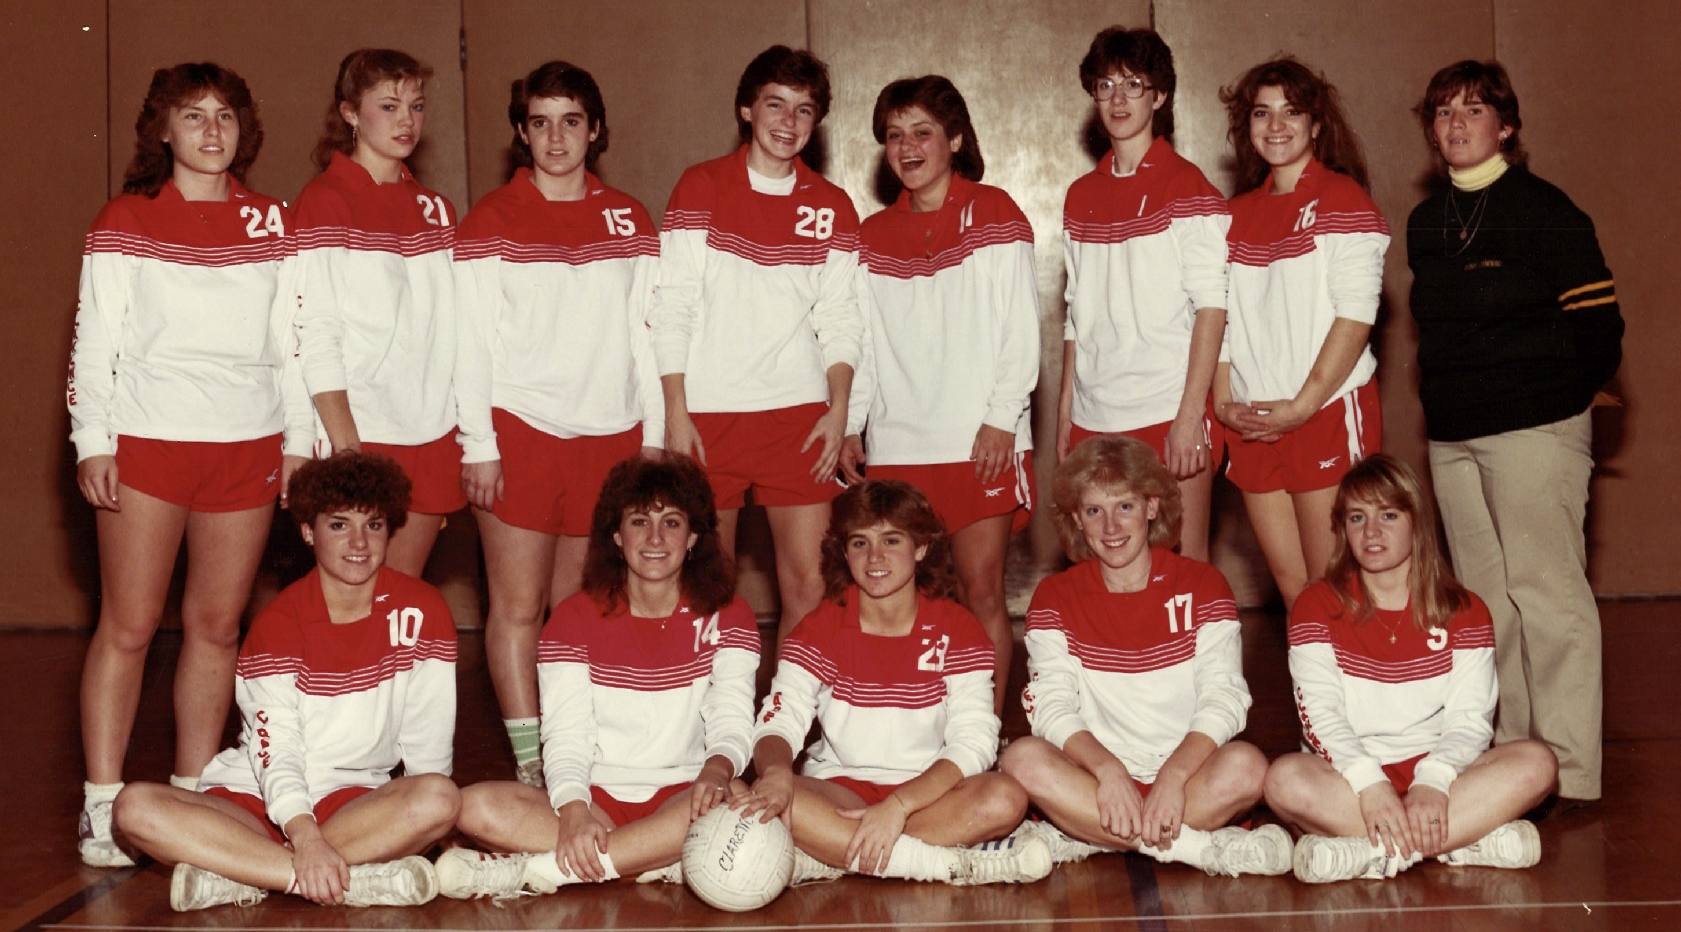
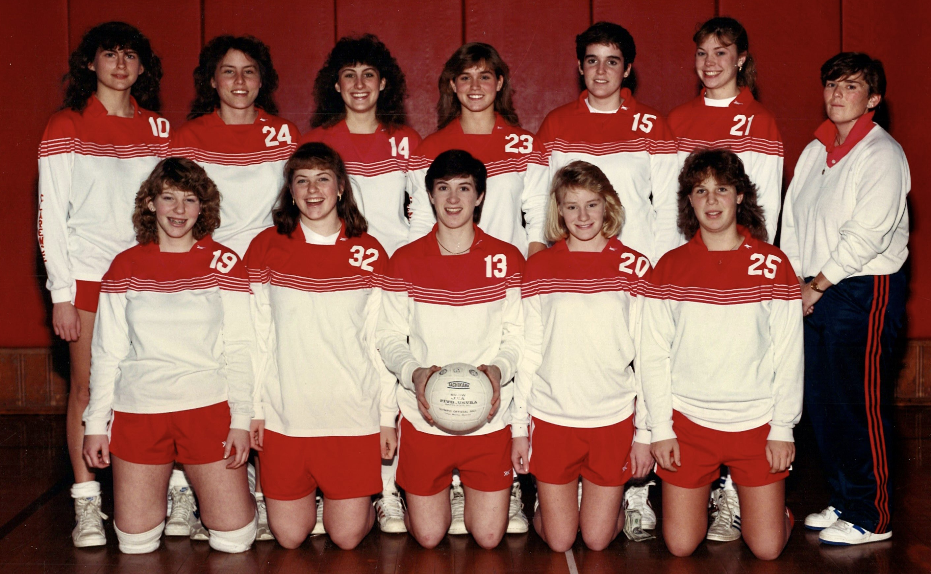
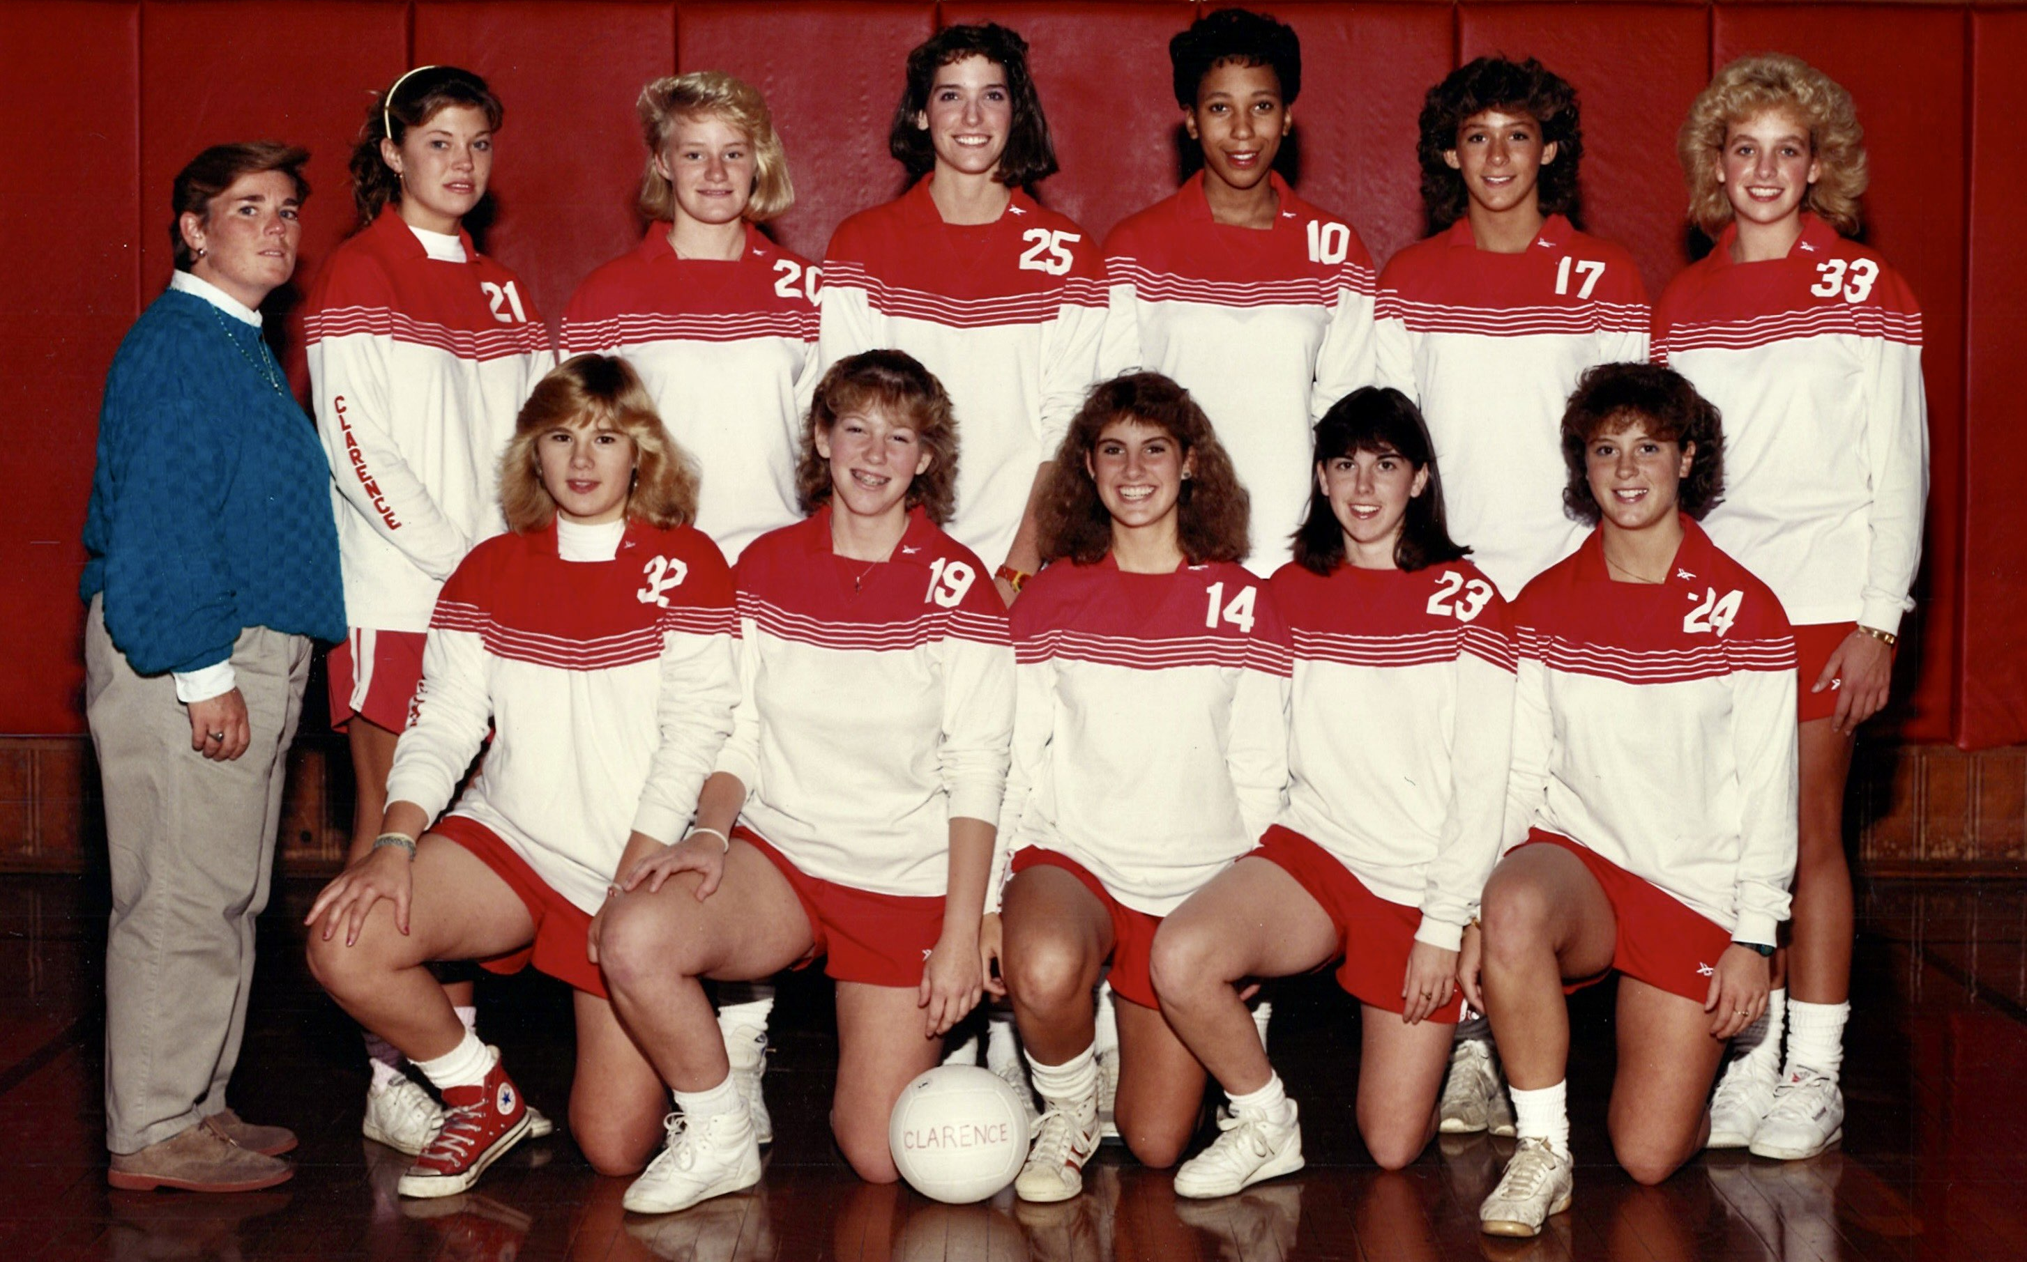

Slide 27
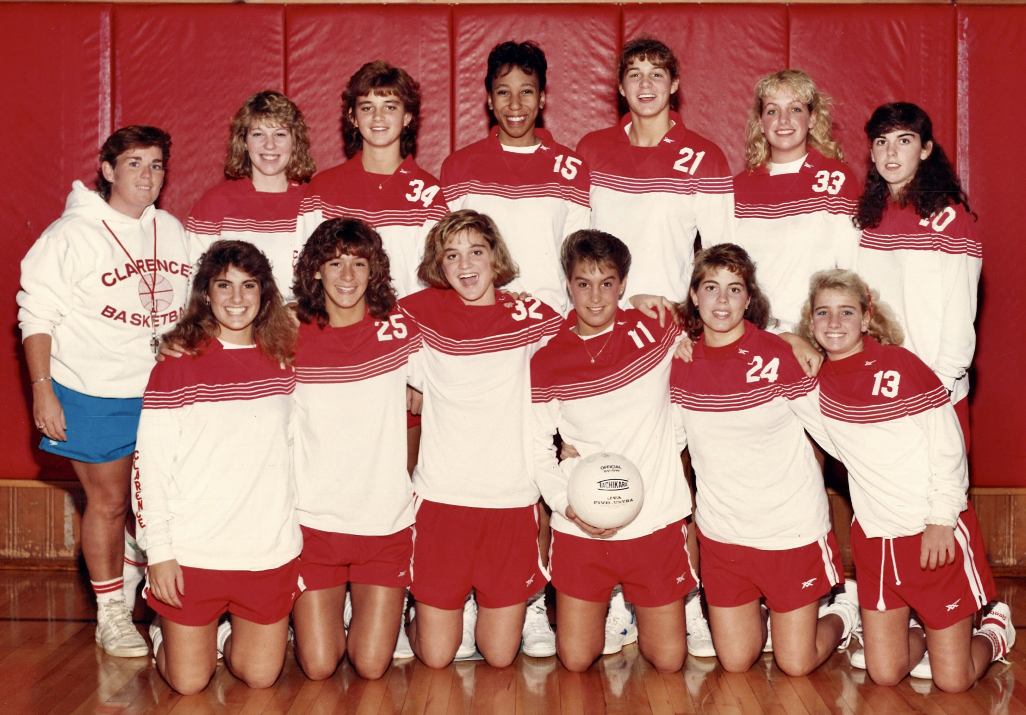
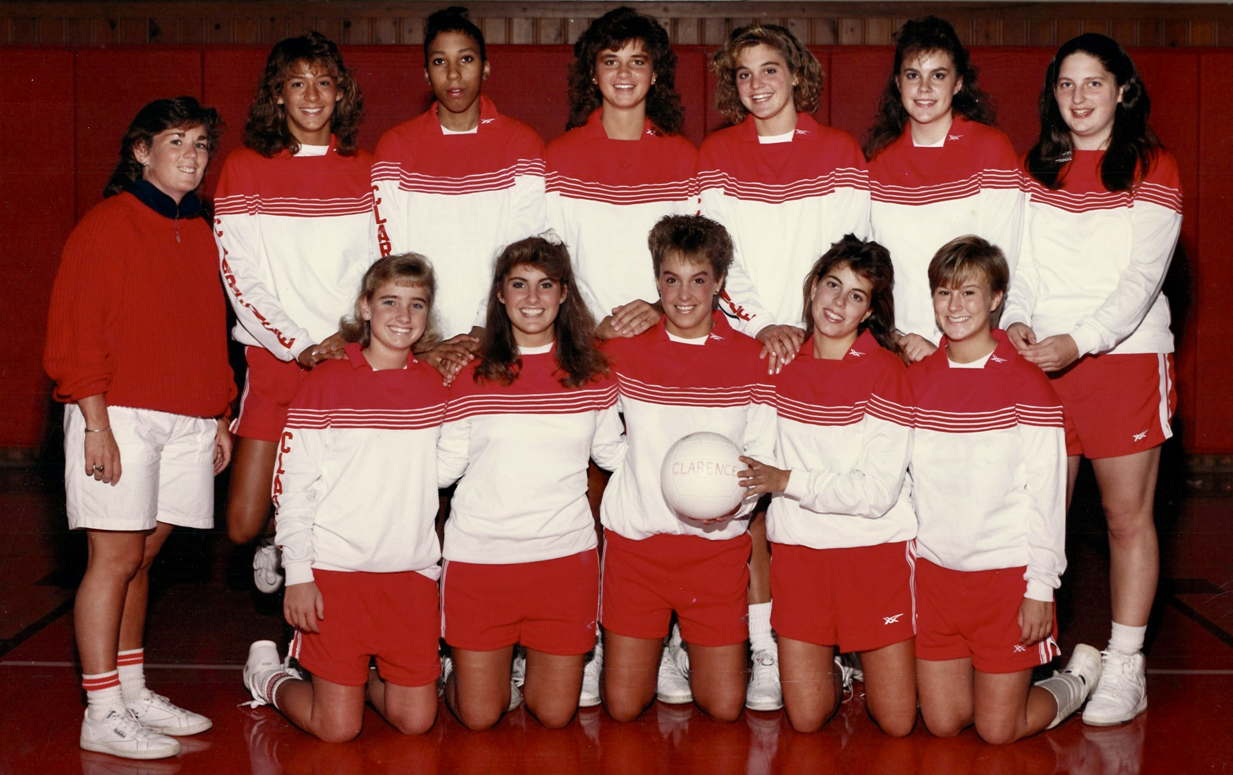
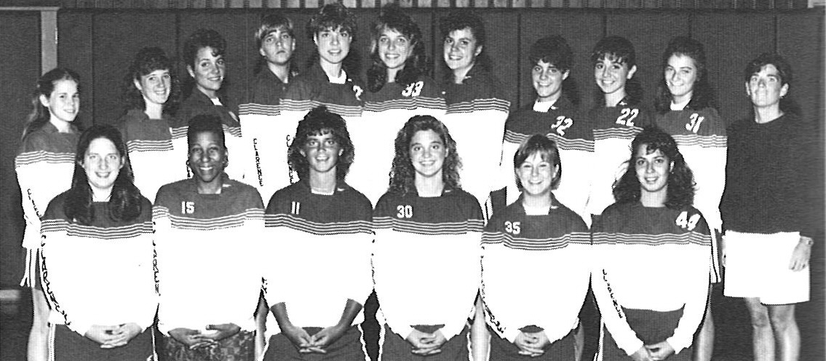

Slide 28
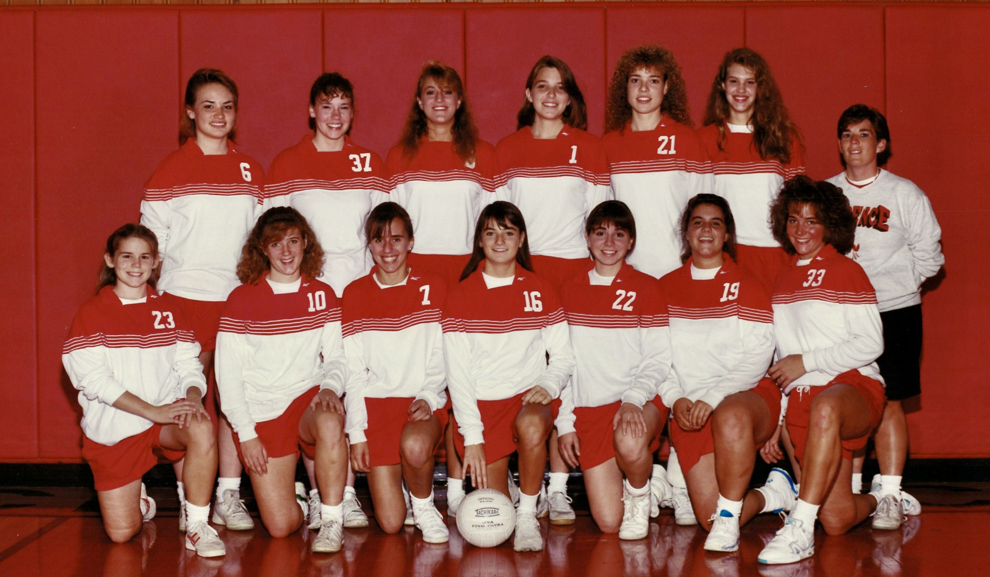
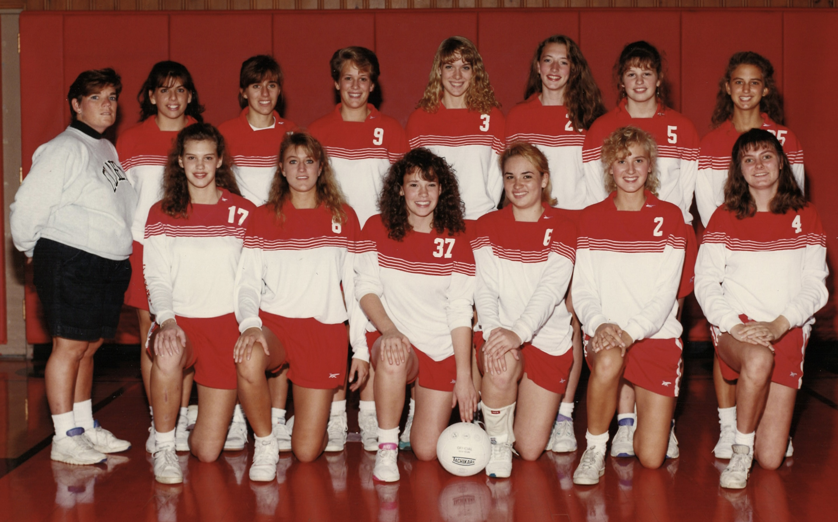

Slide 29
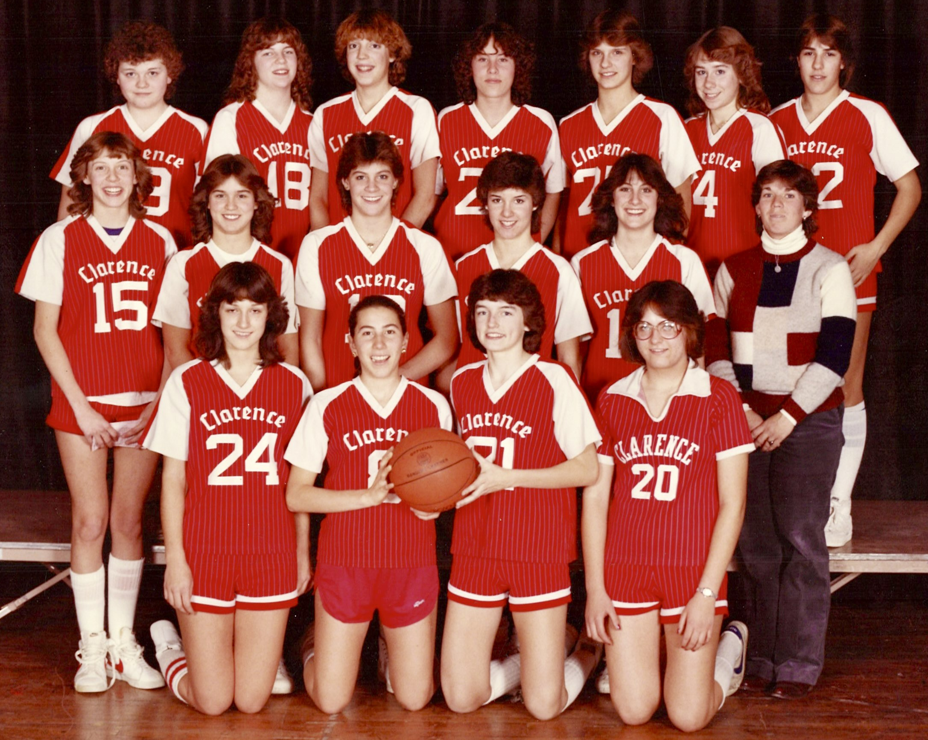
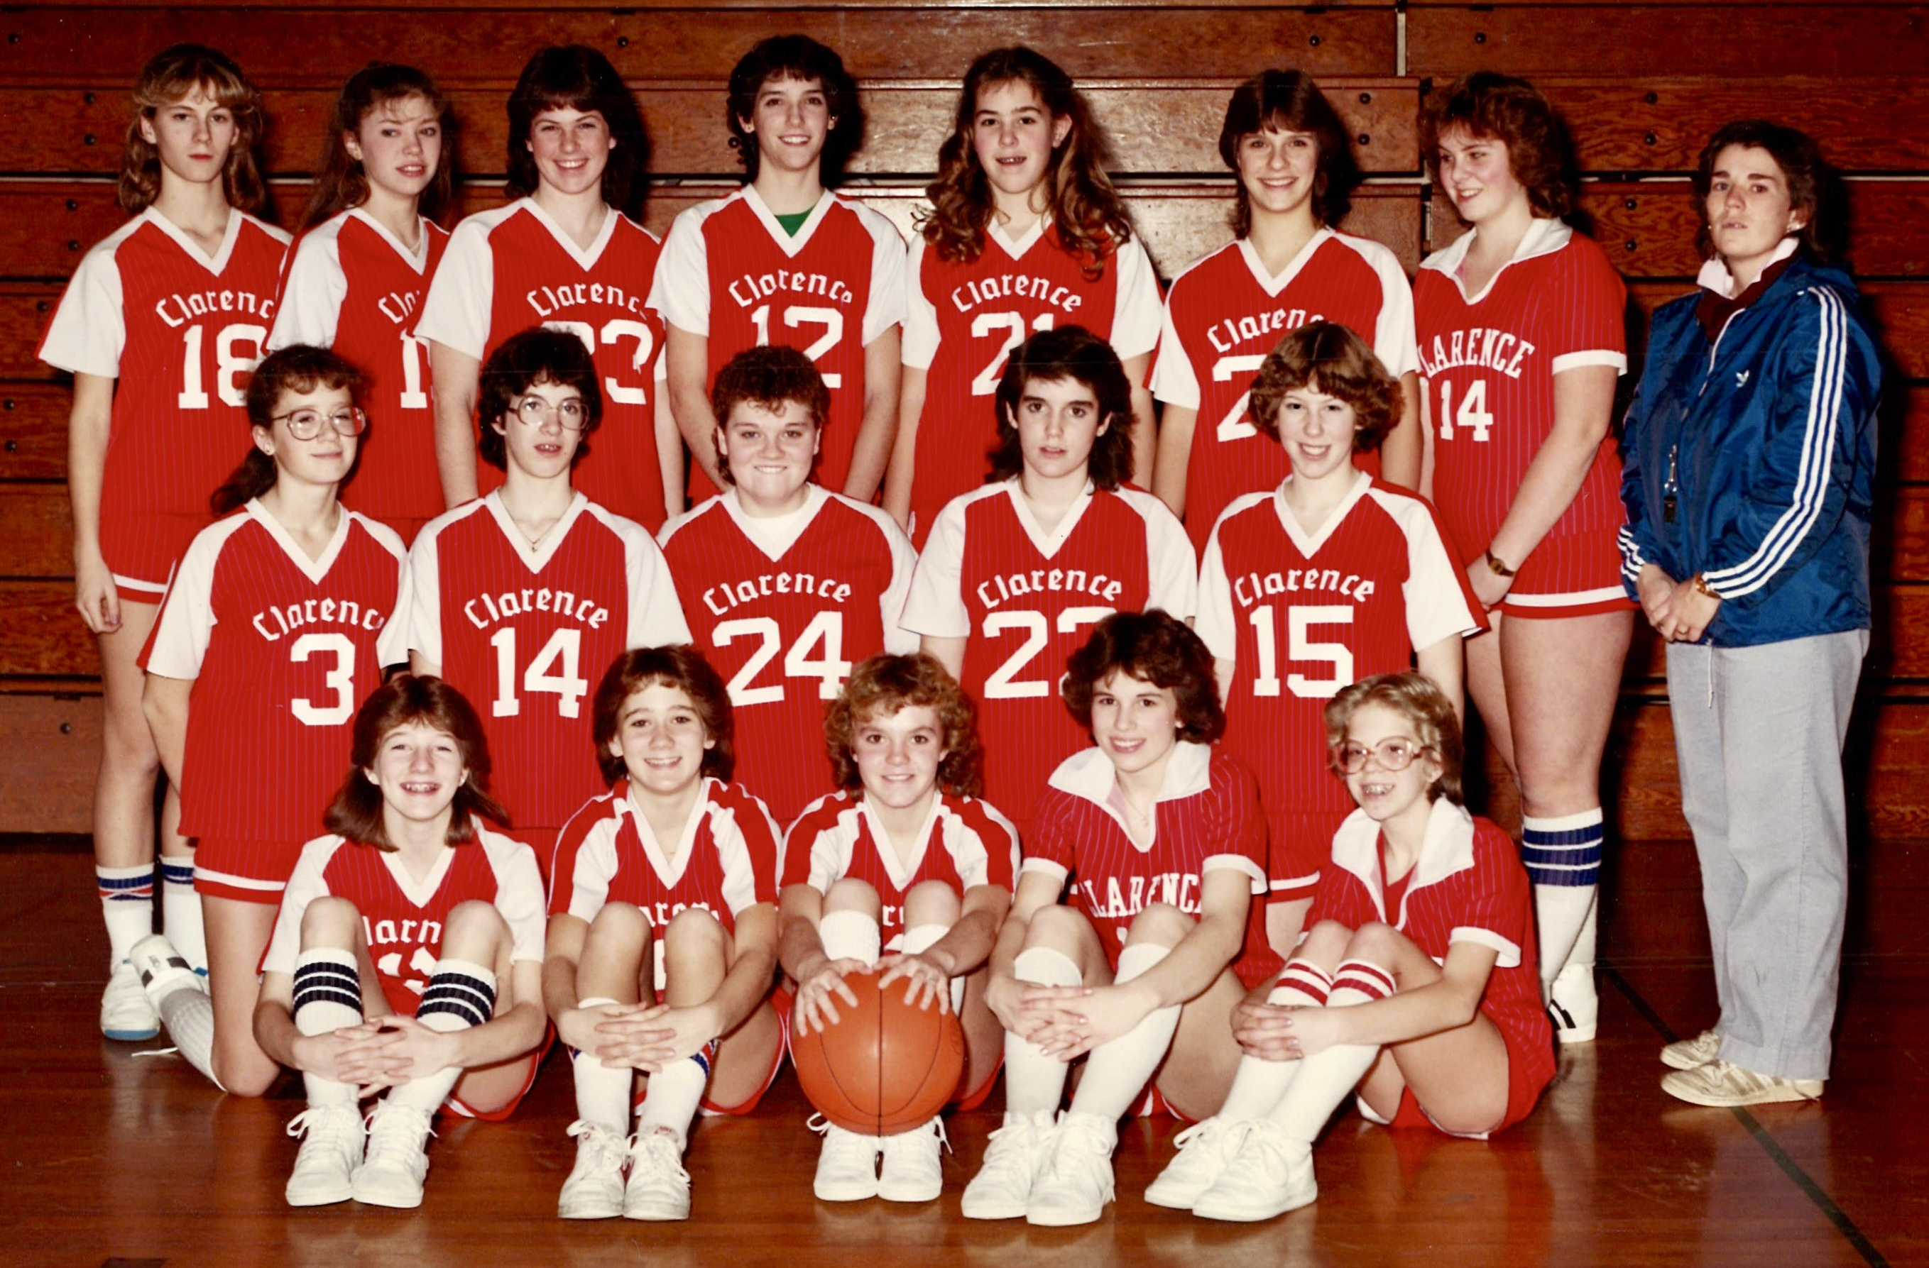
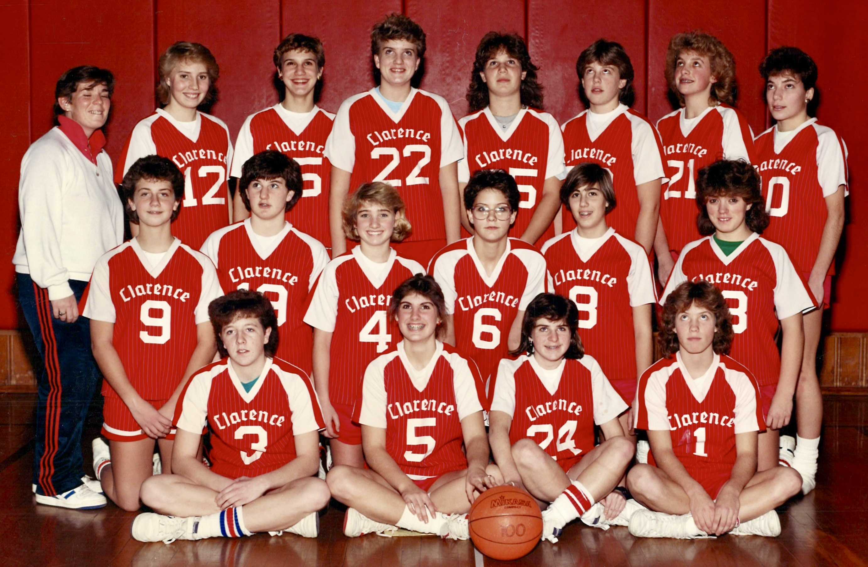
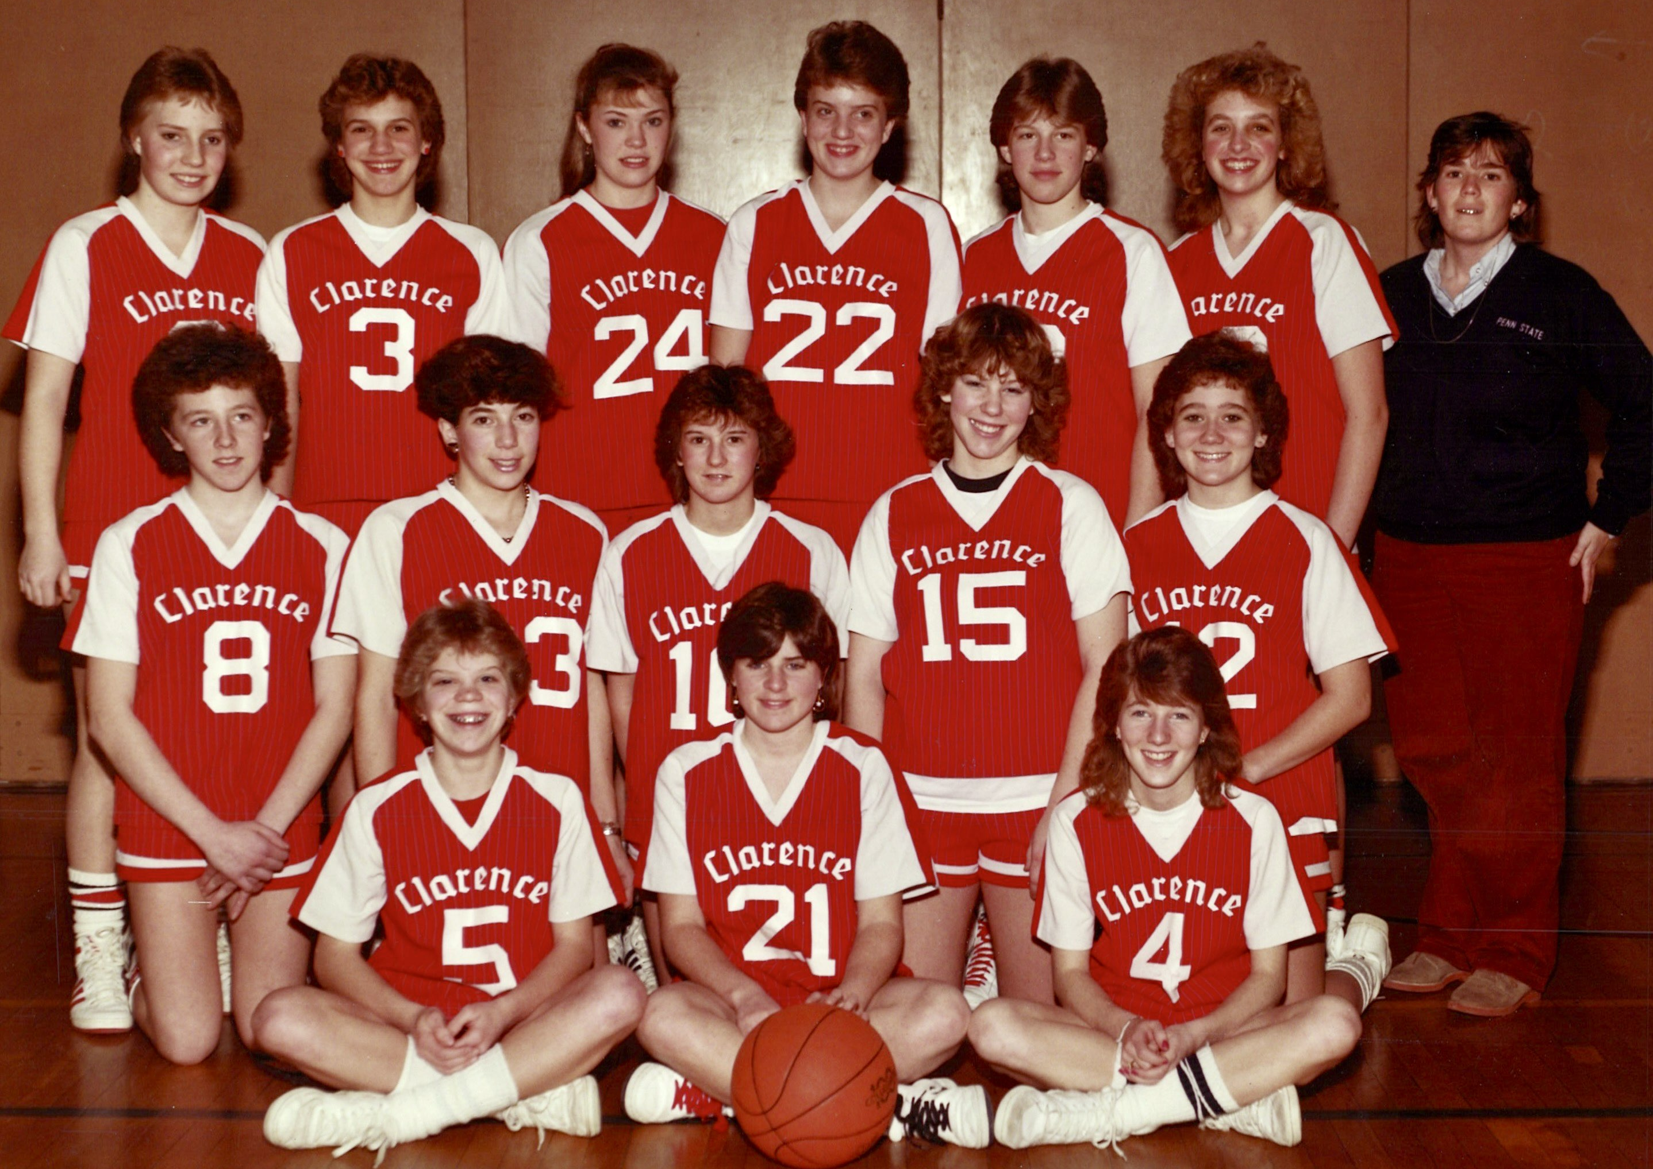

Slide 30
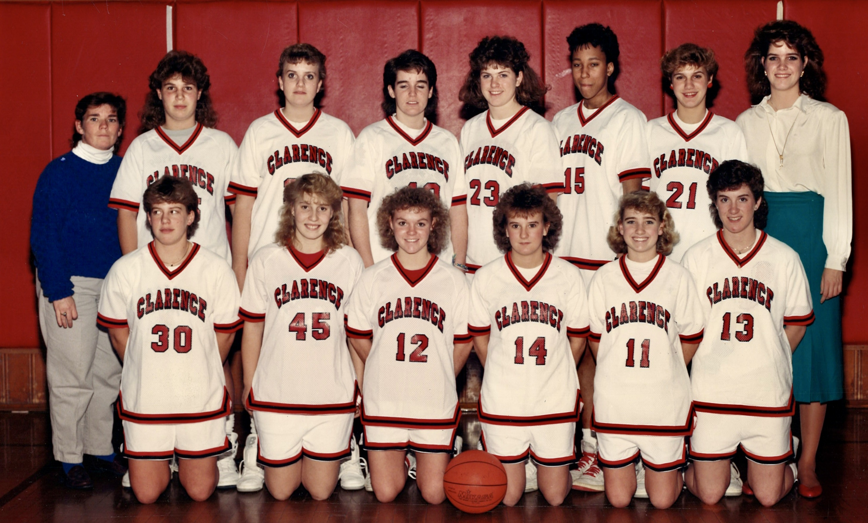
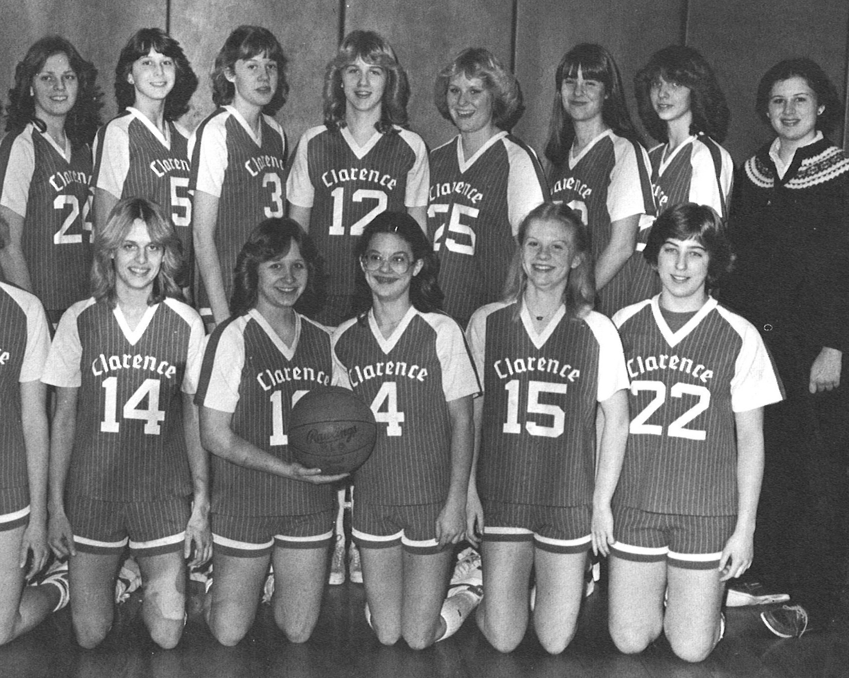

Slide 31
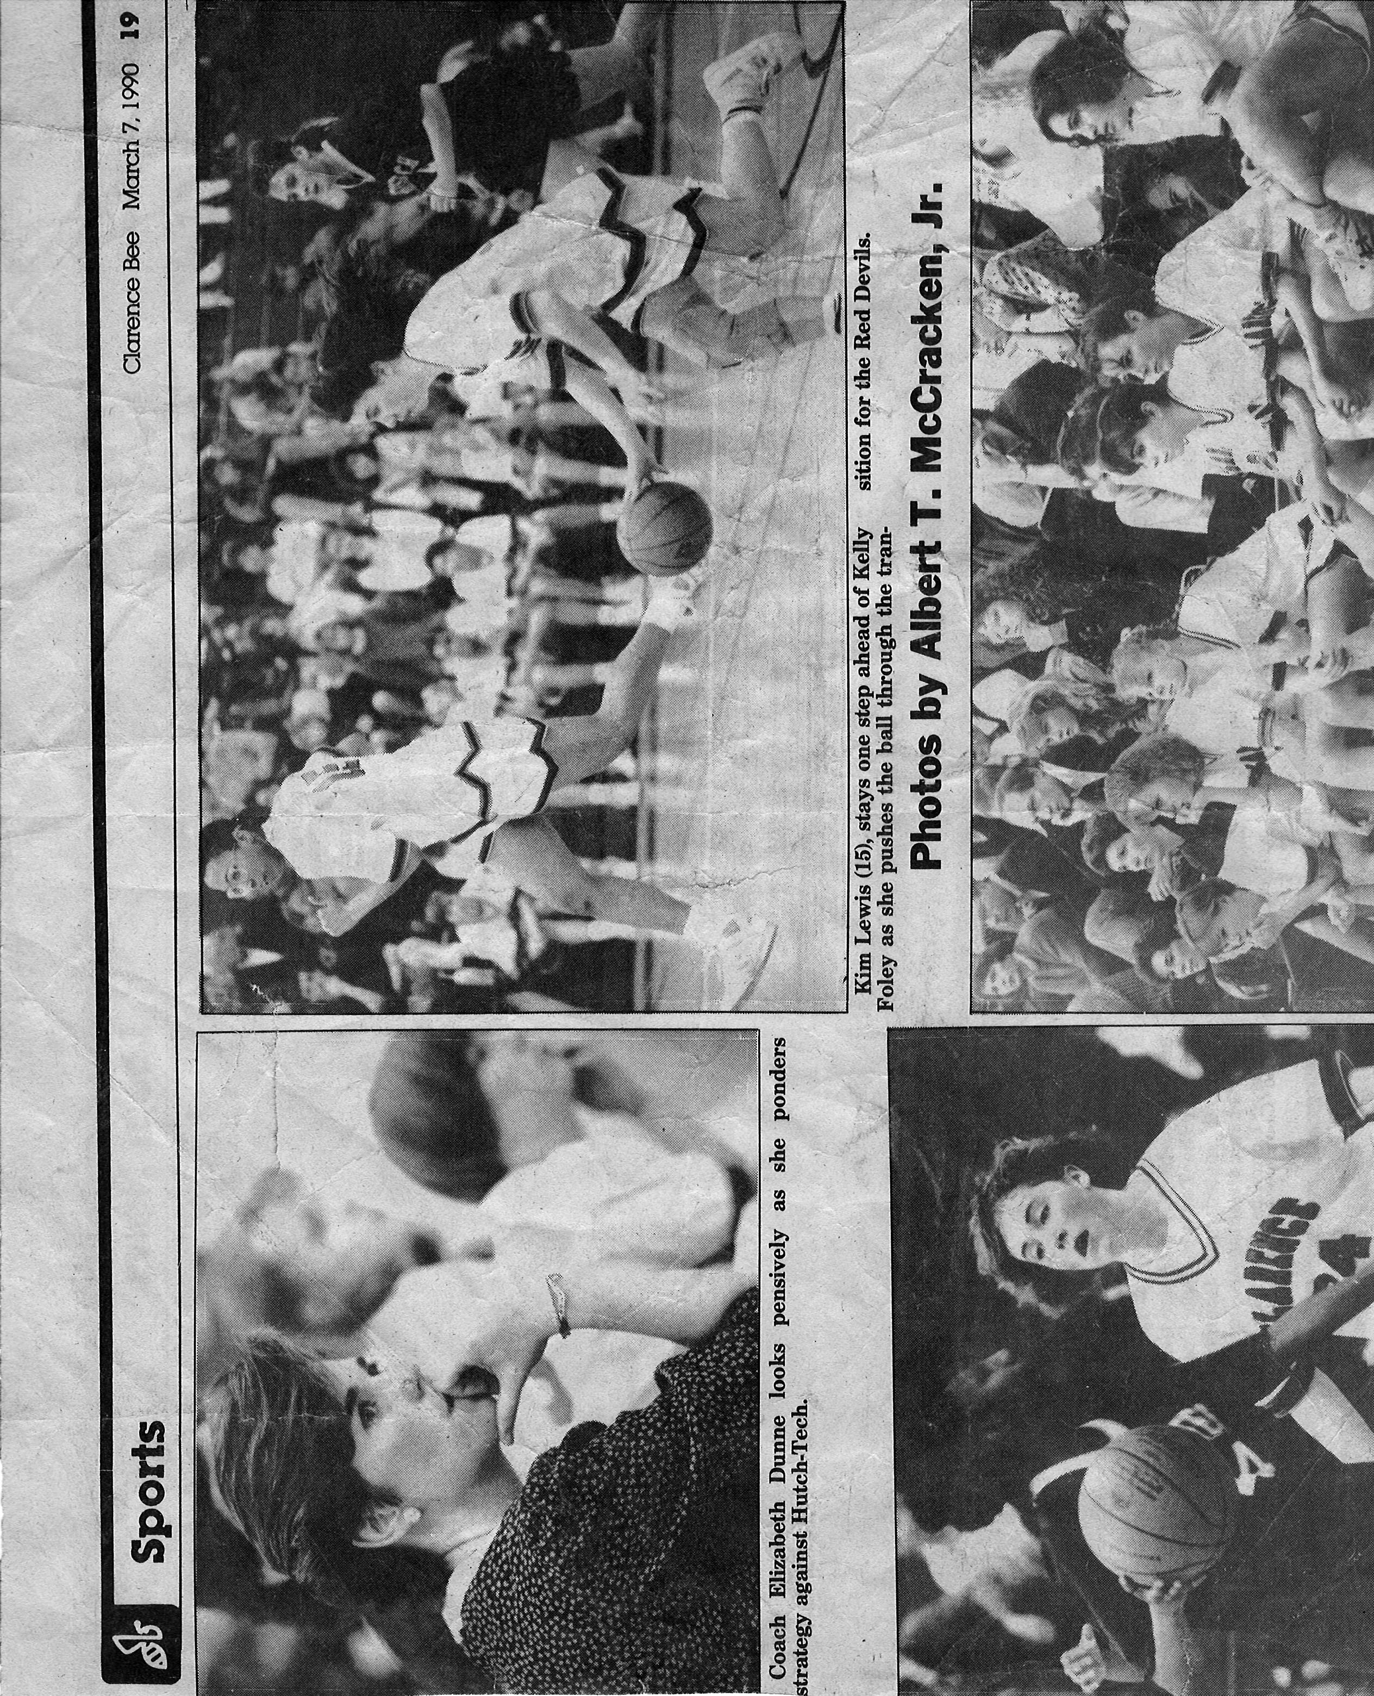
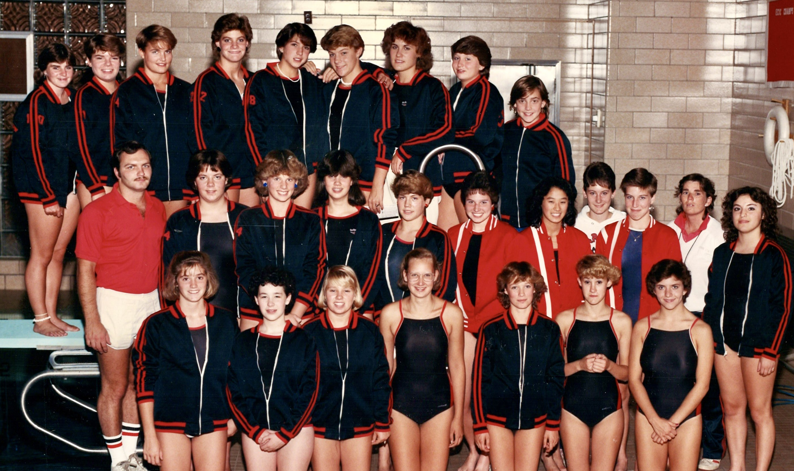
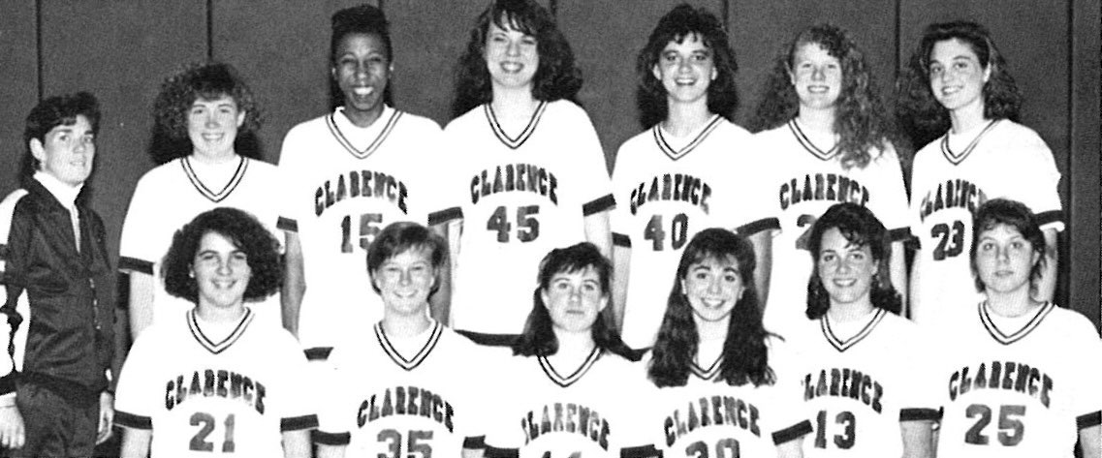

Slide 32
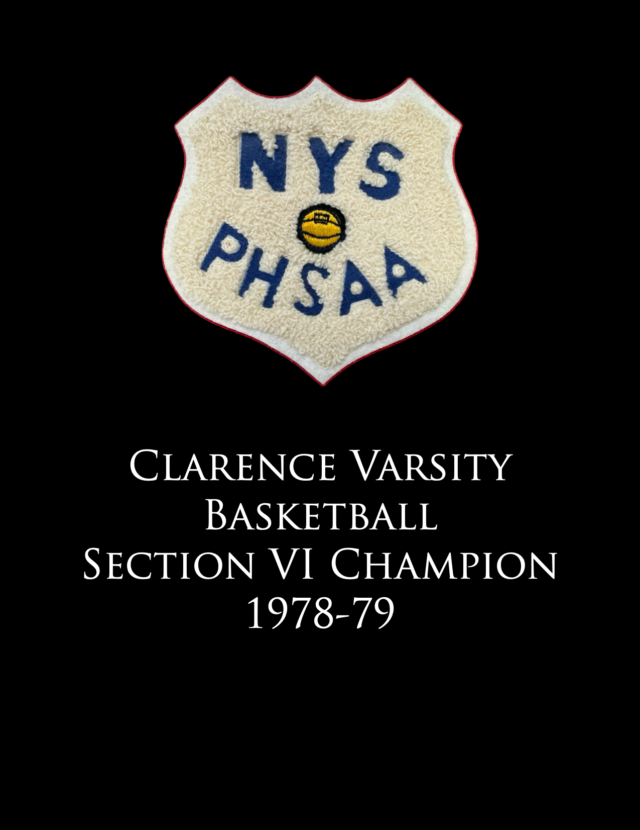
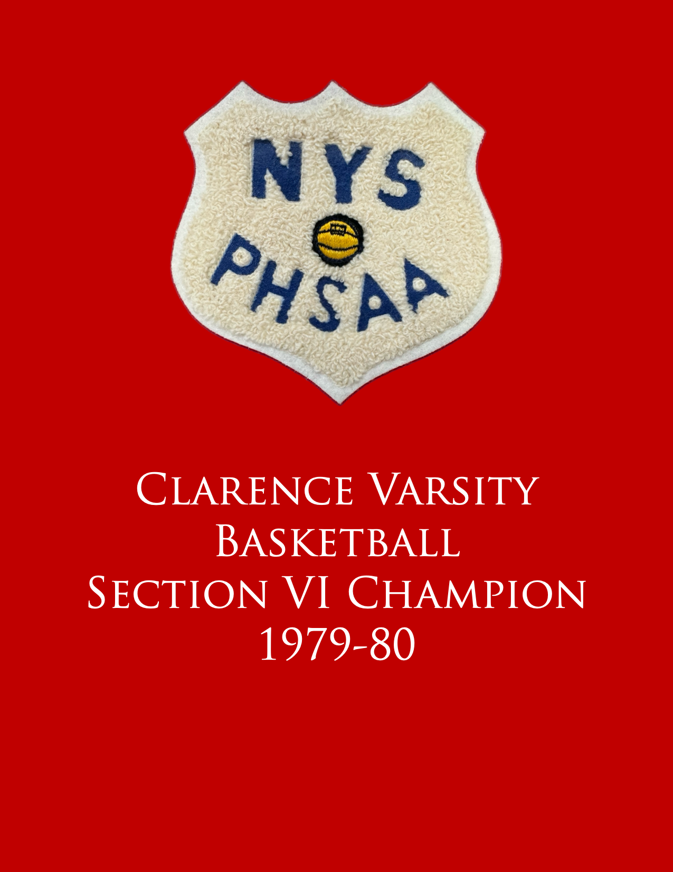
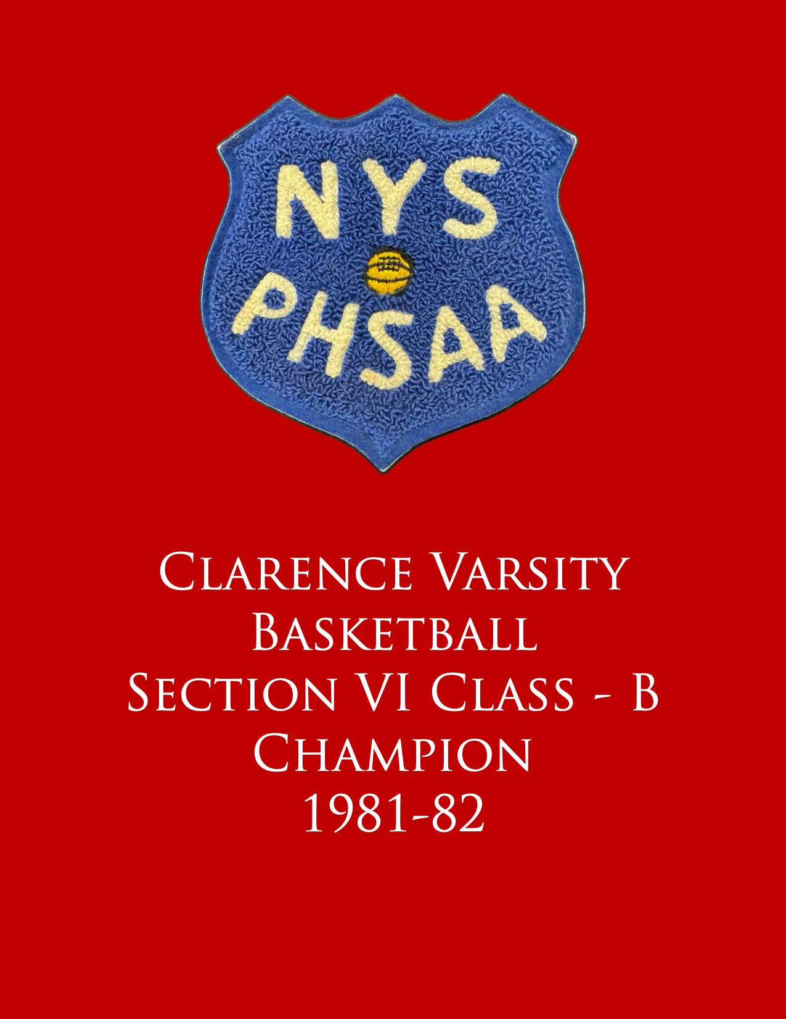
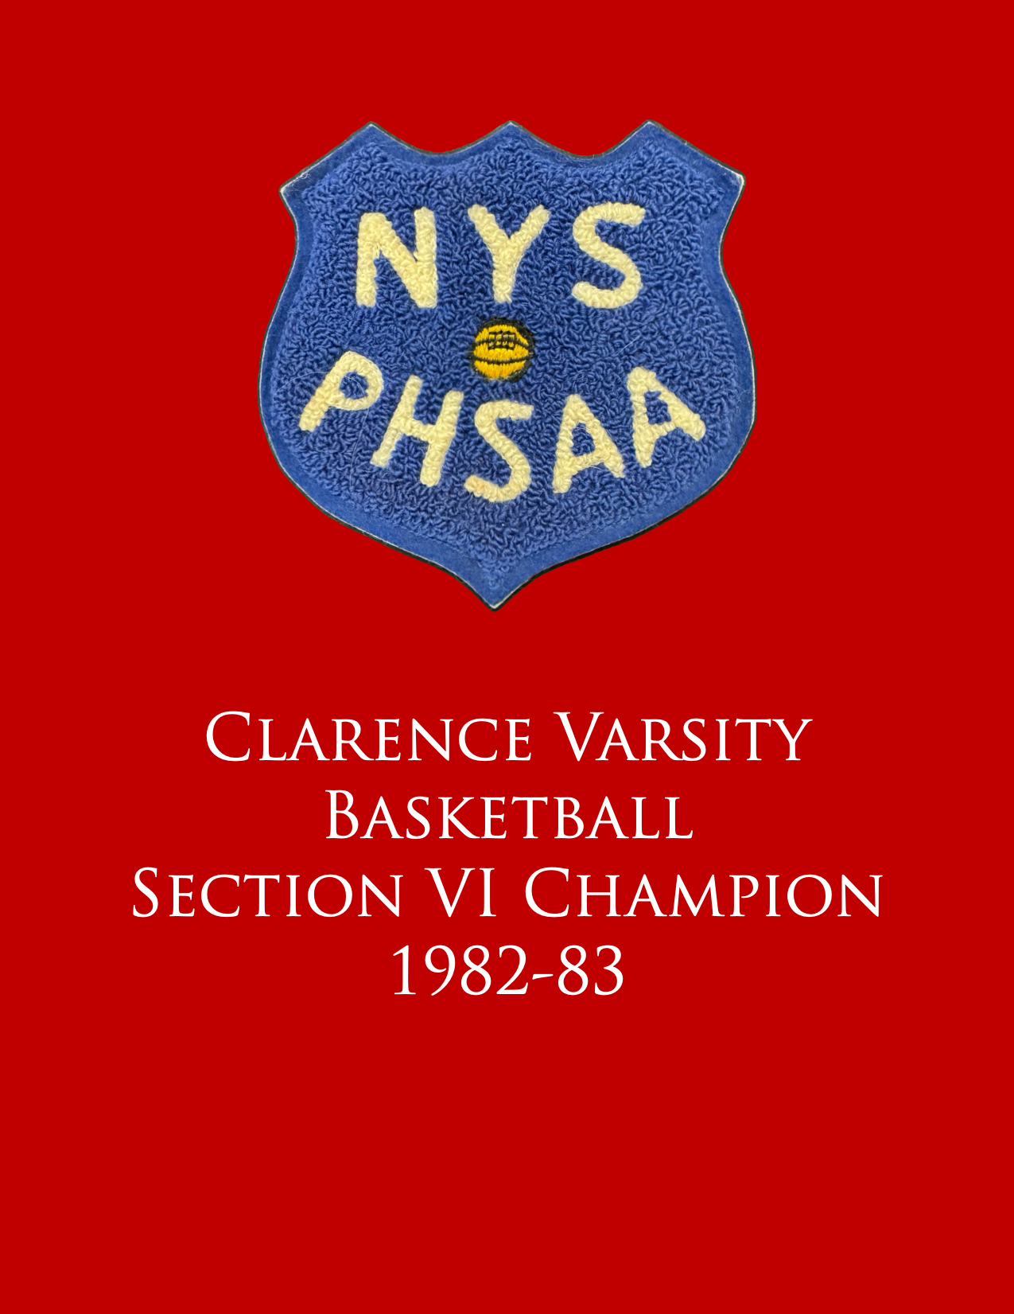

Slide 33
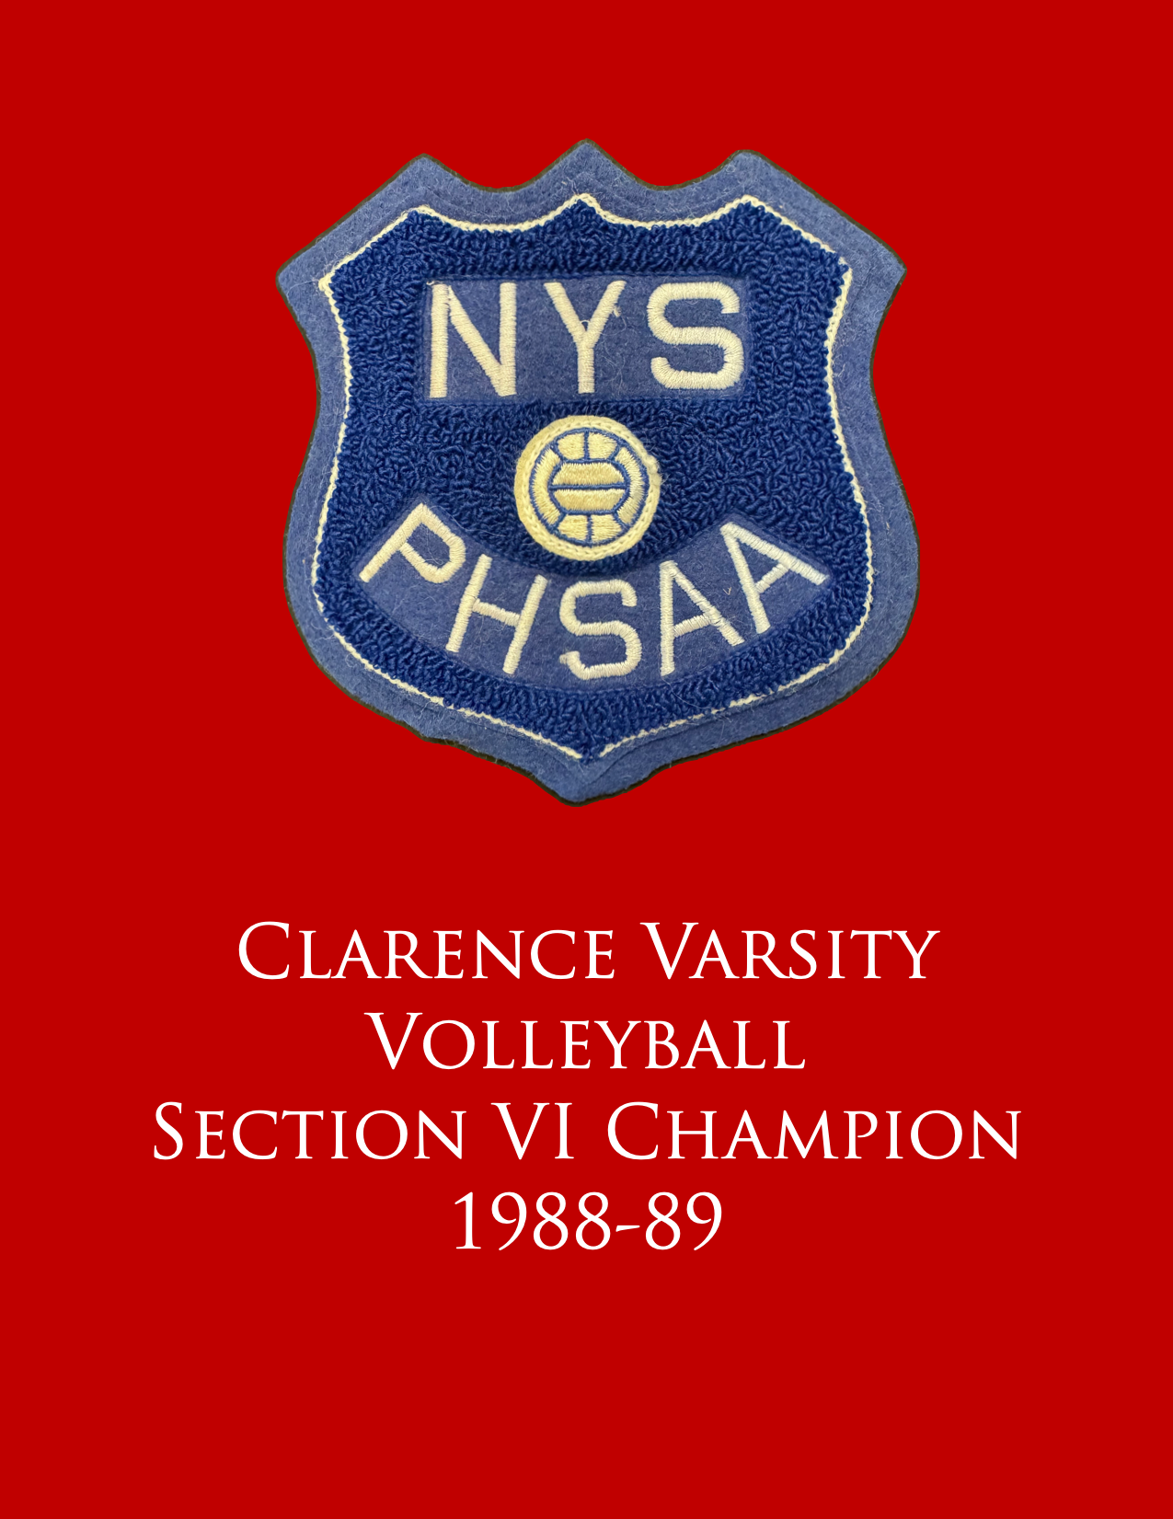
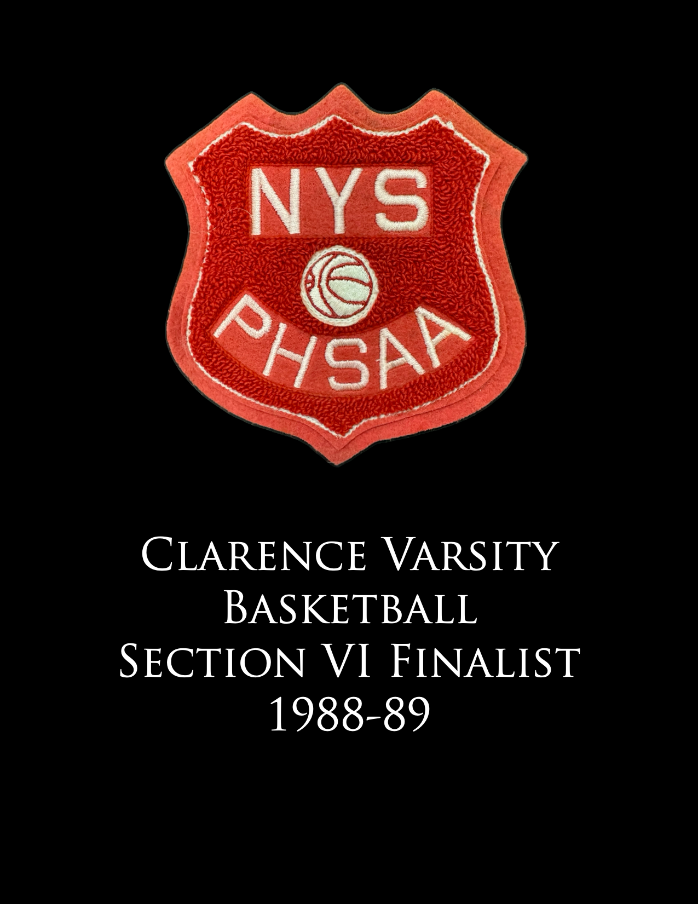
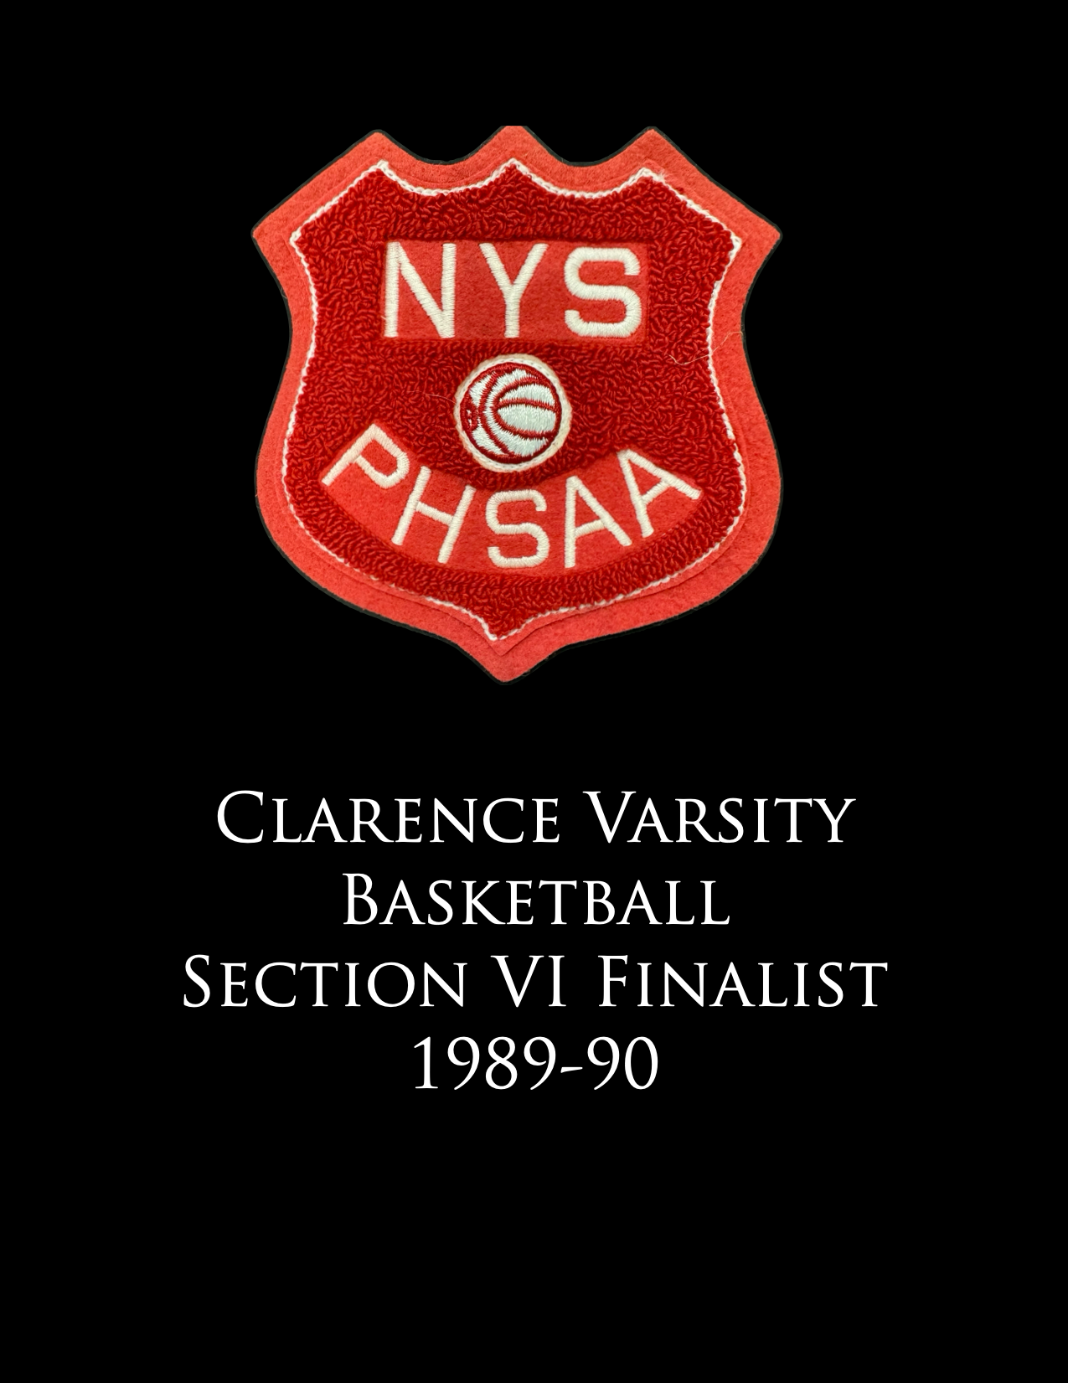

Slide 36
Joan Lloyd
Andrea Tack
John Bernhard
Charlie Vesper

Slide 37
Congratulations Elizabeth

Slide 38
Cross-Country
4 Varsity Letters
2x ECIC Champs
2x Section VI Champs
1 NYS Fed. Champs
White Letter Winner
Deb Gresens Gallagher

Slide 39
Basketball
4 Varsity Letters
4x ECIC Champs
3x Section VI Champs
1 NYSPHSAA Runner-up
Deb Gresens Gallagher

Slide 40
Track and Field
4 Varsity Letters
3x ECIC Champs
Set School Record in the 4 x 800 relay
White Letter Winner
“The Franchise”
Deb Gresens Gallagher

Slide 41
Most Athletic
Deb and Brother Doug

Slide 42
Pep Rally
with
Brothers
Doug and Dan

Slide 43
V
A C
R L
S U
I B
T
Y

Slide 44
Cross-Country

Slide 45
X-C
Champs

Slide 46
X-C
Senior Year

Slide 47
Basketball

Slide 50
B-Ball
Champs

Slide 51
That’s how you box out for a rebound

Slide 52
Soaring and Scoring
as well

Slide 53
Track and Field

Slide 54
Ashland University Hall of Fame
31 years in Education
Coached HS & MS
Cross-Country
Track

Slide 55
Congratulations Deb

Slide 56
Varsity Football – 2 yrs.
2x ECIC 1st Team
All-WNY 1st Team
Offensive Lineman known for crushing opponents off the ball
John Lally

Slide 57
Var. Wrestling – 2 yrs.
Heavyweight and Unlimited weight classes
All-WNY 1st Team
Practiced with the US Olympic Team
John Lally

Slide 58
Varsity Track and Field
3 Varsity Letters
Shot Put
Discus
John Lally

Slide 59
A
Man Amongst Boys

Slide 60
All-WNY
1976

Slide 61
Wrestling

Slide 62
Track and Field

Slide 63
S
Y
R
A
C
U
S
E

Slide 64
Syracuse University

Slide 65
Offensive Lineman

Slide 66
WNY Players at
Syracuse

Slide 67
T
O
U
C
H
D
O
W
N

Slide 68
# 66

Slide 69
Syracuse University
John A. Lally
Sports Complex

Slide 70
Recognition at SU Game

Slide 71
John with Legendary RB Joe Morris

Slide 72
Congratulations John

Slide 73
Varsity Soccer – 2 years
2x ECIC 1st Team All-Star
2x Leading Scorer
Norm Miosi

Slide 74
Varsity Bowling – 4 years
4x ECIC 1st Team All-Star
3x White Letter Winner
Norm Miosi

Slide 75
Varsity Baseball – 2 years
2x ECIC 1st Team All-Star
2x White Letter Winner
2nd Team All-WNY at Shortstop
Norm Miosi

Slide 76
V
A C
R L
S U
I B
T
Y

Slide 77
S
O
C
C
E
R

Slide 78
B
O
W
L
I
N
G
Brother John

Slide 81
B
A
S
E
B
A
L
L

Slide 82
Varsity Baseball

Slide 83
Canisius
College

Slide 84
Canisius
College

Slide 85
Canisius
College

Slide 86
Erie County Suburban Baseball Champs
1981
Brother John

Slide 87
Erie County Suburban Baseball Champs
1982
Norm and Brother John

Slide 88
Class
of
2010

Slide 89
Owner
Chef’s
for
Seniors

Slide 90
Congratulations Norm

Slide 91
Wrestling Coach
Coached for 40 + years
250 Wins Overall
10 League Titles
26 Sectional Champions
11 State Qualifiers
1 – 2x State Champion
Joe Rotundo

Slide 92
Junior High Wrestling
Varsity Wrestling
43 Wins and 5 Losses at Clarence High School
2 ECIC Divisional Championships
1 Section Championship
Joe Rotundo

Slide 93
Started Kid’s Club Wrestling Program
Organized events
Innovation of lighting, sound, activities, clinics for parents, photographs for kids, and tournaments
Joe Rotundo

Slide 94
Rotundo Family contributed greatly
Wife, Jackie
Sons, Mike, Tony and Ben
Daughter, Rebecca
Joe Rotundo

Slide 95
Hosted teams from across the US and abroad
Travelled with teams to Germany and Japan to spread the love of wrestling
Joe Rotundo

Slide 96
Director of the US Junior All-Star Games for 4 years
2016 HOF Inductee
WNY Wrestling Coaches Association
Joe Rotundo

Slide 97
Varsity Wrestling

Slide 98
Camera Shy
Varsity Wrestling

Slide 99
Varsity Wrestling

Slide 100
Varsity Wrestling

Slide 101
WNY Coaches Wrestling Association Hall of Fame

Slide 102
Joe’s Early Era Coat

Slide 103
Congratulations Joe

Slide 104
Thank you for all that you have done for Clarence Athletics and our community.

