Slide 1
New York State Career Development and Occupational Studies Commencement Credential
New York State Education Department
P-12: Office of Special Education
October 2013
MODULE 1: OVERVIEW
Notes:
1

Slide 2
Topics
Guiding Principles
Effective Dates
Eligibility
Credential Option 1
Credential Option 2
Continued Eligibility for Free Appropriate Public Education (FAPE)
Ensuring Students Have Opportunities to Graduate with a Regular Diploma
Students Exiting Prior to July 1, 2015
Transfer Students
Resources for Additional Information and Technical
Assistance

Slide 3
Guiding Principles
1. Instruction in the Career Development and Occupational Studies (CDOS) Learning Standards
2. Student engagement in career planning and preparation
3. Student participation in community and work-based learning experiences

Slide 4
Effective Dates
NYS CDOS Commencement Credential may be awarded beginning in 2013-14 school year.
No IEP diploma shall be awarded on or after July 1, 2013.

Slide 5
Eligibility for Credential
All students with a disability - except those eligible for the New York State Alternate Assessment (NYSAA)
Supplement to Diploma: Issued at the same time student receives a Regents or local diploma; or
Exit Credential: If the student has attended school for at least 12 years excluding Kindergarten or until end of school year student turns 21

Slide 6
Continued Eligibility for FAPE
Student exiting with NYS CDOS Commencement Credential who did not earn regular diploma
Parental notification
Student is eligible for FAPE until the end of school year he/she turns age 21 or earns a regular high school diploma, whichever occurs first

Slide 7
Ensuring Students Have Opportunities to Graduate with a Regular Diploma
Students must also be working toward a regular high school diploma.
A school district that awards the NYS CDOS Commencement Credential to more than 20 percent of students with disabilities in the cohort as their only exiting credential will be required to use a portion of its Part B IDEA grant funds
State will make a district-by-district determination

Slide 8
Credential Option 1
Complete a Career Plan
Demonstrate achievement of the commencement level CDOS learning standards
1. Career Development
2. Integrated Learning
3a. Universal Foundation Skills
Successfully complete 216 hours of participation in
career and technical education (CTE) coursework and/or work-based learning experiences
at least 54 hours must be in work-based learning experiences
Has a completed Employability Profile

Slide 9
Credential Option 2
Meets the requirements for one of the nationally recognized work readiness credentials including, but not limited to:
National Work Readiness Credential;
National Career Readiness Certificate-(ACT) WorkKeys;
SkillsUSA Work Force Ready Employability Assessment; and
Comprehensive Adult Student Assessment Systems Workforce Skills Certification System.

Slide 10
Students Exiting Prior to July 1, 2015
If the student has not met the requirements for the equivalent of 2 units of study in CTE coursework/work-based learning
School principal, in consultation with relevant faculty, determines if the student otherwise demonstrated knowledge and skills relating to the CDOS learning standards:
1. Career Development
2. Integrated Learning
3a. Universal Foundation Skills

Slide 11
Transfer Students
School principal, in consultation with relevant faculty, evaluates work-based learning experiences and coursework on transcript to determine if student has otherwise:
Demonstrated commencement level knowledge of CDOS learning standards:
1. Career Development
2. Integrated Learning
3a. Universal Foundation Skills
Had experiences equivalent to 2 units of study in CTE coursework and/or work-based learning experiences

Slide 12
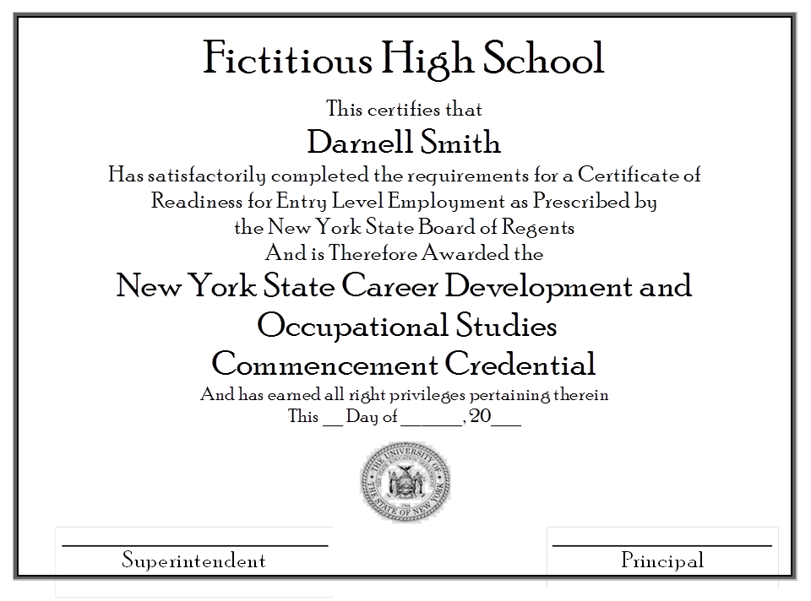

Slide 13
Resources
June 2013 Special Education Field Advisory: NYS Career Development and Occupational Studies Commencement Credential - http://www.p12.nysed.gov/specialed/publications/ CDOScredential-memo-613.htm
CDOS Learning Standards http://www.p12.nysed.gov/cte/cdlearn/
Career Development and Occupational Studies (CDOS) Resource Guide - http://www.p12.nysed.gov/cte/cdlearn/cdosresourceguide.html
NYS Career Plan - http://www.p12.nysed.gov/cte/careerplan/
CareerZone: A comprehensive career exploration and planning system developed by the NYS Department of Labor - www.careerzone.ny.gov
NYS Work-Based Learning Manual http://www.p12.nysed.gov/cte/wbl/home.html

Slide 14
Resources (con’t)
The National Secondary Transition Technical Assistance Center (NSTTAC) - http://www.nsttac.org/content/summary-performance-resources
Regional Special Education Technical Assistance Support Centers (RSE-TASC)Transition Specialists - http://www.p12.nysed.gov/specialed/techassist/rsetasc/tslist.htm
Training RSE-TASC -http://www.p12.nysed.gov/specialed/techassist/rsetasc/locations.htm
Transition Services Professional Development Support Center http://www.p12.nysed.gov/specialed/techassist/announcePDSC.htm
Transition Source - http://www.transitionsource.org

Slide 15
Technical Assistance
Questions: email CDOScomment@mail.nysed.gov
P-12: Office of Special Education: Diploma and Nondiploma Exiting Credentials http://www.p12.nysed.gov/specialed/gradrequire.html
Special Education Policy (518) 473-2878

Slide 16
Webinars
Module 1 – Overview
Module 2 – Career Plan and CareerZone
Module 3 – CDOS Learning Standards
Module 4 – CTE Coursework and Work-
based Learning
Module 5 – Employability Profile
Module 6 – National Work Readiness
Credentials

