Slide 1
Woodlake Hills Middle School
Open House
Annual Title I Meeting and Benefits of Parent and Family Engagement
Annual Title I Meeting and Benefits of Parent and Family Engagement

Slide 2
Annual Title I Meeting
Parent’s Rights: All schools receiving Title I funds are required to convene an annual Title I parent meeting twice a year
to inform parents and families of their school’s participation
to explain the requirements of the Title I program
to explain the right of parents to be involved
Our school is a Title I Schoolwide program
ALL students are able to participate and receive additional support

Slide 3
What is Title I ?
Title I is a federal funded grant program that provides schools with additional academic support and learning opportunities for students at schools that have higher percentages of socioeconomically disadvantaged children
How do we receive Title I Funds ?
A Title I school is a campus that receives Title I funds based on the eligibility of students for Free & Reduced Lunch (Turn in lunch application asap).
What is the purpose of Title I ?
To ensure that all children have a fair, equal and significant opportunity to obtain a high-quality education, and reach, at a minimum, proficiency on challenging State academic achievement standards and State academic assessments.
Notes:
Preparation:
Create a list of acceptible dad jokes (google will help with this). Put the list in an envelope marked: OPEN IN CASE OF DAD JOKE EMERGENCY. Place envelops around the room so that anyone needed help finding a dad joke can easily access one.
Display this slide so that all participants can see.
If possible, have a visible timer and give the groups about 2-3 minutes per round.

Slide 4
Title I Campus Goals-DIP & CIP
High-quality student academic assessments
Supplemental services to assist struggling students
Coordination and integration of federal funds and programs
Strategies to implement effective parent and family engagement
Title I, Part A parents have the right to be involved in the development of this plan
Notes:
If you have time, you could have all the “last to laugh” people from each circle form a “CIRCLE of CHAMPIONS”. Everyone, those in the circle and those watching, chants to see how long the champions can last without laughing.

Slide 5
Title I Schoolwide Program ADVANTAGES
Title I Funds provide additional opportunities to supplement the school's existing programs such as but not limited to;
Tutoring support to assist students struggling to meet state standards
Additional supplemental staff, programs, materials and supplies
Conduct parental involvement meetings, trainings, and activities
Recruiting, hiring and retaining highly effective teachers
Title I Parental Engagement Requirements
Annual Title I Meeting
Parent Engagement Policy
Parent Compact
Parent Opportunities (volunteering, committee memberships, trainings and activities
Notes:
Directions:
Give each person in the room an index card or sheet of scratch paper and make sure everyone has something to write with
Use a visible timer that everyone in the room can see.
After partners have shared with each other, randomize to choose 1-3 groups to share their favorite question and answer.

Slide 6
Parent's Rights
As a parent you are entitled to know
the qualifications of your child's teacher
if your child has been assigned or taught for 4 or more consecutive weeks by a teacher who is not Highly Effective the school's current paraprofessional and teacher Highly Effective status
how your school is performing on campus and state assessments
Parent is aware that we Use campus and state assessment data to align curriculum to state and district academic standards
Adjust instructional practices based on assessment data analysis
Notes:
Directions:
You can change the question to one you prefer or to repeat the activity at different times.
Use a visible timer.
Demonstrate both positions while giving directions. The upside-down flamingo is included so that anyone who may have mobility or balance issues can participate without being singled out.
After partners have had a chance to share, randomize to call on 1-3 people to share their answer.

Slide 7
Parent's Rights-Continued
As a parent you have the right to be involved in the school's programs and take part in opportunities provided:
Volunteer in child's classroom
Observe classroom activities
Participate in decisions relating to the education of their children
Serve on parent advisory board
Assist in the review and revision of Parent Engagement Policy, School Compact, and Title I Plan (Campus Improvement Plan-CIP)
Notes:
Directions:
Notify the person or people sharing ahead of time. If you are going to have 1-3 people share at a time at a faculty meeting, let them know 1-2 weeks ahead of time when their turn will be.
OR
During a longer meeting, give everyone one time to find something to share (get something from your desk during a break, or find something in your backpack, etc.). Then put everyone into groups of 4-6 to share with each other.
Consider having a THEME: Share something that reminds you of your favorite teacher. Share something that make you think of our cores value of Consistency.
Take a picture of the person with their object and make a collage when everyone staff member has shared.

Slide 8
Parent Engagement Plan
This plan addresses how the school will involve parents in an organized, ongoing and timely way in the development, implementation, and review of the parent engagement program. Components include:
Convene an annual meeting
Provide a flexible number of meetings
Provide timely information about parent and family engagement activities
Provide information to parents about curriculum and assessment
If requested, provide additional meetings with parents to discuss decisions for the education of their child
How the school will build capacity in parents and staff for strong parental involvement

Slide 9
School-Parent Compact
The school-parent compact is a written agreement…
That describes how parents and families, school staff, and students share the responsibility for improved student academic achievement
That addresses high-quality curriculum and instruction to meet State academic standards
The ways in which parents will support their child’s learning
That stresses the importance of frequent communication between school and home, and the value of parent-teacher conferences
That affirms the importance of parents and families in decisions relating to the education of their children
Title I, Part A parents have the right to be involved in the development of the school-parent compact

Slide 10
Additional Title I Expenditures How will Parental Engagement funds be spent?
Parent Nights – to provide parents with information, tools and strategies on how they can reinforce and support learning at home.
Kindergarten Parent Report Card Progress Information Meeting
•Math Night
•Literacy Night
•Science/STEAM Night
•NEW Family Leadership Institute (FLI)
Title I Funded Staff Positions
Supplemental Materials and Supplies
Reading & Math Materials
Assessment Materials
Professional Learning for Staff
Parental Engagement Activities
Extended Day Tutoring
HB 4545

Slide 11
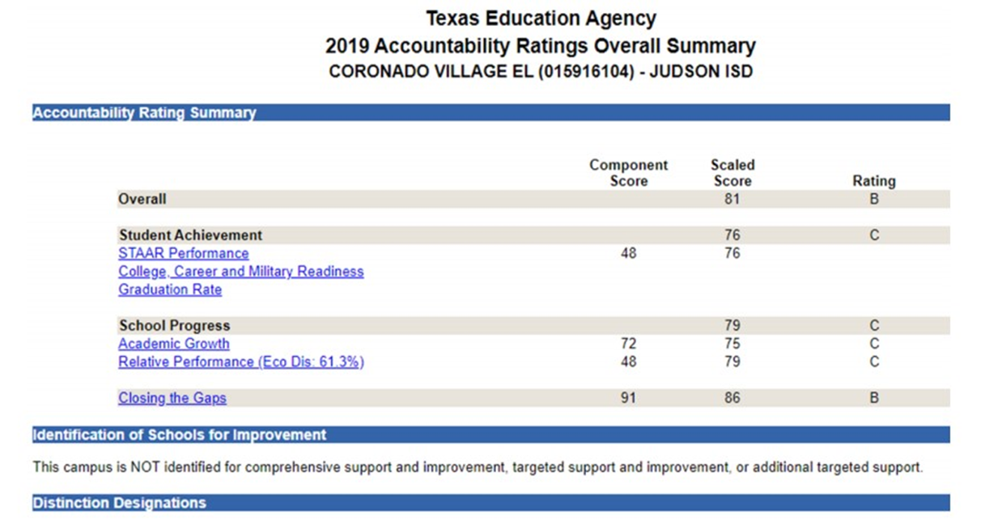
Accountability Ratings
Notes:
Take a deck of cards with symbols in all four corners. Choose some cards in the deck (roughly the same number of cards as participants), cut the cards into 4 pieces with the symbol on each piece.
Mix the cards up and divide them into envelopes. One envelope per group.

Slide 12
STAAR Performance Goals
Subject Overall score: all grade levels combined | 2021-2022 School Yr. (Approaches) | 2022-2023 Goal
RLA | 67.08% | 70%-Approaches
Math | 53.29% | 60%-Approaches
Science | 70.99% | 75%-Approaches
Social Studies | 48.99% | 60%-Approaches
Notes:
Directions:
You can change the question to one you prefer or to repeat the activity at different times.
Use a visible timer.
Change the question stems on screen to match your campus academic talk stems
After partners have had a chance to share, randomize to call on 1-3 people to share their answer.

Slide 13
VOLUNTEER
Classrooms
Library
Cafeteria
Office
bus loop/loading area
Hallways
Field trips
Student events (field day, science fair, etc…)
PARTICIPATE
Review, revision & update meetings of Parental Engagement Policy and School-Parent Compacts
Parent Surveys & Survey meetings
Parent (academic) nights
Parent Workshops/trainings
•Parent-Teacher Conferences
Opportunities to Engage
Notes:
Directions:
You can change the question to one you prefer or to repeat the activity at different times.
Use a visible timer.
Change the question stems on screen to match your campus academic talk stems
After partners have had a chance to share, randomize to call on 1-3 people to share their answer.

