Slide 1
Community Relations – Conduct on School Premises
GKA (Legal) and (Local)
Tuesday, November 28, 2023
Principals Meeting

Slide 2
GKA Legal
Refusal of Entry or Ejection of Unauthorized Persons
Person poses substantial risk of harm to any person OR
Person behaves in a manner that is inappropriate for a school setting AND
The administrator, resource officer or peace officer issues a VERBAL warning to the person that the person’s behavior is inappropriate and may result in the person’s refusal of entry or ejection; AND
The person persists in that behavior.
A district shall maintain a record of each verbal warning issued, including the name of the person to whom the warning was issued and the date of issuance.
At the time of the refused entry or ejection from a school district property, the district shall provide written information explaining the appeal process.

Slide 3
GKA Local – Additional Parameters
District Officials may request assistance from law enforcement in an emergency or when a person is engaging in behavior rising to the level of criminal conduct.
District’s appeal process is the formal grievance process as explained in FNG (Legal/Local)
A person appealing under the District’s grievance process shall be permitted to address the Board in person within 90 calendar days of filing the initial complaint, unless the complaint is resolved before the Board considers it.

Slide 4
Translation of Policy
What this means…
What this does NOT mean…
Must be based on an activity happening at a campus.
Administrators are the first line of defense in handling disruptions by visitors on campus/district property.
Warnings must be issued prior to a formal Administrative Trespass Warning (ATW) or Criminal Trespass Warning (CTW).
Warnings must be tracked and documented.
ATWs should be utilized prior to a formal CTW by law enforcement.
ATW timelines are flexible but may not exceed 1 year.
CTW timelines may not exceed 1 year.
CTWs are no longer being issued.
CTW or ATWs can be issued for items occurring at locations not related to Judson ISD.
Persons do not have to be notified of their rights.
Police officers may not be called upon for assistance.
CTWs or ATWs can be issued indefinitely.
First time offenders that leave the premises peaceably may be issued a CTW or ATW after the fact.

Slide 5
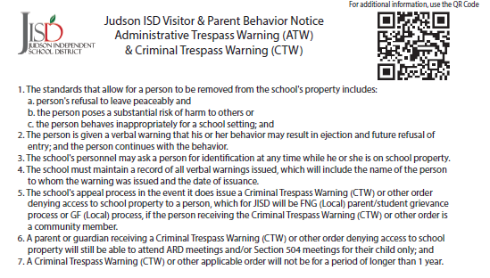
Documentation
Cards
Campuses will be provided with an initial set of information cards
Additional copies of the cards can be obtained from the Judson ISD Print Shop
Cards will be delivered asap
A copy of the information is provided in the Principal Leadership Hub
Warning/ATW Form
https://forms.office.com/r/Wv5VyjBwuR

