Slide 1
Understanding Conflict
Anthony j. Harrison, lmsw

Slide 2
When thinking about conflict, what words come to mind?
Natural
Necessary
Normal

Slide 3
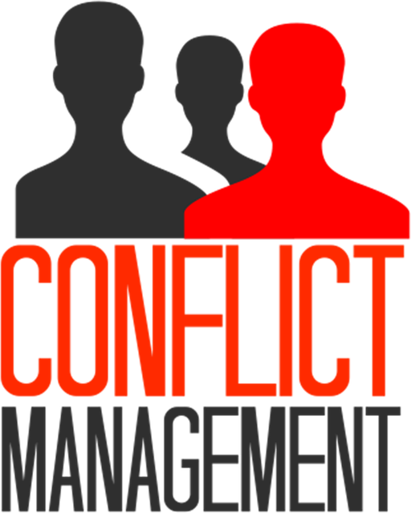
Remember…
The problem is not that conflict exists, but it is the way we handle it

Slide 4
Take a moment to think about a recent conflict you’ve had…
How did you handle it?
What were the end results?

Slide 5
In order to adequately handle conflicts…
We must thoroughly understand the nature of them.
Conflicts can seem insurmountable in the moment.
A lot of times, however, there is an opportunity for something productive to come out of a conflict.

Slide 7
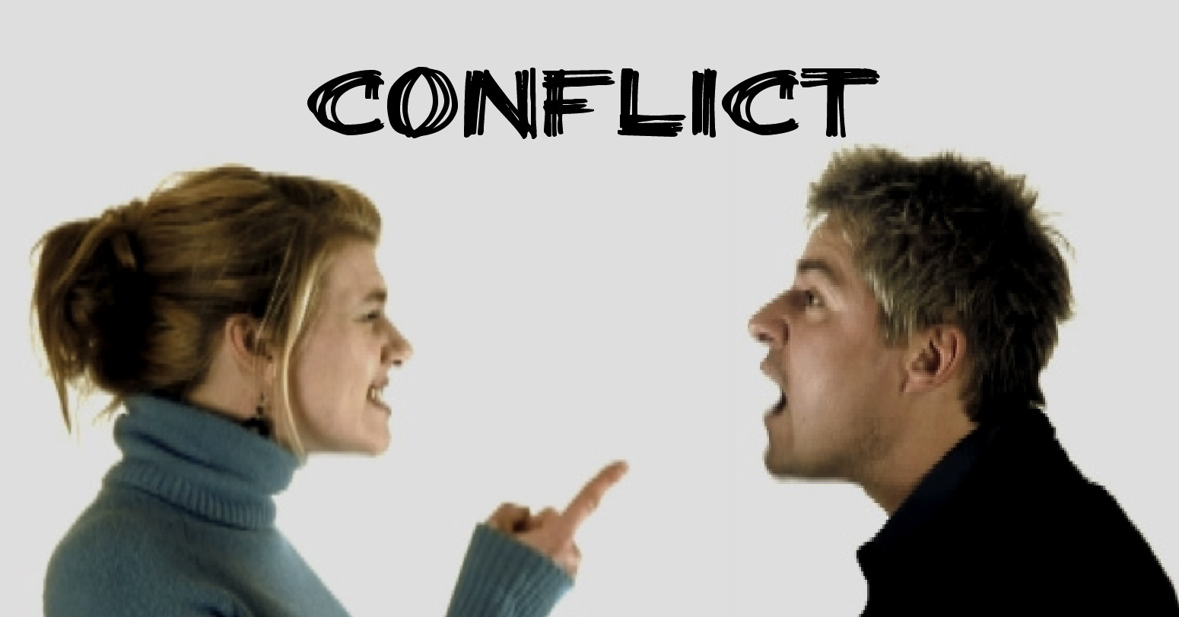
What is conflict?
When do YOU consider yourself to be in a conflict?
What do these conflicts typically involve?
Are there common themes that you can identify?

Slide 8
When does conflict occur?
We must learn to recognize the very first instance conflict occurs
What are some examples of when conflicts typically happen?

Slide 10
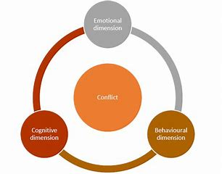
The three dimensions of conflict
The cognitive dimension (Perception)
The emotional dimension (Feeling)
The behavioral dimension (Action)
Every person handling a conflict MUST identify in which dimension/s the conflict first manifests itself

Slide 11
Conflict as PERCEPTION
“a belief or understanding that one’s own needs, interests, wants, or values are incompatible with someone else’s

Slide 12
Example of Conflict as Perception

Slide 13
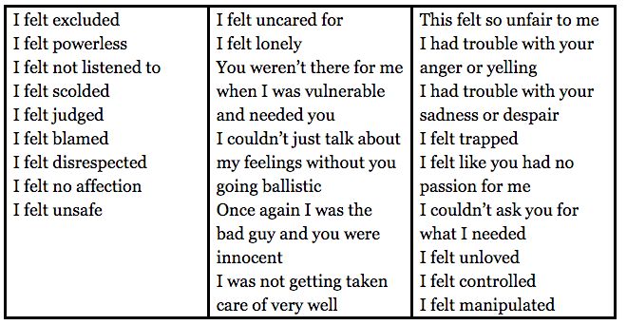
Conflict as FEELING
Conflict also involves an emotional reaction to a situation or interaction that signals a disagreement of some kind.
Some emotions that might be felt:
Fear
Sadness
Bitterness
Anger
Hopelessness

Slide 14
Conflict as FEELING cont.
If we feel any of these emotions in response to another person or situation, we FEEL that we are in conflict, so therefore we are.
Often, a conflict exists because one person feels in conflict with another, even though those feelings are not reciprocated by (or even known to) the other person.
The conflict is REAL to the individual experiencing the emotions.
Once the feelings are addressed, the chance of resolving the conflict increases

Slide 15
Conflict as ACTION
“What we do to express our feelings, articulate our perceptions, and get our needs met in a way that has the potential for interfering with someone else’s ability to get his or her needs met”
Conflict behavior may be:
Destructive or violent
Constructive
Friendly

Slide 16
Conflict as ACTION cont.
Whether the nature of the action is positive or negative, the purpose of the conflict behavior is either to express the conflict or get one’s needs met.

Slide 17
Remember…
When people or groups are in conflict, they are dealing with different and sometimes contradictory dynamics in these different dimensions which make people in conflict appear to behave irrationally.
Stopping the behavioral aspect of conflict does not necessarily mean the conflict will be resolved. Dealing with ALL dimensions of the conflict will bring more lasting solutions.

Slide 18
Think back to a recent conflict you’ve experienced…
What dimension of conflict was at play?
When did the conflict first manifest?

Slide 19
What causes conflict?

Slide 20
The center of conflict
All conflicts stem from a person’s needs
These needs, however, are heavily affected by other forces

Slide 21
History
People’s histories affect their values, communication style, emotional reactions, and the structure in which they operate
It is a powerful influence on the course of a conflict.

Slide 22
Values
Values are the beliefs we have about what is important, what distinguishes right from wrong, and which principles should govern how we lead our lives.
When a conflict is experienced as an issues of values, the conflict oftentimes becomes more charged.
People define themselves by their values. When they believe these beliefs are under attack, they feel attacked.

Slide 23
Reflection:
Can there ever be a conflict in which no one is wrong?
Have you ever been in a conflict with someone who thinks he/she is wrong?

Slide 24
Structure
The external framework (structure) in which an interaction takes place or an issue develops.
This may include:
Available resources
Decision making procedures
Time constraints
Communication procedures
Physical setting

Slide 25
Emotions
Emotion is the energy that fuels conflict
Emotions have the power to control behavior
Emotions can also be a source of power (strength, courage, perseverance)
Emotions are generated both by particular circumstances/interactions, and by previous experiences.

Slide 26
Emotions ex.
Let’s say, for instance:
Somebody raises their voice to me.
I may be reacting to:
A) the context and meaning of that particular behavior
B) all the times in the past when somebody raised their voice to me.

Slide 27
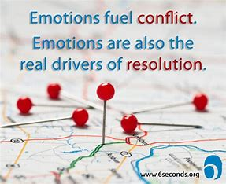
Emotions cont.
Emotions can fuel conflict, but they are also key to de-escalating them as well.
Emotions can prevent, moderate, or control conflict.

Slide 28
Communication
People are imperfect communicators, and this reality oftentimes generates conflict.
Miscommunications play a major role in many conflicts.
Conflict often escalates because people feel that they have communicated something accurately when they actually did not.

Slide 29
The disconnect…
Some people in conflict are interested in getting to a solution as quickly as possible.
Others, however, are most interested in sharing or expressing their feelings than getting results.
The kicker is that neither of these approaches are wrong. It all ties back to what a person needs.

Slide 30
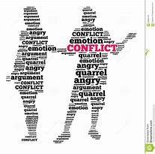
People in conflict
Is it acceptable to be in a conflict?
How should people behave in a conflict?

Slide 31
Raise your hand if…
You tend to avoid conflict whenever possible
You tend to confront them head on when faced with potential conflicts

Slide 32
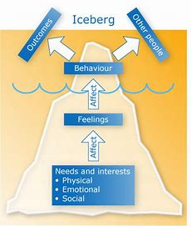
Behavior in conflict
People tend to behave differently when it comes to conflict
Furthermore, people’s behavior may vary depending on the type of conflict.

Slide 33
The range of conflict styles
Conflict styles range from behaviors that engages conflict to that which tends to avoid conflicts.
Avoidance: efforts are focused on preventing a conflict from surfacing, denying a conflict’s existence, or staying out of an existing conflict.
Engagement: person’s energy is directed towards participating in conflict, asserting their needs, expressing their feelings, putting forward their ideas, and promoting particular outcomes.

Slide 34
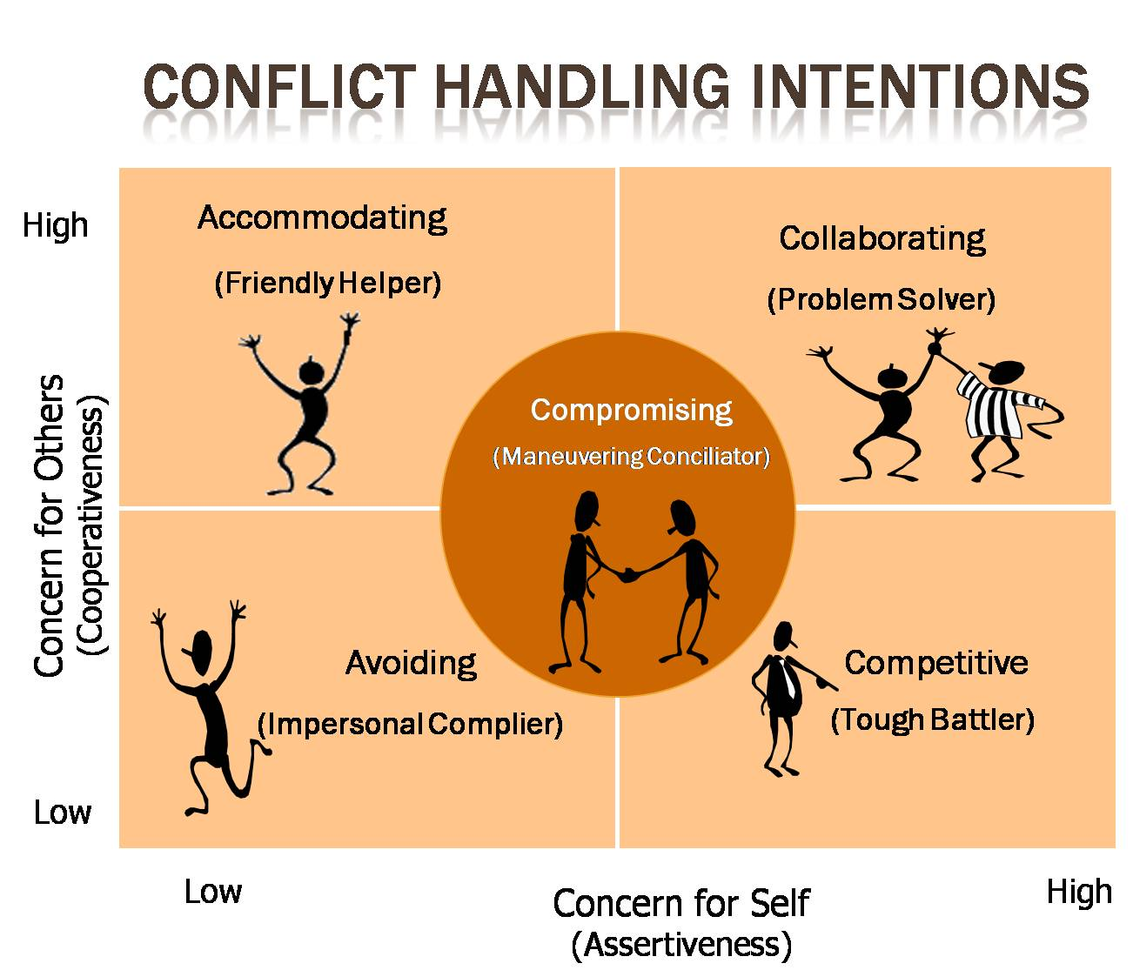
Five general strategies of approaching conflict
Competition
Collaboration
Accommodation
Compromise
Avoidance

Slide 35
Competition
Emphasizing your own interests
Going all out to meet your own needs
Defending your rights
One right solution
Winning over losing

Slide 36
Collaboration
Involves efforts to solve both sets of interests
Seeks a solution that meets all needs
Preserves a relationship
Explores a variety of solutions

Slide 37
Accommodation
Satisfying the interests of the other party, rather than your own interests
Focusing on maintaining a good relationship

Slide 38
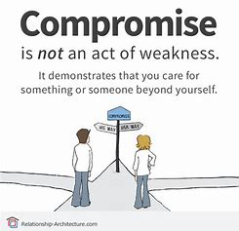
Compromise
Paying equal attention to both parties’ needs
Directed at sharing gains and losses jointly
Each conceding something to the other

Slide 39
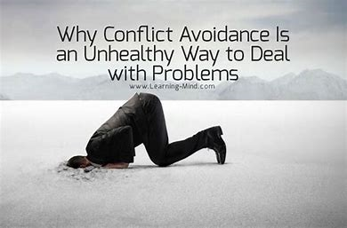
Avoidance
Low commitment to addressing your own and the other person’s interests and needs
Ignoring the conflict
Forgetting or dropping hard feelings
Moving away from the situation

Slide 40
Approaches to conflict
When people decide to engage in a conflict, they do so using different approaches depending on
a) their general assumptions about conflict
b) the particular circumstances they are facing

Slide 41
Power-based approaches
Key message: “Do what I want because I have the power to reward you or punish you in some way.
These approaches are often destructive, occasionally violent, and less likely to lead to improved relations.

Slide 42
Interest-based approaches
Involves the assertion of own needs and concerns and working toward a resolution that addresses them
Usually involves trying to understand and address interests of both parties

Slide 43
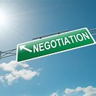
Negotiating during a conflict
Negotiators attack each other personally
Negotiators withhold information from each other and are suspicious of each other
Negotiators go straight into bargaining without understanding exactly why they are taking a particular position or what the alternatives are.
Negotiators proceed with a win-lose mindset

Slide 44
You cannot solve a problem without identifying the root cause of it…
Dealing with the perception of the problem
Dealing with the emotions associated with it
Focusing on communication

Slide 45
Active Listening
Concentrating on the messages you hear
Identifying feelings
Providing appropriate feedback

Slide 47
Active Listening
Think of a time when…
You felt actively listened to
How did it make you feel?

Slide 48
Active listening cont.
Think of a time when…
Somebody was distracted while you were speaking with them
How did this make you feel?

Slide 49
How anger plays a role in conflict

Slide 50
The very important role of calming techniques
Think about something that helps you calm down or relax when you feel frustrated (i.e. deep breathing, listening to music, etc.)
The key is to first RECOGNIZE your triggers, IDENTIFY you are beginning to feel irritated, and UTILIZE your calming techniques.
Never try to solve a conflict when you are angry.

Slide 51
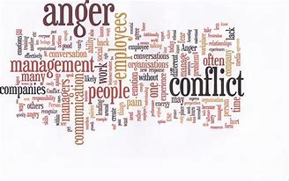
Remember…
The problem is not that conflict exists, but it is in the way we choose to handle it.

