Slide 1
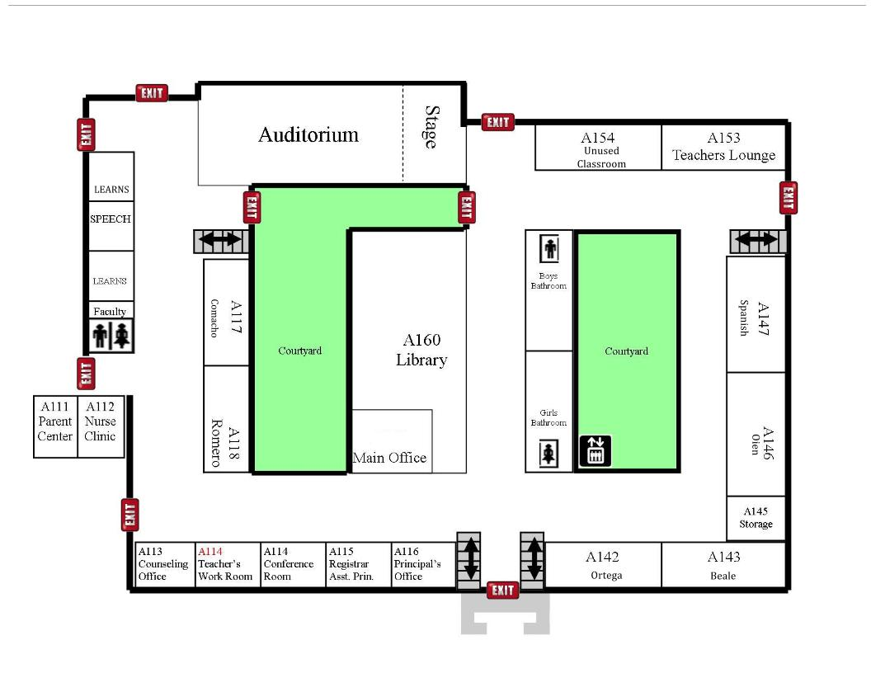
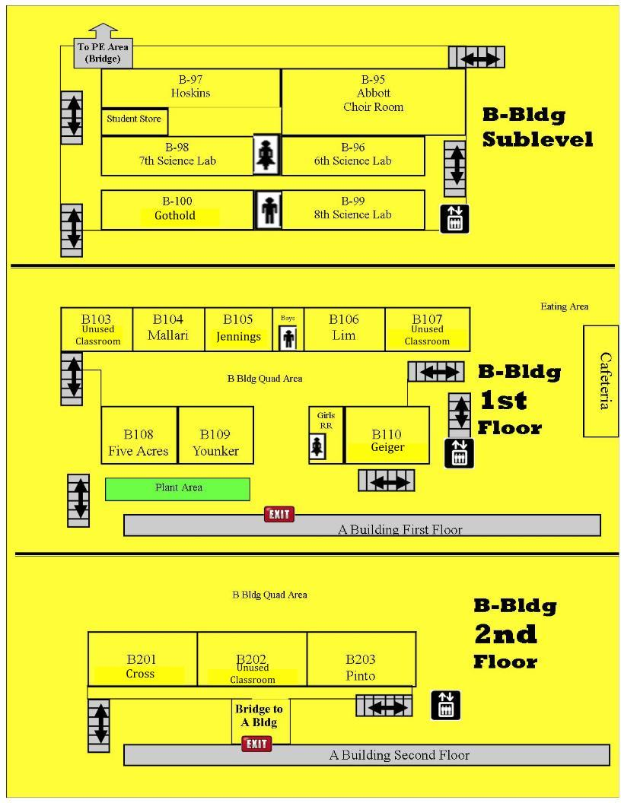
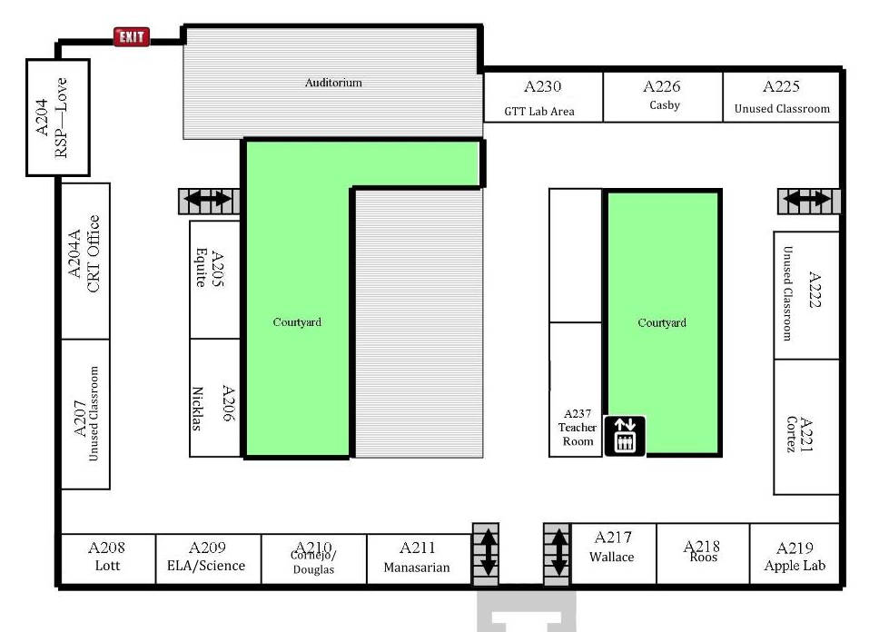
A-Building Level 1 - Main Floor
B-Building Levels 1-3
Confer-
ence
Room
A154
Teachers Lounge
A153
Cooking Room
B97
Holmes
8th Science Lab
A117
Wehrly
A147
Fonteno-
Hughes
A147
Love/Vanis
7th Science Lab
A126
Parent Center
A146
Roos
A146
Farinas
B103
Skycak
B105
Terre
B106
Bracamonte
Registrar
B104
Oien
B107
A114
Farinas
Instr. Coach
Attendance
Assist. Prin
A143
Fontenot
B109
Gaul
Lower
Band Room
B110
Chapman
C130
Nevarez
Band Room
A-Building Level 2
A230
Career Lab
A226
Design Lab
A225
Casby-Math
CWAS
B201
LEARNS
B202
LEARNS
B203
LEARNS
204A
VACANT
A205
Trapp
A222
Harris
A207
Haro-Banuelos
A206
Uka
A221
STARS
WSMA School Map
Mapa de Escuela
2020-2021
A208
Rosa
A209
Melchor
A210
Kobey
A211
Milnes
A217
Silverio
A218
Ko
A219
Avid Lab

