Slide 1
Hi!
Welcome to 8th Grade Math

Slide 2
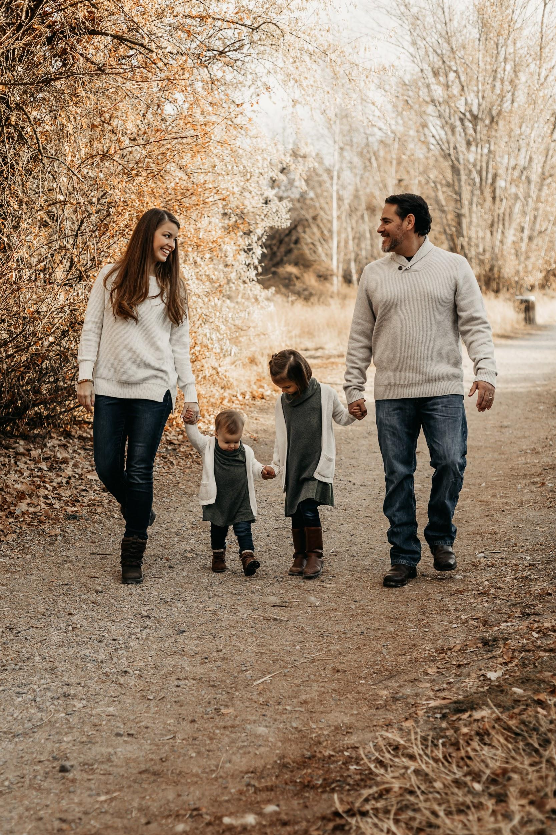
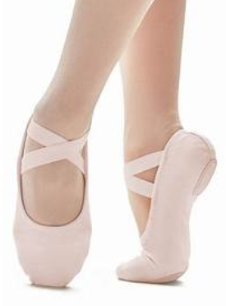
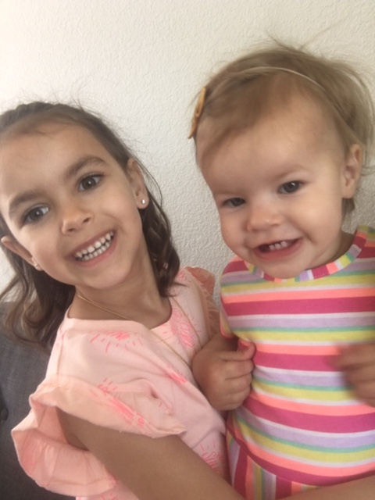
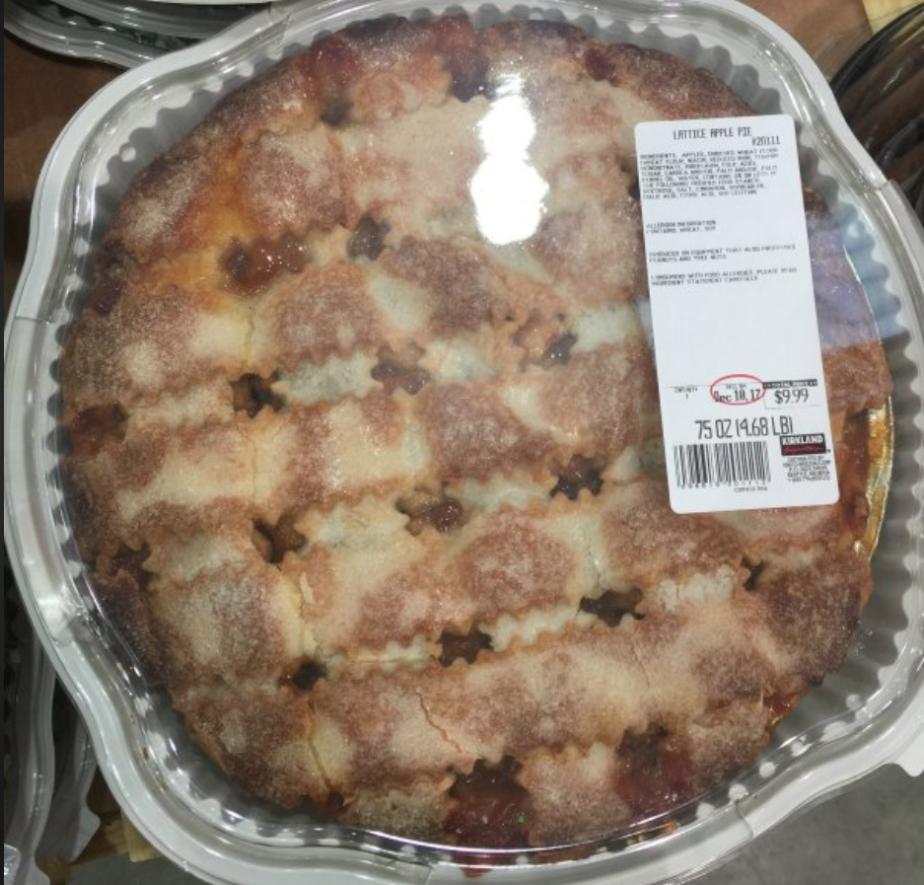
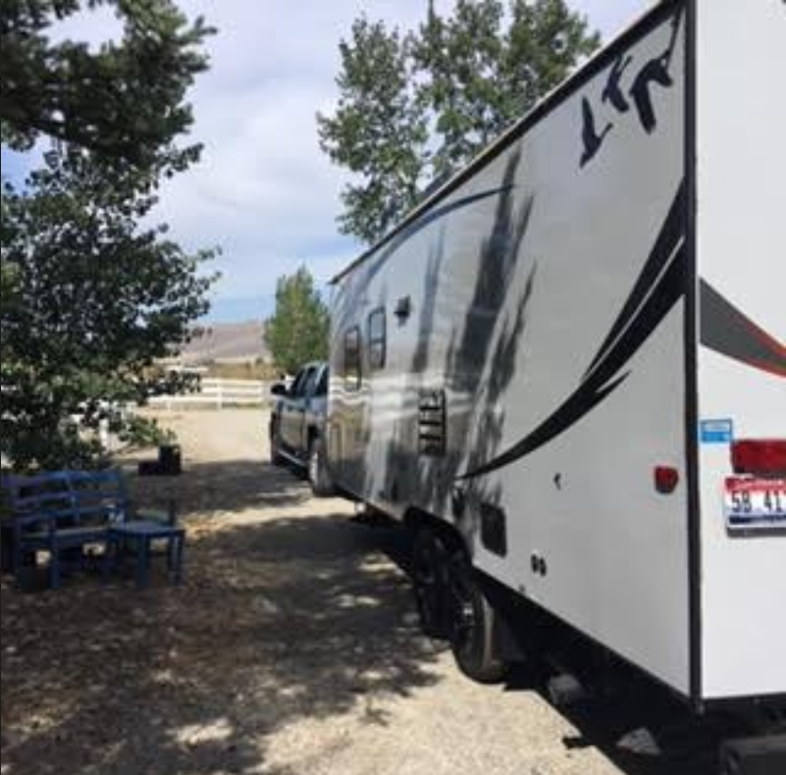
A little about me!
Amy Chilcote
I have run over 600 miles so far this year!

Slide 3
Materials for this class
Here’s what will be used this year in our class.
CC3 online ebook (code will be given in class)
Composition notebook
Glue stick, colored pens/markers, ruler
TI-30X calculator or higher
LOTS of pencils
Chromebook
Cell phones cannot be used during class.
Please ensure that your student is prepared each day. If you need help finding supplies please let me know.

Slide 4
Class Time
In class we will be learning new concepts, exploring ideas, taking notes, completing projects and sharing our thinking. We have an hour to spend together each day!

Slide 5
HOMEWORK
At the start of each unit I will give the students ALL of the homework for the entire unit. They can work on it at their own pace. However, at the start of class each day I will be going over specific problems. The schedule for these problems is located in daily agenda in google classroom. Ideally, the student should have the problems done that I will go over each day.
It is my expectation that students correct their work and check with me for understanding. Homework is our practice so it will not be given a formal grade in the gradebook. But it has value. First off, we need to practice concepts in order to learn them properly. Secondly, the completed and corrected homework can be used on homwork quizzes and tests throughout the unit.

Slide 6
Tests and quizzes
Quizzes:
Homework quizzes will be given periodically throughout each unit. The questions on the quiz match homework questions.
Test:
We will have a test at the conclusion of each unit (with the exception of unit 1). Students can use their completed homework and math notebook on tests.

Slide 7
RETAKES
I do allow retakes on tests. The criteria to meet in order to be given a retake are as follows:
Score lower than a 92% on the original assessment
Completed retake form with original test
Must be retaken before the next unit assessment
Students will be able to retake during VIKES. The highest they can score on a retake is a 92%.

Slide 8
Our Google Classroom
Make sure your student enrolls. Important and valuable inofrmation is uploaded daily.
Enrollment Codes:
2rd Period : hwqgbyv 3rd Period : xoota3x 4th Period : kei76nh 5th Period : wxnsuoa 7th Period : b6r3v4f

Slide 9
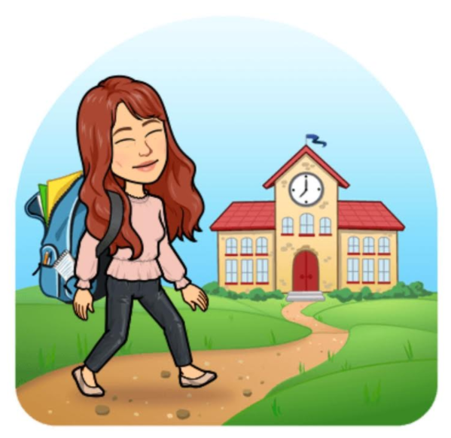
Email me anytime!
achilcote@msd134.org
Every Thursday, I will be sending out progress reports with added information about what we were working on, what we will be working on and any important due dates. The google classroom will be a great resource for your students as well.
Please don't hesitate to email if you have any questions or concerns.
* All infromation is subject to change based on teacher discretion

