Slide 1

OPEN ENROLLMENT
DATA PRESENTATION
February 8, 2024
Dr. Karen Dabney-Lieras
Executive Director, Student and Family Services

Slide 2


Priority Open Enrollment and Open Enrollment
A total of 1,384 families impacted by reconfiguration for the 2024-25 school year
were invited to complete a Priority Open Enrollment Survey.
974
Priority Open Enrollment
Applications Processed
December 11, 2023 - December 22, 2023
Families were notified - Monday, January 15th
25
Open Enrollment
January 1, 2024 - February 1, 2024
999
480 Open Enrollment Applications
January 1, 2024 - February 1, 2024
1,454 Total Applications
2

Slide 3
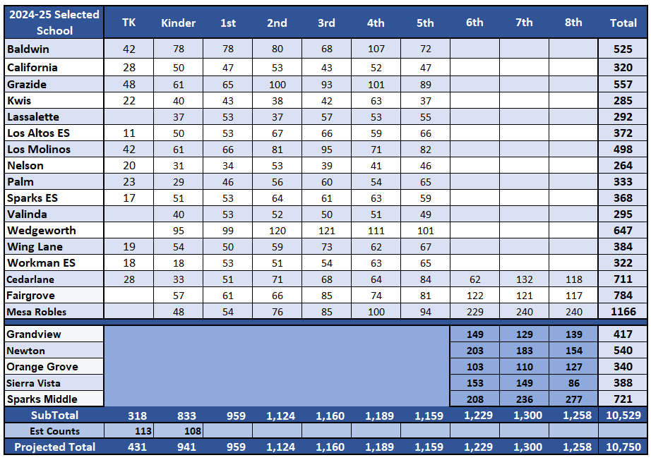
Rollover Projected Enrollment 2024-25 (TK-8)
With Historical Trends and Reconfiguration
3

Slide 4
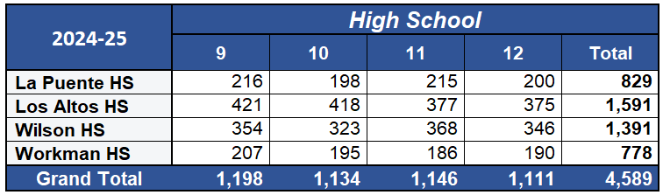
Rollover Projected Enrollment With Historical Trends
High Schools (9-12)
4

Slide 5
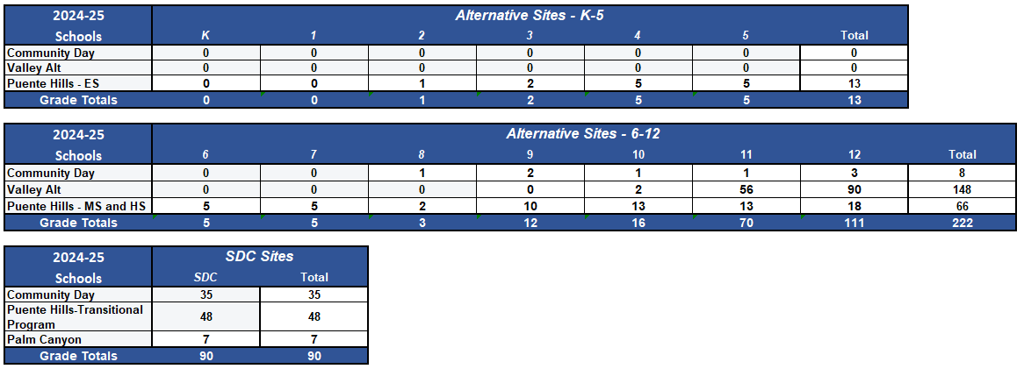
Additional Programs and Sites (K-12)
5

Slide 6
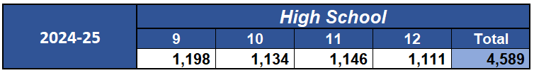

Total Projected Enrollment (TK-12)
2024-2025 Projected Enrollment 15,664
6

Slide 7


QUESTIONS?

