Slide 1
Celebrations Achievement, Commitment, Excellence
Hacienda La Puente Unified School District
Board of Education Meeting
February 8, 2024
Notes:
Are your classroom colors different than what you see in this template? That’s OK! Click on Design -> Variants (the down arrow) -> Pick the color scheme that works for you!
Feel free to change any “You will…” and “I will…” statements to ensure they align with your classroom procedures and rules!

Slide 2
Conditions of Learning

Slide 3
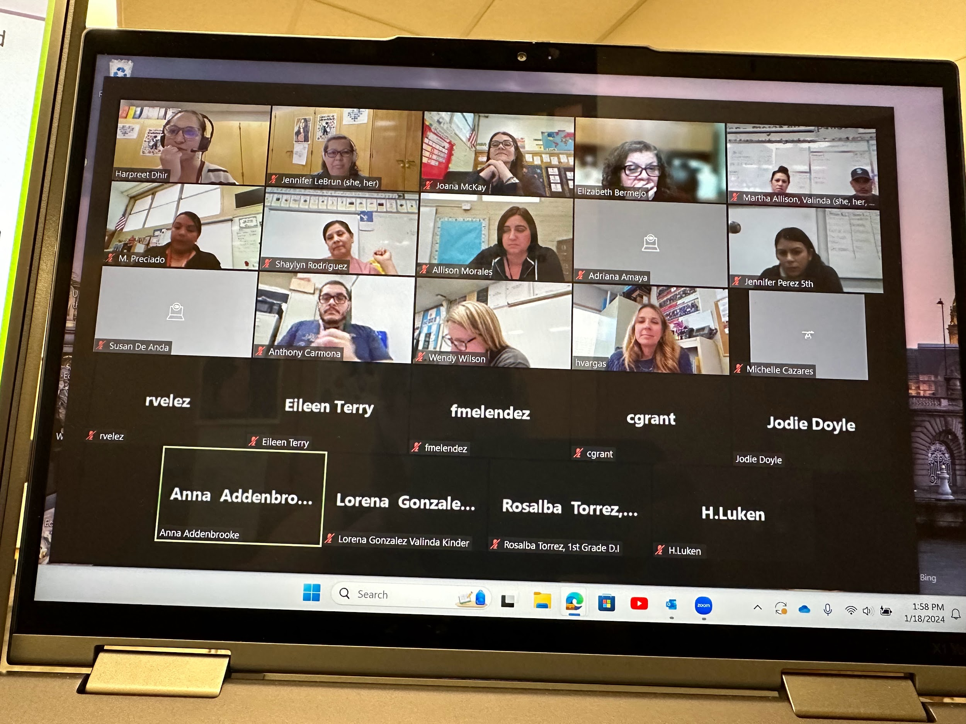
#DeeperIntoTheFourElements
Teachers collaborated to develop their
understandings of the NPDL’s four
elements using the Learning Design
Rubric and Dive into Deep Learning: Tools for Engagement.
NPDL PD 2.2
@ Valinda
1/18/24
3

Slide 4
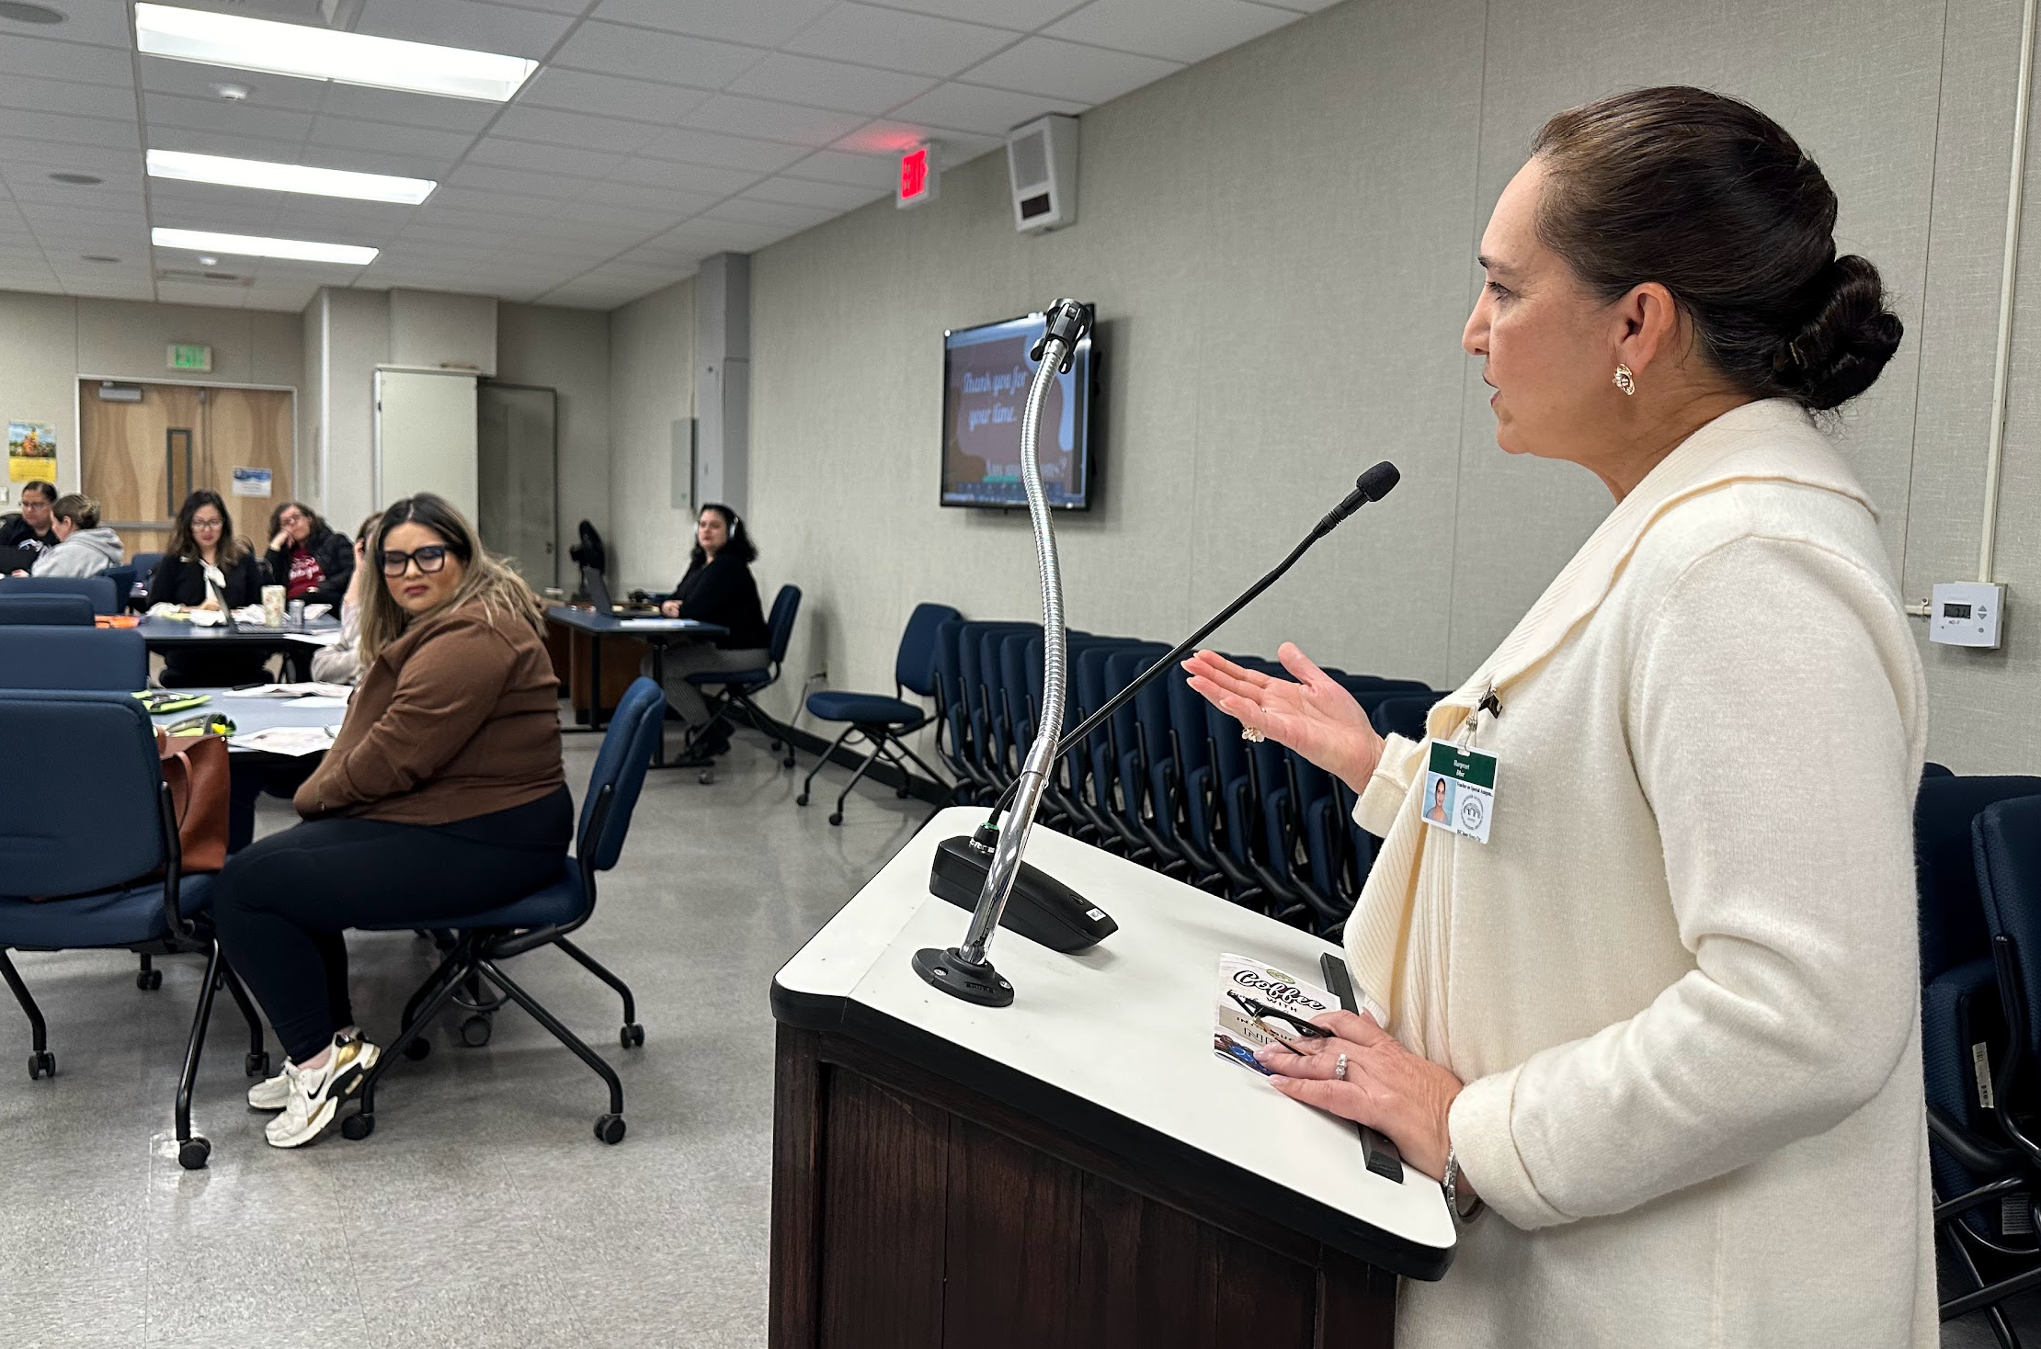
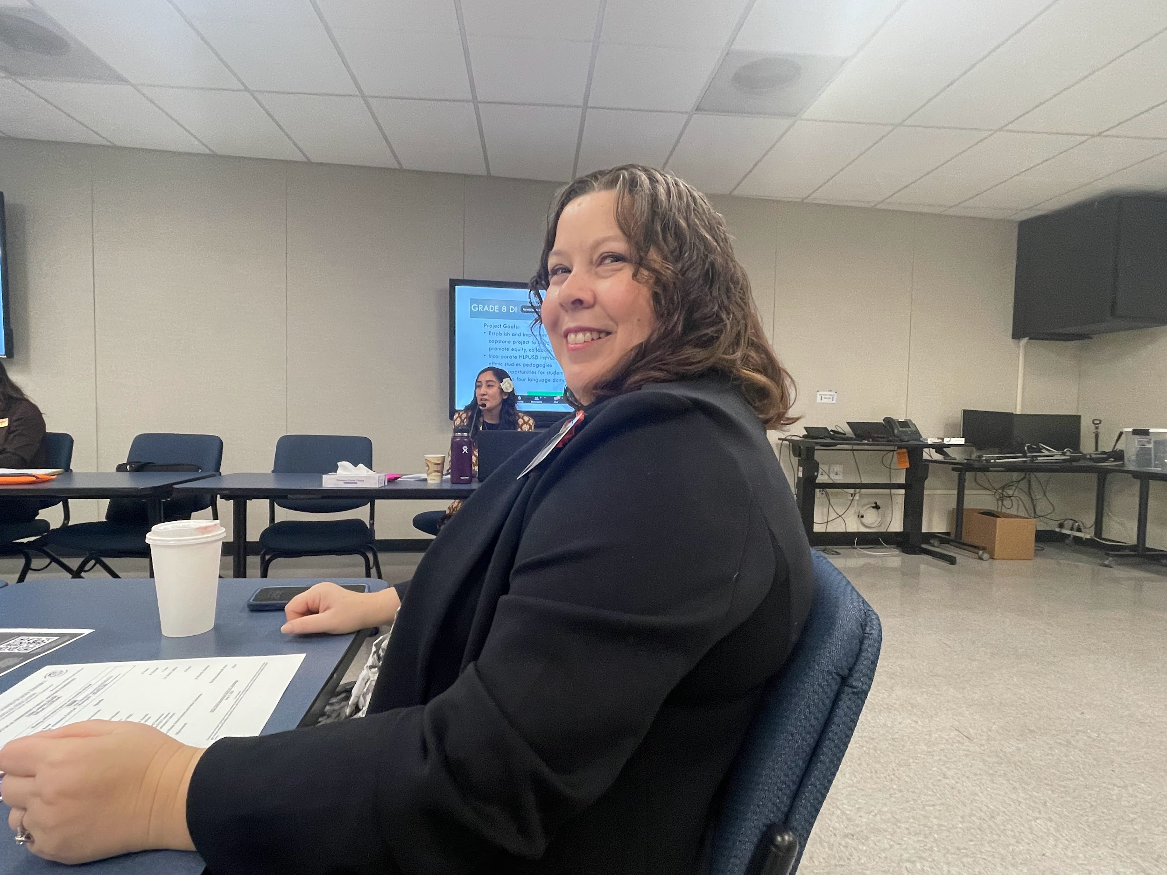
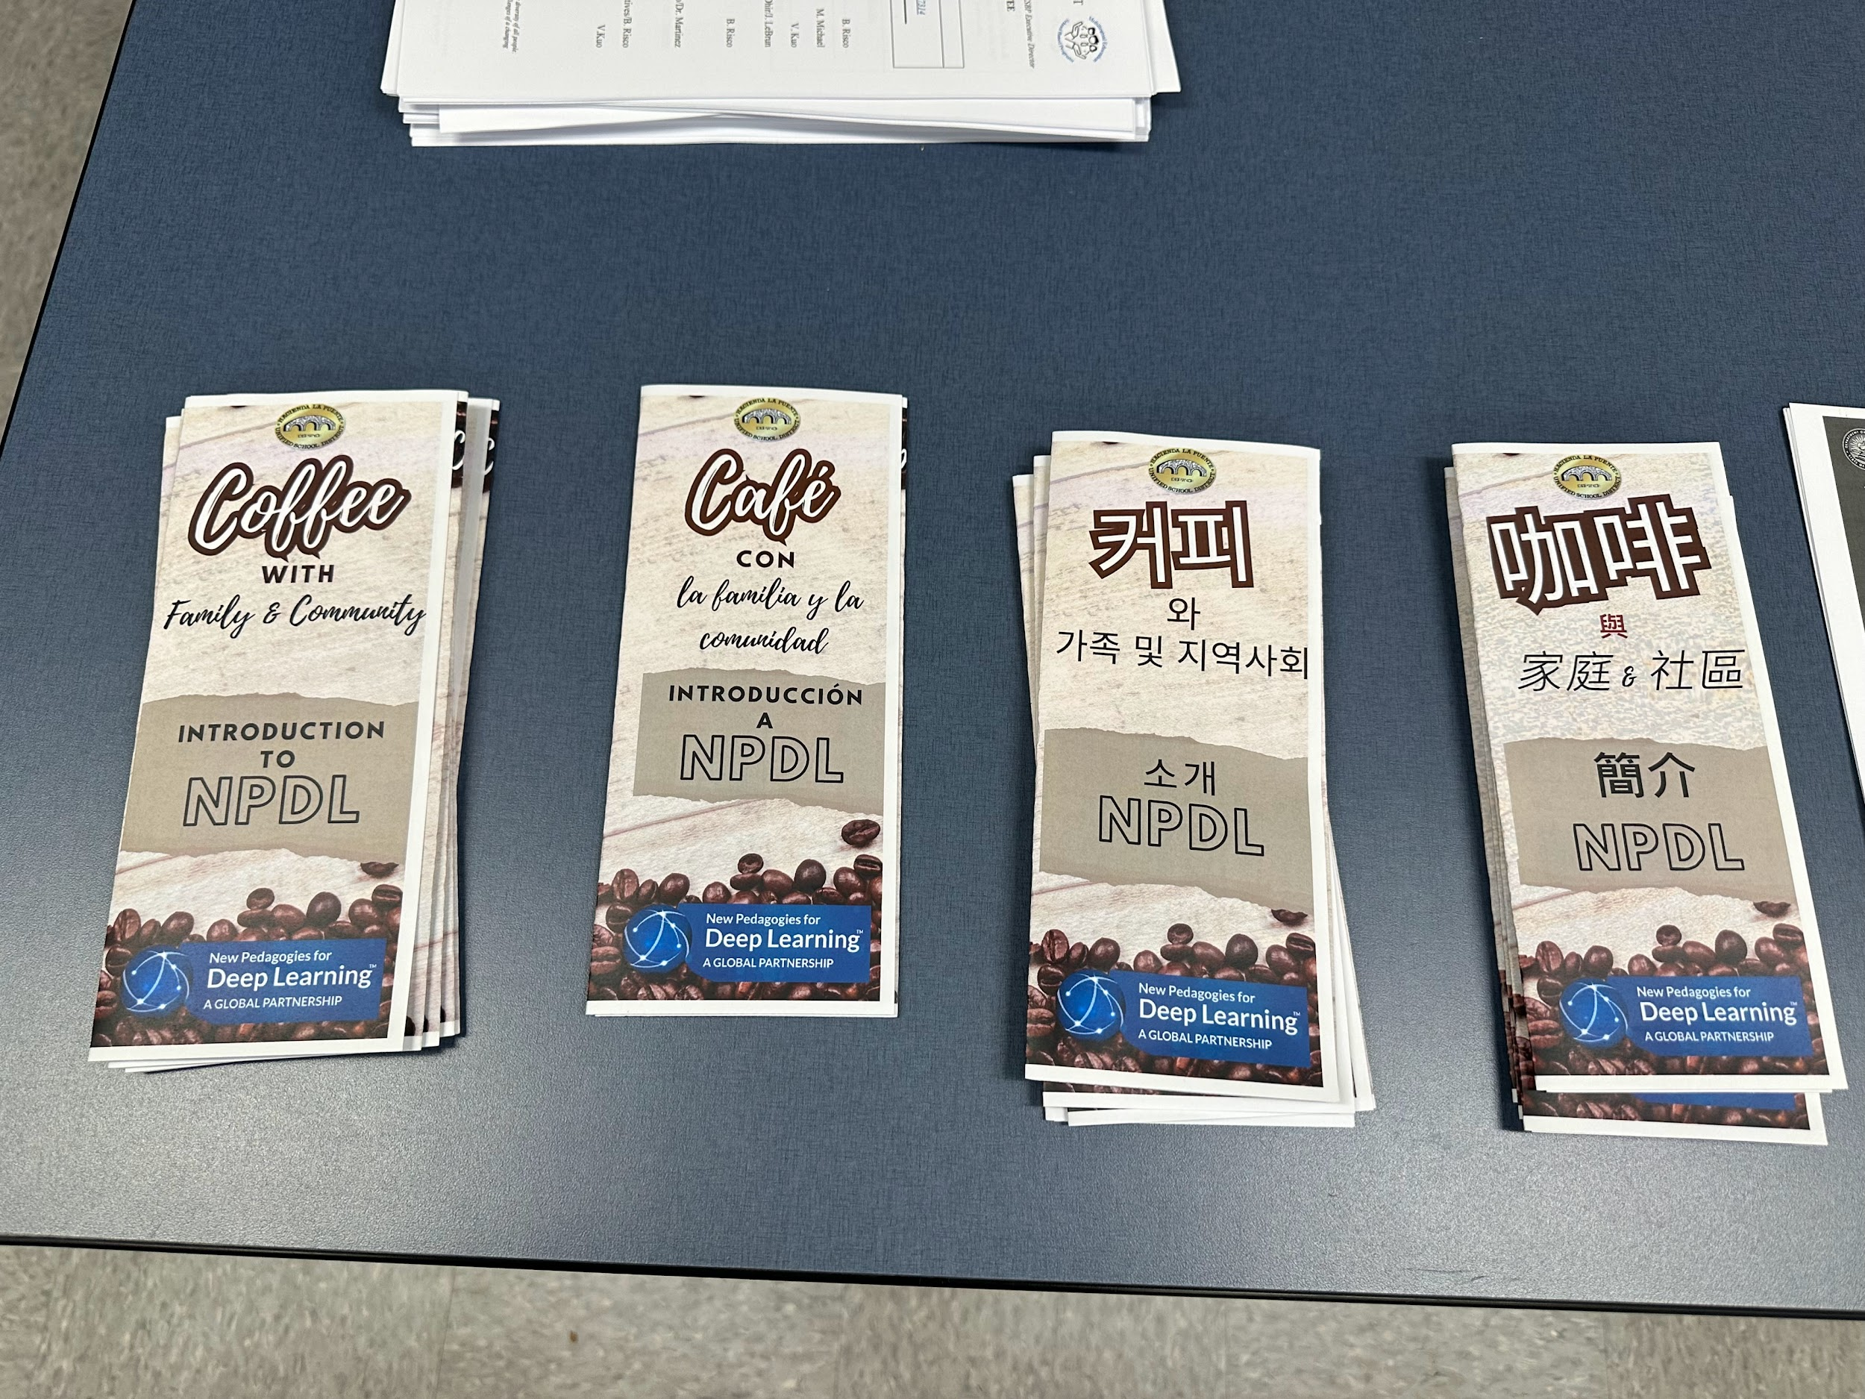
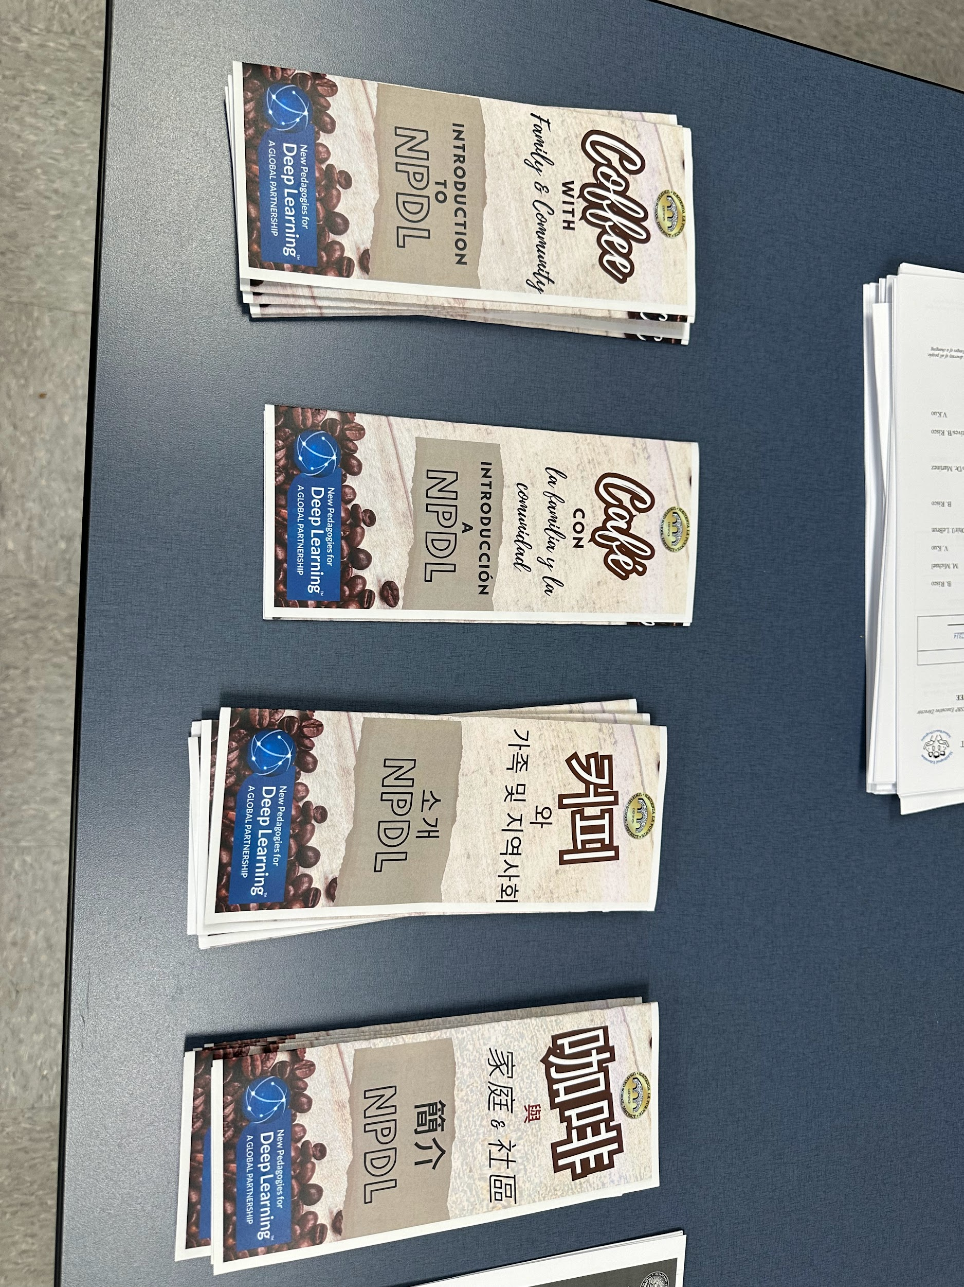
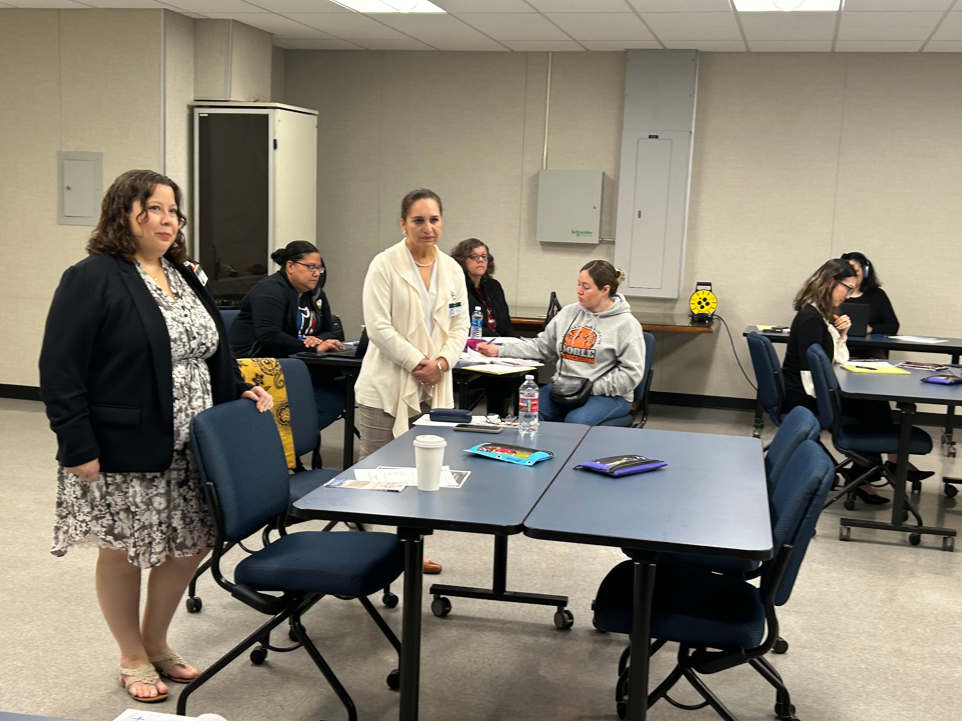
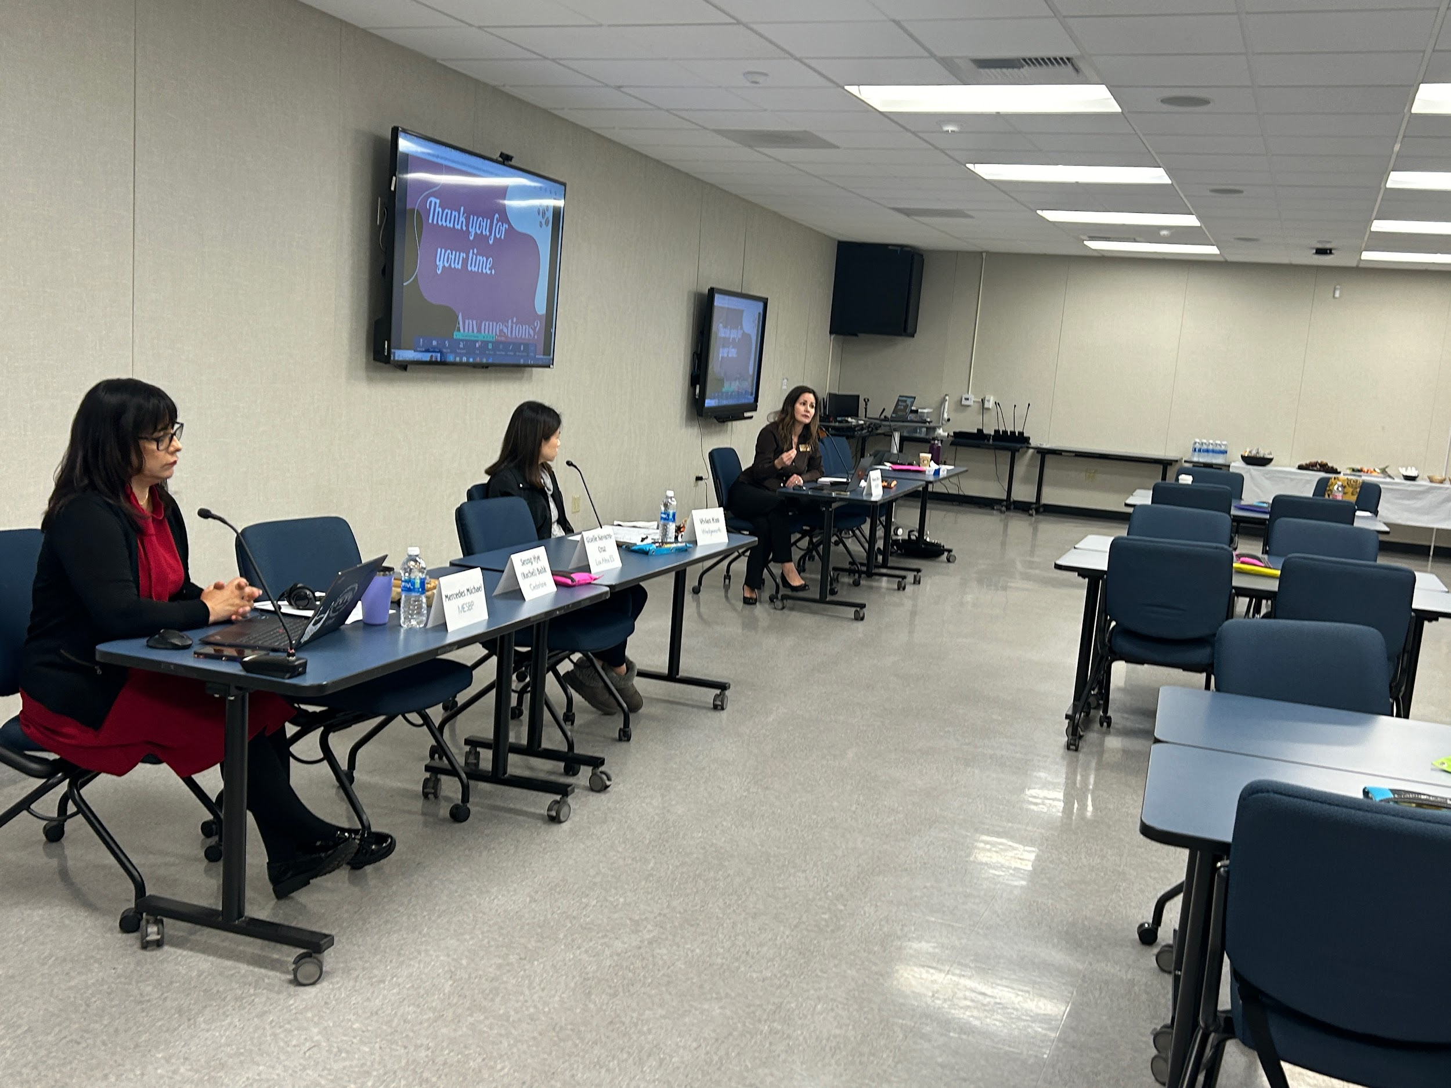
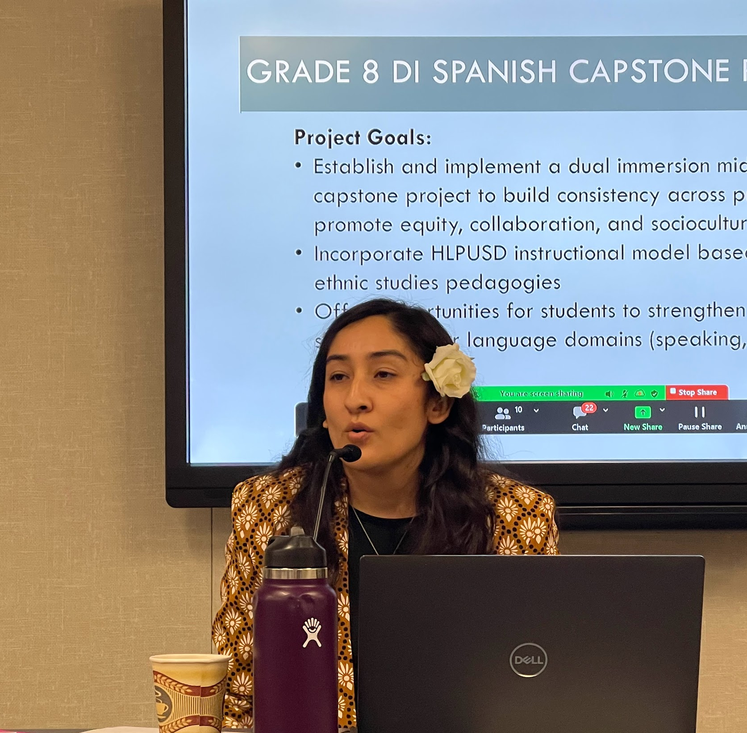
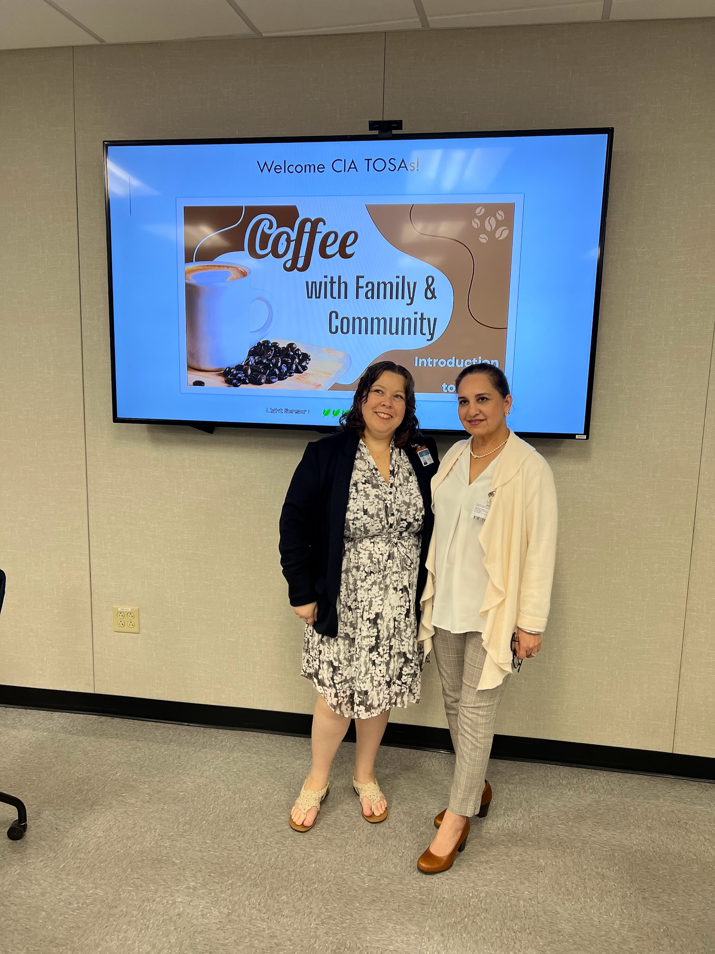
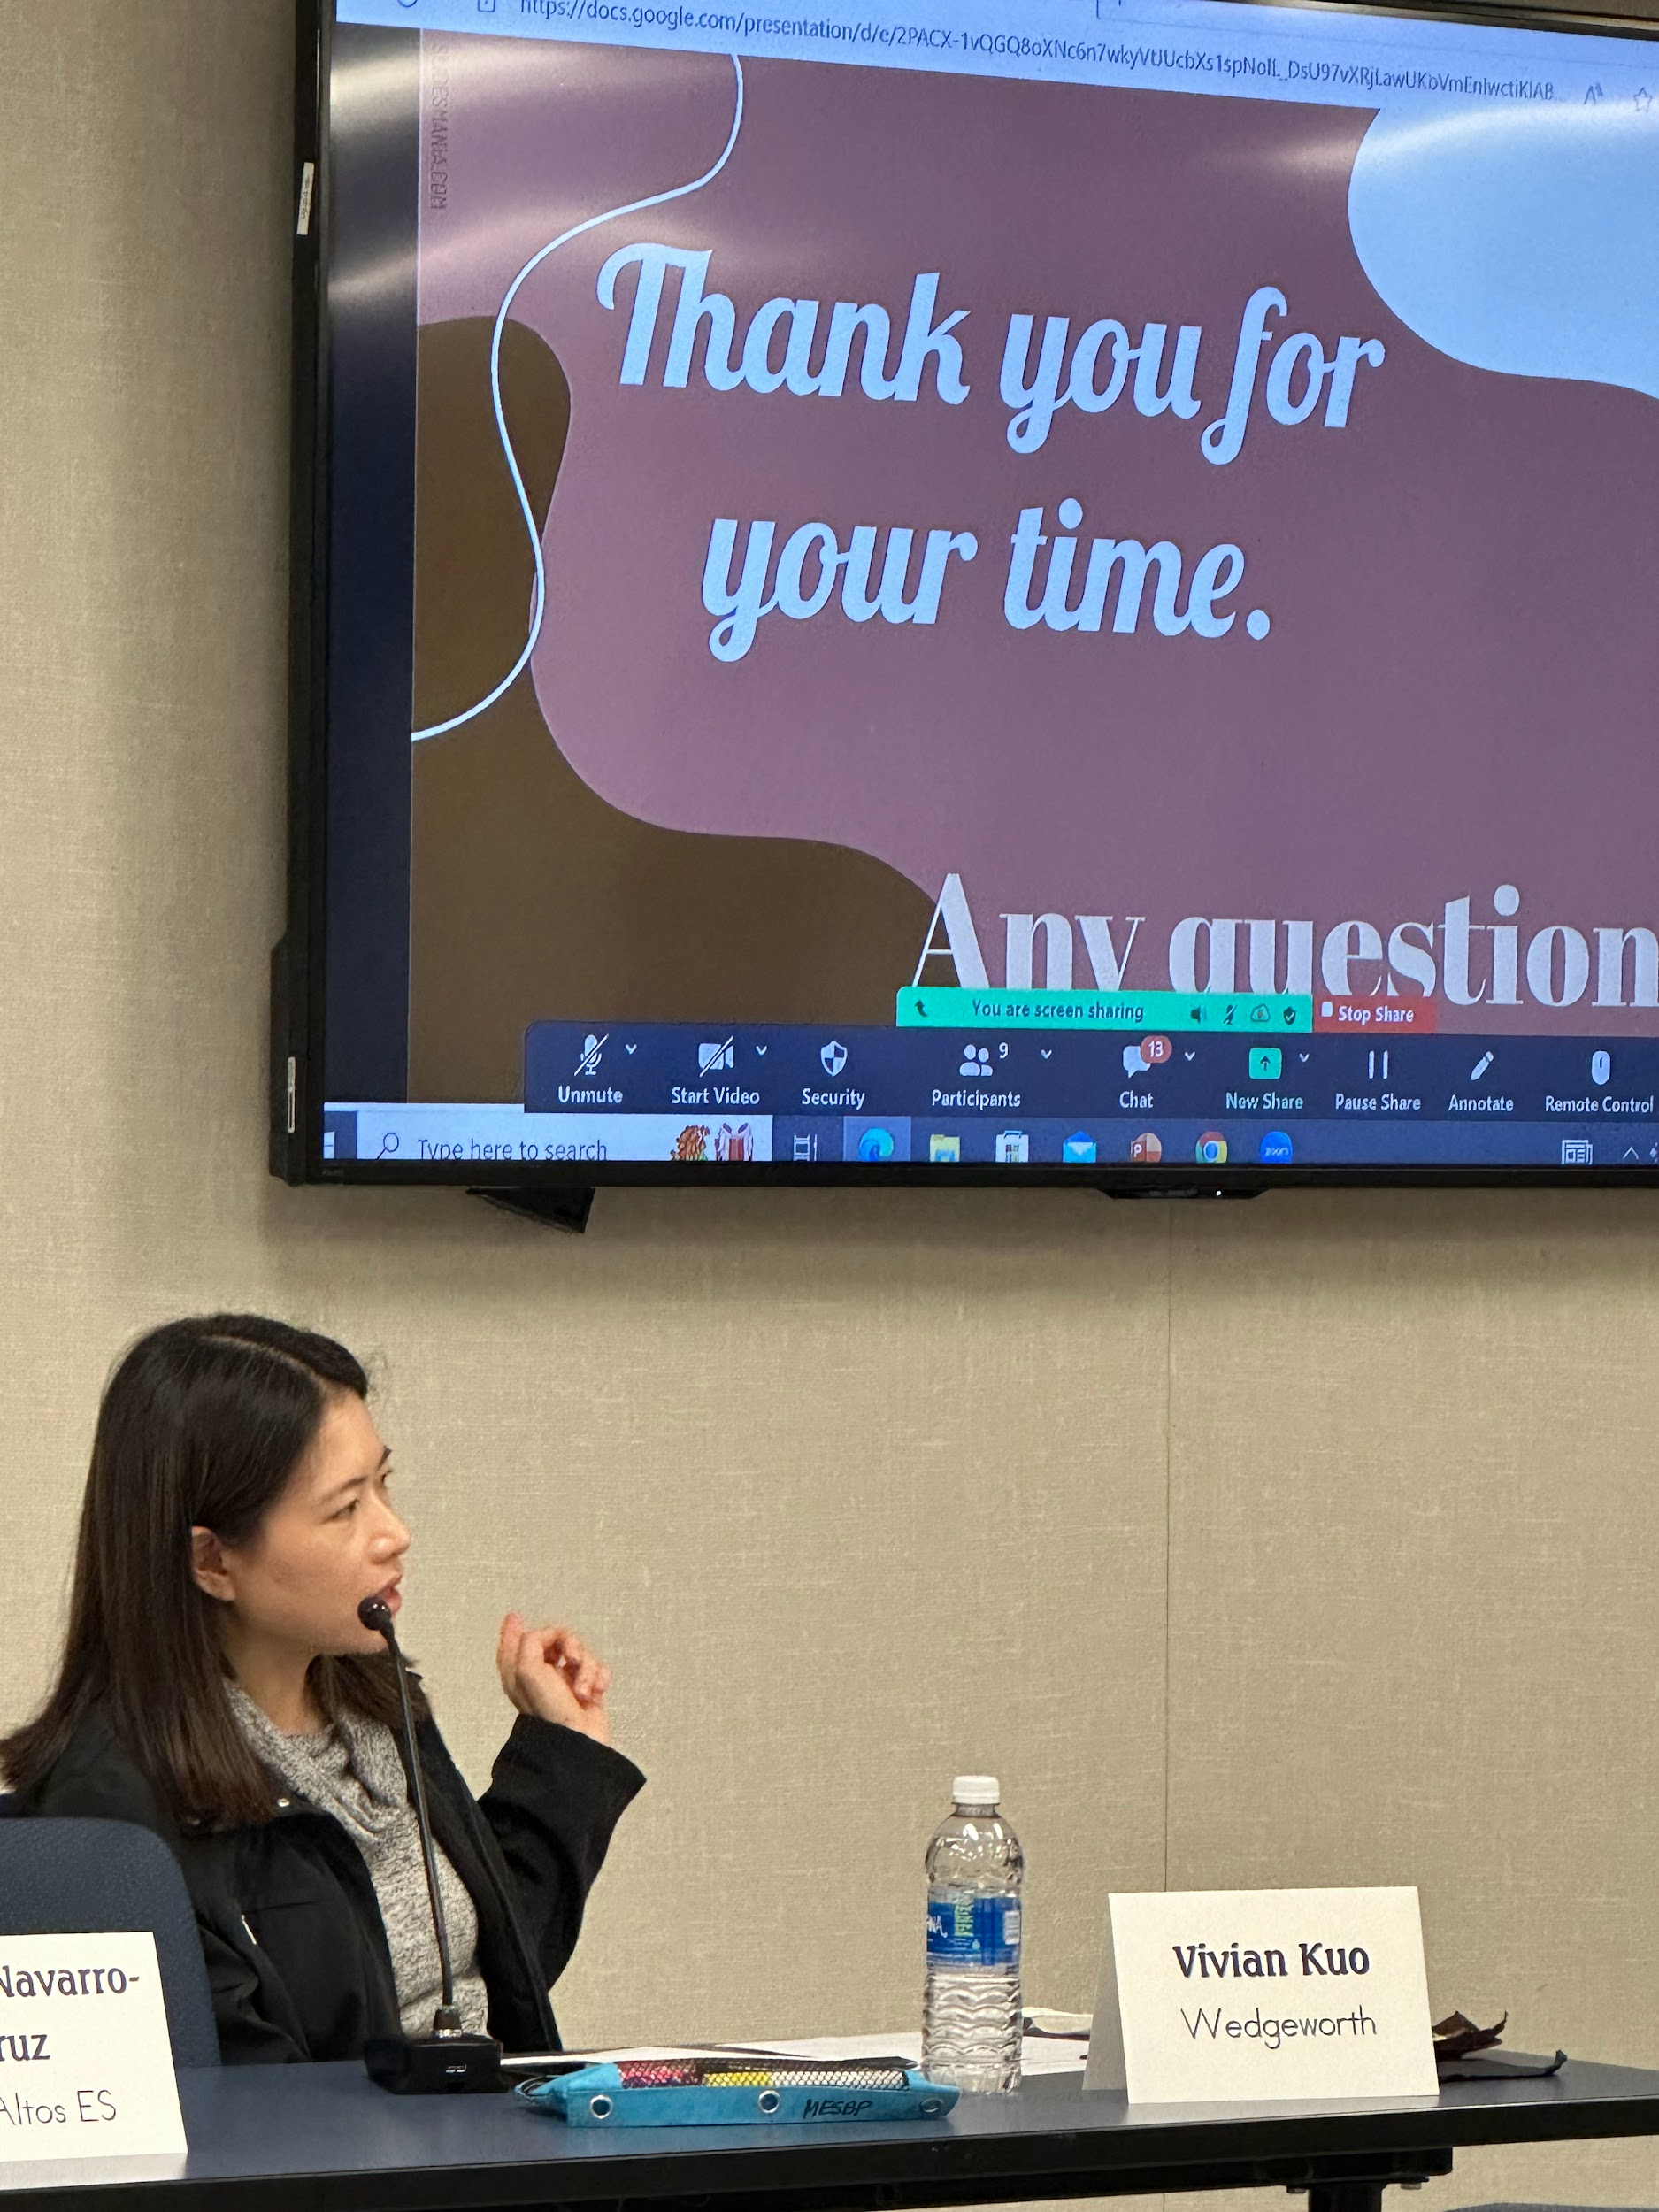
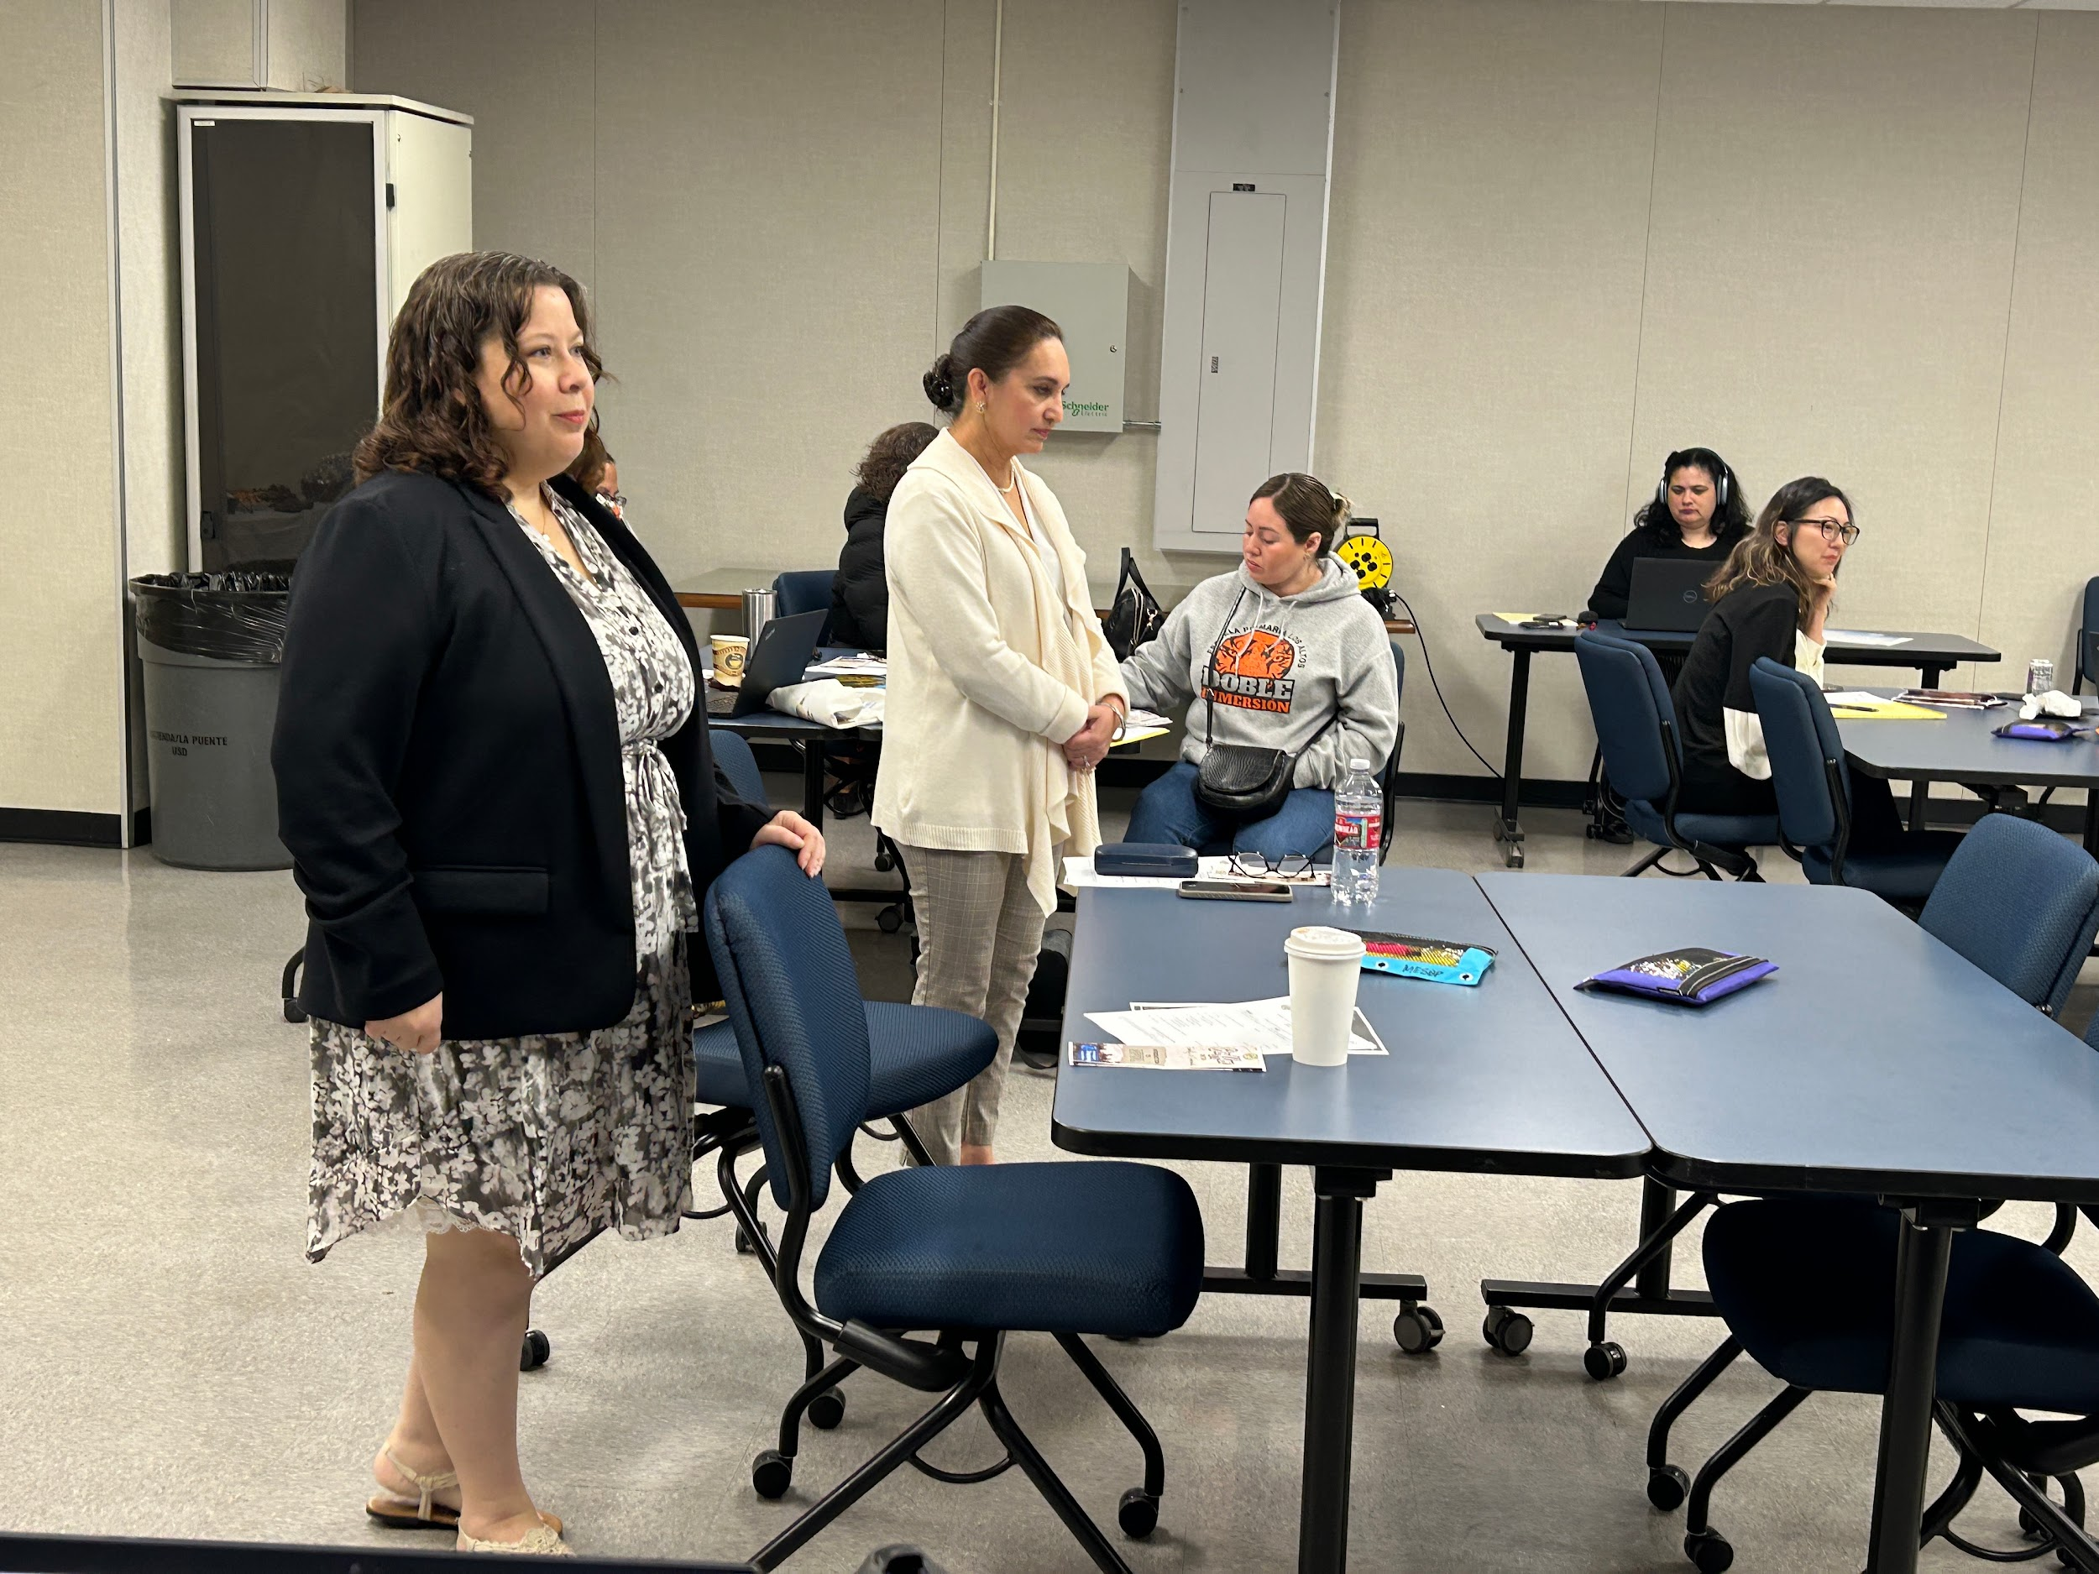
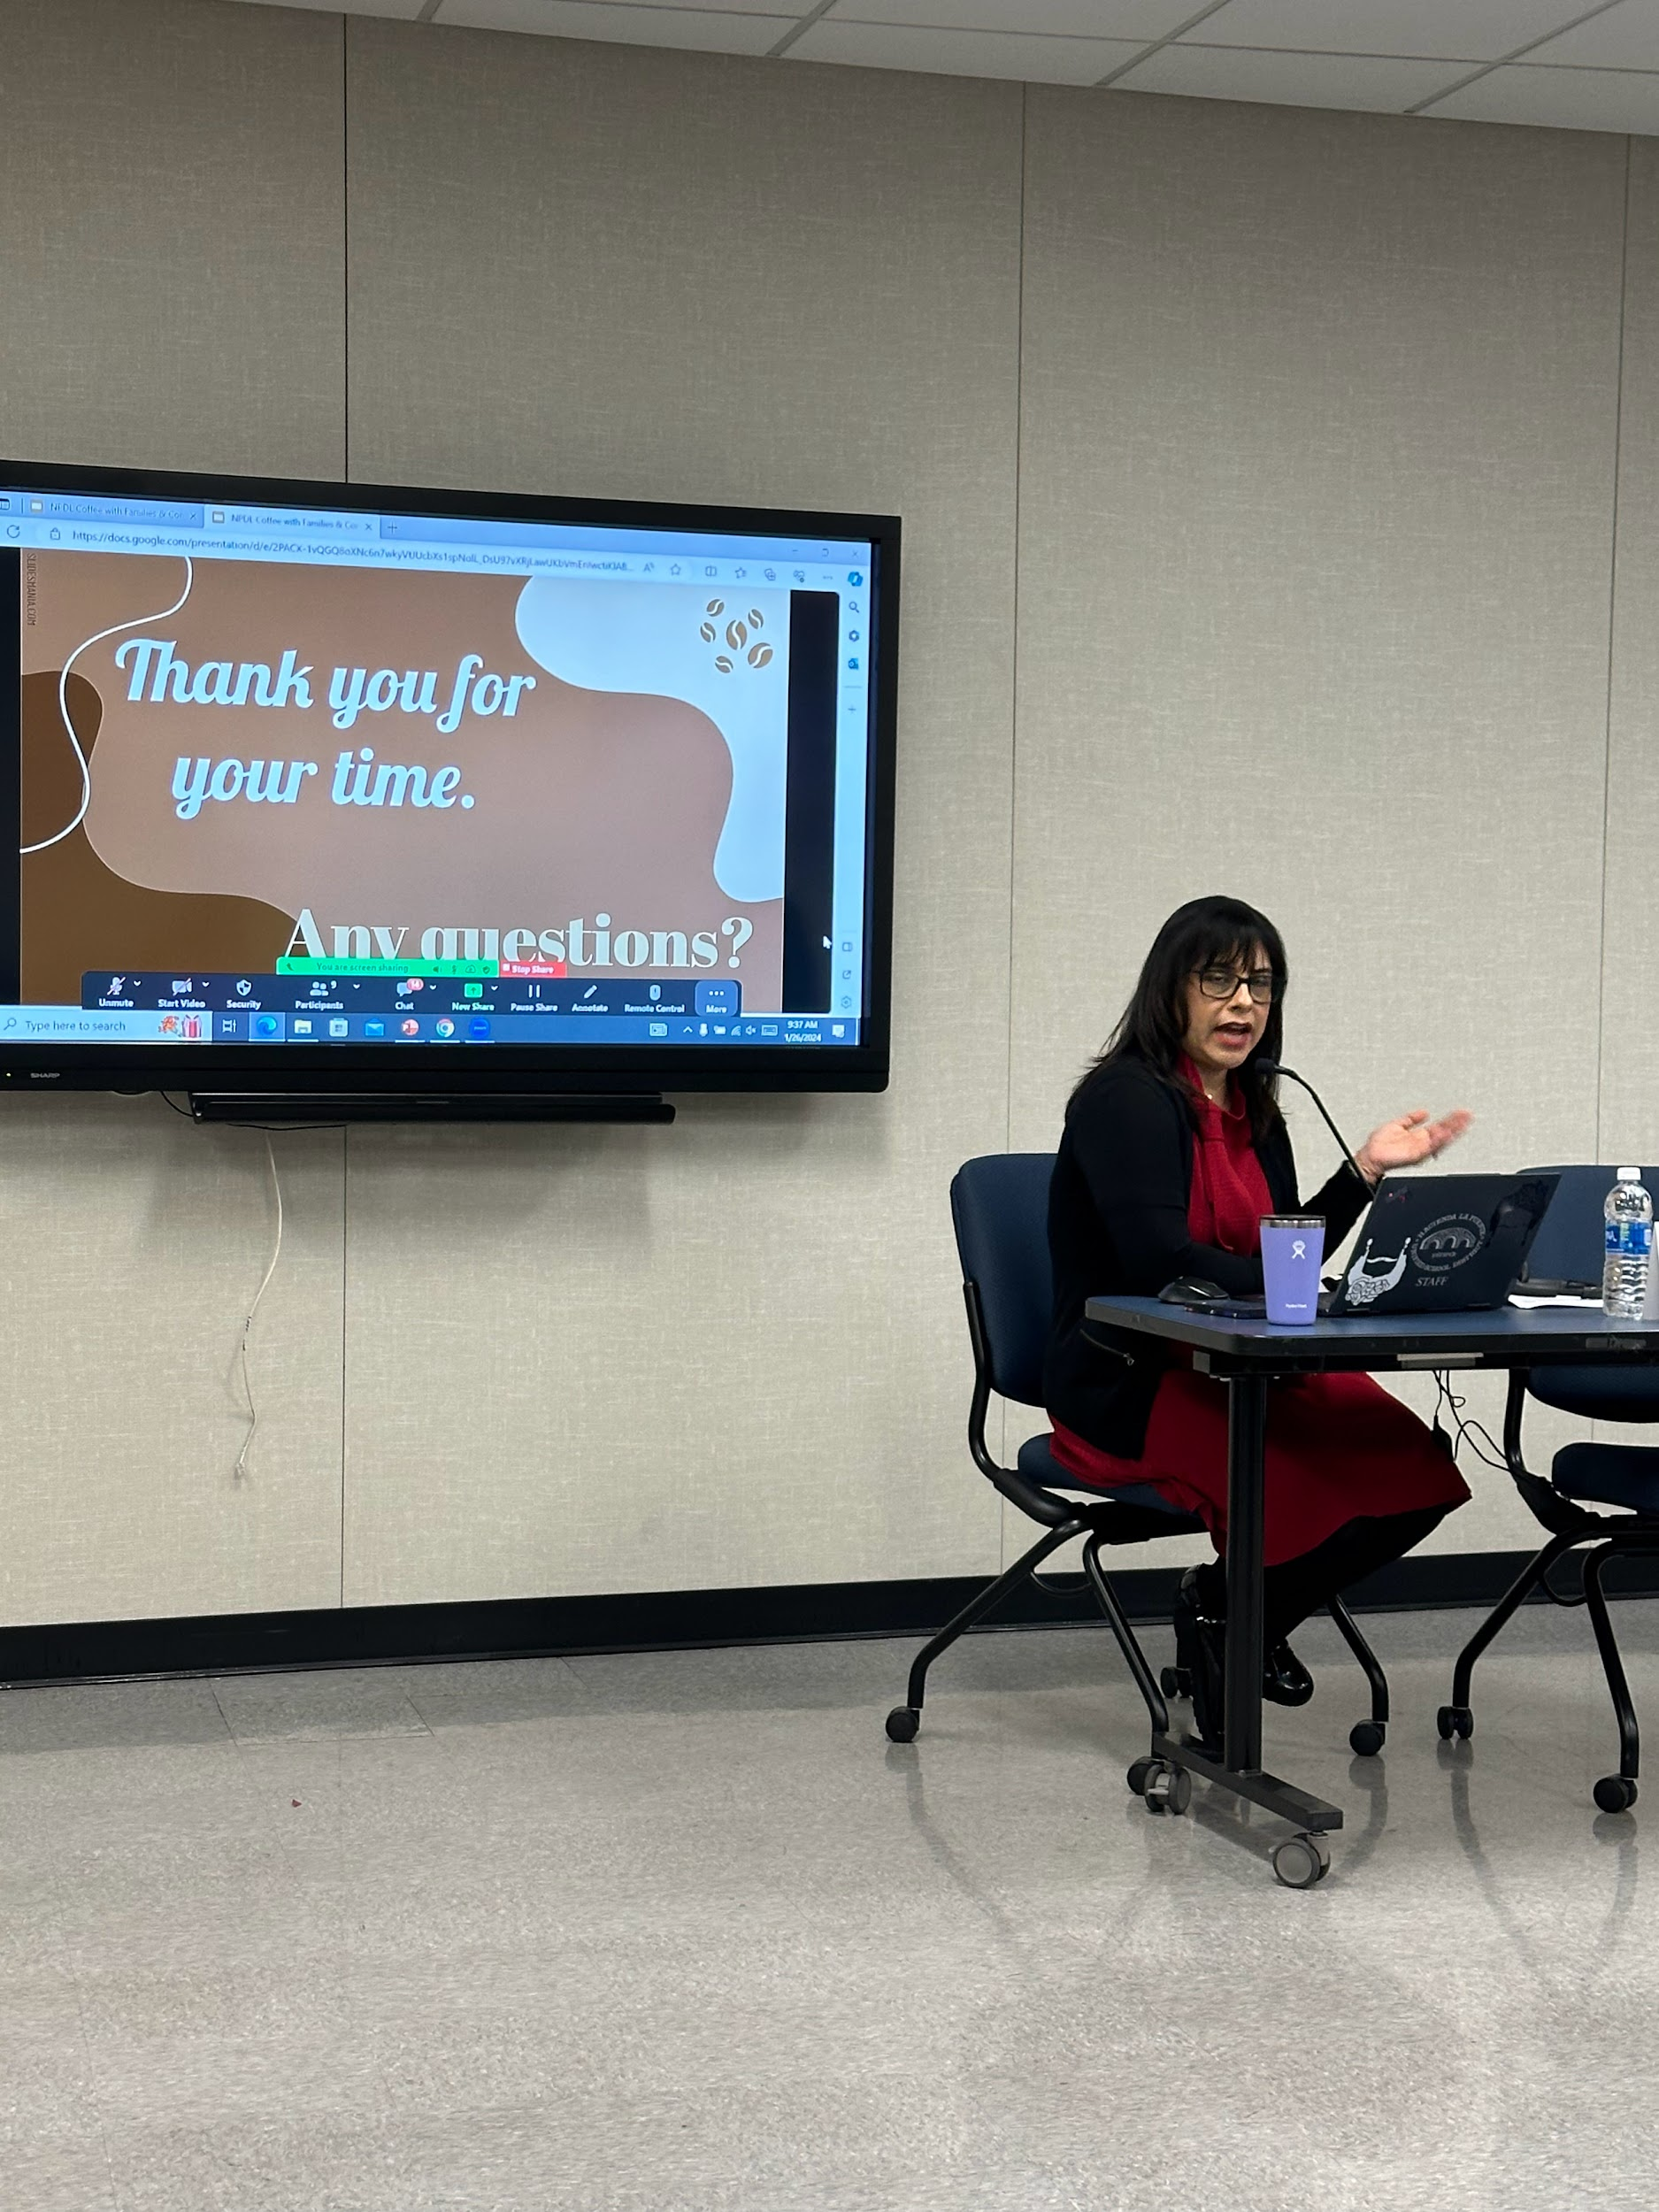
Presenting NPDL to Parents of the HLPUSD Dual Immersion Community
- TOSAs from CIA & MESBP
January 26, 2024

Slide 5
National School Counseling Week
FEBRUARY 5-9, 2024
THANK YOU, TO OUR AMAZING HLPUSD COUNSELORS!
WE RECOGNIZE OUR COUNSELORS FOR THEIR TREMENDOUS IMPACT TO STUDENT SUCCESS!

Slide 6
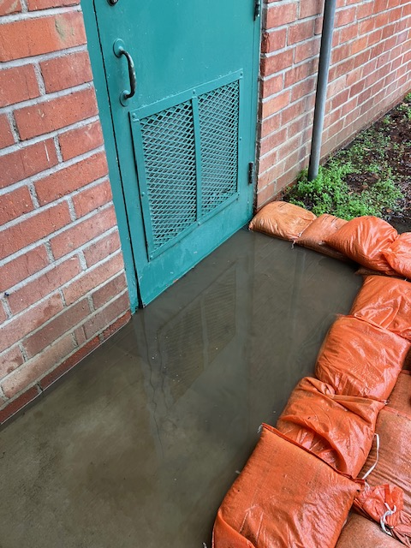
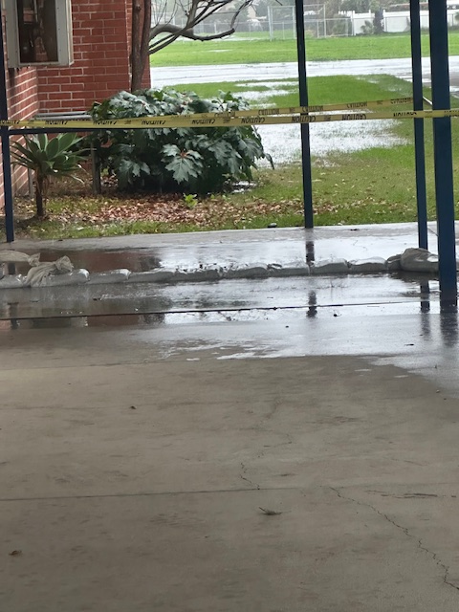
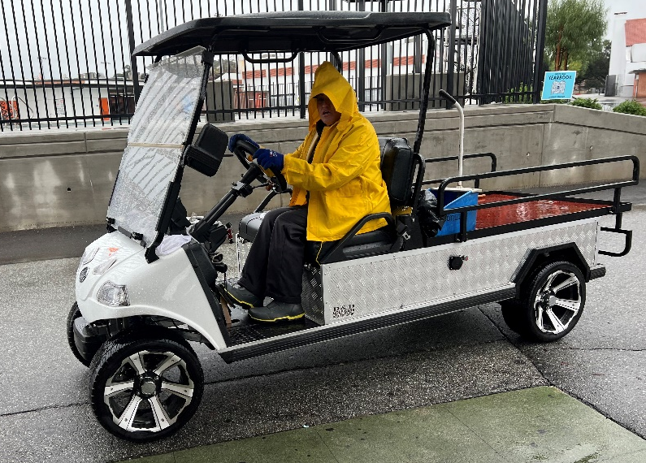
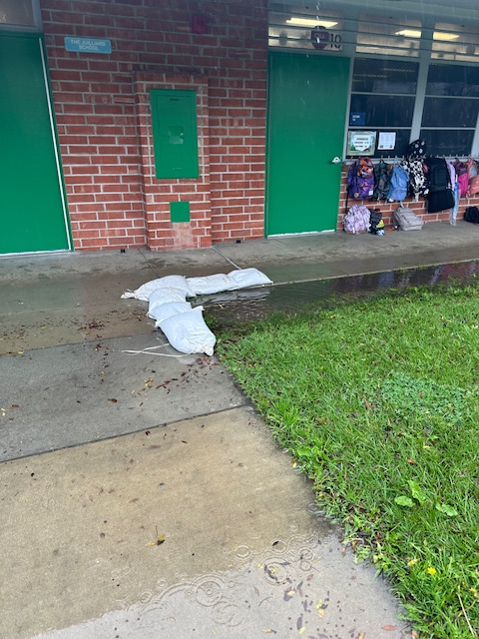
Thank you to the Facilities Team for your hard work to keep the Students & Staff safe before and during the storm.

Slide 7
Student Outcomes

Slide 8
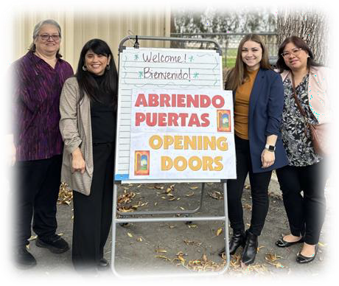
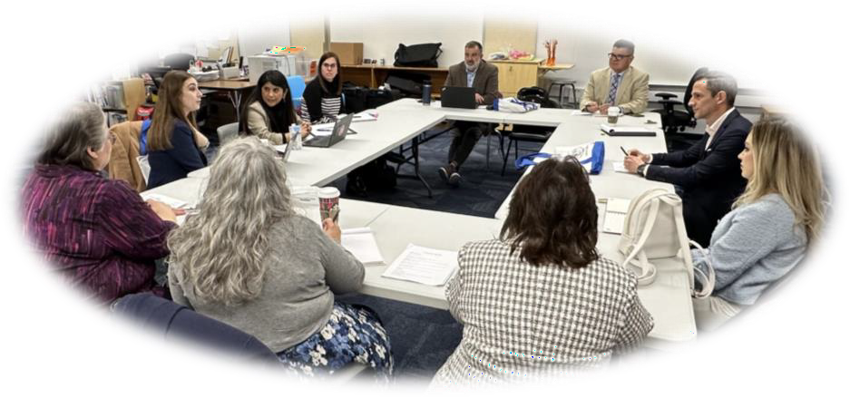
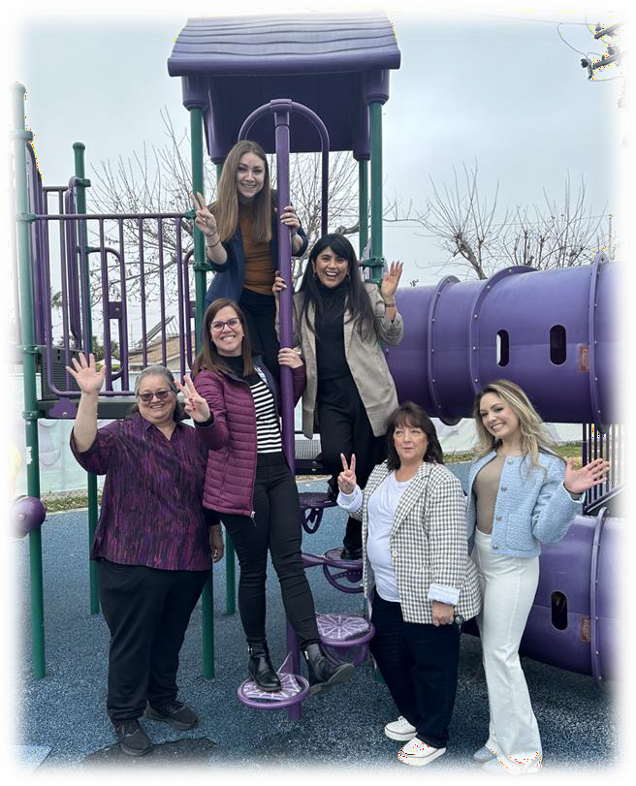
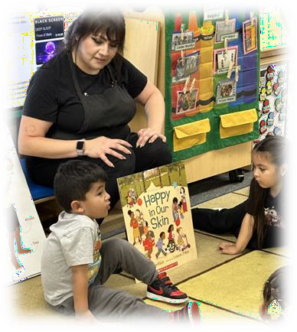
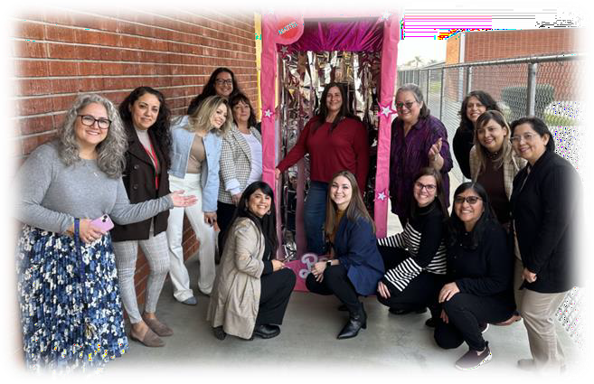
OFFICE OF HEAD START VISITS HLPUSD CHILD DEVELOPMENT
JANUARY 17,2024

Slide 9
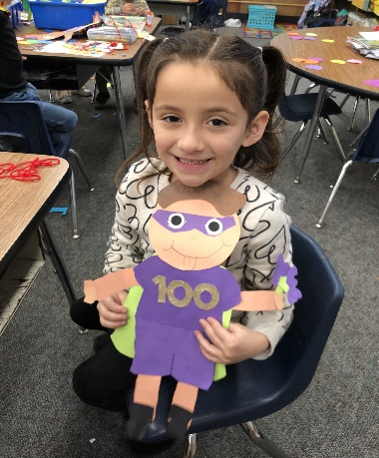
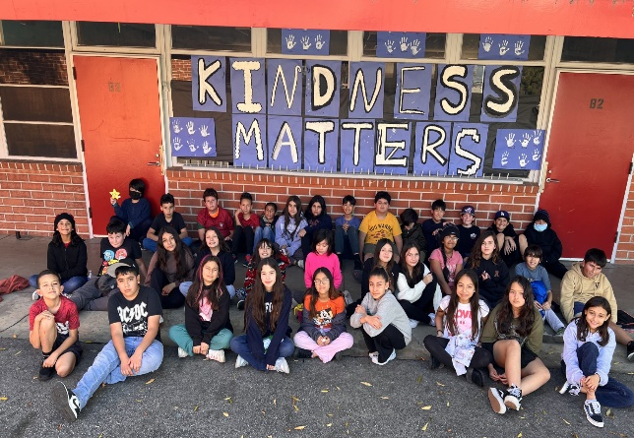
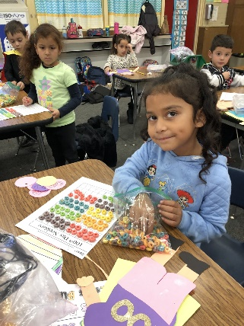
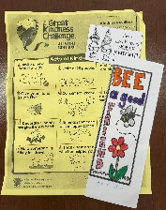
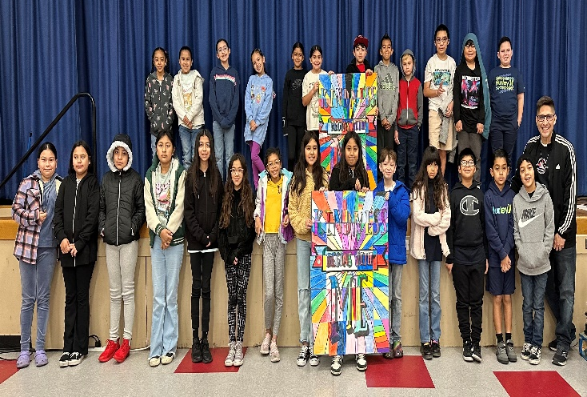
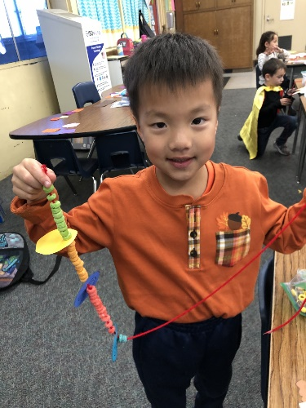
Los Robles Academy’s
Great Kindness Challenge Week
& 100 Days of School!!!

Slide 10
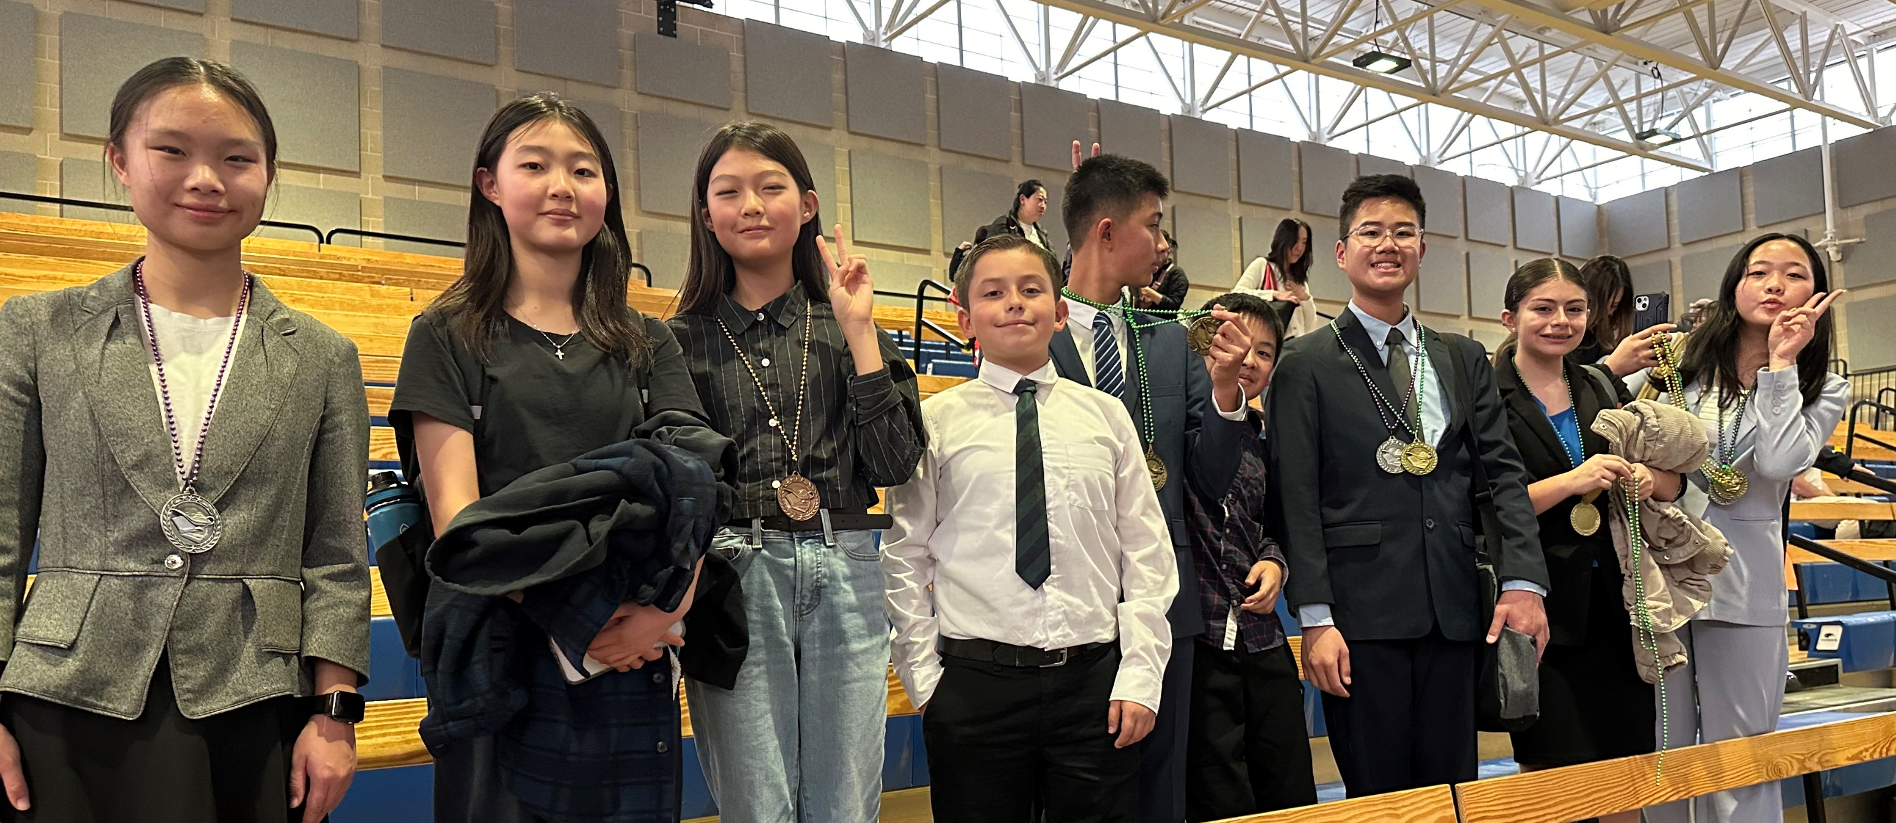
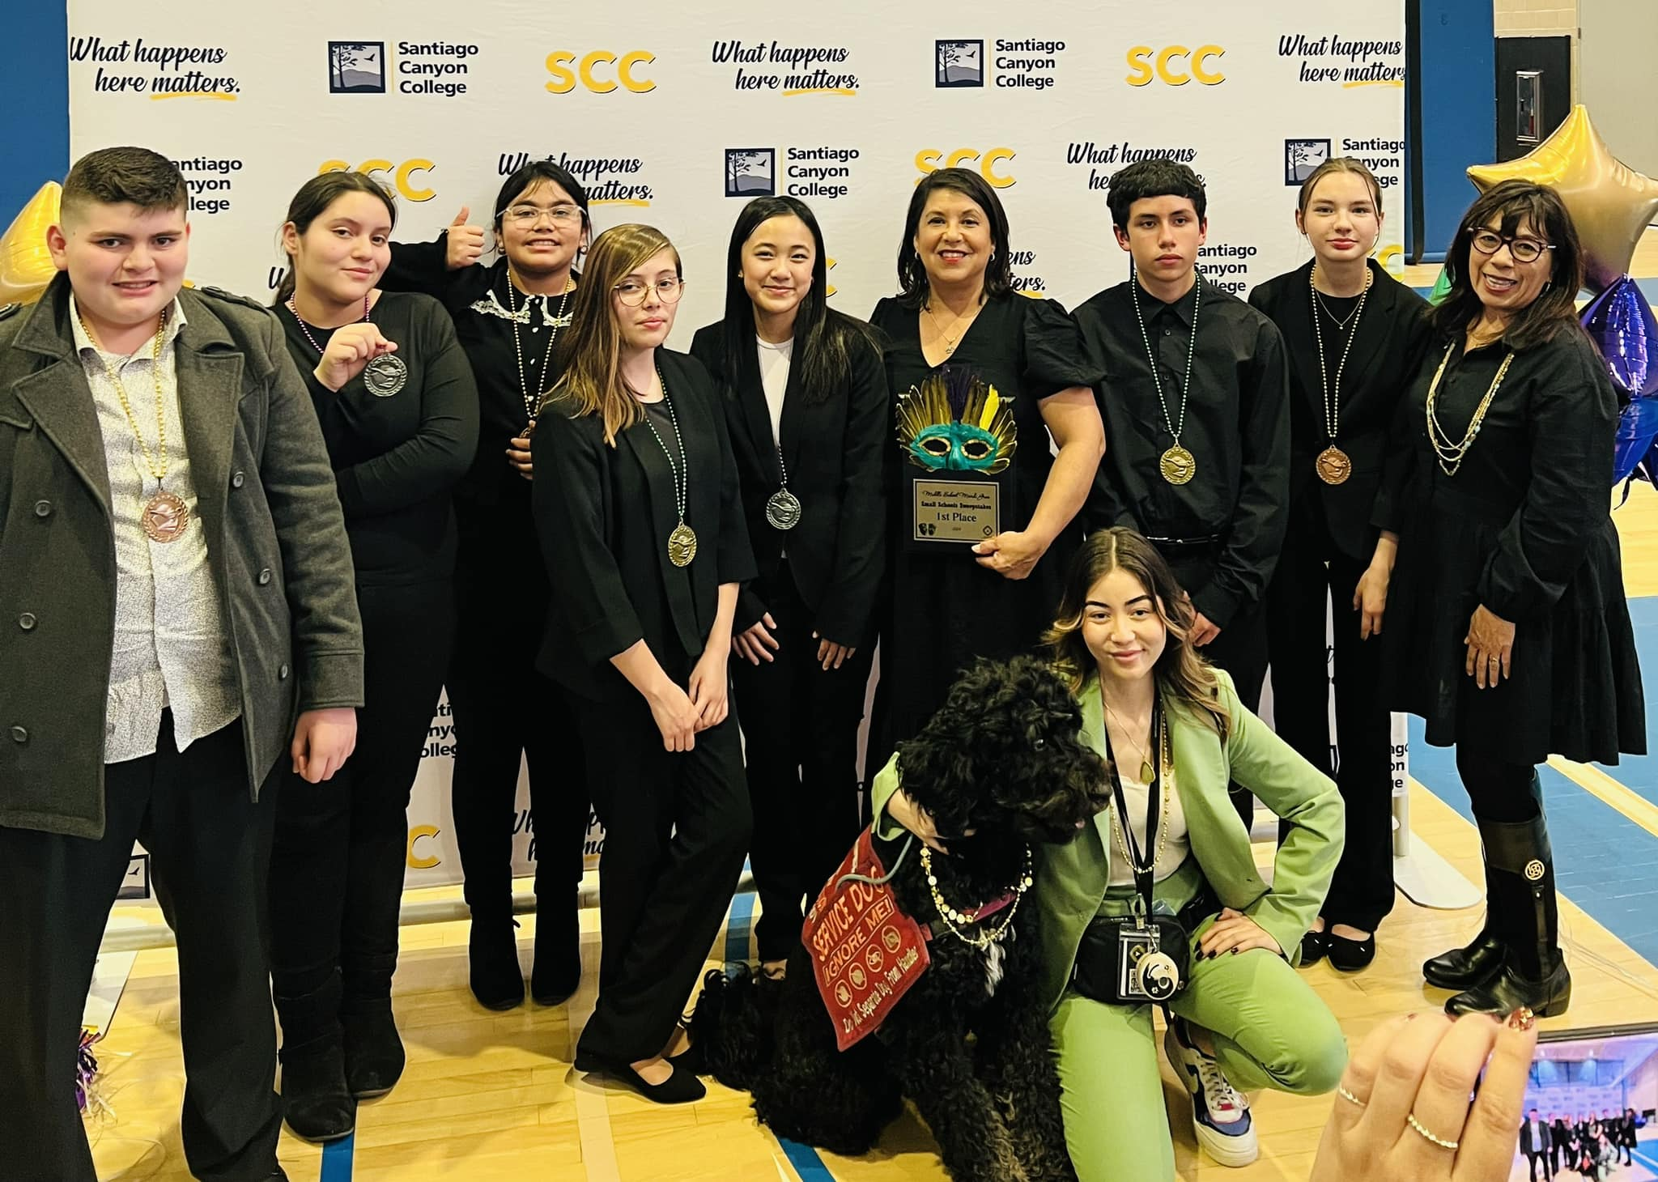
MIDDLE SCHOOL speech Mardi gras tournament January 27, 2024 Santiago Canyon college
Mesa Robles
SWEEPSTAKES WINNERS
SMALL team DIVISION:
1ST Place: Fairgrove academy
3rd Place: Orange Grove
5th Place: Baldwin academy
Mid-size team division:
1ST Place: mesa robles
Large team division:
4th Place: Cedarlane academy
Individual wins:
11 Gold medalists
Congratulations!
Fairgrove Academy
Cedarlane Academy

Slide 11
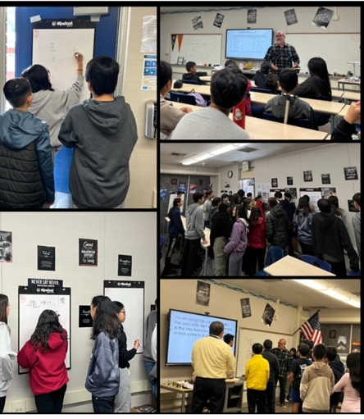
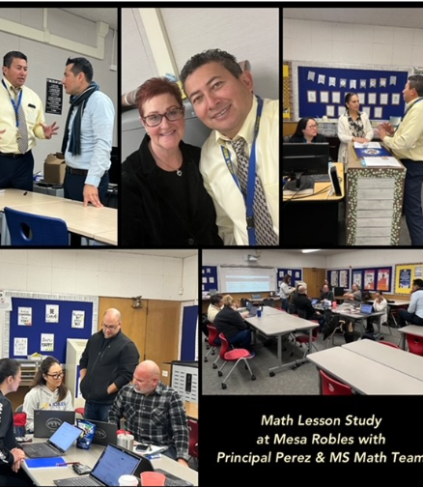
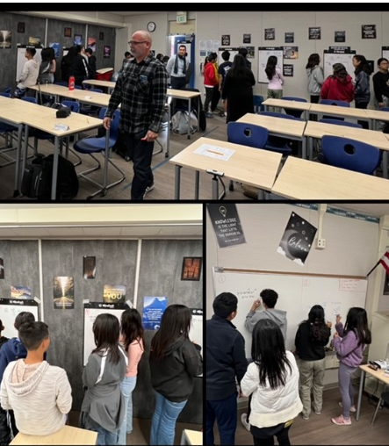
Robust Student Engagement during a Math Lesson Study @ Mesa Robles with Math TOSA, Math Teachers, Principal, and Director of CIA on 1/31/24
Mesa Robles
“Home of
the Mustangs”

Slide 12
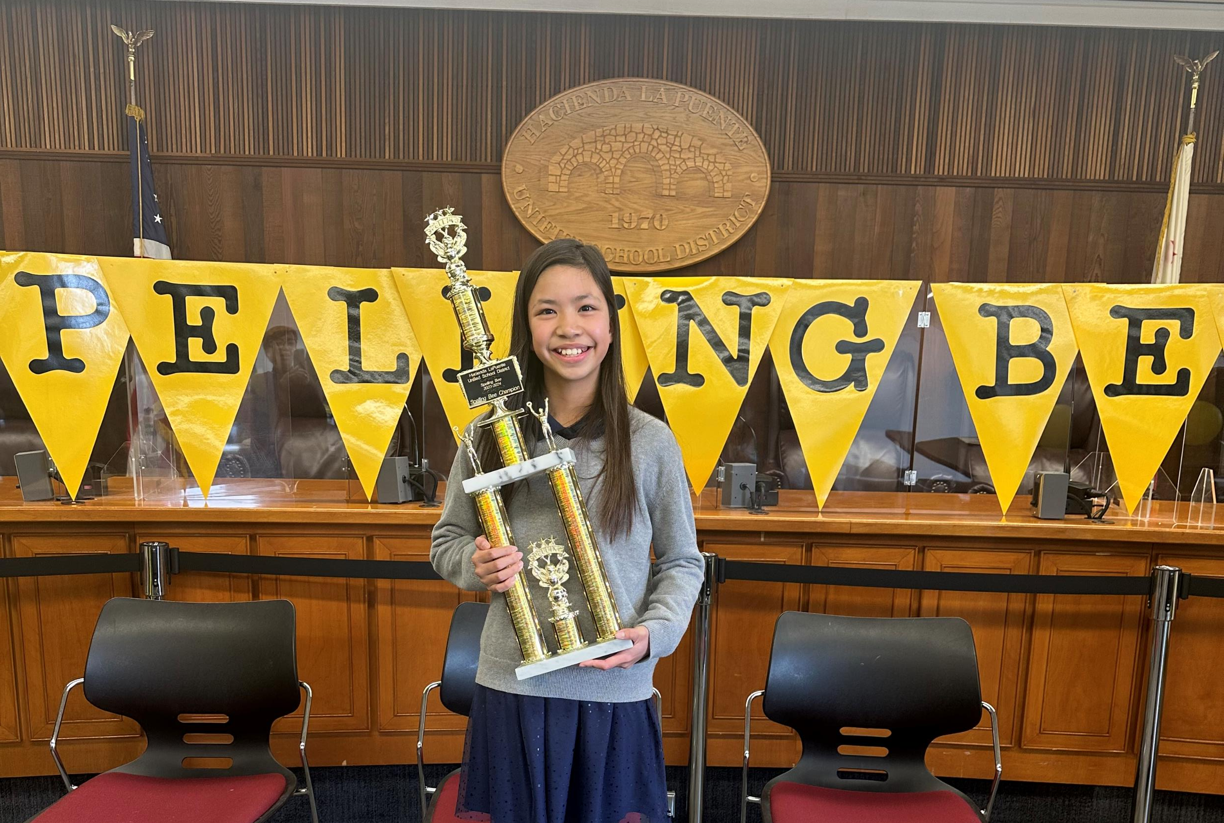
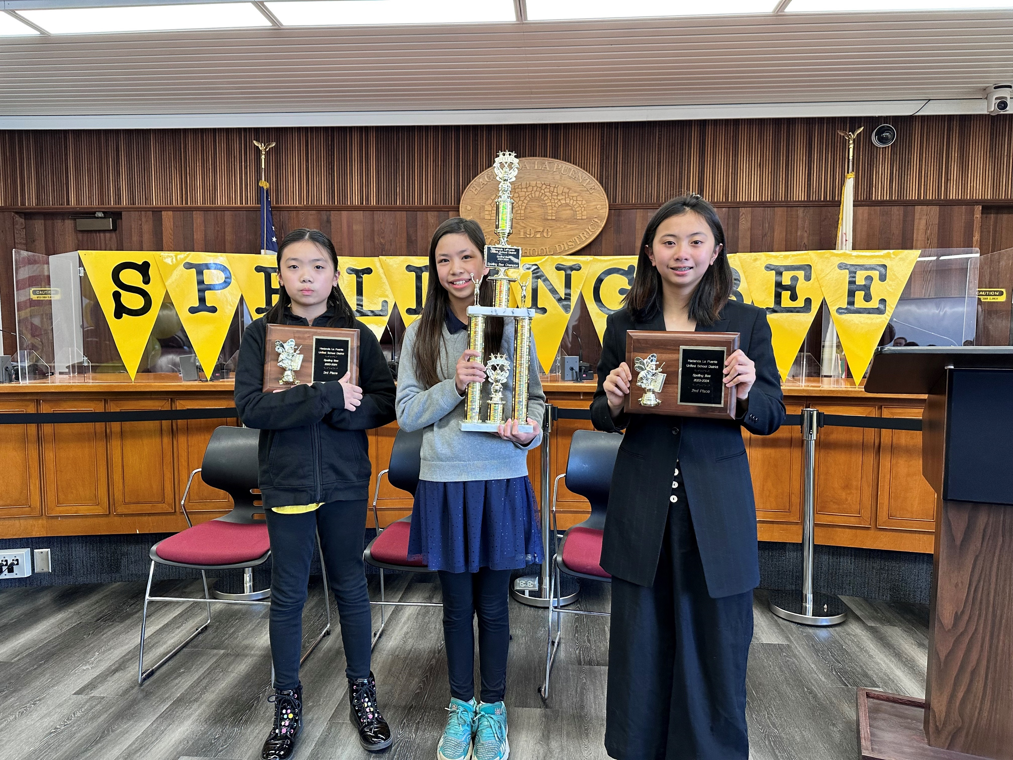
2024 Spelling Bee
Cedarlane, Fairgrove, and Wedgeworth were active participants in the Spelling Bee. A heartfelt congratulations to all our school winners! Congratulations to 1st place winner Casey Fan (5th grader from Wedgeworth). 2nd place winner Mikayla Nguyen (6th grader from Cedarlane), and 3rd place winner Alena Thai (4th grade from Fairgrove). Casey Fan will proudly represent our district at the LA County Spelling Bee Competition. Our entire community is filled with pride for each and every one of our students.

Slide 13
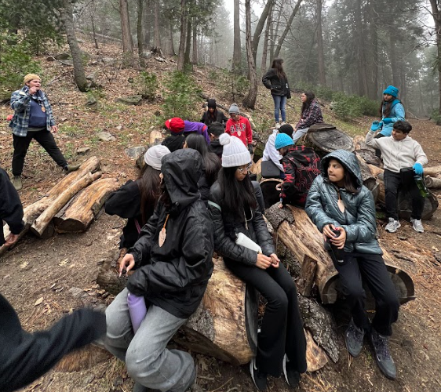
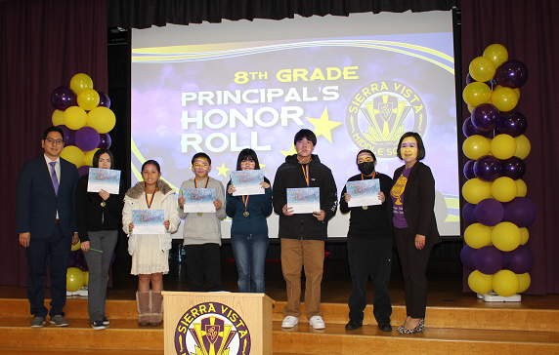
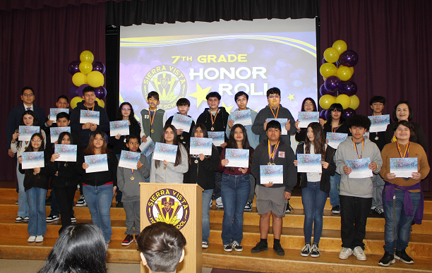
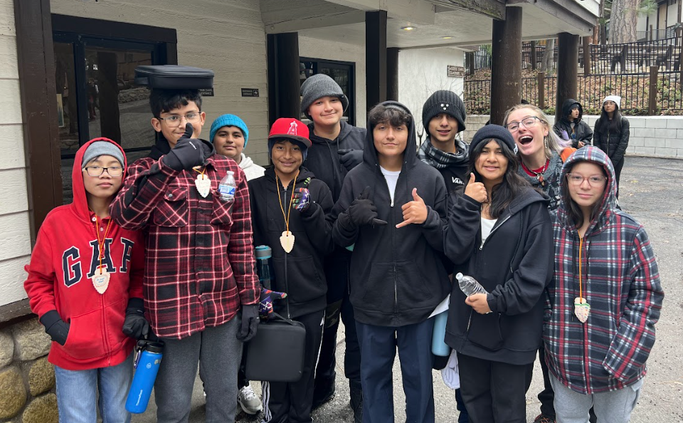
SIERRA VISTA MIDDLE SCHOOL
Viking Excellence Continues into the Second Semester
The Sierra Vista Viking students enjoyed a 2-night, 3-day outdoor science camp in the mountains made possible by a grant from Dr. Anderson and the CTE team. The hands-on learning in a beautiful setting was an exciting opportunity for which students were extremely grateful.
We also held an awards ceremony honoring nearly 100 students for outstanding academic and attendance achievements in the first semester, encouraging their continued excellence.

Slide 14
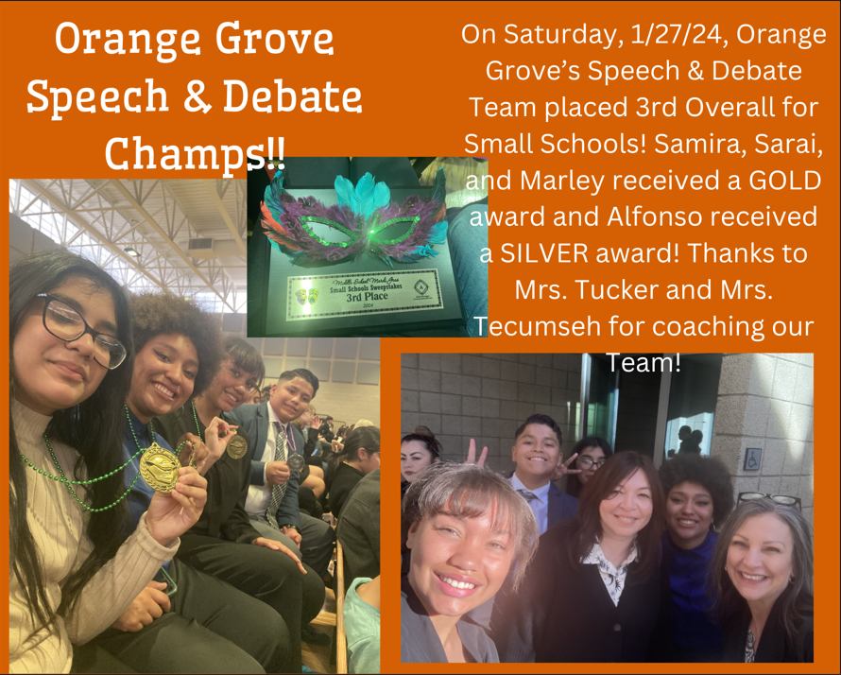
OGMS Celebrating Success!!!
14

Slide 15
Congressional App Challenge Award Ceremony
Office of Congresswoman Linda Sanchez
CONGRATULATIONS WILSON AND LOS ALTOS
High Schools!

Slide 16
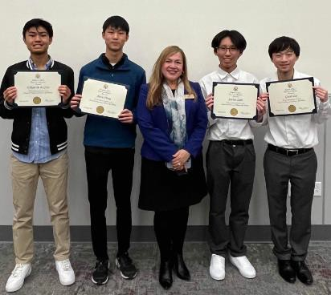
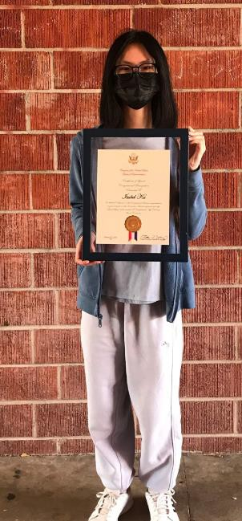
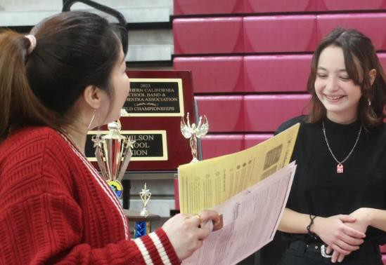
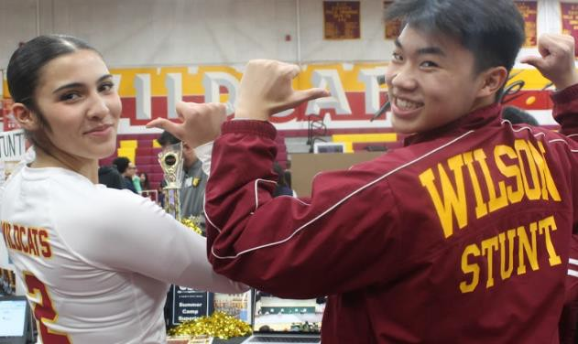
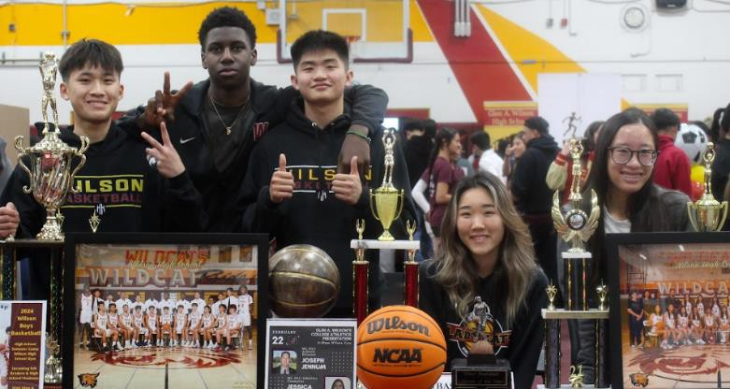
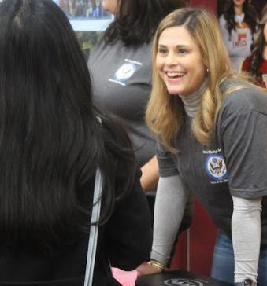
CONGRESSIONAL APP CHALLENGE
HONORABLE MENTION
Ethan, Alvin, Jordan, and Gavin
INNOVATION AWARD
Isabel

Slide 17
October 13-15, 2023
CONGRATULATIONS TO ALL OF OUR WINNERS!!
Most Original Category
1st Camila M., Wing Lane Elementary
2nd Haley Y., Wedgeworth Elementary
3rd Julieth G., Wing Lane Elementary
Most Artistic Category
1st Jordan R., Baldwin Academy
2nd Mia Bella C., Wing Lane Elementary
3rd Emily A., Wing Lane Elementary
Most Historic Category
1st Layla P., Baldwin Academy
2nd Marilyn C., Wing Lane Elementary
3rd Emma L., Wedgeworth Elementary
17

Slide 18
Parent & Family Engagement

Slide 19
HACIENDA LA PUENTE UNIFIED SCHOOL DISTRICT
Equity & Access Family Engagement
On Wednesday, January 24, 2024, Equity and Access along with HLPUSD VAPA TOSA, Lisa Ruiz and Meghann Kraft hosted a family paint night at Sparks Elementary School as part of our Parent University Workshops.
19

Slide 20
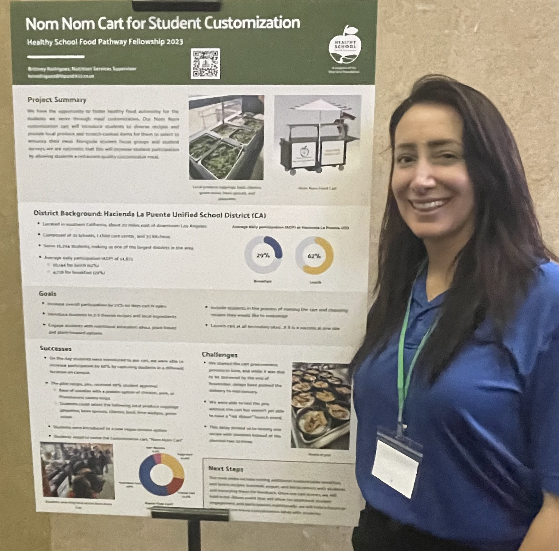
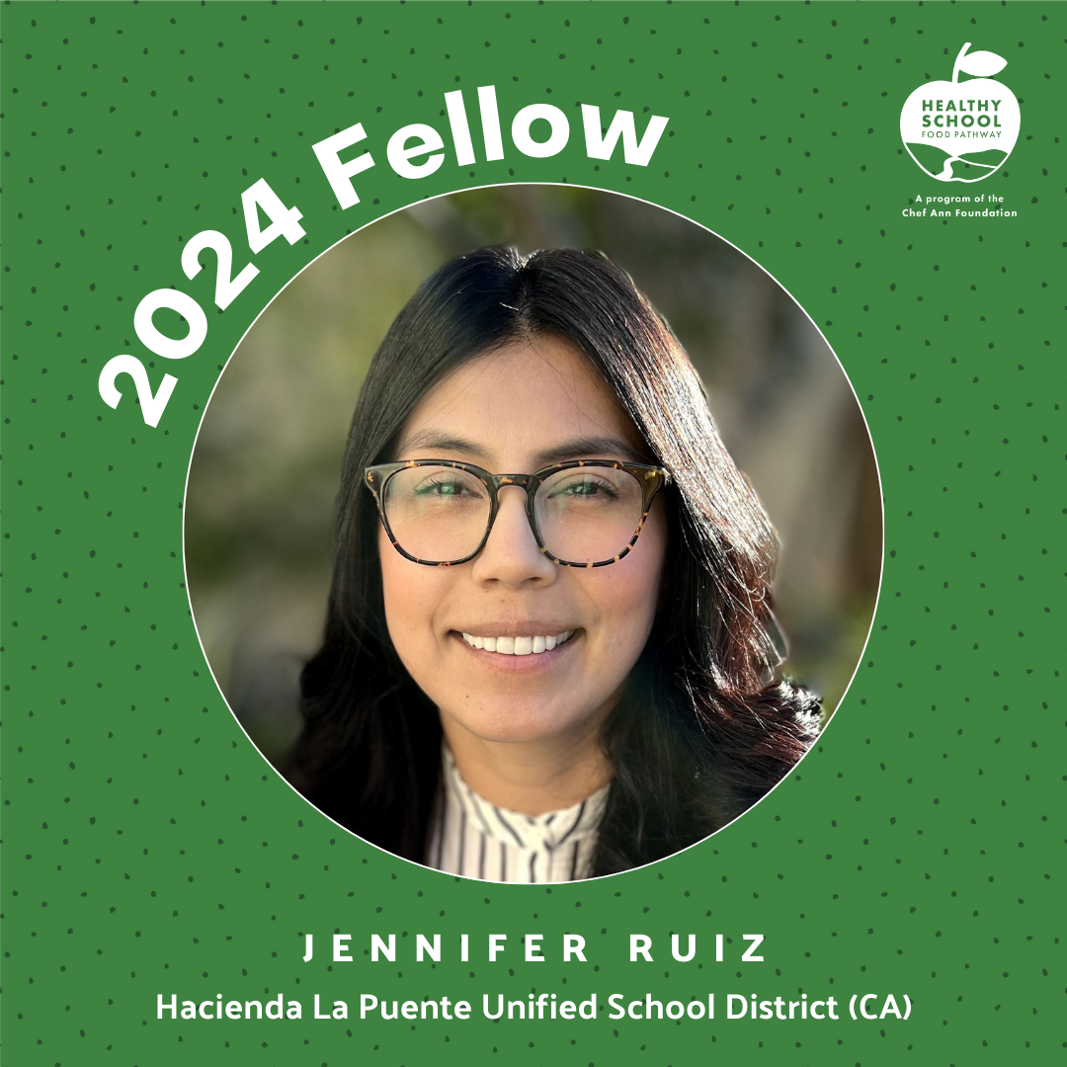
Fellowship
Brittney Rodriguez
Nutrition Services Supervisor
Graduate
2023-2024
Healthy School Food Pathway Fellowship Program
Jennifer Ruiz
Nutrition Services Supervisor
Participant
2024-2025
Healthy School Food Pathway Fellowship Program

Slide 21
La Puente High School Festival of Unity
Black History Month Celebration

Slide 22
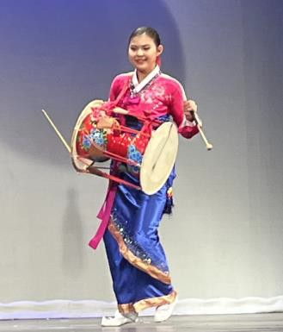
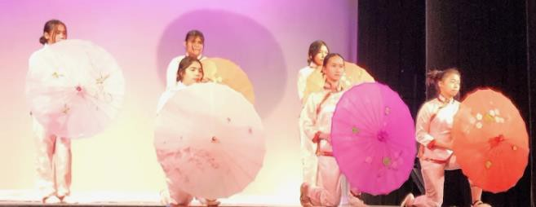
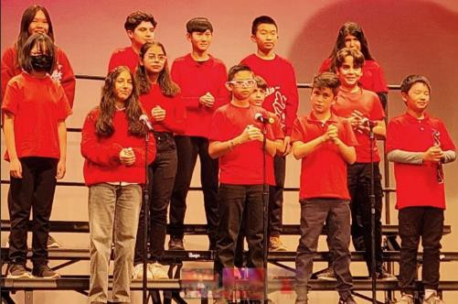
Hacienda La Puente Lunar New Year Celebration
22

Slide 23
To ensure we meet the needs of our District community, consistent with the District's Local Control and Accountability Plan (LCAP), Hacienda La Puente Unified invites our students, staff and families to participate in a brief survey, and share your anonymous thoughts and feedback.
We appreciate your input as we continue to improve the programs and services that foster success across HLPUSD! Please visit bit.ly/HLP24LCAP to complete the survey today!

Slide 24
Thank you

