Slide 1
Hacienda La Puente USD Local Control & Accountability Plan (LCAP) LCAP Mid-Year Update
Presented by:
Blanca Risco
Executive Director
Multilingual Programs and Assessment
Regular Board meeting – February 8, 2024

Slide 2
Impact to the Budget Overview for Parents
When Hacienda La Puente Unified School District adopted our LCAP and Budget on June 22, 2023, the state budget act was not complete. The adopted state budget included additional funds that were not anticipated by our district. The impact to our adopted Budget Overview for Parents is as follows:
Item | As adopted in BOP | Amount per Budget Act
Total LCFF Funds | $ 197,456,279 | $ 234,532,925
LCFF Supplemental/ Concentration Grants | $ 39,392,038 | $ 52,265,416

Slide 3
Goal 1: Conditions of Learning Basic Services Implementation of CA Standards Course Access
Planned Expenditures Total: $94,152,214
Mid-Year Expenditures: $48,273,715
All Actions Are In Progress
Core Instructional Materials and Textbooks
Improve, Maintain, and Repair School Facilities
CA Academic Standards Implementation Plan
State Seal of Biliteracy
State Seal of Civic Engagement

Slide 4
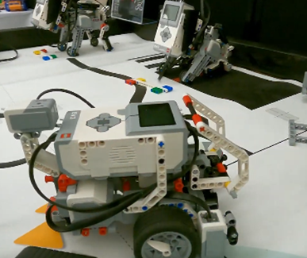
Goal 2: Student Outcomes Student Achievement Other Student Outcomes
Total Planned Expenditures: $192,214,504 Mid-Year Expenditures: $84,766,647
All Actions Are In Progress
Class Size Reduction in Grades TK-3
Districtwide PD to Improve Student Achievement
CTE Pathways
Data, Research, and Innovation Department
VAPA Integration

Slide 5
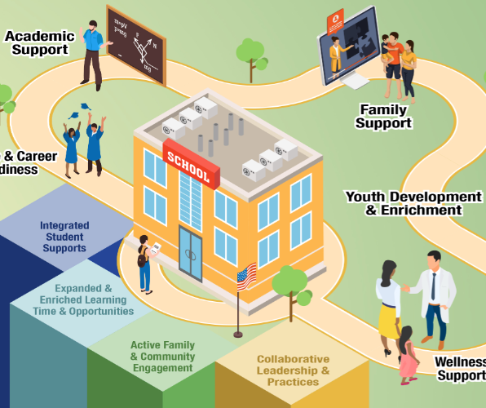
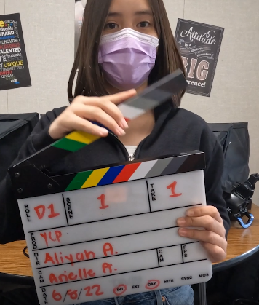
Goal 3: Engagement Parent Involvement Student Engagement School Climate
Total Planned Expenditures: $31,354,170 Mid-Year Expenditures: $9,706,986
All Actions Are In Progress
Districtwide Parent University Workshops
Elective Options for Student Engagement
Counselor Supports for Student Engagement
Support Services for Student Safety and Wellness
Equity & Access Supports for Engagement

Slide 6
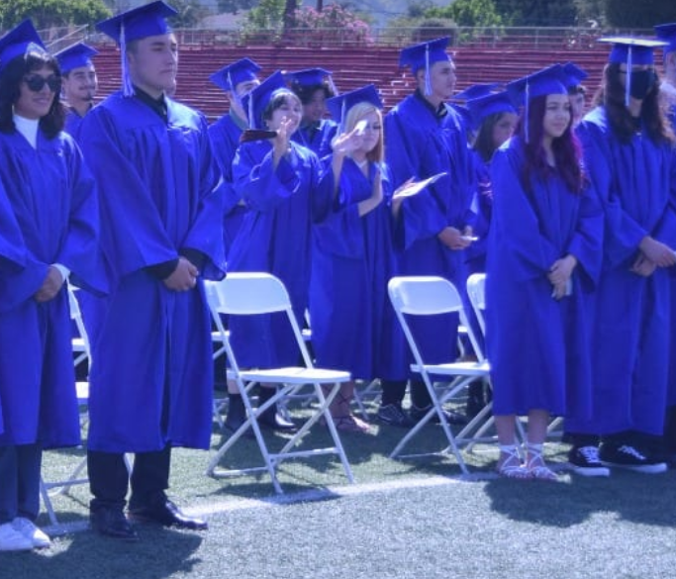
Goal 4: School Performance Valley Alternative HS Student Engagement School Climate
Total Planned Expenditures: $24,600
Mid-Year Expenditures $9,840
Academic Support Services
Academic/ Behavioral Monitoring
Professional Development
Counseling/ Transition Support Services
Schoolwide Recognition/ Positive Reinforcement
All Actions Are In Progress

Slide 7
Metrics* Highlights | Desired Outcome for 2023-24 | 2023-24 Mid-Year Update
Goal 1: Facilities in "Good" Repair | Fall 2023 Number of schools that met the "Good" repair standard on the FIT: 31 of 31 schools | Fall 2023 Number of schools that met the "Good" repair standard on the FIT: 31 of 31 schools; 24 “Good” and 7 “Exemplary”
Goal 2: Reclassification Rate | 2022-23 Reclassification Rate - Maintain Reclassification Rate at 16% to 18% or higher. | 2022-23 Reclassification Rate - Reclassification Rate 14.49%. Increased from 9.5% in 2021-22.
Goal 2: CA Dashboard College/Career Indicator | 2023 CA Dashboard College/Career Indicator: All Students: 48.2% or more prepared Low Income: 44.9% or more prepared English Learner: 20.8% or more prepared Foster Youth: 17.3% or more prepared Homeless Youth: 30.7% or more prepared SWD: 8.1% or more prepared | 2023 CA Dashboard College/Career Indicator: All Students: 52.4% Low Income: 48.1% English Learner: 33% Foster Youth: 18.2% Homeless Youth: 23.5% SWD: 13.4%
Goal 3: High School Graduation Rate DataQuest 5-Year Cohort Grad Rate | 2022-23 Five-Year Cohort Graduation Rate: Increase/ maintain to: All Students: 94.5% or higher Low Income: 94% or higher English Learners: 85% or higher SWD: 85% or higher Foster Youth: 89% or higher Homeless Youth: 90% or higher | 2022-23 Five-Year Cohort Graduation Rate: Increase/ maintain to: All Students: 96.1% Low Income: 95.8% English Learners: 92.2% SWD: 84.7% Foster Youth: 85% Homeless Youth: 90.4%
Goal 4: Student Engagement Attendance Rate Local Data | 2023 Attendance Rate: Increase from 74.38% in 2022 to 79.38% or more | Cumulative attendance rate has increased months 1-6 by 1.72% to an average of 84.05% as compared to last year at this time.
* Mid Year Updates on all Metrics provided in Mid-Year Metrics Report for the Board
7

Slide 8
The 2023-24 has presented both opportunities and challenges. We are proud of the following: Implementing NPDL Districtwide, Speech and Debate Program, Ethnic Studies Curriculum, and prioritizing Social Emotional Wellness.
Our district is still working through some lingering challenges, such as a substitute shortage, hiring challenges, declining enrollment, etc.
Despite these challenges, Hacienda La Puente Unified School District is committed to implementing the LCAP to provide the necessary services to our students.
We acknowledge, and sincerely thank, the hard work and dedication of our Board and employees, the support of our parents, and the resilience of our students to continue our reach for excellence.

