Slide 1
Northshore school district career & technical education course information 2024-2025 School Year

Slide 2
https://www.nsd.org/schools/academics/career-college-readiness Resources & support
Director Career & College Readiness Damen Schuneman 425-408-7718 dschuneman@nsd.org
CTE Admin Specialist Kimberly Campbell 425-408-7711 kcampbell3@nsd.org
Bothell High School BJ Dawson 425-408-7028 bdawson@nsd.org
Inglemoor High School Jim Allen 425-408-7228 jallen2@nsd.org
North Creek High School All Counselors 425-408-8821 jagfutures@nsd.org
Woodinville High School My Tang 425-408-7423 mtang@nsd.org
Innovation Lab High School Jon Cohn 425-408-6209 jcohn@nsd.org
Secondary Academy For Success Heatherjoy Boi 425-408-6620 hboi@nsd.org
All High Schools Lisa Allen 425-408-6209 lallen@nsd.org

Slide 3
Benefits of CTE Programs
Connected, hands on learning
Academically rigorous- many AP, IB, college level offerings
Expands educational and career options with career exploration and preparation
All classes meet the 1.0 CTE credit graduation requirement but several classes also satisfy other HS graduation requirements
Meet Graduation Pathway Requirements (CTE Graduation Pathway Option)
College credits offered through Pacific NW College Credit program and University College In The High School credit programs
You can go to work, college or both with prep from these classes
Industry certification earned in several classes
Practical application of knowledge in real-world settings/industry labs

Slide 4
Student leadership & employability
Career and Technical Student Organizations (CTSO's) are student leadership organizations for students enrolled in Career and Technical Education programs.
Career and Technical Student Organizations are the preferred method for CTE programs to address the Leadership requirement and Core Leadership Standards in their program. Washington State has eight recognized CTSO organizations.
Each CTSO focuses on a different area of CTE. CTSO's provide leadership, skill development and service opportunities, career planning information, and competitive events to demonstrate our students technical and leadership skills.

Slide 5
Program specifics
Northshore School District Stand Alone:
Vary at each school location and are available for only those students at that school.
Many of these courses are taught at most if not all schools.
.5 and 1.0 credit offerings
Register as you would for any other course in StudentVue
Northshore School District Satellite:
Offerings are available only at the location indicated within the Northshore School District and available to NSD students.
Satellite programs are typically available to Juniors and Seniors only and students are encouraged to drive themselves as transportation is limited.
1.0 and 2.0 credit offerings
Washington Network for Innovative Careers (WaNIC)
Regional skills center in Kirkland (LWIT) that provides advanced-level Career and Technical Education programs based on rigorous academic and industry standards, preparing students for post-secondary education and successful entry into high-skill, high-demand careers and employment.
3.0 credit offerings

Slide 6
Course information
Where can I learn about all of the courses?
https://www.nsd.org/schools/academics/career-college-readiness/course-registration
Health Science Nursing/Medical Professions
Hospitality & Culinary Arts
Human Services
Information Technology
Manufacturing
Robotics
Sports Medicine
Welding
Architecture & Construction
Automotive Technology
Arts, A/V Technology & Communications
Aviation
Business
Education & Training
Engineering
Emergency CERT

Slide 7
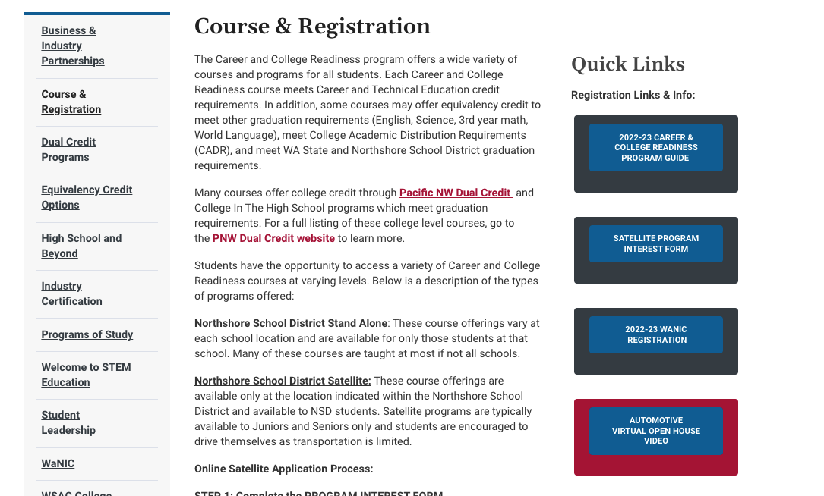
Course information
Where can I learn about all of the courses?
https://www.nsd.org/schools/academics/career-college-readiness/course-registration
2024-25 Career and College Readiness Handbook
Program Videos

Slide 8
Program specifics
Northshore School District Stand Alone:
Vary at each school location and are available for only those students at that school.
Many of these courses are taught at most if not all schools.
.5 and 1.0 credit offerings
Northshore School District Satellite:
Offerings are available only at the location indicated within the Northshore School District and available to NSD students.
Satellite programs are typically available to Juniors and Seniors only and students are encouraged to drive themselves as transportation is limited.
1.0 and 2.0 credit offerings
Washington Network for Innovative Careers (WaNIC)
Regional skills center in Kirkland (LWIT) that provides advanced-level Career and Technical Education programs based on rigorous academic and industry standards, preparing students for post-secondary education and successful entry into high-skill, high-demand careers and employment.
3.0 credit offerings

Slide 9
How Do Students apply to Satellite (NSD) Programs?
Step 1: Fill out the PROGRAM INTEREST FORM. More information about the application process can be found at our website.
Step 2: After filling out the PROGRAM INTEREST FORM, continue checking your email for the SATELLITE APPLICATION that will be emailed to you. Once you receive the application, please complete the student section. From there, the application will automatically be sent via email to your parent/guardian for approval. Following the parent e-signature, the application will automatically be sent via email to your schools career counselor for review. That’s it, complete those steps before the deadline and you’ve applied! REMINDER: Please list accurate student and parent email addresses to prevent delays and be sure to check deadlines.
Please complete the PROGRAM INTEREST FORM several days prior to the application deadline to allow enough time to receive, complete and submit the SATELLITE APPLICATION.
Apply for the class you want and we’ll worry about bell schedule conflicts later.
When requesting your BHS courses for next year in StudentVUE, please choose a full schedule of classes that DOES NOT include Satellite classes (just in case you don’t get accepted into the Satellite class). If you apply and are accepted into the Satellite class, we will contact you to see which other classes you’d like to drop.
You will be notified by the district via email later in spring with the status of your application.

Slide 10
How do students apply to a wanic class (Class outside NSD)?
Step 1: Go to WANIC.org or to this link: WANIC Application.
Step 2: On the registration page, for 3 period/credit WANIC classes, go to WANIC.org. Once at the site, scroll down and click on "Full Year Info," then "APPLY FOR 2023-24 FULL YEAR," then "APPLY FOR WANIC FULL YEAR PROGRAM" and complete the application online for the class you want (and time). List accurate email address that you will check regularly.
Step 3 (for DigiPen classes only): Attend a virtual site visit/information session if applying to DigiPen. Go HERE to RSVP. Contact teacher or Career Counselor if having trouble attending the virtual site visit/information session at DigiPen.
Be sure to check the application deadlines. You will be notified via email from WANIC if accepted, so please continue checking the email you used on application.
When requesting your courses for next year in StudentVUE, please choose a full schedule of classes that DOES NOT include the WANIC class (just in case you don’t get accepted into the WANIC class). If you apply for and are accepted into the WANIC class, we will contact you to see which other classes you’d like to drop.
YOU ONLY NEED TO APPLY AT WANIC.org IF THE CLASS ISN’T OFFERED AT A NORTHSHORE SCHOOL DISTRICT HIGH SCHOOL.

Slide 11
Satellite Classes located at BHS
Auto Technology: Beginning and Advanced (10th-12th grades)
3 credits per year. Sophomores and 1st year Auto students take the beginning class (AM or PM) 2nd year + Auto students take the Advanced Class (AM or PM). AM offered periods 1-3. PM offered periods 5-7.
The advanced class also offers English 11 or 12 (1.0) credit and Lab Science/3rd Credit of Science credit (1.0).
The beginning class offers Lab Science/3rd Credit of Science credit (1.0).
Up to 26 college credits available for $50 if if a B or better is earned.
Gives students a “real world” experience of an automotive career, including a significant amount of vehicle diagnosis, maintenance and repair.
Paid internships available, scholarships available.
Multiple ASE Industry Certifications available.
CORE Plus Construction Academy (11th-12th grades)
3 credit course offered in the afternoon (5-7th period).
Students will participate in all aspects of building a structure, including: planning, blueprint reading, floor, wall and roof systems, electrical, plumbing and interior finishes.
Students will also gain insight into the different pathways within the construction industry and the different career opportunities associated with each pathway.

Slide 12
Satellite Classes located at BHS
Careers in Education (11th-12th grades)
2 credit course, up to 5 college credits available for $50 if a B or better is earned through CTE Dual Credit. Course also offers College In The High School Credit through Central Washington University and offers 1 credit of equivalency credit in English 11 or 12 (just 1 year/not both years). Offered during periods 6-7 at BHS or IHS depending on enrollment numbers.
This class will give you the opportunity to explore multiple careers such as a teacher, counselor, coach, principal, para educator, technology specialist, bi-lingual specialist and more.
Gain experience and training involved in becoming a teacher.
Participate in the inner workings of the classroom, school and district through interviews, shadowing, and interning.
Learn about current psychology theories on the brain and learning and child development and spend 3-4 days per week helping out during class in an elementary, preschool or middle school classroom.
Students will also earn their MERIT Child Care STARS certification required to work in licensed childcare centers AND take the state Para Educator exam as part of this course.

Slide 13
Satellite Classes located at BHS
Culinary Arts (10th-12th grades)
2 credit course, up to 10 college credits available for $50 if a B or better is earned. Offered 6th and 7th periods.
Learn hands on industry experience through food preparation, entry level baking (cookies, quick breads, cakes), cooking methods (grilling, sauté, stir fry) & techniques (knife skills, presentation, service, garnishing).
Also counts for a Lab Science/3rd Credit of Science, if needed.
Students will explore culinary careers in the food industry, work with industry professionals, tour food establishments and work with college culinary programs.
Students will also do culinary projects for school and district events.
Earn Industry Certification if you complete 2 years.
Work with industry professionals and take fun field trips to restaurants.

Slide 14
Satellite Classes located at BHS
Baking and Pastry (11th-12th grades)
3 credit course, up to 15 college credits available for $50 if a B or better is earned. Offered periods 1-3.
Also offers Lab Science/3rd Credit of Science, if needed.
Become eligible for scholarships.
Students will learn the baking techniques of mixing, shaping, folding and baking while exploring the science and math behind baking.
Learn how to make quick breads, decorated cakes, pies, mousses, sauces, custards, frozen desserts, cookies, and confections. Plated desserts, international baked foods, yeast dough and chocolate and sugar work will be explored in this year long course.

Slide 15
Satellite Classes located at BHS
Sports Medicine (10th-12th grades)
Beginning (5th & 6th period) and Advanced (7th period).
1 credit class (per year), beginning and advanced, up to 25 college credits available if both years taken.
Connect to different careers in sports medicine and athletic training
Classroom and internship components.
Work with the BHS sports team as assistant athletic trainers.

Slide 16
Satellite classes located at InglEmoor HS
IB Design and Technology SL or HL (11th-12th grades)
1 credit class for non-IHS students, up to 5 college credits available for HL class for $50 if a B or better is earned. Offered during period 7 at IHS.
Recommended to be seniors only but also available to juniors.
Project-based course.
Through a series of college-level projects (product design, building design/urban planning, and graphic design), individual portfolios will be developed for college applications.
Exploration of the process and tools used in industrial (products) design including an in-depth look at human factors and ergonomics, CAD/CAM, material science and sustainable design.
Work with industry partners to apply concepts.
Learn basics of material selection, manufacturing processes and techniques, production systems, clean technology, and green design.

Slide 17
Beginning Sports Medicine (10th-12th grades)
7th period
1 credit class (up to 15 college credits available).
Connect to different careers in sports medicine and athletic training
Satellite classes located at InglEmoor HS

Slide 18
Satellite classes located at Woodinville HS
Health Science Careers (a.k.a. Medical Professionals Academy) (11th-12th grades)
3 credit class, up to 26 college credits available for $50 fee if B or better is earned.
Offered periods 1-3 or 5-7 at WHS.
Offers Lab Science/3rd credit of science (1.0) and Health credit (.50), if needed.
Opportunity to become Nursing Assistant-Certified (NAC) by the end of the year.
100% employment rate as NAC’s upon graduation, if that route is taken by student.
Health care field exploration.
Anatomy and physiology, Medical terminology.
Infection control, patient care.
Preventative and restorative care.
Electronic charting.
Clinical internship/shadowing at Harborview Medical Center at the end of year.
CPR & First Aid certification.
HIV Certification AND MORE!

Slide 19
Satellite classes located at Woodinville HS
CORE Plus Welding and Fabrication (11th-12th grades)
1 credit course, 1 semester, 2 periods. Offered during periods 1-2.
Up to 6 college credits available for $50 if a B or better is earned.
Course is aligned with CORE Plus Aerospace Manufacturing curriculum and offers students industry recognized certification at the successful completion of the program. CORE Plus Aerospace Manufacturing prepares students for high-demand jobs through hands-on learning. Students gain real-world skills that open doors to good-paying manufacturing jobs and give them an advantage when applying for apprenticeships, post-high school certificates, and college degrees.
Gas welding, GMAW (Mig) and SMAW (stick or arc) are the welding processes taught in this class.
Create a project from concept to physical product using CAD with CNC machines and welding skills.
Work with multiple types of metals.

Slide 20
Satellite classes located at Woodinville HS
Emergency CERT
1 credit course, 1 semester, 2 periods. Offered during periods 1-2.
The Community Emergency Response Team (CERT) is a nationally recognized Federal Emergency Management Agency (FEMA) program that covers the topics of disaster preparedness, fire safety and suppression, disaster medical treatment, search and rescue, the Incident Command System, disaster psychology, and terrorism. Students enrolled in CERT will learn and master the skills of disaster medical treatment, fire suppression, triage, light search and rescue, and cribbing. Students successfully demonstrating the knowledge and skills of CERT will earn a FEMA certification. CERT is a skills based course ideal for students who prefer hands-on learning; throughout the course, students learn about emergency response equipment to build their own emergency response pack. In addition, students will participate in first aid training, CPR, AED (certification upon demonstration of knowledge and skills), radio communications, active shooter training, and other emergency response skills.

Slide 21
Satellite classes located at North creek HS
Aviation: Introduction to Flight (11th-12th grades)
1 credit course offered during periods 1 or 7 at NCHS (not both).
Exploratory course into the aviation careers.
Learn the principles of flight, aircraft and aircraft systems, flight environment, meteorology, radio communications, flight planning, aircraft performance, navigation and more.
The curriculum used in this course will prepare any student to take the FAA private pilot written exam.

Slide 22
Satellite classes located at North creek HS
Intermediate Data Programming (11th and 12th grades)
1 credit course offered during 1st period at NCHS.
Students will earn 4 credits from UW’s CSE 163 course.
Learn Python with an emphasis on class structure, reading files, data structures (lists, dictionaries, sets and data frames) and data analysis.
Students will learn code complexity and how to efficiently work with different types of data: tabular, text, images, geo-spatial.
The class will use an ecosystem of data science tools including Jupyter Notebook and various data science libraries including scikit image, scikit learn, and Pandas data frames which will be leveraged to execute data visualization, Machine Learning and data analysis.
Prerequisites are UW’s CS 142 or 143 or AP Computer Science A.

Slide 23
WANIC CLASSES
See WANIC.org for list of classes and descriptions for classes that are offered to Northshore School District students but offered outside our school district.
Create an application of interest to the Non-NSD WANIC classes
Check out the cool videos showcasing WANIC classes and other important information.
WANIC has a great list of courses!
DigiPen Game Design
DigiPen Music & Sound Design
DigiPen Video Game Programming
Fire and EMS
Health Science Careers-Nursing
Institute of Systems Biology (ISB) Systems Medicine
Medical Careers
Sports Medicine
Automotive Technology
Aviation Technology
Baking & Pastries
Core Plus Construction
Cisco Networking
Culinary Arts
Dental Careers
DigiPen Art and Animation
DigiPen Data Analytics & Visualization

Slide 24
Things to remember
Satellite classes (classes taught at BHS, IHS, WHS, NCHS) require the Career and College Readiness SATELLITE INTEREST FORM.
WANIC classes (classes taught outside our school district) require an application to be filled out at WANIC.org and a virtual site visit for DigiPen classes.
When requesting your courses for next year in StudentVUE, please choose a full schedule of classes that DOES NOT include Satellite or WANIC classes (just in case you don’t get accepted into the Satellite or WANIC class). If you apply for and are accepted into the Satellite or WANIC class, we will contact you to see which other classes you’d like to drop.

Slide 25
https://www.nsd.org/schools/academics/career-college-readiness Resources & support
Director Career & College Readiness Damen Schuneman 425-408-7718 dschuneman@nsd.org
CTE Admin Specialist Kimberly Campbell 425-408-7711 kcampbell3@nsd.org
Bothell High School BJ Dawson 425-408-7028 bdawson@nsd.org
Inglemoor High School Jim Allen 425-408-7228 jallen2@nsd.org
North Creek High School All Counselors 425-408-8821 jagfutures@nsd.org
Woodinville High School My Tang 425-408-7423 mtang@nsd.org
Innovation Lab High School Jon Cohn 425-408-6209 jcohn@nsd.org
Secondary Academy For Success Heatherjoy Boi 425-408-6620 hboi@nsd.org
All High Schools Lisa Allen 425-408-6209 lallen@nsd.org

