Slide 1
HACIENDA LA PUENTE UNIFIED SCHOOL DISTRICT
La Puente Quad
Los Altos Quad
Wilson Quad
Workman Quad
School Site Improvement Projects
Regular Board Meeting January 23, 2024
Business Services

Slide 2
PROJECT COMPLETE LIST
2023-2024
Site | Item Description | Funding Source | Completed Date
Dibble | Fire Alarm Installation | Adult ED | 12/2023
District Office | Fuel Station Repairs | Facilities | 11/2023
Del Valle, La Puente HS, Nelson ES, Sierra Vista MS, Sparks MS, Sunset ES, Workman ES | Golden Bell Award Signage | District | 11/2023
Wilson HS | Bottle Filler Handrails | Facilities | 11/2023
Valley AS | Administration Landscaping | Facilities | 11/2023
Sparks ES | School Beautification | Facilities | 11/2023
Sparks ES | Flooring (Room 21 &22) | Facilities | 10/2023
Amar | Interior Painting (Room 30) | Child Development | 10/2023
Wing Lane | K1 & K2 Flooring | Facilities | 6/2023
La Puente HS | Weight Room – Flooring and Painting | Facilities | 6/2023
Amar | Ramp Repair | Child Development | 6/2023
Mesa Robles | Kinder Asphalt | Facilities | 6/2023
Nelson ES | Asphalt Slurry and Paint | Site | 7/2023
Bixby | Parking Lot Re-Striping | Facilities | 7/2023
Del Valle | Parking Lot Re-Striping | Facilities | 7/2023
Nelson Elementary | Parking Lot Re-Striping | Facilities | 7/2023
Sierra Vista MS | Parking Lot Re-Striping | Facilities | 7/2023
Sparks ES | Parking Lot Re-Striping | Facilities | 7/2023
Sparks MS | Parking Lot Re-Striping | Facilities | 7/2023
Changes And Progress Since Last Report - Blue

Slide 3
PROJECT COMPLETE LIST
2023-2024
Site | Item Description | Funding Source | Completed Date
Fairgrove | 3 Bottle Filling Station | Facilities | 7/2023
Kwis | 3 Bottle Filling Station | Facilities | 7/2023
La Puente HS | 2 Bottle Filling Station | Facilities | 7/2023
Sparks MS | 3 Bottle Filling Station | Facilities | 7/2023
Wilson HS | 3 Bottle Filling Station | Facilities | 7/2023
Stimson Building / Adjacent District Equity & Access | Refurbish (Facilities, Flooring, Painting, Ramp, and Roofing) | Facilities | 7/2023
Valley AS | C1 & C2 Renovations (Ceiling Tiles, Flooring and Painting) | Facilities | 7/2023
Cedarlane | Synthetic Turf | Facilities | 7/2023
District Office | Wayfinding & Police Handicapped Striping | Facilities | 8/2023
Lassalette | Restroom Upgrades | Facilities | 8/2023
La Puente HS | Pool Gate Closures | Facilities | 9/2023
Los Altos HS | Boys Locker Room Wall Repairs | Facilities | 9/2023
Equity & Access | Parking Lot Re-Striping | Facilities | 9/2023
District Office | Reflooring (Education Services) | Facilities | 9/2023
District Wide | National Blue Ribbon Banners | District | 10/2023
Valinda | Bottle Filler (MPR) | Facilities | 10/2023
Wedgeworth | Bottle Filler (MPR) | Facilities | 10/2023
Newton | Exterior Paint Basketball Backboards | Facilities | 10/2023
Changes And Progress Since Last Report - Blue

Slide 4
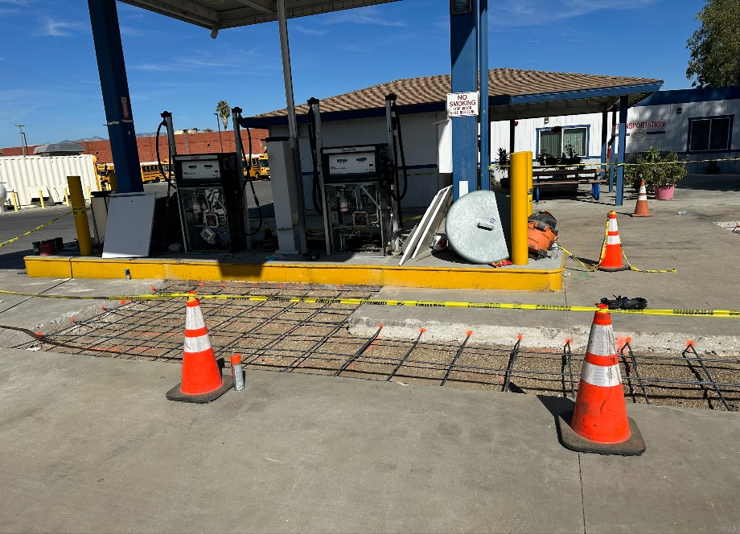
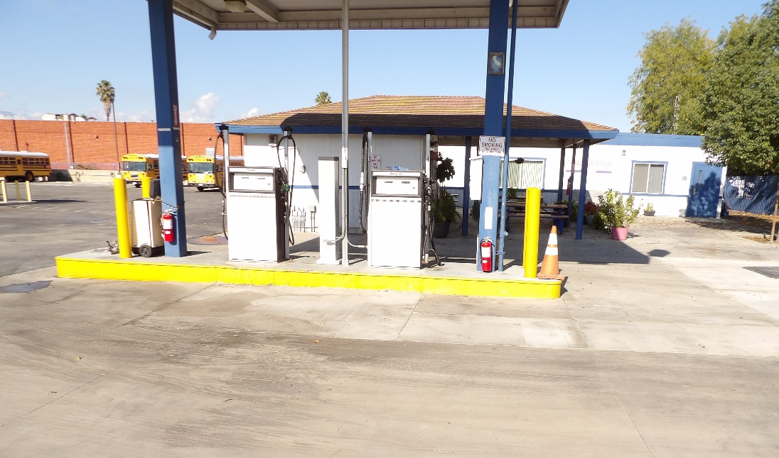
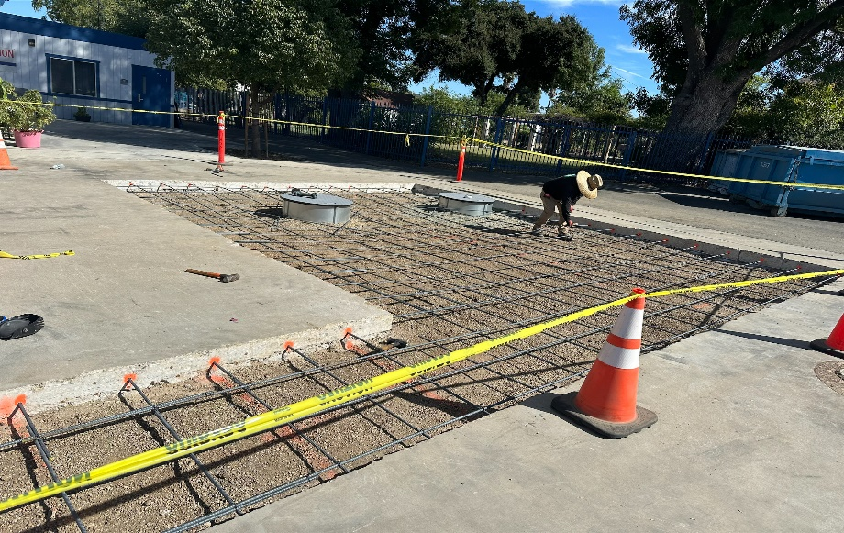
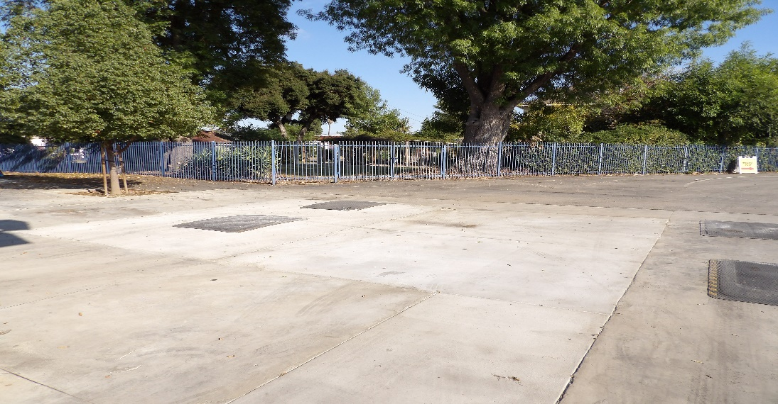
Projects Completed as of January 23, 2024 District Office – Transportation Fuel Station Repairs (11/2023)
BEFORE
AFTER
BEFORE
AFTER

Slide 5
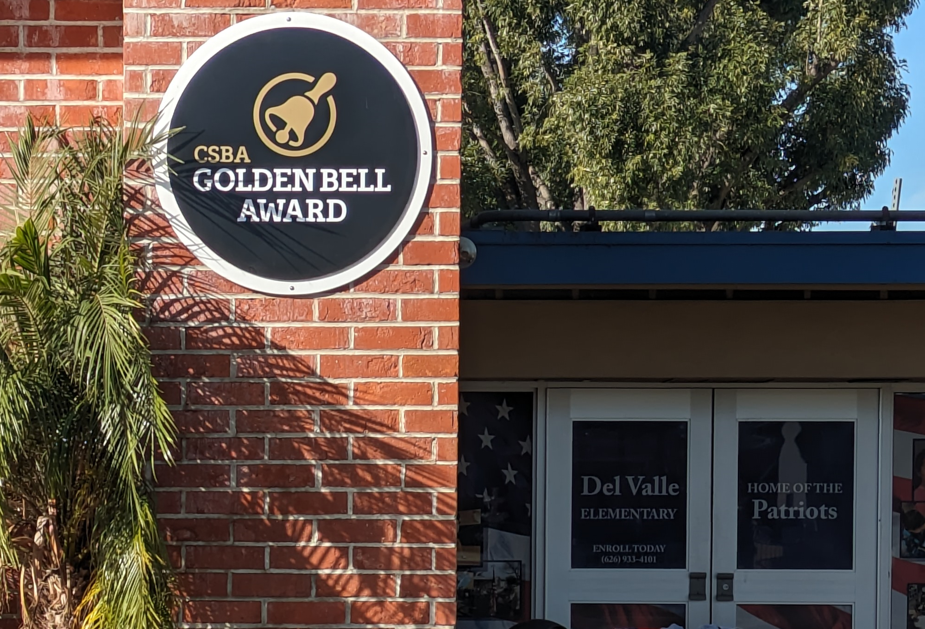
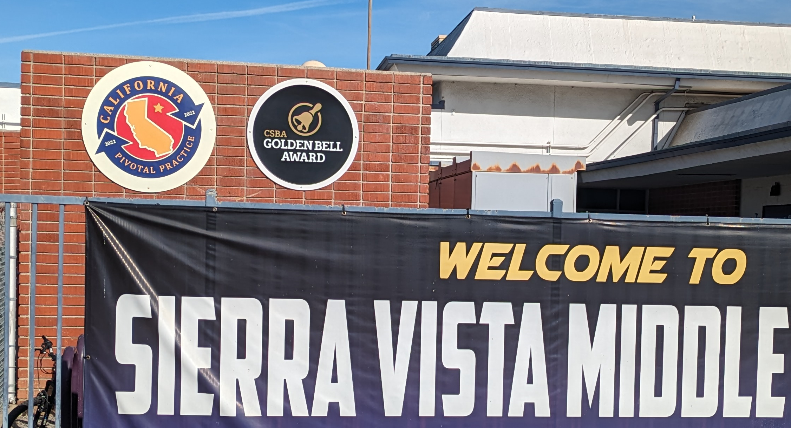
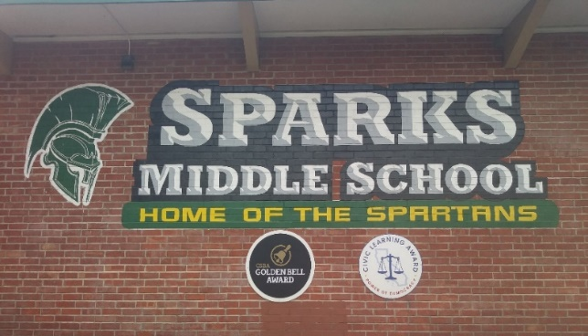
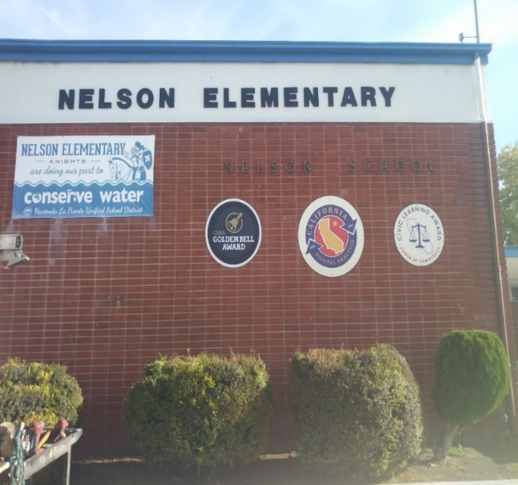
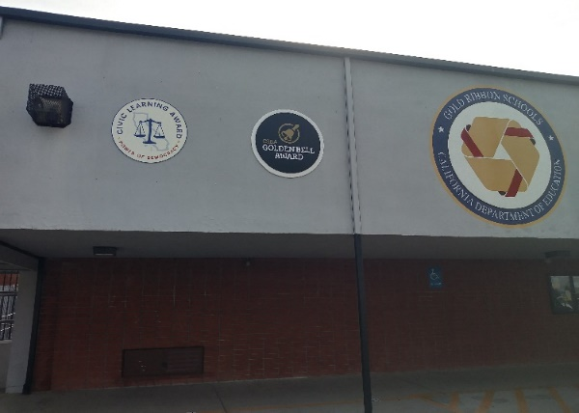
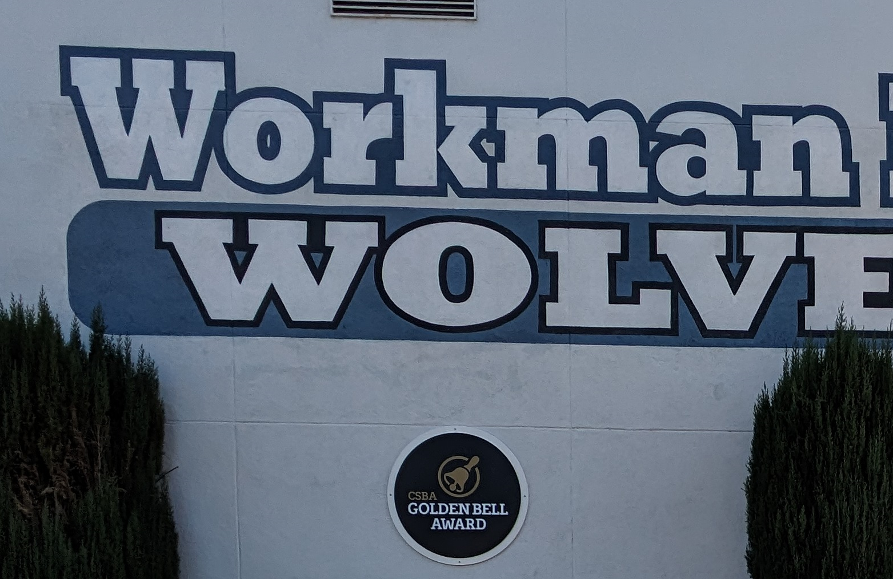
Projects Completed as of January 23, 2024 Del Valle, La Puente HS, Nelson ES, Sierra Vista MS, Sparks MS, Sunset ES, Workman ES – Golden Bell Award (12/2023)

Slide 6
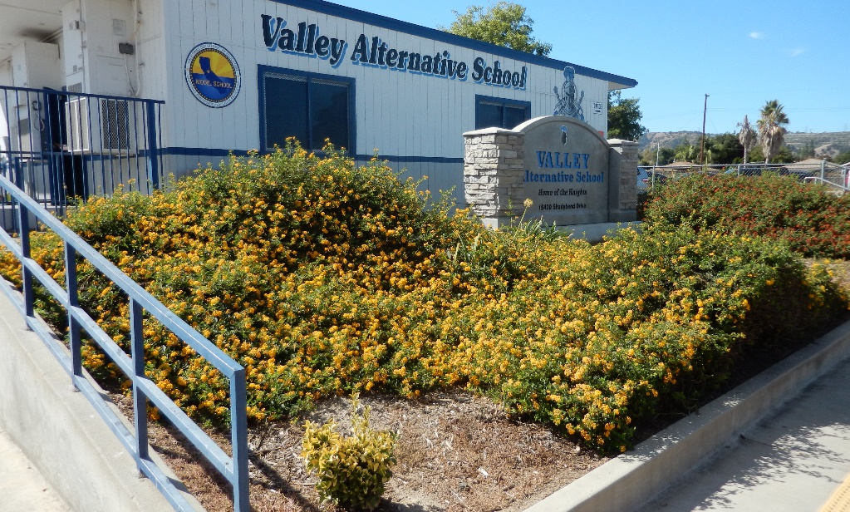
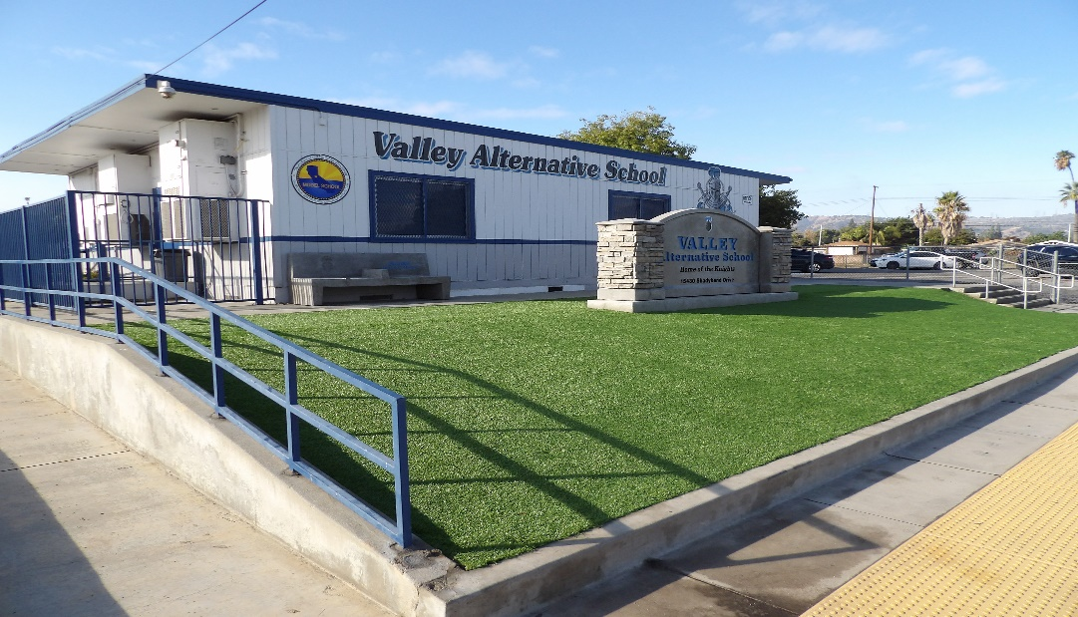
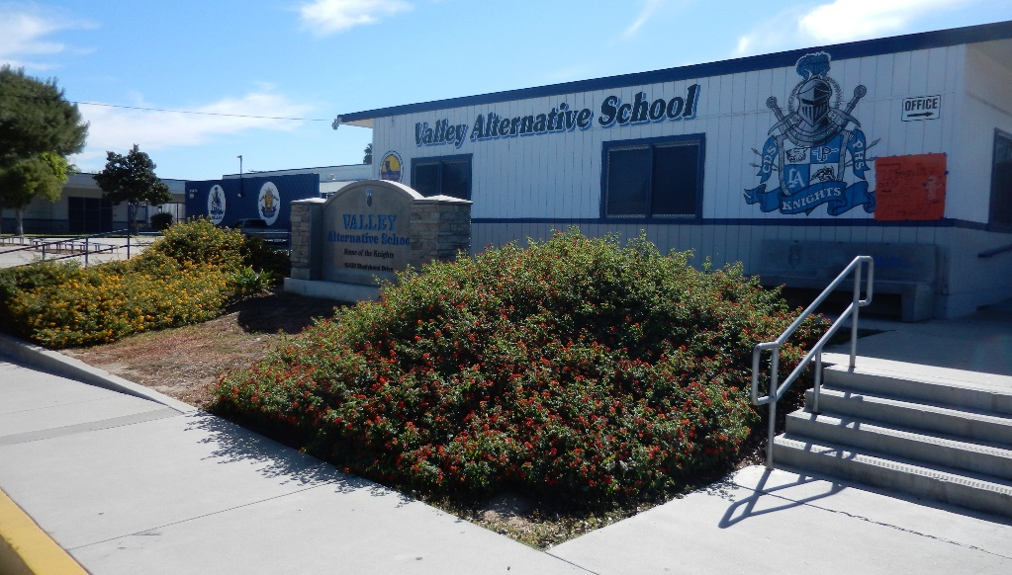
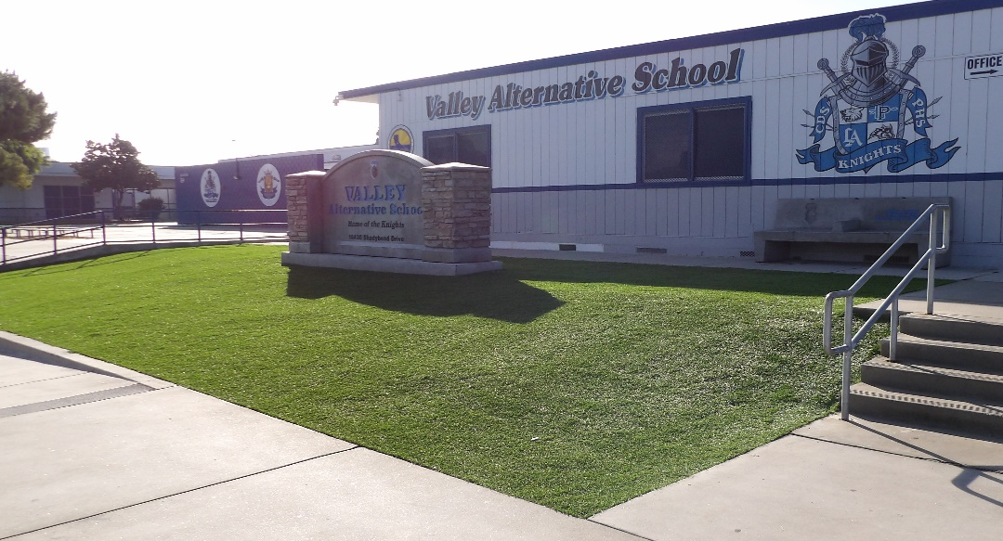
Projects Completed as of January 23, 2024 Valley AS – Administration Landscaping (11/2023)
BEFORE
AFTER

Slide 7
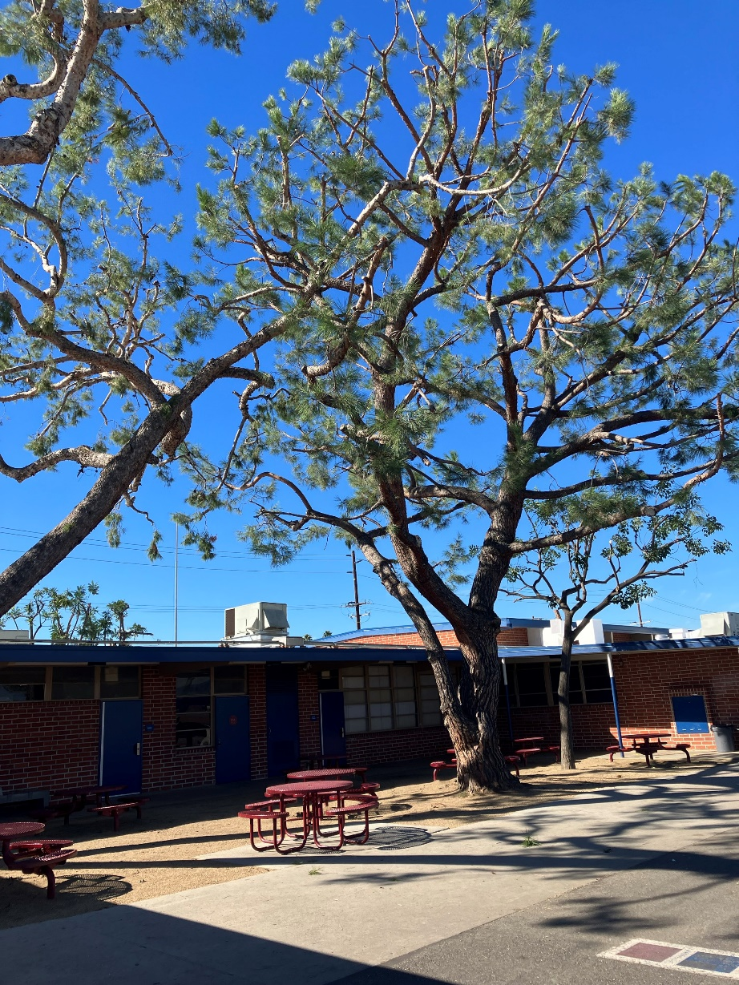
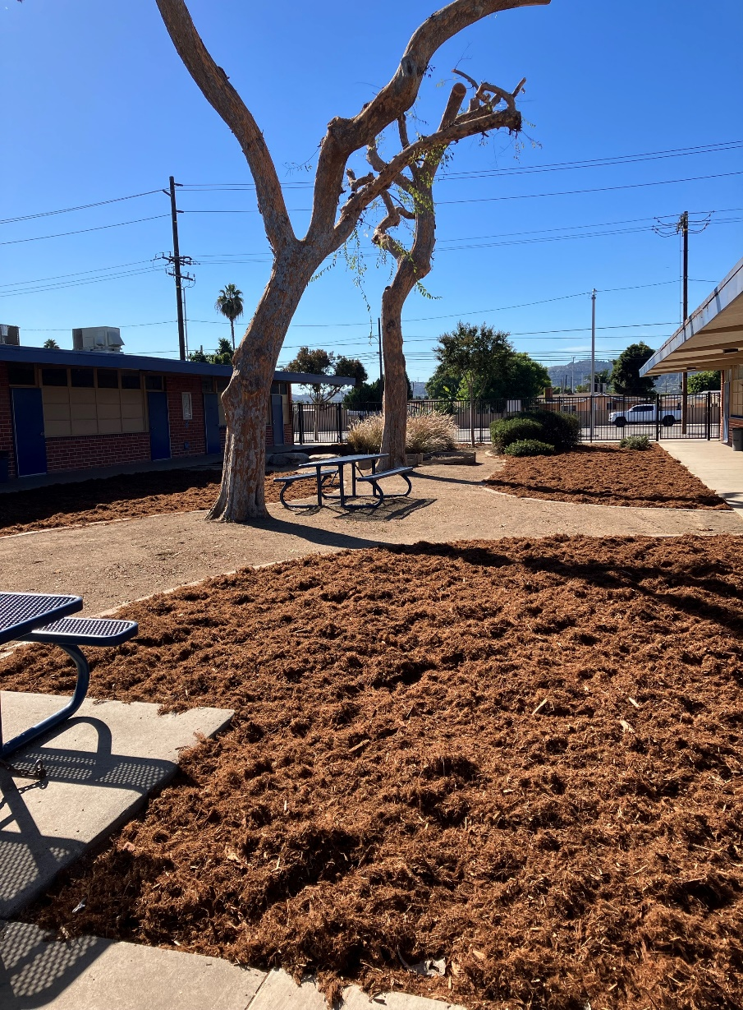
Projects Completed as of January 23, 2024 Sparks ES – School Beautification (12/2023)

Slide 8
Projects In Progress
2023-2024

Slide 9
Projects In Progress as of January 23, 2024
Site | Item Description | Architect Plans | DSA Approval | Procurement | Construct | Funding Source | Target Completion Date
Baldwin ES Cedarlane Fairgrove Lassalette Sparks ES | Blacktop Asphalt & Striping | NA | NA | Bidding | Pending | Facilities | TBD
Willow AS | Fire Alarm Installation | Complete | NA | Complete | In Progress | Adult Ed | 01/2024
Dibble AS | HVAC Replacement | Complete | NA | Complete | In Progress | Adult Ed | 02/2024
Willow AS | HVAC Replacement | Complete | NA | Complete | In Progress | Adult Ed | 02/2024
Wedgeworth | K-5 Permanent School | Complete | Complete | Complete | In Progress | COPS | 06/2025
California ES Cedarlane District Office Bldg C Grazide ES Lassalette Los Altos HS SSC (Sierra Vista) Sparks ES Stimson LC Valley Alt AS – CDS Workman ES 26/27 Workman HS | Reroof Various Buildings | In Progress | NA | Complete | In Progress | Deferred Maint. | 01/2024
Workman HS | Phase II Stadium and Baseball Field (Phase I Track & Field and Softball Field Complete) | Complete | Complete | In Progress | Pending | Various - Estimate Cost $18 M | TBD (14-18 months after Board approval of the Bid)
Changes And Progress Since Last Report - Blue

Slide 10
Projects In Progress as of January 23, 2024
Site | Item Description | Architect Plans | DSA Approval | Procurement | Construct | Funding Source | Target Completion Date
Kwis Elementary | Baseball Fields (Two Youth) | Complete | Complete | In Progress | TBD |  | TBD
Center for the Performing Arts | Construction of NEW Performing Arts Center @ Temple Academy | Complete | Complete | Pending | 03/2024 | Adult Ed | 08/2025
District Office | Portable Installation Meeting/Flex Space | Complete | NA | Complete | 01/2024 | Facilities | 04/2024
Willow AS | Two Story Renovation | Complete | NA | Complete | In Progress | Adult Ed | 02/2024
District Office | Warehouse Freezer | Complete | NA | Pending | Pending | Food Services | TBD
Changes And Progress Since Last Report - Blue

Slide 11
Projects with Division of State Architect (DSA) Waiting on Approval
Site | Item Description | Architect Plans | DSA Approval | Procurement | Est. Construct Start | Target Completion Date
Los Altos HS | Gym & Locker Room HVAC (65 tons of temporary HVAC units have been installed) | Complete | Pending | Complete | TBD | Approx. 3 months after DSA approval
Wing Lane ES | Headstart Portable | Complete | Pending | Pending | TBD | TBD
Projects in Design
Site | Item Description | Architect Plans | DSA Approval | Procurement | Est. Construct Start | Target Completion Date
Districtwide | HVAC System Replacements | Pending | Pending | Pending | TBD | TBD
Changes And Progress Since Last Report - Blue

Slide 12
Next Report – February 22, 2024

