Slide 1
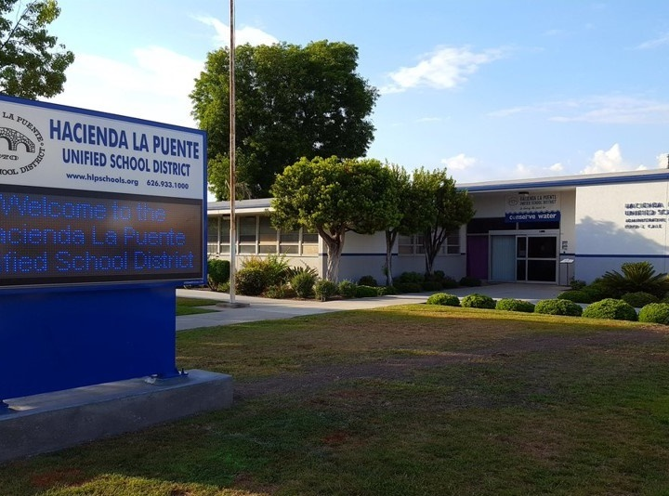
21st Century Classroom Improvements
August 24, 2023, Board Update
Notes:
1

Slide 2
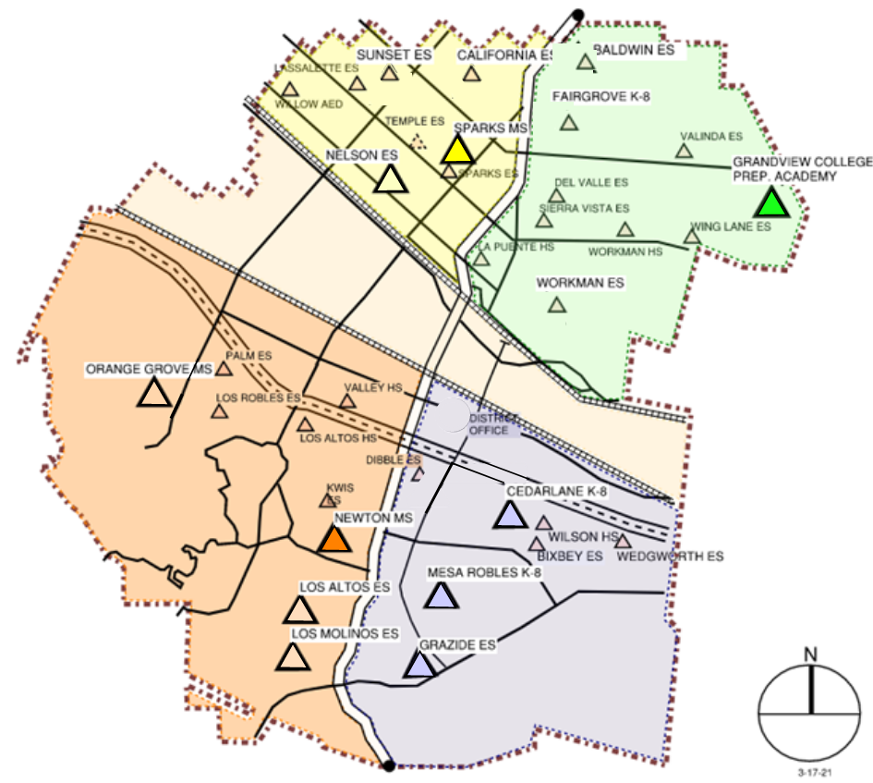
Sites In Progress & Completed
IN PROGRESS
Newton MS
Grandview K-8
HIGH SCHOOL REFRESH
La Puente HS
Workman HS
COMPLETED
Nelson ES
Los Altos ES
Workman ES
Mesa Robles K-8
Cedarlane K-8
Sparks MS

Slide 3
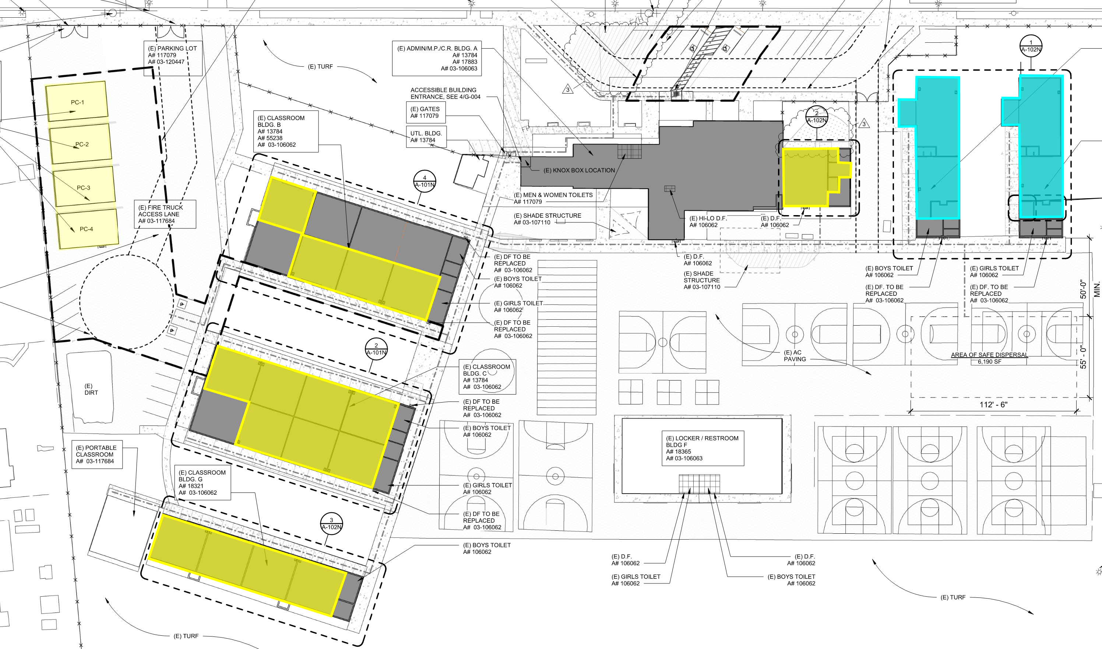
Newton Middle School
Phase 1: D-1 to D-4 Complete
Phase 2: C-6 to C-8 Complete
Phase 3: C-1 to C-4 Complete
Phase 4: B-4, B-6 to B-8 Complete
Phase 5: Music Room Complete
Phase 6: E-1, E-2, F-1, F-2 Next Phase
Site Plan & Status
Construction

Slide 4
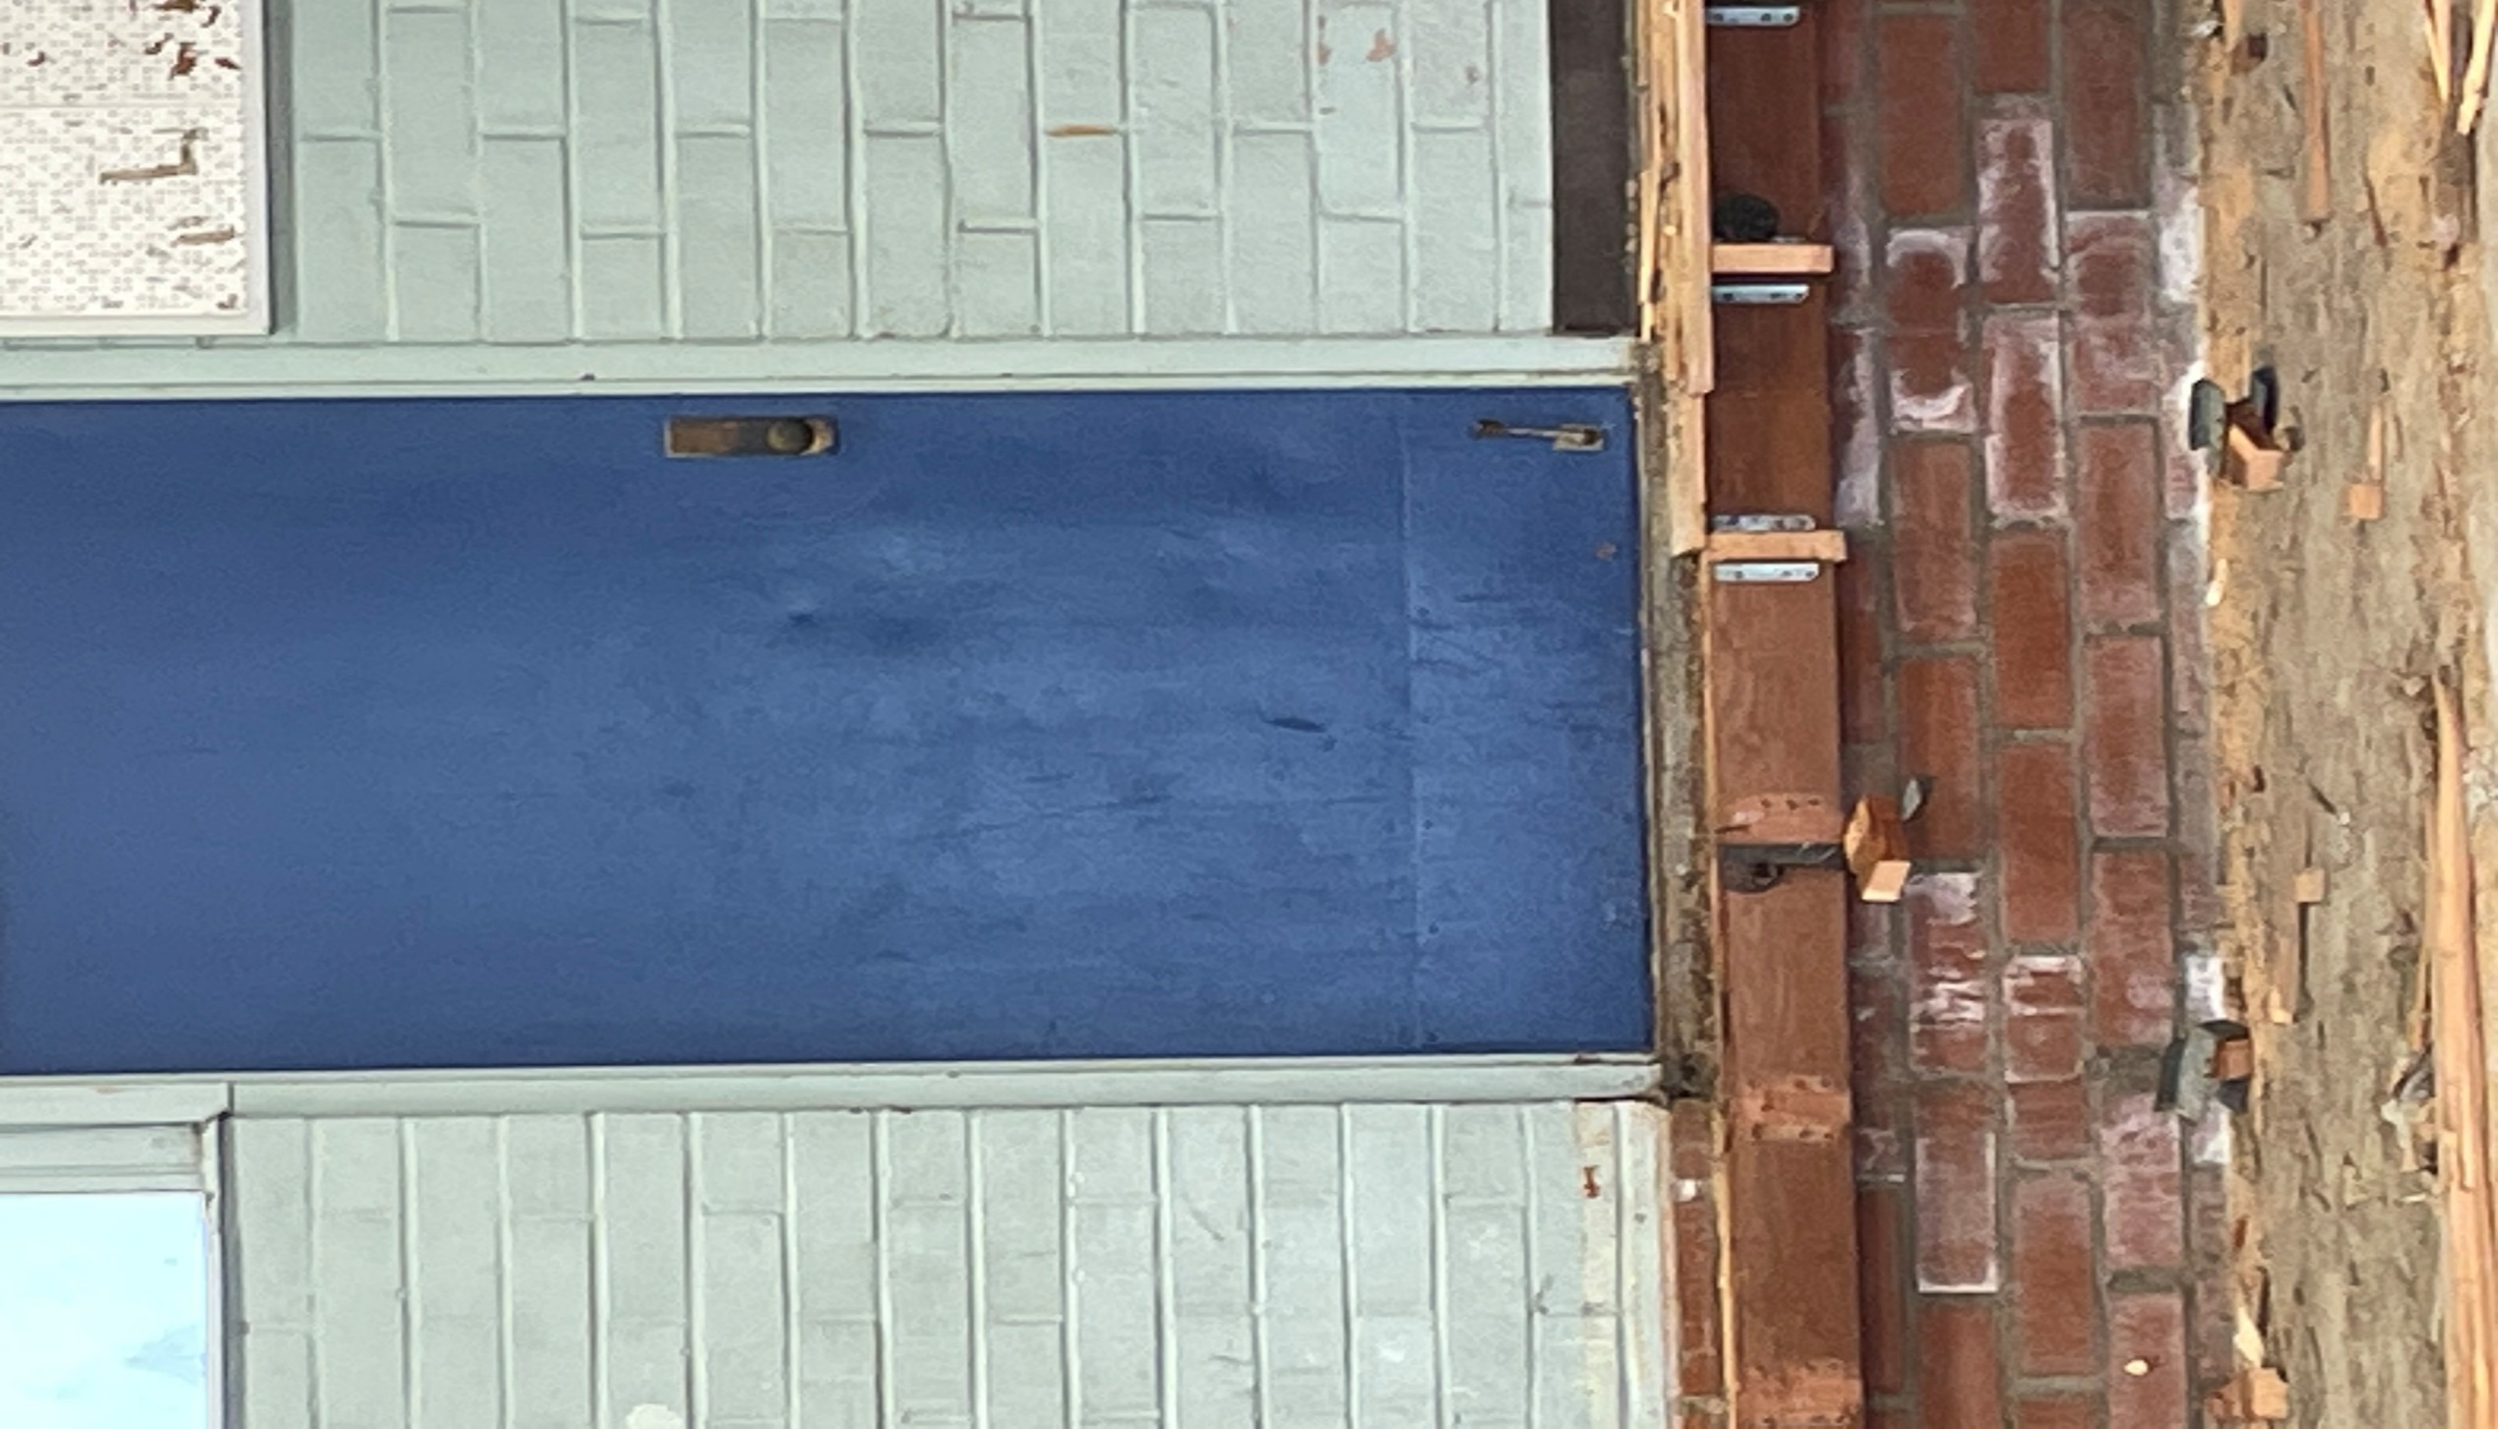
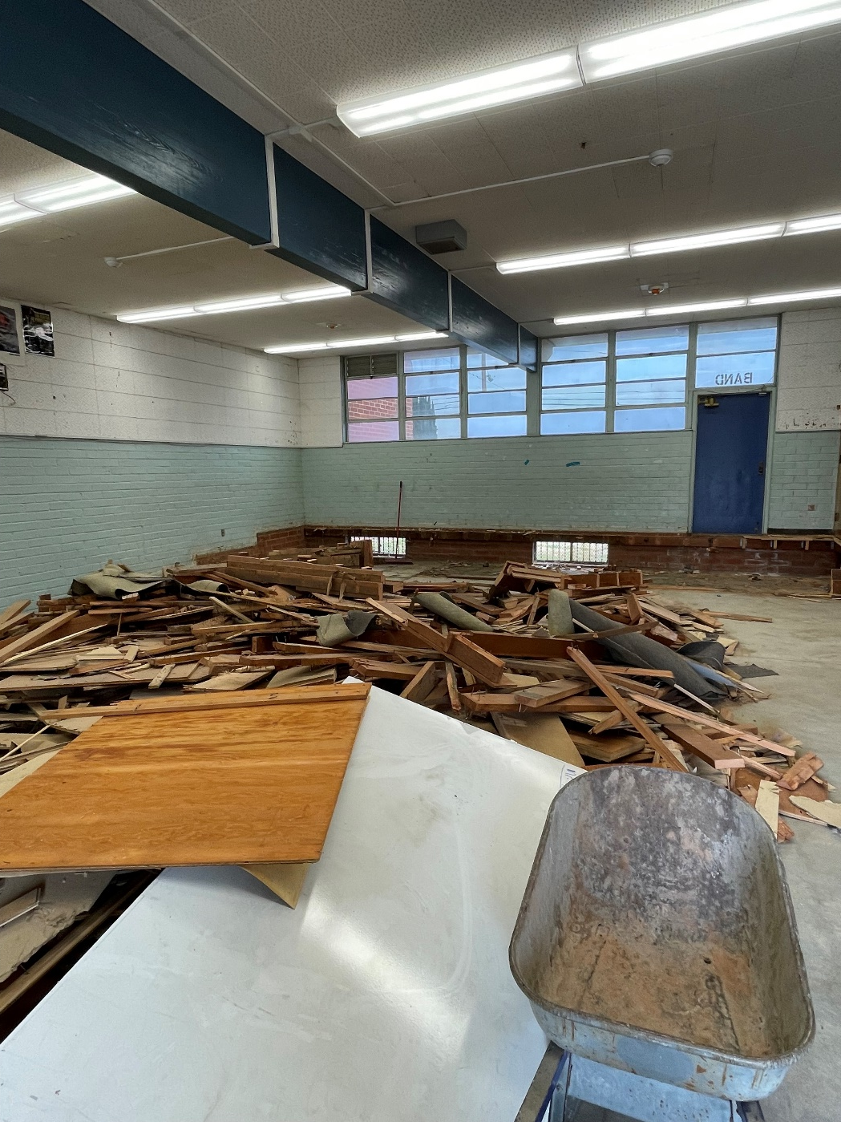
Newton Middle School
Band Room
BEFORE
BEFORE
Project Status
Construction

Slide 5
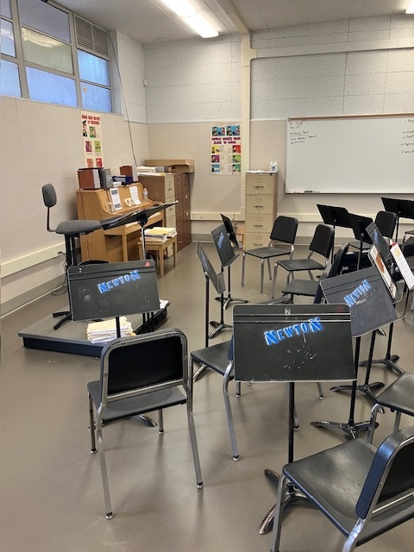
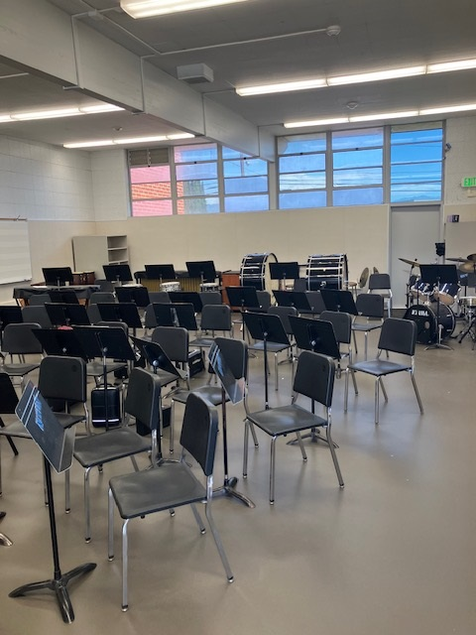
Newton Middle School
Band Room
AFTER
AFTER
Project Status
Construction

Slide 6
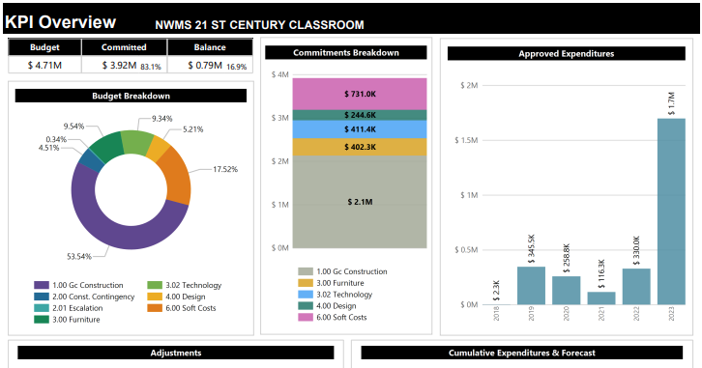
Newton Middle School
80% Complete
Modernization Plan
Classrooms: 19
Music Room: 1
Project Status
Construction

Slide 7
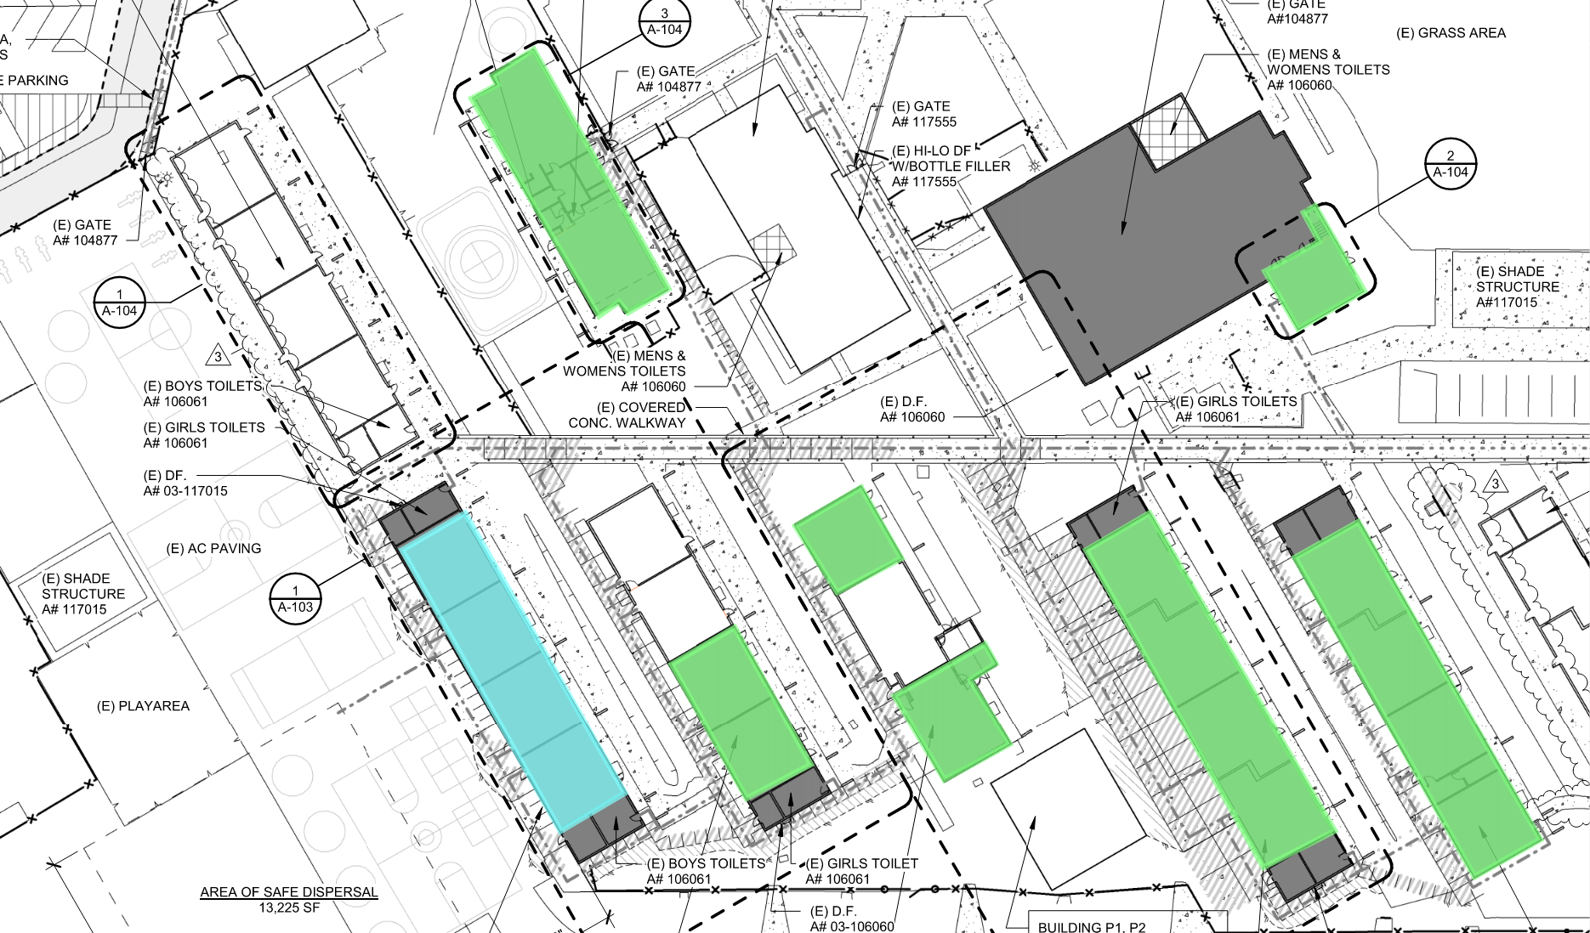
Grandview College Prep. Academy
Phase 1: 51-54 & 61-64
Complete
Phase 2: K-1, K-2, 32-33,
41, 43
Complete
Phase 3: B-4, Music/Band
Complete
Phase 4: 20-24
Next Phase
Site Plan & Status
Construction

Slide 8
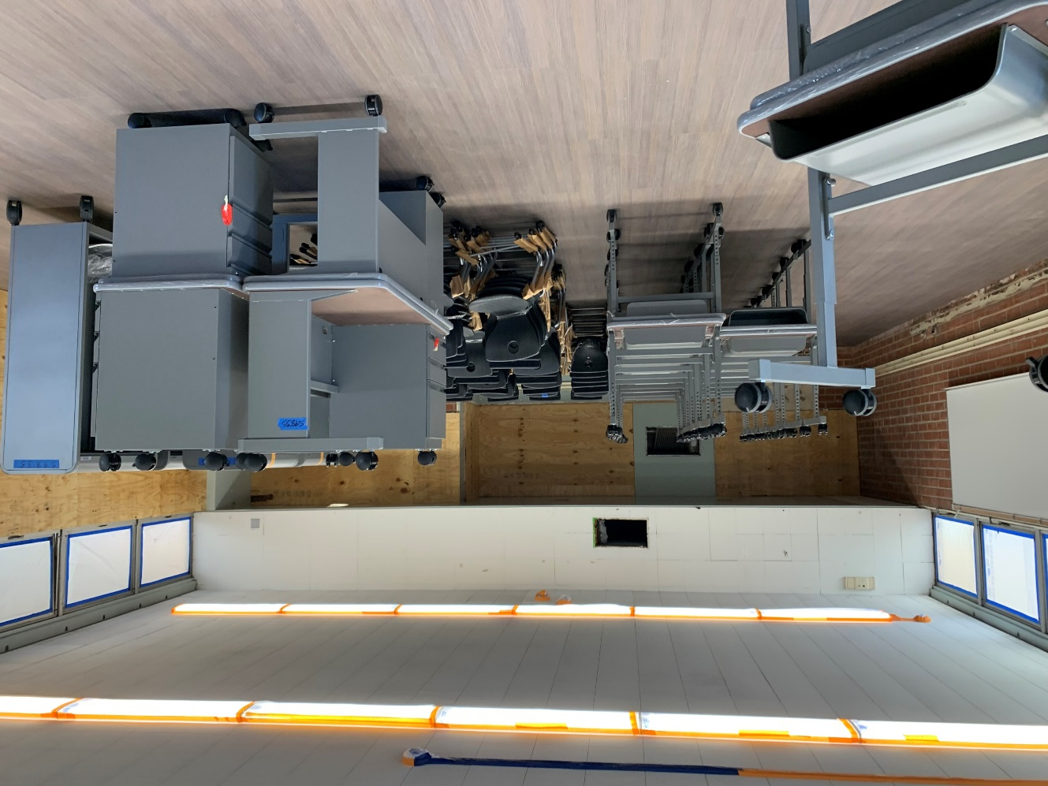
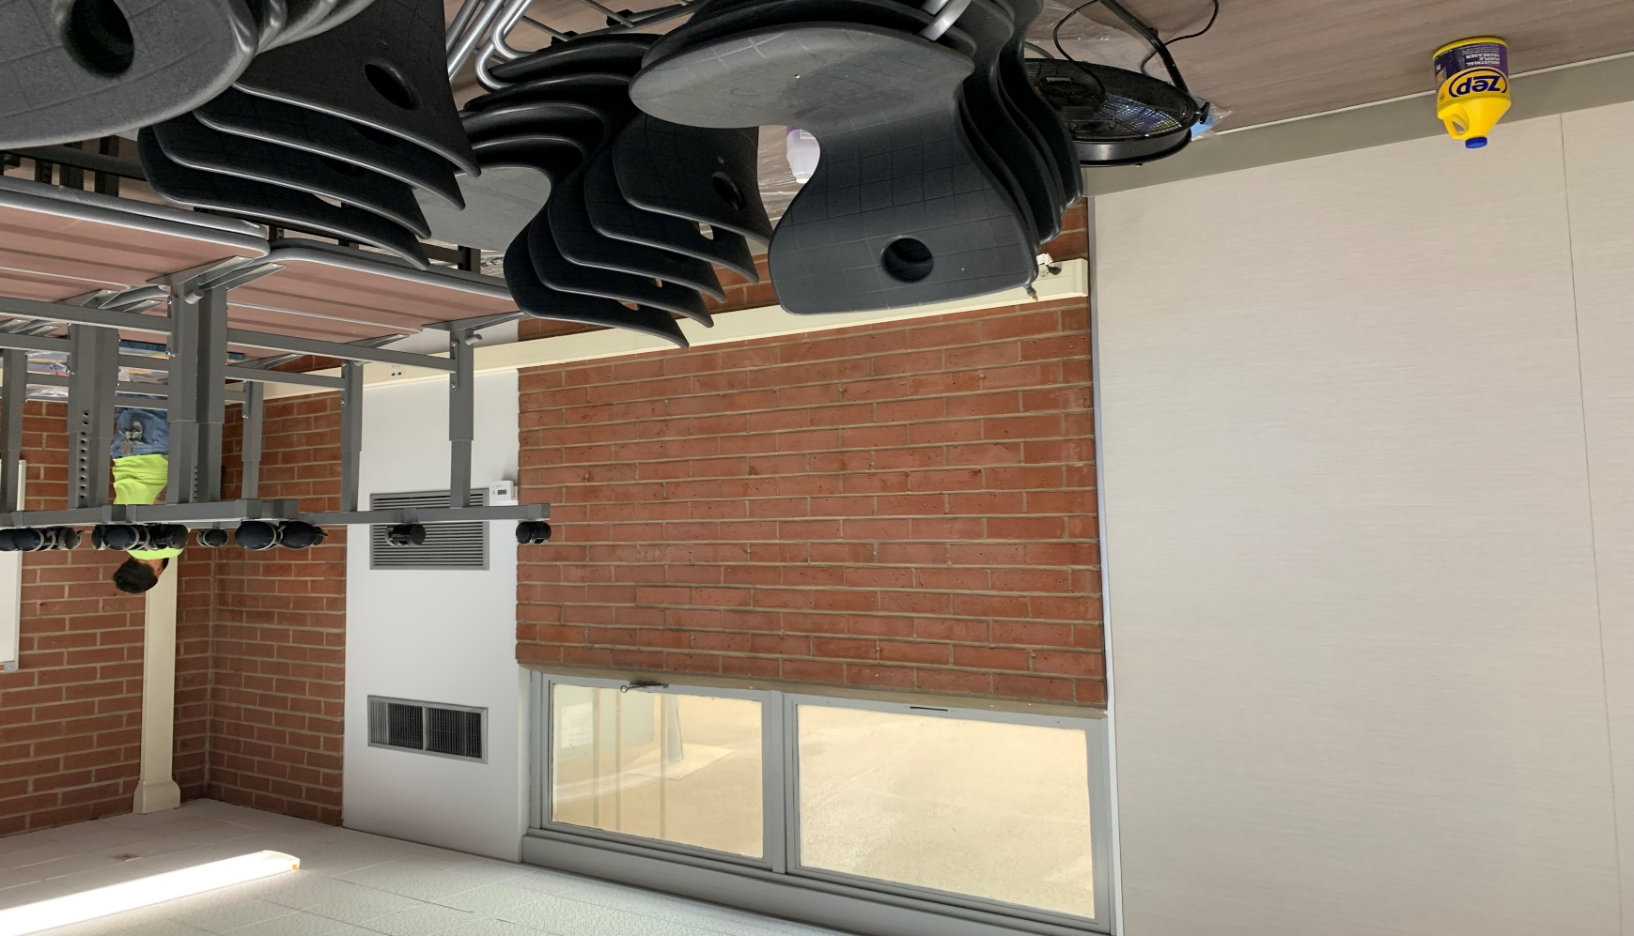
Grandview College Prep. Academy
Construction Improvements
Project Status
Construction
8

Slide 9
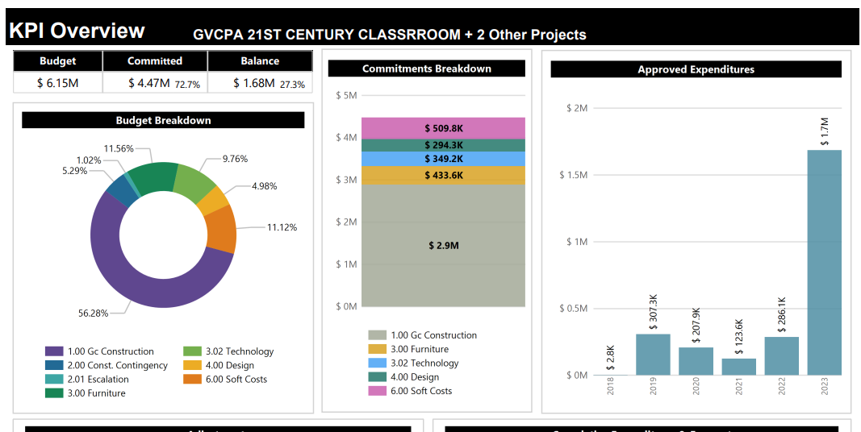
Grandview College Prep. Academy
84% Complete
Modernization Plan
Classrooms: 16
Music Room: 1
Kinder: 2
Project Status
Construction

Slide 10
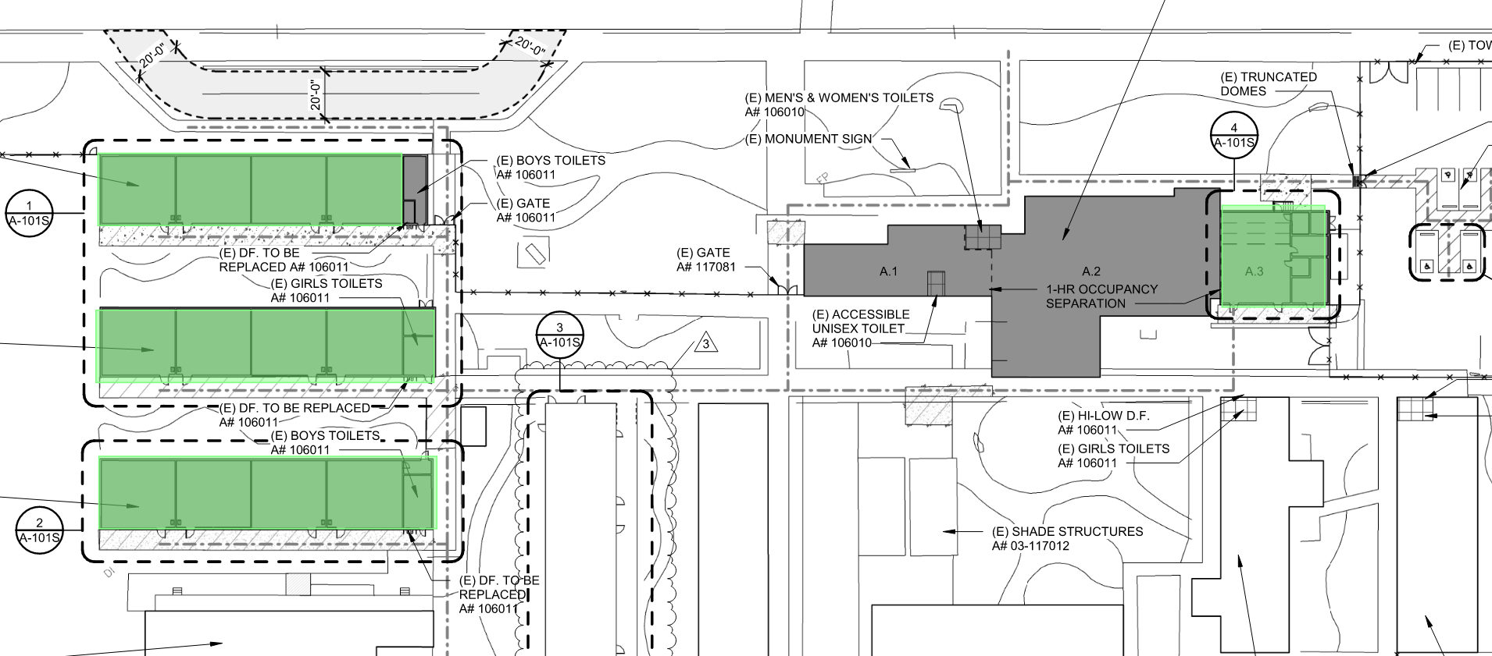
Sparks Middle School
Phase 1 : 9-16 Complete
Phase 2: 17-20 Complete
Music Complete
Site Plan & Status
Construction

Slide 11
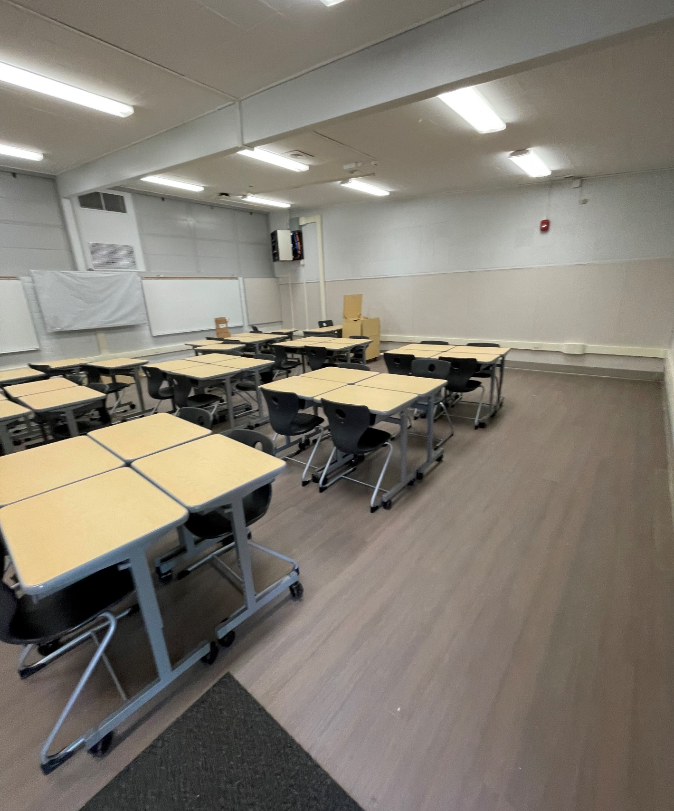
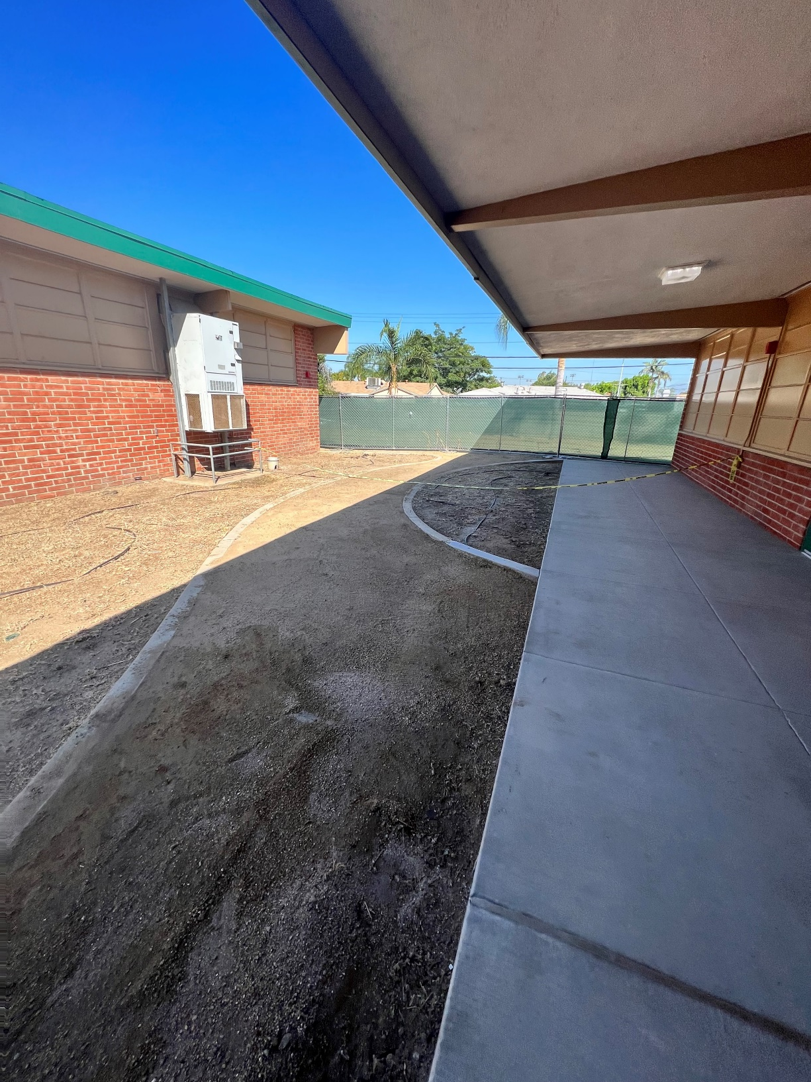
Sparks Middle School
Project Status
Construction

Slide 12
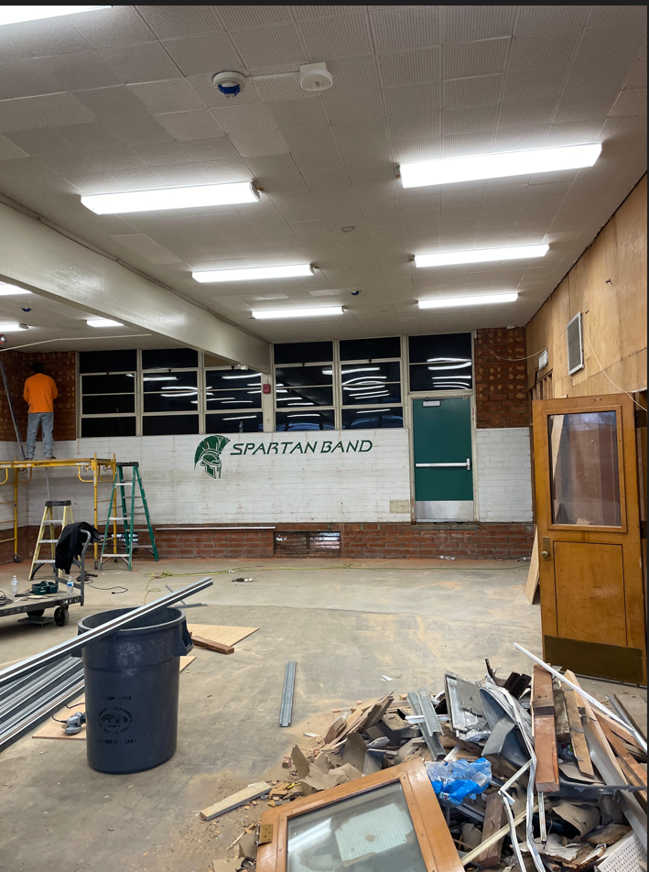
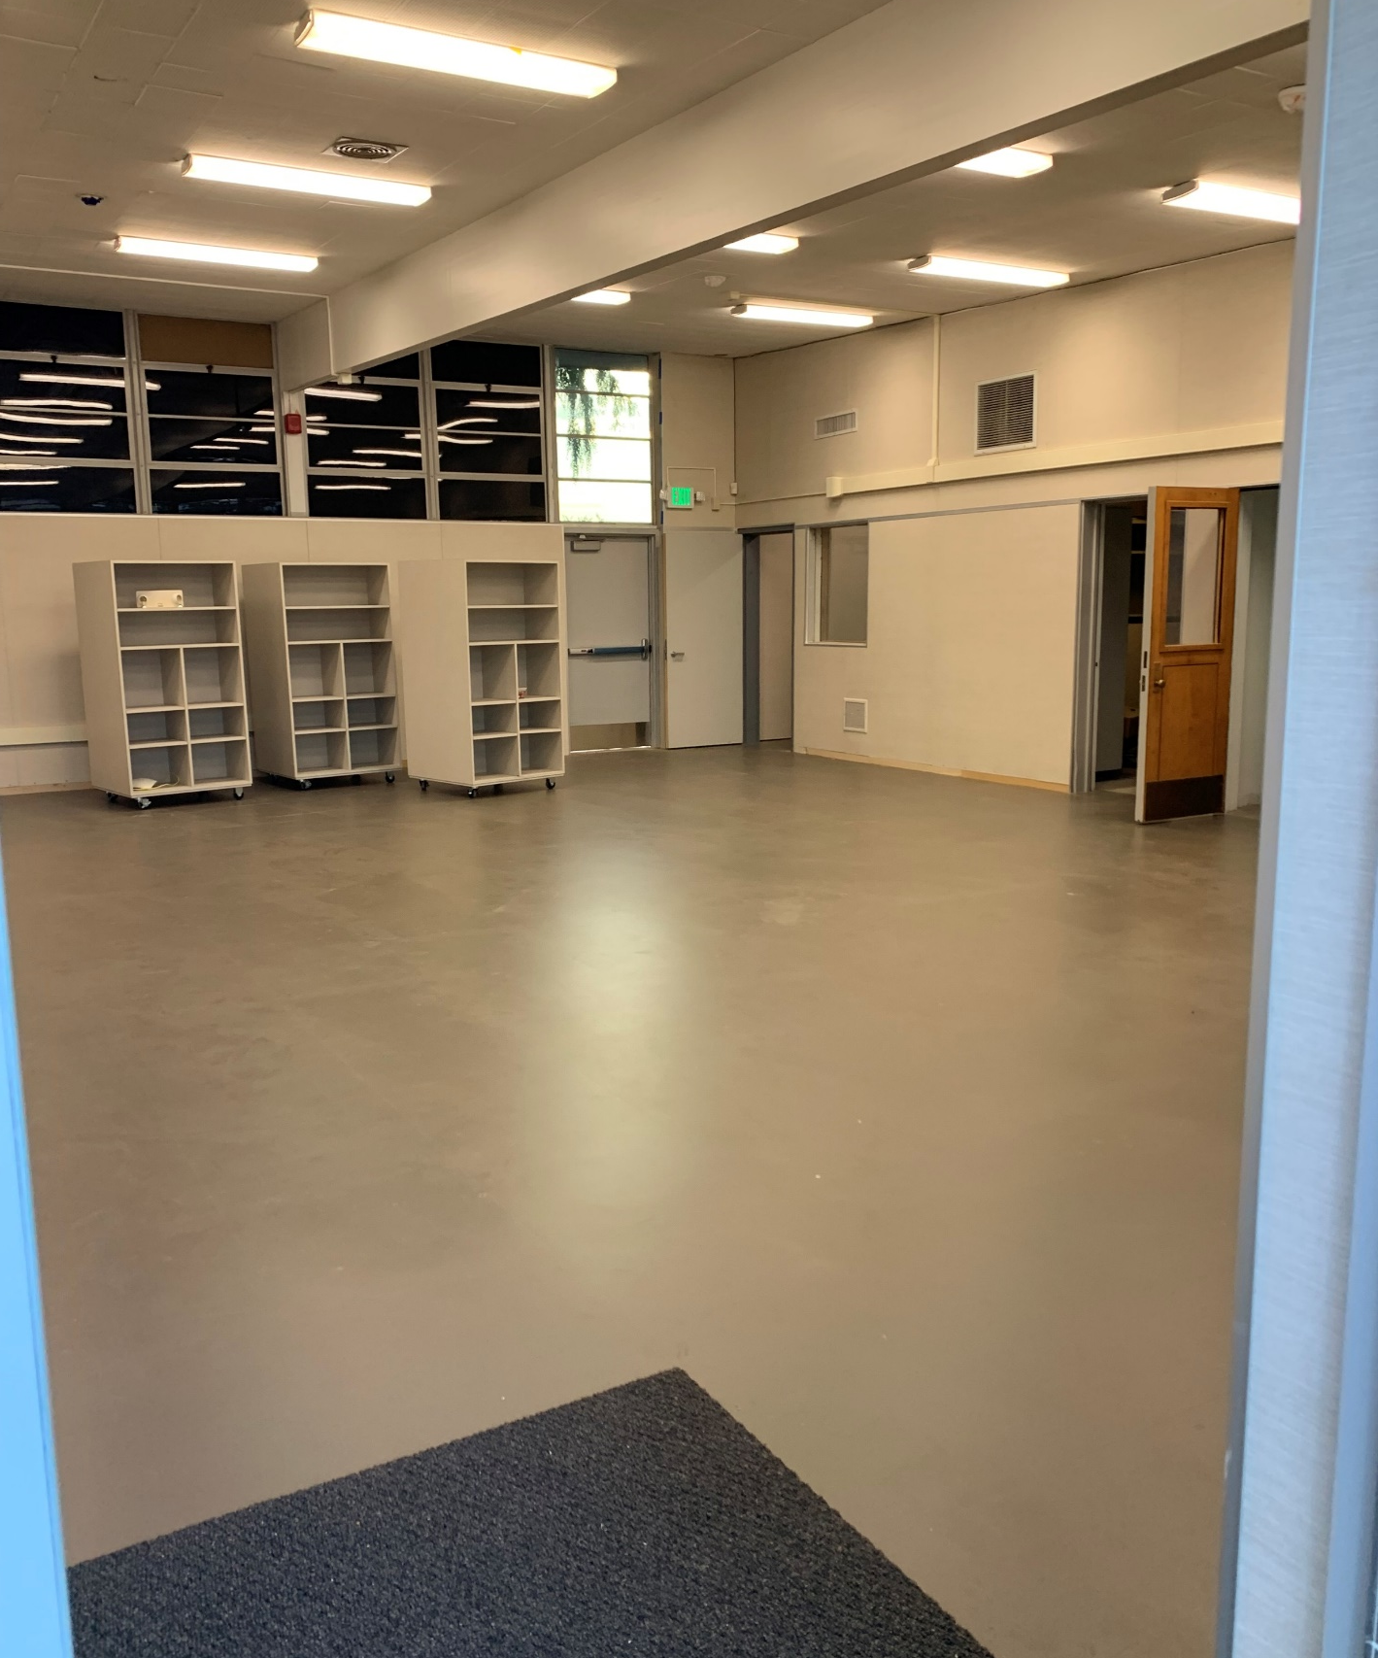
Sparks Middle School
BEFORE
AFTER
Project Status
Construction

Slide 13
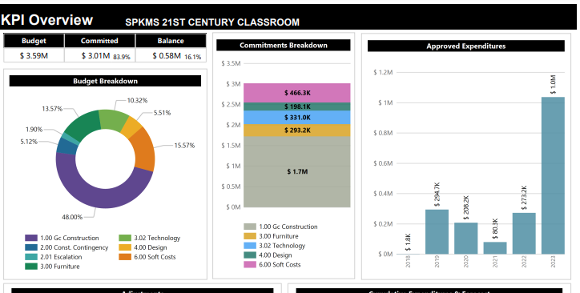
Sparks Middle School
Complete
Modernization Plan
Classrooms: 12
Music Room: 1
Project Status
Construction
Project Complete
94% billed and 11% Remaining

Slide 14
Scheduled Completion
Sparks MS Complete
Grandview: September 2023
Newton MS: October 2023
Project Status

Slide 15
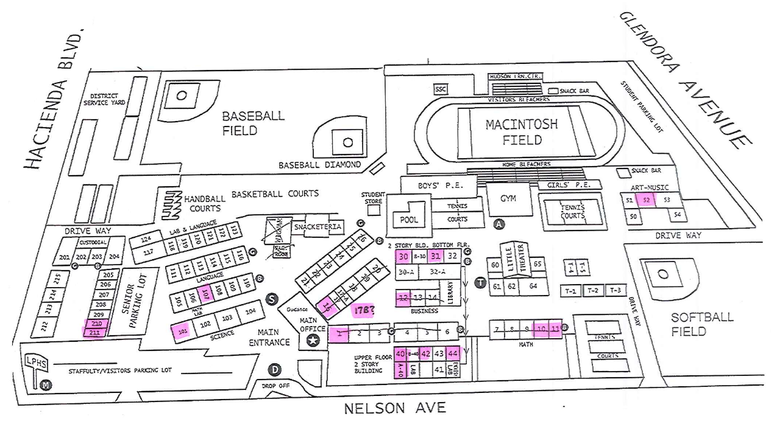
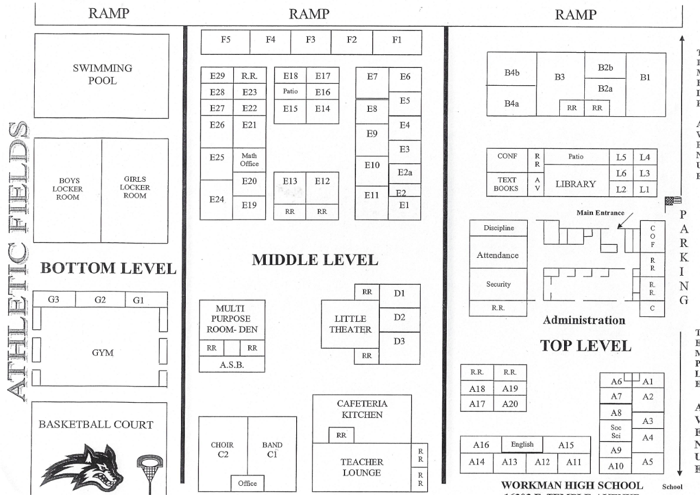
HIGH SCHOOL REFRESH
Rooms That Have Been Photographed
and Cataloged

Slide 16
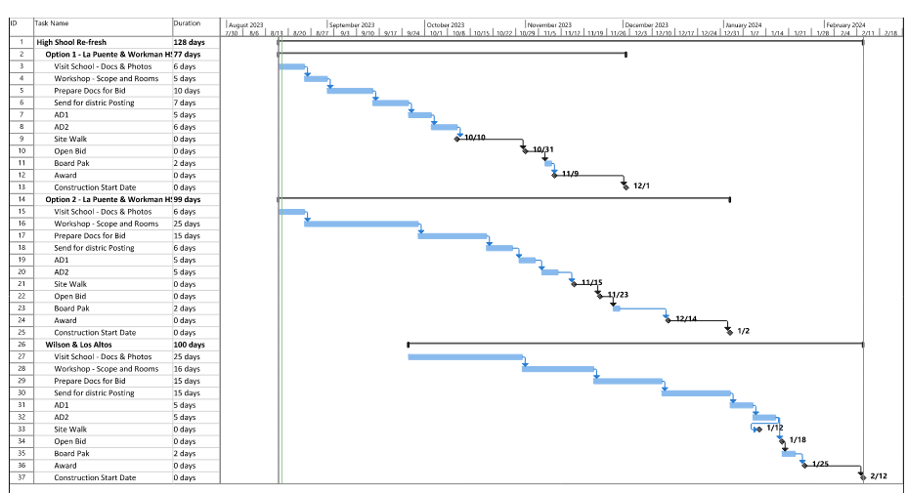
HIGH SCHOOL REFRESH
La Puente High School and Workman High School
Option 1 and Option 2

Slide 17
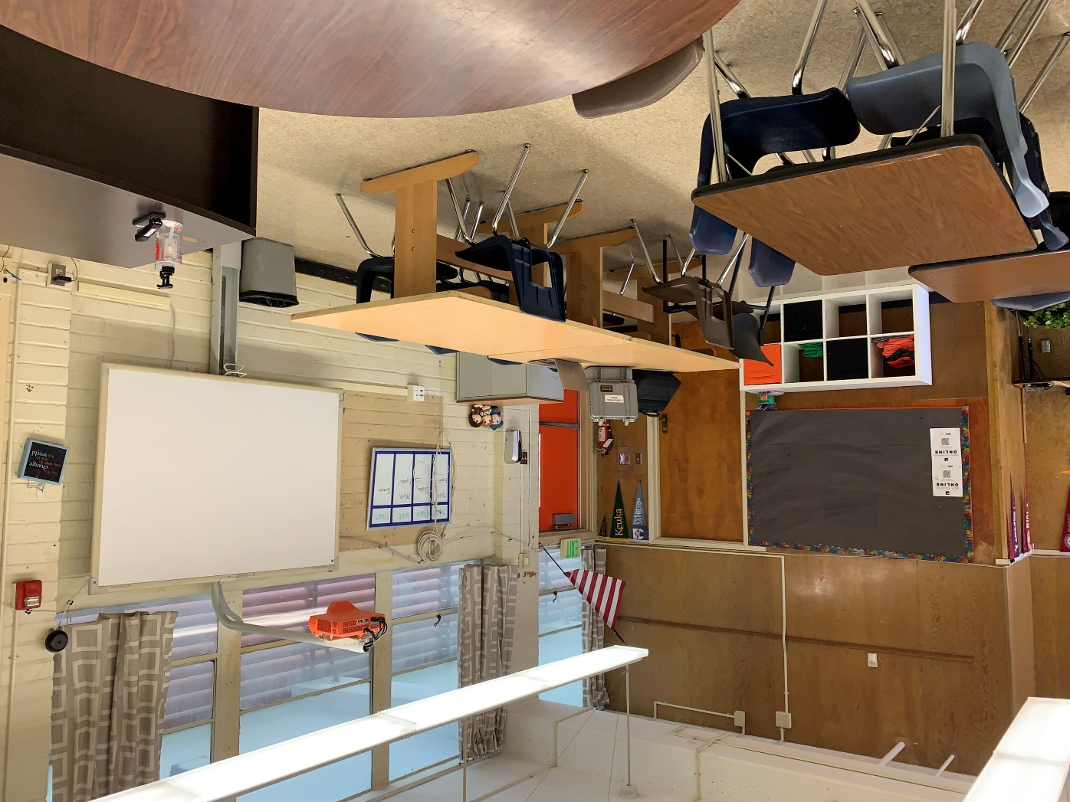
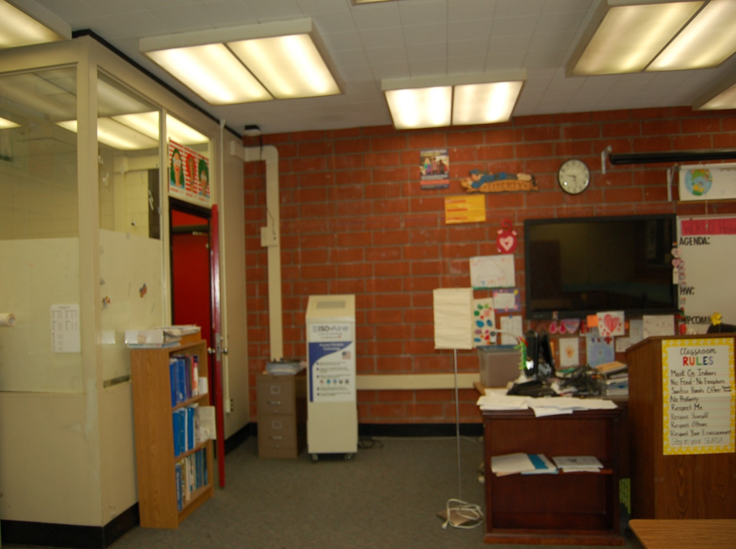
HIGH SCHOOL REFRESH
La Puente High School
Workman High School
Project Status
Project Status

Slide 18
Measure BB Bond Phase B
Contract Proposals Received From Studio + Architects
Meeting and Site Visits Resumed
Professional Fees negotiated
Request for Proposal Updates Out to PBK Architects
Meeting and Site Visits In Planning

Slide 19
Questions + answers

