Slide 1
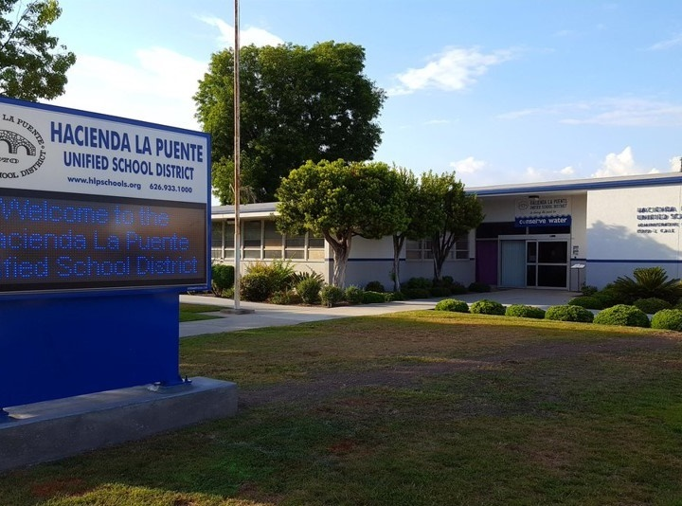
21st Century Classroom Improvements
January 23, 2024, Board Update
Notes:
1

Slide 2
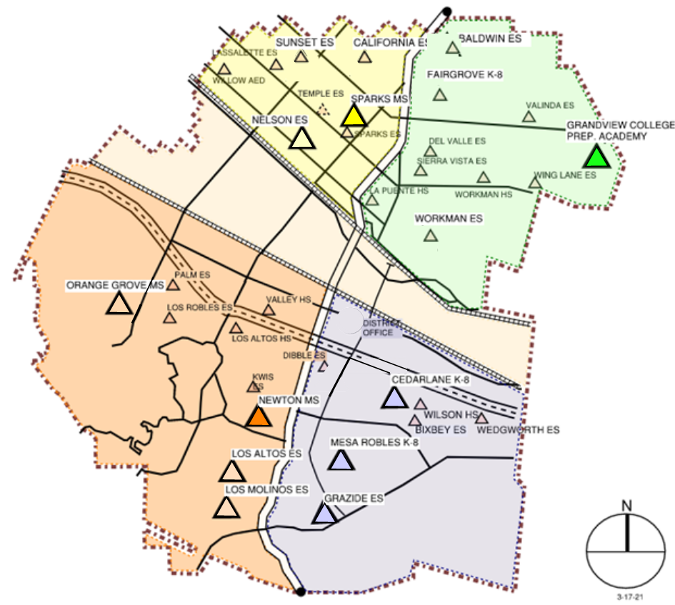
IN PROGRESS
CONSTRUCTION
La Puente HS Refresh
Workman HS Refresh
OUT TO BID
Los Altos HS Refresh
Wilson HS Refresh
Stimson EC
SITE IN PROGRESS & COMPLETED
GOING TO DSA
California ES this month
Baldwin ES this month
IN DESIGN
Los Molinos ES
Grazide ES
Kwis ES
Lassalette ES
Fairgrove K-8
Orange Grove MS
STIMSON
COMPLETED
Nelson ES
Los Altos ES
Workman ES
Mesa Robles K-8
Cedarlane K-8
Sparks MS
Newton MS
Grandview K-8

Slide 3
Phase B Progress
Baldwin ES Construction Documents to DSA 1/23/2024
California ES Construction Documents to DSA 1/23/2024
Anticipated Construction Start Fall of 2024
Los Molinos ES Construction Documents to DSA 3/12/2024
Grazide ES Construction Documents to DSA 3/12/2024
Anticipated Construction Start of 2024
Kwis ES Construction Documents Schematic Design
Lassalette ES Construction Documents Schematic Design
Anticipated Construction Start of 2025
Fairgrove K-8 Construction Documents Schematic Design
Orange Grove MS Construction Documents Schematic Design
Anticipated Construction Start of 2025

Slide 4
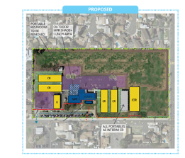
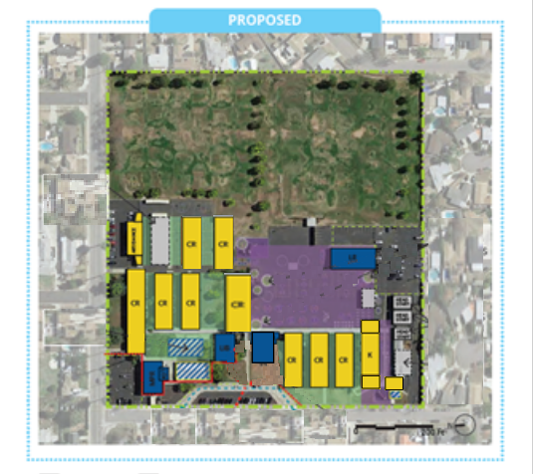
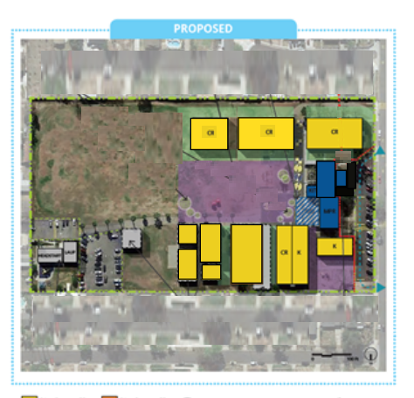
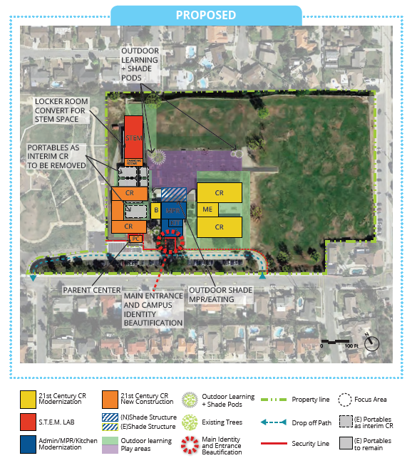
PHASE B PROJECTS IN DESIGN
California ES
Fairgrove K-8
Baldwin ES
Orange Grove MS

Slide 5
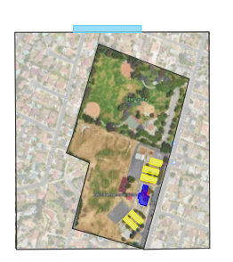
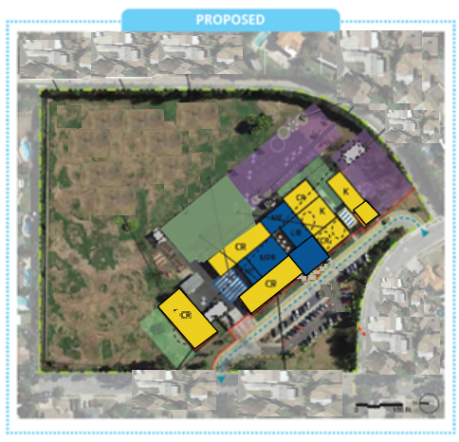
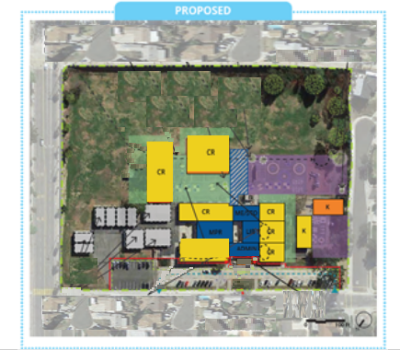
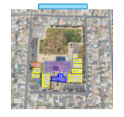
PHASE B PROJECTS IN DESIGN
PROPOSED
Los Molinos ES
Kwis ES
PROPOSED
Grazide ES
Lassalette ES

Slide 6
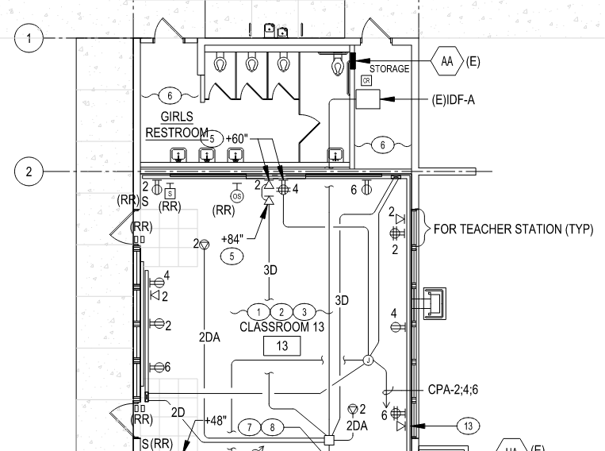
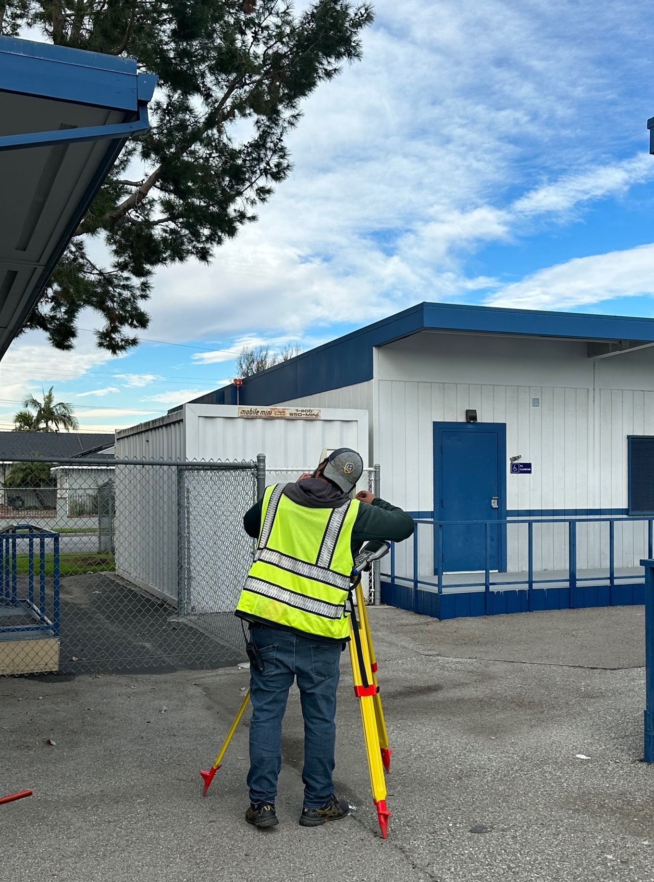
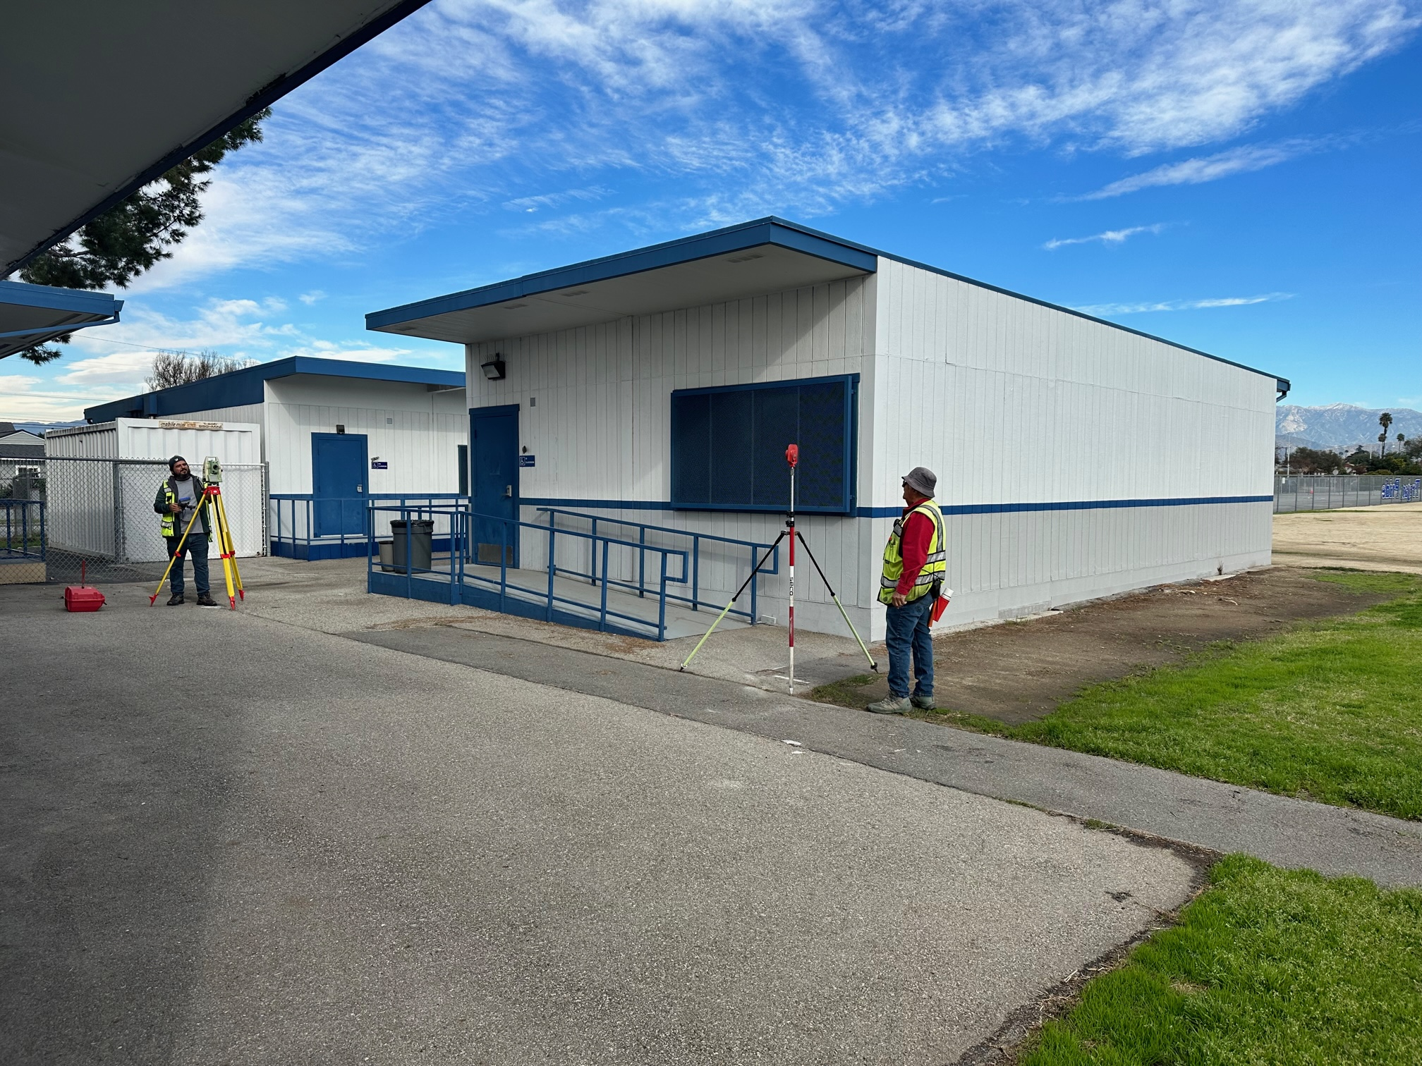
CIVIL SURVEY LASSALETTE COMPLETE

Slide 7
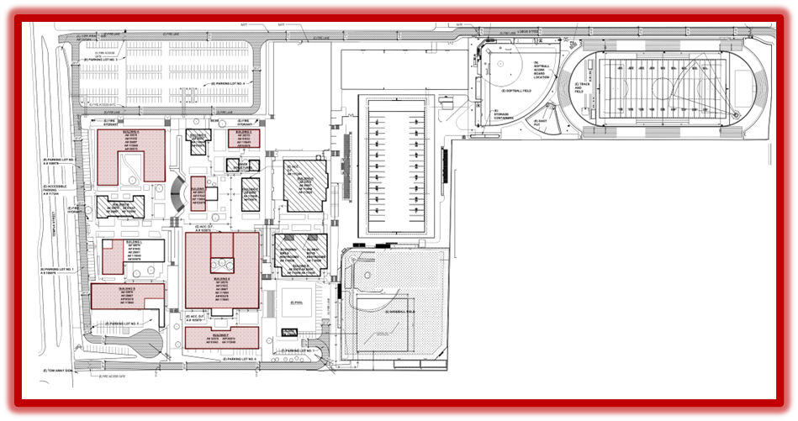
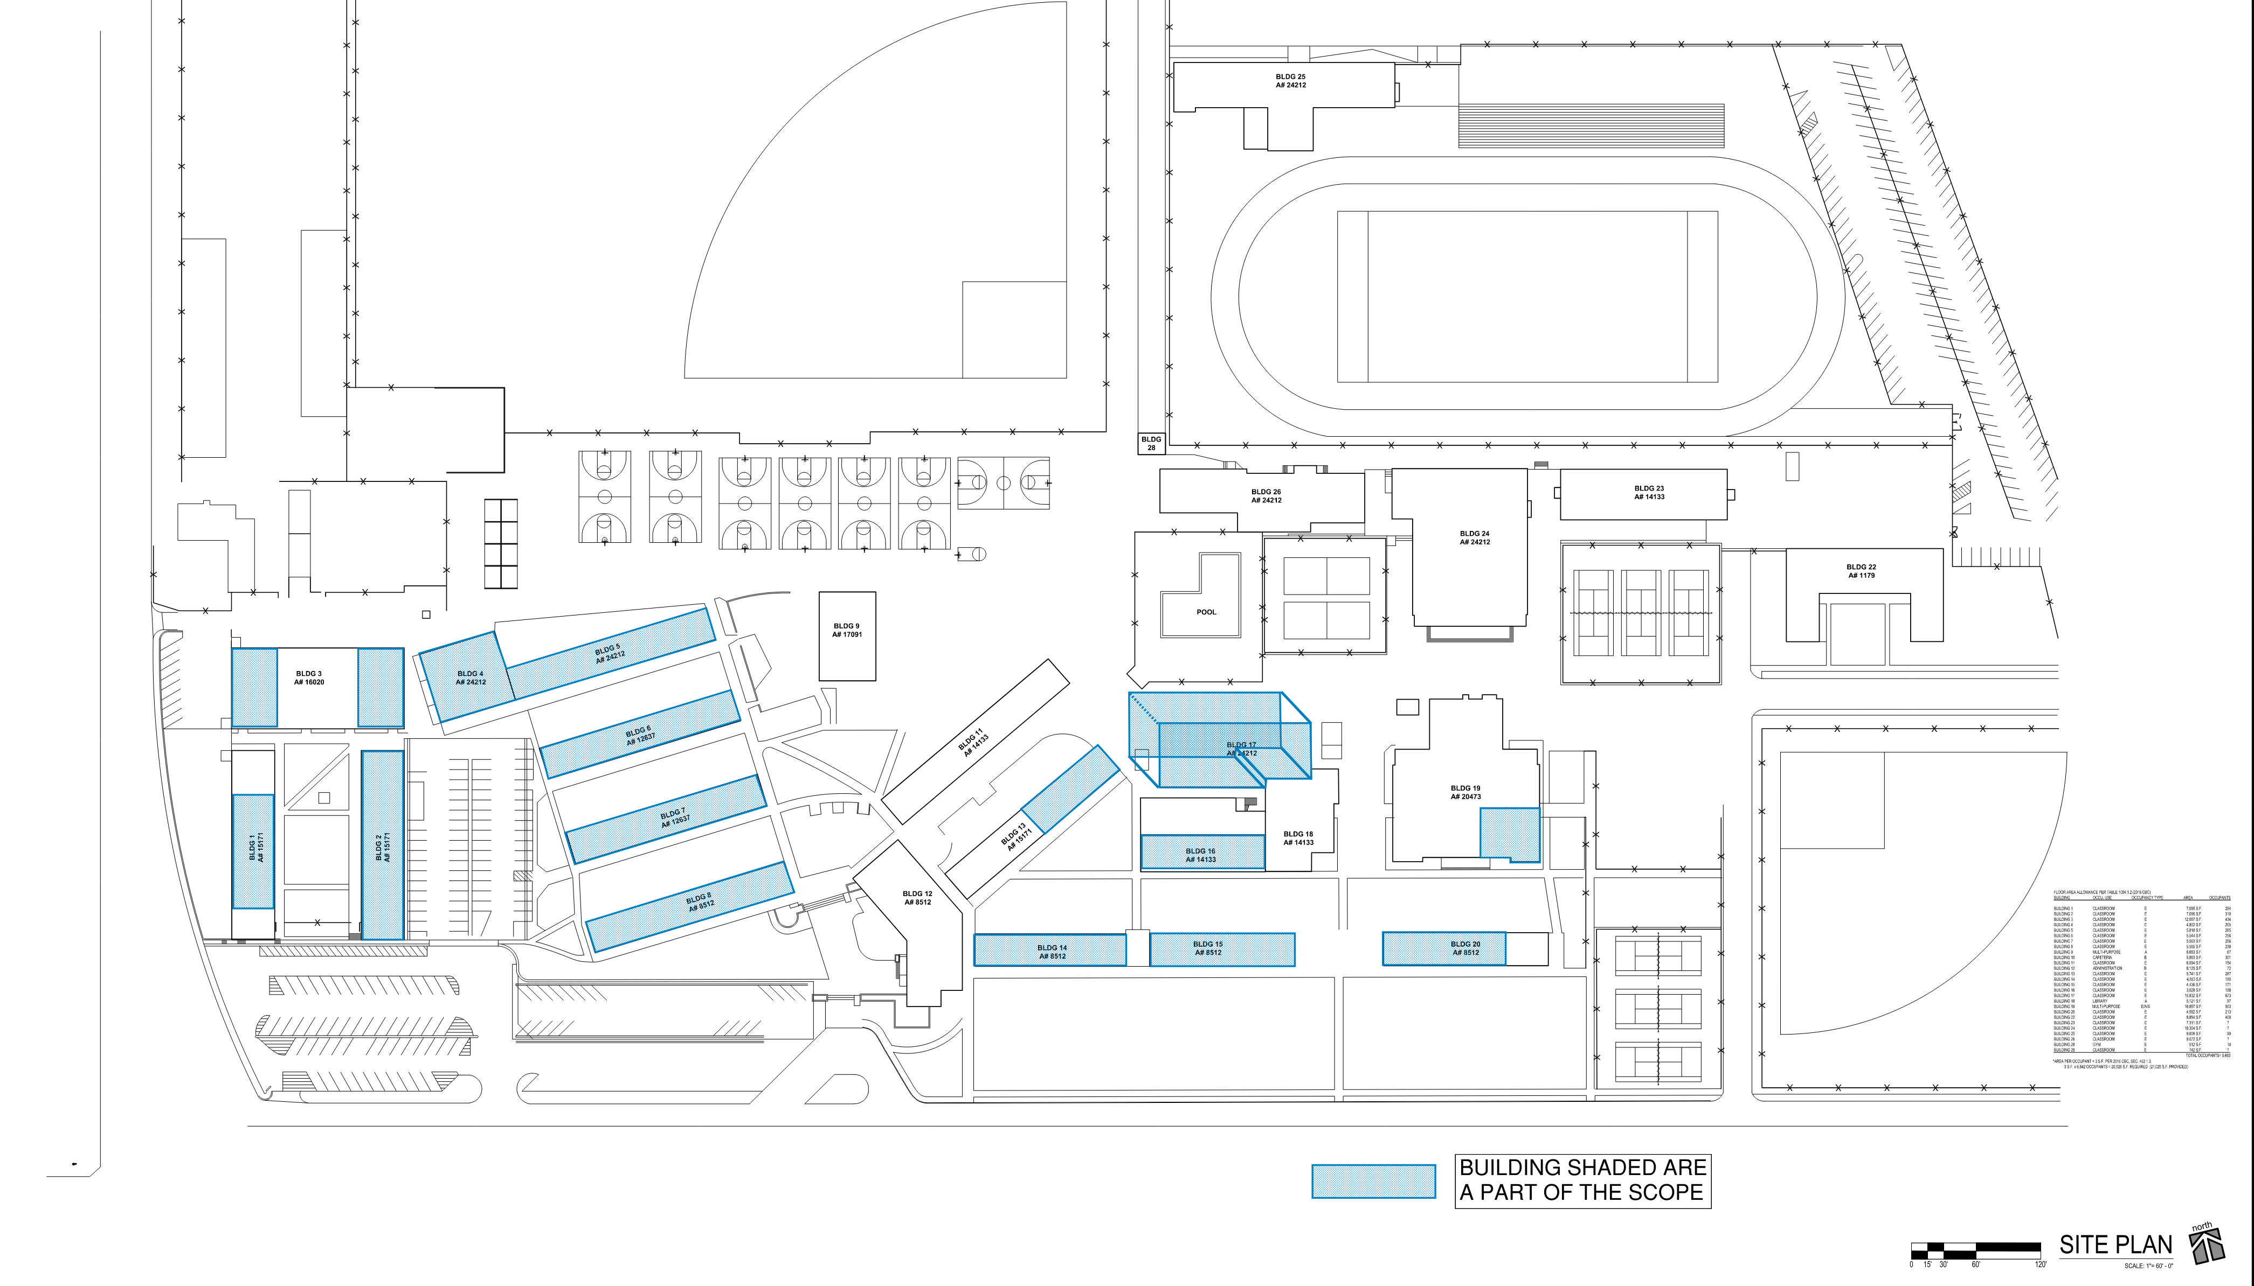
HIGH SCHOOL REFRESH
New LVT Flooring
New Wall Base
New Paint, Repair, Prep.
Walls
Trim
Ceilings
Doors
Windows
New Grilles at Heat Pumps
Repair and Replace Damaged Ceiling Tile
Repaint Ceiling Grid
Interior Brick cleaning
Re-lamp at light (By District)
Deep Cleaning
Hazmat Abatement
Scope Limited to Replacement of Finishes
Benefits:
Avoid DSA Review Requirements
Saving Time
Improvements Starting Sooner
Conserving Bond Funds
WORKMAN HIGH SCHOOL
43 CLASSROOMS
LA PUENTE HIGH SCHOOL
55 CLASSROOMS

Slide 8
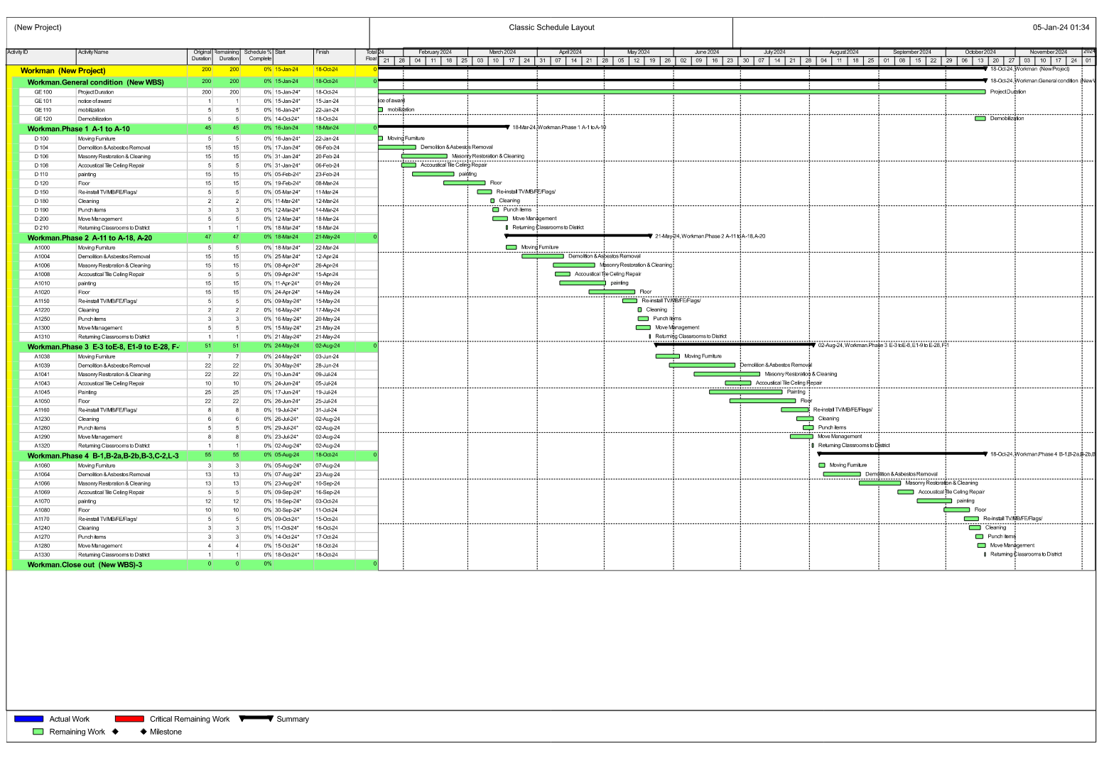
WORKMAN HIGH SCHOOL SCHEDULE

Slide 9
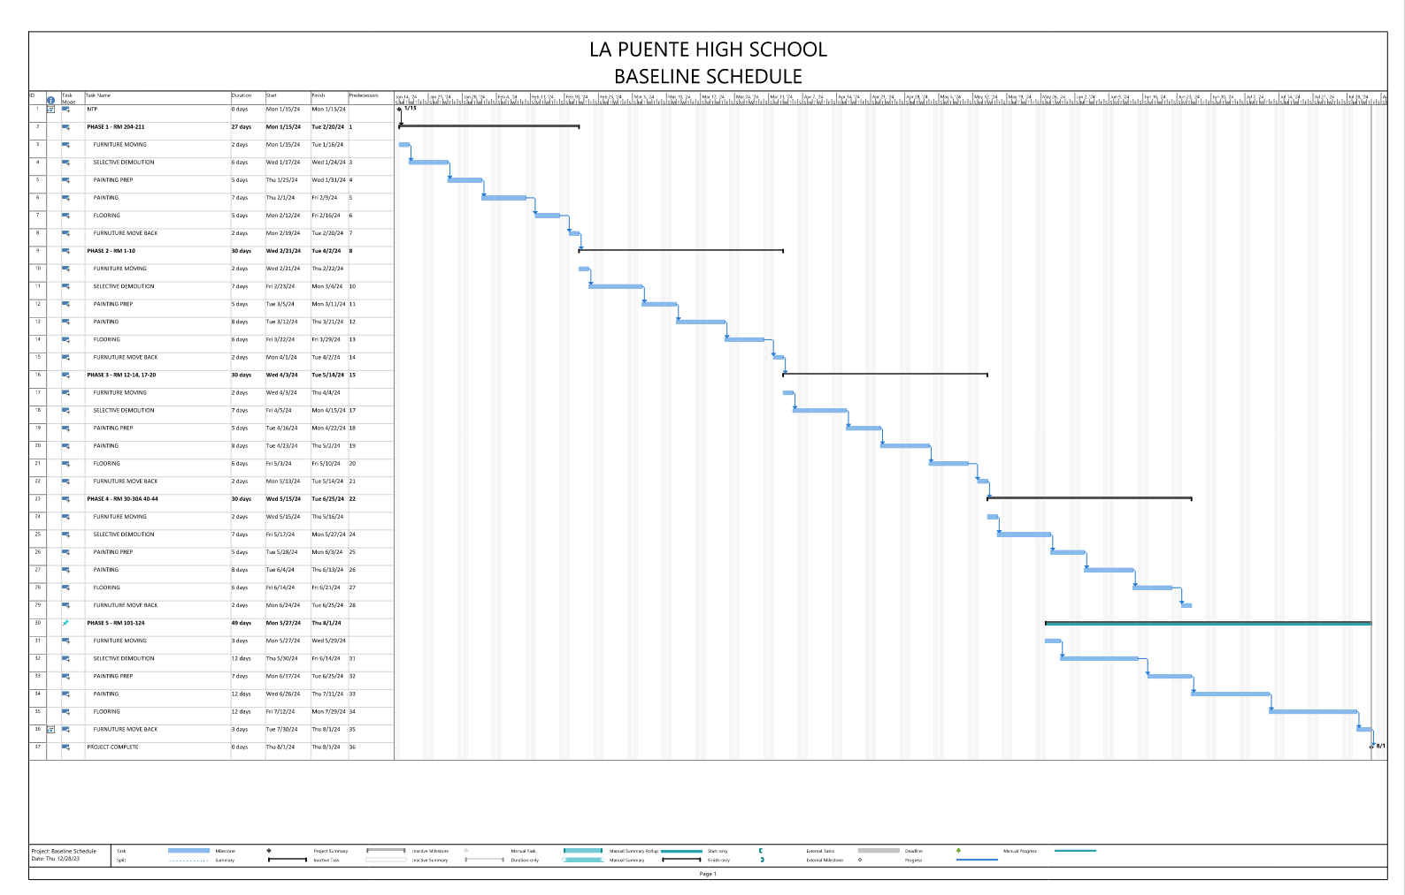
LA PUENTE HIGH SCHOOL SCHEDULE

Slide 10
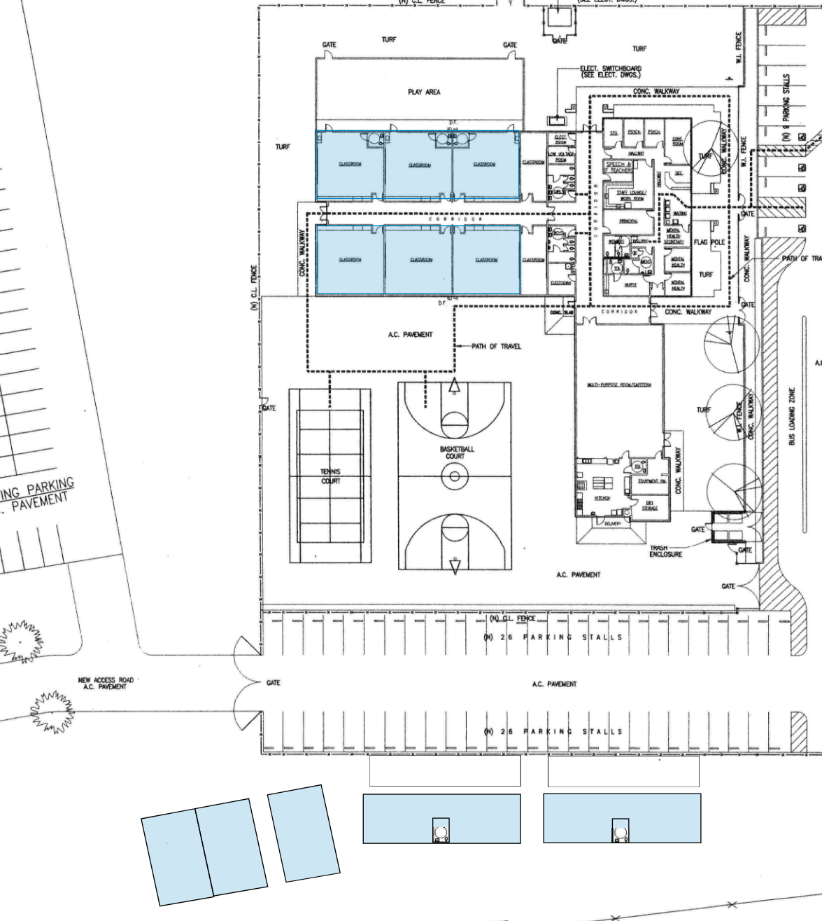
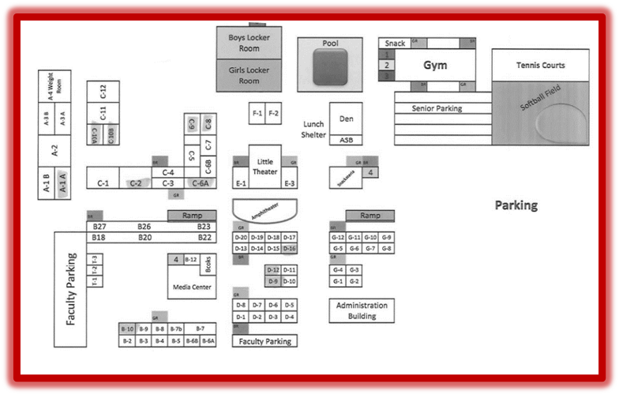
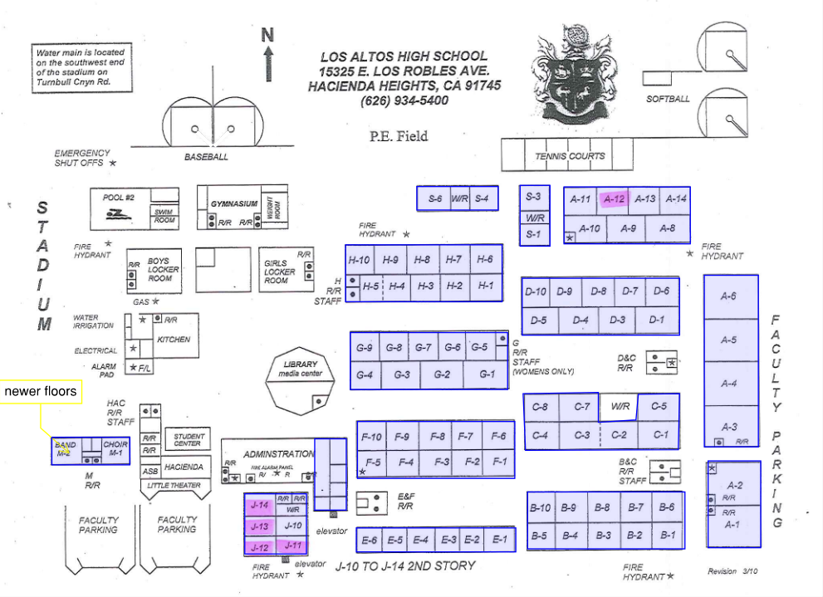
HIGH SCHOOL REFRESH
STIMSON LEARNING CENTER
10 CLASSROOMS
WILSON HIGH SCHOOL
59 CLASSROOMS
LOS ALTOS HIGH SCHOOL
69 CLASSROOMS

Slide 11
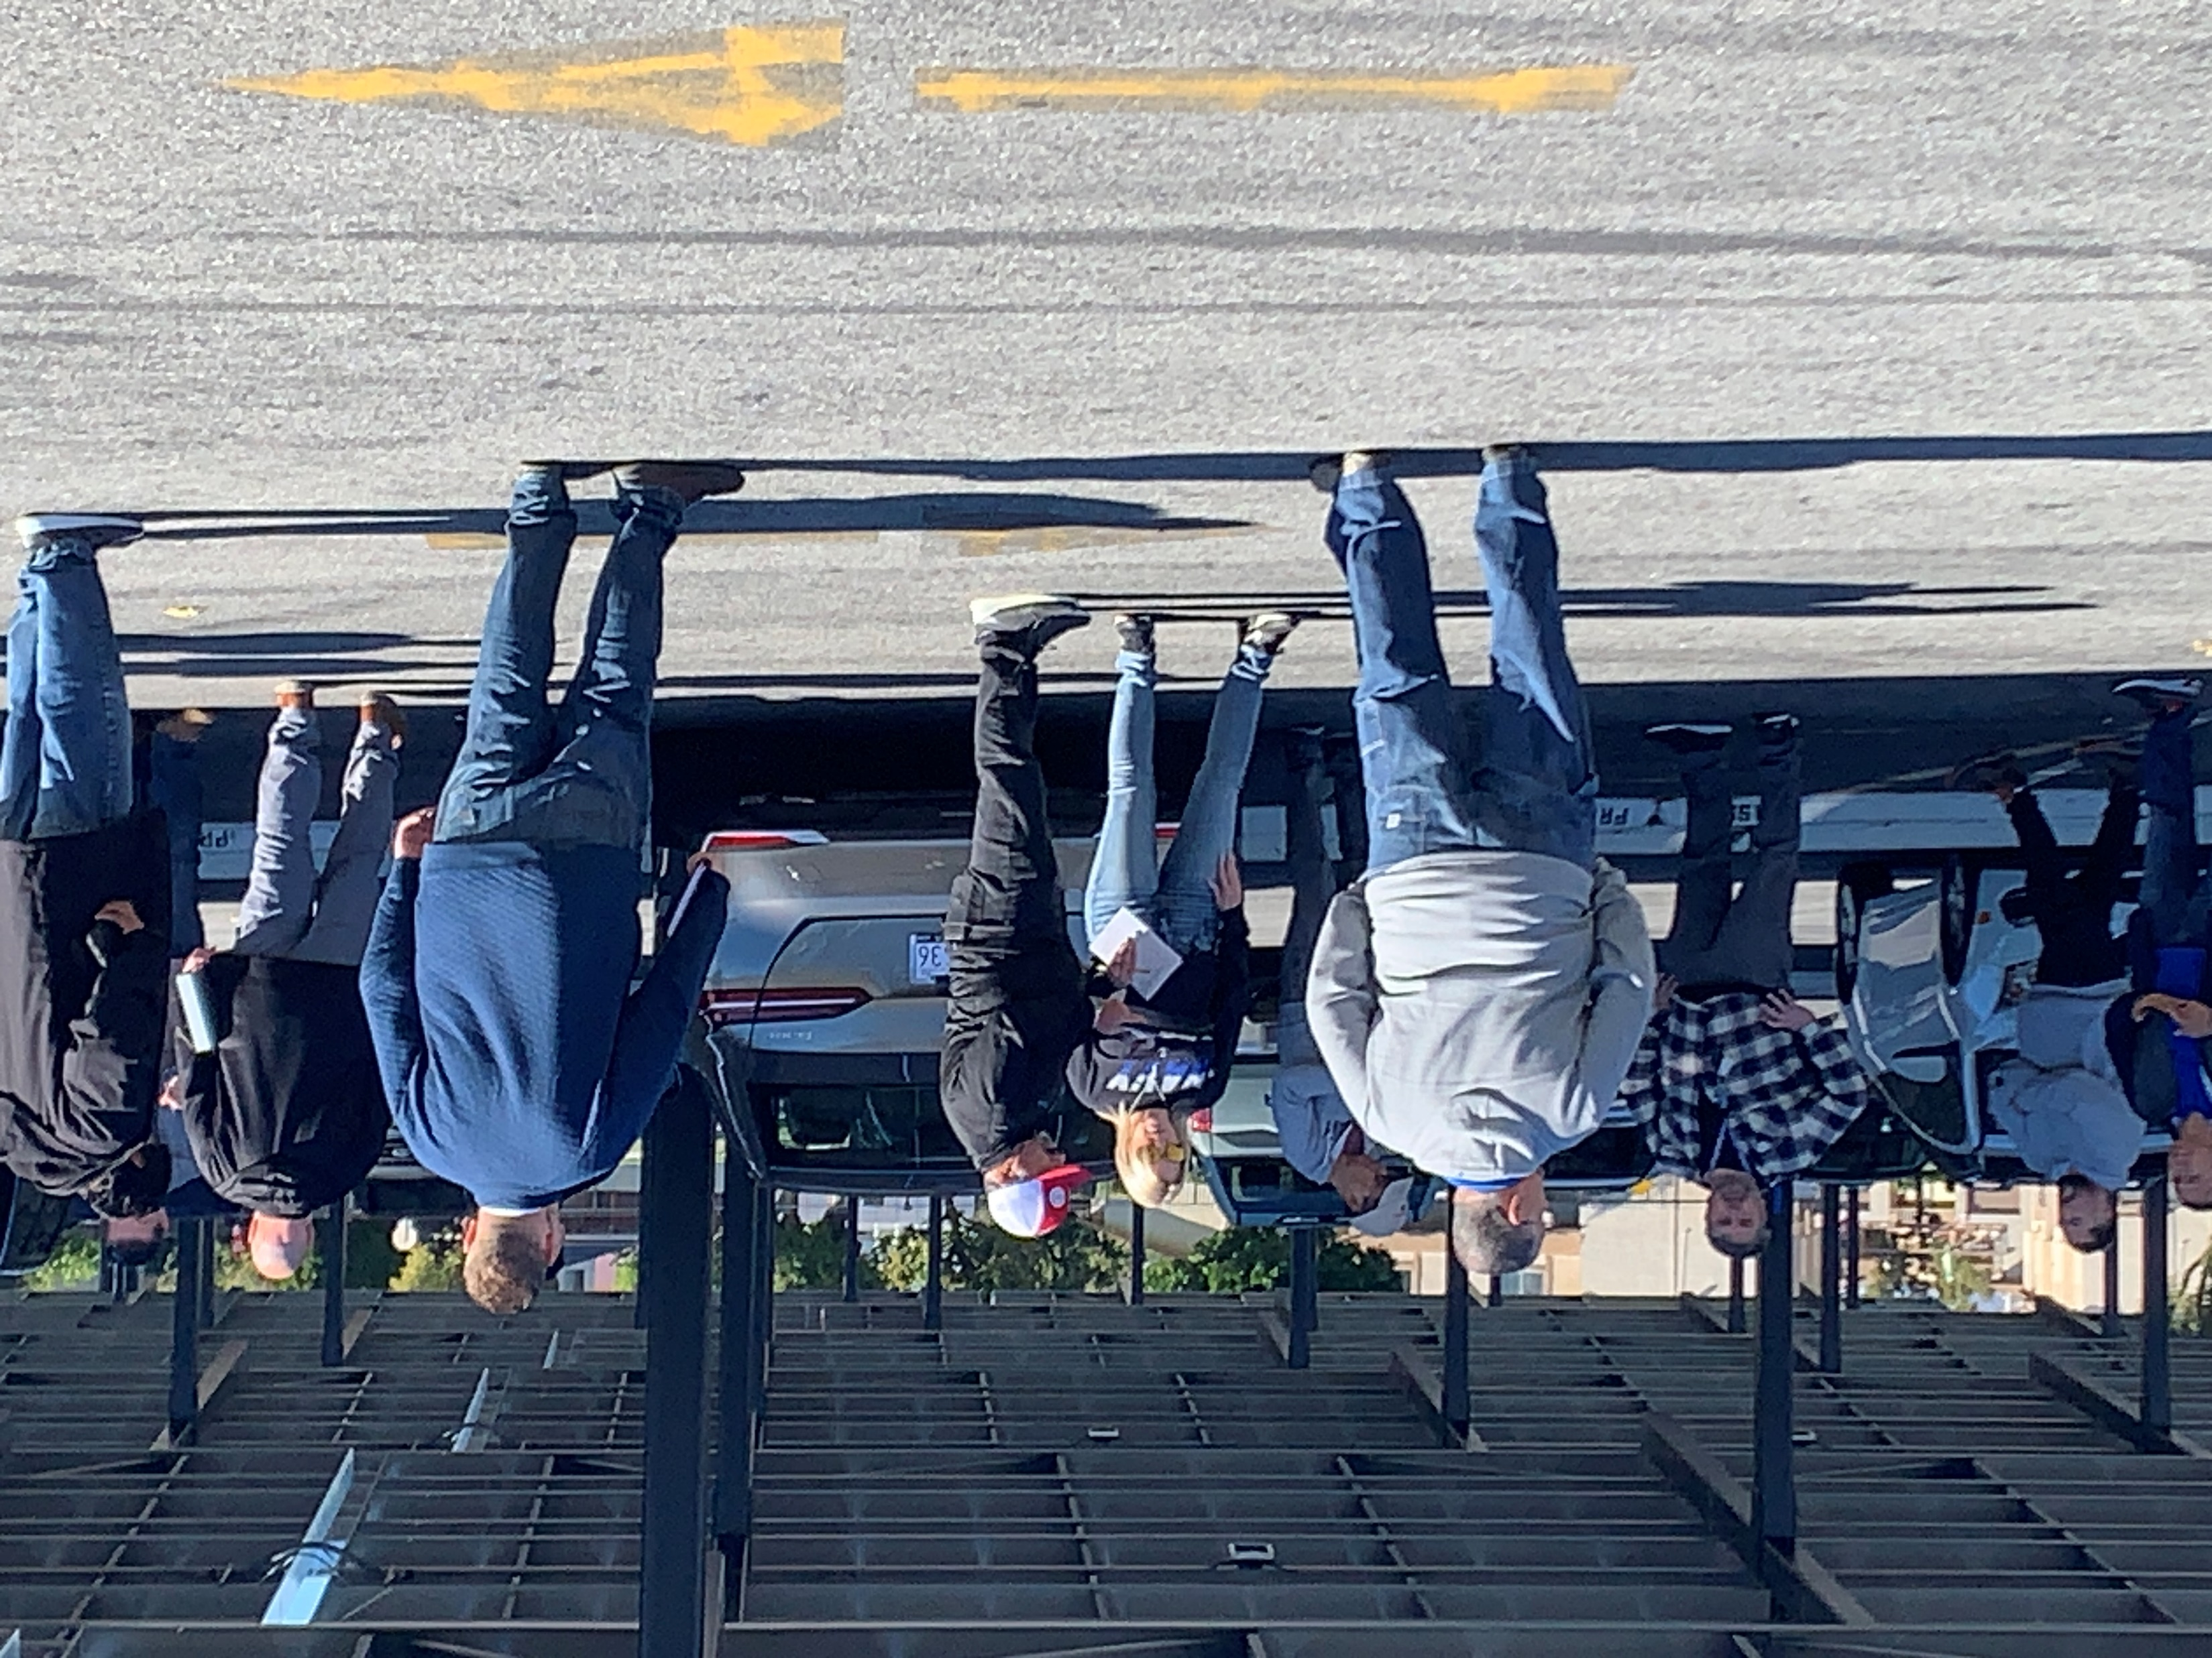
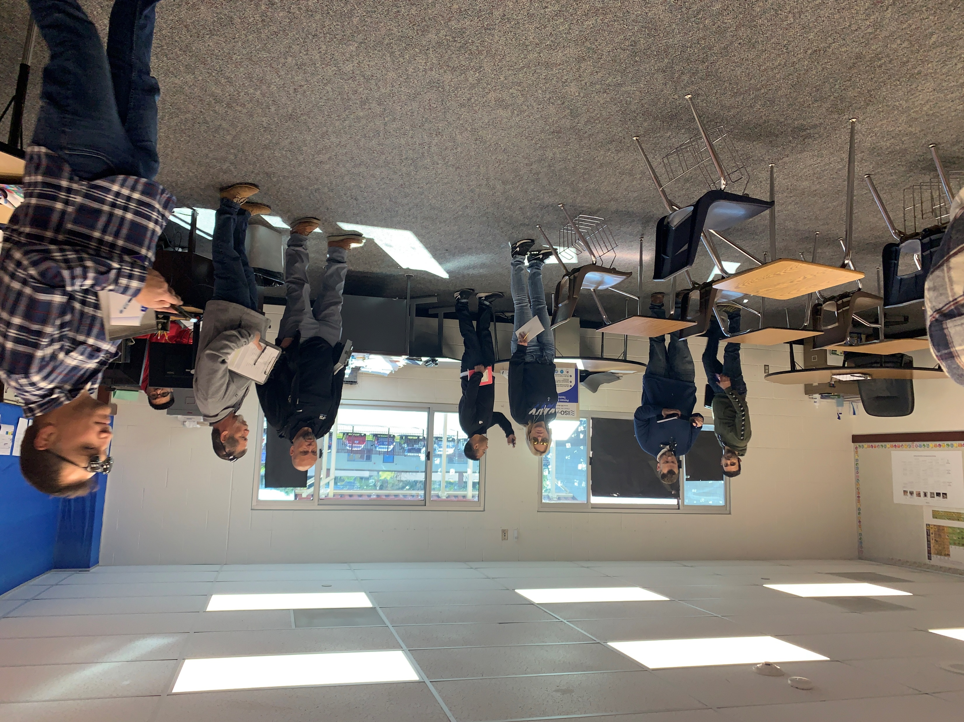
PRE-BID JOB WALK:
Los Altos HS, Wilson HS & Stimson EC
Pre-Bid Walk January 8, 2024
Bib Opening January 18, 2024
Anticipated Bid Award February 8, 2024
Anticipated Construction Date March 4, 2024
20 Contractors Participated in the pre bid job walk

Slide 12
Questions + answers

