Slide 1
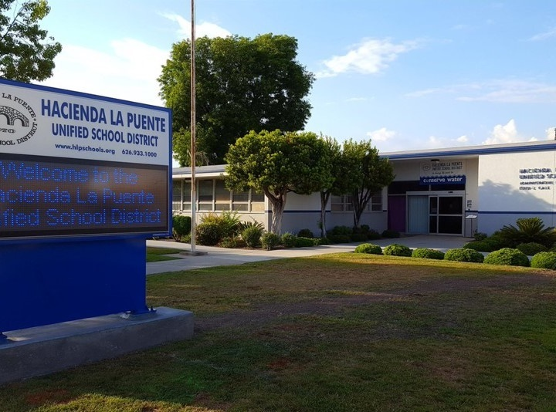


21st Century Classroom Improvements
September 26, 2023, Board Update
Notes:
1

Slide 2
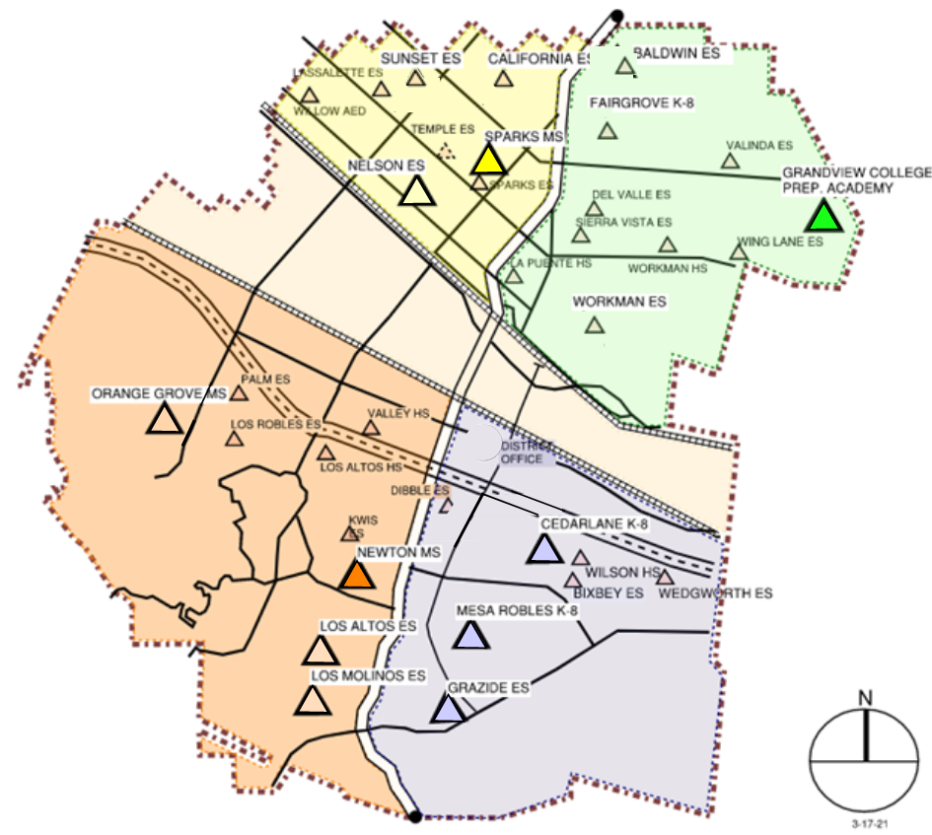
Sites In Progress & Completed
IN PROGRESS
Newton MS
Grandview K-8
HIGH SCHOOL REFRESH
La Puente HS
Workman HS
COMPLETED
Nelson ES
Los Altos ES
Workman ES
Mesa Robles K-8
Cedarlane K-8
Sparks MS

Slide 3
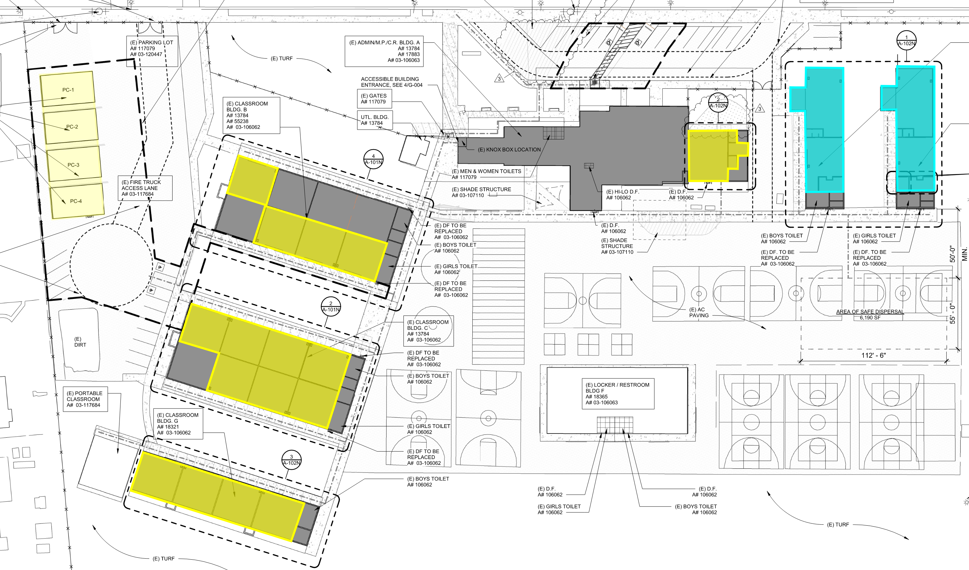
Newton Middle School
Phase 1: D-1 to D-4 Complete
Phase 2: C-6 to C-8 Complete
Phase 3: C-1 to C-4 Complete
Phase 4: B-4, B-6 to B-8 Complete
Phase 5: Music Room Complete
Phase 6: E-1, E-2, F-1, F-2 Next Phase
Site Plan & Status
Construction

Slide 4
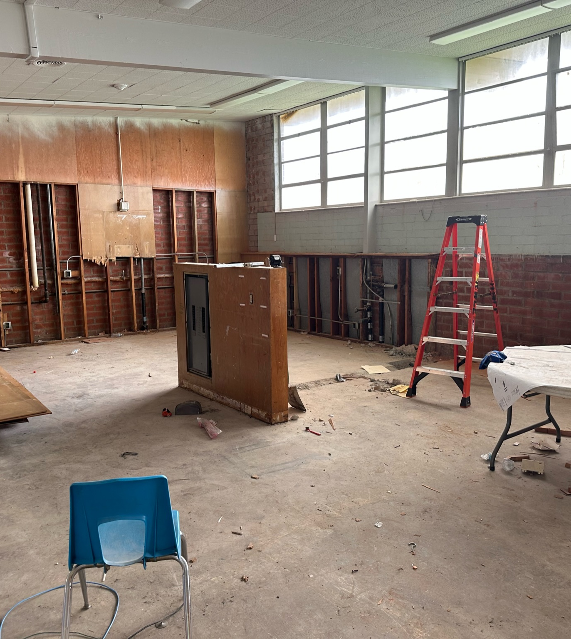
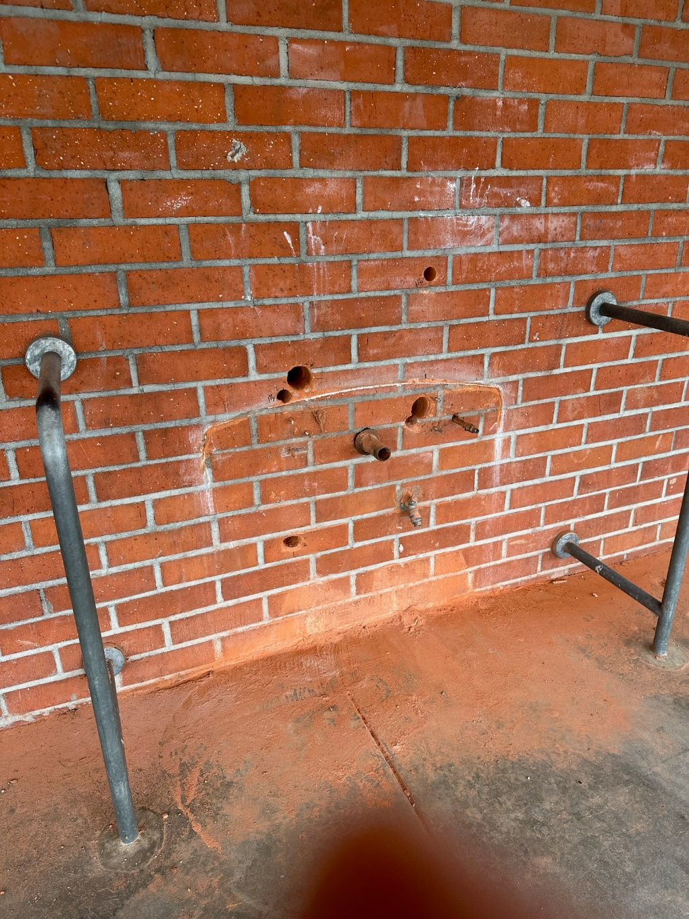
Newton Middle School
Drinking Fountain Upgrades
Project Status
Classroom Upgrades
Construction

Slide 5
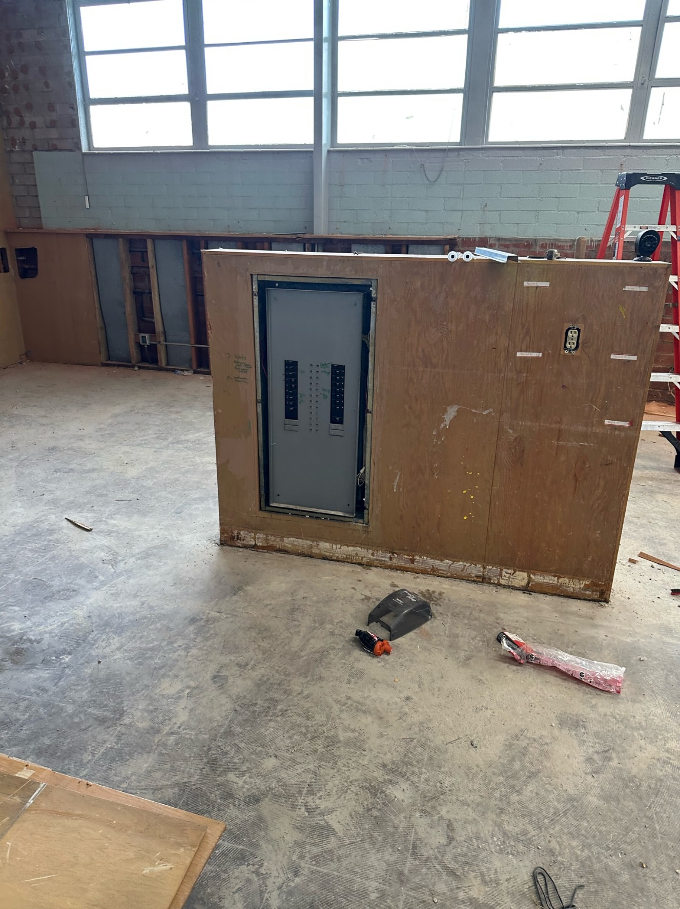
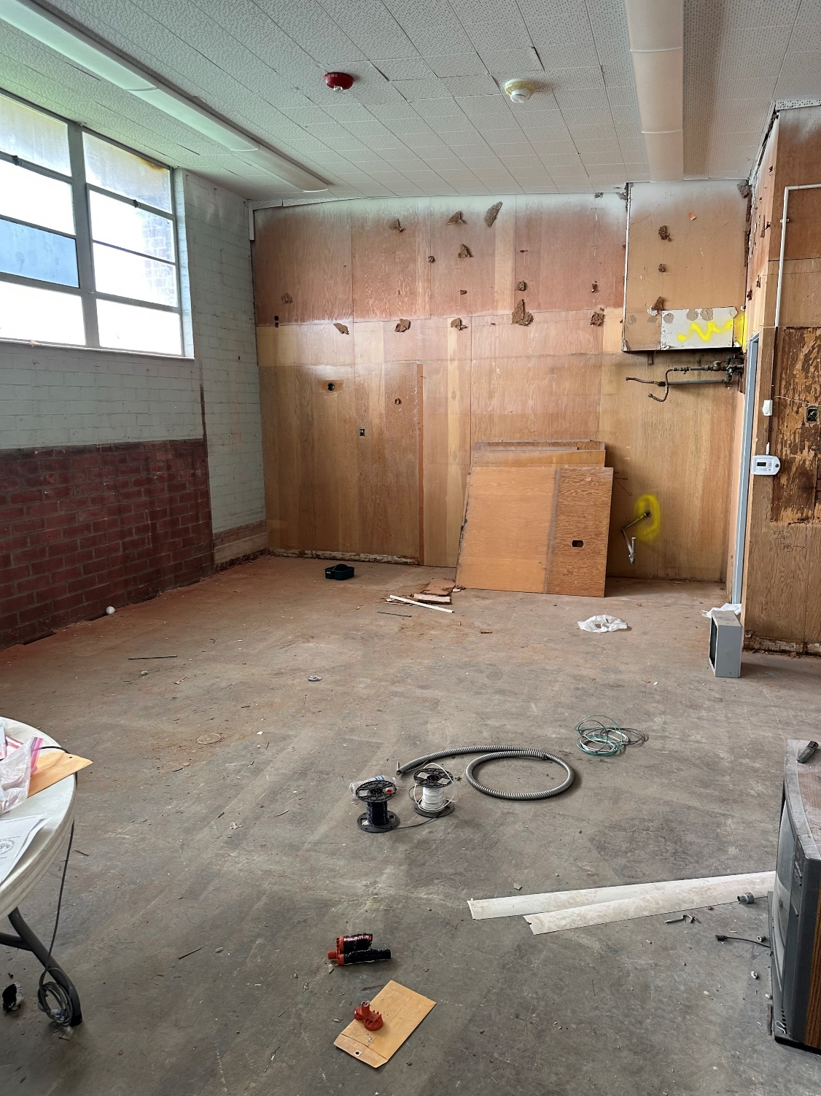
Newton Middle School
CLASSROOM UPGRADE
Project Status
Completion

Slide 6
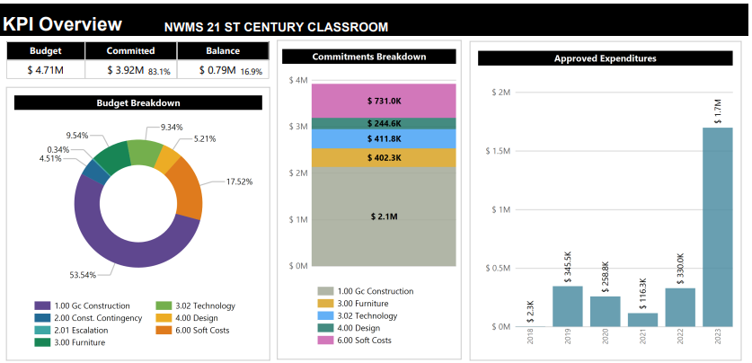
Newton Middle School
95% Complete
Modernization Plan
Classrooms: 19
Music Room: 1
Project Status
Construction

Slide 7
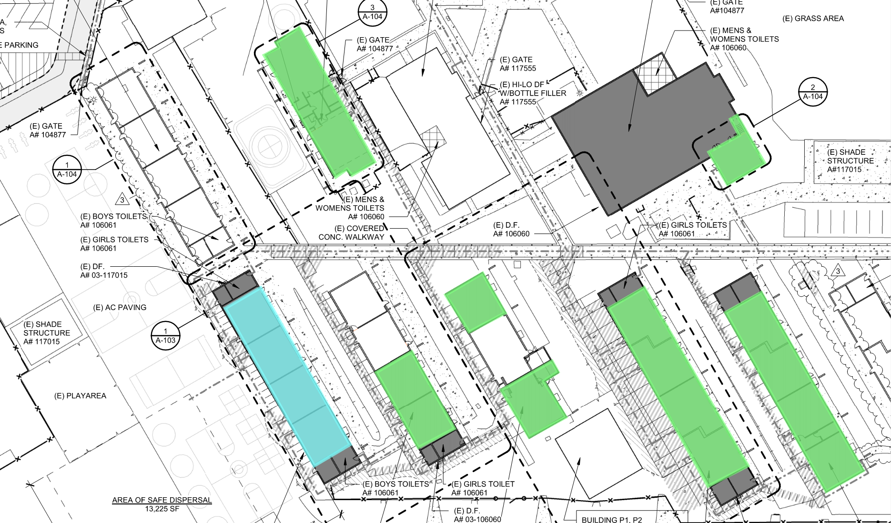
Grandview College Prep. Academy
Phase 1: 51-54 & 61-64
Complete
Phase 2: K-1, K-2, 32-33,
41, 43
Complete
Phase 3: B-4, Music/Band
Complete
Phase 4: 20-24
Next Phase
Site Plan & Status
Construction

Slide 8
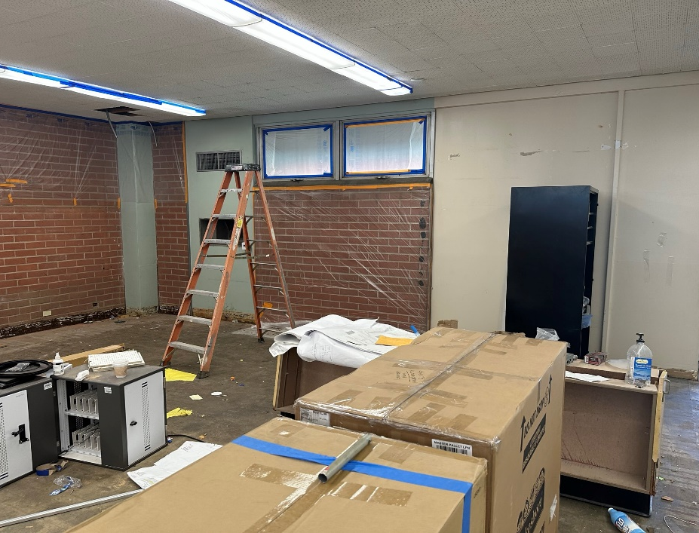
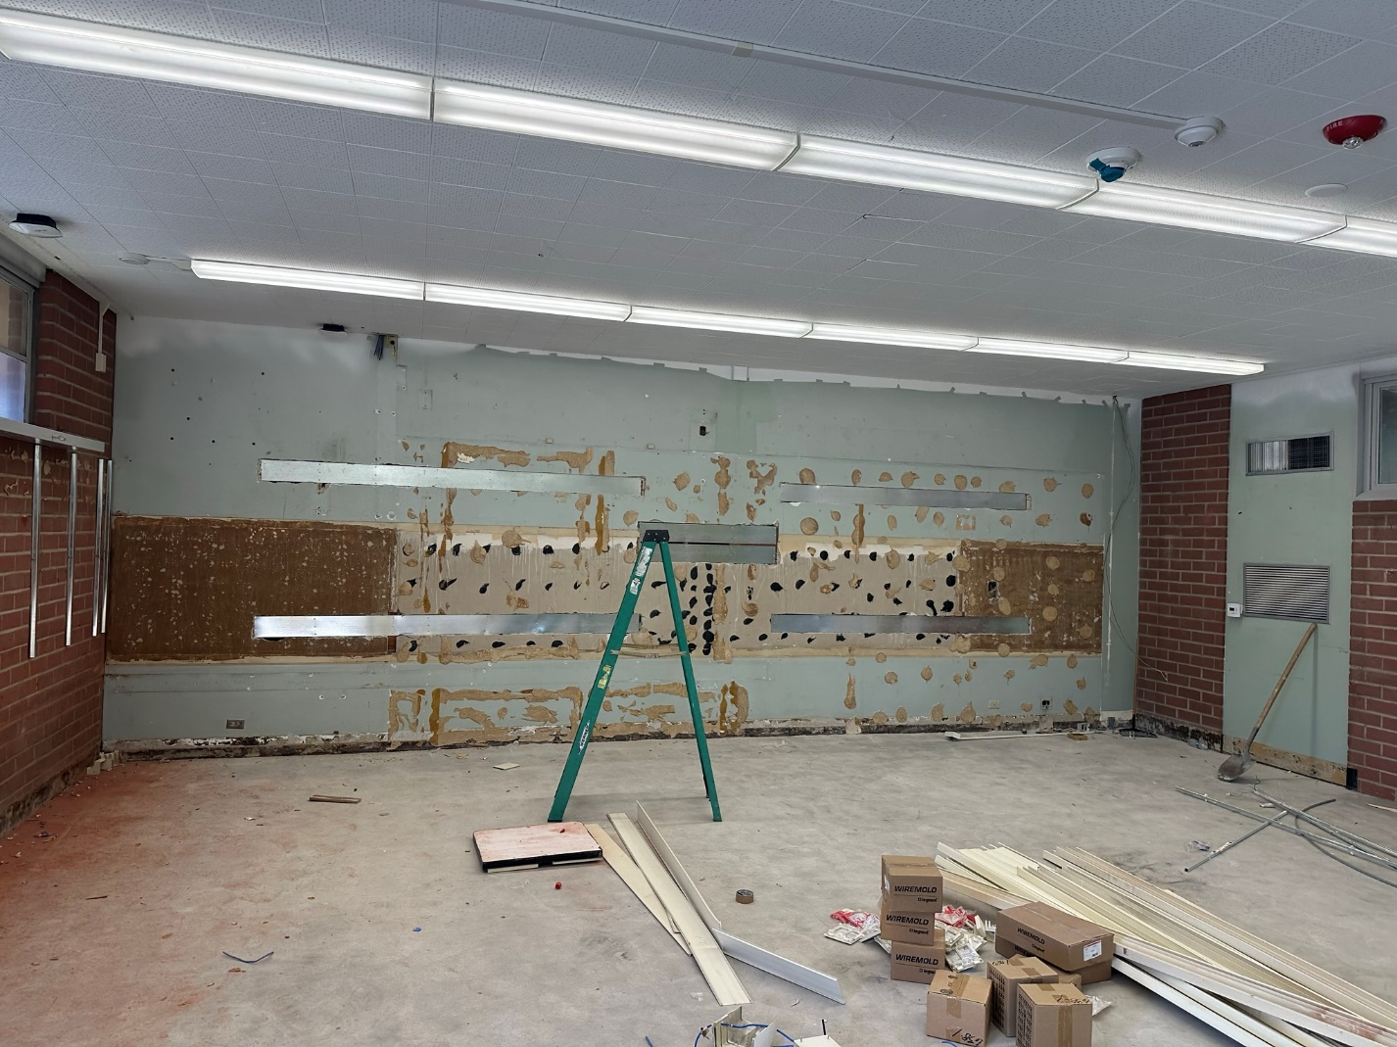
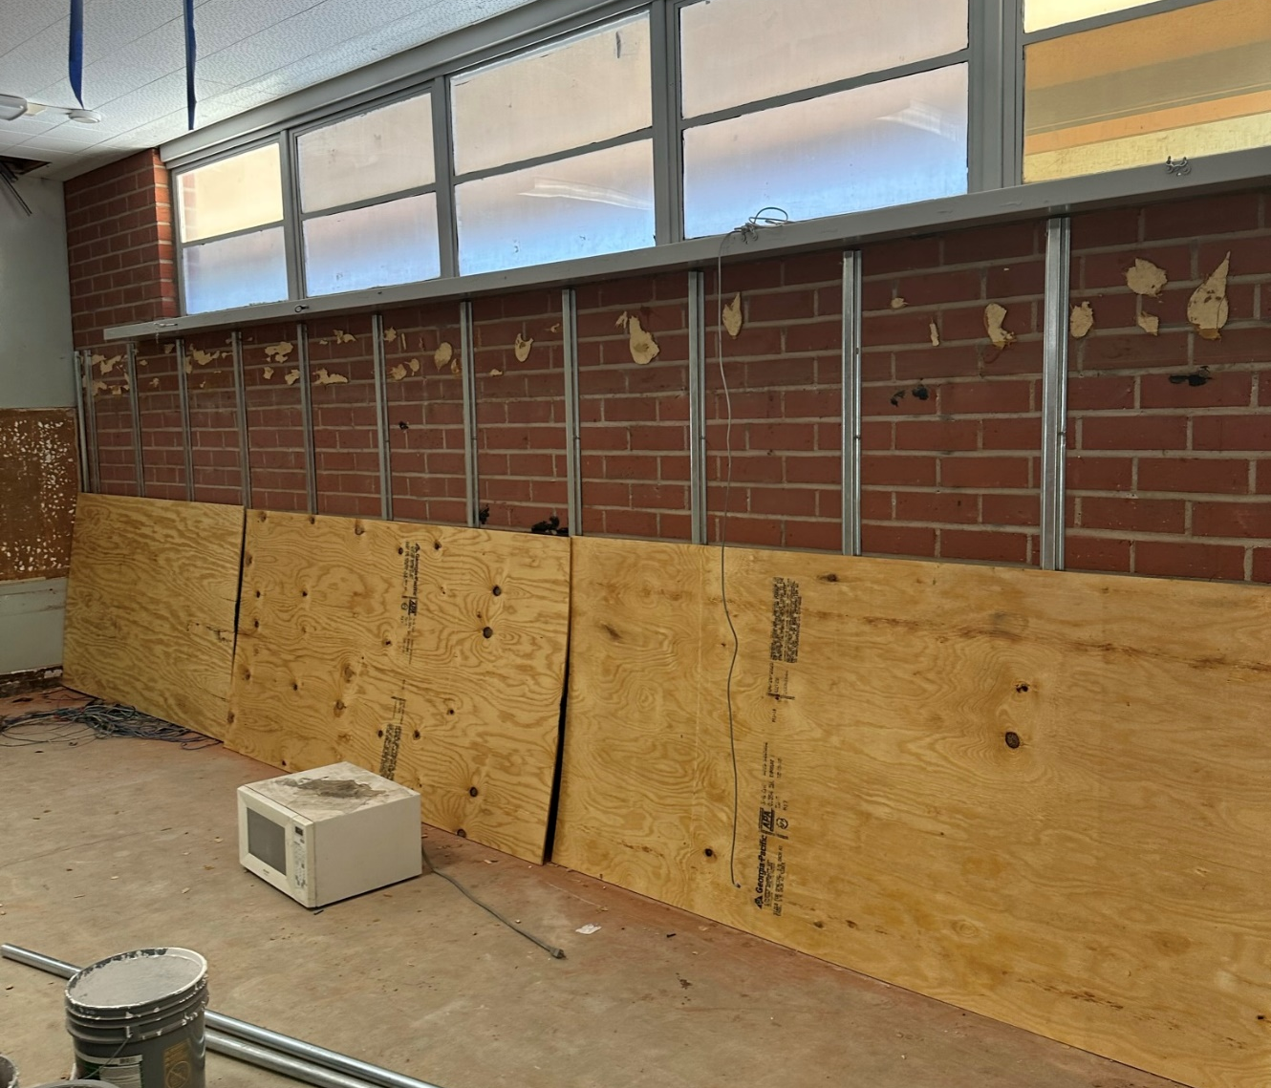
Grandview College Prep. Academy
Demolition 20 Wing
Project Status
Construction
8

Slide 9
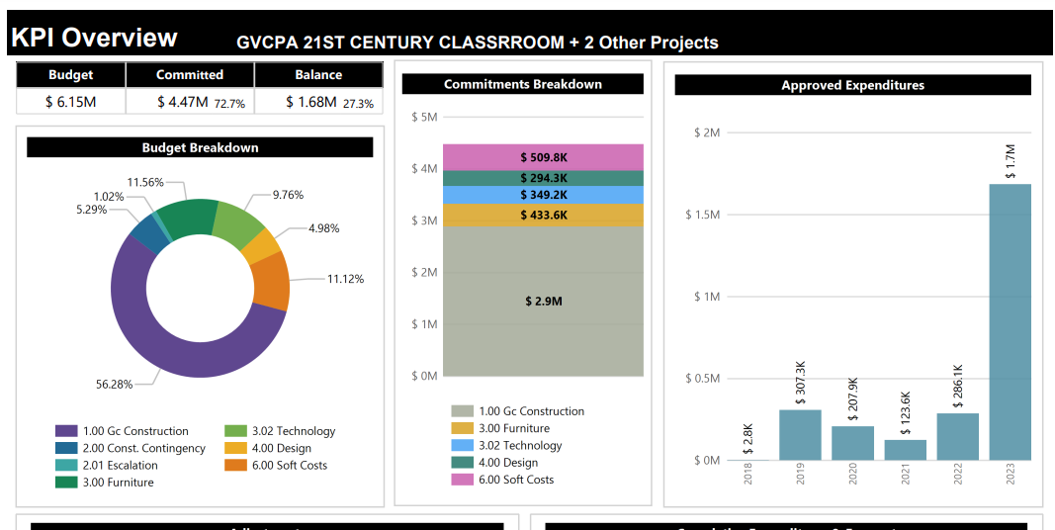
Grandview College Prep. Academy
95% Complete
Modernization Plan
Classrooms: 16
Music Room: 1
Kinder: 2
Project Status
Construction

Slide 10
Scheduled Completion
Grandview K-8 & Newton MS: October 2023
Sparks MS Complete
Project Status

Slide 11
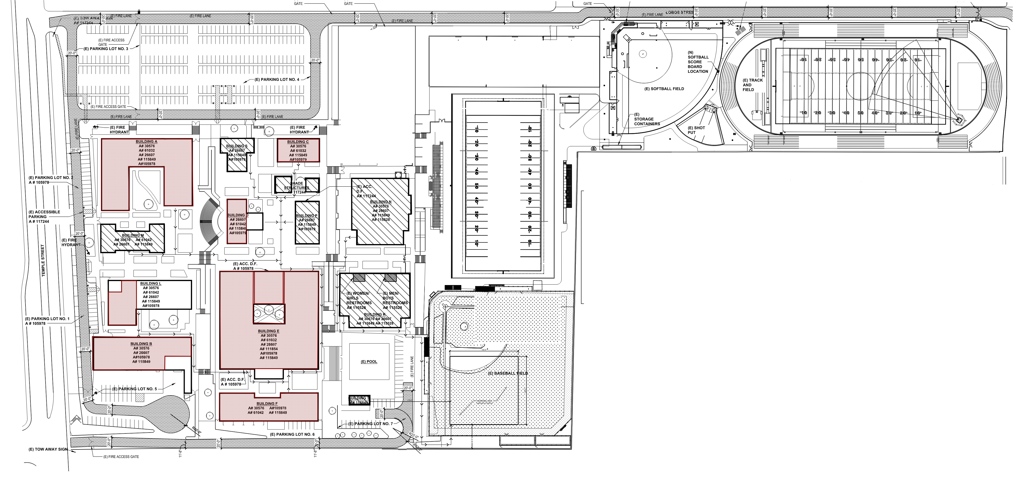
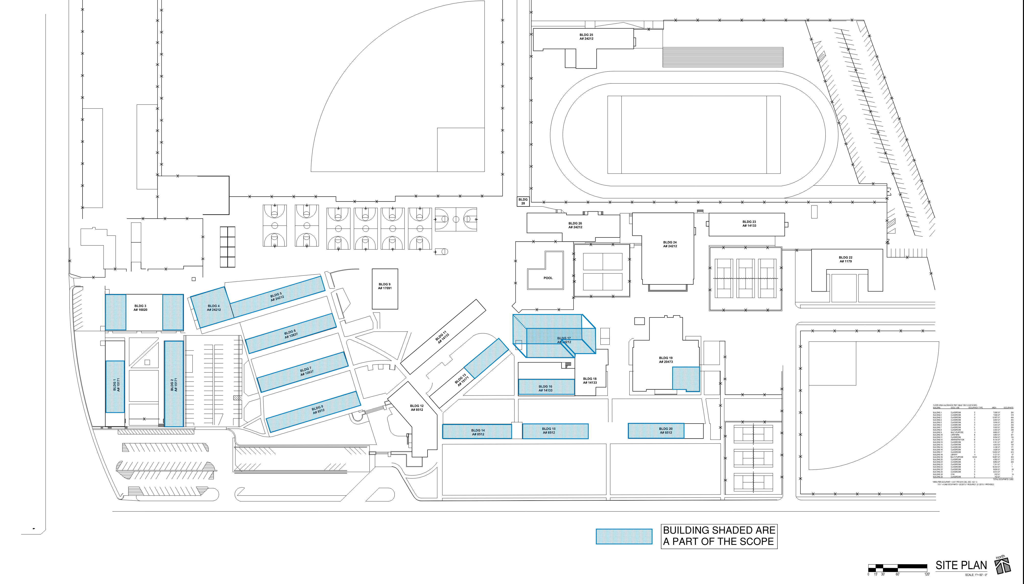
HIGH SCHOOL REFRESH
WORKMAN HIGH SCHOOL
LA PUENTE HIGH SCHOOL

Slide 12
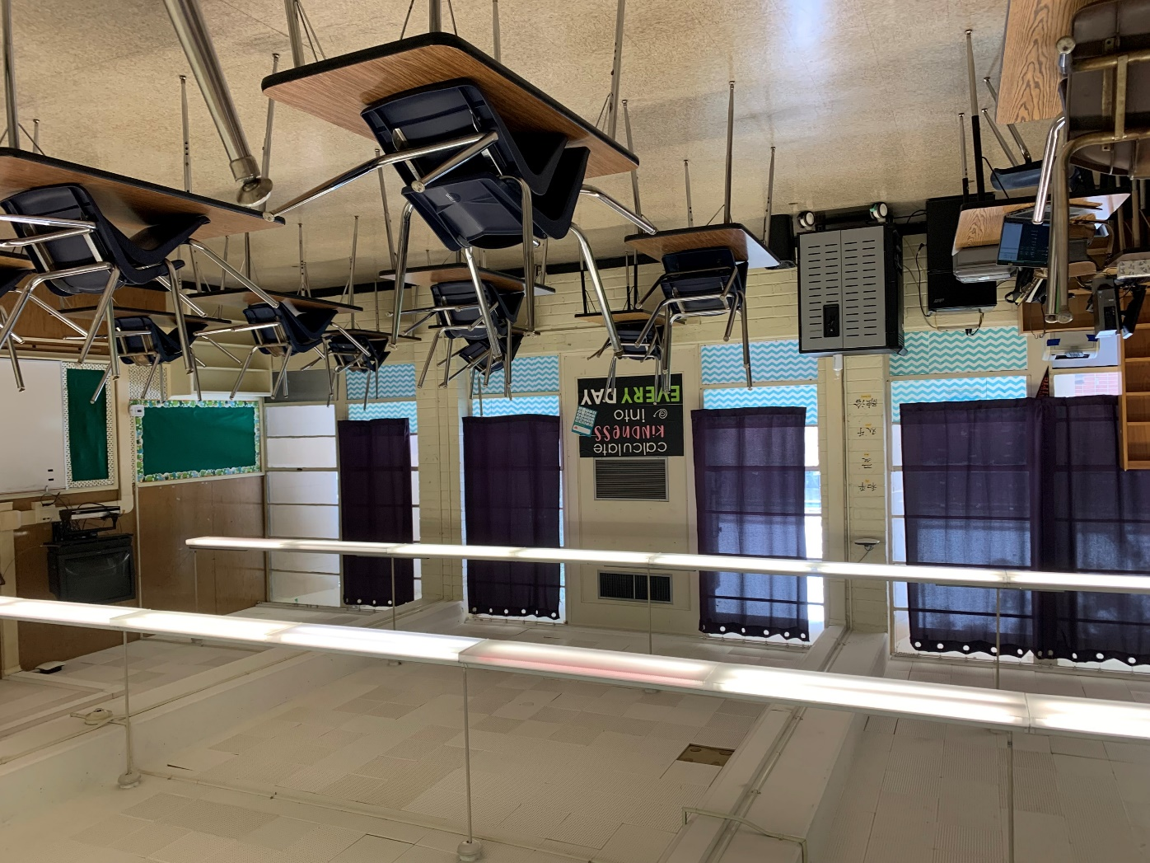
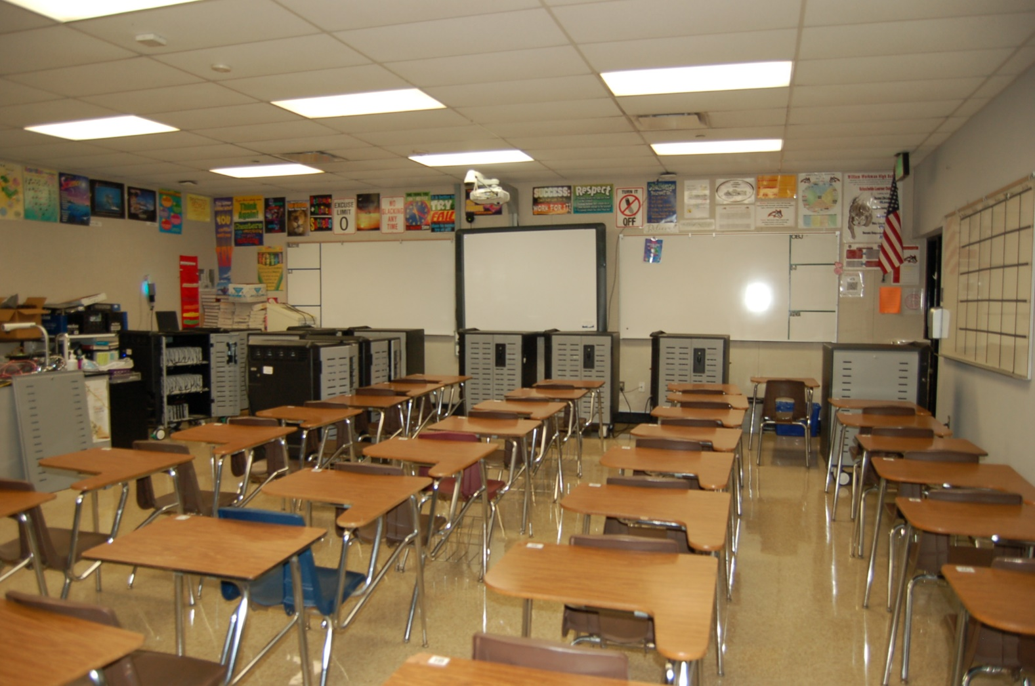
HIGH SCHOOL REFRESH
La Puente High School
Workman High School
Project Status
Project Status

Slide 13
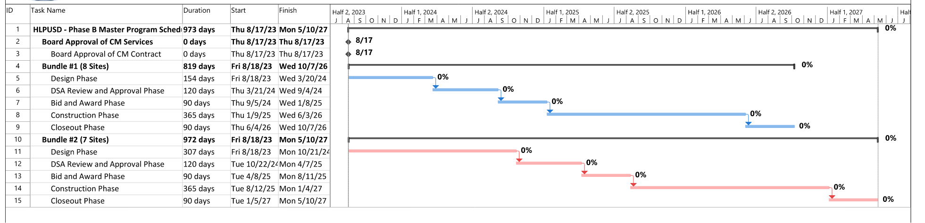
Measure BB Bond Phase B
TIMELINE CONTINGENT UPON BOARD RECONFIGURATION DECISION BY NOVEMBER 2023
Contract Proposals Received From Studio + Architects
Meeting and Site Visits Resumed
Professional Fees Negotiated
Request for Proposal Updates Out to PBK Architects
Meeting and Site Visits In Planning

Slide 14

Questions + answers

