Slide 1
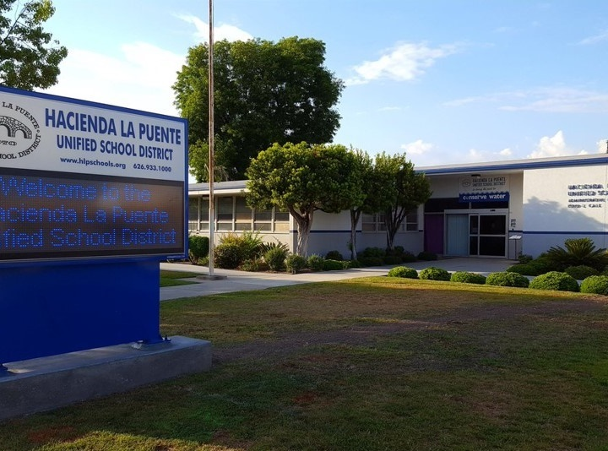


21st Century Classroom Improvements
November 9, 2023, Board Update
Notes:
1

Slide 2
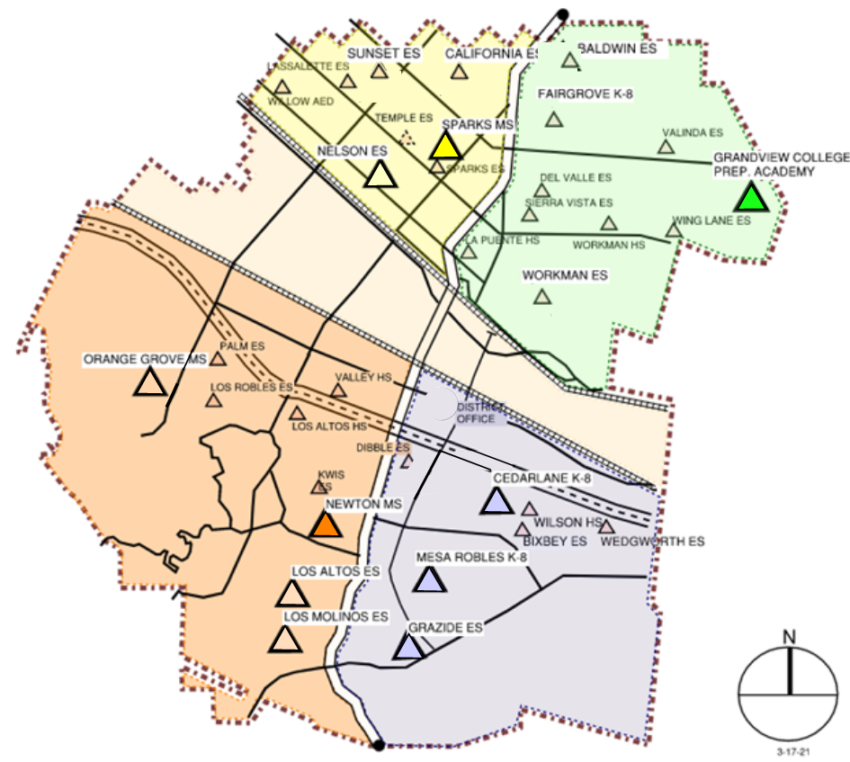
Sites In Progress & Completed
IN PROGRESS
Newton MS
Grandview K-8
HIGH SCHOOL REFRESH
La Puente HS
Workman HS
Wilson HS
Los Altos HS
COMPLETED
Nelson ES
Los Altos ES
Workman ES
Mesa Robles K-8
Cedarlane K-8
Sparks MS

Slide 3
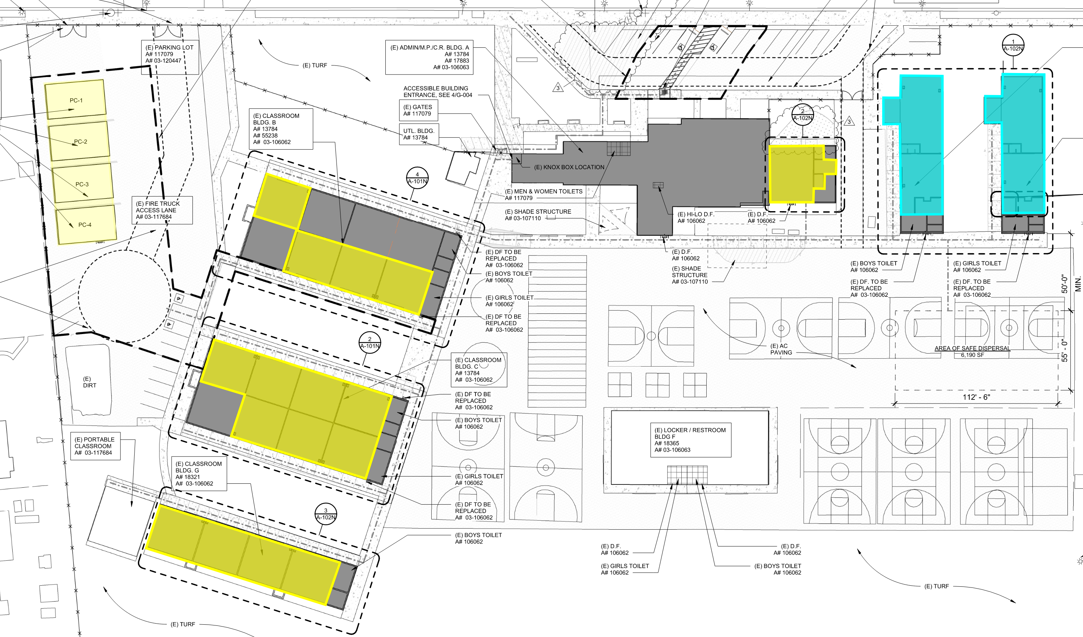
Newton Middle School
Phase 1: D-1 to D-4 Complete
Phase 2: C-6 to C-8 Complete
Phase 3: C-1 to C-4 Complete
Phase 4: B-4, B-6 to B-8 Complete
Phase 5: Music Room Complete
Phase 6: E-1, E-2, F-1, F-2 Final Phase
Site Plan & Status
Construction

Slide 4
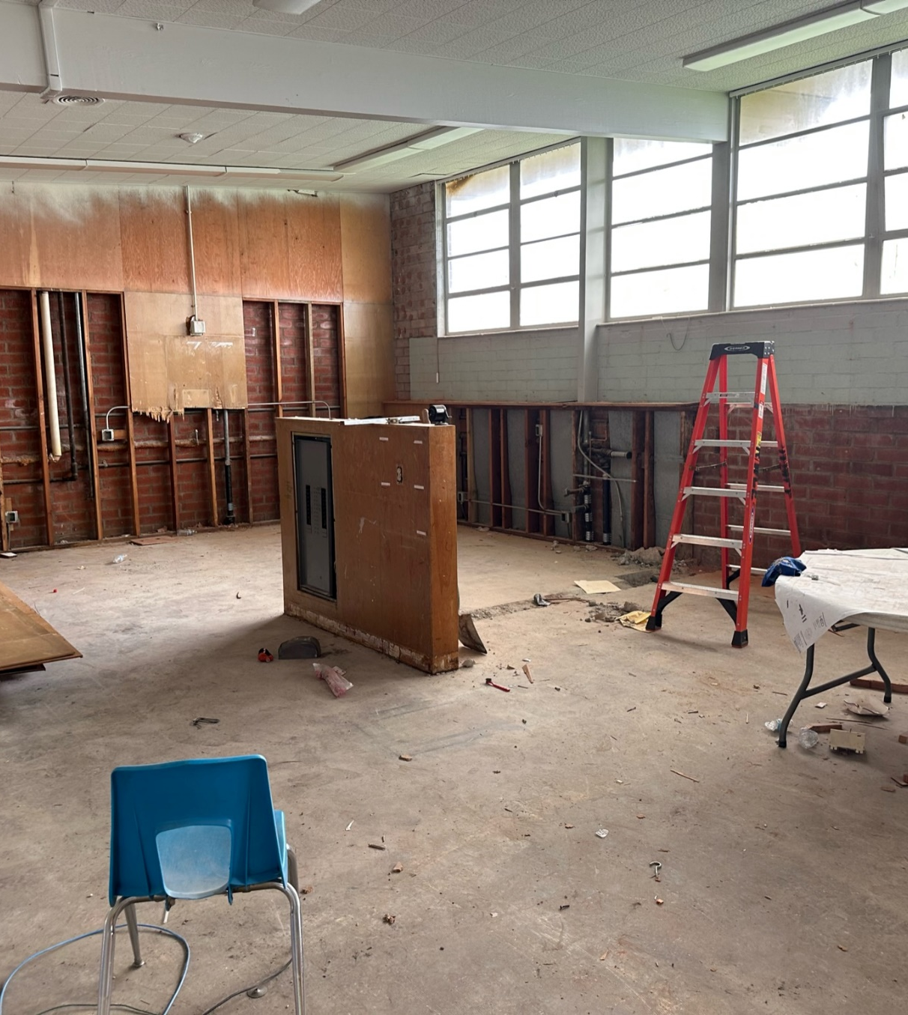
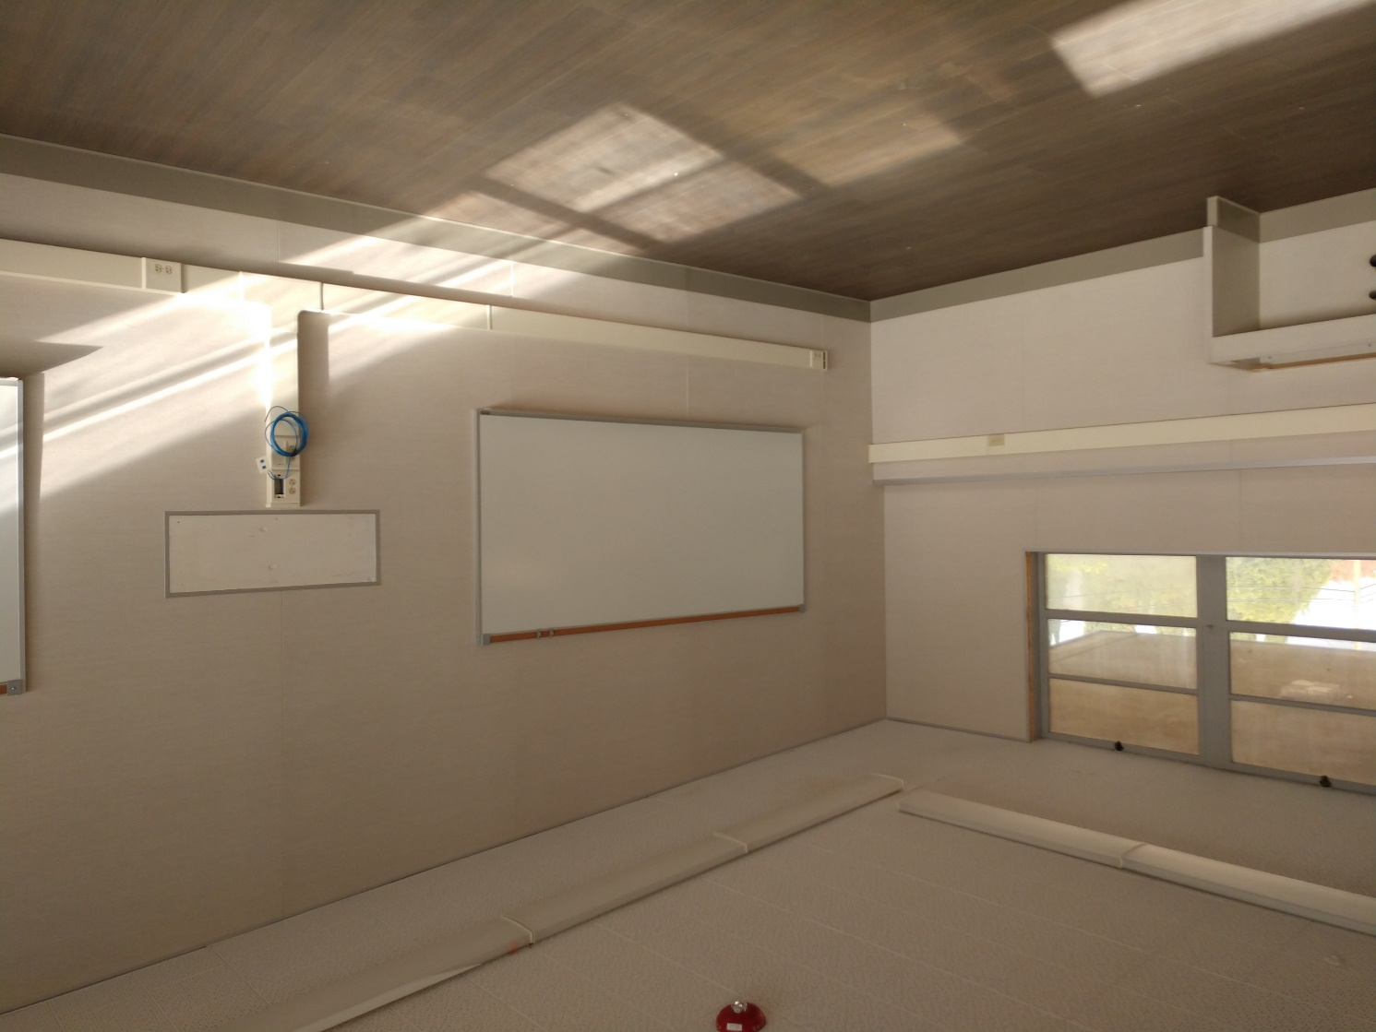
Newton Middle School
Before
During
Project Status
Classroom Upgrades
Construction

Slide 5
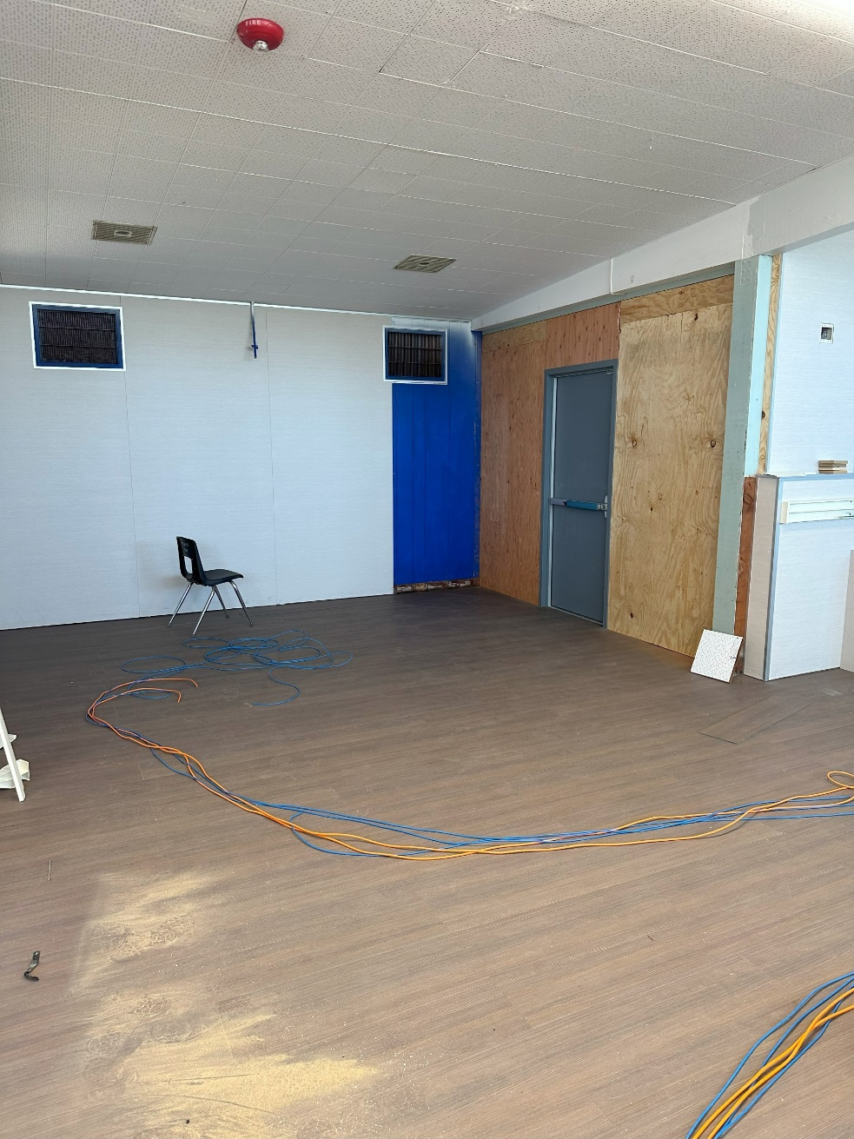
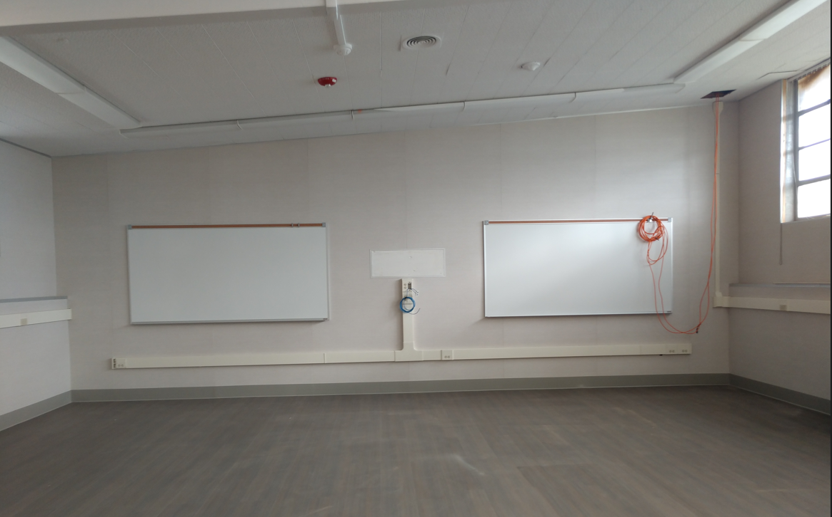
Newton Middle School
CLASSROOM UPGRADES
Project Status
Construction

Slide 6
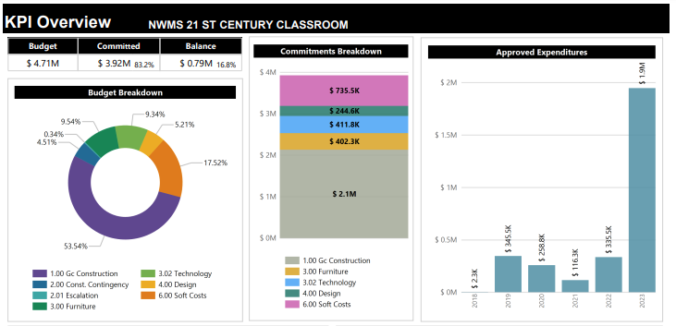
Newton Middle School
96% Complete
Modernization Plan
Classrooms: 18
Music Room: 1
Project Status
Budget

Slide 7
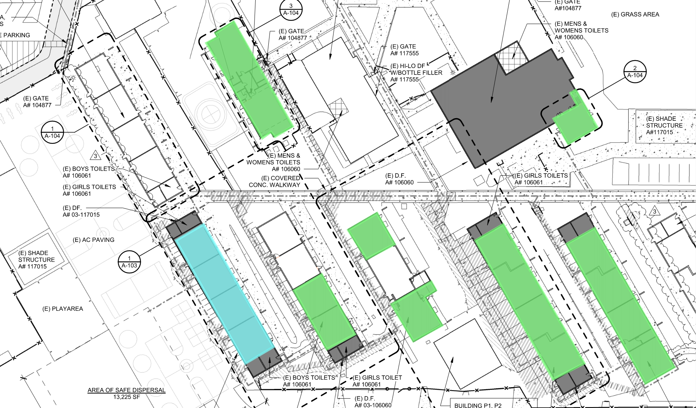
Grandview College Prep. Academy
Phase 1: 51-54 & 61-64
Complete
Phase 2: K-1, K-2, 32-33,
41, 43
Complete
Phase 3: B-4, Music/Band
Complete
Phase 4: 20-24
Next Phase
Site Plan & Status
Construction

Slide 8
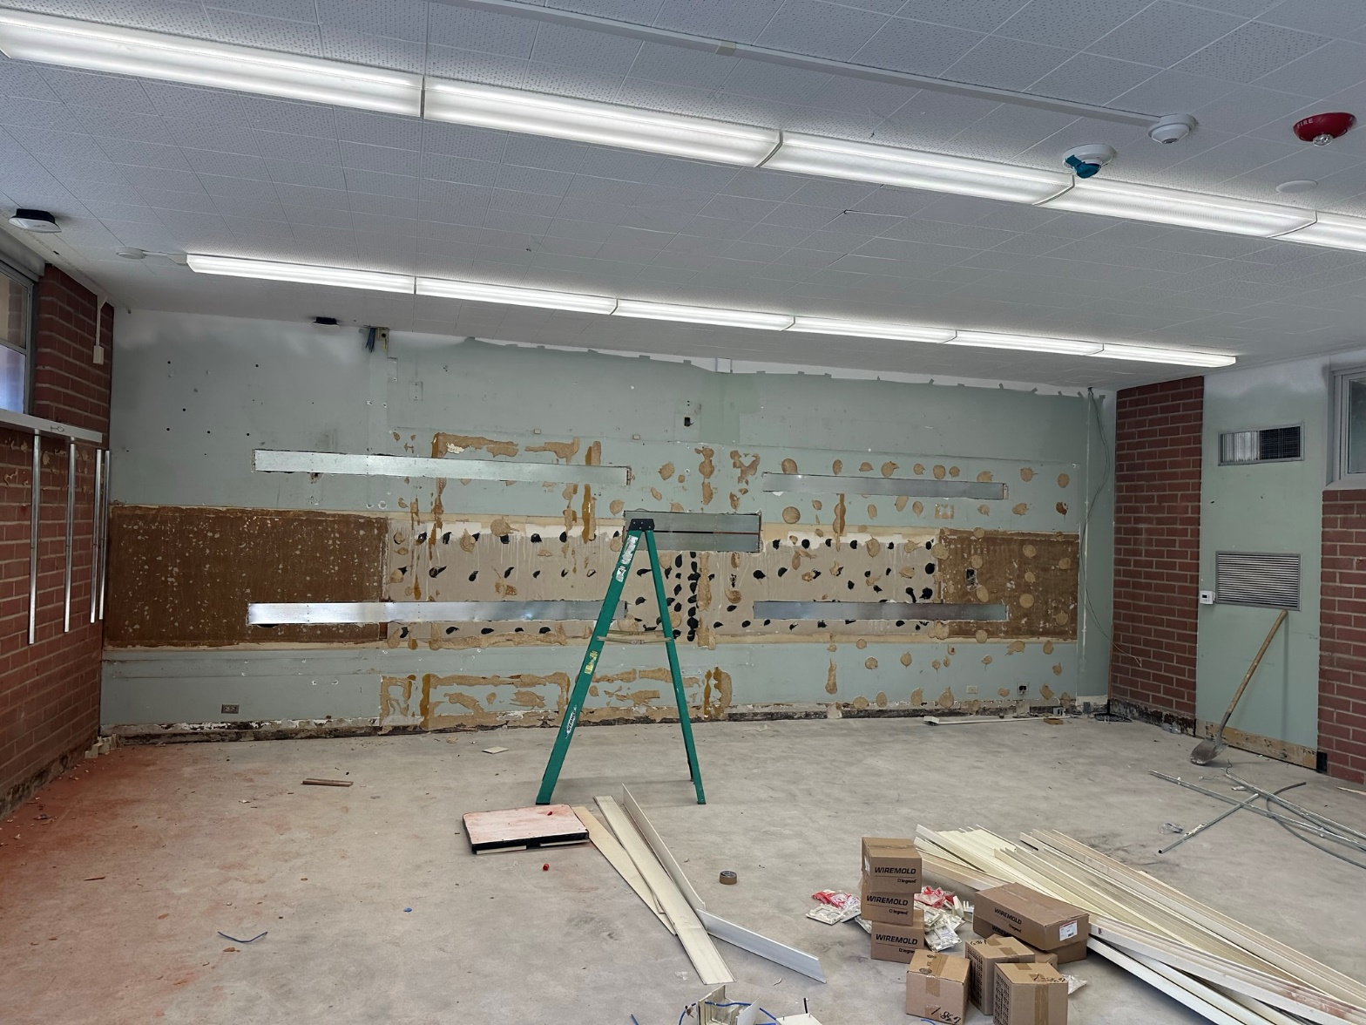
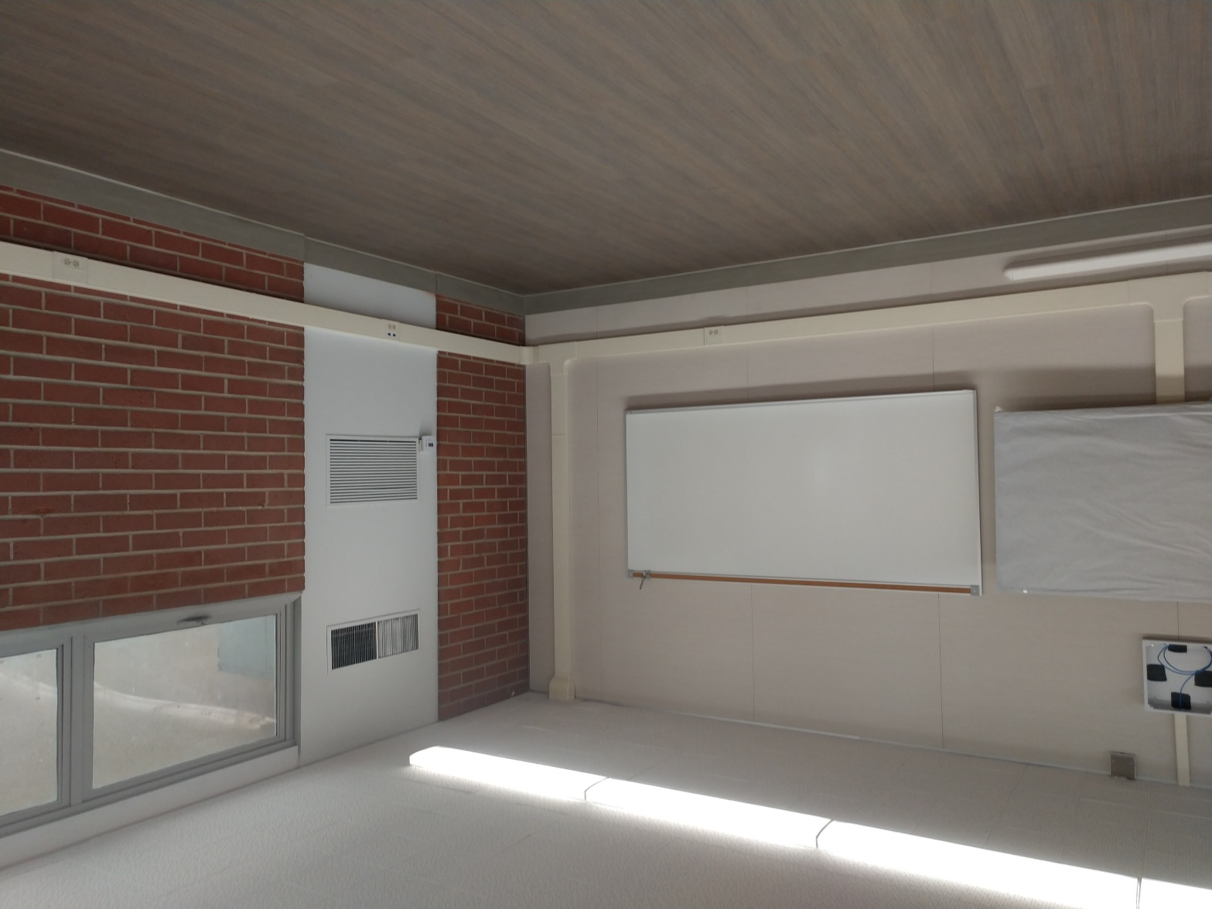
Grandview College Prep. Academy
20 Wing Final Phase
Before
After
Project Status
Construction
8

Slide 9
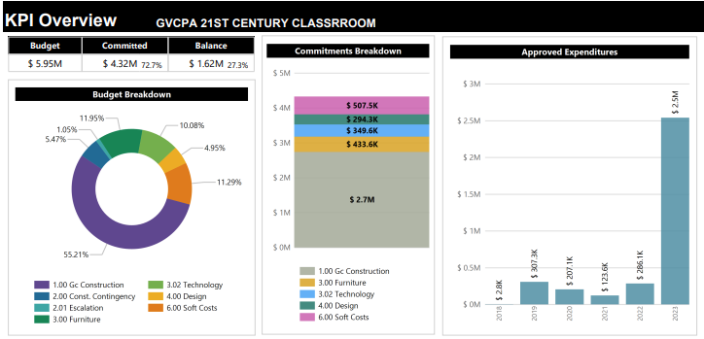
Grandview College Prep. Academy
98% Complete
Modernization Plan
Classrooms: 16
Music Room: 1
Kinder: 2
Project Status
Budget

Slide 10
Scheduled Completion
Grandview K-8 & Newton MS: November 2023
Project Status

Slide 11
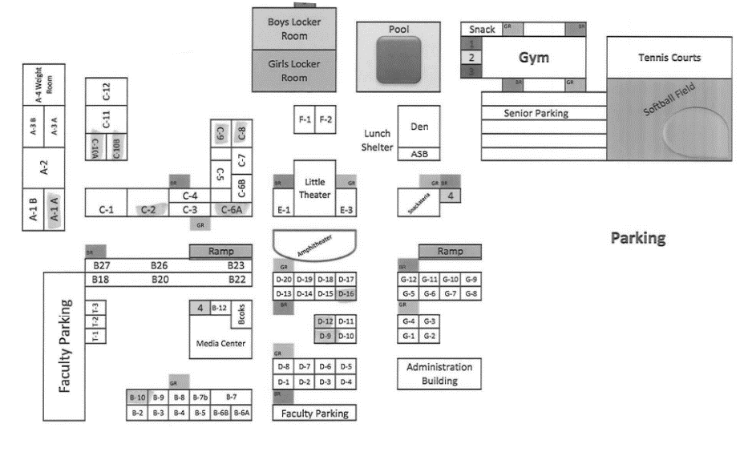
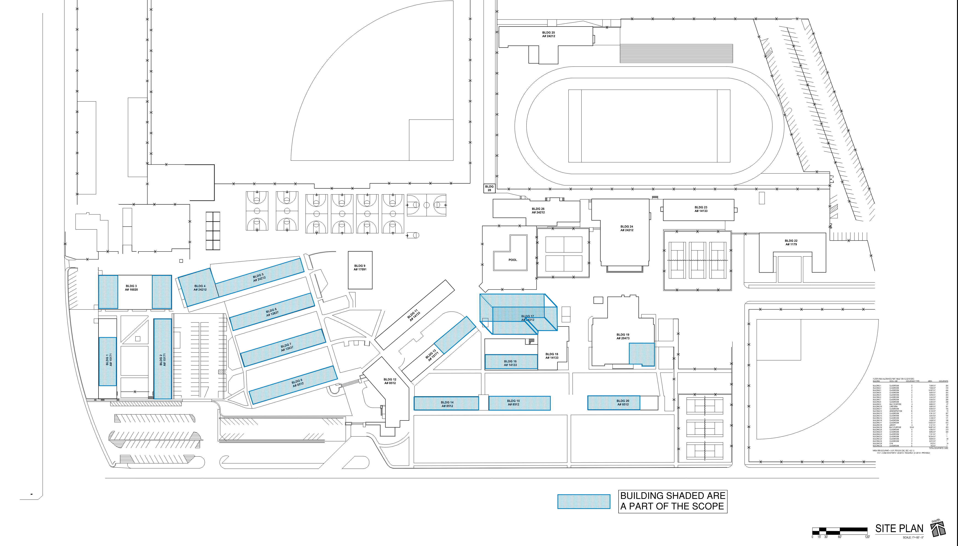
HIGH SCHOOL REFRESH
WILSON HIGH SCHOOL
LA PUENTE SCHOOL

Slide 12
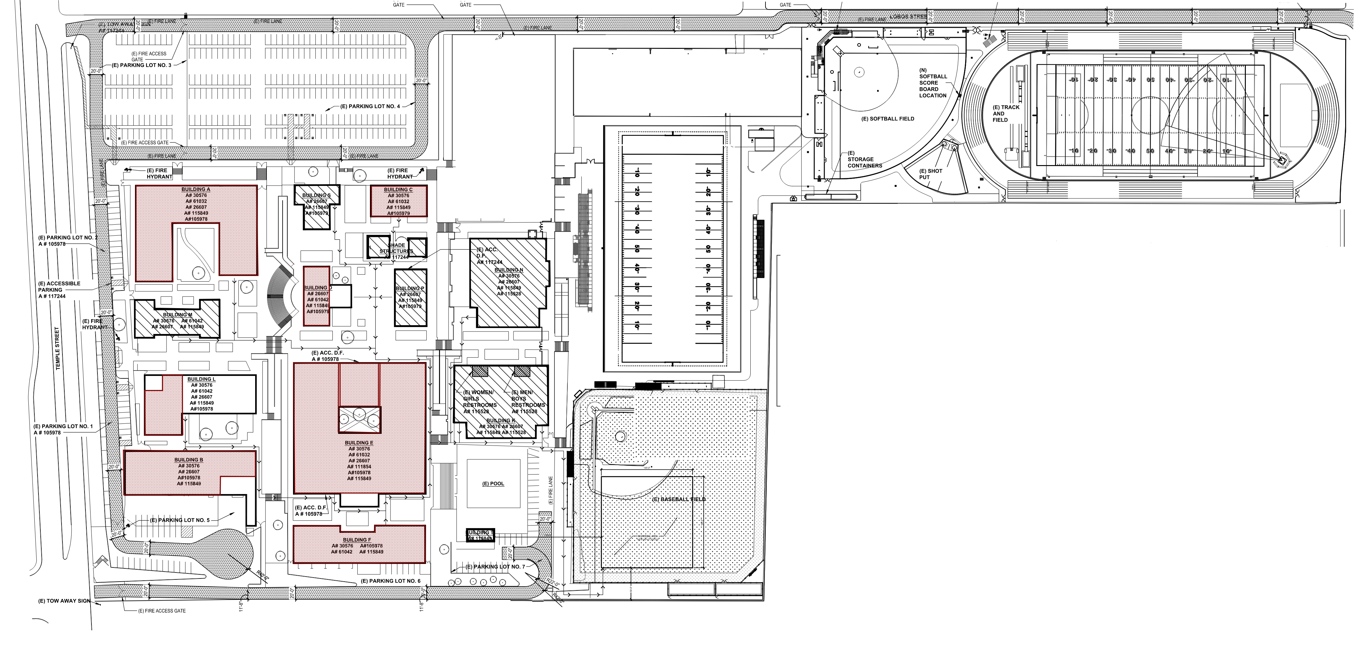
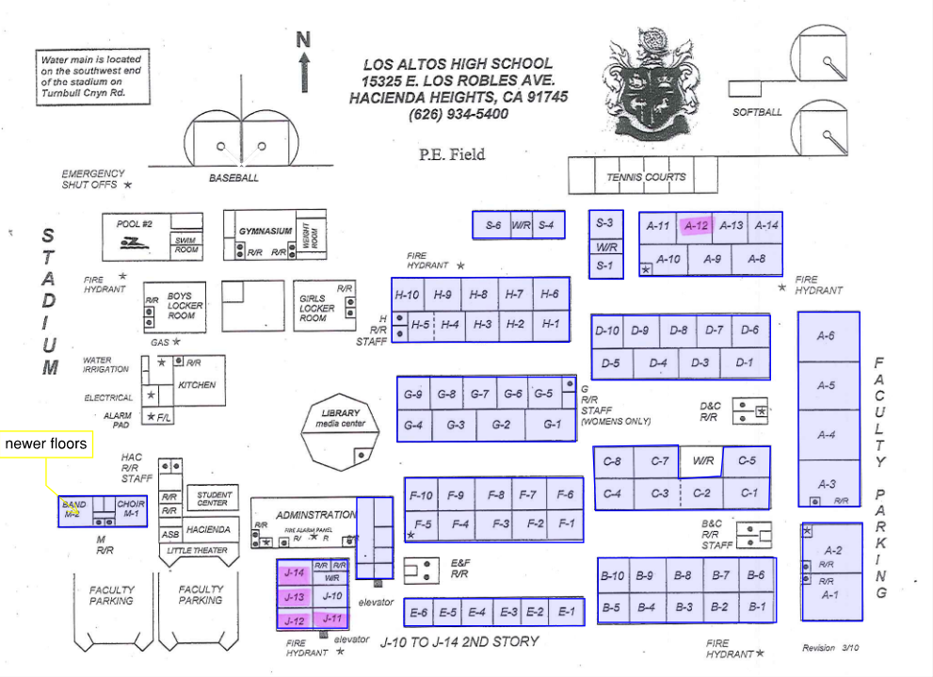
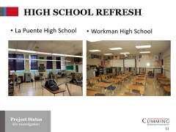
HIGH SCHOOL REFRESH
WORKMAN HIGH SCHOOL
LOS ALTOS HIGH SCHOOL

Slide 13
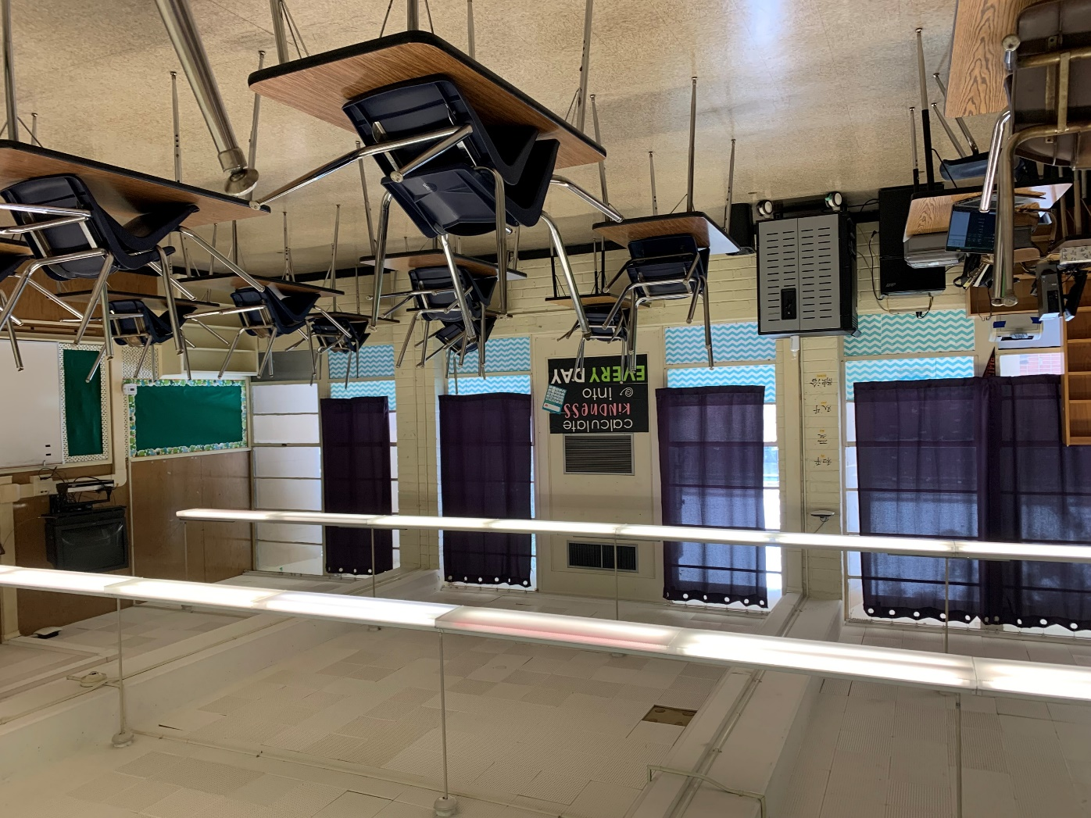
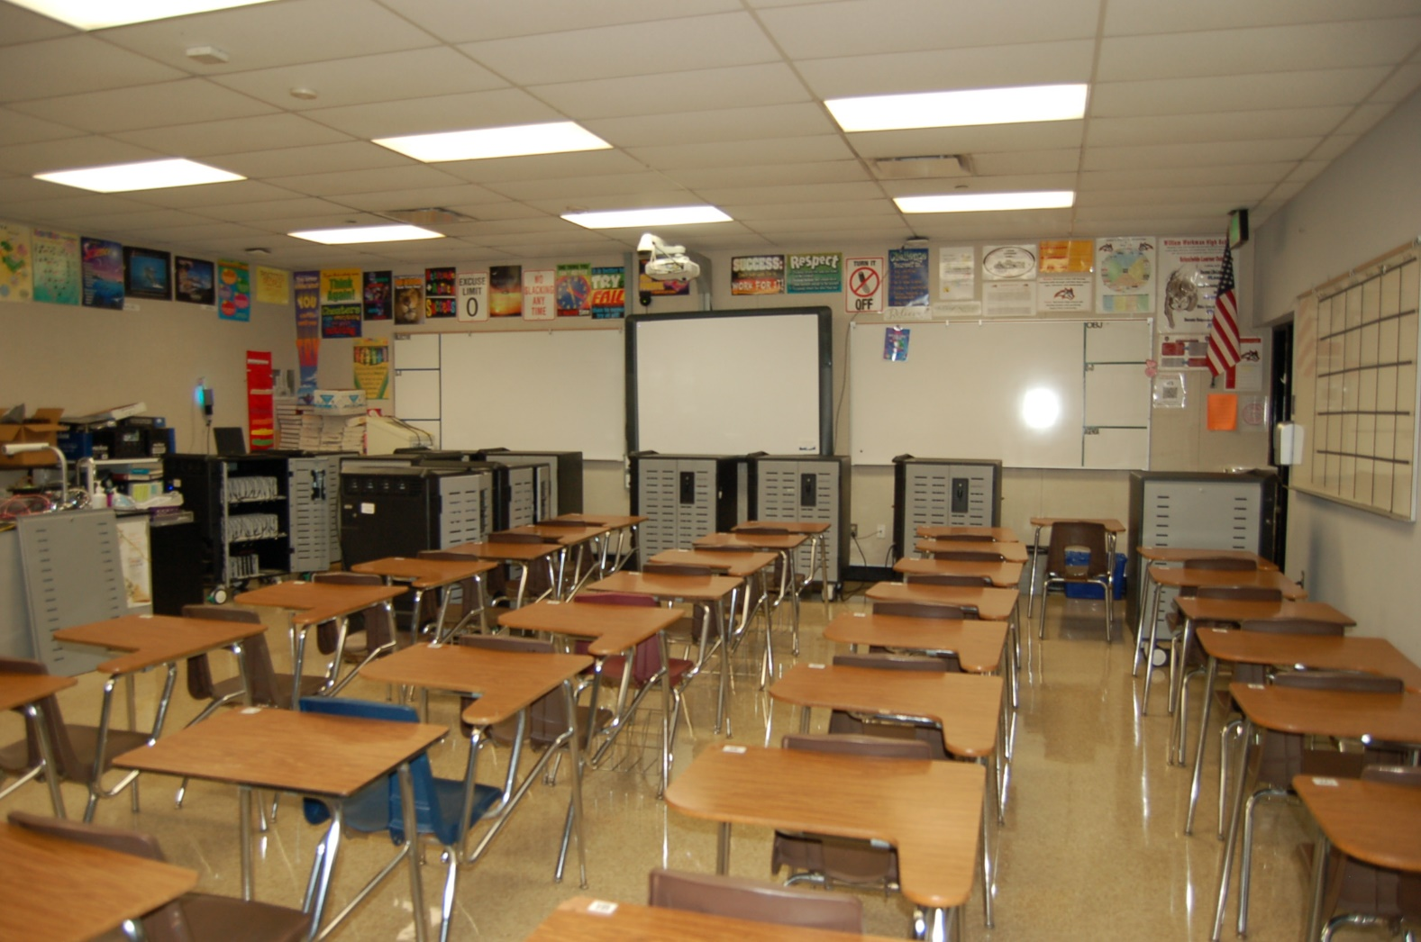
HIGH SCHOOL REFRESH
La Puente High School
Workman High School
Project Status
Project Status
Site Investigation

Slide 14
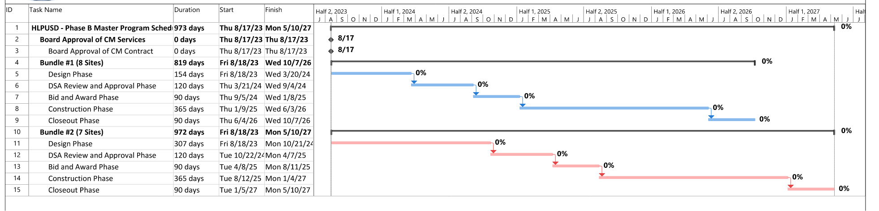
Measure BB Bond Phase B
Contract Proposals Received From Studio + Architects
Meeting and Site Visits Resumed
Professional Fees Negotiated
Request for Proposal Updates Out to PBK Architects
Meeting and Site Visits In Planning

Slide 15

Questions + answers

