Slide 1
Junior Parent & Student Information Night
January 31, 2024

Slide 2
Prayer

Slide 3
Tonight's Agenda
Welcome & Introductions
Fall Junior Parent Night Review
Defining Your Fit
College & Career Search Tools
Timeline and Upcoming Events
Questions

Slide 4
Introductions
Ms. Siobhan McVeigh – Director of College and Career Counseling; Works with last names A-L
Ms. Kelsey Mark – Associate Director of College and Career Counseling; Works with last names M-Z
Ms. Laura Breshock – SEL Counselor and Career Specialist; Works with A-D for SEL and all students for College & Career

Slide 5
Fall Junior Parent Night Review

Slide 6
Post High School Options
Community College (Two Year)
Earn an A.A. or an A.S.
Direct Transfer to a University
Cost Effective
University (Four Year)
Earn a B.A. or B.S.
A variety of options exist
Small, medium, large
Private, public
Religious
Gap Year: Take time to work, mature, and gain life experience. Some colleges offer a gap year program
Trade School (Technical and Community College)
Career-oriented Programs
For more information, go here
Military Service
Service Academies
ROTC
Enlisting

Slide 7
Two-Year College Considerations
Ex. Highline College, Bellevue College​, Green River
Earn an Associate Degree and direct transfer to a four-year college for junior & senior years (Direct Transfer Agreement) ​
Benefits:​
Cost​
Size​
Convenience: flexibility and location​
Transitional step​
For comprehensive information, check out Washington State Board for Community & Technical Colleges: ​
http://sbctc.edu/

Slide 8
Four-Year University Considerations
What colleges are looking for:
GPA​
Strength of Coursework
Grade Trends​
Standardized Test Scores ​
Personal Statement​
Extracurricular Activities ​
Demonstrated Interest
Interviews
Campus visits/calls)
Letters of Recommendation
What students should be thinking about:
Requirements/Selectivity​
Location​
Size​
Majors/Fields of Study​
Public or Private​
Cost​
Campus Life​
Programs​
Campus Diversity​
Special Needs

Slide 9
Technical/Trade School Considerations
Career-oriented programs​ (Example: Engineering, Automotive Tech, Ultrasound Technician​, Wind Turbine Technician, Diesel Mechanic)
Often found on community college campuses
Focus on placement into the workforce
Six months to two years in length​ (in general)
Paid apprenticeships are available in some trades
If interested in this route, talk to Ms. Breshock, our career specialist
For comprehensive information, check out Washington State Board for Community & Technical Colleges: ​
http://sbctc.edu/

Slide 10
Military Academies and Direct Enlistment
Service Academies ​
USNA Annapolis, USMA West Point, Air Force Academy Colorado Springs
Rigorous process, including comprehensive health screening, the need for a Senatorial nomination, fitness assessment, and interview (start now!)
Speak with recruiters during school visits or through ROTC programs at colleges
Contact local recruiters through each branch’s website ​
Army, Navy, Marine Corps, Air Force, Coast Guard​
Male U.S. citizens need to register with the Selective Service within 30 days of their 18th birthday

Slide 11
Gap Year
Take time to enhance job or college resumes​ and to add life experience
Possibilities include:​
Traveling domestically or internationally​
Gaining work experience​
Volunteer/Service Corps experience​
May be able to defer college admission
Some colleges offer a gap year program
Verto Education – Earn guaranteed admission through Direct Transfer Partner Colleges

Slide 12
Defining Your Fit

Slide 13
Defining Fit
Finding a school that is the best fit for you
Where are you going to be the most successful?
What factors are most important to you in your college experience?
What do you want from the college experience?
Where do you find your sense of home or belonging?
What is the college’s focus or mission?
Consider financial fit

Slide 14
Choosing a College
Location & Size
Academic Programs
Campus Resources
Cost of Attendance
Campus Life & Activities
Facts & Figures
Campus Visit
Overall Fit
Notes:
CHOOSING A COLLEGE
Location & Size
•In-state vs. out of state
•Small, medium, big
•Undergrad/grad programs
•Urban setting, college-town
Academic Programs
•Does this school offer the program you are looking for?
•Direct-entry vs. coming in a premajor
•Premajor studies programs
Campus Resources
•Tutoring centers
•Career center
•Availability of faculty and staff
•Research opportunities
•Internships
Cost of Attendance
•Tuition vs cost of attendance
•Scholarships
•Financial Aid
Campus Life & Activities
•Housing and residence life
•Is it required?
•Clubs
•Sports
•Intramural
•Club
•Collegiate level
•Campus events
•Location of campus – city events
Facts & Figures
•Graduation rates
•Retention rates – freshmen to sophomore year
Campus Visit
•Do you see yourself on this campus?
Overall Fit
•Is this school a place you feel you belong? (addressed more later in presentation)

Slide 15
How Important?
Notes:
Admissions Notes:
Top 3 contributing factors for 2023 were all based on things found on the transcript – course rigor, academic performance, cumulative GPA
Significantly less importance on test scores (from 58% in 2013 --> 5% in 2023)

Slide 16
Graduation Requirements & CADRs
Subject | KCHS Graduation Requirements | Washington State CADRs
English | 4 | 4
Math – Algebra II or higher Senior Year Math-Based Quantitative Course | 3 | 3
Science – Including 2 years of lab science | 3 | 3
World Language – Second level proficiency | 2* | 2
Social Sciences | 3 | 3
Arts | 2 | 1
Theology | 4 | N/A
Health / Fitness | 0.5 / 1.5 | N/A
Career & Technical Education | 1 | N/A
Electives | 4 | N/A

Slide 17
Paying for College
FAFSA (Free Application for Federal Student Aid) is an application each family will complete starting Oct. 1 of senior year
Priority deadline is Oct. 31 of senior year, and a student’s college application is generally considered incomplete without it
Use Net Price Calculators -- Google: “[college name] net price calculator” to determine your estimated Expected Family Contribution (EFC)
CSS profile
Approximately 400 schools, mostly private
$25 for the first app, $16 per app after that
List of participating schools and other helpful information found here
Western Undergraduate Exchange
Western colleges that participate offer tuition at 1.5 times the in-state cost
View information about this program here

Slide 18
College & Career Search Tools

Slide 19
College Kickstart
Helps develop a well-rounded list of colleges
Provides information on how to capitalize on early admission opportunities
Delivers customized plan including application deadlines and requirements
Reviews merit and need-based aid opportunities
Creates a college application timeline
Compiles information on required application materials

Slide 20
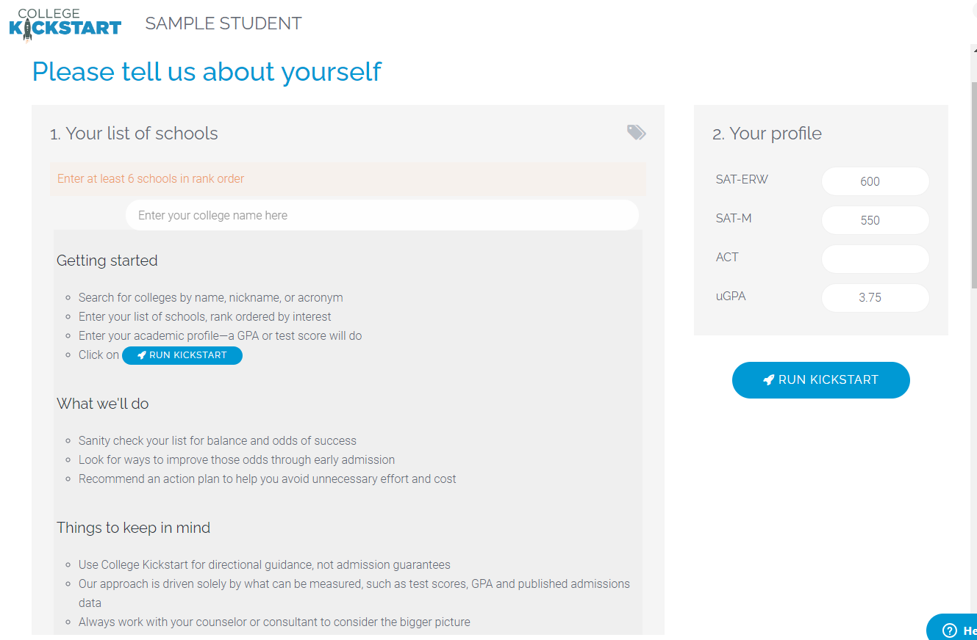
College Kickstart Demo

Slide 21
College Board BigFuture
Career Quiz
College Quiz
Scholarship Quiz
Career Exploration
Plan for College
College Search Tool

Slide 22
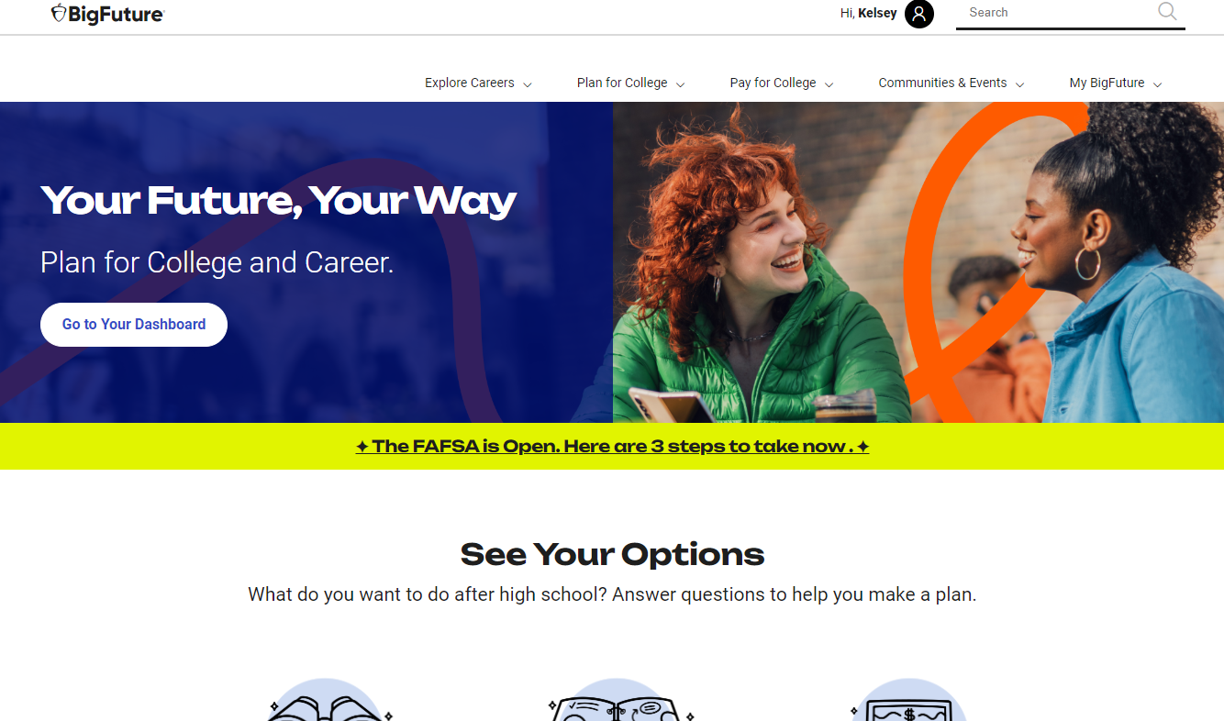
BigFuture

Slide 23
Gear Up Washington State
Explore Pathways
Virtual Campus Tours
Search for Scholarships
How to Pay for College

Slide 24
The Occupational Information Network (O*NET)
The Occupational Information Network (O*NET) is developed under the sponsorship of the U.S. Department of Labor/Employment and is the nation’s primary source of occupational information. Click here to start exploring career clusters, check out occupations in demand, or complete the free Interest Profiler, a web-based self-assessment career exploration tool.
The O*NET database contains hundreds of standardized and occupation-specific descriptors on almost 1,000 occupations covering the entire U.S. economy.
The database is available to the public at no cost and is continually updated from input by a broad range of workers in each occupation.
O*NET information is used by millions of individuals every year.

Slide 25
Going Merry
Personalized Scholarships
College Cost Comparisons
FAFSA Support
Auto-filled scholarship application forms

Slide 26
Going Merry

Slide 27
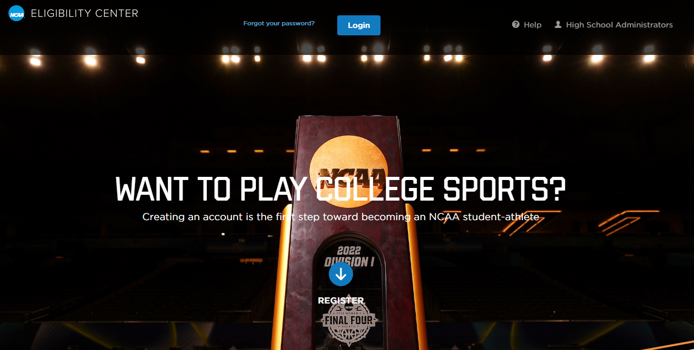
NCAA Eligibility

Slide 28
For Prospective Athletes
Know your eligibility (DI, DII, or DIII)
Create your account in the NCAA portal
Download and review NCAA Guide for the College-Bound Student-Athlete
Meet the core academic requirements ​
16 core courses total​​
Review sliding scale for GPA and test scores​
Request Kennedy Catholic to send your transcript to the NCAA at the end of junior year
Outside of the NCAA Eligibility Center, start completing prospective athlete forms on college websites (Example: University of Oregon)

Slide 29
Timeline and Upcoming Events

Slide 30
Upcoming Events
Spring
March 20: SAT School Day*
April 14: Review SAT Results
April 15: ACT National Testing Date*
May 1 – June 6: Request Teacher Rec & Complete Brag Sheet for Teacher in Naviance
May 4: SAT National Testing Date*
End of May: SAT Test Prep at Kennedy
June 1: SAT National Testing Date*
Summer
June: Summer Essay Workshops
June 8: ACT National Testing Date
July 13: ACT National Testing Date
August: Application Workshops
August 1: Begin Common & UC Applications
Fall
Sept. 4: Senior Parent Night
Sept. 30:
Brag Sheet for Counselor Due in Naviance
College List Locked on Naviance
*Note: SAT School Day is at Kennedy. National Testing Dates are off site

Slide 31
A Timeline of Events for Families
Spring 2024 | Summer 2024 | Fall 2024
Students participate in training using school provided resources: College Search (College Kickstart, Naviance & Big Future) Scholarship Search (Going Merry) Test Prep (Albert.io) - AP, SAT, ACT | Create an organization system! (Spreadsheets, folders and checklists) Participate in the College Application Workshops | Participate in the College Application Workshops in Community Period Schedule meeting(s) with counselor
Schedule an initial meeting with college counselor | Prepare a list of schools College Kickstart*NEW* (Likely, Target and Reach) | Meet with college reps Attend college fairs​
Schedule college visits for spring break, summer, or fall​ | Start preparing essays, personal statements, and applications ​ | Confirm teacher letters of rec.​
Identify teachers for letters of recommendation Attend the Junior Parent College & Career Night ​ | Work, read, travel, volunteer, attend summer program on a college campus or do an internship​ | Apply for scholarships, FAFSA Set up interviews Meet all deadlines​

Slide 32
Questions?
Thanks for attending.
You can reach Ms. McVeigh at mcveighs@kennedyhs.org, Ms. Breshock at breshockl@kennedyhs.org, and Ms. Mark at markk@Kennedyhs.org

