Slide 1
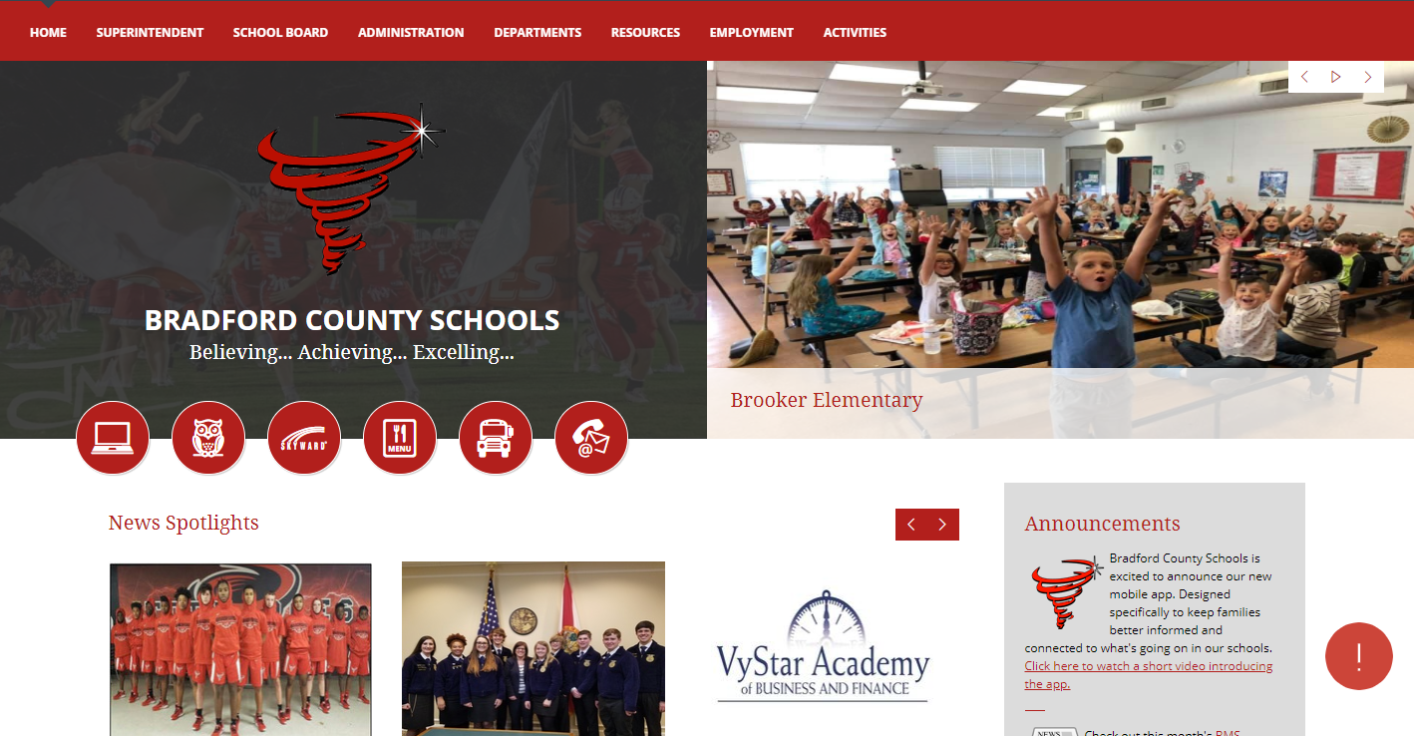
Visit the new Bradford County Schools Website
www.bradfordschools.org

Slide 2
At BradfordSchools.org you can access...
News
Pictures
Announcements
Lunch Menus
Sports Information including Schedules & Scores
Classlink Product Information
FOCUS Student Information
Skyward Employee Information
School Board Members & Meeting Minutes
Education Foundation & Partnerships
District/School Policy, Forms and Documents
District/School Employee Directory
District Office Department Information
Employment Information
Employee Professional Development Information

Slide 3
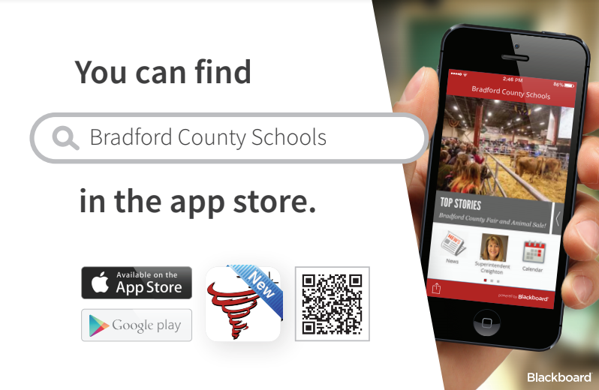
We Have an App!

Slide 4
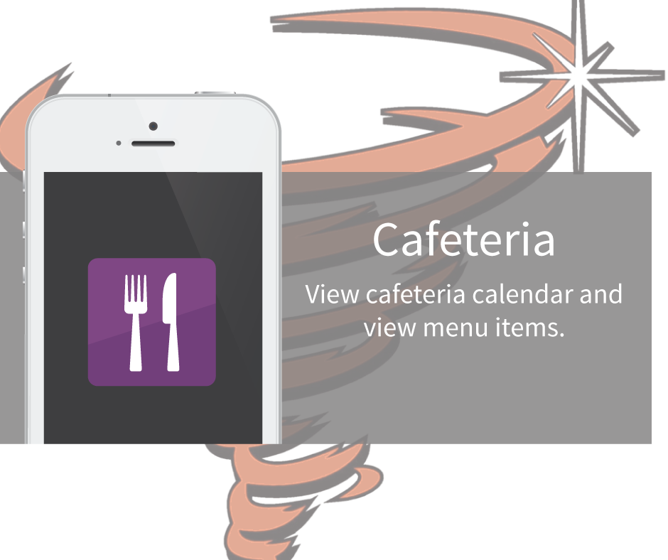
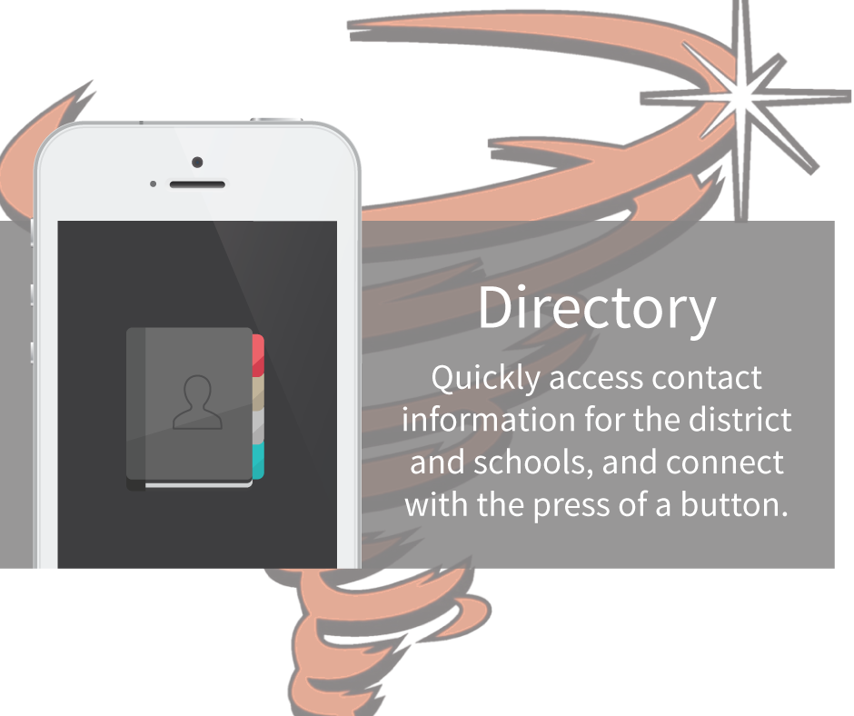
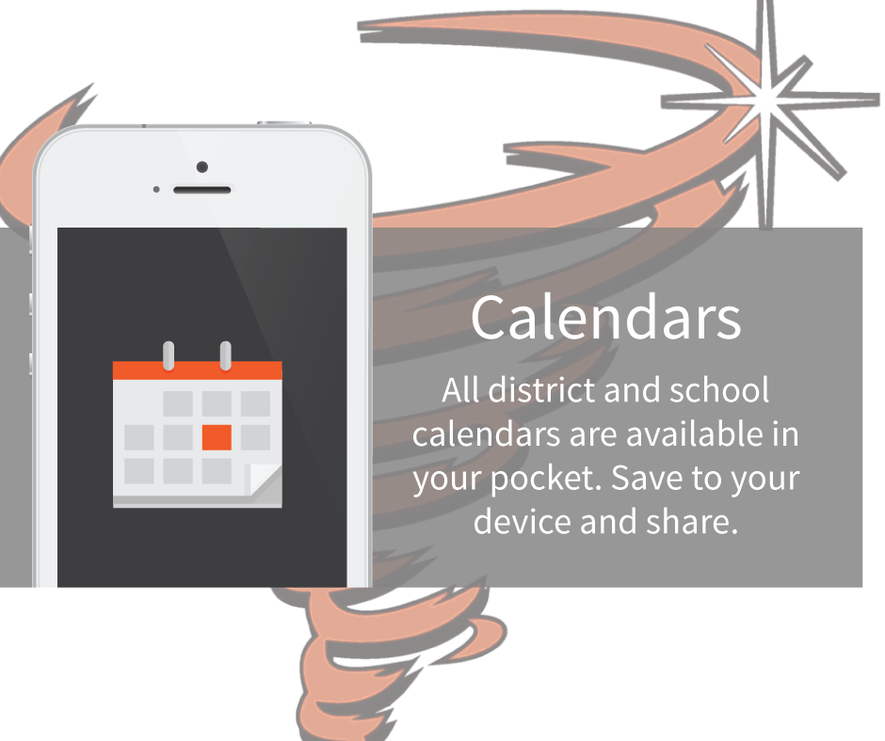
Your source of information for…

Slide 5
Bradford County Schools
Classroom Technology
Every Teacher's toolkit is supplied with:
Windows Desktop Computer
Chromebook
Printer
Document Camera
Projector
Classlink Single Sign-On portal to include access to dozens of classroom products

Slide 6
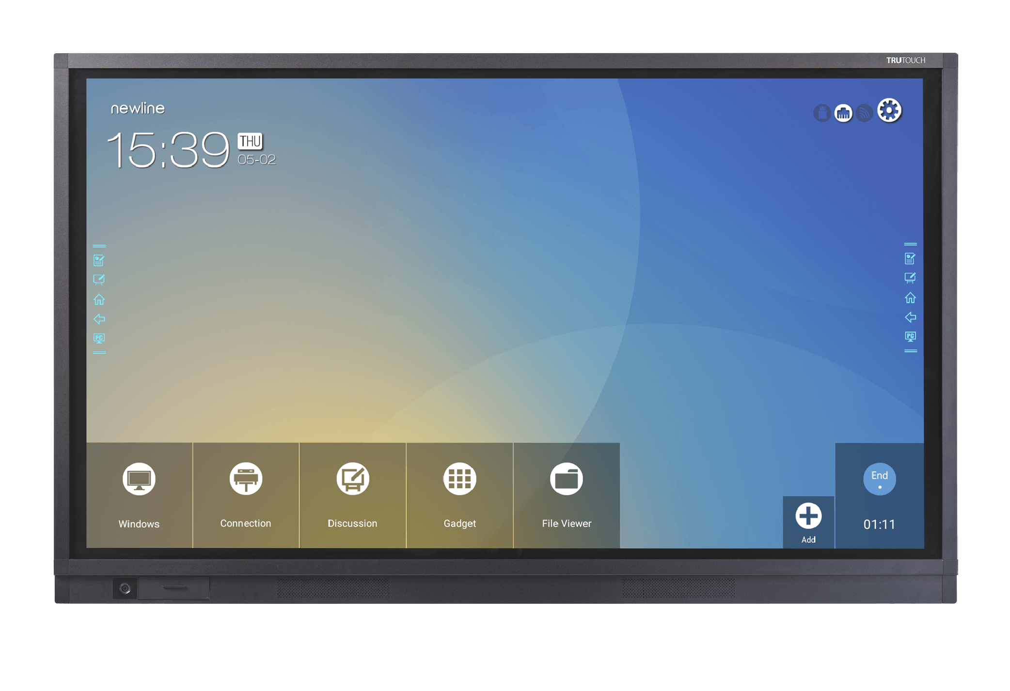
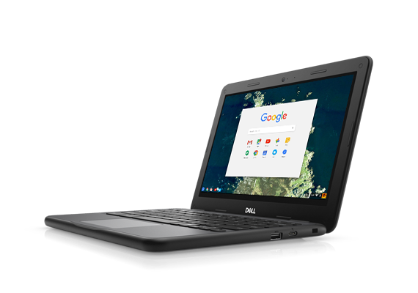
Bradford County Schools
Classroom Technology
60 Classrooms with 75” Interactive Flat Panels
94 Classrooms with Audio Enhancement Speaker Systems
2500 Student
Chromebooks

Slide 7
The Safety of Bradford County Students is important to us
Gated entry to all campuses.
Visitor Check in required at all campuses using a database to identify predators and trespassers.
Emergency Alert systems in place at every campus with access to County and City Emergency Personnel.
214 cameras placed throughout the District with the ability to recall stored footage.
Network restrictions and monitoring are in place to protect Employee and Student Internet use.
Network restrictions and protocols are in place to protect Employee and Student Information.

Slide 8
See Something... Say Something...
FortifyFL is available from every computer in the district.
Anyone may download this app to their mobile device.
Report suspicious activity or Bullying event thru the BradfordSchools.org website or thru the Bradford Schools
app using the “Tip Line“ feature.

Slide 9
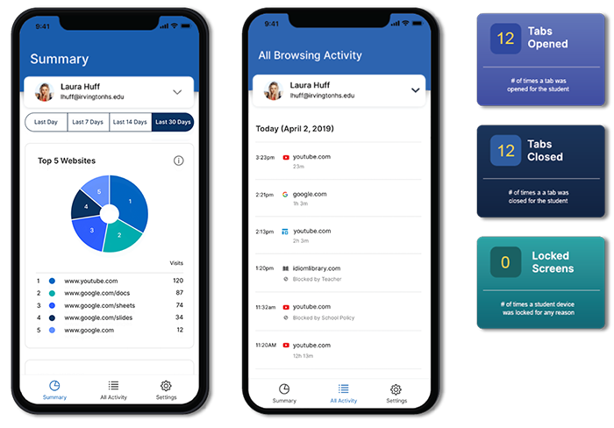
Coming Soon…
Parent App
View a daily summary of your
students browsing history.
What is included in this app:
Top 5 summary of student browsing (apps, documents, & websites visited)
Teacher interventions
30-day view of websites, videos, documents & apps

